Slide 1
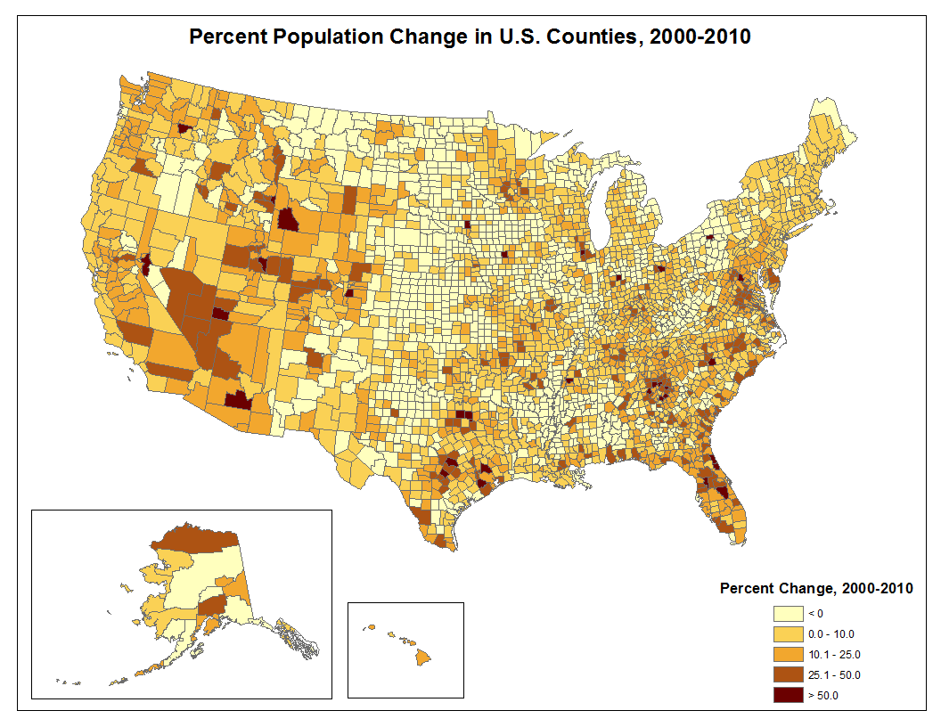
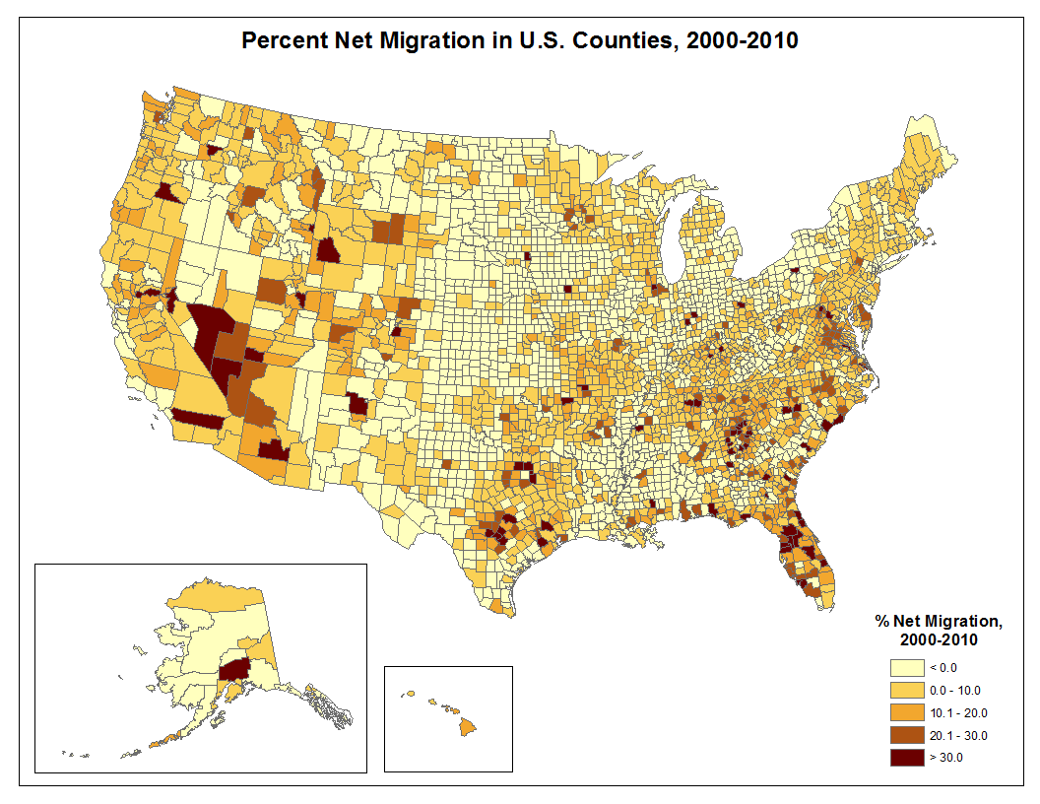
U.S. Population: Change in Size, Composition, and Distribution, 2000-2010
Nazrul Hoque, Ph.D., Jeffrey Jordan, Ph.D., Beverly Pecotte, M.A., Miguel Flores, Ph.D.
Institute for Demographic and Socioeconomic Research, The University of Texas at San Antonio
Introduction
According to the recent release of 2010 census counts U.S. population has increased from 281,421,906 in 2000 to 308,745,538 in 2010, an increase of 27,323,632 or 9.7 percent. During the 1990s, U.S. population increased from 248,709,873 in 1990 to 281,421,906 in 2000. This is an increase of 32,712,033 persons or 13.2 percent between April 1, 1990 and April 1, 2000. The growth of U.S. population has slowed during the 2000s compared to the 1990s. The population of the Northeast has increased from 53,594,378 in 2000 to 55,317,240 in 2010, a change of 1,722,862 persons or 3.2 percent. During the same time the Midwest population increased by 2,885,018 persons or 3.9 percent. The population of the South grew from 100,236,820 in 2000 to 114,555,744 in 2010, an increase of 14,318,924 persons or 14.3 percent. The population of West grew from 63,197,932 in 2000 to 71,945,553 in 2010, an increase of 8,747,621 persons or 13.8 percent. In this paper we examine the change in size, composition, and distribution of U.S. population from 2000-2010.
Change in Size, 2000-2010
The size of the U.S. population has more than doubled in the past 60 years, increasing from 150.7 million in 1950 to 308.7 million in 2010. The population growth of 27,323,632 persons between 2000 and 2010 represents the third largest annualized increase of 2,732,362 persons per year in U.S. history. The increase of 27,323,632 persons during the 2000-2010 period was equivalent to the total 2010 census populations of Texas and New Mexico. Almost 63 percent of the growth of U.S. population was due to natural increase while 37 percent was due to international migration.
Change in Composition, 2000-2010
The populations of 2000 and 2010 by race/ethnicity were derived by the authors from PL94-171 for each respective census year [1, 2]. During 2000-2010, the Non-Hispanic White only population increased from 194,552,774 to 196,817,552 the Non-Hispanic Black population increased from 33,947,837 to 37,685,848 the Non-Hispanic Asians increased from 10,123,169 to 14,465,124, the Non-Hispanic Native Hawaiians and Non-Hispanic Other Pacific Islanders increased from 353,509 to 481,576, the Non-Hispanic Some Other Race group increased from 467,770 to 604,265, and the Non-Hispanic Two or More Races group increased from 4,602,146 to 5,966,481. The Hispanic or Latino ethnic group, which can be of any race, increased from 35,305,818 to 50,477,594.
In terms of percent change, the Hispanic or Latino grouped gained the most (43.0); they were followed by Asians (42.9), Native Hawaiian and Other Pacific Islanders (36.2), and Some Other Race group (29.2). As a result of these changes, the proportion of the Anglo (Non-Hispanic White) population decreased from 69.2 percent of the U.S. population in 2000 to 63.8 percent in 2010. The proportion of Black population increased from 11.0 percent in 2000 to 12.0 percent in 2010. The Hispanic proportion increased from 12.5 percent in 2000 to 16.3 percent in 2010. The proportion of Asian population increased from 3.6 percent in 2000 to 4.7 percent in 2010. The proportion of Other (the sum of all other Non-Hispanic groups) population increased from 2.6 percent in 2000 to 3.0 percent in 2010.
Change in Distribution, 2000-2010
Population growth has not been distributed evenly throughout the nation. Some parts of the nation have grown rapidly, some have grown slowly and others have grown steadily. The following sections examine the patterns of population growth for regions and divisions.
Population Change by Regions, 1990-2000 and 2000-2010
In this section we examine the patterns of population growth by regions. There are 4 regions in the U.S. (see Figure 1). All four regions experienced population growth during the 1990s and also during the 2000s. During the 1990s, the South gained the most population (14,790,890), followed by the West (10,411,850). The Northeast region gained the least population (2,785,149). A similar pattern of change has been observed during 2000-2010. The population of the South region increased from 100,236,820 in 2000 to 114,555,744 in 2010. The population of the West Region increased from 63,197,932 in 2000 to 71,945,553 in 2010. The population of the Midwest Region increased from 64,392,776 in 2000 to 66,927,001 in 2010. The population of the Northeast region increased from 53,594,378 in 2000 to 55,317,240 in 2010. In terms of numerical increase, the South Region gained 14,318,924 persons, the West Region gained 8,747,621 persons, the Midwest Region gained 2,534,225 persons, and the Northeast Region gained 1,722,862 from 2000 to 2010.
In terms of percent population change, the fastest growing regions during 2000-2010 have been the South with a 14.3 percent increase, followed by the West with an increase of 13.8 percent. The slowest growing regions have been the Northeast with a 3.2 percent increase, followed by Midwest with an increase of 3.9 percent.
Population change results either from natural increase or net migration. If these factors are examined in conjunction with the data on total population change, several important patterns are evident. An examination of the data in Table 1 indicates that the Northeast and the Midwest regions have experienced net outmigration while the South and West experienced net inmigration.
Table 1: US Population and Component of Population Change
Census Region Code | Census Count 2000 | Census Count 2010 | Numerical Change 2000-2010 | Percent Change 2000-2010 | Natural Increase 2000-2010 | Domestic Migration 2000-2010 | International Migration 2000-2010
Northeast | 53,594,378 | 55,317,240 | 1,722,862 | 3.2 | 2,015,520 | -2,257,347 | 1,964,689
Midwest | 64,392,776 | 66,927,001 | 2,534,225 | 3.9 | 3,212,000 | -1,917,103 | 1,239,328
South | 100,236,820 | 114,555,744 | 14,318,924 | 14.3 | 6,309,631 | 4,661,166 | 3,348,127
West | 63,197,932 | 71,945,553 | 8,747,621 | 13.8 | 5,620,468 | 99,985 | 3,027,168
Population Change by Divisions, 2000-2010
Post-2000 patterns of population change varied significantly by divisions. In terms of percent population change, the Mountain Division gained the most (21.4), followed by the West South Central (15.6) and the South Atlantic (15.5). The East North Central Division gained the least (2.8 percent).
Population Change in States in the U.S., 2000-2010
The nine most populous states contained more than 50 percent of U.S. total population in 2010. These states are California, Texas, New York, Florida, Illinois, Pennsylvania, Ohio, Michigan and Georgia. California remains the most populous State with 37.3 million people, accounting for 12.1 percent of U.S. population. Texas, with 25.1 million people, was the second most populous state, accounting for 8.1 percent of the U.S. total population. New York was the third largest state with 19.4 million population, or 6.3 percent of the total population. The 20 least populous states contained less than 10.0 percent of the U.S. total population.
In terms of numerical change, Texas gained the most population followed by California, Florida and Georgia. Michigan is the only state that lost population during 2000-2010. In terms of percent population change, Nevada increased by 35.1 Percent followed by Arizona (24.6 percent), Utah (23.8 percent), Idaho (21.1 Percent), and Texas (20.6 percent).
Population Change in Counties in the U.S., 2000-2010
There are more 3,100 counties in the U.S. and thus is not feasible to describe patterns of population change for individual counties. In this section we summarize general patterns of population change evident across counties and county equivalent areas during the 2000-2010 period. Detailed data for all counties on population change can be obtained from the authors and also from the PL94-171 for the respective census year [1, 2].
In terms of numerical change, Maricopa County in Arizona gained the most population (744,968) followed by Harris County in Texas (691,881), Riverside County in California (644,254)Clark County in Nevada (575,504), and Tarrant County in Texas (362,815). The largest percentage increases were in Kendall County in Illinois with an increase of 110.4 percent, Pinal County in Arizona with a 109.1 percent increase, Flagger County in Florida with 92.0 percent, Lincoln County in South Dakota with 85.8 percent, Loudoun County in Virginia with an increase of 84.1 percent, Rockwall County in Texas with 81.8 percent, and Forsyth County in Georgia 78.4 percent. St. Bernard Parish in Louisiana lost the most population (46.6 percent), followed by Kalawao County in Hawaii (38.8 percent), Issaquena County in Mississippi (38.2 percent), and Cameron Parish in Louisiana (3.5 Percent). More than 200 Counties lost 10 percent or more of their population during the 2000-2010 period.
Net in-migration is also an important factor in population growth, and presents challenges for a population as opposed to natural increases. Riverside County in California gained the most population due to net in-migration (475,870), followed by Clark County in Nevada (428,815), Maricopa County in Arizona (377,645), Harris County in Texas (227,161), and Collin County also in Texas (209,256). Los Angeles County in California lost the most population due to net outmigration (610,730), followed by Cook County in Illinois (558,427), Wayne County in Michigan (328,971), and Kings County in New York (185,325). The highest rates of net in-migration were observed in Pinal County in Arizona with 97.35 percent, followed by Flagler County in Florida (93.9 percent), Kendall County in Illinois (89.4 percent), and Sumter County in Florida (80.4 percent). Among the counties with rates of net out-migration, the highest rates were in St. Bernard Parish in Louisiana (47.9 percent), Issaquena County in Mississippi (41.2 percent), and Chattahoochee County (38.2 percent). Figure 4 provides a graphical view of the rates of net migration in U.S. counties
Conclusions
The post-2000 population patterns in the U.S. are ones which show substantial population growth in regions, divisions, most of the states, and Counties. The annual rate of population growth in the U.S. has slowed during the 2000-2010 period (9.7 percent) compared with 13.2 percent during 1990-2000. One must be careful to note that patterns based on only a few years may change quickly. The U.S. population also diversified during 2000-2010; the proportion of Anglo population has decreased from 69.2 percent in 2000 to 63.8 percent in 2010. The proportion of Hispanic population has increased from 12.5 percent in 2000 to 16.3 percent in 2010. In 2010, almost 31 percent of the U.S. populations are in minority groups (i.e., Black, Hispanic, and Others). There are significant implications for these changes on education, the labor market, and voting patterns.
References
[1] U.S. Census Bureau. 2011. 2010 Census Redistricting Data (Public Law 94-171). Machine Readable data files prepared by the U.S. Census Bureau.
[2] U.S. Census Bureau. 2011. 2010 Summary File 1. Machine Readable data files prepared by the U.S. Census Bureau
Notes:
PBS: RT012004,M7
EAE: RT010704,M9
Graphs generated in Excel file: ypeng/meeting/SFN2005/EAE_Poster

