Slide 1
A Method to Forecast Local Hispanic Voting Strength
Peter A. Morrison
RAND (retired)
Presented at the 2014 Applied Demography Conference, San Antonio, TX January 8-10
Notes:
The advent of Hispanic numerical majorities in local populations across the nation focuses attention on Hispanics’ forthcoming electoral strength in these locales.
Hispanic enclaves coalesce, draw newcomers, and enlarge the scale of Hispanic residential settlement as they expand outward.
As Hispanics’ potential voting strength materializes across an expanding area, age structure and citizenship patterns amplify that potential.

Slide 2
Overview
FOCUS
  How does Hispanic voting strength materialize in heavily Hispanic locales?
  Can a demographic accounting framework forecast this process?
IMPORTANCE:
  Hispanics’ evolving voting strength spurs concerns with potential empowerment under alternative local election systems
Notes:
Focus:
[read from slide]
Importance:
Pertains to an important issue in redistricting is:
How might Hispanics’ ability to elect favored candidates arise in future years within election districts encompassing such communities?

Slide 3
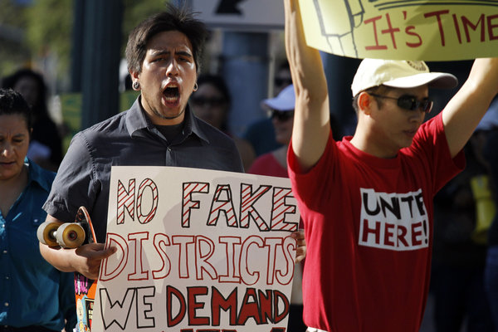

Slide 4
Presentation Outline
  Background and context
  Logic of my approach
  Accuracy of simulated 2000-2010 “forecasts” for 8 communities
  Conclusions and next steps

Slide 5
Background and Context
Local electorates typically evolve as
  Ethnic residential enclaves mature & expand
  Their juvenile citizens reach adulthood
  Their elderly citizens die off
Approaches to foreseeing the future:
  From geography: Spatial diffusion
  From demography: Cohort progression
Notes:
APPROACHES:
A theory from geography--spatial diffusion—and a familiar demographic concept--cohort succession—offer a foundation for anticipating that future.
Spatial coalescence and diffusion occurs as Hispanic movers cluster spatially in centralized ethnic enclaves, and as these enclaves expand outward over time through spatial diffusion.
Cohort succession: embodies the familiar premise that birth cohorts matures from one year to the next, reaching adulthood, and eventually dying off.
Cohort succession both adds new young members to the voting-age population and subtracts existing old members.
Where two populations differ sharply in age structure (as Hispanics and non-Hispanics typically do), cohort succession has a predictable influence on the composition of an electorate.

Slide 6
Logic of This Approach
  Calibrate spatial diffusion model to project Hispanic enclave expansion
  Calibrate cohort progression models to project evolving future electorate:
    Add juvenile citizens as they attain voting age
    Subtract elderly citizens as they die off
Notes:
This isn’t everything that’s happening—people come & go—but it captures several consistent effects whose importance may be quite prominent in certain communities, like those I’ll examine next.
Big picture—lawyer sponsored research. Analogy of piecemeal scientific advance--moving pieces of car forward

Slide 7
Local Hispanic Enclaves Are Varied

Slide 8
Milwaukee, WI
Hispanic Enclave in Milwaukee County, WI

Slide 9
Multiple Hispanic Enclaves:
Greater Los Angeles

Slide 10
Orange County, FL -- Multiple Enclaves

Slide 11
Spatial Diffusion Model
Portrays coalescence & outward growth of Hispanic residential enclaves
Projects future growth according to adjacent past growth
Model is easily calibrated & interpreted
Notes:
Models of such diffusion provide a scientific basis for anticipating the future course of such growth—that’s a separate topic
How I quantify the outward diffusion of Hispanic population from a densely populated ethnic enclave into adjacent outlying areas.

Slide 12
How Voting Strength Materializes

Slide 13
City of Yakima, WA

Slide 14
Young Hispanics Age Into an Electorate,
Elderly non-Hispanic Voters Die Off

Slide 15
Cohort Progression Model
Accounts for Hispanics aging into the electorate as older non-Hispanics die off
Isolates effects of age structure apart from other possible influences
Documents how Hispanics may ripen into a majority of future eligible voters
Notes:
Start with CP model:
This is a demographic accounting model for quantifying gains in Hispanics’ voting strength over time through cohort succession.

Slide 16
Predictive Accuracy:
2000-2010 Simulated Forecasts
Notes:
I evaluate the model’s predictive accuracy in seven cities and counties where I have applied this model.
Using Census 2000 data as a starting point, I project gains in Hispanics’ intrinsic voting strength by 2010 through the progression of juvenile cohorts of Hispanic citizens.

Slide 17
Forecast Detail
Notes:
Using Census 2000 data as a starting point, I projected gains in Hispanics’ intrinsic voting strength as of 2010 using a demographic accounting model shown in Table 4.
I then compare the projected gains with actual measured 2000-2010 gains.

Slide 18
Forecast Summary
Notes:
Overall, projected 2000-2010 gains in voting strength compare favorably with actual measured gains over the decade.

Slide 19
Conclusions & Next Steps

Slide 20
What Have We Learned?
Youthful cohort succession increases voting strength in Hispanic immigrant communities
A model quantifying this process accounts for much of that prospective increase
Further possible refinements could account for:
Adult noncitizen Hispanics who will naturalize
Migratory influx of adult citizen Hispanics
Mortality loss through elderly cohort succession

