Slide 1
Who Attends Private Schools?
Enrollment rates by ethnicity in California
Magali Barbieri, Shelley Lapkoff, Jeanne Gobalet
Lapkoff & Gobalet Demographic Research, Inc.
www.demographers.com
January 9, 2014
University of Texas, San Antonio
Applied Demography Conference

Slide 2
Public school districts are interested in local private school enrollment rates
  This is because:
  Changes in private school enrollments often result in changes in public school enrollments
  Transfers between public and private schools can explain oddities in grade progression patterns (such as many more 9th graders than 8th graders the year before)
  Private school rates can indicate how the public school district is perceived

Slide 3
Two sources of data on private school enrollments
Administrative data from the private schools, reported to state agencies, but
    Students may live outside the public school district boundaries in which the private school is located
    Poor reporting, at least in California, since there is no penalty for misreporting or not reporting
Census and survey data
    2000 Census long form SF3
    American Community Survey

Slide 4
California and two of its Counties
San Francisco, CA (city/county/school district)
Fresno, CA (county, city)
  Studied using PUMS data from the 2007-2011 American Community Survey
  Descriptive statistics + logistic regression analysis
  Geographic units: counties and PUMAs within each county

Slide 5
San Francisco and Fresno’s K-12 private enrollment rates couldn’t be more different

Slide 6
Yet in both counties, and in the state, private school enrollment rates vary
By:
  Race/ethnicity
  Household income
  Other socioeconomic measures
  School level (kindergarten, elementary, middle, high)
  Location of school district
  But how much do they vary, and which factors matter most? Do the effects differ by area?

Slide 7
African Americans have relatively higher rates in Fresno than in San Francisco

Slide 8
San Francisco has an unusual pattern: students in the lowest quartile of household income have higher rates than those in the 2nd quartile
  Private school scholarships?

Slide 9
San Francisco and Fresno have different patterns of private school enrollment by grade level
  Different perceptions of desirability of public and private schools for each school level?

Slide 10
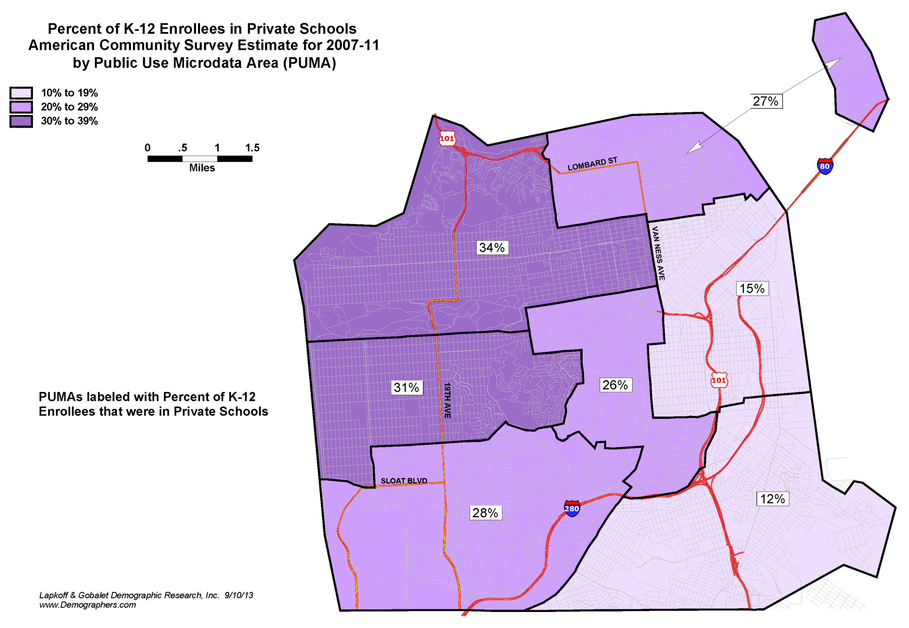
Private school enrollment rates vary by geographical subarea (PUMA) – San Francisco

Slide 11
Private school enrollment rates vary by geographical subarea (PUMA) – Fresno County

Slide 12
Multivariate regression analysis
To understand the geographical difference in private school enrollment patterns, it is necessary to:
control for correlations among the variables
measure differences in the impact of each factor on private school rates in Fresno, San Francisco and the whole of California
Statistical strategy = one big logistic regression model with interactions

Slide 13
Logistic regression on the odds of attending private school (with interactions)for all K-12 Students in California
2007-11 ACS

Slide 14
To convert odds into probabilities : the formula is
p = odds/(1+odds)
The probability of attending private school for a student in California with all the reference characteristics (white, born in the US, male, living with both parents in a single family home, in the poorest income quartile but not receiving food stamps) is 0.101/(1+0.101) = 0.09207,
or about 9.2%.

Slide 15
The odds are the result of the multiplication of the constant by the odds ratio for each relevant variable.
If the student has all the baseline characteristics but lives in Fresno PUMA 3401, his probability of attending private school is (0.101*0.474)/(1+(0.101*0.474))=0.04585
or about 4.6%

Slide 16
For example, the probability of an Hispanic girl attending a private school:
(1) If she lives in California but in neither Fresno or San Francisco is: (0.101*0.448*1.067)/(1+(0.101*0.448*1.067)) = 4.6%
(2) If she lives in Fresno PUMA 3301, 3302, or 3402, her probability is the same as in (1) because the coefficients for these Fresno PUMAs and for being a girl in Fresno and being Hispanic in Fresno (which are equal to 0.900 and 0.985, respectively, for the last two) are not significant.
(3) If she lives in Fresno PUMA 3401 , the probability is: (0.101*0.448*1.067*0.474)/(1+(0.101*0.448*1.067*0.474)) = 2.3%
(4) If she lives in San Francisco PUMA 2207 (here we need to include both the coefficient for San Francisco PUMA 2207 and the coefficients for female and Hispanic because these are significant), the probability is: (0.101*0.448*1.067*1.395*0.814*3.053)/(1+(0.101*0.448*1.067*1.395*0.814*3.053)) = 14.4%

Slide 17
Main results (1)
Overall, largest differences are due to:
place of residence (San Francisco vs. rest of California)
wealth (income and food stamps)
race and ethnicity (Hispanics vs. Whites)

Slide 18
Main results (2)
Geographic variations in the impact of some explanatory variables:
Race and ethnicity (differ from statewide patterns in Fresno and San Francisco – especially for African Americans)
Income (smaller in Fresno)
Housing type (smaller in San Francisco)

Slide 19
Conclusions:
Household income has the largest effect on private school enrollment rates.
Whites have higher rates of private school enrollment, even after controlling for income.
Hispanics have the lowest rates statewide but not in Fresno or San Francisco, where African Americans rank lowest.
Race/ethnicity and household income are strong variables in both cities.
San Francisco has a “culture” of private schooling; even the poorest households in the city have private school enrollment rates 3 to 11 times higher than elsewhere.
Jeanne Gobalet
gobalet@demographers.com
Lapkoff & Gobalet Demographic Research, Inc.
www.demographers.com
Notes:
Note: African American have lower private school enrollment rates in Fresno AFTER controlling for everything else (but not before – while in San Francisco, they have lower rates even when not controlling for the other factors), compared with the rest of California.

