Slide 4
Applying a shift-share technique to analyze poverty change
A shift-share analysis is a descriptive technique to identify components of regional growth and decline.
Traditionally, the components are associated with a national effect, an industrial mix effect and a competitive effect.
Study’s Approach: State Effect, Regional Effect, and Local Effect
Note: Shift-Share competitive effects and local poverty measure are residual measures and as such should have a zero mean in repetitive sampling if they are random effects.

Slide 6
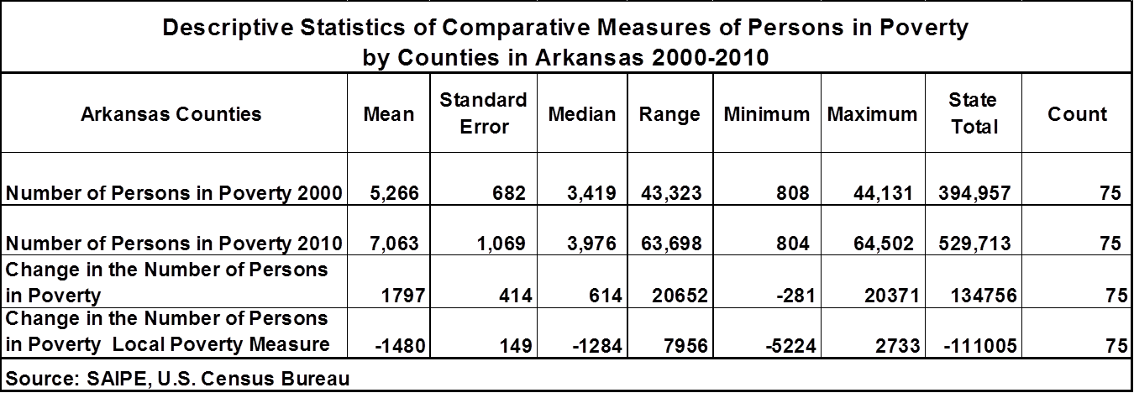

Slide 7
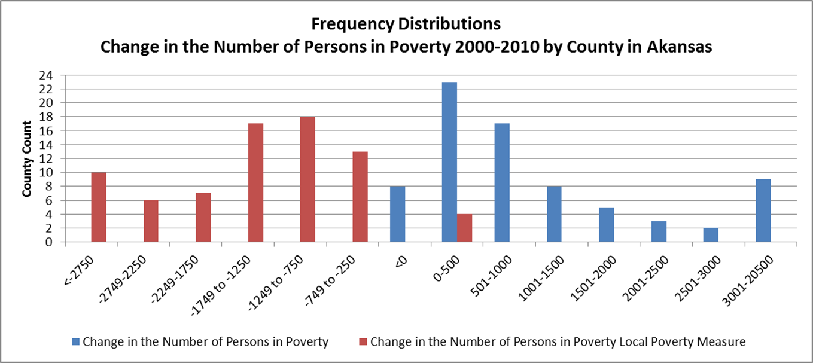

Slide 13
Conclusions:
Does shift-share’s competitive effect component when used as a dependent variable improve the explanatory power of regression equations commonly used in regression studies focused on the causes of poverty.
Not in this case!
Why?
Local poverty measure is a residual measure.
Time frame in this study is too short and not enough observations- Use a Dynamic Shift-Share Technique and more states
Alternatives
Alternative local poverty measures
Alternate Regression Analysis with explanatory variables controlling for external factors and then analyze the local factors.

