Slide 1
Understanding Spatial Spillovers & Feedbacks
Paul R. Voss
University of North Carolina at Chapel Hill
and
André Braz Golgher
University of Minas Gerais (UFMG), Brazil
Applied Demography Conference
San Antonio 1/8-10/14
Notes:
This is work being collaboratively carried out with Andre Braz Golgher with the Center for Development & Planning, University of Minas Gerais, Brazil

Slide 2
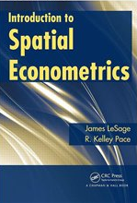
Spatial Effects
Spatial spillovers
Spatial feedbacks
Notes:
Published 2009
Paul Elhorst in a lengthy review of the book remarks that it has “raised the bar” for spatial analysts

Slide 3
Spatial Lag Model (SAR model)
Model assumes large-scale spatial heterogeneity is handled by Xβ ;
remaining small-scale (localized) spatial dependence is handled as an autoregressive, interactive, effect through Wy & ρ

Slide 4
Rearranging the terms in this model we obtain the reduced form:
Not an easy model to explain in words
Notes:
Inverse matrix is a n x n full matrix.
Commonly encountered matrix. For example, in social network analysis, with W being a binary peer matrix, it is referred to as the Katz-Bonacich Centrality Matrix, and measures the number of direct & indirect connections that an individual in a social network has.
In network analysis, rho would be the “attenuation factor”. We’ll call it the spatial parameter

Slide 5
Fortunately…
So we can re-express our model…
and taking expected values…
Notes:
Known as the Wassily Leontief power expansion.
But discovered much earlier by Prussian born mathematician Carl Gottfried Neumann
This is a “simultaneously specified Gaussian model” (SAR)

Slide 6
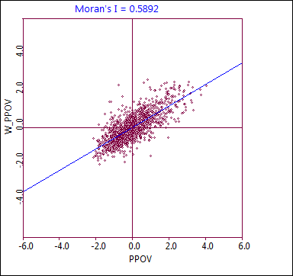
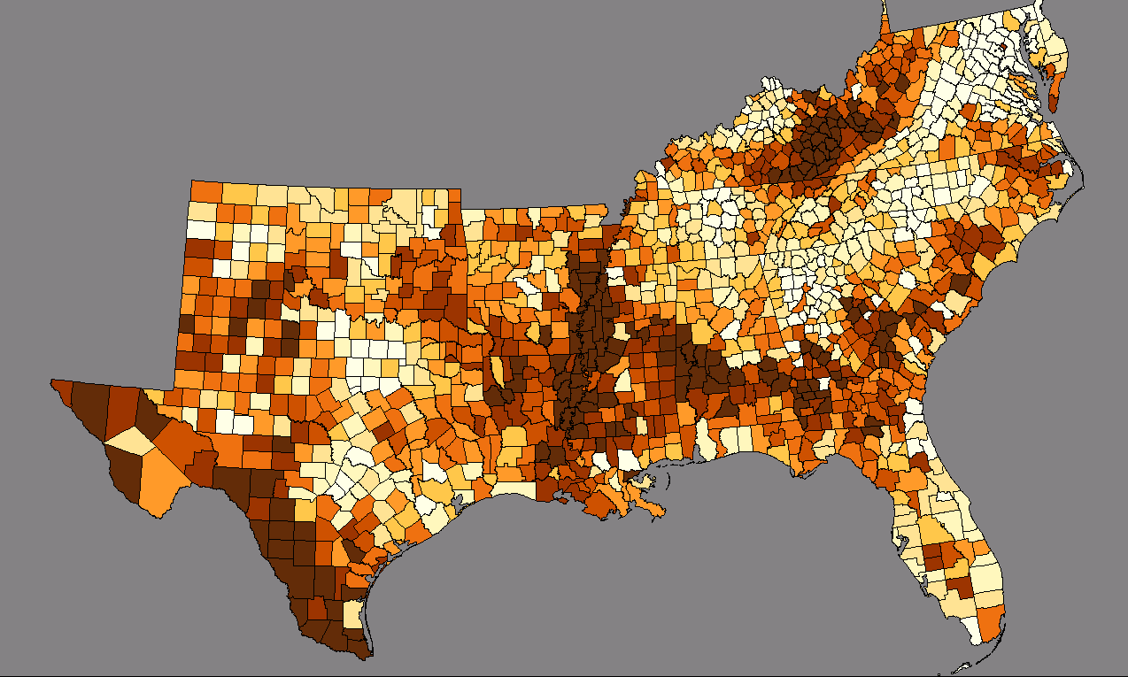
Example: Counties in U.S. South, 2000 Census
n = 1,387
Source:
SF3 Table P87

Slide 7
Standard Linear Model (transformed variables)
For this model, we all know how to interpret the fixed marginal effects
Notes:
Variables are transformed (PPOV, FEMHH, UNEM are square root transformations; HIED is log transformed)

Slide 8
But now… Spatial Lag Model (SAR) (transformed variables)
avg. of “neighbor’s” child poverty rate
For this model, interpreting marginal effects is much more difficult
I’ll return to this model at the end of my presentation

Slide 9
Why more difficult?
Spatial Spillovers & Spatial Feedbacks
recall expected values for SAR model…
and what does this mean?

Slide 10
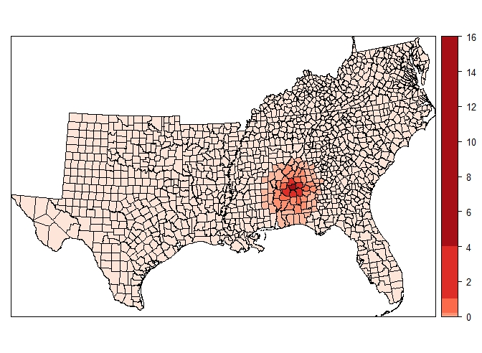
Effect of arbitrary increase in FEMHH rate in Autauga Co. on Child Poverty Rate (SAR Model)
Illustration of “spatial spillover” on child poverty from a simulated increase in female-headed HH (with kids) only in Autauga Co. AL (SAR model with 1st-order queen W)
Notes:
The FEMHH variable is the number of Fem-Headed HH with children (<18) divided by the total number of family HH with children (<18)

Slide 11
The next several slides attempt to show (mathematically) what’s happening here

Slide 12
Back to the Standard Linear Model (SLM)
In matrix notation:
Q: For the standard linear model, what (mathematically) do the beta coefficients represent?
A: They represent the partial derivatives of y with respect to x_{k} .
and a reminder: ε ~ N_{iid}(0,σ²I)

Slide 13
Think of it like this…
In matrix notation:
one of these for each β coefficient; i.e., one for each x_{k}
(n x n)
(n x n)
(n x n)

Slide 14
That is…
row 1: change in DV in region 1 based on change in x_{ik} each region (i = 1,…,n)
cross-partial derivatives are zero; change in x_{ik} affects only y_{i}; no spatial spillovers

Slide 15
and…
column 1: change in DV in each region i (i = 1,…,n) based on change in x_{1k} (i.e., x_{k} in region 1)
cross-partial derivatives are zero; change in x_{ik} affects only y_{i}; no spatial spillovers

Slide 16
Simple example…
Region 1
Region 2
Region 3
Assume:
3 regions; independent observations
Standard linear model (SLM) estimated by OLS
Dependent variable y ; Independent variable x₁
Slope coefficient for x₁, β₁ = 2
Partial derivatives matrix for x₁:

Slide 17
Simple example (continued)…
Region 1
Region 2
Region 3
Now, further assume that variable x₁ in Region 3 changes by 10 units:
Only the value of y₃ is affected by the change in x₃; no spatial spillovers

Slide 18
Again… things are more complex for SAR model (spatial spillovers!)

Slide 19
Now the partial derivative matrix looks like this…
The n x n matrix (I-ρW)⁻¹ has non-zero elements off the main diagonal. These non-zero cross-partial derivatives imply the existence of spatial spillovers. This follows from the power series approximation shown above:

Slide 20
With W row-standardized, the elements of W lie between 0 & 1. Further, under positive spatial autocorrelation, ρ is constrained to be strictly < |1|. Thus, the spatial spillovers associated with higher powers of ρ & W dampen out, often quickly.
Again, assume:
Region 1
Region 2
Region 3
Further, assume the row-standardized W matrix:

Slide 21
For this particular weights matrix, we have (by simple matrix arithmetic):
and its inverse:

Slide 22
Thus:
The n x n matrix of partial derivatives is a function of the exogenously specified weights matrix, W, the spatial scalar parameter, ρ , and the parameter β_{k}. But the β-term appears not only along the major diagonal but also in the cross-partial derivatives. When ρ = 0, the matrix of partial derivatives is the one we saw for the SLM. When ρ ≠ 0, the partial derivatives (diagonal) are greater than the β-term, augmented by spatial spillovers as follows:

Slide 23
Diagonal terms of the partial derivatives matrix (for our 3-region example and the specified 1st-order weights matrix, W):
Again, when ρ = 0, the diagonal partial derivatives are simply the β-terms. When ρ ≠ 0, the diagonal elements represent the β-terms, augmented by spatial spillovers

Slide 24
Simple example revisited…
Region 1
Region 2
Region 3
Assume:
3 regions; independent observations
SAR model
Dependent variable y ; Independent variable x₁
Slope coefficient for x₁, β₁ = 2
Partial derivatives matrix for x₁:

Slide 25
Simple example (continued) …
Region 1
Region 2
Region 3
Further, assume an increase by 10 units the value of x₁ in Region 3:

Slide 26
When ρ = 0, we obtain the earlier results for the SLM (i.e., increase of 10 units for variable x₁ in Region 3 results in y₃ increasing by 20 units):

Slide 27
If, however, ρ = 0.2, then we see that an increase of 10 units for variable x₁ in Region 3 results in y increasing in all regions:

Slide 28
Can we describe this outcome?
y increases everywhere because of spatial spillovers. The spillover effect is strongest for Region 2 (an immediate neighbor of Region 3 (which we might have anticipated because of the 1st-order spatial weights matrix, W). But Region 1 is a “neighbor of the neighbor” and also is affected by the change in Region 3 for this SAR model.
But why did y in Region 3 increase by more than 20? The answer is feedback spillover. A portion of the change in the other regions is feeding back to further change y₃.

Slide 29
Calculate the extent of spatial spillover for this simple SAR model by subtracting the results for ρ = 0.0 from the results for ρ = 0.2
The change in Region 3 spills over to affect Region 2 and, much more mildly, even Region 1. Since Region 3 is also a neighbor or Region 2, the same degree of spillover comes back to Region 3 as feedback spillover

Slide 30
For the southeastern counties, and for the simple model & estimated parameters shown earlier (3 independent variables plus spatial lag)…
Employing the SAR model, we chose arbitrarily to increase the independent variable FEMHH in Autauga County AL by 20 percentage points (from 19% to 39%) and inquired about the impact of this change on county-level poverty rates

Slide 31
Change in child poverty rate due to simulated increase in FEMHH variable in Autauga Co.

Slide 32
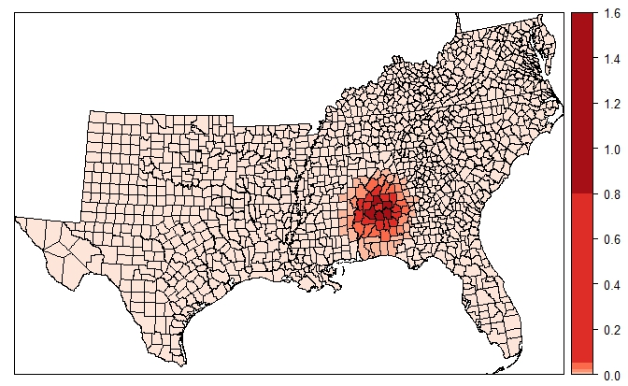
Spatial spillovers due to change in child poverty rate due to simulated increase in FEMHH variable in Autauga Co. (direct effect removed)

Slide 33
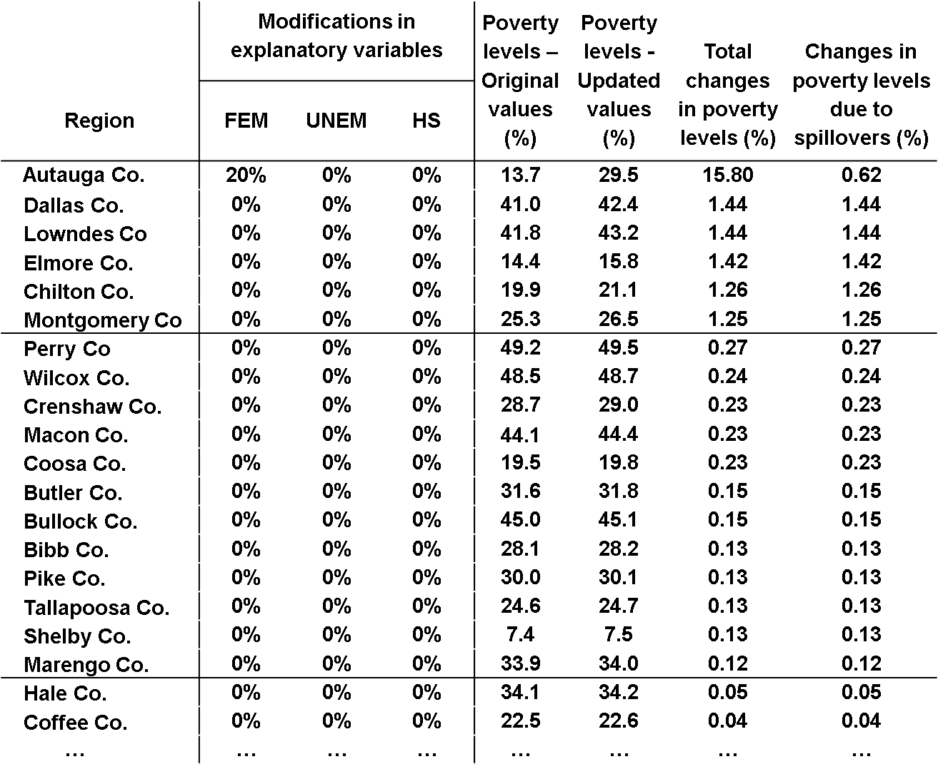
Simulated spatial effects of change in child poverty rate due to increase in femhht variable in Autauga Co.

Slide 34
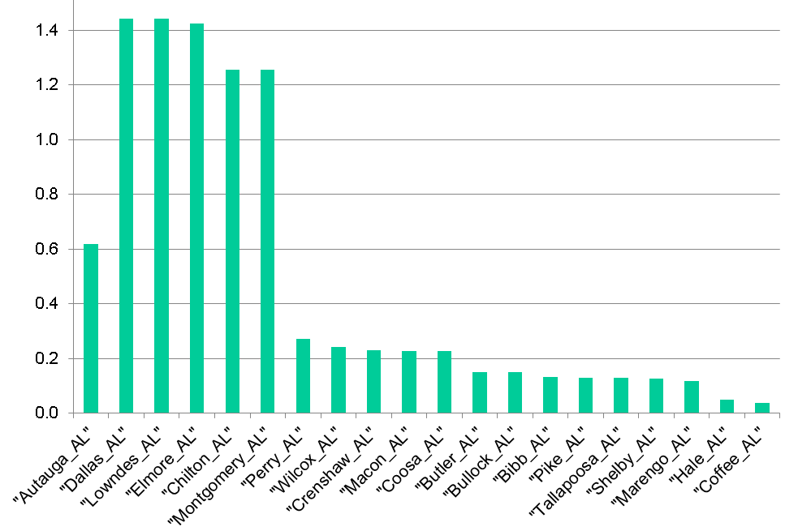
Graph of spatial spillovers
1st-order neighbors
2nd-order neighbors
3rd-order neighbors

Slide 35
Comments…
Interpreting marginal effects in spatial regression models becomes complicated
They are influenced by effects direct & indirect (spatial spillovers & feedbacks)
They are a function of:
Our data and estimated parameters (β_{k} & ρ)
Our assumed neighborhood definition and spatial weights matrix, W
An example such as shown here is helpful for understanding what’s going on in these models but requires some cautions

