Slide 1
Rurality Not the Determinant of Access to Primary Health Care in Mississippi
Ronald E. Cossman. Ph.D.
Presented to: Applied Demography Conference
January 10, 2014
Mississippi Center for Health Workforce
Social Science Research Center
Mississippi State University

Slide 2
Three ways to measure health care workforce
        Supply
        Demand
        Access

Slide 3
Supply
Simple: Physician-to-population ratio
Complex: Health Professional Shortage Areas (HPSAs)
(ratio of physicians-to-population) and other factors such as:
1) Poverty rate (all categories)
2) Travel distance/time (all categories)
3) Infant mortality/low birth weight (primary care)
3) Fluoridated water (dental)
3) Pop under 18, over 65, alcohol or substance abuse (mental health)
Note: This “assumes” total access to care for patients.

Slide 4
Demand
Via the National Health Interview Survey.
“Were you unable to obtain health care in the last 12 months?”
Note: The question is relative, does not ask the reasons, and is not available below the state level.

Slide 5
Access
1. Physician Reimbursement Records (who accepted what kind of patient)
Note: This is a retrospective measure.
2. Telephone survey of Primary Care offices (by type of health care insurance)

Slide 6
Assumption/Hypothesis:
Health insurance equates to access to primary care. and….access is worse in rural places

Slide 7
Methodology
Telephone each primary care physician practice office using G-mail voice-over-internet-protocol (VOIP) to mask calling identity and location.
Poise as a new patient to the area asking for a visit to establish a relationship with the physician
Volunteer health insurance status:
Blue Cross & Blue Shield (the 800-lb gorilla)
Medicare (automatic insurance for the elderly)
Medicaid (means-based insurance)

Slide 8
Descriptives
There were 5,098 “licensed” physicians in the state of Mississippi
There are 2,138 active “primary care” physicians in the state
There are 678 primary care facilities that were used in our study
  Local government clinics, hospitals and E.R.s were excluded
  88 facilities were excluded because they were walk-in facilities
  580 offices were successfully contacted
“Core” Primary Care is comprised of: general practitioner, family practice, and internal medicine. The other two categories are pediatrics and OB/GYN. (Note: HPSA definition of primary care)

Slide 9
FINDINGS:
Private (Blue Cross and Blue Shield of Mississippi)

Slide 10
Note the “Other” category. We may be significantly understating the denial rate.
Type of Insurance/Specialty
Private (Blue Cross and Blue Shield of Mississippi)
Accept Decline Other*
Core Primary Care** 75% 8% 17%
OB/GYN 91% 0% 9%
Pediatrics 83% 5% 12%
Total*** 78% 7% 16%
* Did not resolve an appointment, required call-back, additional information, valid insurance number
** General practitioner, family practice, internal medicine
*** May not add to 100% due to rounding

Slide 11
Medicare (elderly)

Slide 12
Types of Insurance/Specialty
Medicare (elderly)
Accept Decline Other*
Core Primary Care** 63% 16% 21%
OB/GYN 76% 8% 16%
Pediatrics N/A N/A N/A
Total 64% 15% 21%
* Did not resolve an appointment, required call-back, additional information, valid insurance number
** General practitioner, family practice, internal medicine

Slide 13
Medicaid (means-based)

Slide 14
Decline may range from 43% to 50%
Type of Insurance/Specialty
Medicaid (means-based)
Accept Decline Other*
Core Primary Care** 47% 43% 10%
OB/GYN 59% 28% 13%
Pediatrics 61% 21% 17%
Total 50% 38% 12%
* Did not resolve an appointment, required call-back, additional information, valid insurance number
** General practitioner, family practice, internal medicine

Slide 15
Number of Residents that Practices Serve in Selected* Cities
*Randomly selected cities

Slide 16
Beale Code Frequencies in MS

Slide 17
Primary Care and Counties by Beale Code

Slide 18
Notes:
Our MSA cities are: Memphis, Jackson, Gulfport-Biloxi, Pascagoula and Hattiesburg.

Slide 19
Percent Not Currently Accepting New Patients

Slide 20
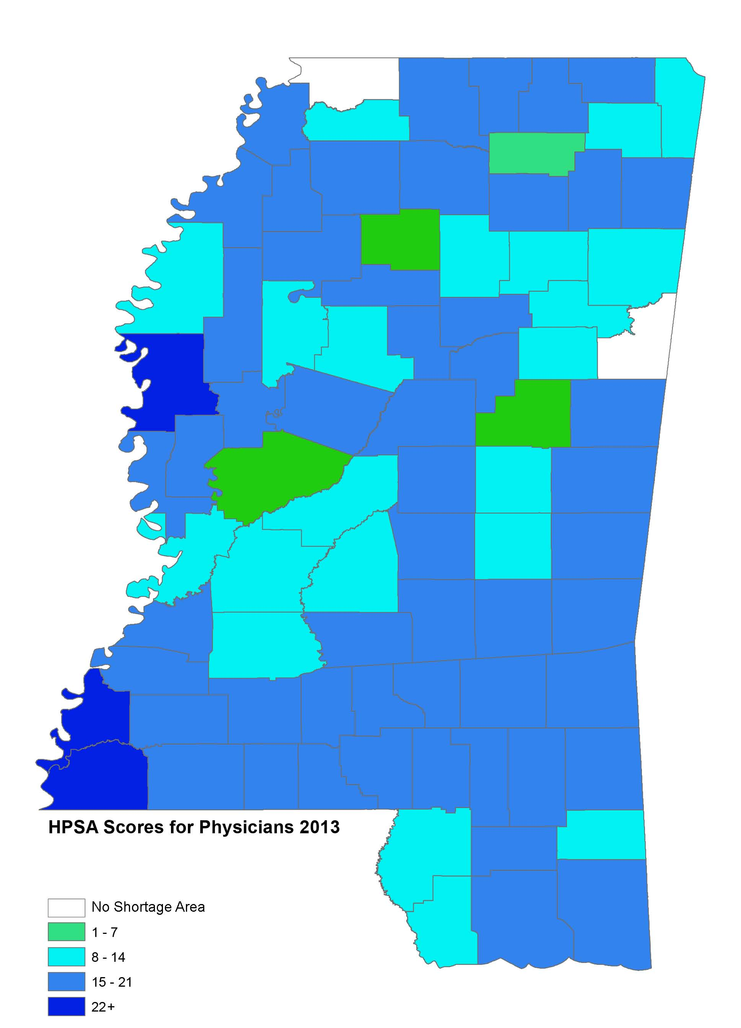
The 2 counties in white (DeSoto & Lowndes) are not HPSA physician shortage areas in Mississippi

Slide 21
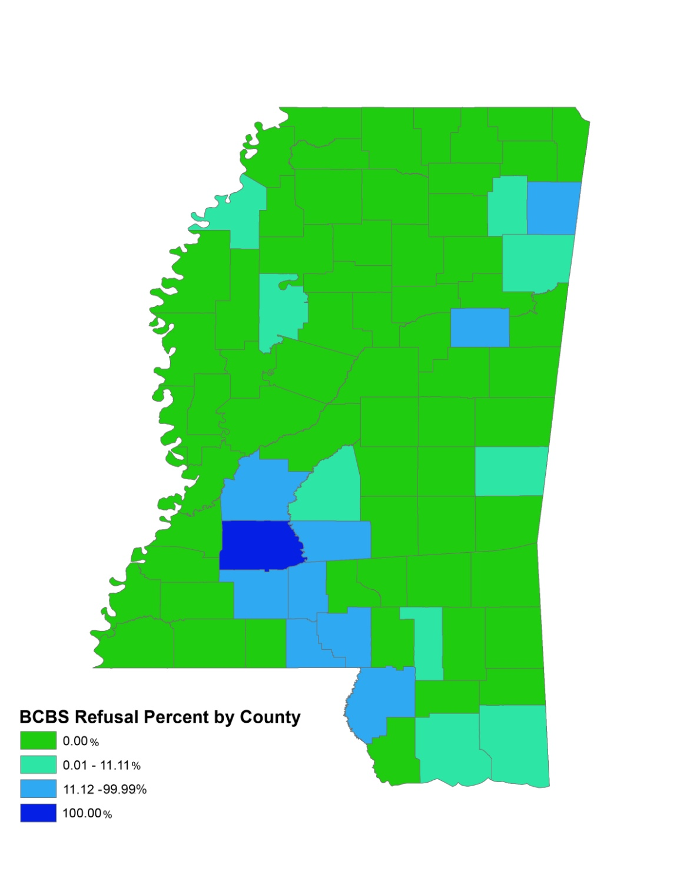
Primary care offices in only 1 county (Copiah) did not accept private (BC&BS) insurance. More than three quarters of MS counties (primary care offices) (77%) had zero decline rates of BCBS.

Slide 22
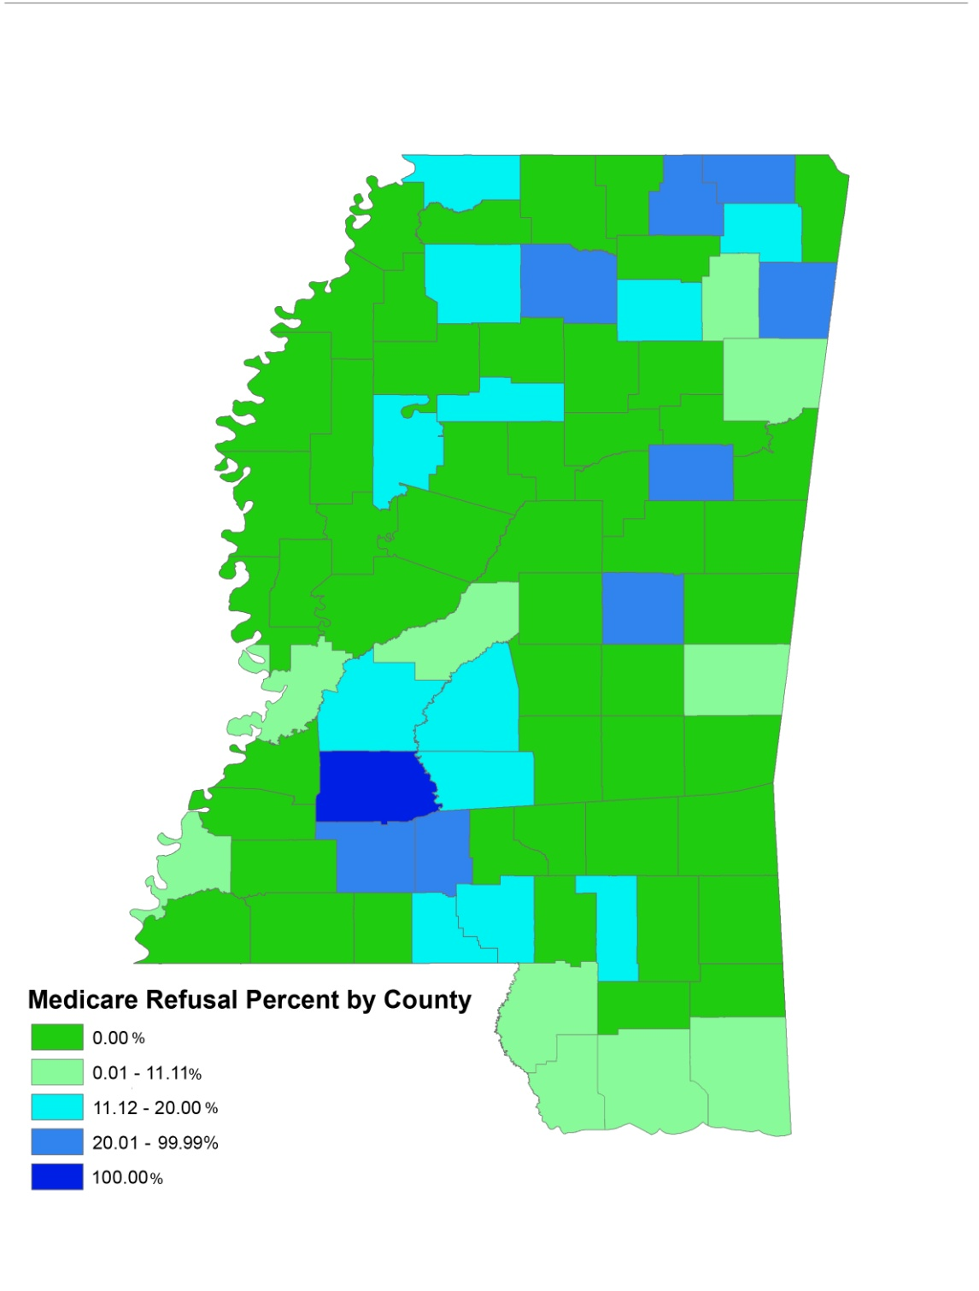
In one county (Copiah) there was zero acceptance of new Medicare patients.

Slide 23
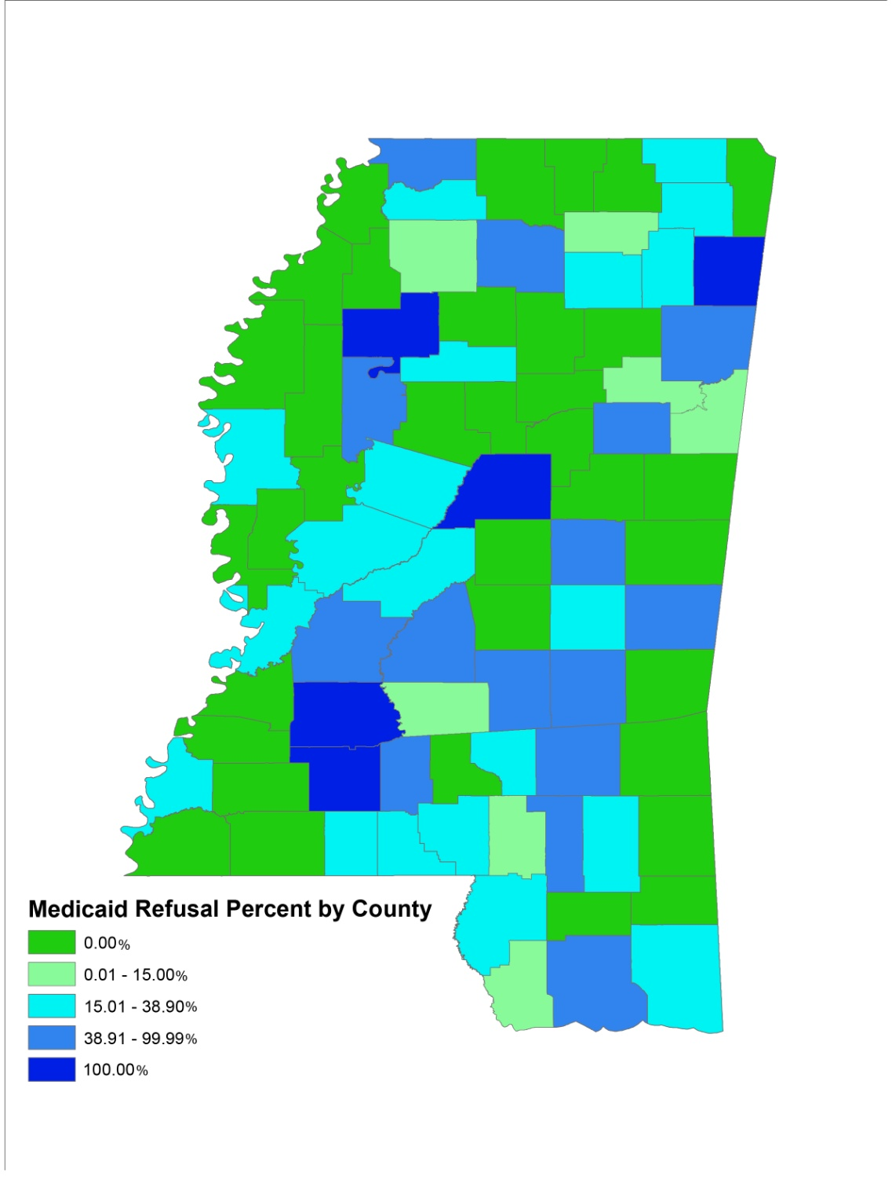
There are 5 counties that were not currently accepting new Medicaid patients.
They are (NE to SW) Itawamba, Tallahatchie, Attala, Copiah and Lincoln.

Slide 24
Additional Finding:
Our results my underestimate the percentage of declines. When the unresolved calls are factored in, decline of service could be as high as 57%.

Slide 25
Implications of the findings
Health insurance does NOT equate to access to primary care

Slide 26
Implication #1
A Medicaid expansion will not necessarily provide access to primary care to all.
Thus, the impact of expansion will be less.
Thus, the non-critical emergency room load will not drop as expected

Slide 27
Implication #2
Since physician offices are a business, a substantial portion have chosen not to accept certain kinds of insurance.
Thus, we need to revisit the payment/reimbursement system

Slide 28
Implication #3
Using physicians ratios treats all physicians as independent. However, if there are five physicians in a county and they all practice together, a decline of service from one is a decline from all 5 health care providers.

Slide 29
Thank you for your attention
Ronald E. Cossman, Ph.D.
Research Professor
Mississippi Center for Health Workforce
Social Science Research Center
P.O. Box 5287
Mississippi State University
Mississippi State, MS. 39762
Office: (662) 325-4801
E-mail: rcossman@ssrc.msstate.edu
Web: http://www.ssrc.msstate.edu

