Slide 1
Characterization of Household Residential Energy Consumption Using a Housing Unit Archetype Framework
Steve White
Lloyd Potter
Jeffrey Jordan
Lila Valencia
Carlos Valenzuela

Slide 2
Introduction
Understanding the energy efficiency of housing units is important for targeting conservation efforts.
Type of construction, age, and size of a housing unit are expected to result in variation in household energy consumption patterns.

Slide 3
Method
County tax appraisal district data (housing unit characteristics) and local energy company data (source KBTUs in gas and electricity consumption for each unit in 2010) are used.
Analysis restricted to dwellings occupied over the year. Housing units are distributed into a 100 cell grid (Table 1) based on vintage (year built) and size (square feet of living area).

Slide 4
SIZE DECILES | Before 1948 | 1948-1957 | 1958-1966 | 1967-1974 | 1975-1981 | 1982-1986 | 1987-1995 | 1996-2000 | 2001-2004 | After 2004
<10 Percentile | [1] <792 | [11] <816 | [21] <927 | [31] <975 | [41] <1134 | [51] <1078 | [61] <1386 | [71] <1354 | [81] <1376 | [91] <1458
10-19 Percentiles | [2] 792-911 | [12] 816-934 | [22] 928-1035 | [32] 975-1117 | [42] 1134-1292 | [52] 1078-1237 | [62] 1386-1598 | [72] 1354-1568 | [82] 1376-1604 | [92] 1458-1661
20-29 Percentiles | [3] 912-1015 | [13] 935-1019 | [23] 1036-1151 | [33] 1118-1223 | [43] 1293-1419 | [53] 1238-1367 | [63] 1599-1807 | [73] 1569-1794 | [83] 1605-1801 | [93] 1662-1854
30-39 Percentiles | [4] 1016-1111 | [14] 1020-1107 | [24] 1152-1261 | [34] 1224-1321 | [44] 1420-1538 | [54] 1368-1472 | [64] 1808-2048 | [74] 1795-2074 | [84] 1802-2071 | [94] 1855-2101
40-49 Percentiles | [5] 1112-1207 | [15] 1108-1204 | [25] 1262-1367 | [35] 1322-1447 | [45] 1539-1681 | [55] 1473-1601 | [65] 2049-2237 | [75] 2075-2228 | [85] 2072-2255 | [95] 2102-2311
50-59 Percentiles | [6] 1208-1314 | [16] 1205-1308 | [26] 1368-1493 | [36] 1448-1580 | [46] 1682-1803 | [56] 1602-1765 | [66] 2238-2399 | [76] 2229-2423 | [86] 2256-2427 | [96] 2312-2520
60-69 Percentiles | [7] 1315-1441 | [17] 1309-1435 | [27] 1494-1651 | [37] 1581-1723 | [47] 1804-1957 | [57] 1766-1953 | [67] 2400-2575 | [77] 2424-2653 | [87] 2428-2675 | [97] 2521-2745
70-79 Percentiles | [8] 1442-1631 | [18] 1436-1605 | [28] 1652-1858 | [38] 1724-1927 | [48] 1958-2174 | [58] 1954-2211 | [68] 2576-2855 | [78] 2654-2959 | [88] 2676-2968 | [98] 2746-3030
80-89 Percentiles | [9] 1632-2063 | [19] 1606-1928 | [29] 1859-2207 | [39] 1928-2236 | [49] 2175-2516 | [59] 2212-2621 | [69] 2856-3282 | [79] 2960-3325 | [89] 2969-3352 | [99] 3031-3440
90+ Percentile | [10] >2063 | [20] >1928 | [30] >2207 | [40] >2236 | [50] >2516 | [60] >2621 | [70] >3282 | [80] >3325 | [90] >3352 | [100] >3440

Slide 5
Consumption efficiency
Examined as follows :
The median source KBTUs for each of the 100 Vintage by Size categories were calculated.
SKBTU's for the 100 were ranked from highest to lowest.
Consumption categories were assigned as follows:
Tier 1 - Rank = 1-25: Lowest Efficiency
Tier 2 - Rank = 26-50: Moderate-Low Efficiency
Tier 3 – Rank = 51-75: Moderate-High Efficiency
Tier 4 – Rank = 76-100: Highest Efficiency

Slide 6
Size/Vintage | Before 1948 | 1948-1957 | 1958-1966 | 1967-1974 | 1975-1981 | 1982-1986 | 1987-1995 | 1996-2000 | 2001-2004 | After 2004
<10 Percentile | 1 | 2 | 3 | 5 | 11 | 10 | 22 | 17 | 30 | 49
10-19 Percentiles | 4 | 6 | 7 | 13 | 25 | 21 | 46 | 44 | 47 | 73
20-29 Percentiles | 8 | 9 | 15 | 20 | 35 | 28 | 56 | 53 | 62 | 81
30-39 Percentiles | 14 | 12 | 24 | 27 | 42 | 34 | 63 | 66 | 71 | 92
40-49 Percentiles | 16 | 18 | 31 | 33 | 47 | 40 | 76 | 75 | 77 | 95
50-59 Percentiles | 19 | 23 | 37 | 38 | 55 | 43 | 78 | 79 | 85 | 96
60-69 Percentiles | 26 | 29 | 45 | 52 | 59 | 50 | 82 | 84 | 87 | 97
70-79 Percentiles | 32 | 35 | 56 | 58 | 61 | 60 | 83 | 86 | 93 | 98
80-89 Percentiles | 39 | 41 | 67 | 65 | 68 | 64 | 88 | 91 | 94 | 100
90+ Percentile | 51 | 53 | 72 | 74 | 68 | 70 | 89 | 80 | 90 | 99
 | TIER 1
 | TIER 2
 | TIER 3
 | TIER 4

Slide 7
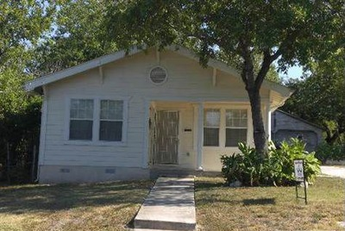
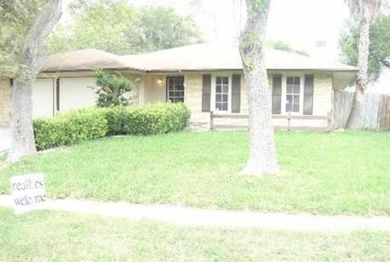
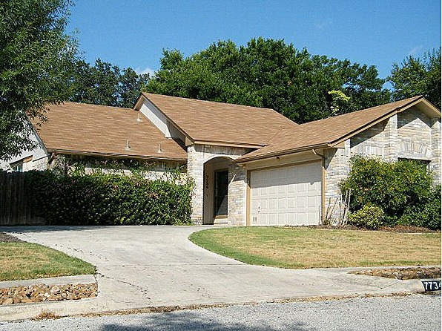
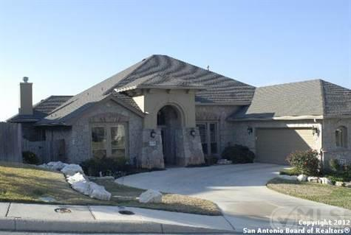
Housing Unit Examples
1
1932
942
2
1977
1,384
3
1985
1675
4
2008
3,117

Slide 8
Refinement of Other Characteristics.
The archetype grid can be further refined to include details. Using foundation types:
Pier and beam is less efficient across all tiers.
Pier and beam housing units have lower improvement values across all tiers.
In the first three tiers, based on median year built, pier and beam housing units are 23 or more years older than slab housing units.
In tier 4, housing units (built between 1987 and 2010), pier and beam is almost non-existent.

Slide 9
TIER 1 | Number | Med. SKBTU per Square Foot | Med. GBA (Square Feet) | Med. Year Built | Med. Improvement Value, 2010
All | 75,764 | 154.4 | 1,052 | 1958 | $40,770
Slab | 44,266 | 149.6 | 1,081 | 1970 | $45,750
Pier & Beam | 31,475 | 163.3 | 992 | 1947 | $33,880
TIER 2
All | 75,934 | 124.5 | 1,460 | 1976 | $62,940
Slab | 62,465 | 123.0 | 1,452 | 1980 | $78,070
Pier & Beam | 13,454 | 132.5 | 1,502 | 1945 | $64,250
TIER 3
All | 75,269 | 106.6 | 1,989 | 1979 | $86,740
Slab | 70,797 | 106.1 | 1,970 | 1980 | $86,830
Pier & Beam | 4,806 | 116.1 | 2,384 | 1945 | $84,900
TIER 4
All | 79,180 | 90.3 | 2,624 | 2003 | $98,860
Slab | 79,020 | 90.3 | 2,624 | 2003 | $98,890
Pier & Beam | 114 | 110.2 | 2,522 | 2003 | $90,655

Slide 10
Refinement of Tiers
Subdivision of the four tiers based on additional vintage, size, and consumption details. Original four tiers subdivided into 16 archetypes based on:
Reducing the number and narrowing the range for vintages.
Deriving 'Small' and 'Large' size categories within each new vintage category.
Deriving 'High' and 'Low' SKBTU consumption categories by size and by vintage

Slide 11
VINTAGE | <1958 | <1958 | <1958 | <1958 | 1958-1981 | 1958-1981 | 1958-1981 | 1958-1981 | 1982-2000 | 1982-2000 | 1982-2000 | 1982-2000 | >2000 | >2000 | >2000 | >2000
year built
SIZE | Small | Small | Large | Large | Small | Small | Large | Large | Small | Small | Large | Large | Small | Small | Large | Large
square feet | <1,300 | <1,300 | >1,300 | >1,300 | <1,500 | <1,500 | >1,500 | >1,500 | <2,000 | <2,000 | >2,000 | >2,000 | <2,500 | <2,500 | >2,500 | >2,500
CONSUMPTION | High | Low | High | Low | High | Low | High | Low | High | Low | High | Low | High | Low | High | Low
SKBTUs/sq. ft. | >160 | <160 | >125 | <125 | >146 | <146 | >111 | <111 | >125 | <125 | >97 | <97 | >102 | <102 | >85 | <85
New Archetypes | 1 | 2 | 3 | 4 | 5 | 6 | 7 | 8 | 9 | 10 | 11 | 12 | 13 | 14 | 15 | 16
Original Tiers | 1 [1] | 1 [4] | 1 [7] | 1 [9] | 1 [21] | 1 [24] | 2 [26] | 2 [28] | 3 [51] | 3 [55] | 3 [58] | 3 [67] | 4 [81] | 4 [85] | 4 [87] | 4 [97]
[Categories] | 1 [2] | 1 [5] | 1 [8] | 1 [10] | 1 [22] | 1 [25] | 2 [27] | 2 [29] | 3 [52] | 3 [56] | 3 [59] | 3 [68] | 4 [82] | 4 [86] | 4 [88] | 4 [98]
 | 1 [3] | 1 [6] | 1 [17] | 1 [19] | 1 [23] | 2 [33] | 2 [35] | 2 [30] | 3 [53] | 3 [57] | 3 [60] | 3 [69] | 4 [83] | 4 [93] | 4 [89] | 4 [99]
 | 1 [11] | 1 [13] | 1 [18] | 1 [20] | 2 [31] | 2 [34] | 2 [36] | 2 [38] | 3 [54] | 3 [62] | 3 [65] | 3 [70] | 4 [84] | 4 [94] | 4 [90] | 4 [100]
 | 1 [12] | 1 [14] |  |  | 2 [32] | 2 [42] | 2 [37] | 2 [39] | 3 [61] | 3 [63] | 3 [66] | 4 [77] | 4 [91] | 4 [95]
 |  | 1 [15] |  |  | 2 [41] | 2 [43] | 2 [45] | 2 [40] | 3 [71] | 3 [64] | 3 [75] | 4 [78] | 4 [92] | 4 [96]
 |  | 1 [16] |  |  |  | 2 [44] | 2 [46] | 2 [47] |  | 3 [72] | 4 [76] | 4 [79]
 |  |  |  |  |  |  |  | 2 [48] |  | 3 [73] | 4 [80]
 |  |  |  |  |  |  |  | 2 [49] |  | 3 [74]
 |  |  |  |  |  |  |  | 2 [50]

Slide 12
Conclusion
Older, smaller houses are less energy efficient.
An archetype framework has significant potential for targeting housing units with specific conservation efforts.

