Slide 1
Leveraging the strengths of the prcs
Lessons from pph and other household characteristics estimated using the prcs
Matt Kaneshiro
Christine Pierce
1/8/2014

Slide 2
Issue
Budget cuts consistently affect the Census Bureau’s efforts to produce accurate and timely estimates.
Risk of inaccurate control estimates for the ACS/PRCS
Risk of decreased quality of Household and Person characteristics determined by the ACS/PRCS

Slide 3
Why puerto rico?
Let’s assume that budget cuts will affect the quality of:
Methodology development (e.g. for migration estimates)
Supplemental resources (e.g. MAF updates)
Base estimates (e.g. housing units)
…in this case, the PRCS can be used to explore the quality that the ACS could have under a “worst-case scenario”

Slide 4
objective
Use the Puerto Rico Community Survey (PRCS) as a case study to explore the quality and uses of the ACS if it were to have poor household and persons’ controls, highlighting:
Potential:
Persons Per Household are usable using an alternate method …which can be used to estimate Households
Estimates of household distributions are relatively accurate
Cautions:
Biases are produced by the data-collection structure

Slide 5
population estimate method: 2000 – 2009
Births: Puerto Rico Planning Board
Deaths: Puerto Rico Planning Board
Net Migration rates (residual method): [2000 enumerated] – [1990-based 2000 projection]
Assumptions:
Migration rates of the 1990s = migration rates of 2000s
Differential coverage across the two censuses is equal

Slide 6
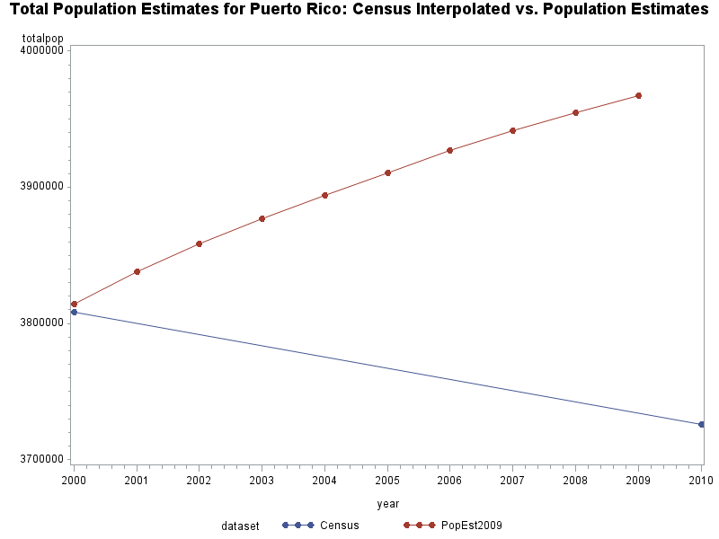
population estimate quality: 2000 – 2009
The application of 1990s-based net migration rates to the 2000s produced poor population estimates

Slide 7
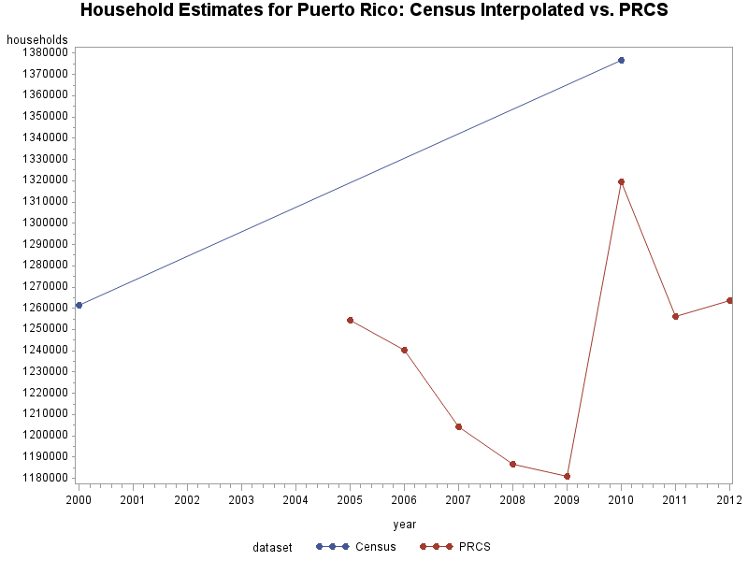
household estimate quality: 2000 – 2009
Stable Household estimates were unstable (no MAF updates)
*Note: it looks like the problem returns after the 2010 Census
Notes:
MAF, sampling weights,

Slide 8
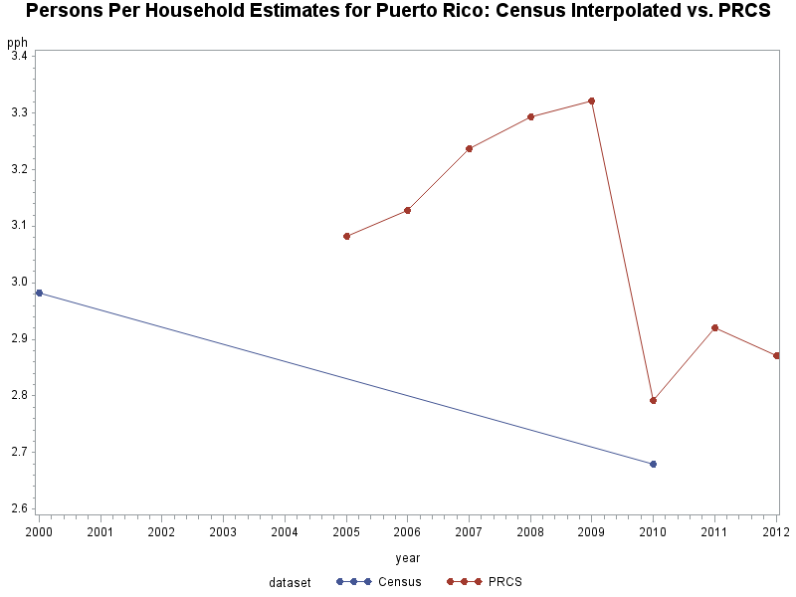
Put the two together: pph
Inflated persons + deflated households = really inflated PPH

Slide 9
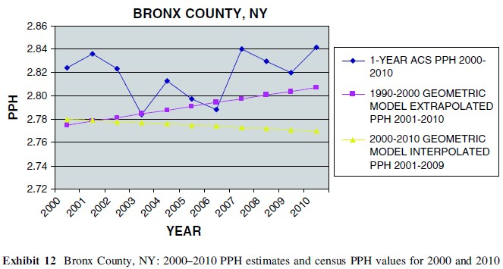
Some context: acs’ pph difficulties
The “statistical perspective” of ACS weighting (Swanson and Hough, 2010)

Slide 10
Are we doomed to poor household estimates for puerto rico?
Not so fast…
What is the PRCS?
A household survey with sampling rates stratified by block size
Household weights are determined by sampling and non-response rates
Can we determine PPH if we simply treated the PRCS as a weighted household survey?

Slide 11
Persons-per-household
An alternative method
PPH as a weighted average of Household Size
$$PPH=\frac{\sum{{HHSize}_{i}×{HHWeight}_{i}}}{\sum{{HHWeight}_{i}}}$$
…where $i$ = a PRCS-sampled household

Slide 12
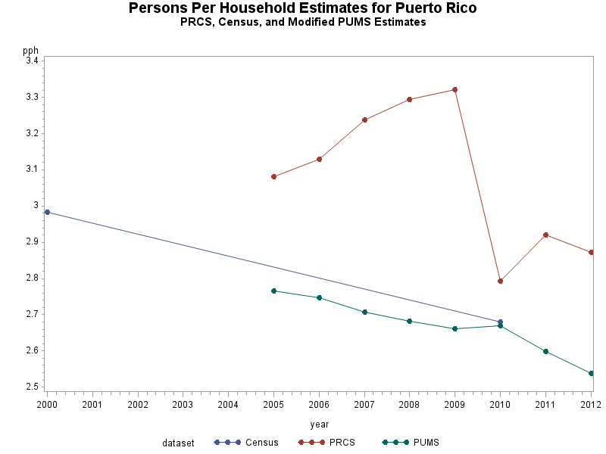
results
“PUMS” method for Puerto Rico: average annual sample size = 12732

Slide 13
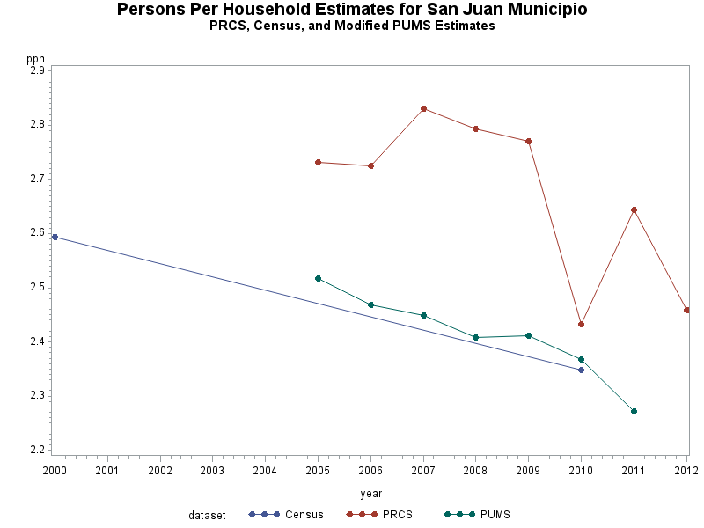
which still works for smaller geographies
San Juan Municipio: average sample size = 1637

Slide 14
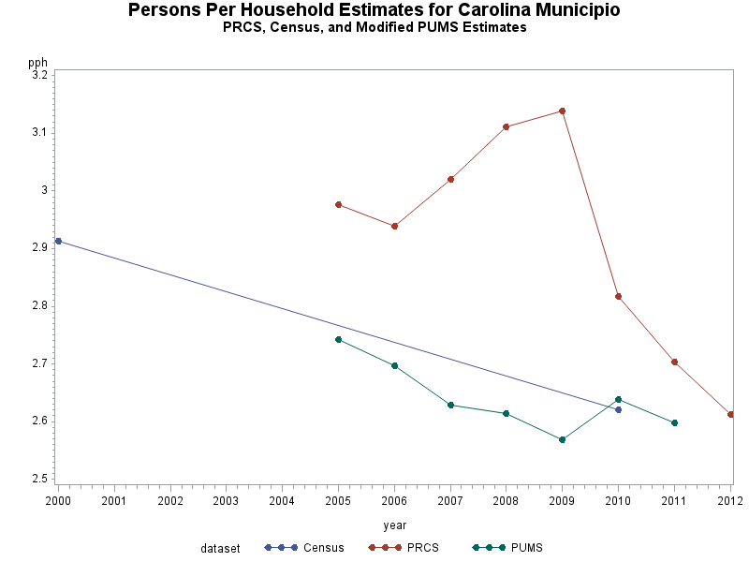
which still works for smaller geographies
Carolina Municipio: average sample size = 644

Slide 15
which still works for smaller geographies
Arecibo Municipio: average sample size = 314

Slide 16
Viewing the Prcs as a household survey
The alternate PPH method suggests that, controls and weighted counts non-withstanding, the PRCS may still produce good household % distributions.
…which begs the question: How does the PRCS perform in estimating other household distributions?

Slide 17
ALLOW ME TO OPEN UP A CAN OF WORMS
Let us consider highly mobile populations
A Decennial Census captures household members that “live or sleep [here] most of the time”, whereas the ACS captures “everyone who is living or staying [here] for more than 2 months”
The ACS is closer to a snapshot-in-time
Thus… the ACS may be more sensitive to mobile populations
Census ACS

Slide 18
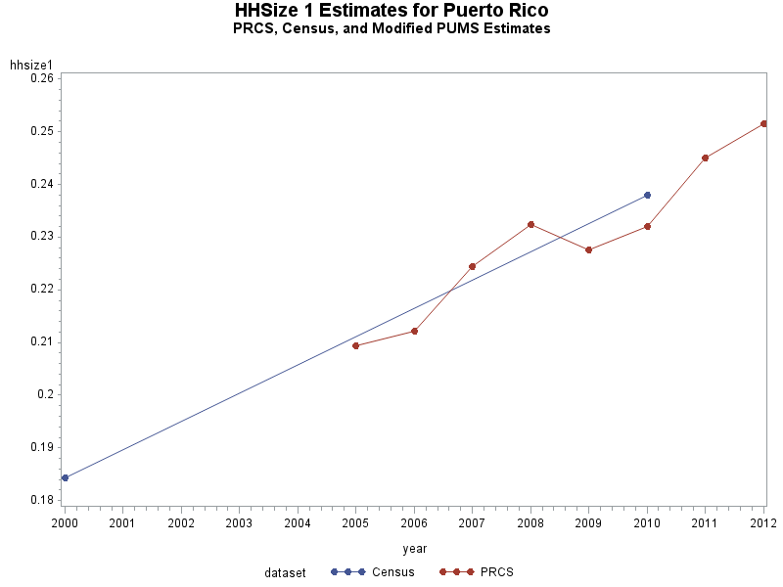
household size 1: bingo
…which is presumably a more stable household size

Slide 19
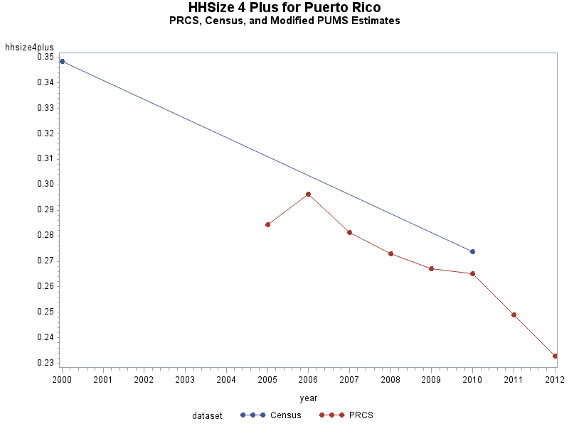
household size 4+: underestimate
…presumably has more workers “abroad”

Slide 20
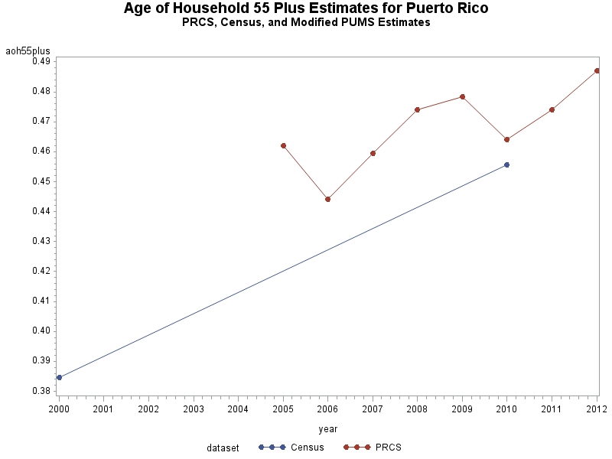
Age of householder 55+: overestimate
…presumably has fewer workers “abroad”

Slide 21
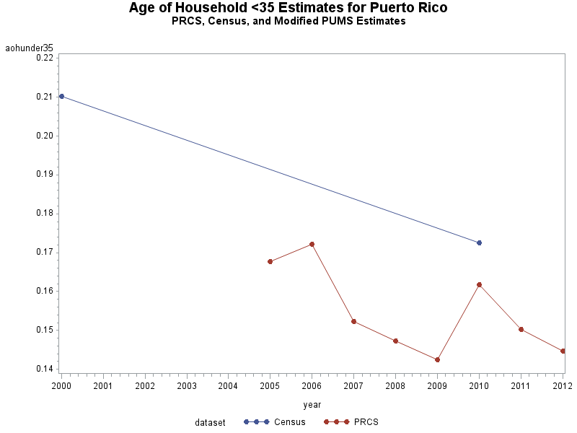
Age of householder < 35: underestimate
…presumably has more workers “abroad”

Slide 22
conclusions
Persons-Per-Household estimates can be computed by using a weighted average of household size using the PRCS
The PRCS can still produce relatively accurate household characteristic distributions.
HOWEVER, differences exist between the PRCS and the Decennial Census (i.e. The PRCS is sensitive to mobile populations).

Slide 23
Taking it a step further
The PRCS (ACS?) may be leveraged to assist with Household estimates
In a world of dramatically-limited budgets, are there other uses of the PRCS/ACS for assisting the Census Bureau?
The Master Address File remains to be of high importance
The utility of the “statistical perspective” of household weighting continues to be open to debate (Swanson and Hough 2010)
The ACS as a surrogate for the “long form” may require greater consideration to the differences between the ACS and Decennial Census
Side note: the weighted household size method of estimating PPH does not perform as well for the continental U.S.
More research is needed to determine why
My guess: overweighting of the ACS

Slide 24
Thanks!

