Slide 1

Advances in population projection methods and their implications for the future
Hania Zlotnik

Slide 2
Projecting the components of change
Fertility: Future trends in total fertility
Age distribution of fertility
Mortality: Future trends in life expectancy
Mortality rates by age and sex
Migration: Future net number of migrants
Migrants by age and sex

Slide 3
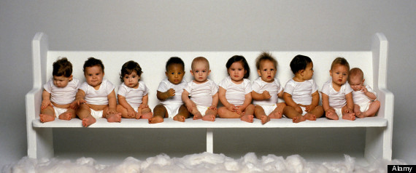
PROJECTING THE First component of change: fertility

Slide 4
In projecting future fertility trends one can take advantage of two things:
The availability of a complete set of past estimates of fertility change
The empirical existence of a “typical” pattern of fertility change as described by the demographic transition

Slide 5
Fertility estimates from 1950 to 2015

Slide 6
Typical fertility trend from high to low
Phase I
Phase II
Phase III

Slide 7
Countries classified by fertility level
18%
40%
42%
Note: The boundaries shown on this map do not imply official endorsement or acceptance by the United Nations.

Slide 8
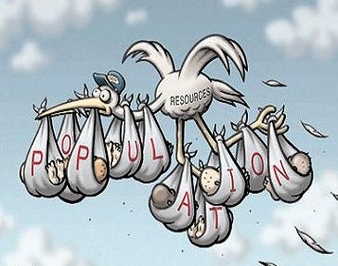
PROJECTING Fertility for countries in phase II
2

Slide 9
Fertility decrements during Phase II
Total fertility

Slide 10
Modeled fertility decrements, Phase II
Total fertility

Slide 11

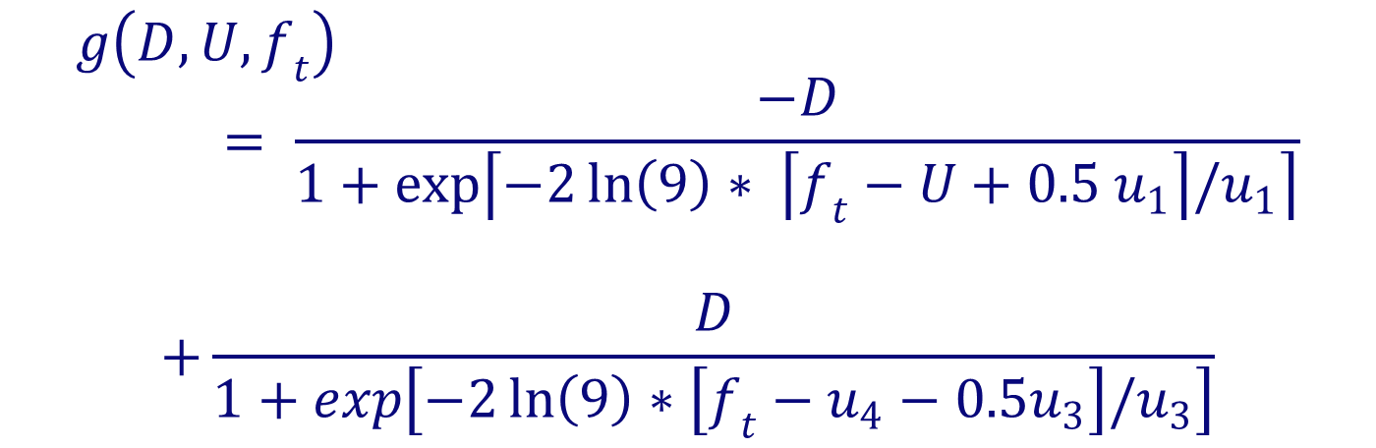
Fertility decrements are modeled using a double logistic function with five parameters
$$g\left(D, U,f_{t}\right)= \frac{−D}{1+exp\left\lceil −2\ln\left(9\right)∗ \left\lceil f_{t}−U+0.5 u_{1}\right\rceil /u_{1}\right\rceil }$$
$$+\frac{D}{1+exp\left[−2\ln\left(9\right)∗\left[f_{t}−u_{4}−0.5u_{3}\right]/u_{3}\right]}$$
where $U=u_{1}+ u_{2}+ u_{3}+ u_{4 }$
and it represents the level at which fertility begins to decline.

Slide 12
Double logistic decrement function (D=1)
u₁
u₂
u₃
u₄

Slide 13
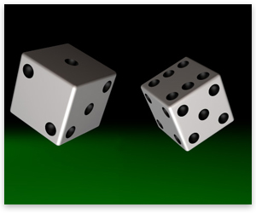
Adding uncertainty

Slide 14
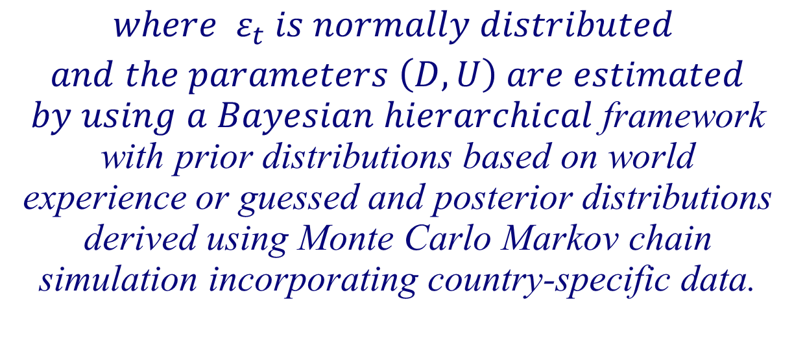
Fertility is projected by using the decrements yielded by the logistic model. Uncertainty is captured by a random distortion term
$$f_{t+1}=f_{t}{+ g\left(D, U, f_{t} \right)+ ε_{t} }^{ }$$
$$where ε_{t} is normally distributed$$
$and the parameters \left(D, U\right) are estimated$ $by using a Bayesian hierarchical$framework with prior distributions based on world experience or guessed and posterior distributions derived using Monte Carlo Markov chain simulation incorporating country-specific data.

Slide 15
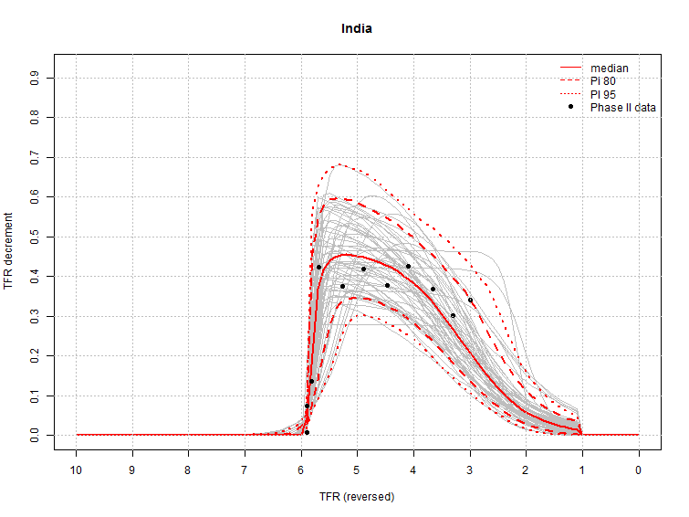
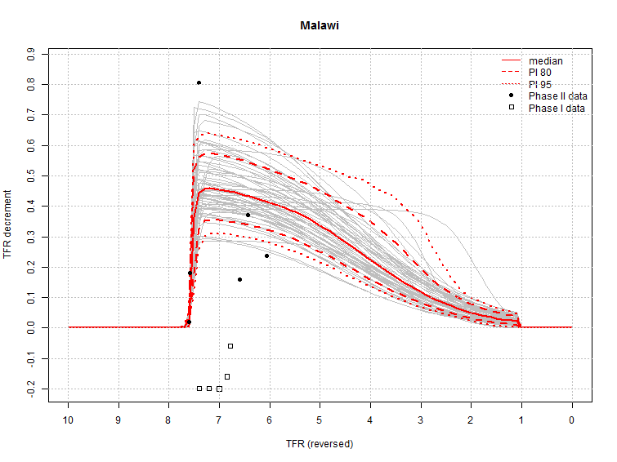
Examples of decrement paths
India: Sustained decline
Malawi: Stalling decline

Slide 16
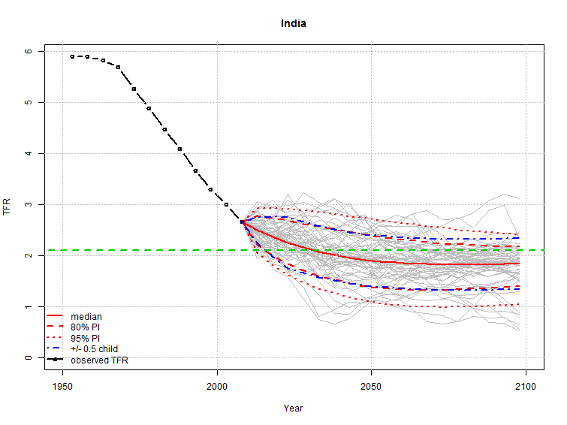
India: Projection of fertility
6
2.1

Slide 17
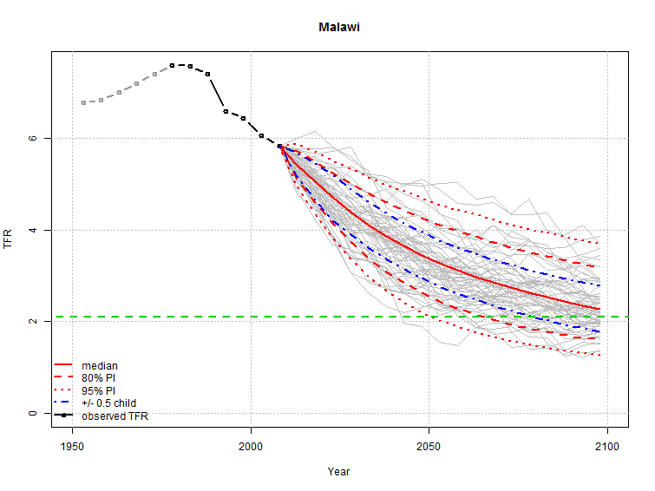
Malawi: Projection of fertility
8
2.1

Slide 18
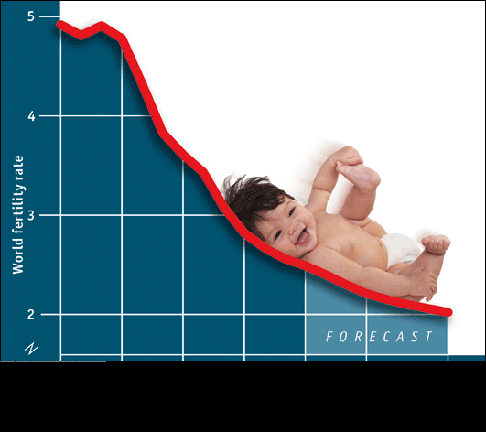
PROJECTING Fertility for countries in phase III

Slide 19



Projection for countries in Phase III

Slide 20
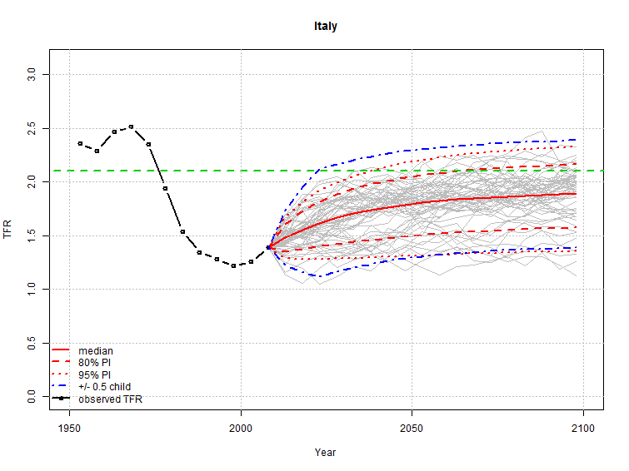
Italy: Projected fertility
2.1

Slide 21
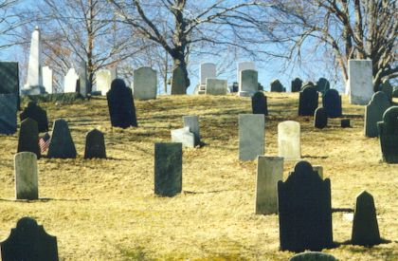
PROJECTING THE SECOND component of change:
MORTALITY

Slide 22

Probabilistic projection of life expectancy
$$Raftery et al. assume that life expectancy$$
$follows a random$ $walk with drift:$
$$e_{t+1}=e_{t}+g\left(e_{t}, θ\right)+ ε_{t+1}$$
$$where g\left(e_{t}, θ\right) is a double logistic similar$$
$$to that used in modeling fertility change$$
$$and ε_{t+1} is a random error with a normal$$
$$distribution.$$

Slide 23

Probabilistic projection of life expectancy
$$A Bayesian hierarchical approach is used to$$
$$estimate the model^{′}s parameters. This approach$$
$$is used to project female life expectancy.$$
$Male$ $life expectancy is derived from a$
$$regression model for the female to male gap in$$
$$life expectancy$$

Slide 24

Putting it together

Slide 25
Malawi: Projected population in millions
2 570
1 468
1 225
880

Slide 26
India: Projected population in millions
2 570
1 468
1 225
880

Slide 27
Italy: Projected population in millions
2 570
1 468
1 225
880

Slide 28
Some patterns emerge:
For high-fertility countries, the intervals between the high and low variants are too narrow compared to those yielded by the probabilistic projections
For low-fertility countries, the high-low intervals are too wide
For intermediate-fertility countries they are about right

Slide 29
Fertility trends, 1950-2100

Slide 30
Least developed countries: projected fertility

Slide 31
Developing countries: projected fertility

Slide 32
Developed countries: projected fertility

Slide 33
Annual population increments, medium variant
World: 10.8 billion in 2010
Developing
2043: 26 million
Least developed
Developed

Slide 34
Projected population, medium variant
World: 10.8 billion in 2100
1.3
Developed
1.3
6.6
Developing
5.0
Least developed
2.9
0.9

Slide 35
Projected population, high variant
World: 16.6 billion in 2100
2.0
Developed
10.4
1.3
Developing
5.0
Least developed
4.3
0.9

Slide 36
Projected population, low variant
World: 6.8 billion in 2100
1.3
Developed
0.8
Developing
4.0
5.0
0.9
Least developed
1.9

Slide 37
Median age vs. population size in different projections: least developing countries

Slide 38
Median age vs. population size in different projections: other developing countries

Slide 39
Median age vs. population size in different population projections: developed countries

Slide 40
Conclusions
Curbing population growth in developing countries is still a challenge
Least developed countries have the highest potential for growth
Achieving the high variant is well within the realm of possibility for the least developed countries
Even the contraction or slow growth of the rest of the world might not counterbalance that growth.

Slide 41
Conclusions
Population ageing is inevitable if the world population is not to grow excessively
The medium variant offers a path where population ageing occurs at acceptable levels while population growth remains moderate
The low variant would produce faster and more profound ageing.

Slide 42
For more information, consult:
www.unpopulation.org

