Slide 1
2015 National Content Test
Results and Recommendations
U.S. Census Bureau
Applied Demography Conference
San Antonio, Texas | January 12, 2017
Any views expressed are those of the authors and not necessarily those of the U.S. Census Bureau.
1

Slide 2
Session Overview
Introduction and Background
Question Format (Separate vs. Combined)
Testing a Middle Eastern or North African Category
Evaluating Alternative Instructions and Terminology
Overall Findings and Question Design Decisions
Discussion
Notes:
2

Slide 3
Introduction and Background
Hyon B. Shin
Chief, Racial Statistics Branch
U.S. Census Bureau

Slide 4
Concerns with Current Questions
Growing number of groups find the race and Hispanic origin questions confusing
Increasing responses of “Some Other Race”
Campaigns and lobbying of the U.S. Census Bureau and the U.S. Congress for changes to the race and Hispanic origin questions
Led to the 2010 Census Race and Hispanic Origin Alternative Questionnaire Experiment (AQE)

Slide 5
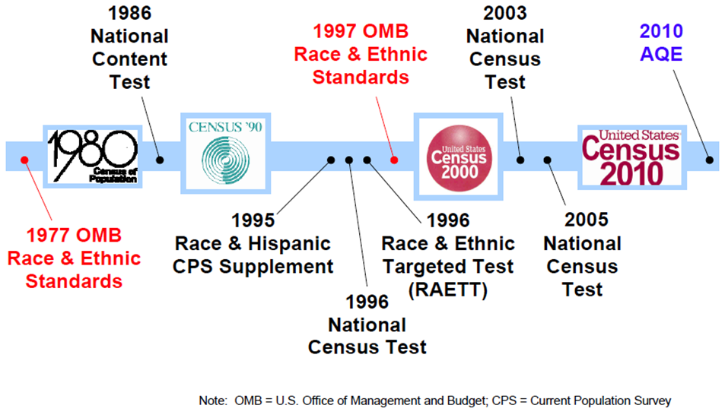
Background on Race/Ethnicity Research

Slide 6
2010 AQE Main Research Findings
Results for the Combined Question
Did not reduce Hispanic, Black, AIAN, Asian, NHPI
Reduced reporting of Some Other Race
Reporting of White dropped to levels reflecting the
Non-Hispanic White population
Yielded lower item nonresponse rates
Increased detailed reporting for most groups, but decreased reporting for others
Reflects better self-identity, per reinterview

Slide 7
2010 AQE Main Research Findings
Results from the Focus Groups
Fair, equitable treatment for all groups with a combined question
Middle Eastern and North African participants did not see themselves in the current race/ethnicity categories and recommended a separate Middle Eastern, North African, or Arab response category

Slide 8
2015 National Content Test (NCT)
Census Day of September 1, 2015
Used large, nationally representative sample of 1.2 million addresses, including Puerto Rico
Evaluate and compare different census content
Refine estimates of national self-response and Internet response rates and continue testing different contact strategies for optimizing self-response
Content reinterview with subsample of NCT respondents, to measure accuracy
Overall response rate was 51.9%
8
Notes:
8

Slide 9
Goals for 2015 NCT
Race/Ethnicity Research
Key Dimensions to Explore
Separate questions vs. combined question
Middle Eastern or North African (MENA) category
Instruction wording and terminology
Web-based designs to improve question understanding and optimize reporting of detailed racial and ethnic groups
Notes:
9

Slide 10
Question Format
(Separate vs. Combined)
Nicholas A. Jones
Director & Senior Advisor,
Race Ethnicity Research & Outreach
U.S. Census Bureau

Slide 11
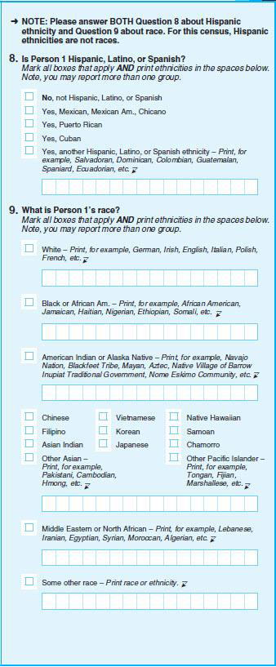
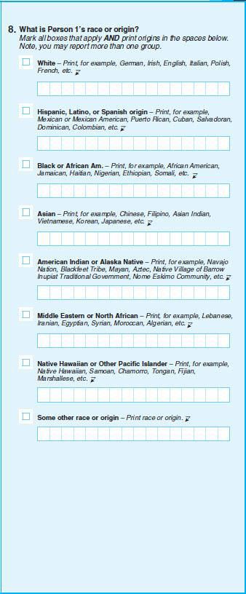
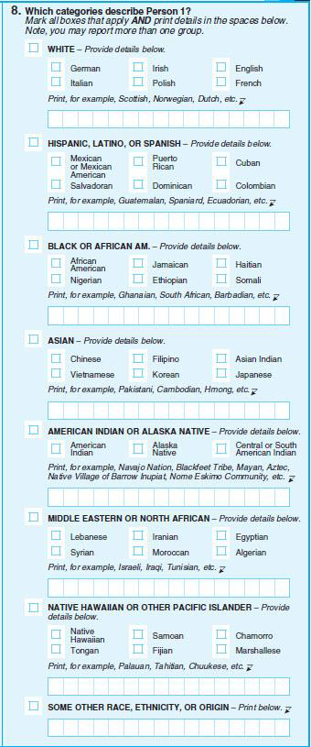
Question Format
Separate
Combined w/ Write-Ins
Combined w/ Checkboxes
11
Notes:
11

Slide 12
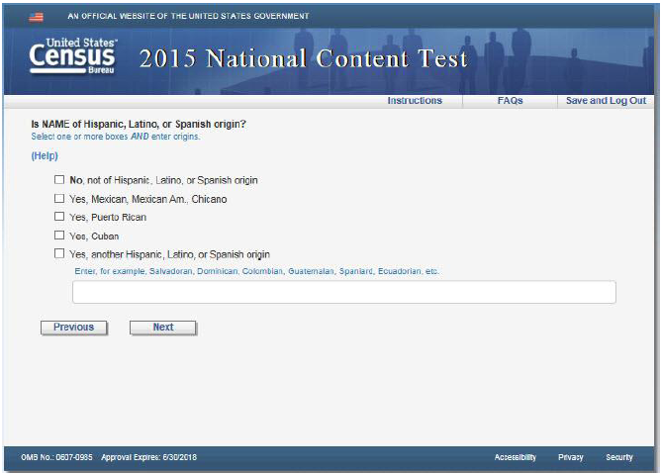
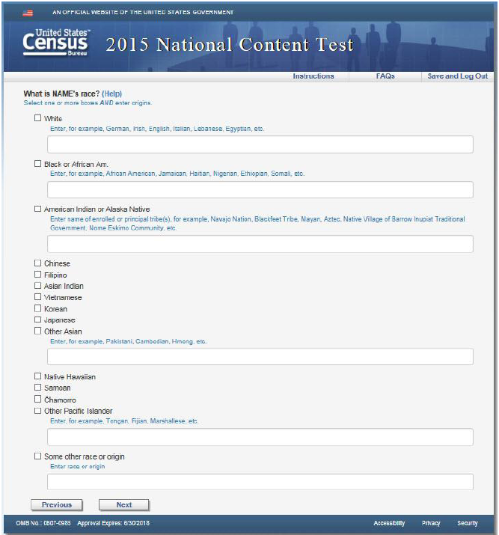
Web-Based Designs
Separate Question
for Hispanic Origin
Separate Question
for Race
12
Notes:
12

Slide 13
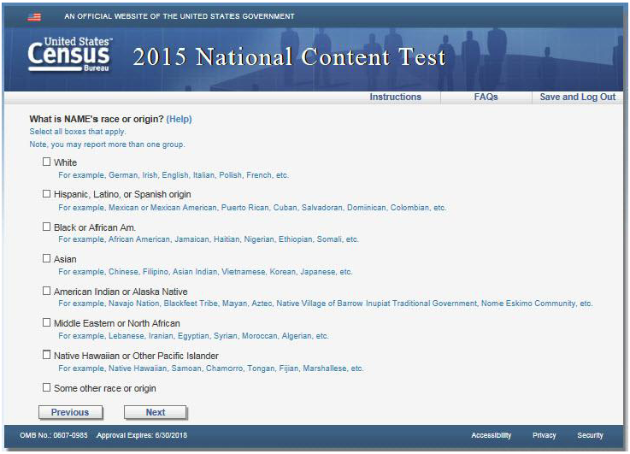
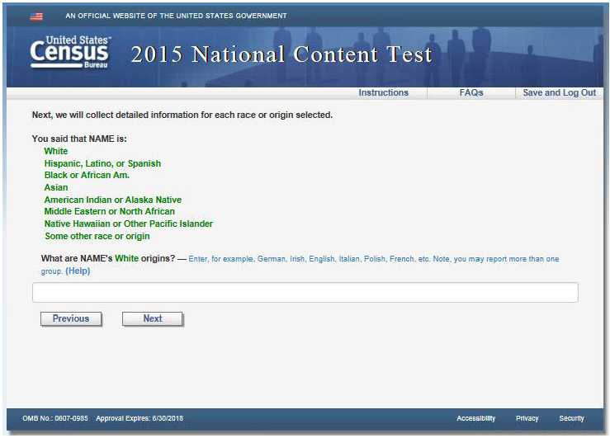
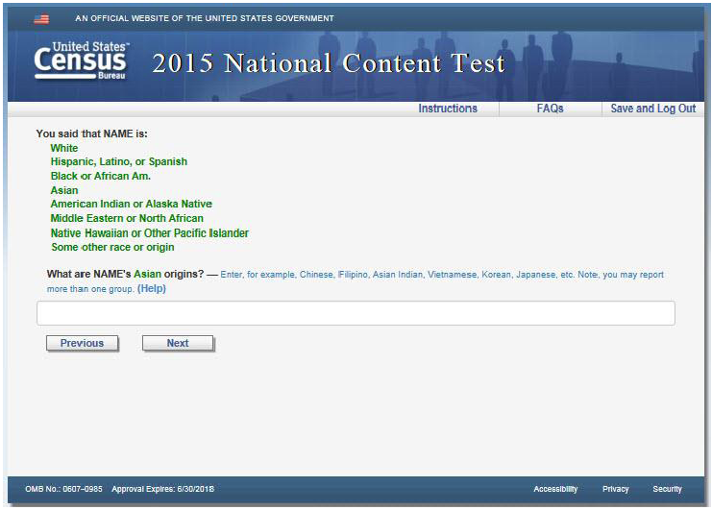
Web-Based Designs
Combined Question for Race and Ethnicity
with Write-in Areas
13
Notes:
13

Slide 14
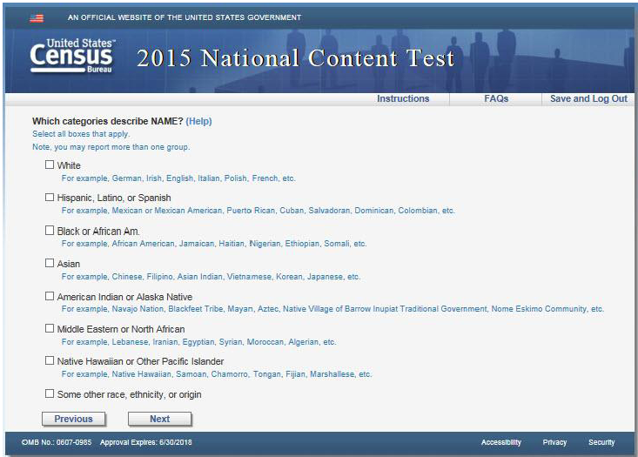
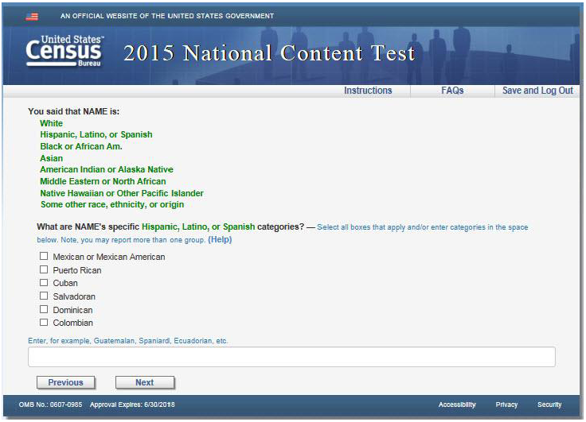
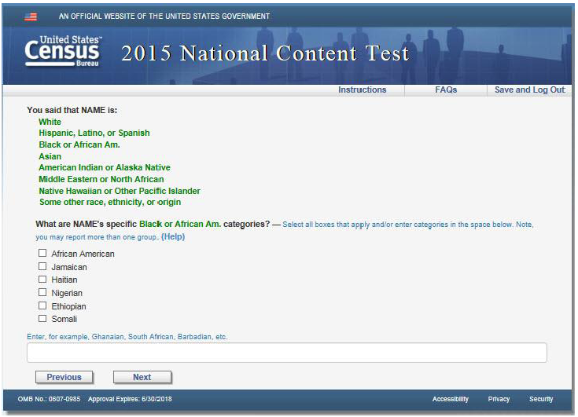
Web-Based Designs
Combined Question for Race and Ethnicity
with Detailed Checkboxes and Write-in Areas
Notes:
14

Slide 15
Race/Ethnicity Distributions by Question Format
(Percent Alone or in Combination)
White lower in Combined Question formats
SOR lower in Combined Question formats
Source: 2015 NCT, Internet responses

Slide 16
Percent Distribution of Hispanic Responses and Non-Hispanic Responses by Question Format
Other categories have similar levels of reporting regardless of question format,
consistent with 2010 AQE findings
Combined Question approaches
more easily
allow Hispanics
to report their Hispanic identity
Source: 2015 NCT, Internet responses

Slide 17
Percent Distribution of Race for Hispanic Respondents by Question Format
Most Hispanics reported only a Hispanic response in the Combined Questions
SOR alone and Two or More
are higher in Separate Questions
No differences
for Hispanics
who identify as Black
Source: 2015 NCT, Internet responses

Slide 18
Percent of Item Nonresponse by Question Format
Paper questions yielded higher nonresponse for the Separate Questions
Soft edits on the Internet instrument helped reduced nonresponse
Source: 2015 NCT, Internet and paper responses

Slide 19
Detailed Reporting for Major Race/Ethnicity Groups by Question Format
(Percent Alone or in Combination)
Detailed reporting was the same or higher across all major categories
for the Combined Question with Detailed Checkboxes format
Source: 2015 NCT, Internet responses

Slide 20
Consistency of Reinterview and Self-Response by Race/Ethnicity Group by Question Format
(Percent Alone or in Combination)
Differences in consistency
for Hispanics
between Separate & Combined w/ Checkboxes
Source: 2015 NCT

Slide 21
Question Format
Summary of Preliminary Findings
The combined question with detailed checkboxes design appears to elicit higher quality data on race and ethnicity; this is in keeping with the results of 2010 AQE
No changes to distribution for major groups
Decreased Some Other Race reporting
Lower item nonresponse for the combined race/ethnicity question than for the separate race question
Same or higher level of detailed reporting
Higher overall consistency for Hispanics

Slide 22
Testing a Middle Eastern or North African Category
Rachel Marks
Senior Analyst, Ethnicity & Ancestry Branch
U.S. Census Bureau

Slide 23
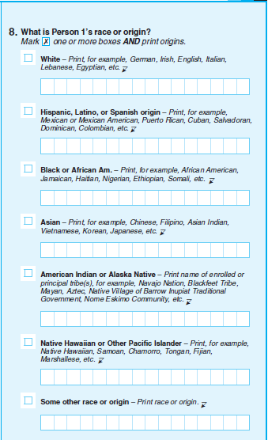
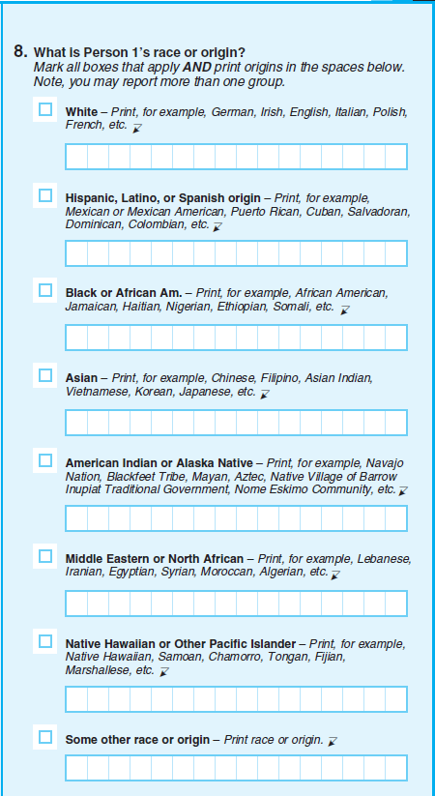
Middle Eastern or North African
(MENA) Category
Notes:
23

Slide 24
MENA Classification
Researched MENA classifications from 15 government, academic, and non-governmental organizations
Nationalities in more than half of classifications researched are included in the Census Working Classification

Slide 25
Detailed Groups for MENA Analysis
NCT Working Classification of MENA Category
  Includes 19 nationalities
Algerian, Bahraini, Egyptian, Emirati, Iraqi, Iranian, Israeli, Jordanian, Kuwaiti, Lebanese, Libyan, Moroccan, Omani, Palestinian, Qatari,
Saudi Arabian, Syrian, Tunisian, Yemeni
  Includes 11 ethnicities and pan-ethnic terms
Arab or Arabic, Amazigh or Berber, Assyrian, Bedouin, Chaldean,
Druze, Kurdish, Middle Eastern, North African, Syriac
NCT Oversample for MENA also included
Afghan, Armenian, Azerbaijani, Cypriot, Djiboutian, Georgian, Mauritanian, Somali, South Sudanese, Sudanese, Turkish, Turkish Cypriot

Slide 26
Where MENA Responses are Reported by Presence of MENA Category
(Percent Alone or in Combination)
MENA respondents use MENA category when it is available
MENA respondents use White category when no MENA category is available
*
*
Indicates that a dedicated MENA checkbox was not available
Source: 2015 NCT

Slide 27
Self-Response Reporting Patterns of MENA Reinterview Population by Presence of MENA Category
Many people have difficulty identifying as only MENA when there is no MENA category
Some MENA respondents did not identify as MENA in the self-response
Source: 2015 NCT

Slide 28
Detailed Reporting for Groups in the MENA Working Classification by Presence of MENA Category
(Percent Alone or in Combination)
No MENA Category
With MENA Category
Lebanese
Iranian
Egyptian
Syrian
Moroccan
Algerian
Israeli
Iraqi
Tunisian
White
MENA
Black
SOR
Another Category
Source: 2015 NCT

Slide 29
Detailed Reporting for Groups Not in the MENA
Working Classification by Presence of MENA Category
(Percent Alone or in Combination)
No MENA Category
With MENA Category
Afghan
Armenian
Azerbaijani
Cypriot
Georgian CIS
Somali
Sudanese
Turkish
White
MENA
Black
SOR
Another Category
Source: 2015 NCT

Slide 30
MENA Category
Summary of Preliminary Findings
The use of a distinct Middle Eastern or North African category appears to elicit higher quality data for people who would identify with MENA
People who identify as MENA use the MENA category when it is available
People who are MENA have trouble identifying as only MENA when no category is available
The nationalities and ethnicities in the 2015 NCT working classification of MENA identified as MENA when the category was available
The nationalities and ethnicities in the MENA oversample did not identify as MENA when the category was available

Slide 31
Evaluating Alternative Instructions and Terminology
Beverly M. Pratt
Analyst, Racial Statistics Branch
U.S. Census Bureau

Slide 32
Instructions and Terminology
Instruction Wording:
Mark [X] one or more boxes.
Mark all boxes that apply…
Note, you may report more than one group.
Question Terminology:
“Race,” “Ethnicity,” “Origin”
No terms = “Categories”
Notes:
32

Slide 33
Race/Ethnicity Distribution by Instructions and Terminology
Source: 2015 NCT, Internet responses

Slide 34
Consistency Between Self-Response and Reinterview for Major Race/Ethnicity Groups by Instructions
Source: 2015 NCT, Internet responses

Slide 35
Consistency Between Self-Response and Reinterview for Major Race/Ethnicity Groups by Terminology
There is no statistical difference in consistency
across the question terminology used
Source: 2015 NCT, Internet responses

Slide 36
Qualitative Research on
Question Terminology
Census Bureau’s Center for Survey Measurement and RTI International conducted 40 face-to-face cognitive and usability testing interviews with Spanish-speaking respondents
¿Cuál es la raza o el origen étnico de Persona 1?
(What is Person 1’s race or ethnicity?)
“had the same meaning,”
“roots,” “where you were born,” “ancestry”
¿Cuáles de estas categorías describen a Persona 1?
(Which categories describe Person 1?)
“hierarchal listing of options in which
the ordering of the options implied ranking”
“show a pattern of respondents linking the word ‘categoría’
to a hierarchical order or ranking, rather than to a natural list of options”
“social status or hierarchy”

Slide 37
Instructions and Terminology
Summary of Preliminary Findings
Wording of Instructions:
Select all boxes that apply …
Note, you may report more than one group.
Question Terminology:
What is Person 1’s race or ethnicity?
Only one major race/ethnicity group (AIAN alone or in combination) had a significant increase in reporting when the instructions were changed from old to new with the Race/Origin terminology; all other distributions were not significantly different
The new instructions increased the rate of consistency of multiple-responses when compared to the old instructions; there was no difference in the rate of consistency for any of the other major race/ethnicity groups
Qualitative research findings show that Race/Ethnicity terminology was better understood than Categories terminology in Spanish

Slide 38
Overall Findings and
Question Design Recommendations for the 2018 Census Test
Merarys Ríos-Vargas
Chief, Ethnicity & Ancestry Branch
U.S. Census Bureau

Slide 39
Selecting
Elements for Question
Design

Slide 40
Selecting
Elements for Question
Design

Slide 41
Preliminary Recommendation for 2018 Census Test:
Separate vs. Combined
Use the Combined Question
with Detailed Checkboxes Design

Slide 42
Selecting
Elements for Question
Design
Combined Question
with Detailed Checkboxes

Slide 43
Preliminary Recommendation for Census Bureau Director
Use the Combined Question
with Detailed Checkboxes Design
for 2018 Census Test

Slide 44
Preliminary Recommendation for 2018 Census Test:
Inclusion of MENA response category
Include a dedicated response category
“Middle Eastern or North African” (MENA)

Slide 45
Selecting
Elements for Question
Design
Dedicated
MENA
response category

Slide 46
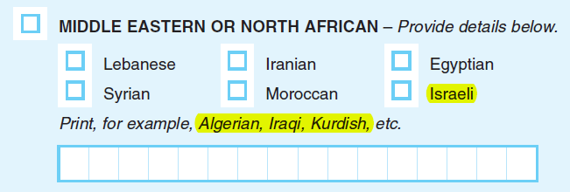
Explore MENA Designs in 2017 Census Test & Qualitative Research
Test alternative examples and detailed checkboxes
to represent the broad diversity
of the Middle Eastern and North African population
* Note: This design is proposed for testing in future qualitative explorations and the 2017 Census Test,
to emphasize the diversity of the Middle Eastern and North African population.

Slide 47
Preliminary Recommendation for 2018 Census Test:
Instructions
Use “Select all boxes that apply”
(New Instructions)

Slide 48
Selecting
Elements for Question
Design
Instructions to “Select all boxes that apply”

Slide 49
Preliminary Recommendation for 2018 Census Test:
Terminology
Use “race / ethnicity”
(Terminology)

Slide 50
Selecting
Elements for Question
Design
Use
“race / ethnicity” terminology

Slide 51
Preliminary Recommendation for Census Bureau Director
Use new instruction wording
and “race / ethnicity” terminology

Slide 52
Summary of
Preliminary Recommendations for 2018 Census Test
Use combined question with detailed checkboxes (green)
Use instructions
to “Select all boxes
that apply”
(green)
Include dedicated MENA response category
(green)
Use “race / ethnicity” terminology
(yellow)

Slide 53
Selection of Question Design for 2018 Census Test

Slide 54
QUESTIONS
DISCUSSION

