Slide 1
Evaluating County Population Forecast Errors
for Florida and Beyond
Stefan Rayer and Ying Wang
Bureau of Economic and Business Research
University of Florida
Applied Demography Conference
January 11–13, 2017
San Antonio, Texas

Slide 2
Background:
BEBR produces population projections for all counties in Florida each year.
We project county populations with four extrapolation methods:
• Linear
• Exponential
• Share-of-Growth
• Shift-Share
The specific methods and base periods used may change from year to year (e.g., we dropped the constant population method last year).
From these individual methods, we calculate various averages.
The final projection – usually a trimmed average – then gets controlled to a separately produced projection for the state.

Slide 3
Study Motivations / Questions:
How do these methods perform for projecting county populations?
How many years of base data to include? Should the base period be similar in length to the projection horizon? Should it be the same for all methods?
Are trimmed averages preferable to a simple average? How much trimming makes sense?
What about adjustments such as excluding institutional populations?
How to deal with negative projections (or run-away growth)?
How to apply the share-of-growth method when population change for a county has a different sign from state-level growth?

Slide 4
Data and Methods:
Study Period: 1980–2015.
Data: Census counts and intercensal estimates (BEBR and Census Bureau).
Base Periods: 1–25 years.
Projection Horizons: 1–25 years.
Total of 6,810 projections (base period, projection horizon, target year combinations) for each method.

Slide 6
Data and Methods (continued):
Six trend extrapolation methods, plus various averages:
• Linear
• Exponential
• Share-of-Growth
• Shift-Share
• Constant-Share
• Constant Population
• Overall Average & Trimmed Averages
Error Measures: MAPEs, MALPEs, MedAPEs, and MedALPEs.
Study Area: 67 counties in Florida, plus 694 counties in 7 other states.

Slide 7
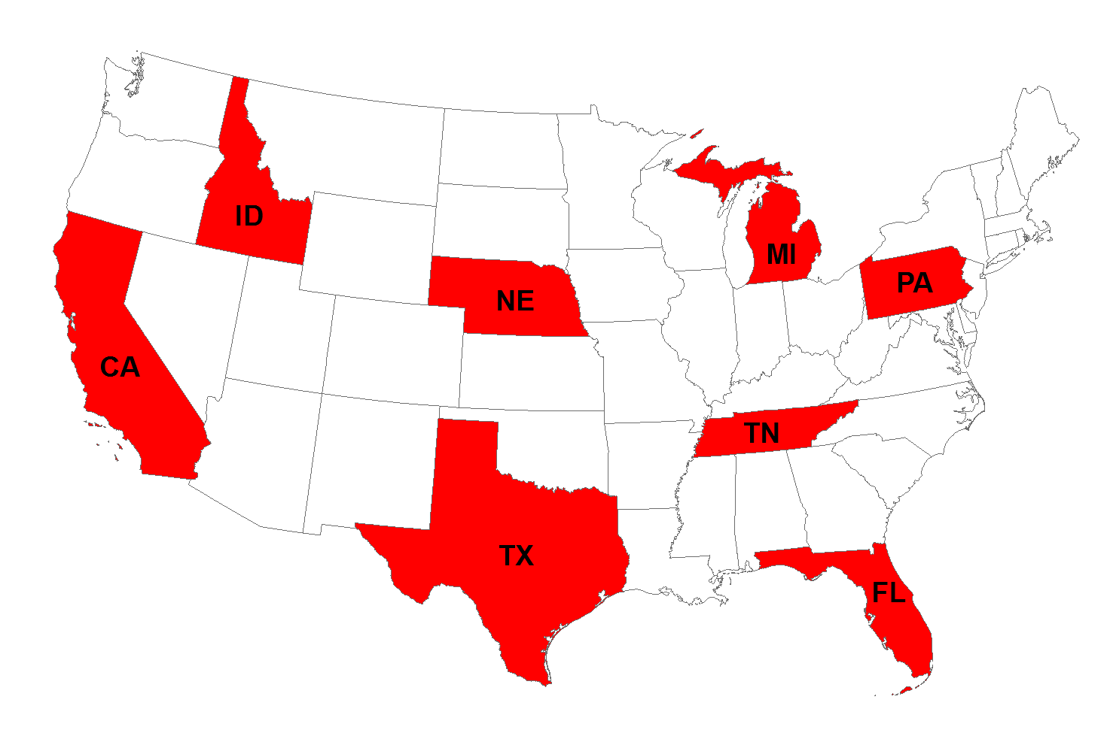
Study Area: 761 Counties in 8 States

Slide 8
Data and Methods (continued):
Criteria for selecting these states:
• States cover all geographic regions of the country
• Wide range of county (and state) population sizes
• Wide range of county (and state) population growth rates
• Sufficient number of counties per state to allow for calculation of mean and median error measures
• No significant county boundary changes over study period

Slide 9
Study Area Population Characteristics:

Slide 10
Building a Suitable Model
Trend extrapolation projection models, while simple in mathematical form, require care in their application.
Each trend method has certain strengths and weaknesses.
Potential problems to look out for include:
• Run-away growth with the exponential method
• Negative projections, especially for longer horizons, for counties with declining populations (mainly with shift-share and linear)
• Applying the share-of-growth method when growth in the smaller area is in the opposite direction of growth in the larger area

Slide 11
Minimum/Maximum Brackets
Projections should not be negative!
A common approach is to set negative projections to zero.
While better than having negative projections, this is not ideal:
• County populations rarely go to zero
• It is a one-sided approach (i.e., it does not address run-away growth)
We developed minimum and maximum projection values, below or above which projected populations could not go.
These were based on actual growth rates experienced over the study period (~ 1st and 99th percentiles), and they vary by horizon length.

Slide 15
Minimum/Maximum Brackets: Results
Applying a lower and an upper bound to the projections improved forecast precision virtually everywhere.
Improvements in precision were more noticeable in the MAPEs than the MedAPEs.
Improvements in precision were more noticeable for longer horizons, and for states with many declining or fast growing counties.
The results for forecast bias were similar, though there were a few instances where bias increased.
Using min-max brackets resulted in more reasonable projections overall.
We plan to use them in the future.

Slide 16
Refining Share-of-Growth: The Plus-Minus Method
The share-of-growth method often produces quite accurate projections.
It projects as follows: Each county’s share of state population growth in the future will be the same as its share during the base period.
The share-of-growth method struggles when county population change is in the opposite direction of state growth.
In that scenario, if growth in the state increases, a declining county is projected to lose more population.
This does not make sense. If statewide growth increases, one would expect a declining county to lose less population, or maybe even start growing.
The plus-minus method has been proposed as a fix for such a scenario.

Slide 22
Plus-Minus Method: Results
Applying the plus-minus adjustment to the share-of-growth method improved forecast accuracy almost everywhere.
Improvements in accuracy were strongest in states that had many declining counties.
Even in states where the plus-minus adjustment had little impact on overall accuracy (e.g., California and Florida), it improved the projections for individual counties that were declining.
We recommend using the plus-minus adjustment whenever population growth for a county is in the opposite direction of that of the state.

Slide 23
Plus-Minus Method: Issues to Consider
There are many different options for implementing the plus-minus adjustment.
P/M adjustment requires experimentation with what works best.
We tried several different specifications, such as doubling the factor. There were some differences, but applying P/M vs. no P/M had a much bigger impact on forecast accuracy than the particular P/M specification.
P/M needs a different implementation when state growth is negative.
P/M in its current form causes declining counties to decline less, but it does not allow for population growth for these counties.

Slide 24
Next Steps
This presentation just covered the initial aspects of our analysis.
We have started evaluating forecast accuracy by projection technique, by horizon and base period length, by size and growth rate, and for the different states.
The vast amount of data and results are a challenge to process, interpret, and present.
We are still trying to figure out how to condense this plethora of information, and how to present our findings visually.

Slide 28
Next steps (continued)
We will have more results at PAA.
Comments and suggestions are greatly appreciated!
Contact:
Stefan Rayer
Bureau of Economic and Business Research
University of Florida
elzer@ufl.edu
352.392.0171 x334

