Slide 1
Estimating emigration as a residual
Jan Vink
Applied Demography Conference, San Antonio, TX, January 11-13, 2017

Slide 2
Outline
Motivation – Research question
Methods
Results
Conclusions - More questions

Slide 3
Motivation – Research question
Working on a County level projection model based on gross migration flows
What about emigration?
How large is emigration compared to immigration?
Can we find information on age of emigrants?

Slide 4
Method 1
$NIM=I−E\underset{⇒}{}E=I−NIM$
I - In migration from abroad
ACS table B07001: Where did you live one year ago? Answer: outside US
NIM – Net International Migration
Population estimates: NIM is a component of change in the annual estimates

Slide 5
Results: US Totals, Method 1
 | Moved in from abroad ACS table C07001 | Net internation migration (POPEST) | Emigration
2006/07 | 1,813,675 | 1,037,657 | 776,018
2007/08 | 1,895,103 | 888,825 | 1,006,278
2008/09 | 1,687,595 | 854,905 | 832,690
2009/10 | 1,750,145 | #N/A
2010/11 | 1,826,277 | 703,824 | 1,122,453
2011/12 | 1,833,217 | 885,804 | 947,413
2012/13 | 1,903,247 | 843,145 | 1,060,102
2013/14 | 2,042,205 | 995,944 | 1,046,261
2014/15 | 2,085,698 | 1,150,528 | 935,170

Slide 6
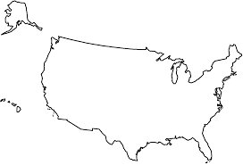
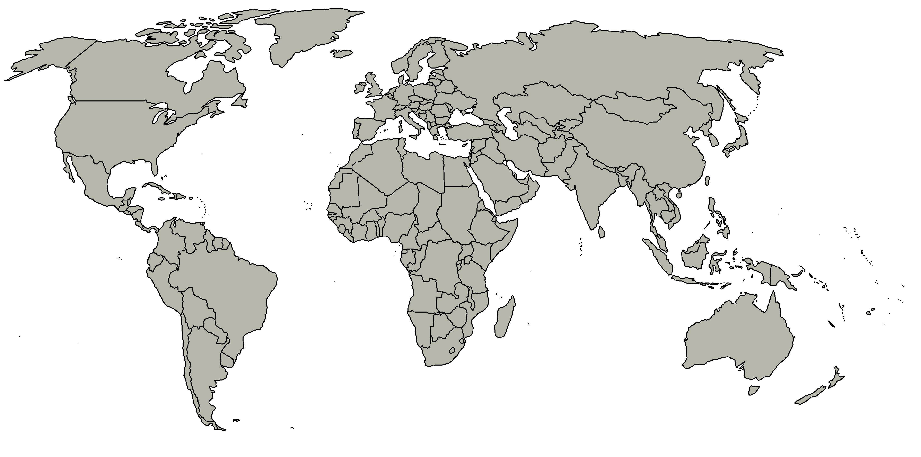
Method 2
Year Y
Year Y+1
Mortality
Population in area of interest
Still in US
Emigration

Slide 7
Method 2
Population in area of interest in year Y =
Population that was in area and
died before Y+1
+ is still in the US at Y+1
+ emigrated before Y+1
OR
E = Pop_{Y}-Deaths-US_{Y+1}

Slide 8
Method 2
Pop_{Y}:
population in year Y from population estimates
Deaths
From Vital Statistics
US_{Y+1}
ACS table C07401: Population 1 year and over that lived in the area one year ago

Slide 9
Method 2
Year Y
Year Y+1
Population in area of interest
Still in US
ACS table C07401: Population 1 year and over that lived in the area one year ago

Slide 10
Results: US Totals, Method 2
 | Pop_{Y} | US_{Y+1} | Deaths | Emigration
2006/07 | 298,754,819 | 295,731,474 | 2,426,264 | 598,357
2007/08 | 301,290,332 | 298,030,784 | 2,423,712 | 811,700
2008/09 | 304,374,846 | 301,263,957 | 2,471,984 | 656,316
2009/10 | 306,771,529 | 303,878,462 | 2,437,163 | 440,268
2010/11 | 309,330,219 | 306,074,042 | 2,468,435 | 764,231
2011/12 | 311,587,816 | 308,379,538 | 2,515,458 | 678,910
2012/13 | 313,873,685 | 310,529,573 | 2,543,279 | 773,976
2013/14 | 316,497,531 | 313,053,188 | 2,596,993 | 832,638
2014/15 | 318,907,401 | 315,550,022 | 2,626,418 | 730,961

Slide 11
US total emigration estimates
+ 200,000 gap

Slide 12
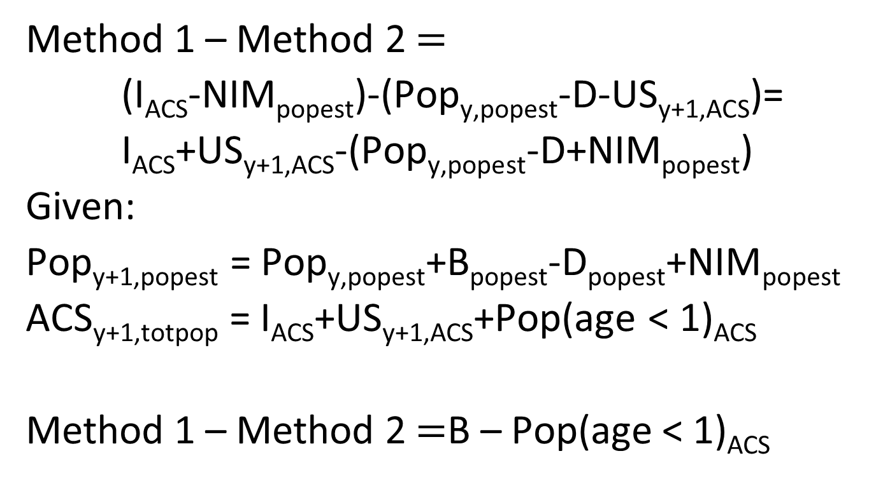
Difference between the methods
Method 1 – Method 2 $=$
(I_{ACS}-NIM_{popest})-(Pop_{y,popest}-D-US_{y+1,ACS})=
I_{ACS}+US_{y+1,ACS}-(Pop_{y,popest}-D+NIM_{popest})
Given:
Pop_{y+1,popest} = Pop_{y,popest}+B_{popest}-D_{popest}+NIM_{popest}
ACS_{y+1,totpop} = I_{ACS}+US_{y+1,ACS}+Pop(age < 1)_{ACS}
Method 1 – Method 2 $=$B – Pop(age < 1)_{ACS}

Slide 13
Comparing Method 1 – Method 2 $\text{and}$B – Pop(age < 1)_{ACS}
 | Method 1 | Method 2 | M1 – M2 | B - ACS_{<1} | Births | ACS_{<1}
2010/11 | 1,122,453 | 764,231 | 358,223 | 316,402 | 4,008,000 | 3,691,598
2011/12 | 947,413 | 678,910 | 268,504 | 252,308 | 3,953,593 | 3,701,285
2012/13 | 1,060,102 | 773,976 | 286,126 | 256,918 | 3,952,937 | 3,696,019
2013/14 | 1,046,261 | 832,638 | 213,624 | 195,914 | 3,957,577 | 3,761,663
2014/15 | 935,170 | 730,961 | 204,209 | 202,824 | 3,985,924 | 3,783,100

Slide 14
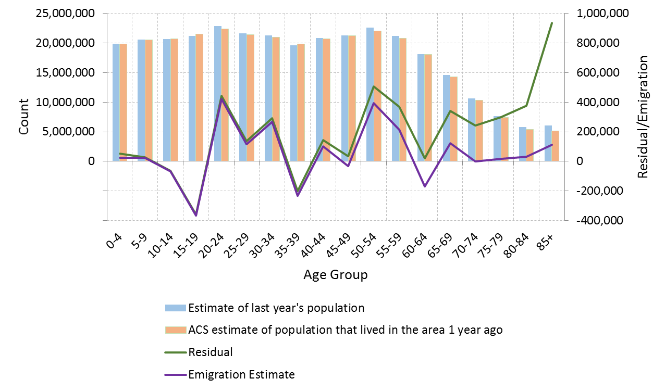
Age distribution of emigration

Slide 15
NY State emigration estimates
+ 30,000 gap
< 0

Slide 16
Tompkins County, NY
Emigration exceeding in migration

Slide 17
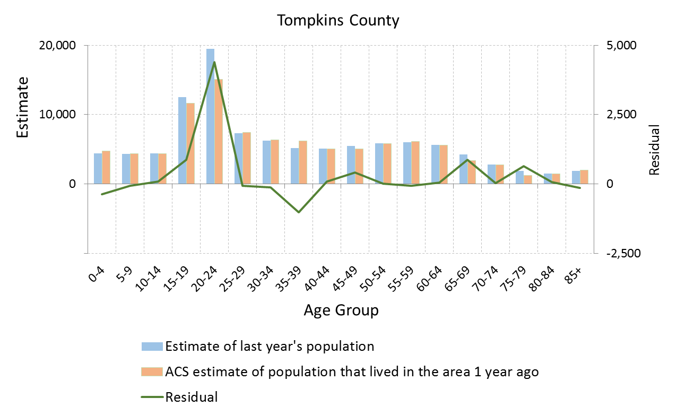
Age distribution of residual
High emigration or underreporting of college as place of previous residence?

Slide 18
Kings County, NY (Brooklyn)
Negative values

Slide 19
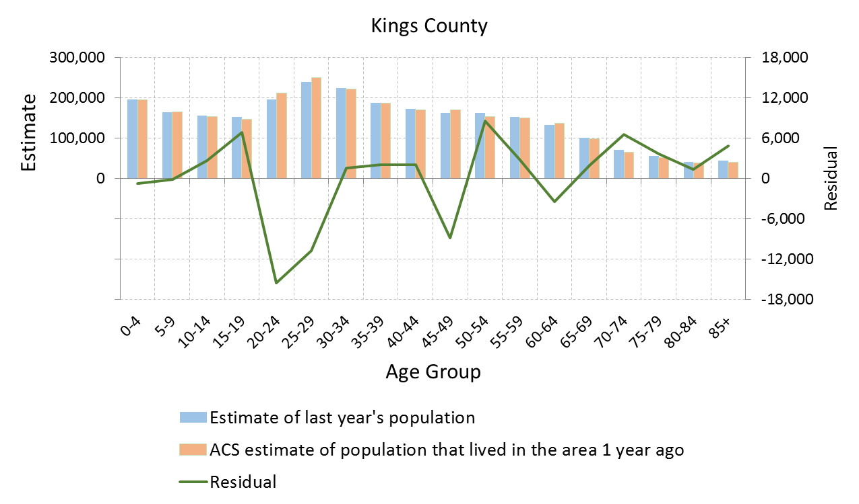
Age distribution of residual
More people that claimed Kings as place of previous residence than there were?

Slide 20
Selected other counties (2015 data)
 | ACS estimate of persons living in area previous year | Population estimate of previous year | Deaths | Emigration residual | ACS estimate of immigration
Pasco County, Florida | 497,417 (+ 5,986) | 485,640 | 5,742 | -17,519 | 2,657(+ 949)
Jackson County, Mississippi | 146,761 (+ 5,270) | 141,504 | 1,305 | -6,562 | 228 (+ 268)
Brazos County, Texas | 195,095 (+ 4,376) | 209,201 | 1,018 | 13,088 | 2,679 (+ 1,227)
Spokane County, Washington | 464,421 (+ 6,716) | 484,418 | 4,298 | 15,699 | 1,787 (+ 768)

Slide 21
Conclusions – more questions
Emigration is a component to be dealt with, but how?
Method 2 does not lead to reliable numbers.
Use Method 1 for totals?
How to get an age distribution?
How do others do it?

Slide 22
And even more questions
Implausible differences between ACS and POPEST estimates of people living in area a year prior
Controls/weights problems?
Imputation problems?
Reporting problems?
Geocoding problems?
If there is an error in the ACS estimate of people living in the area the prior year, is that error more likely to be in the number of people still there or in the number of people that are now elsewhere (domestic out migration)?

