Slide 1
A Spatial Analysis of Income Inequality
Joe D. Francis
Dept. of Development Sociology, Cornell University
Dept. of Sociology and Anthropology, College of Charleston
Presentation to Applied Demographic Conference
San Antonio, TX
January 11-13, 2017

Slide 2
Introduction
Research on income growth/decline and inequality are perennial topics of investigation.
New study--Pop Reference Bureau--Jarosz and Mather, found dramatic growth in association between inequality and poverty across America’s 3,000-plus counties over the past two-and-a-half decades—41% counties with both high inequality and high poverty.
The goals of this presentation--highlight two aspects of the distribution of measures of income inequality—scale and edge effects—and the problems they present for interpretation.

Slide 3
Introduction
To set the stage, likely everyone in this room uses the ACS.
We all know that as you move down the geographic scale from nation to state to county to subcounty, etc. the amount of uncertainty in our estimates increases.
To counter--well known admonitions to improve the reliability of ACS estimates are (1) combine geographies and/or (2) collapse categories.
However, for some measures these words of advice don’t fit.
Medians and Gini Indices are two examples in that they can’t be aggregated or decomposed like totals, counts and percentages—i.e. they don’t “scale.”
This lack of malleability is part of what motived this presentation.

Slide 4
Introduction
Specifically, the question being asked is: If Gini Indices
  are the main measure of (money) income inequality we use, and
  their reliability deceases with smaller geographic areas, but
  their reliability can’t be readily improved through “simple” manipulation, and
  we are stuck with what is available in census summary tables,
  then what level of geography is optimal to understanding and asserting the extent of income inequality.
Geographers and spatial analysts refer to this a Modifiable Areal Unit Problem (MAUP)—i.e. you get different results for the same phenomenon depending on the areal unit analyzed.

Slide 5
Introduction
Spatial analysts recognize that when some underlying statistical processes, like those that produce income inequality in a population, act independently of an arbitrary political or statistical unit to which the responses are assigned (e.g. a census tract, county or state), those processes and statistics are:
  unstable through time
  not likely to be the best or even accurate representation of the underlying dynamics
  aggregation and summary measures of the individual responses may be biased.
The first part of this paper attempts to uncover the extent of that possible bias when we examine income inequality across a landscape like the coterminous United States—what are called “scale effects.”

Slide 6
Background
MAUP really consists of two components: one is the scale problem (aggregation problem) and the other is the grouping or zoning problem.
We will address the scale issue first. If time permits we will look at spatial clustering as a way to address zoning.
To examine scale effects, researchers employ maps to visualize the spatial distribution of a phenomenon of interest, like income inequality, at several different scales (states, counties, subcounty units) and then summarized the values of measures like the Gini Index at those different geographic levels.
We follow that tradition.

Slide 7
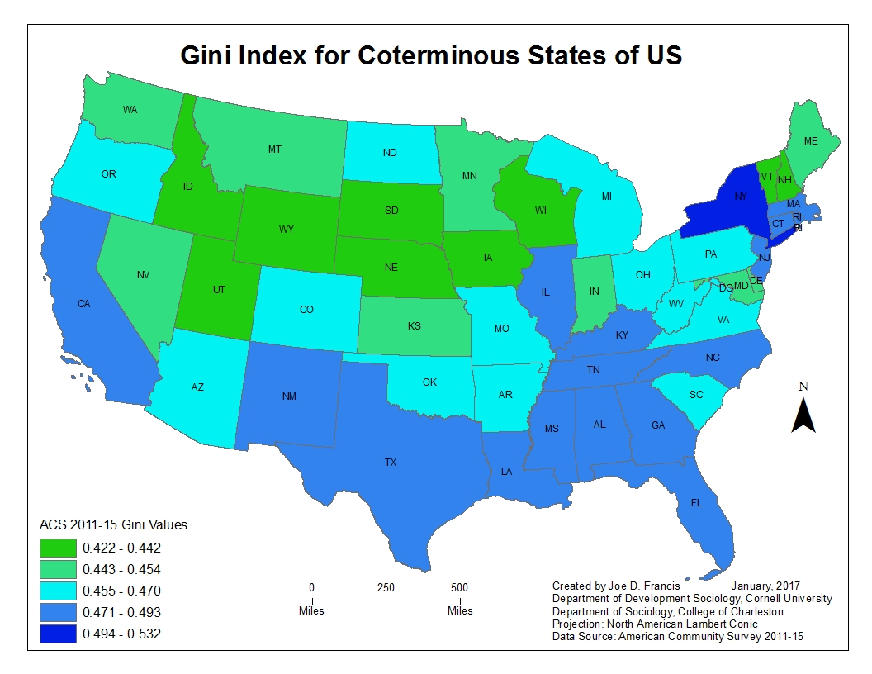

Slide 8
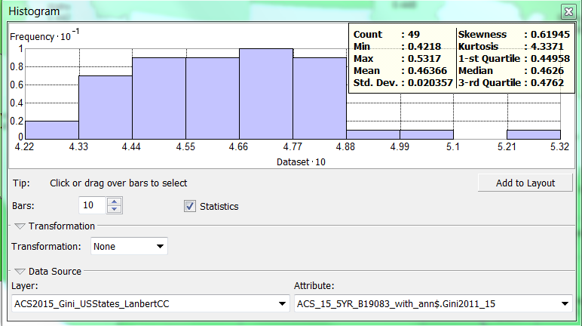

Slide 9


States with the Highest Gini Index
State
Gini 2011-15
MOE
States with the Lowest Gini Index

Slide 10
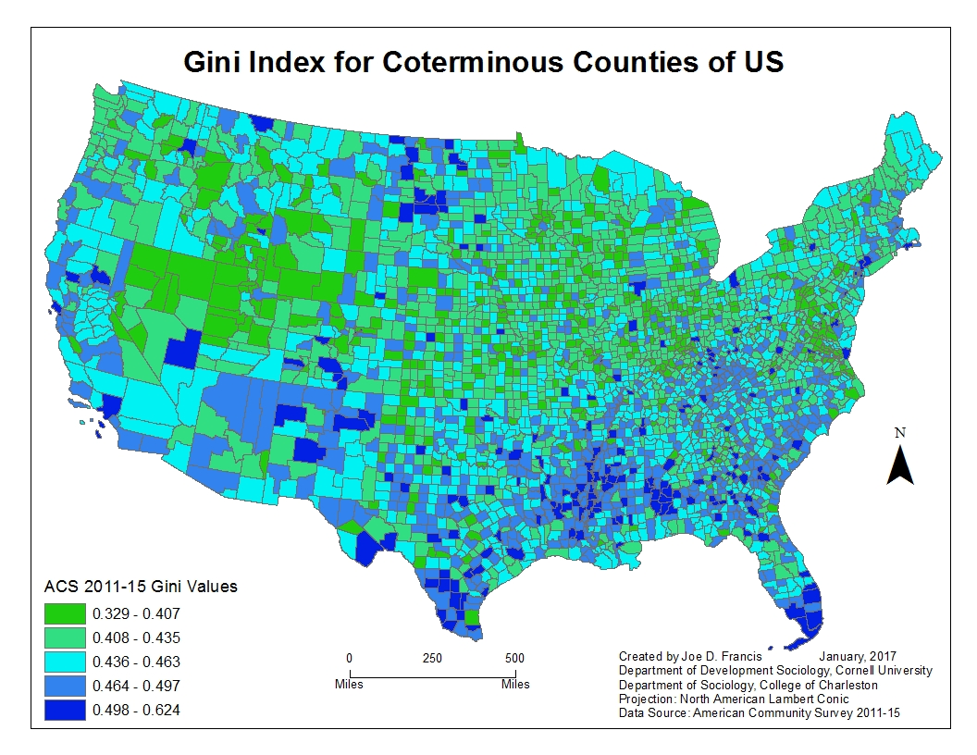

Slide 11
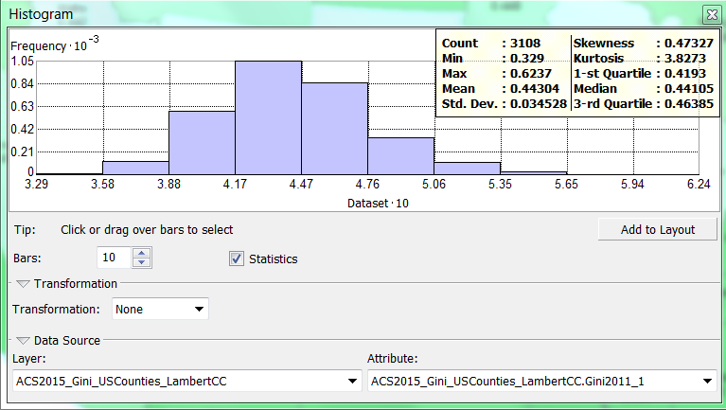

Slide 12


Counties with the Highest Gini Index
County
Gini 2011-15
MOE
Counties with the Lowest Gini Index
County
Gini 2011-15
MOE

Slide 13
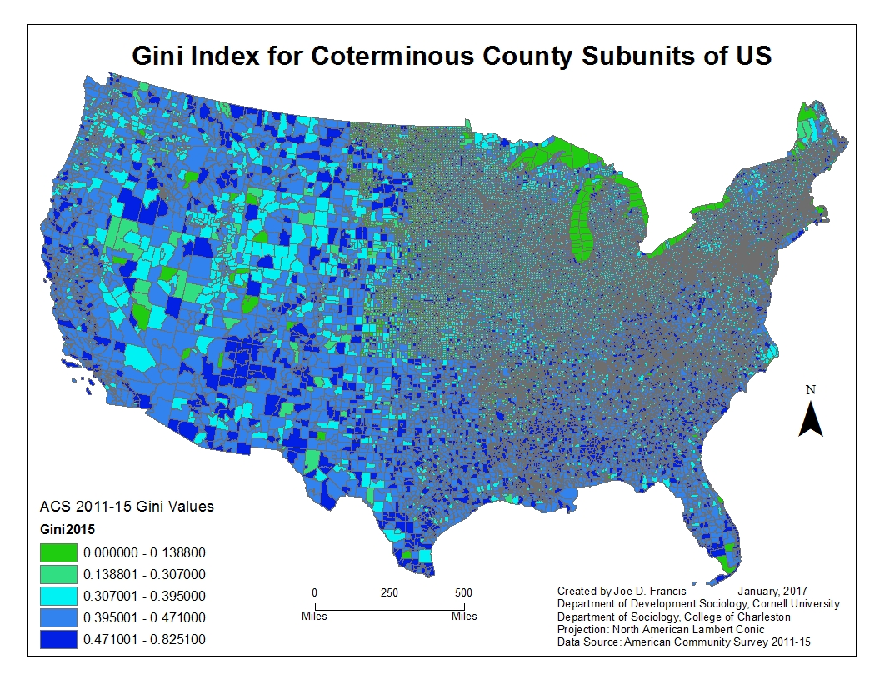

Slide 14
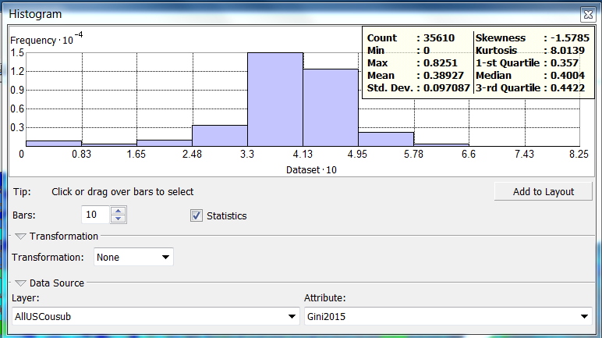

Slide 15


County Subunits with Highest Gini Index
County Subunit
Gini 2011-15
MOE
County Subunits with Lowest Gini Index
County Subunit
Gini 2011-15
MOE

Slide 16
Summary of Statistical Properties Revealed at Different Geographic Scales
The above results clearly reveal differential visions of income inequality depending on the choropleth lens of geographic scale.
What can we learn by looking at statistical parameters?
Statistic | State | County | Subcounty | Significance
N | 49 | 3108 | 35610
Minimum | 0.42 | 0.33 | 0.0007 (excl. 0’s)
Q1 | 0.45 | 0.42 | 0.36
Mean | 0.46 | 0.44 | 0.39 | All sig mean diff tests
Q2 (median) | 0.46 | 0.44 | 0.40
Q3 | 0.48 | 0.46 | 0.44
Maximum | 0.53 | 0.62 | 0.83
Range | 0.11 | 0.29 | 0.83
Interquartile Range | 0.03 | 0.04 | 0.08

Slide 17
A Closer Look at Consistency of Gini
Another way to examine the effects of geographic scale is via the consistency of Gini Index values among counties within states with high Gini values at the state level.
If there is considerable variation among the counties within the state, that is evidence that scale matters.
Next are maps and summary statistics for counties within the states with the highest Gini values.

Slide 18
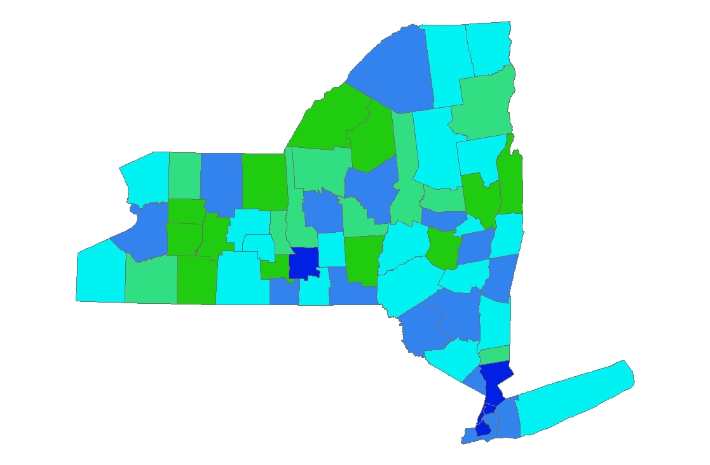
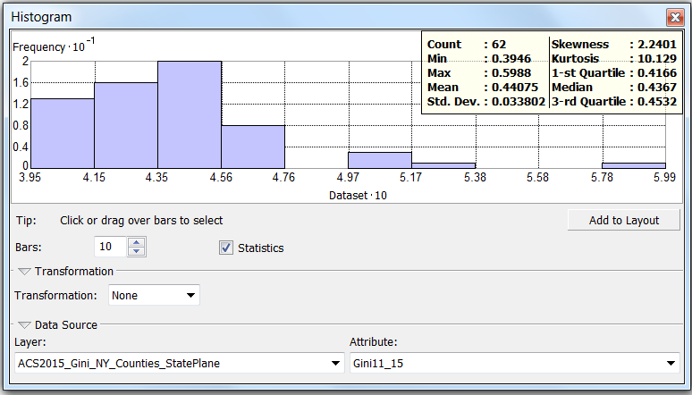
New York Gini=0.508

Slide 19
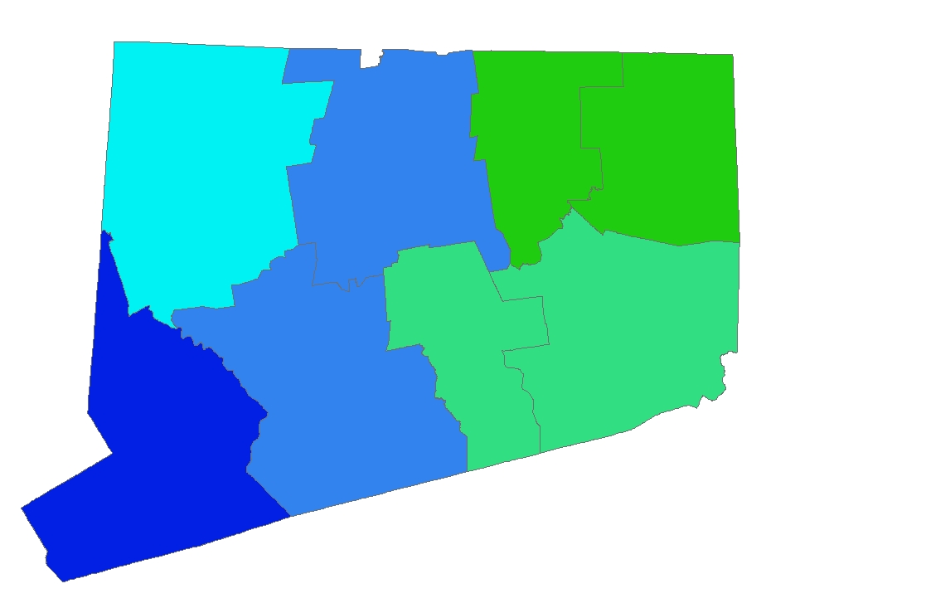
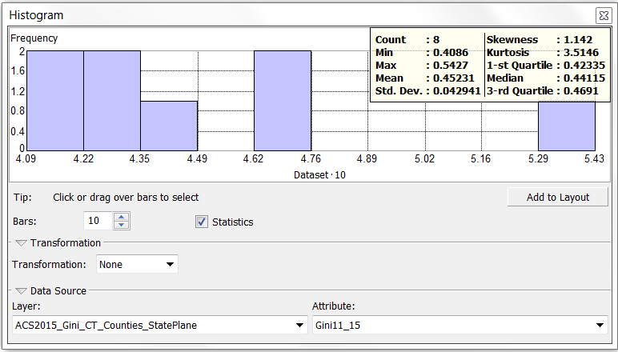
Connecticut Gini =0.493

Slide 20
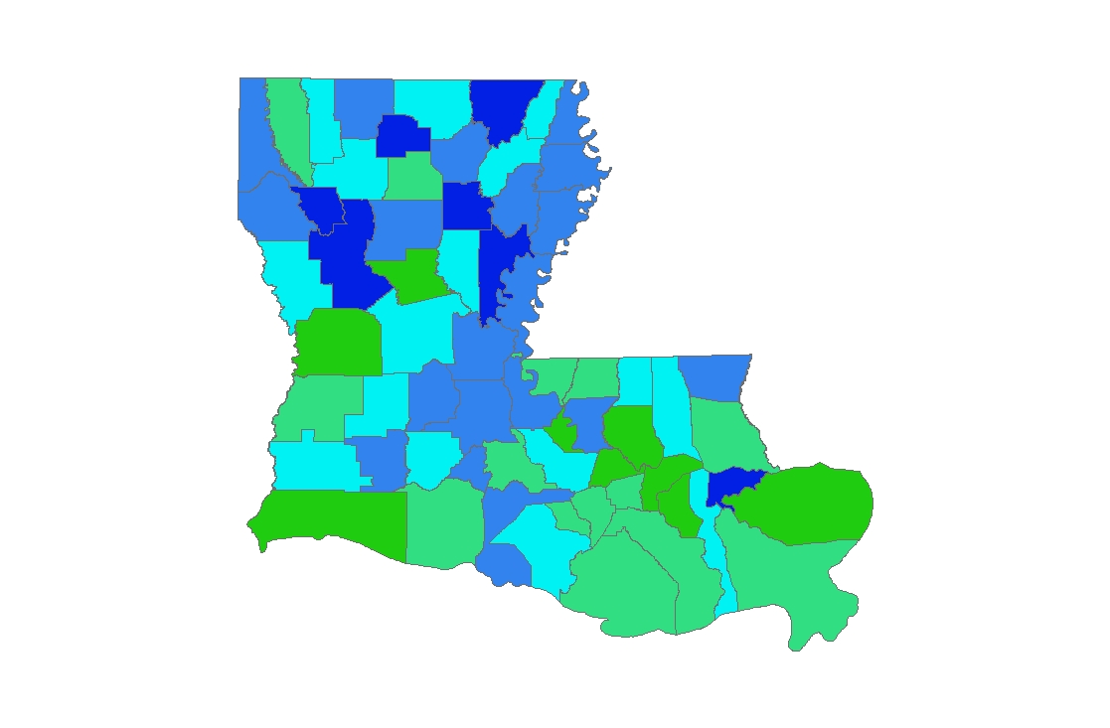
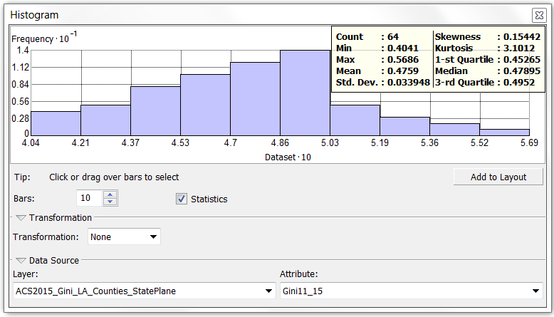
Louisiana Gini=0.488

Slide 21
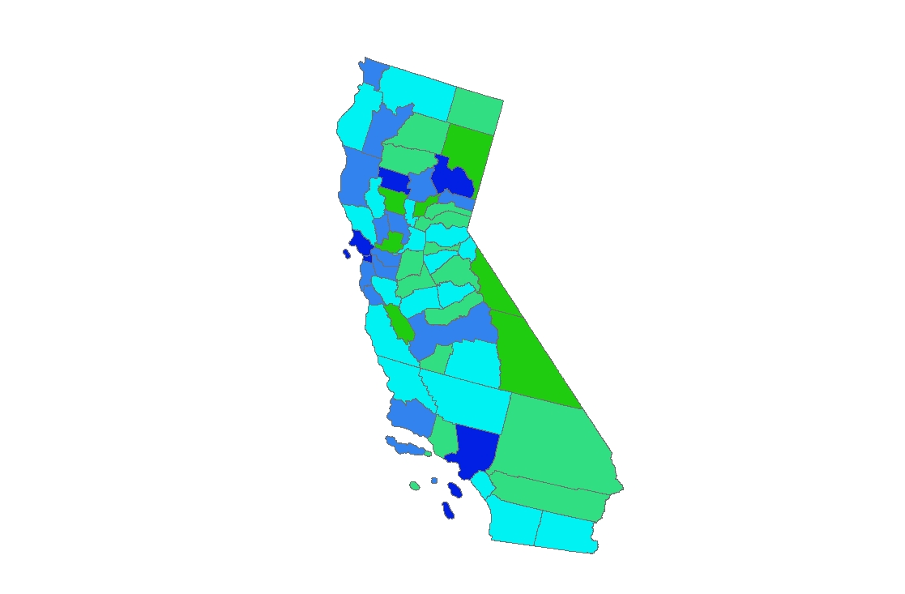
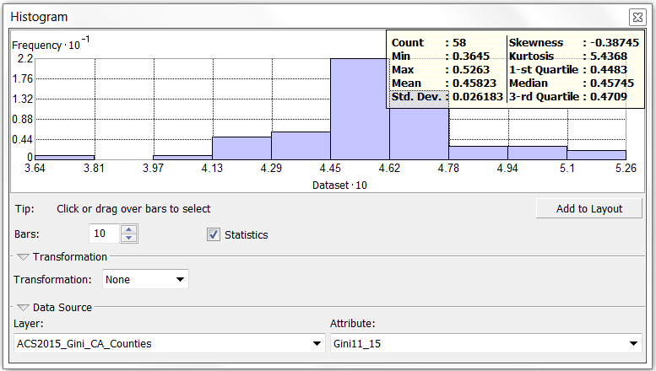
California Gini = 0.486

Slide 22
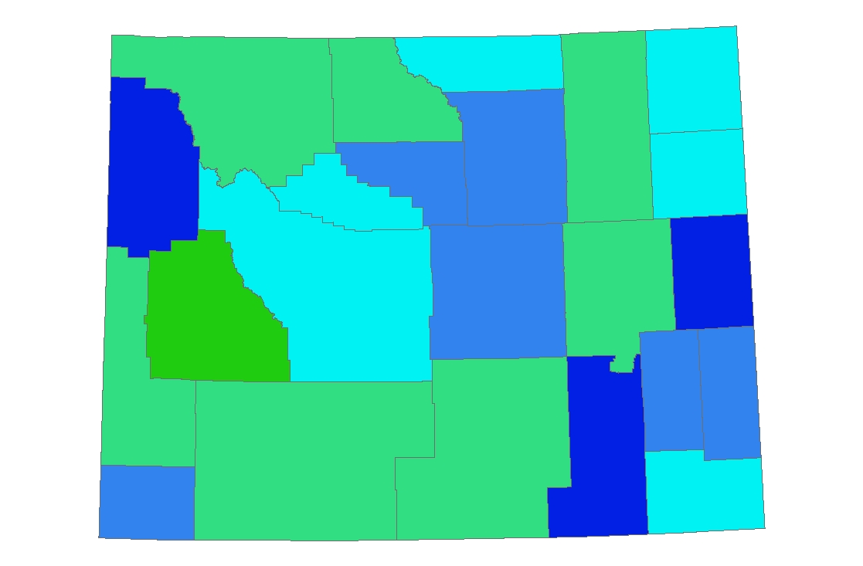
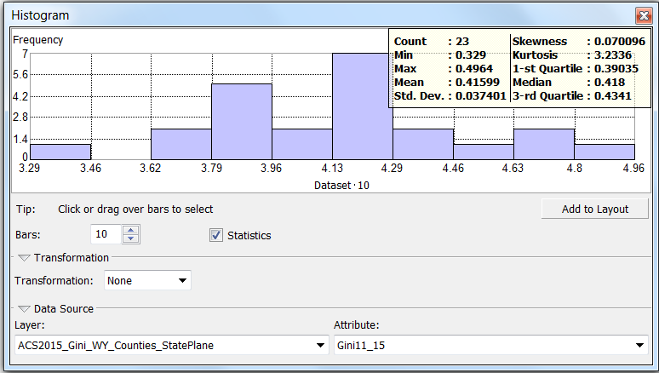
Wyoming Gini=0.422

Slide 23
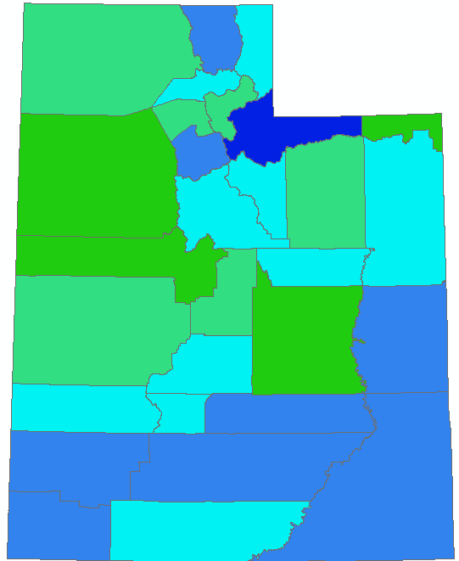
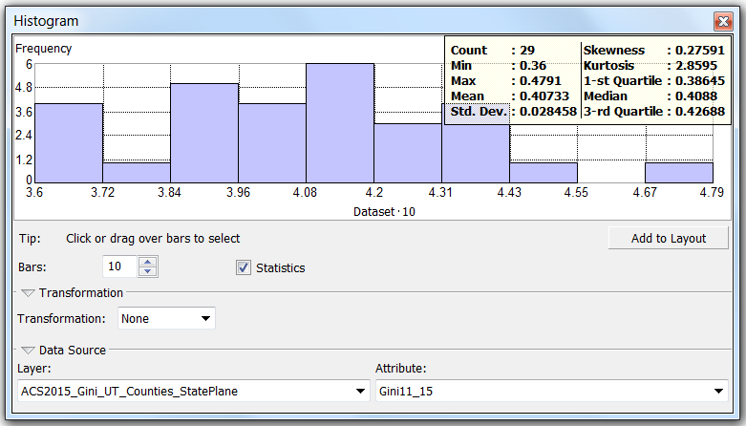
Utah Gini = 0.4259

Slide 24
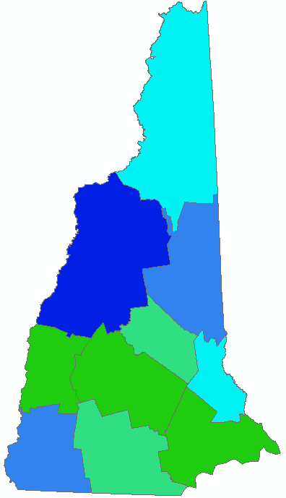
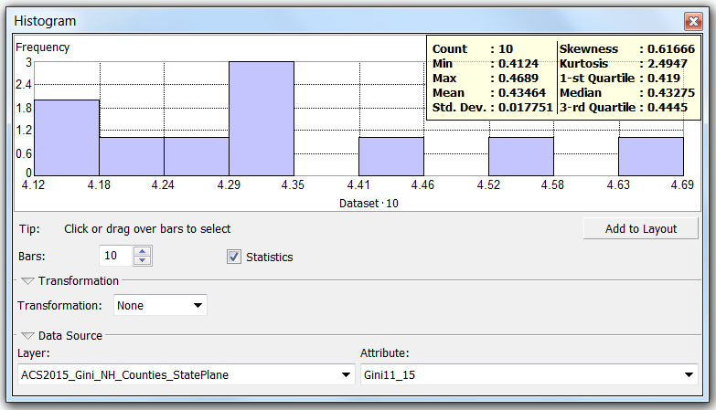
New Hampshire Gini = 0.4359

Slide 25
Solutions to the MAUP Scale Problem
So clearly scale effects exist. What to do about it?
T.C. Yang ( ) states “Currently, there is no agreement on the solution to MAUP yet, while several studies have attempted to solve it (Openshaw and Charlton 1987; Besag and Newell 1991; Gatrell et al. 1996)… Despite the lack of a solution to MAUP, recognizing the scale (aggregation) and grouping (zoning) problems is imperative.”
Population GIScience (gispopsci.org/maup/)comments “If you are unable to choose the scale of your data, be aware of its implications and, if possible, choose a finer scale than you think is necessary…”
Best advice at this point is be aware of the issue before making substantive judgments or policy for the entire state (or entire county) based on Gini values or median values for that level of geography.

Slide 26
Edge Effects and Spatial Autocorrelation
The second spatial analysis issue I would like to address is what are called edge effects.
The phrase “edge effect” can mean many things but is always directly related to a boundary problem and represents a loss of neighbors.
In spatial statistics, specifically point pattern analysis, edge effects have a direct effect on the expected null of complete spatial randomness (CSR) that the observed point pattern is tested against.
For lattice spatial structures (e.g. polygons), the loss of neighbors from the entire observed set of polygons can affect the resulting statistic. Edge correction accounts for this bias.

Slide 27
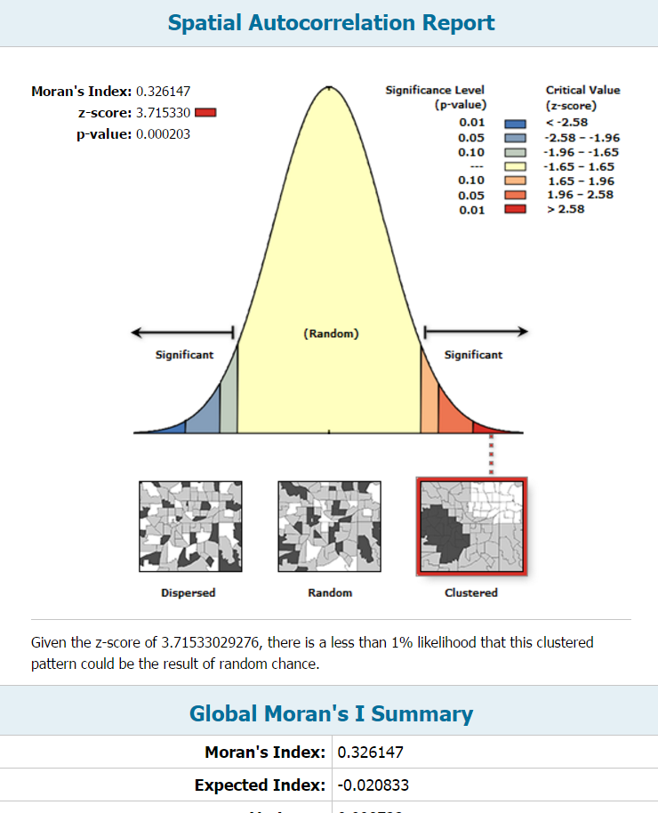
Moran’s I for Coterminous States

Slide 28
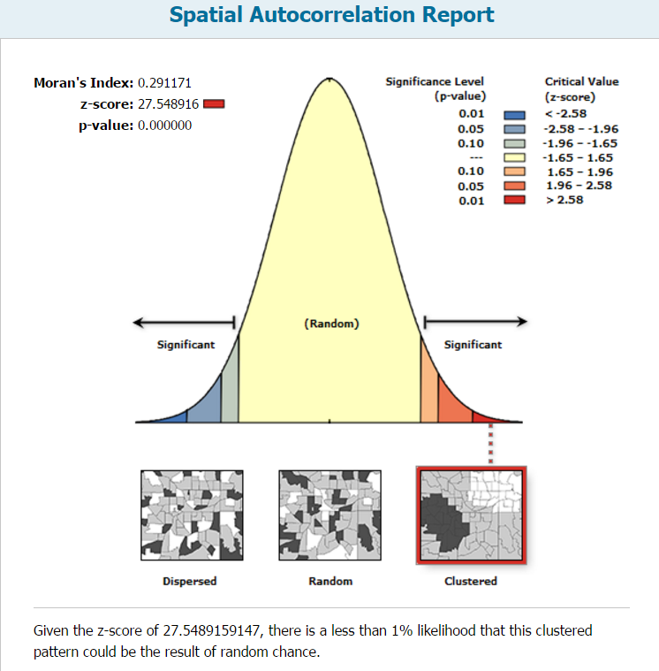
Moran’s I for Counties of Coterminous States

Slide 29
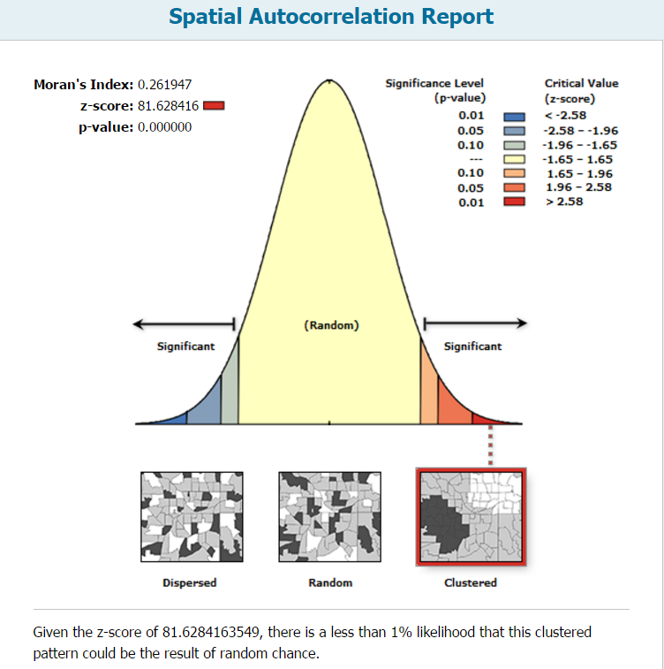
Moran’s I for Subcounty of Coterminous States

Slide 30
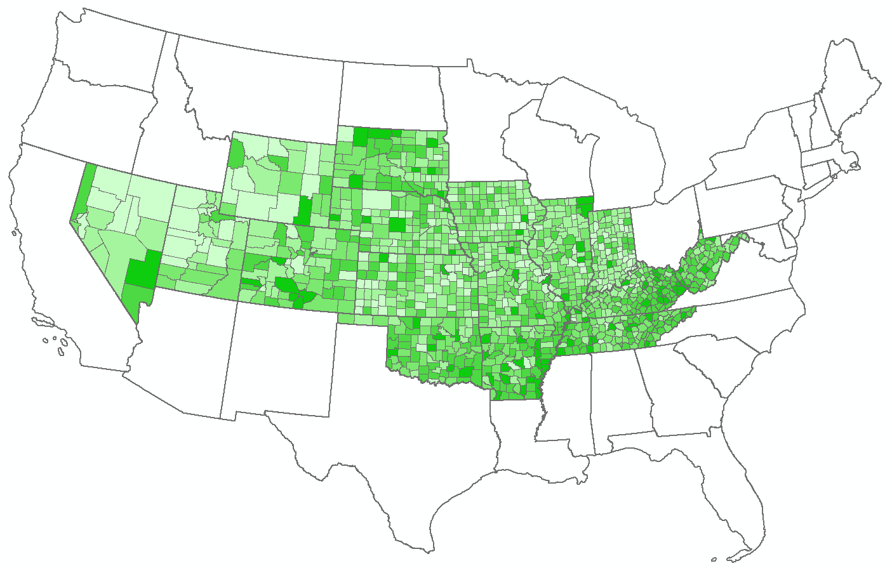
Counties of Interior States

Slide 31
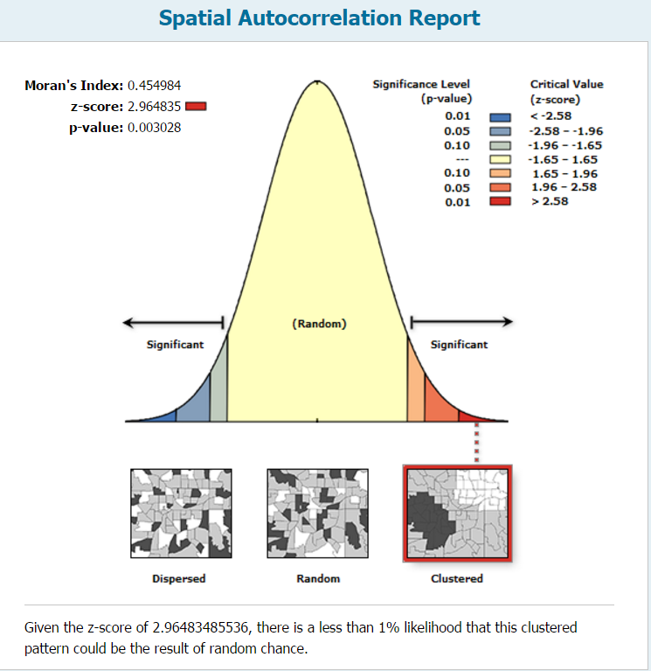
Moran’s I for Counties of Interior States

Slide 32
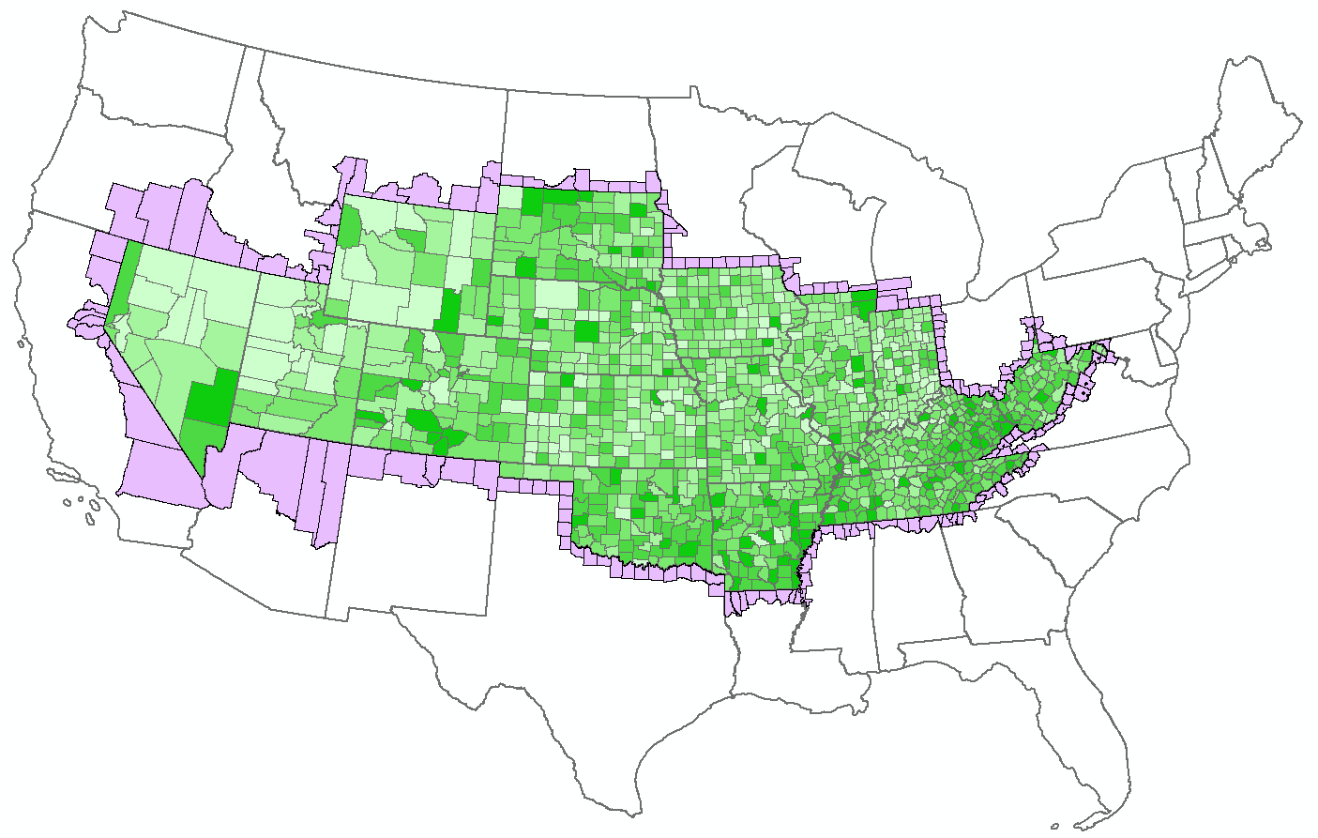
Counties of Interior States Plus Band of Contingent Counties

Slide 33
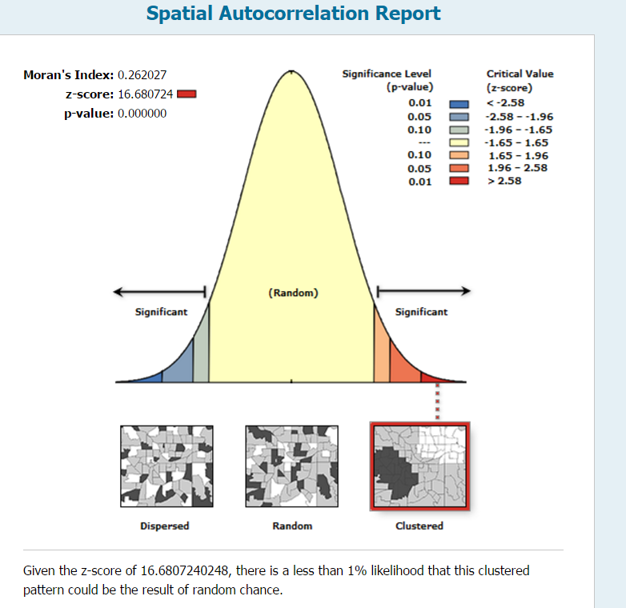
Moran’s I for Interior Counties plus Band

Slide 34
Summary of Edge Effects
Geography | N of Entities | Moran’s I | Z value (Significance)
Contiguous States | 49 | 0.33 | 3.72 p<.001
“Interior” States | 16 | 0.45
Counties of Contiguous States |  | 0.29 | 27.55 p<.001
“Interior” Counties |  | 0.45
“Interior” Counties plus Band1 |  | 0.26 | 16.68 p<.001
Subcounty of Coterminous States |  | 0.26 | 81.63 p<.001

