Slide 1
Babies no Longer: Projecting the 100+ Population by
Howard Hogan, Ph.D.
Chief Demographer
U. S. Census Bureau
2017 Applied Demography Conference
San Antonio, TX

Slide 2
In collaboration with
Sandra Colby
U.S. Census Bureau
This presentation is released to inform interested parties of ongoing research and to encourage discussion of work in progress. Any views expressed are those of the author and not necessarily those of the U.S. Census Bureau.

Slide 3
What’s the Problem?
In the last two series of national projections, there has been concern over the large projected increases in the centenarian population.
Series Start 2060
  2012 65 690
  70 604
  (in ‘000)

Slide 4
Projected Centenarian Population in the United States: 2014-2060

Slide 5
Proportion of the Population 65 and Over Surviving to ages 100 and Over

Slide 6
Proportion Surviving

Slide 7
Proportion Surviving Log2 Scale

Slide 8
Projected Sex Ratio of the Centenarian Population in the United States: 2014-2060

Slide 9
Male Life Expectancy at Birth for Select Developed Nations: 2000-2060

Slide 10
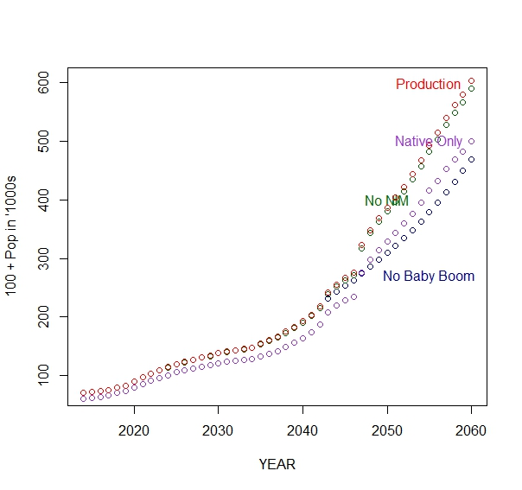
Alternative Base
Total Pop

Slide 11
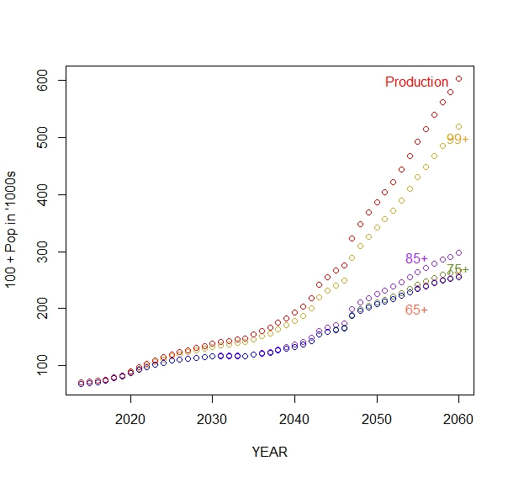
Alternative Survival
Total Pop

Slide 12
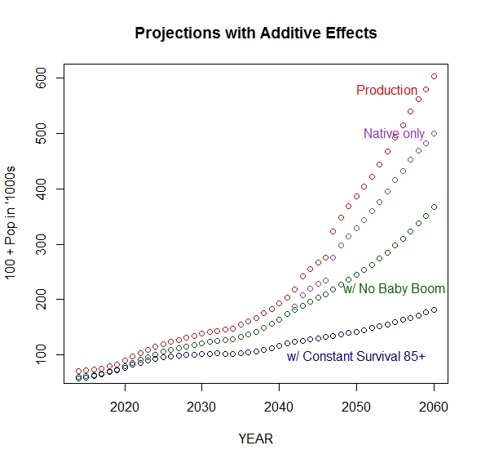
Major Effects

Slide 13
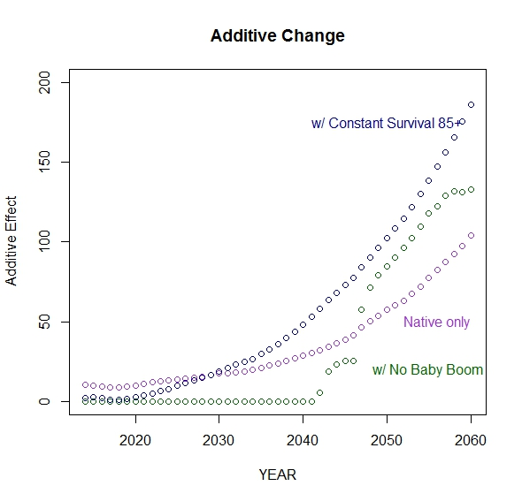
Additive Change

Slide 14
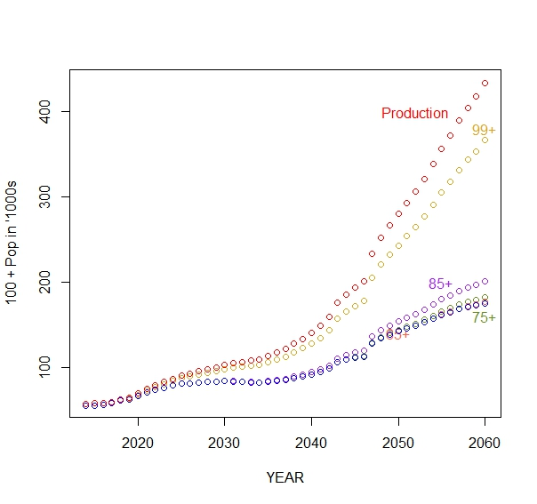
Alternative Survival: Female

Slide 15
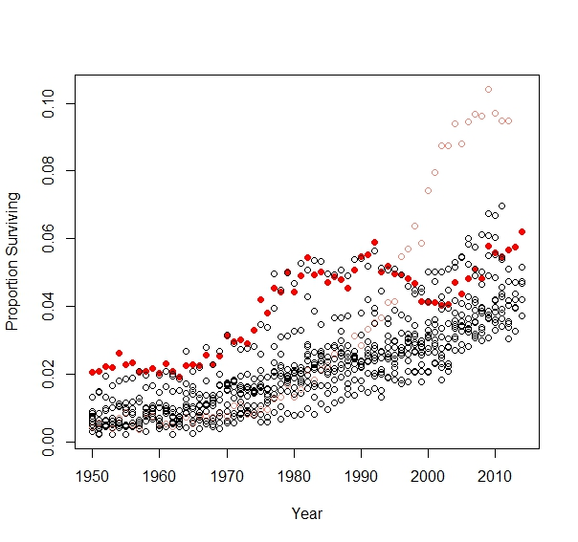
Female Survival Rates 85 to 100
Low Mortality Countries

Slide 16
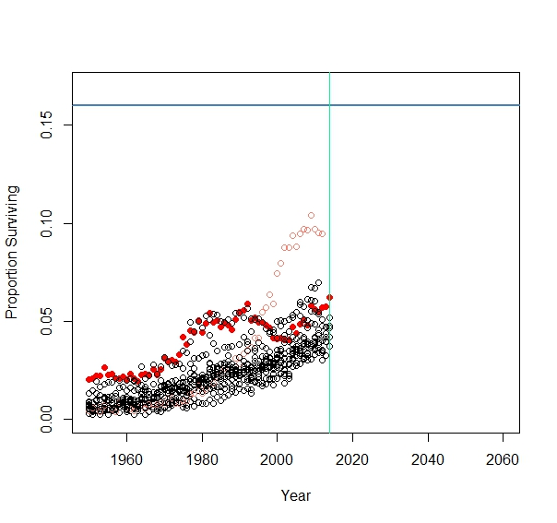
Female Survival Rates 85 to 100
Low Mortality Countries

Slide 17
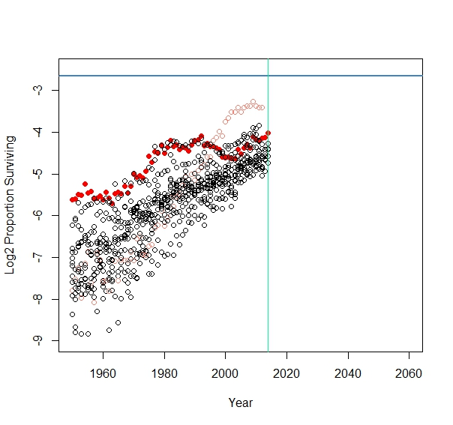
Female Survival Rates 85 to 100
Low Mortality Countries: Log2 Scale

Slide 18
Conclusion
Projected 100+ Population is well within the range of plausible results.

Slide 19
Future Research
Modeling of older age mortality patterns for recent low mortality populations.

Slide 20
Female Survival Rates 85 to 100
Low Mortality Countries: Log2 Scale

Slide 21
Thank you
Howard.R.Hogan@Census.Gov

