Slide 1
The Aging Population in Texas: A Brief Insight to the Future
TxSDC
Demographic Data Users Conference
May 19, 2015
Austin, Texas
Notes:
Lloyd Potter is the Texas State Demographer and the Director of the Texas State Data Center based at the University of Texas at San Antonio.

Slide 2
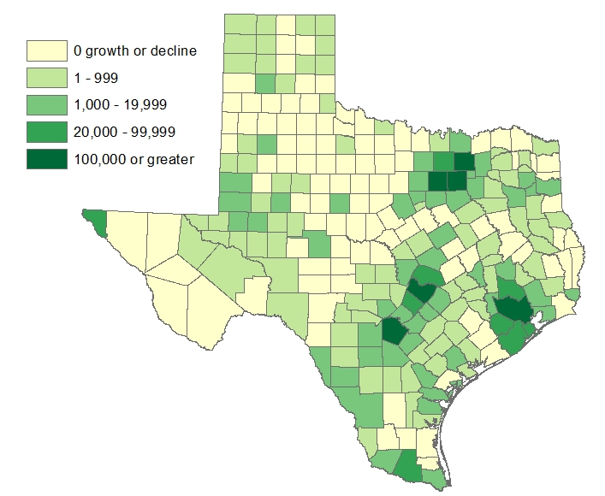
Estimated Change of the Total Population by
County, Texas, 2010 to 2014
Source: U.S. Census Bureau Population Estimates, 2014 Vintage.
Notes:
Population change over the decade has been greatest in the urban and suburban population triangle counties. Counties in the lower Rio Grande Valley also had significant growth as did El Paso county. Overall, 152 counties gained population while 102 (40%) lost population since 2010.

Slide 3
Top 10 States with the Largest Older Populations, 2010 to 2013
 | 2010 |  | 2011 |  | 2012 |  | 2013
 | Population 65 years plus | Percent of Total Population | Population 65 years plus | Percent of Total Population | Population 65 years plus | Percent of Total Population | Population 65 years plus | Percent of Total Population
United States | 40,267,984 | 13.0% | 41,369,513 | 13.3% | 43,143,745 | 13.7% | 44,704,074 | 14.1%
California | 4,246,514 | 11.4% | 4,402,483 | 11.7% | 4,599,968 | 12.1% | 4,791,731 | 12.5%
Florida | 3,259,602 | 17.3% | 3,358,818 | 17.6% | 3,510,753 | 18.2% | 3,647,617 | 18.7%
New York | 2,617,943 | 13.5% | 2,670,040 | 13.7% | 2,757,053 | 14.1% | 2,832,481 | 14.4%
Texas | 2,601,886 | 10.3% | 2,704,534 | 10.5% | 2,841,582 | 10.9% | 2,966,167 | 11.2%
Pennsylvania | 1,959,307 | 15.4% | 1,978,759 | 15.5% | 2,042,916 | 16.0% | 2,091,330 | 16.4%
Ohio | 1,622,015 | 14.1% | 1,644,651 | 14.2% | 1,704,906 | 14.8% | 1,752,297 | 15.1%
Illinois | 1,609,213 | 12.5% | 1,639,121 | 12.7% | 1,694,505 | 13.2% | 1,743,641 | 13.5%
Michigan | 1,361,530 | 13.8% | 1,388,405 | 14.1% | 1,442,583 | 14.6% | 1,487,593 | 15.0%
North Carolina | 1,234,079 | 12.9% | 1,279,582 | 13.3% | 1,347,638 | 13.8% | 1,407,099 | 14.3%
New Jersey | 1,185,993 | 13.5% | 1,208,404 | 13.7% | 1,250,263 | 14.1% | 1,283,468 | 14.4%
Source: U.S. Census Bureau Population Estimates, 2013 Vintage.

Slide 4
Median Age for the Top 10 Youngest States, 2010 to 2013
 | 2010 | 2011 | 2012 | 2013
United States | 37 | 37 | 38 | 38
Utah | 29 | 30 | 30 | 30
Texas | 34 | 34 | 34 | 34
District of Columbia | 34 | 34 | 34 | 34
Alaska | 34 | 34 | 34 | 33
Idaho | 35 | 35 | 35 | 36
California | 35 | 35 | 36 | 36
Georgia | 35 | 36 | 36 | 36
Louisiana | 36 | 36 | 36 | 36
Arizona | 36 | 36 | 37 | 37
Mississippi | 36 | 36 | 36 | 37
Source: U.S. Census Bureau Population Estimates, 2013 Vintage.
Notes:
While the Texas population 65 years of age and older is the fifth largest in the nation, it is the second youngest after Utah with a median age of 34.

Slide 5
Estimated Population Change, Texas Counties, 2010 to 2014
102 counties lost population over the four year period.
95 counties lost population between 2013-14
Of these:
36 (38%) had natural decline
89 (94%) had net out migration
30 (32%) had both natural decline and net out migration
Source: U.S. Census Bureau Population Estimates, 2014 Vintage.
Notes:
Population change over the decade has been greatest in the urban and suburban population triangle counties. Counties in the lower Rio Grande Valley also had significant growth as did El Paso . Overall, 155 counties gained population while 99 (39%) lost population over the decade.

Slide 6
Percent of Households with at Least One Person Over the Age of 64 Years, Texas Counties, 2008-2012
Source: U.S. Census Bureau, American Community Survey, 5-year sample, 2008-2012

Slide 7
Median Age, Texas Counties, 2009-2013
Source: U.S. Census Bureau, American Community Survey, 2009-2013 5 Year Sample

Slide 8
Population Projections, Texas, 2010-2050,
Percent Over and Under 65
Source: Texas State Data Center 2014 Population Projections , Half 2000-2010 Migration Scenario

Slide 9
Texas Population Pyramid by Race/Ethnicity, 2010
Source: U.S. Census Bureau 2010 Decennial Census, SF1
Notes:
This population pyramid represents the age and sex composition of the Texas non-Hispanic white population. Blue represents males, red females, rows are single years of age.

Slide 10
Texas Population Pyramid by Race/Ethnicity, 2010
Source: U.S. Census Bureau 2010 Decennial Census, SF1
Notes:
This population pyramid represents the age, and sex composition of the minority population in Texas. Blue represents males, red females, rows are single years of age, and shades represent specified race/ethnic groups as indicated in the legend.

Slide 11
Texas Population Pyramid by Race/Ethnicity, 2010
Source: U.S. Census Bureau 2010 Decennial Census, SF1
Notes:
This population pyramid represents the age, sex, race and ethnic composition of the Texas population. Blue represents males, red females, rows are single years of age, and shades represent specified race/ethnic groups as indicated in the legend.

Slide 12
Population Projections 65 Years and Over by Race/Ethnicity, Texas, 2010-2050
Source: Texas State Data Center 2014 Population Projections , Half 2000-2010 Migration Scenario

Slide 13
Texas Population Change by Age Group,
2010-2050
Source: Texas State Data Center 2014 Population Projections, Half 2000 to 2010 Migration Scenario
Notes:
This image represents population pyramids for Texas in 2010 and then our projected population in 2050. Population pyramids provide a visual representation of the age structure of a population. In comparing 2010 and 2050 in terms of the impact on our education system, look at the lighter shaded areas from 15 years and above to 25-29. Some proportion of this increased population in these ages will be going to college in Texas. The lighter shaded areas below 15 suggest what’s coming in the future.

Slide 14
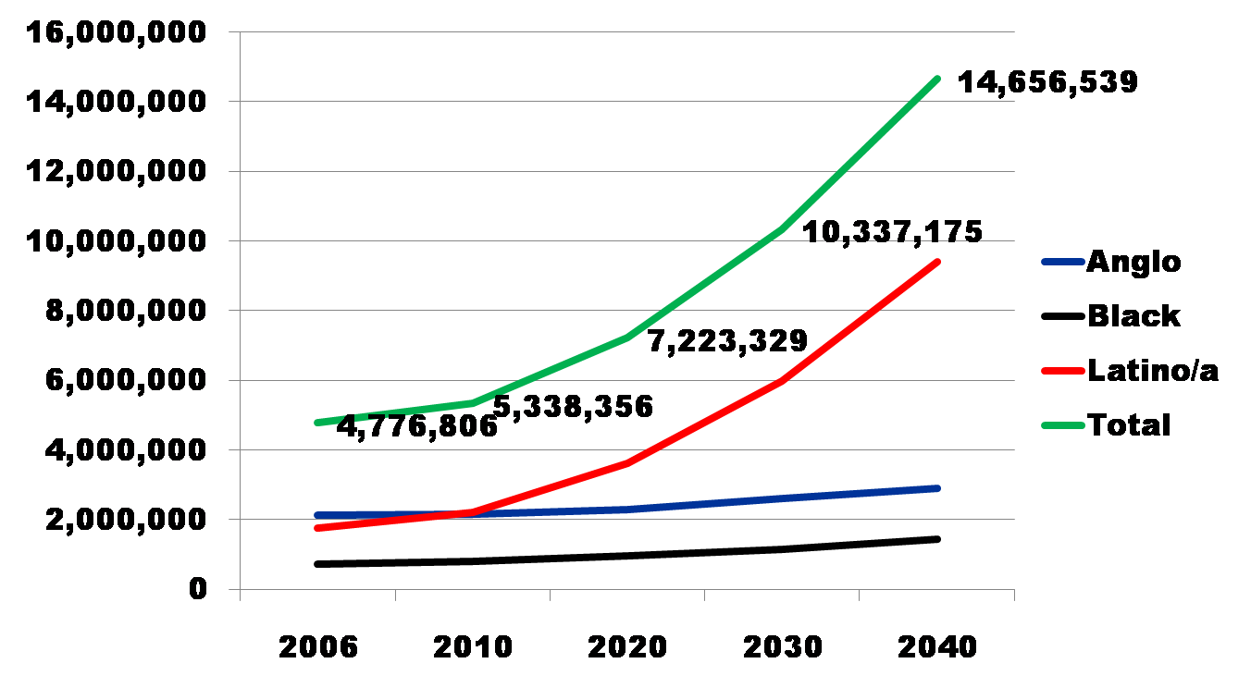
Projected Increase in Obesity in Texas by Ethnicity, 2006 to 2040
Source: Office of the State Demographer projections, using 2000-2004 migration scenario population projections

Slide 15
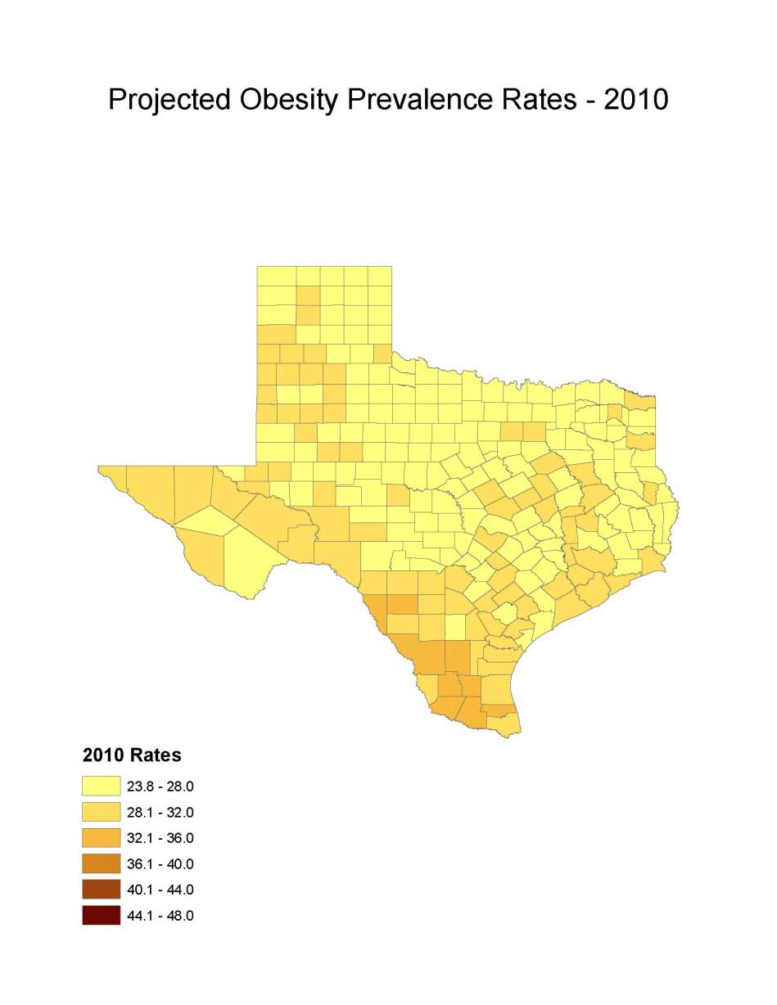
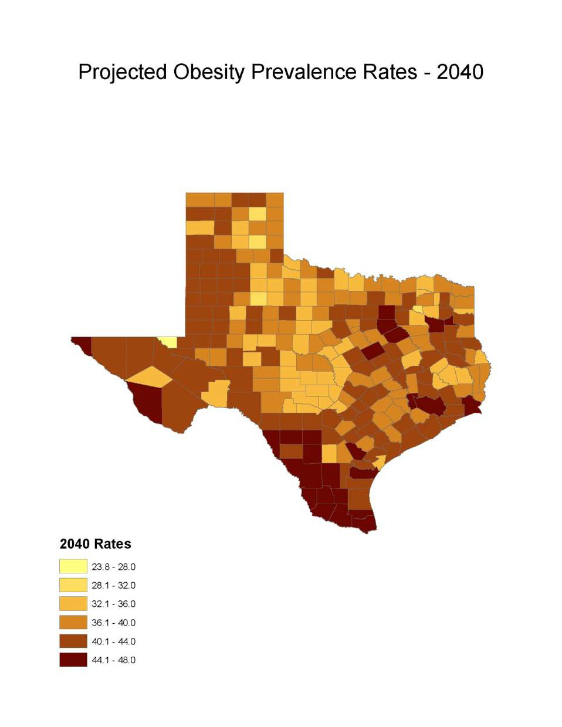
Obesity Prevalence
% adults with obesity: Office of the State Demographer, 2000-2004 Projection

Slide 16
Projected Number of Adults with Diabetes by Race and Ethnicity, Texas, 2010-2040

Slide 17
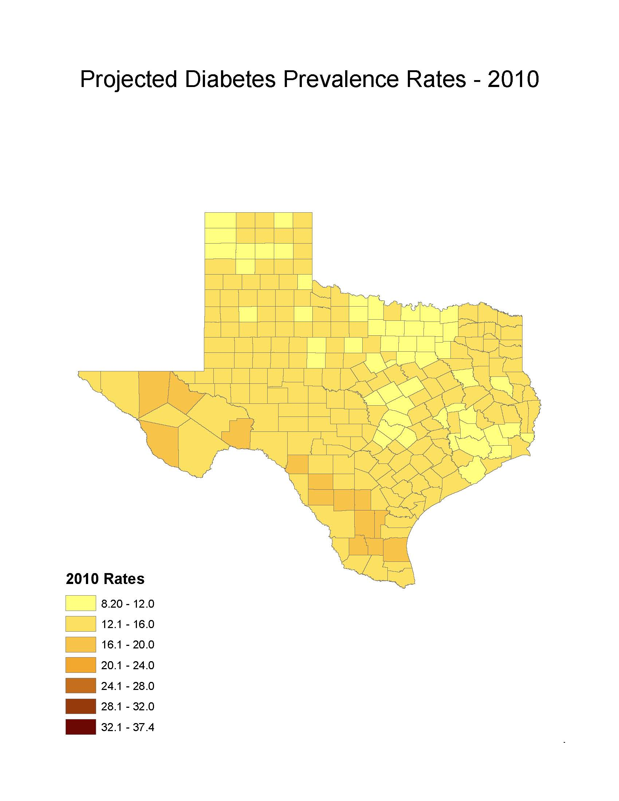
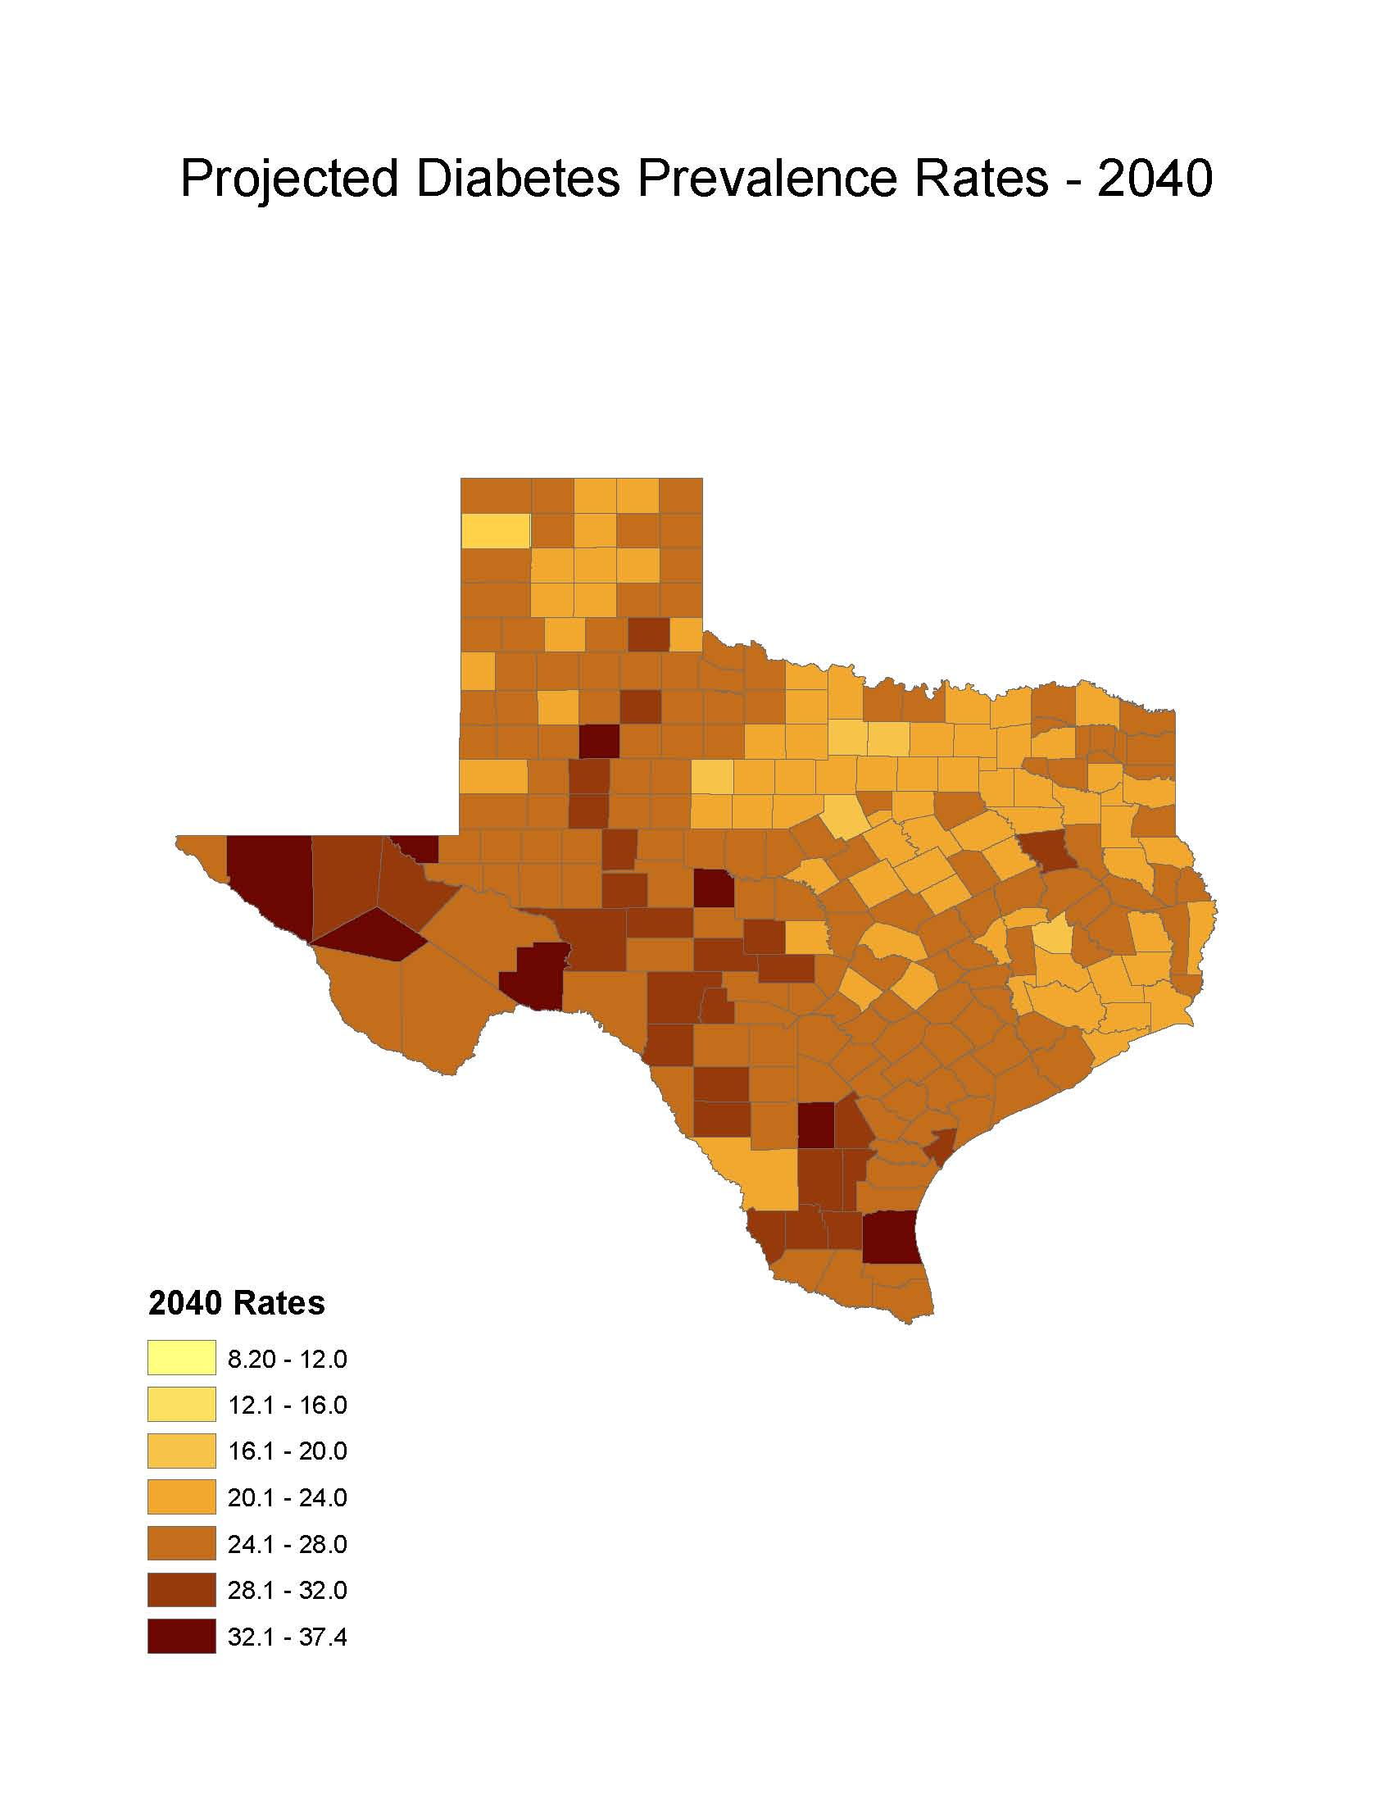
Diabetes Prevalence
% adults with diabetes: Office of the State Demographer, 2000-2004 Projection

Slide 18
Physicians per 1,000 Population Aged 65 Years and Older by County, 2011
Source: U.S. Census Bureau. 2010 Census and Texas Medical Board (2011 physicians).
Notes:
Data on this map about physicians licensed to practice in Texas are from the Texas Medical Board. Some rural counties do not have any practicing physicians. The more urban counties appear to have relatively high ratios of physicians to population aged 65+. This map does not provide information about the type/specialty of physicians.

