Slide 1
Houston’s Growth and challenges: comparing houston to ten largest us cities
City of houston
Planning and development department
Texas Demography Conference
Austin, Texas
May 17 & 18, 2016

Slide 2
Ten largest us cities
Chicago
New York
Los Angeles
Philadelphia
San Jose
Phoenix
Dallas
San Diego
San Antonio
Houston

Slide 3
metro population: numerical change

Slide 4
Metro Population: percent change

Slide 5
metro population: net migration

Slide 6
Top 5 cities Population Estimates: 2010 - 2014

Slide 7
Top 5 cities: numerical increase 2010 - 2014

Slide 8
Top 5 cities: percentage increase 2010 - 2014

Slide 9
Total population

Slide 10
Race \ ethnicity

Slide 11
School age population

Slide 12
Voting age population

Slide 13
Millennial generation

Slide 14
Middle age population

Slide 15
Retirement ages

Slide 16
Median age

Slide 17
Native and foreign born

Slide 18
School enrollment: native and foreign -born

Slide 19
Languages spoken at home

Slide 20
Educational attainment

Slide 21
High school graduates

Slide 22
Graduates and professional

Slide 23
Family and non-family households

Slide 24
Female led households

Slide 25
Households with children under 18 years

Slide 26
Average household size

Slide 27
Marital status

Slide 28
Median household income

Slide 29
Household income

Slide 30
Individuals below poverty level

Slide 31
Not in labor force

Slide 32
selected employment

Slide 33
Class of workers

Slide 34
Persons with health insurance

Slide 35
Housing Occupancy

Slide 36
Owner and renter occupied

Slide 37
median housing value

Slide 38
housing value

Slide 39
Median rent

Slide 40
Rent as a percent to income

Slide 41
Year housing unit built

Slide 42
Moved into housing unit

Slide 43
Vehicles available

Slide 44
Commute to work

Slide 45
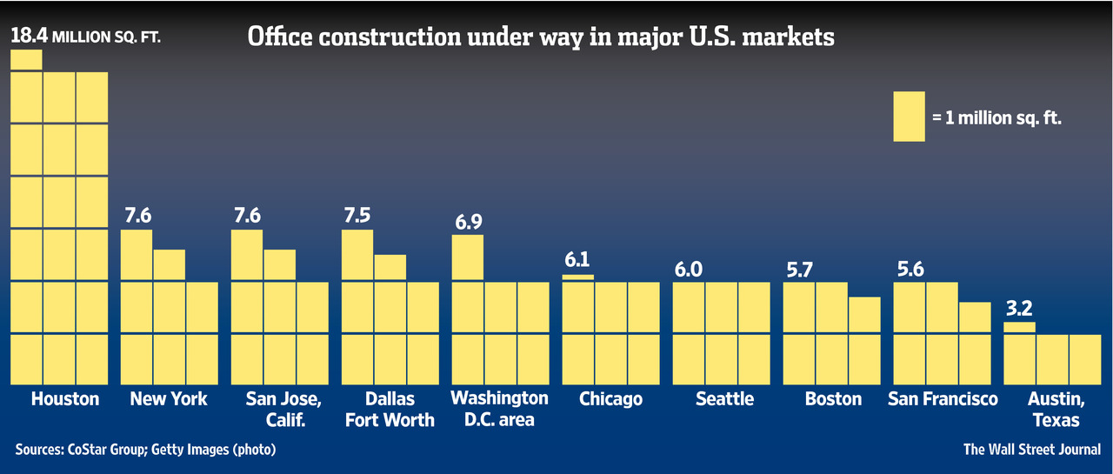
Office construction

Slide 46
2015 Single family permits

Slide 47
2015 multi-family permits

Slide 48
2015 Single family permits by value

Slide 49
2015 demolition permits

Slide 50
Single family Permit trend

Slide 51
Multi-family Permit trend

Slide 52
Plats and site plans

Slide 53
Land Assemblage Redevelopment Authority (LARA)
The Land Assemblage Redevelopment Authority (LARA) is organized for the purpose of aiding, assisting and acting on behalf of the City in the performance of its governmental functions to promote the common good and general welfare of the City and in undertaking and completing one or more projects, as may be defined or determined by the City Council of the City.
In particular, such projects shall include, without limitation, the acquisition, assemblage, management, marketing, development and disposition of properties that have been acquired by taxing authorities through foreclosure of delinquent ad valorem taxes, including the redevelopment of such properties.

Slide 54
LARA Neighborhood Locations

Slide 55
Rail and bus service
Source: Houston Metro

Slide 56
transit centers / park & rides

Slide 57
challenges
Outpacing Chicago
Economic outlook
Density
Gentrification
Housing Affordability
Infrastructure Services
Metro Rail Expansion
Urban Sprawl (ETJ)
Transportation
Professor Stephen Klineberg said “Houston is reinventing itself for the 21st century”

Slide 58
Thank you
Bala J Balachandran
Chief Demographer / Senior Staff Analyst
Planning and Development Department
City of Houston
Phone: 832-393-6521
Email: bala.balachandran@houstontx.gov

