Slide 1
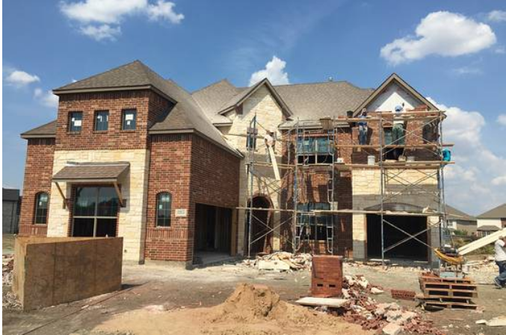
Local Employment Dynamics
Boom or Bust, Determining Which Industries Are Thriving in the Texas Economy
Earlene Dowell
LEHD Program
Center for Economic Studies
U.S. Census Bureau

Slide 2
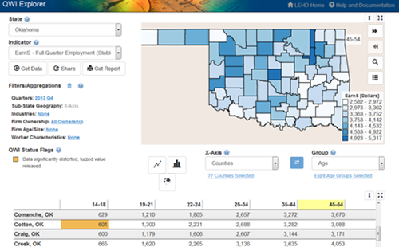
Outline
What is LED and why should I care?
LED Public-use Data and Web Tools
Live Demonstration
Introduction to Job-to-Job Flows

Slide 3
Where Does the Data Come From?
Local Employment Dynamics Partnership
Begun in late 1990s with a few states
Currently producing data for Massachusetts with data as far back as 2010
Pending territories include Puerto Rico and Virgin Islands

Slide 4
Why Are LED Data Special?
100% Coverage of UI Covered Jobs
Firm Characteristics crossed with Worker Characteristics
Detailed Geography
Data Currency
Accessible via powerful and easy-to-use tools
Flexible outputs: PDF reports, Excel tables, high-quality images, and shapefiles

Slide 5
Admin. Records & LED Infrastructure
UI* Wage Records
OPM*
Economic Survey Data
Business Register
Federal Records
Linked National Jobs Data
Firm Data
Jobs Data
Person Data
Demographic Census/Survey Data
QCEW*
QCEW = Quarterly Census of Employment and Wages
UI = Unemployment Insurance
OPM = Office of Personnel Management
Public-Use Data Products…
Job data cover over 95% of private employment and most state, local, and federal jobs
Data availability: 1990-2014, start year varies by state, rolling end date

Slide 6
LED Data Products
Quarterly Workforce Indicators (QWI)
Employment, Job Creation, Job Destruction, Hires, Separations, Turnover, Earnings
By industry, county, and worker characteristics
LEHD Origin Destination Employment Statistics (LODES)
Employment and Workplace-Residence Connections
Detailed geography + firm/worker characteristics
Job-to-Job Flows (J2J)
Data on job transitions broken down by origin/destination industry and geography and worker characteristics
Flows between Jobs
Flows to/from Nonemployment
Beta data being released over coming months

Slide 7
Choosing Among LED Data Products
Data Product | Why Choose It? | Potential Drawbacks
QWI | You need employment, hires, separations, turnover, or earnings by detailed industry or person characteristics, quarterly time resolution, or a relatively short data lag | No geography below county; no residential information
LODES | You need employment for detailed or customized geography, residential patterns of the workforce, or relationship between worker employment and home locations | Annual time resolution; less detailed firm/person characteristics; significant data lag (temporary)
J2J | You need to understand transitions of workers among jobs | No worker characteristics by industry, no geography below Metro/Micro Areas*
*Data product is still under development.

Slide 8
Public Data Tools
All tools are free and available 24/7
Live Demonstrations of
QWI Explorer
LED Extraction Tool (QWI)
OnTheMap
OnTheMap for Emergency Management
Job-to-Job Explorer (coming soon!)

Slide 9
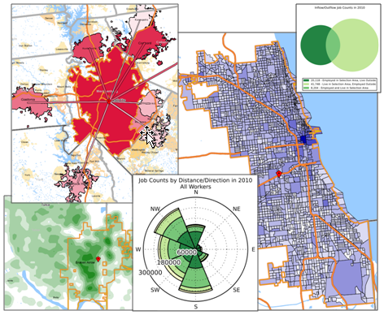
OnTheMap
Recognized by United Nations as a major U.S. statistical innovation
Where do workers live?
Where do residents work?
What are the commuter flows of a particular area?
Analyze/report by worker demographics: age, earnings, race, ethnicity, educational attainment, and sex
Analyze/report by firm characteristics: NAICS Sector, firm age, and firm size
2002-2014 annual data
50 states available (plus DC)
User-selected areas
Based on Census Blocks
Disclosure protection
Flexible Inputs/Outputs

Slide 10
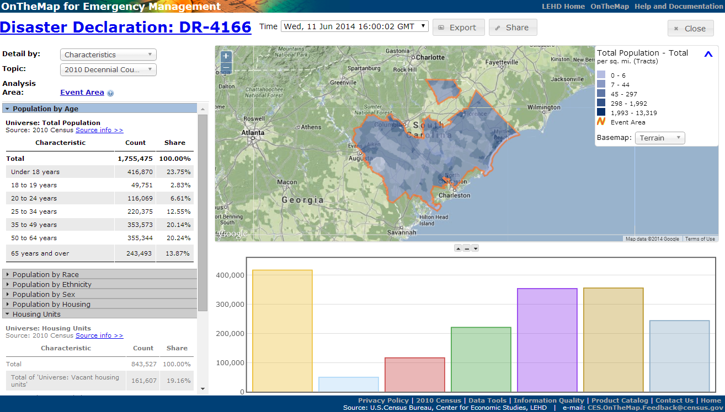
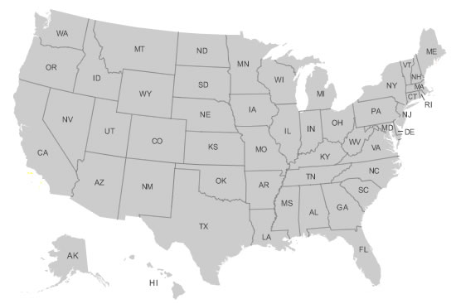
OnTheMap for Emergency Management
Hurricanes, Floods,
Winter Storms
Disaster Areas
Wildfires
Demographic & Economic Data
New Public Data Service for Emergency Preparedness & Response
Comprehensive Reports
Real-time Data Updates
Easy-to-use & Interoperable
Historical Event Archive
Flexible Analyses & Visualizations
Notes:
Assessing Workforce Impacts
Identify the number and location of affected workers
Examine workforce demographics
Identify affected Industries
Visualize where affected workers live
Assessing Population & Housing Impacts
Identify the number and location of affected residents
Examine population demographics of affected areas
Identify vulnerable population groups
Examine housing characteristics of affected areas
Emergency Preparedness & Response Planning
Where should response efforts concentrate?
Are there special or vulnerable population segments?
Uncover surrounding communities with secondary affects to workforce

Slide 11
Questions
Where do the workers employed downtown live?
What share of workers with a short commute to downtown are aged 29 or younger?
What share of workers employed in downtown also live there?
During Hurricane Alex, what was the total Hispanic or Latino population that was impacted?

Slide 12
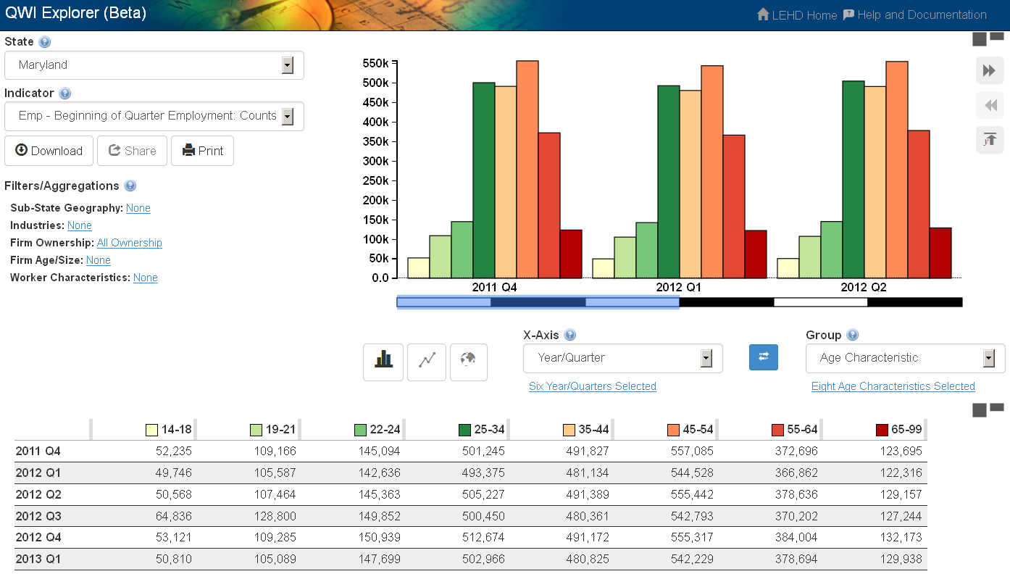
QWI Explorer
32 Quarterly Workforce Indicators
Flexible Pivot Table and Map/Chart interface
Data on detailed interactions between firms and workers include employment, employment change (individual and firm), and earnings
Analyze/report by worker demographics: age, earnings, race, ethnicity, educational attainment, and sex
Analyze/report by firm
characteristics: NAICS
classification (sector, 3, 4), firm
age, and firm size
Quarterly data very current
(9-12 months old)
National and 50 states available
(plus DC)

Slide 13
Questions
Which industries in my region are hiring older workers? Younger workers? Workers without a high school diploma? What do these jobs pay?
How has this changed over time?

Slide 14
LED Extraction Tool
Notes:
Raw data and National QWI

Slide 15
National QWI
Notes:
Total employment counts for all industries

Slide 16
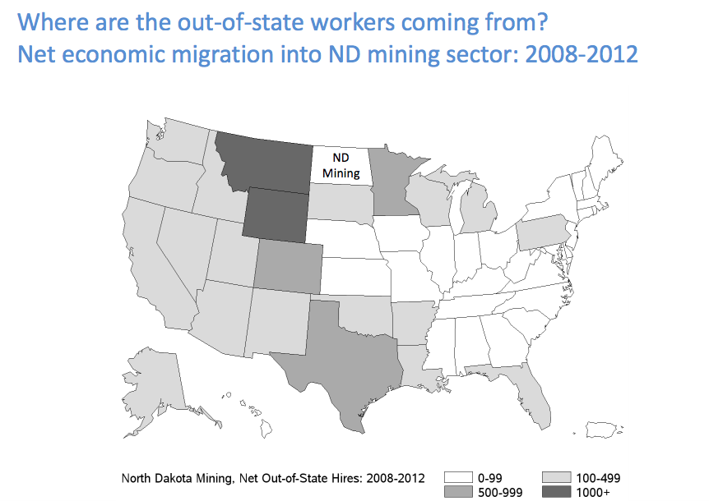
Job-to-Job Explorer
Types of questions that can be answered with this soon-to-be released application:
Where are North Dakota’s oil boom workers coming from?
Download data from http://lehd.ces.census.gov/data/j2j_beta.html

Slide 17
Out-of-State Job-to-Job Flows from Texas
Notes:
We can see the number of people leaving from Texas in the oil and mining industry and which states they are going to.
Majority of the workers are going to the surrounding states, while some went to North Dakota due to the oil boom there and some in PA in possibly the coal mining industry.

Slide 18
Out-of-State Job-to-Job Flows in Texas
Notes:
This map shows those leaving and entering Texas in the oil and mining industry.

Slide 19
Job-to-Job Separations
Notes:
Over time 80% of the workers in oil and mining change jobs but stay in Texas.
20% left the state for the three surrounding states, with Louisiana being the highest until 2012 when Oklahoma passed that total.

Slide 20
http://lehd.ces.census.gov/
Notes:
Among construction workers who became unemployed for more than three months between 2006 and 2009:
About 40% stayed in construction, either returning to their former employer or landing with a new one.
About one-third switched to another industry, but only after sitting on the sidelines for more than a year. Typical destinations included work as general laborers, landscapers and truck drivers.
Contrary to conventional wisdom, few headed off to the booming oil and gas industry. The mining sector–which includes oil and gas extraction–accounted for less than 5% of new jobs for former construction workers heading back into the labor market.
And about one-quarter of displaced construction workers were still out of work five to seven years after they lost their jobs. “These individuals presumably have left the labor market, although they could be working informally or be self-employed,” Janicki and McEntarfer said.

Slide 21
Where are all the construction workers going?

Slide 22
http://lehd.ces.census.gov/data/

Slide 23
Where did all the teachers go (Industry/Geography)?
Notes:
42=Wholesale Trade
71=Arts, Entertainment, and Recreation

Slide 24
Web Addresses for Tools
QWI Explorer
http://qwiexplorer.ces.census.gov/
OnTheMap
http://onthemap.ces.census.gov/
OnTheMap for Emergency Management
http://onthemap.ces.census.gov/em.html
LED Extraction Tool
http://ledextract.ces.census.gov/

Slide 25
Takeaways
The LED Partnership provides unique workforce information and analysis tools at a relatively low cost
LED data products (QWI, LODES, J2J) can give insight into local and regional economies and labor markets
LED’s web tools provide free, 24/7 access to a basic analytical platform for the data

Slide 26
Useful Links
QWI Explorer
Video Walkthrough: http://lehd.ces.census.gov/applications/help/qwi_explorer.html#!video_walkthrough
Example Scenarios: http://lehd.ces.census.gov/applications/help/qwi_explorer.html#!example_scenarios
OnTheMap
Getting Started: http://lehd.ces.census.gov/doc/help/onthemap/GettingStartedwithOnTheMap.pdf
Analysis Guides: http://lehd.ces.census.gov/applications/help/onthemap.html#!analysis_guides
Other Tutorials: http://lehd.ces.census.gov/applications/help/onthemap.html#!more_tutorials

Slide 27
Thank You!
Local Employment Dynamics
http://www.lehd.ces.census.gov
Questions and Feedback
CES.OnTheMap.Feedback@census.gov
CES.QWI.Feedback@census.gov
CES.Local.Employment.Dynamics @census.gov

Slide 28
Slide Appendix

Slide 29
Choosing Data 1
When should I be interested in using LED data compared to other available statistics?
Suppose I’m primarily interested in Employment
?
Do I need the latest national estimate available?
Current Employment Statistics (CES)
Employment by industry - ‘the payroll survey’
Current Population Survey (CPS)
Employment status and demographics - ‘the household survey’
Some sub-state geographies are available concurrently through Local Area Unemployment Statistics (LAUS)

Slide 30
Choosing Data 2
But suppose I need either sub-national employment data or statistics by detailed industry:
Quarterly Census of Employment and Wages (QCEW)
Employment by detailed industry, sub-state geography and better employment coverage (6-month lag)
Quarterly Workforce Indicators (QWI)
Employment by detailed industry, sub-state geography, and worker demographics (age, sex, education, race) and fewer cell suppressions than the QCEW (9-month lag)
American Community Survey (ACS)
Employment status by more sub-state geographies than CPS/LAUS (9-month lag)
LODES/OnTheMap
Employment at the block-level (>1 year lag)
County Business Patterns (CBP)
Employment at the zipcode-level (>1 year lag)
?

Slide 31
Choosing Data 3
Suppose I’m primarily interested in Hires/Separations/Turnover
Do I need the most current national data (1 month lag) or do I want to differentiate between quits and layoffs?
Job Openings and Labor Turnover Survey (JOLTS)
Do I need sub-national data (state/county), data by worker demographics, or for detailed industries?
Quarterly Workforce Indicators (QWI)
Job-to-Job Flows (J2J)

Slide 32
Choosing Data 4
Suppose I’m primarily interested in Wages
State and Regional Wage Information by Occupation?
Occupational Employment Statistics (OES)
Wages by Detailed Industry and Geography?
Quarterly Census of Employment and Wages (QCEW)
Wages by Detailed Industry and Geography and by Worker Demographics? Starting Wages for New Hires by Industry and Geography?
Quarterly Workforce Indicators (QWI)

Slide 33
Choosing Data 5
Suppose I’m primarily interested in Commuting
Transportation mode, time to work, work at home?
American Community Survey (ACS) Commuting Data
Commuting for Detailed/Custom Areas or Multiple Jobholders?
LEHD Origin-Destination Employment Statistics (LODES/OnTheMap)

Slide 34
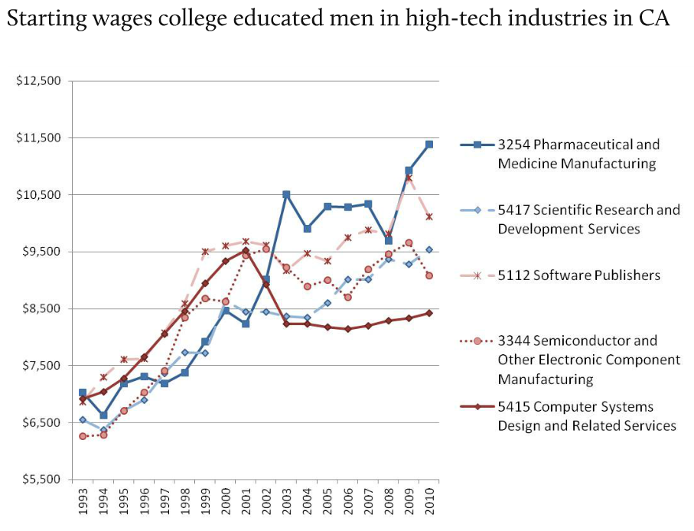
Quarterly Workforce Indicators (QWI)
Detailed workforce dynamics, by worker characteristics and firm characteristics
Popular uses:
Local workforce demographics
Local industry workforce trends
Workforce turnover, job creation and destruction

Slide 35
Quarterly Workforce Indicators (QWI)
Can see workforce composition by detailed firm characteristics
Such as what share of the workforce at startup firms is female?

Slide 36
Job-to-Job flows

Slide 37
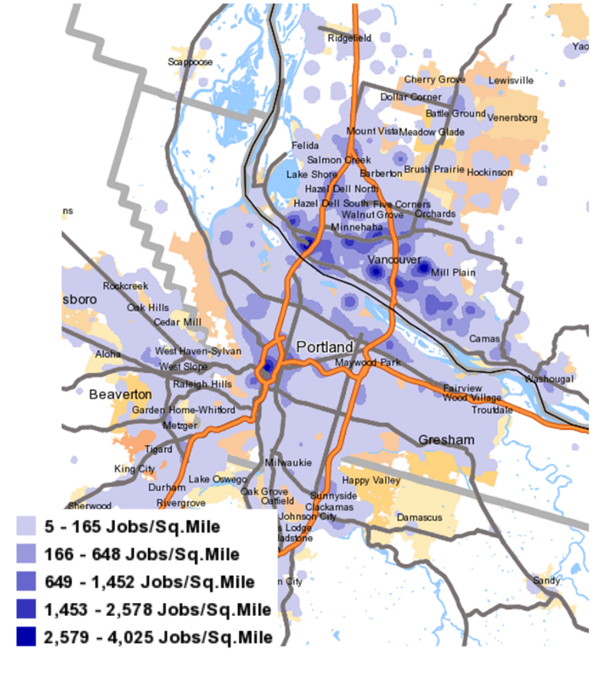
OnTheMap: Where workers live, and where they work
This map shows LODES data of where residents of Vancouver, Washington work
Popular uses:
local economic development
business site selection
emergency planning

Slide 38
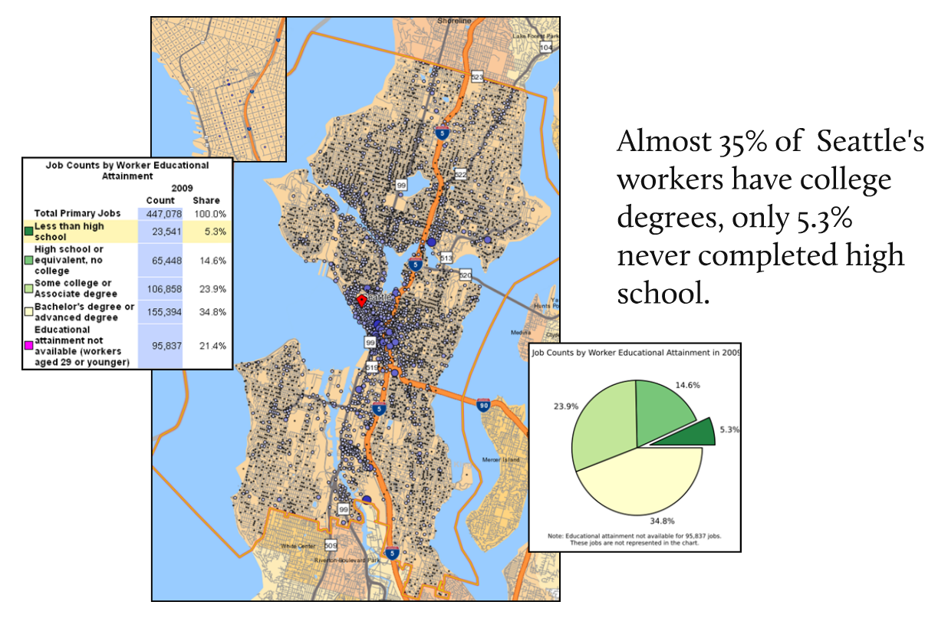
OnTheMap: Block-level employment detail

Slide 39
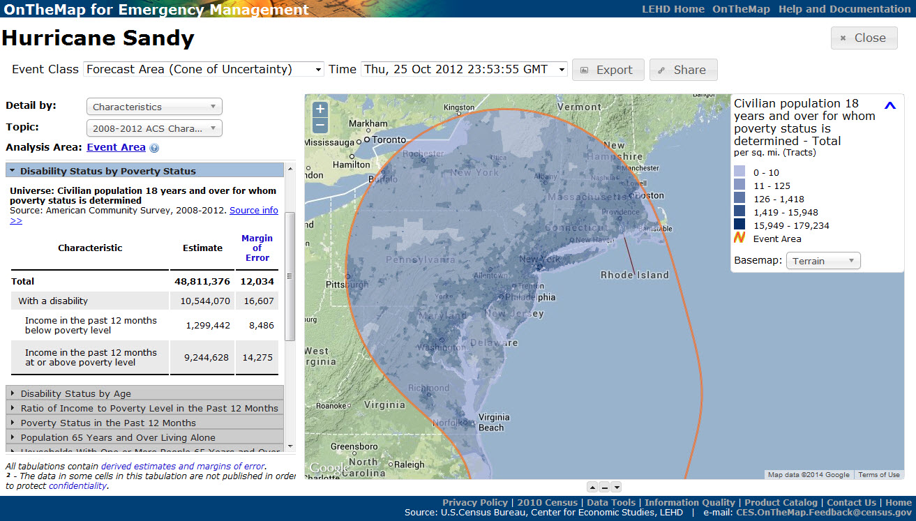
Hurricane Sandy - October 25, 2012
39

Slide 40
Real World Examples
Some brief examples of from our users…

Slide 41
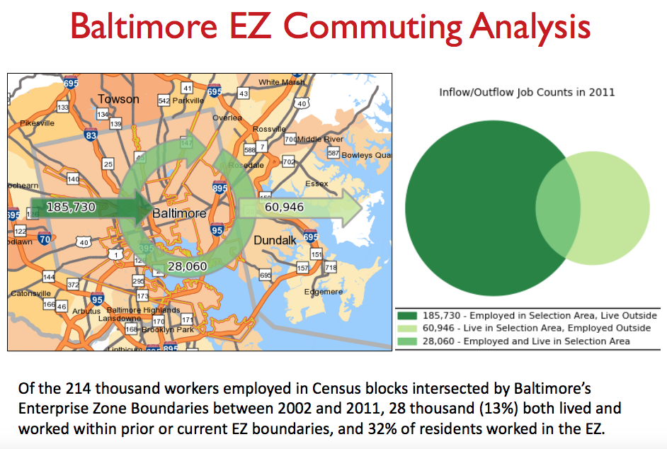
LODES: An Examination of Maryland Enterprise Zones

Slide 42
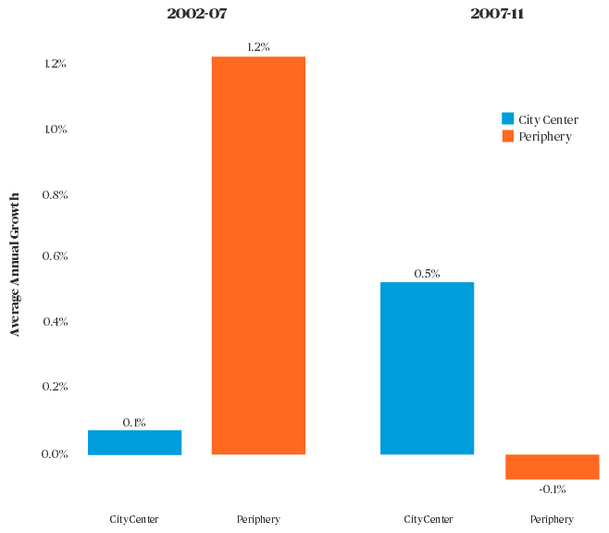
LODES: Growth in City Centers
http://cityobservatory.org/wp-content/uploads/2015/02/Surging-City-Center-Jobs.pdf

Slide 43
QWI: Education and Employment in Utah

Slide 44
QWI: A Comparison of I-95 and I-270 Corridors

Slide 45
QWI: Combining More than One Indicator to Create New Insights

Slide 46
QWI: Combining More than One Indicator to Create New Insights

Slide 47
QWI: Combining More than One Indicator to Create New Insights

