Slide 1

Establishing a Historical Model for Suburban Growth in San Antonio, Texas 1890-2010
Ian Caine, University of Texas at San Antonio Assistant Professor of Architecture
Rebecca Walter, PhD, University of Texas at San Antonio Assistant Professor of Urban and Regional Planning
Nathan Foote, Rutgers University
Bloustein School of Planning and Public Policy

Slide 2
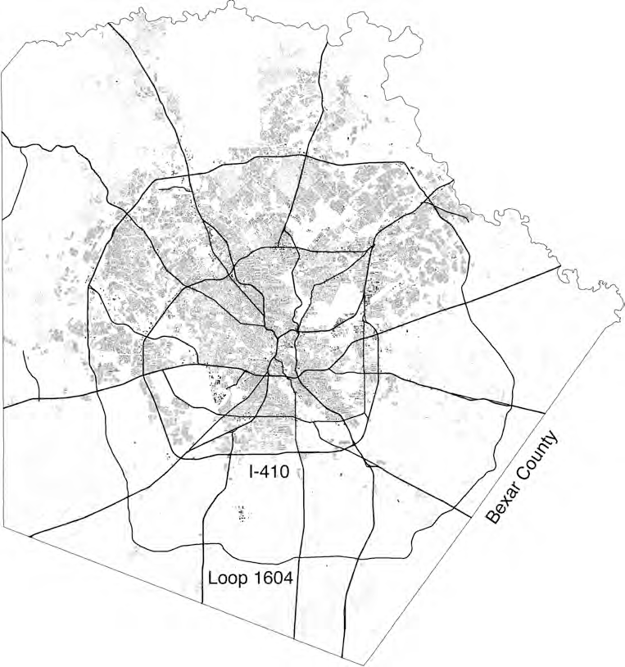
Figure 1. Bexar County 2010
0
25 mi

Slide 3
Metropolitan Growth
SA pop of 1.47M = 7th Largest U.S. City SA will add 500K jobs by 2040
SA will add 500k units of housing by 2040
Figure 1. Bexar County 2010
0
25 mi

Slide 4
Metropolitan Growth
SA pop of 1.47M = 7th Largest U.S. City SA will add 500K jobs by 2040
SA will add 500k units of housing by 2040 Current footprint covers 467 square miles Could expand to over 1,000 square miles
Figure 1. Bexar County 2010
0
25 mi

Slide 5
3 Questions
How did the form of suburban growth shift within Bexar County?
Has the location of suburban growth shifted within Bexar County?
Has the type of suburban growth shifted within Bexar County?

Slide 6
Methods
2015 parcel shapefile for San Antonio from the Bexar County Property Appraiser providing
property ownership, year first building was constructed on the lot, the assessed value of building(s) and lot, land use, and the total acreage for the parcel.
Shapefile with San Antonio building footprints from the Texas Sustainable Energy Research Institute
Spatial join of the parcel shapefile and building footprints, assigning all of the attributes from the Bexar County Property Appraiser dataset to the buildings
Sample size of 609,006 buildings and 475,127 parcel
Converted the polygon building footprint shapefiles for each decade into point shapefiles in ArcGIS.
Used the kernel density spatial analyst tool on the point building footprint shapefiles to calculate the concentration of buildings within an area.
This created a development surface for each time period.
The team utilized total building coverage as a weight in the population field of the kernel density function in order to account for the size of each completed building.
creating maps from the results and classifying them using the equal interval method. The team then compared the kernel density maps across decades to determine how the concentration of development changed in San Antonio over time.
Using ArcGIS near tool to calculate the distance from the center of each building in the data set to the center of downtown’s Main Plaza

Slide 7
3 Results
How did the form of suburban growth shift within Bexar County?
Concentric growth until late late twentieth century, now polycentric configuration
Has the location of suburban growth shifted within Bexar County?
Patterns of centrifugal expansion began to accelerate dramatically in 2000.
Has the type of suburban growth shifted within Bexar County?
The relative import of multifamily completions increased in five of last six decades.

Slide 8
Rise of the suburbs, decline of the central city
1950-1990 : % of people in central cities declines from 1/2 to 1/3
1950-1990 : % of jobs in central cities declines from 70% to 45% Mieszkowski and Mills (1993) Wheeler (2008) Farris (2001)

Slide 9
These shifts mobilize a critique, today known as New Urbanism or Smart Growth
Blake (1964)
Calthorpe (1993, 2001)
Duany, Plater-Zyberg, Speck (2000) Duany, Speck, Lydon (2010)

Slide 10
New Suburbanism accepts inherent form and logic of suburban landscapes
Robert Bruegman (2005)
Joel Kotkin (2005) Judith De Jong (2014)

Slide 11
New Suburbanism might help San Antonio confront population boom in 3 ways
Allows metropolitan area to absorb population, even if core doesn’t fill out
Recognizes political climate in Texas, which is strongly pro-development Focuses on inherent possibilities of suburban infill

Slide 12
Question 1
How did the form of suburban growth shift within Bexar County?
Concentric growth until late late twentieth century, now polycentric configuration
Method
Kernel Density Analysis classifies growth by decade, at the scale of Bexar County
Precedent
Delmelle, Zhou, and Thill (2014)

Slide 13
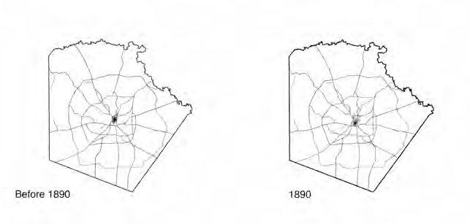
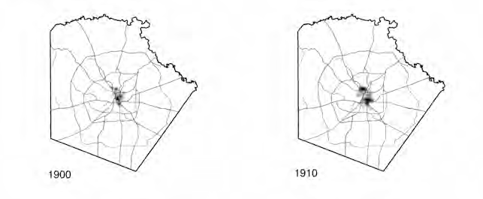
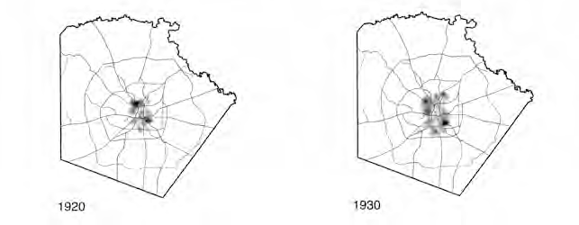
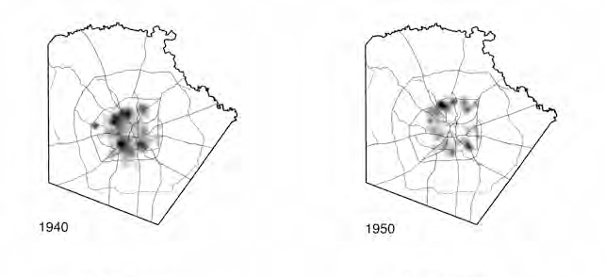
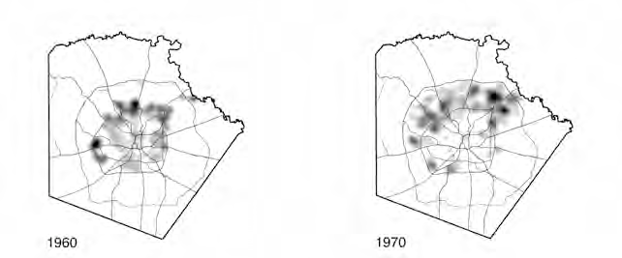
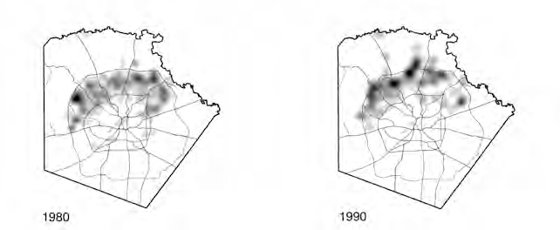
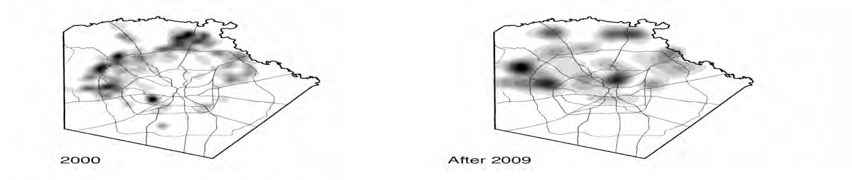
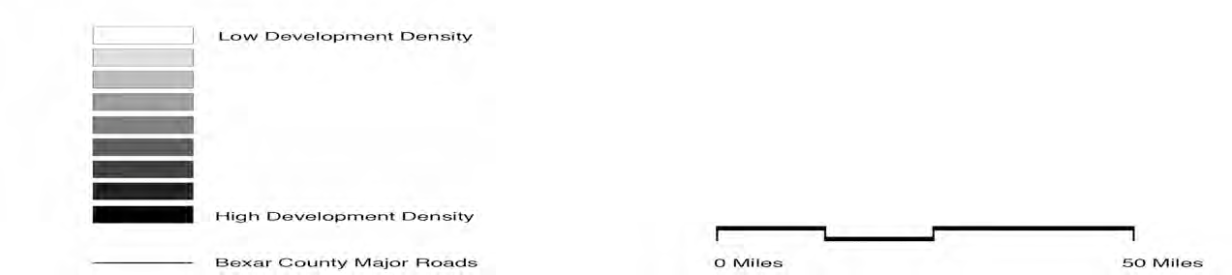
Figure 2. Kernel Density Analysis for Construction in Bexar County 1890-2010

Slide 14
Question 2
Has the location of suburban growth shifted within Bexar County?
Patterns of centrifugal expansion began to accelerate dramatically in 2000.
Method
Examine construction permits by year built and distance from center
Precedent Blumenfeld (1954) Hart (1991) and Pond Yeates (1993, 1994)
Gober and Burns (2002)

Slide 15
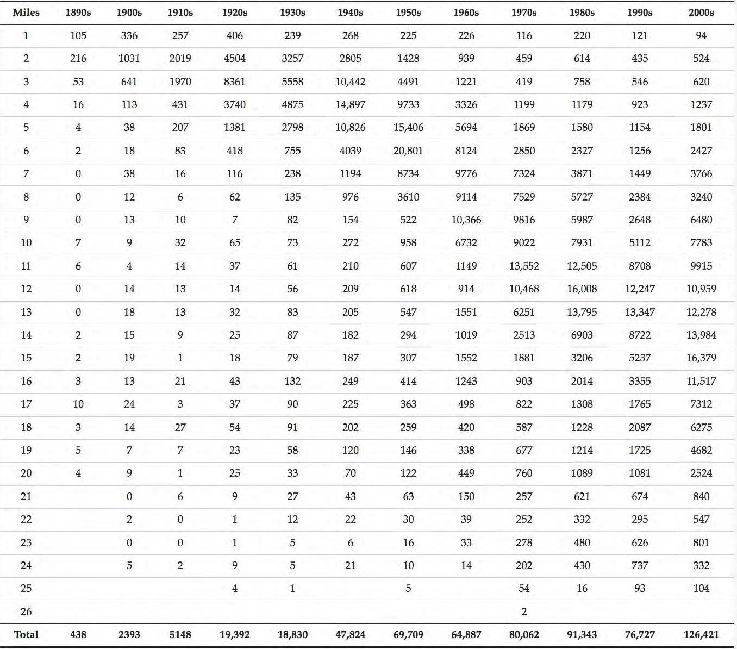
Table 2. Number of Construction Completions by Distance from Center in Bexar County 1890-2009

Slide 16
25
24
23
22
21
1950s
20
19
18
17
1980s
2000s
16
15
Number of Construction Completions (K)
14
13
12
11
10
9
8
7
6
5
4
3
2
1
0
1970s
1990s
1960s
0 1 2 3 4 5 6 7 8 9
Distance from Center (Miles)
10 11 12 13
14 15 16
17 18 19 20 21 22 23 24 25
Figure 3. Number of Construction Completions by Distance from Center in Bexar County 1950-2009

Slide 17
25
24
23
22
21
1950s
20
19
18
17
1980s
2000s
16
15
Number of Construction Completions (K)
14
13
12
11
10
9
8
7
6
5
4
3
2
1
0
1970s
1990s
1960s
0 1 2 3 4 5 6 7 8 9
Distance from Center (Miles)
10 11 12 13
14 15 16
17 18 19 20 21 22 23 24 25
Figure 3. Number of Construction Completions by Distance from Center in Bexar County 1950-2009

Slide 18
Question 3
Has the type of suburban growth shifted within Bexar County?
The relative import of multifamily completions increased in five of last six decades.
Method
Examine location and quantity of single- and multi-family housing types
Precedent
Atkinson-Palombo (2010)

Slide 19
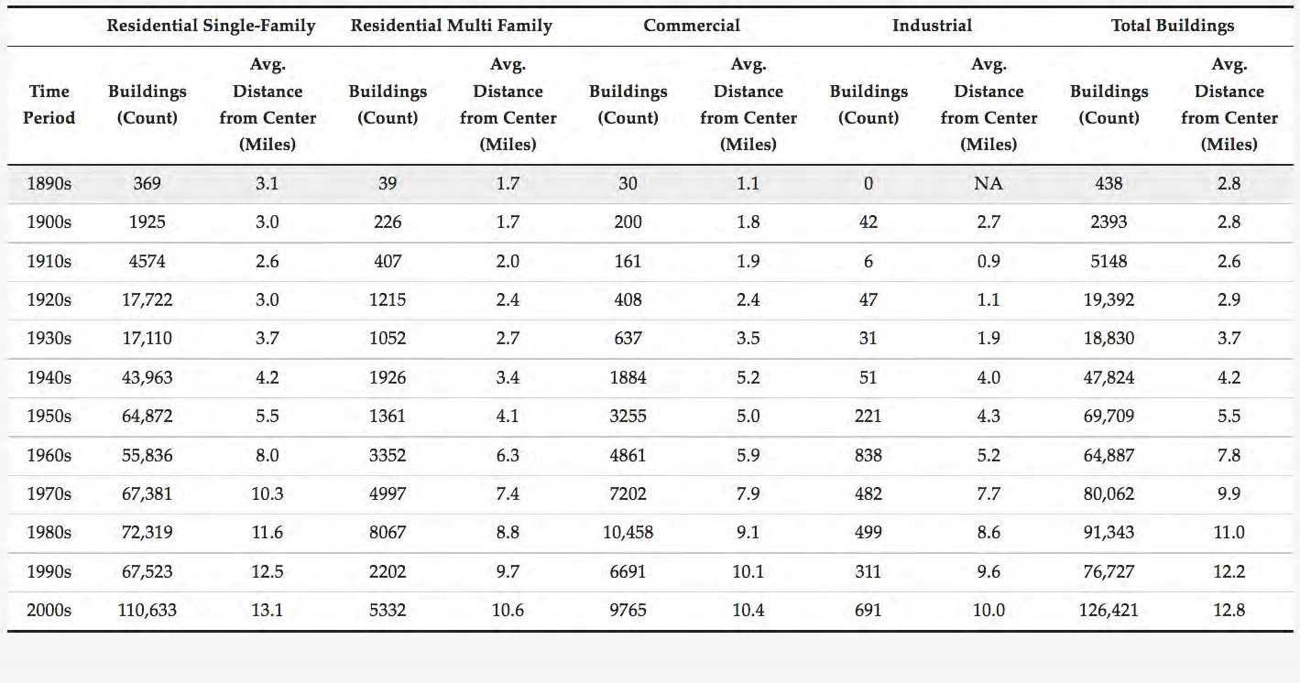
Table 3. Average Distance from the City Center of
Single-Family, Multifamily, Commercial and Industrial Construction Completions in Bexar County 1890-2009

Slide 20
2009 - 9.0
Table 4. Average Distance from the City Center of
Single-Family, Multifamily, Commercial and Industrial Construction Completions in Bexar County 1890-present

Slide 21
Decade of Downtown?
Avg Multi-family is 9 miles from downtown Avg Single-Family is 1 miles from downtown
Figure 1. Bexar County 2010
0
25 mi

Slide 22
San Antonio
rapidly expanding rapidly decentralizing
will resist geographic containment increasingly suburban
Figure 1. Bexar County 2010
0
25 mi

