Slide 1
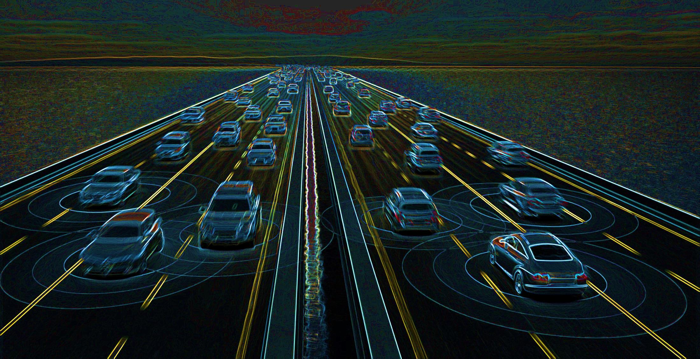
Preparing for the Impacts of Connected and Automated Vehicles:
(non) Driver of Change?
Texas Demographic Conference
May 2017
Tom Williams
Texas A&M Transportation Institute

Slide 2
Today’s Presentation
Technology, Adoption and Change
Planning Goals and CAV Impacts
Broad Issues about CAV Data
Scenario Planning
Conceptual Use Cases

Slide 3
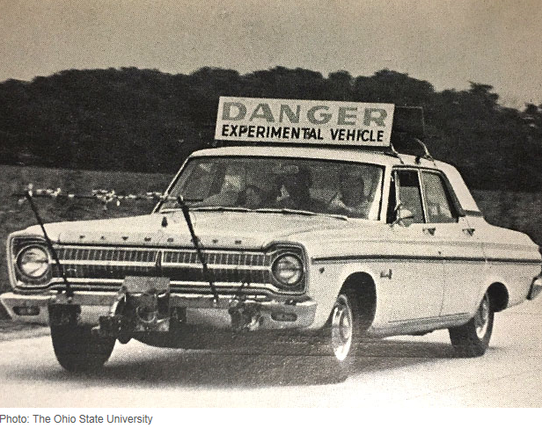
July 1969, IEEE Spectrum
The Electronic Highway, by Robert E. Fenton and Karl W. Olson, Ohio State University
There seems little question that vehicle automation is technologically feasible; however, a tremendous amount of effort in both research and development will be required before a satisfactory automatic system is in operation. This effort must involve not only vehicle-control studies, but also an intensive investigation of the present driver-vehicle complex, since the knowledge gained will be necessary for the proper specification and introduction of the control system components. Further, the need exists for intensive overall system studies so that optimum strategies can be chosen for headway spacing control, merging and lane changing, and the interfacing of automated highways with other modes of future transportation.

Slide 4


Existing Practice
Potential Impacts?

Slide 5
1900 to Today: What’s Different?
Horses → Automobiles → Autonomous Vehicles
We aren’t starting in the mud: we have massive infrastructure ready for use
We don’t have a vast, unlimited landscape to develop
We have the overriding factor of sustainability and climate change
Horses lost jobs; now, people will lose jobs

Slide 6
Polling Probable Usage, 2016
Consumer Technology Association
The CTA questioned 2,001 people and found that 70 percent of them were ready to test-drive an autonomous car and almost as many were interested in replacing the car they own, lease or rent with a vehicle that drives itself.

Slide 7
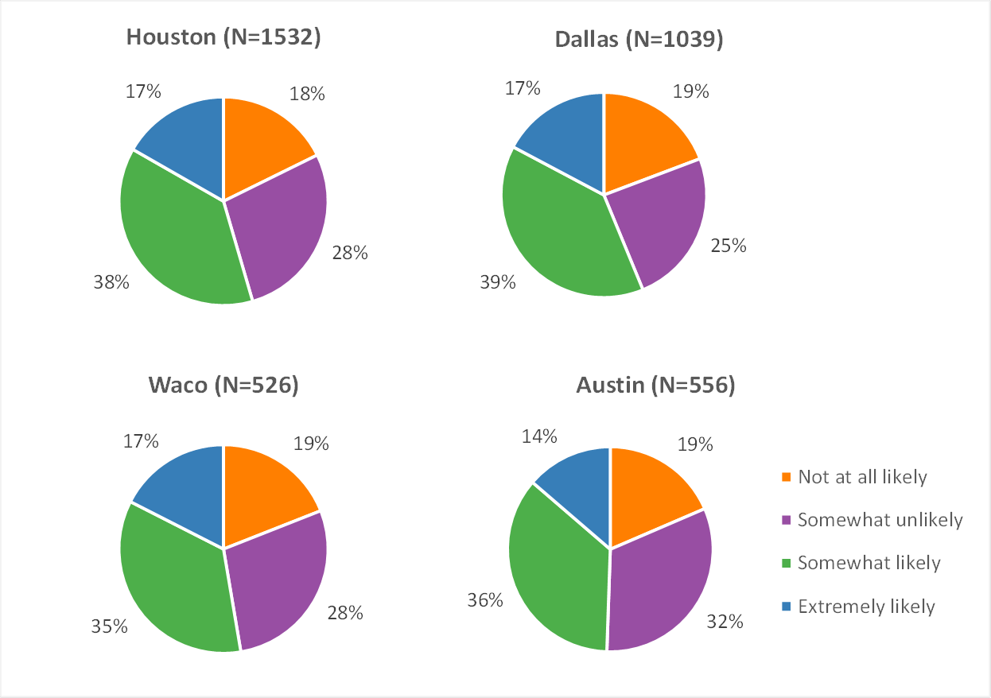
Intent to Use, 2015-2016
TxDOT 0-6848, 2016

Slide 8
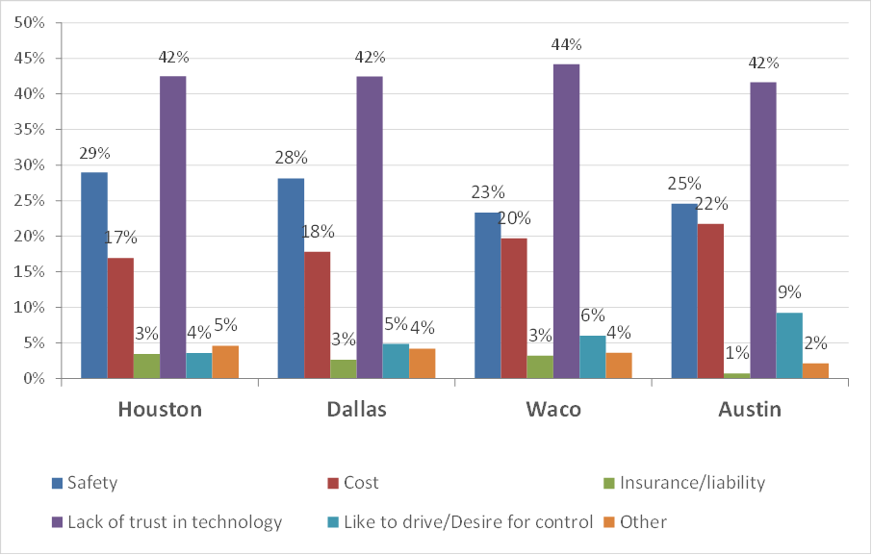
Reasons for NOT Intending to Use, 2015-2016
TxDOT 0-6848, 2016

Slide 9
Question
What autonomous vehicle has been around for >100 years, is used by millions every day around the world, and has an impeccable safety record?
Notes:
Crystal Palace Exhibition, New York, 1854, Elisha Graves Otis

Slide 10
AV/CV Technology is Likely to…
Dramatically Improve Safety
Enhance Capacity
Allow Greater Mobility for Traditionally Mobility-limited Persons
Change Vehicle Ownership/Cost Structures
Enhance System Management, including Congestion Pricing
Reduce Parking Requirements
….Potentially Transformative Changes

Slide 11


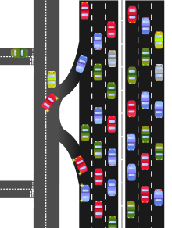
Automated Personal Mobility
Smart Traveler
Smart Vehicles
Smart Infrastructure
Happening Now
Prototyping
Prototyping

Slide 12
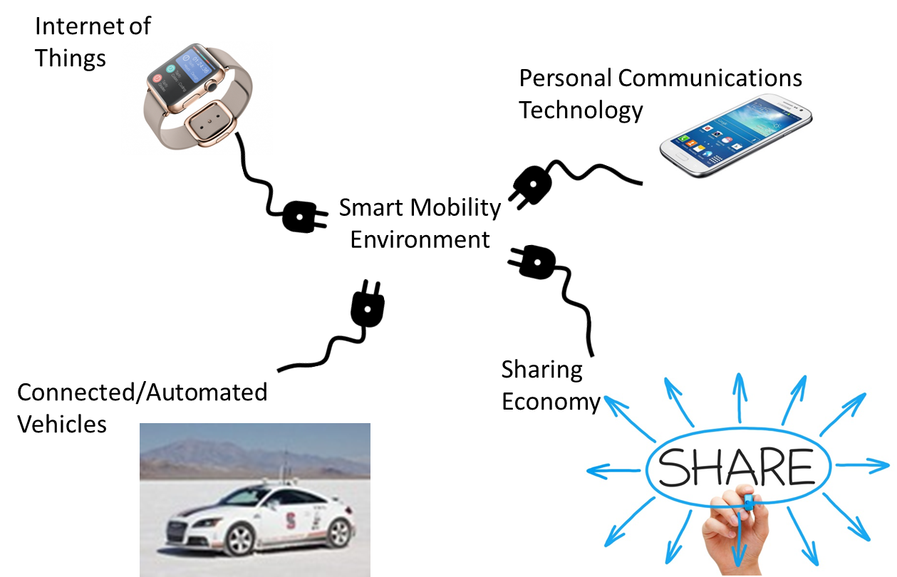
Automated Personal Mobility Environment

Slide 13
Automated Mobility Environment
Technologies… | Change Behavior/Environment… | With these potential Outcomes
Autonomous Vehicles Connected Vehicles Mobile Workplace Mobile Social Activity Mobile Shopping Shared Cars Shared Rides Shared Bikes Shared Desks/Offices Automated Home/Office Delivery Automated Freight Planning Autonomous/Connected Trucks Automated Container Transport Automated Road/Network Pricing Electrification Alternative Fuels Transit System Automation Multimodal Tour/Trip Planning Automation Automated Parking | Personal Safety Non-recurring Congestion Hazardous/oversize materials transport Freight Security Personal Security Expanded Mobile Population Dynamic Workplace Choice Retail Shopping Commercial Land Use Parking Land Use Residential Location Choice Automated Vehicle Regulation Vehicle Ownership Crash Liability Departure Time Choice Route Speed Choice Expanded Tech Sector Economy Fewer On-road Vehicles Less Vehicle Idle Time Empty Office Space | Reduced Congestion Improved Quality of Life Improved Public Health Increased Personal Leisure Time Lower Cost of Mobility Increased Access to Services (from Home/Business) Increase Service Provision (to Home/Business) Improved Air/Water Quality Lower Greenhouse Gas Emissions Improved use of Existing Infrastructure Lower Public Expense on new Infrastructure Lower Cost of Goods Lower Cost of Raw Materials Route Based Speed Harmonization Improved Worker Productivity Reduced Commute Times Reduced need for New Office Space Repurposed Land use (parking) Repurposed Roadway Space

Slide 14

List of Shared Things
Buses, trains, airplanes, elevators, escalators, taxis, shuttles, grocery stores, offices, streets, restaurants, water, electricity, land, bicycles, sidewalks, movies, tools, donuts…
We are a cooperative species…

Slide 15
Some Terms…
Automated vs. Autonomous
Connected
Shared Autonomous Vehicle (SAV)
Zero Occupant Vehicle (ZOV) – Driverless
Highly Automated Vehicle (HAV)

Slide 16
Time in Cars
American Time Use Survey, 2015: 1.13 hours per person spent in travel related to activities during the day
Cars sit 95.3% of the day IDLE in a parking space
412 hours per year in our cars
42 hours “wasted” in congestion

Slide 17
Work and Employment
Level of employment: AV/CV is perhaps the most impactful of the “coming of the robots”
Taxi, TNC drivers
Truck drivers
Delivery
History shows – always a replacement
  Automated systems managers?
  But, who gets left behind?

Slide 18
Work and Employment
Work patterns
  8 to 5, “commuting” home to work goes away?
Lowering disutility of travel – removing the driving task
Will it matter where or when work is done?
  Dynamic Workplace becomes prevalent?

Slide 19
Trip and Delivery Patterns
Today, 9.6 Daily Person Trips per Household
15% work, 53% non-work, 32% non-home based
Automation – Delivery Vehicles come to you
  Economics of drivers vs. technology vs. brick & mortar stores
2016, Expenditures on Retail Food exceeded Grocery Stores for 1st time
  “InstaCart” and Prepared Meals are popularizing

Slide 20
Fuel
The economics of running a Fleet of Shared Autonomous Vehicles (SAVs)
  Leading to Widespread Electrification
Fuel Delivery changes from Rail/Trucking to Wire
  Significant supply chain impacts
Land use for Refueling?

Slide 21
Parking and CAV Effects
Land space in core of cities: doubled?
Could be more dense if built vertically
Could be used for open space
  “Heat Island” effect
If built:
  Re-Orientation of work commuting
  Adjustment to cost of land -> residential location choice

Slide 22
Parking Impacts
Several Changes, Depending on Auto Ownership Trends
Searching for Parking
Revenue Impacts to Cities
Reduced Land needed for Parking (Huge!)
Zero Occupant Vehicles (ZOVs) – added Vehicle Miles of Travel?

Slide 23
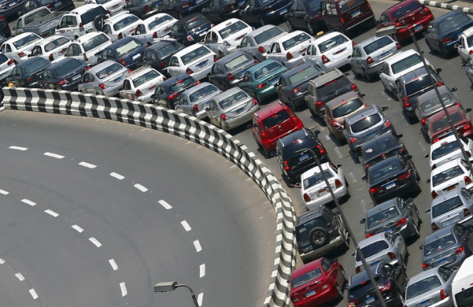
Parking: A Land Gobble
Studies Show up to 60% of Vehicles in CBD searching for parking
Between 2 and 6 Spaces per Vehicle
Land Required for Parking? 10% - 50%?
Much Variability in Data and Research Study Results

Slide 24
Residential Location Choice?
As disutility to travel declines…
  Will we live further out, since the commute is “easier”?
  Will land prices drop, from conversion of parking land uses (increasing inner-city land supply?)
    Prompting an already trending urban residential growth

Slide 25
Adding to Vehicle Miles of Travel?
Age 12-16 cohort
Age 75+ cohort
Mobility-limited Persons
Shift from Shared Ride/Transit to SAV
Transportation Equity – will automation bring a leveling of accessibility to healthcare, jobs, goods, food, and services?

Slide 26
Perhaps the least discussed issue…
CAV brings about a fundamental change: Moving “route plans” and “activity plans” from our heads to a common-access system
The conglomeration of infrastructure, vehicles, and activity needs can be coordinated
…IF we choose to do it…

Slide 27
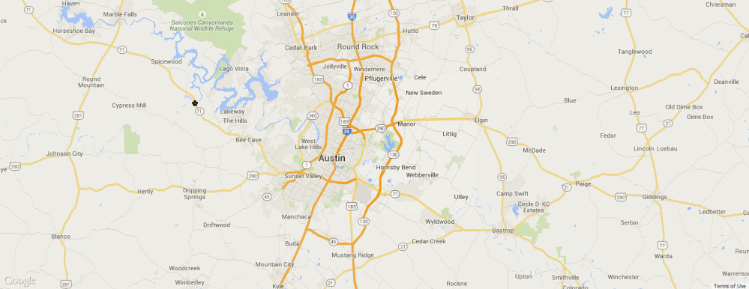
CAV Route Plans - > Coordinated Arrivals
METROPIA – Incentive based App
Can we solve congestion through automated-coordinated travel?
Ye-Tian@metropia.com

Slide 28
Making decisions based on past certainty when faced with knowledge of an uncertain future is folly.

Slide 29
Contact
Tom Williams
Research Scientist, TTI-Austin
512-407-1124
t-williams@tti.tamu.edu

