Slide 1
State Services & Supports for Aging in Texas
Texas Demographics Conference
May 26, 2017

Slide 2
Agenda
Overview of Health and Human Services
Demographics of Texans age 60 or older
Panel discussion on state services for older adults
1

Slide 3
Texas Health and Human Services
Mission
Improving the health, safety and well-being of Texans with good stewardship of public resources.
Vision
Making a difference in the lives of the people we serve.
https://hhs.texas.gov/
By Phone, Call 211

Slide 4
Texas Health and Human Services
State Agencies
Texas Health and Human Services Commission (HHSC)
Texas Department of Aging and Disability Services (DADS)
Texas Department of Family and Protective Services (DFPS)
Texas Department of State Health Services (DSHS)
1

Slide 5
Texas Health and Human Services
Protection and Assistance to Victims of Abuse and Neglect and Family Violence
Disaster Assistance
Public Health and Safety, Including Disease Prevention and Disease/Epidemic Surveillance
Care and Information Support for People Age 60 or Older
Acute Health Care for Low Income Children and Parents; Pregnant Women; the Aged and/or Disabled (Medicaid, CHIP Programs)
Long-Term Care for the Low-Income Aged and/or Disabled (Medicaid and Other Programs)

Slide 6
Texas Health and Human Services
Food and Nutrition Assistance for Low-Income Households (SNAP Program)
Financial Assistance to Low-Income Families With Dependent Children (TANF Program)
Women's Health Services for Low-Income Women of Reproductive Age (Texas Healthy Women Program)
Food and Nutrition Assistance for Women, Infants, and Children (WIC Program)
Early Childhood Intervention for Children With Developmental Delay (ECI Program)
Comprehensive Rehabilitation for People with Traumatic Brain and Spinal Cord Injuries

Slide 7
Texas Health and Human Services
Promoting and Improving Access and Independence for the Blind and Visually Impaired and for the Deaf and Hard of Hearing
Services for People Overcoming Mental Health and Substance Abuse Problems
Services for People With Mental Retardation
Regulation and Facility Licensing (Day Care Centers; Nursing Homes; Hospitals; Health Facilities and Laboratories)
Administration of Vital Records
Collection and Dissemination of Health and Vital Statistics

Slide 8
Thank You!
Edli E. Colberg, Demographer
Center for Analytics and Decision Support
(512) 428-1936
edli.colberg@hhsc.state.tx.us

Slide 9
Demographics of Texans Age 60 or Older
Liliana Santoyo, MA
Center for Analytics and Decision Support
Policy and Performance Division

Slide 10
Texas Demographics
Highlights
In 2016, Texas was 2nd most populous state
Between 2010 and 2016 Texas ranked first in total population growth
Natural increase accounted for 49% of the growth while net migration accounted for 51%
63% of net migration was domestic; 37% was international
Texas Demographic Center projects the State’s total population could reach 30.5 million in 2020 and 54.4 million in 2050

Slide 11
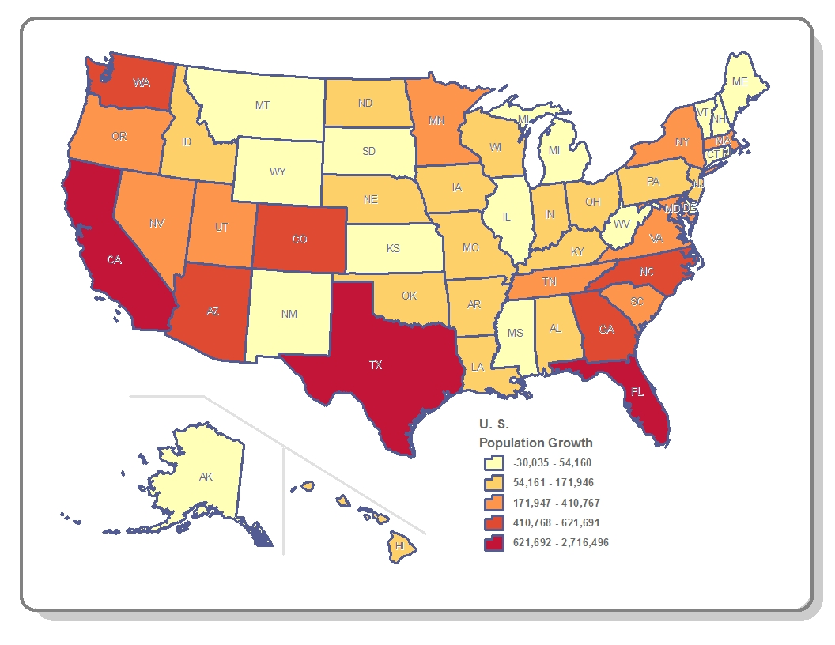
Population Growth By State, 2010-2016
Data Source: U.S. Census Bureau.
Map prepared by Center for Analytics and Decision Support
May 18, 2017

Slide 12
Population Age 60 or Older
Projected Growth
5 Million in 2017, representing 18% of total population
7.7 Million in 2030, representing 21% of total population
12.1 Million in 2050, representing 22% of total population

Slide 13
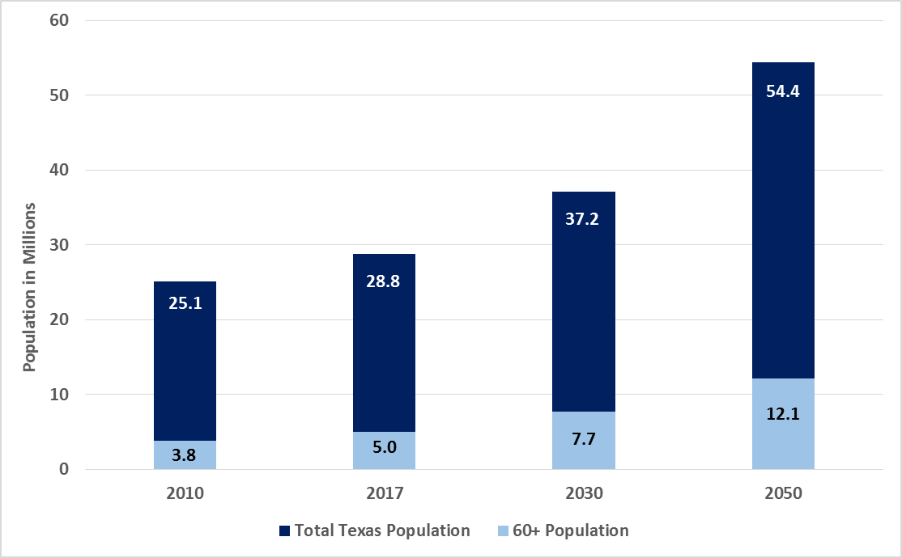
Total Texas Population and Population Age 60 or Older
Data Source: Population Projections 2010-2050. Texas Demographic Center.
Prepared by Center for Analytics and Decision Support
May 18, 2017

Slide 14
Population Age 60 or Older
Impact of Baby Boomers
Baby boomers were born between 1946-1964
Boomer population is projected at 5.6 million in 2017
The oldest boomer turns 71 and the youngest turns 53 in 2017
Adults ages 75-84 are projected to represent 20% of the age 60 or older population in 2017. This percent is projected to increase to 26% in 2030
The percent of people age 60 or older that are age 85 or older is projected to increase from 7% in 2017 to 13% in 2050

Slide 15
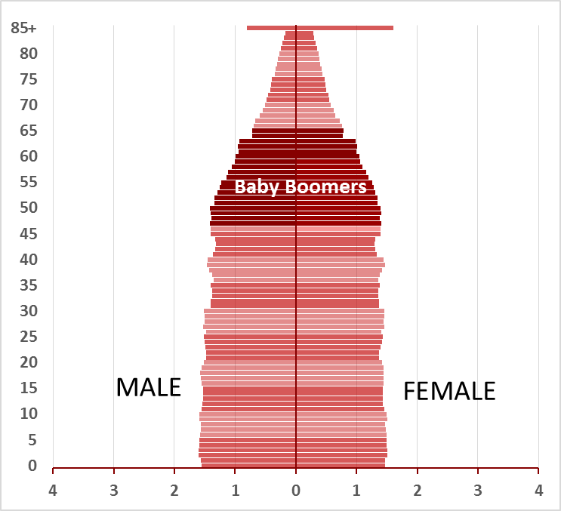
Changes in Texas Population by Age and Sex, 2000
Data Source: Population Projections 2010-2050. Texas Demographic Center.
Prepared by Center for Analytics and Decision Support
May 18, 2017

Slide 16
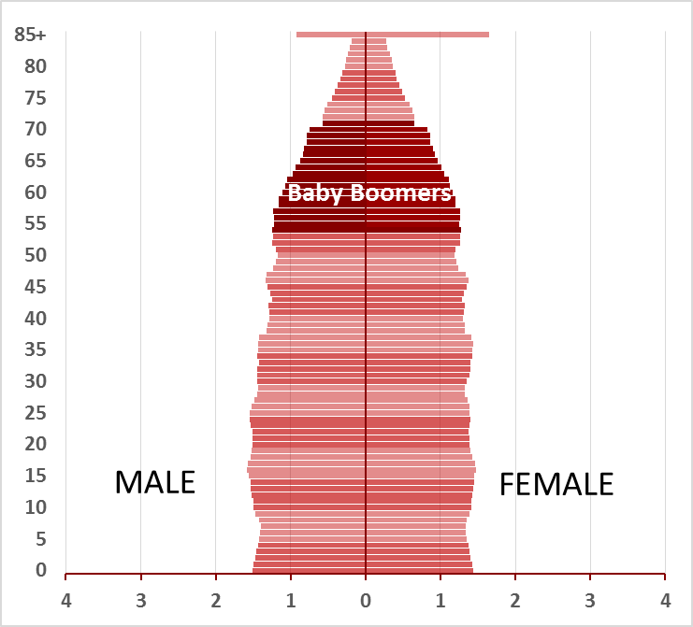
Changes in Texas Population by Age and Sex, 2017
Data Source: Population Projections 2010-2050. Texas Demographic Center.
Prepared by Center for Analytics and Decision Support
May 18, 2017

Slide 17
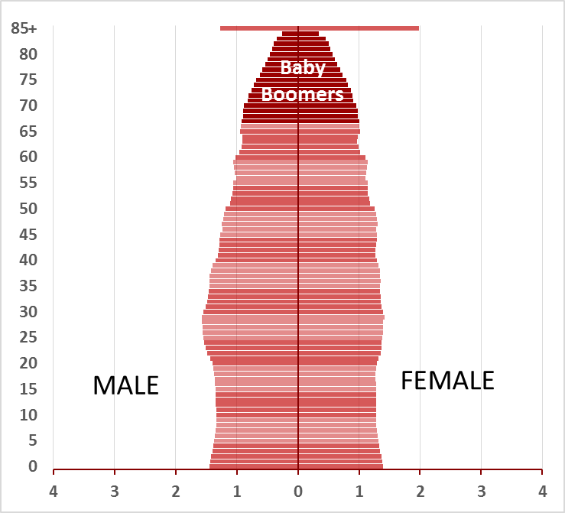
Changes in Texas Population by Age and Sex, 2030
Data Source: Population Projections 2010-2050. Texas Demographic Center.
Prepared by Center for Analytics and Decision Support
May 18, 2017

Slide 18
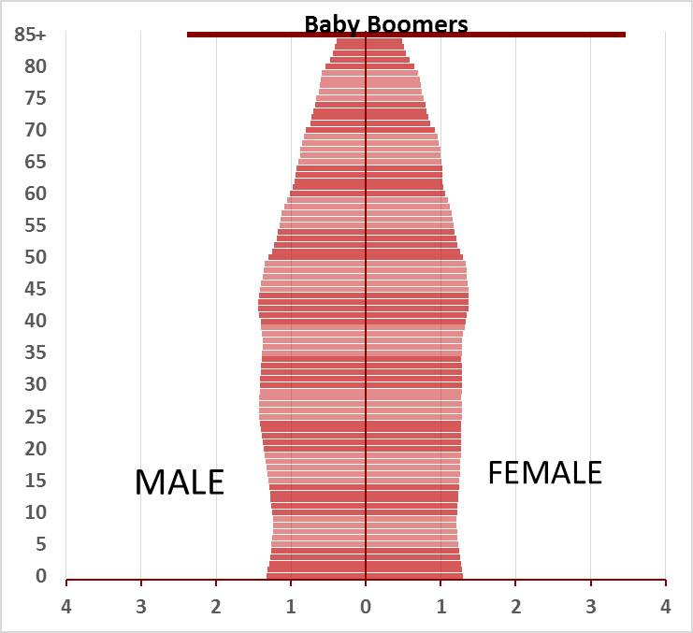
Changes in Texas Population by Age and Sex, 2050
Data Source: Population Projections 2010-2050. Texas Demographic Center.
Prepared by Center for Analytics and Decision Support
May 18, 2017

Slide 19
Population Age 60 or Older
Changes in Race/Ethnic Composition
In 2017, 61% are White Non-Hispanic, compared to 41% for the population as a whole
By 2050, 34% will be White Non-Hispanic
The percent that is Hispanic is projected to increase from 24% in 2017 to 43% in 2050

Slide 20
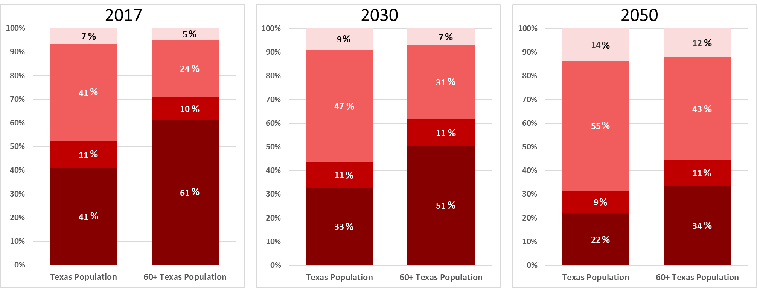
Total Texas Population and Population Age 60 or Older
Data Source: Population Projections 2010-2050. Texas Demographic Center.
Prepared by Center for Analytics and Decision Support
May 18, 2017

Slide 21
Population Age 60 or Older
Disability
The prevalence of chronic disease and disability increases with age
In 2015, 12% of all Texans lived with a disability
In the same year, 35% of persons age 60 or older lived with a disability

Slide 22
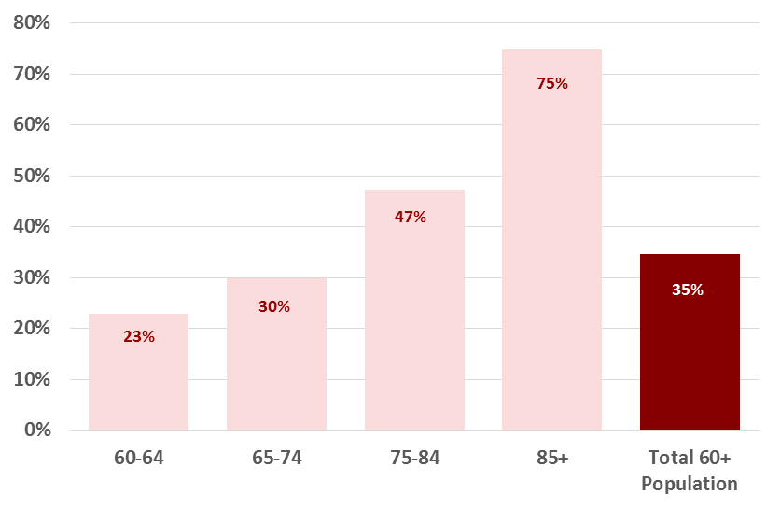
Percent Living With a Disability: Age 60 or Older, By Age Group, 2015
Data Source: 2015 American Community Survey. U.S. Census Bureau
Prepared by Center for Analytics and Decision Support
May 18, 2017

Slide 23
Population Age 60 or Older
Socioeconomics
Approximately 481,000 (10%) lived below the Federal Poverty Level (FPL) in 2015
Poverty rate for older females was higher than for older males (32% compared to 26%)
Poverty rate among minorities was higher than among Non-Hispanic Whites (17% compared to 6%)
Social security was the most frequently cited source of income in 2015

Slide 24
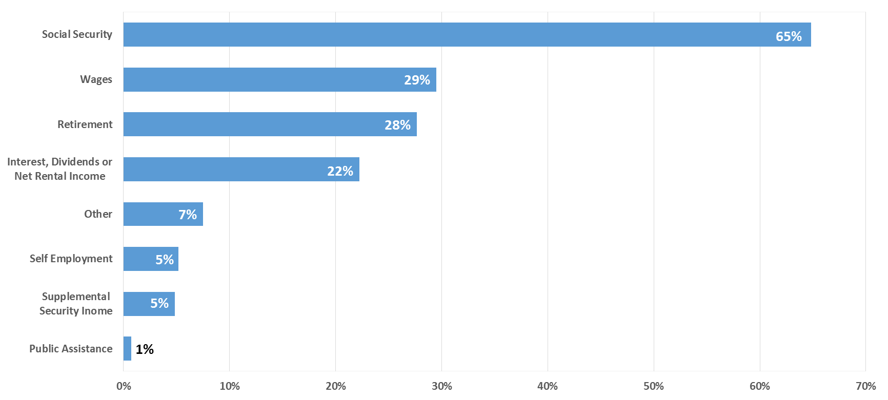
Sources of Income Reported by Adults Age 60 or Older, 2015
Data Source: 2015 American Community Survey. U.S. Census Bureau
Prepared by Center for Analytics and Decision Support
May 18, 2017

Slide 25
Population Age 60 or Older
Socioeconomics
Approximately 14% were enrolled in Medicaid
Female Medicaid enrollees outnumbered male enrollees
Approximately 22% of those living at home lived alone, the majority of them were female
Approximately 5% of grandparents age 60 or older lived with their grandchildren. Of these, 40% had primary responsibility for the grandchildren

Slide 26
Population Age 60 or Older
Employment and Old-Age Dependency Ratio
In 2015, about 29% of persons 60 or older are employed
56% are age 60-64
Old-age dependency ratio measures the number of older adults (those 65 or older) as a share of those of working age (age 15-64)
In 2017, the projected old-age dependency ratio is 18.4
It is projected that in 2050 the old-age dependency ratio will be 27.8

Slide 27
Population Age 60 and Older
Sex Ratio and Life Expectancy
Life expectancy has increased substantially. A person that reaches age 65 can expect, on average, to live an additional 19 years
In 2017, females outnumber males (2.7 million versus 2.3 million)
The sex ratio for this population in 2017 is 84.8.
Among those age 75-84, the sex ratio is 77.5
Among persons age 85 or older, the sex ratio is 55.6

Slide 28
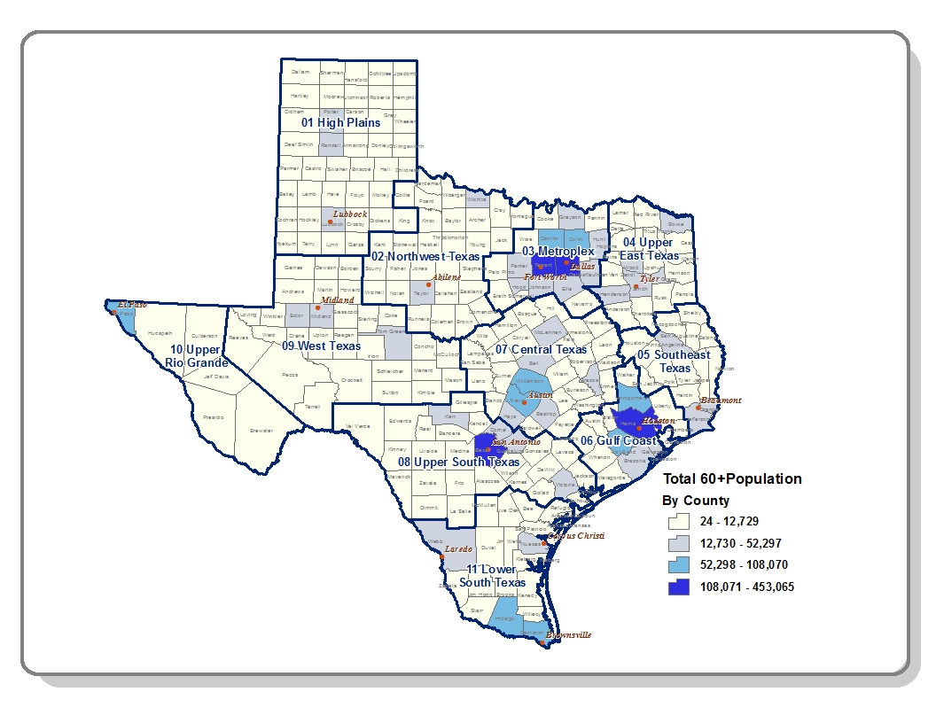
Total Population Age 60 or Older, 2017
Data Source: 2017 Population Projections. Texas Demographic Center.
Map prepared by Center for Analytics and Decision Support
May 18, 2017

Slide 29
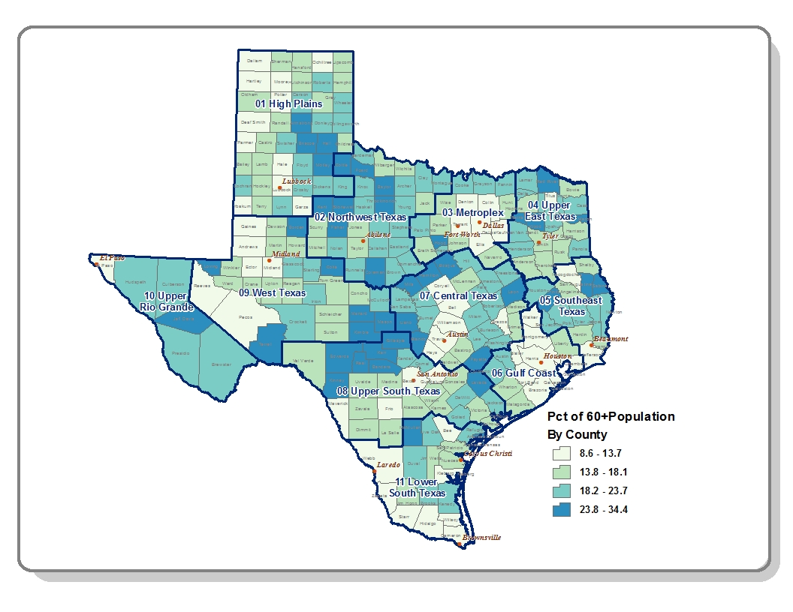
Adults Age 60 or Older as Percent of Total County Population, 2017
Data Source: 2017 Population Projections. Texas Demographic Center.
Map prepared by Center for Analytics and Decision Support
May 18, 2017

Slide 30
Thank You!
Liliana Santoyo, MA, Researcher/Demographer
Center for Analytics and Decision Support
Policy and Performance Division
(512) 424-6588
liliana.santoyo@hhsc.state.tx.us

Slide 31
Panelists
Michael Aguirre
MIPPA Program Manager
HHSC’s Office of the Area Agencies on Aging.
Julian Christian
Curriculum Designer
HHSC’s Community Care Services Eligibility unit.
Cody Rothschild
Age Well Live Well Coordinator
HHSC’s Aging Services Coordination Office.

