Slide 1
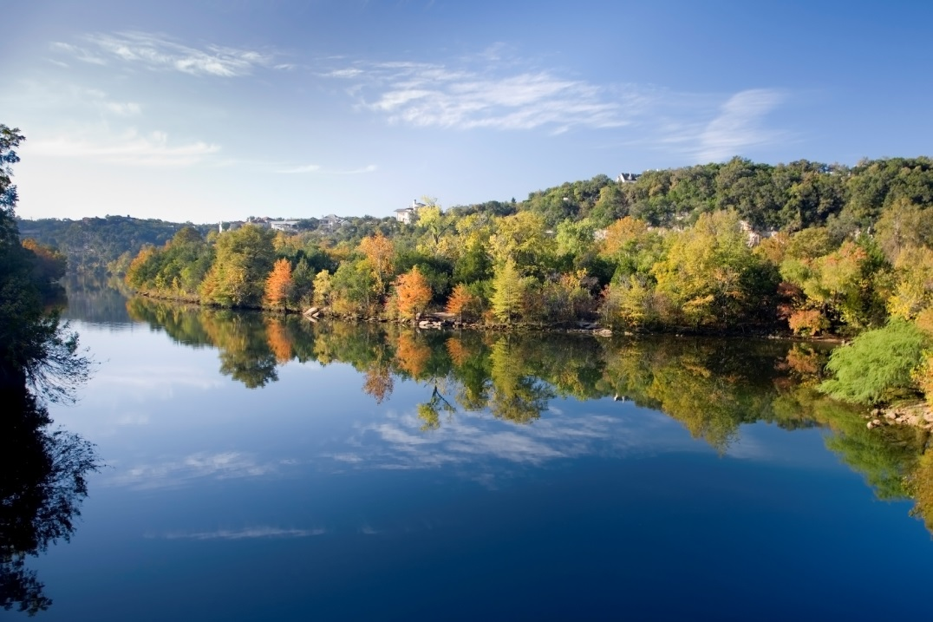

WATER for TEXAS
Water for the Future
Kathleen Jackson, Director

Slide 2
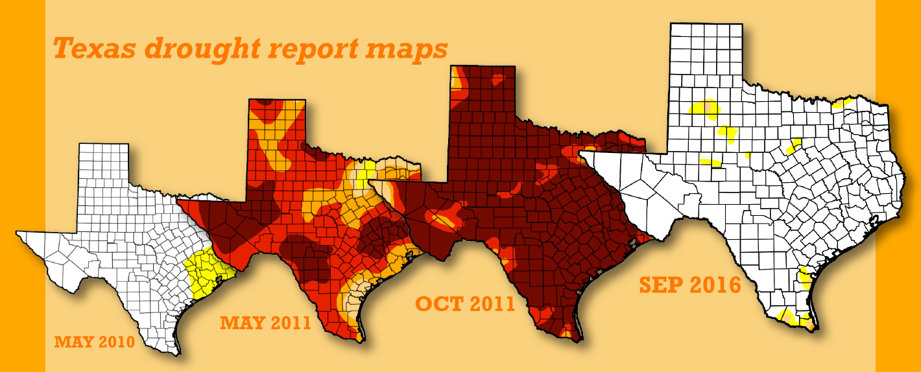
PERCENT TIME IN DROUGHT

Slide 3
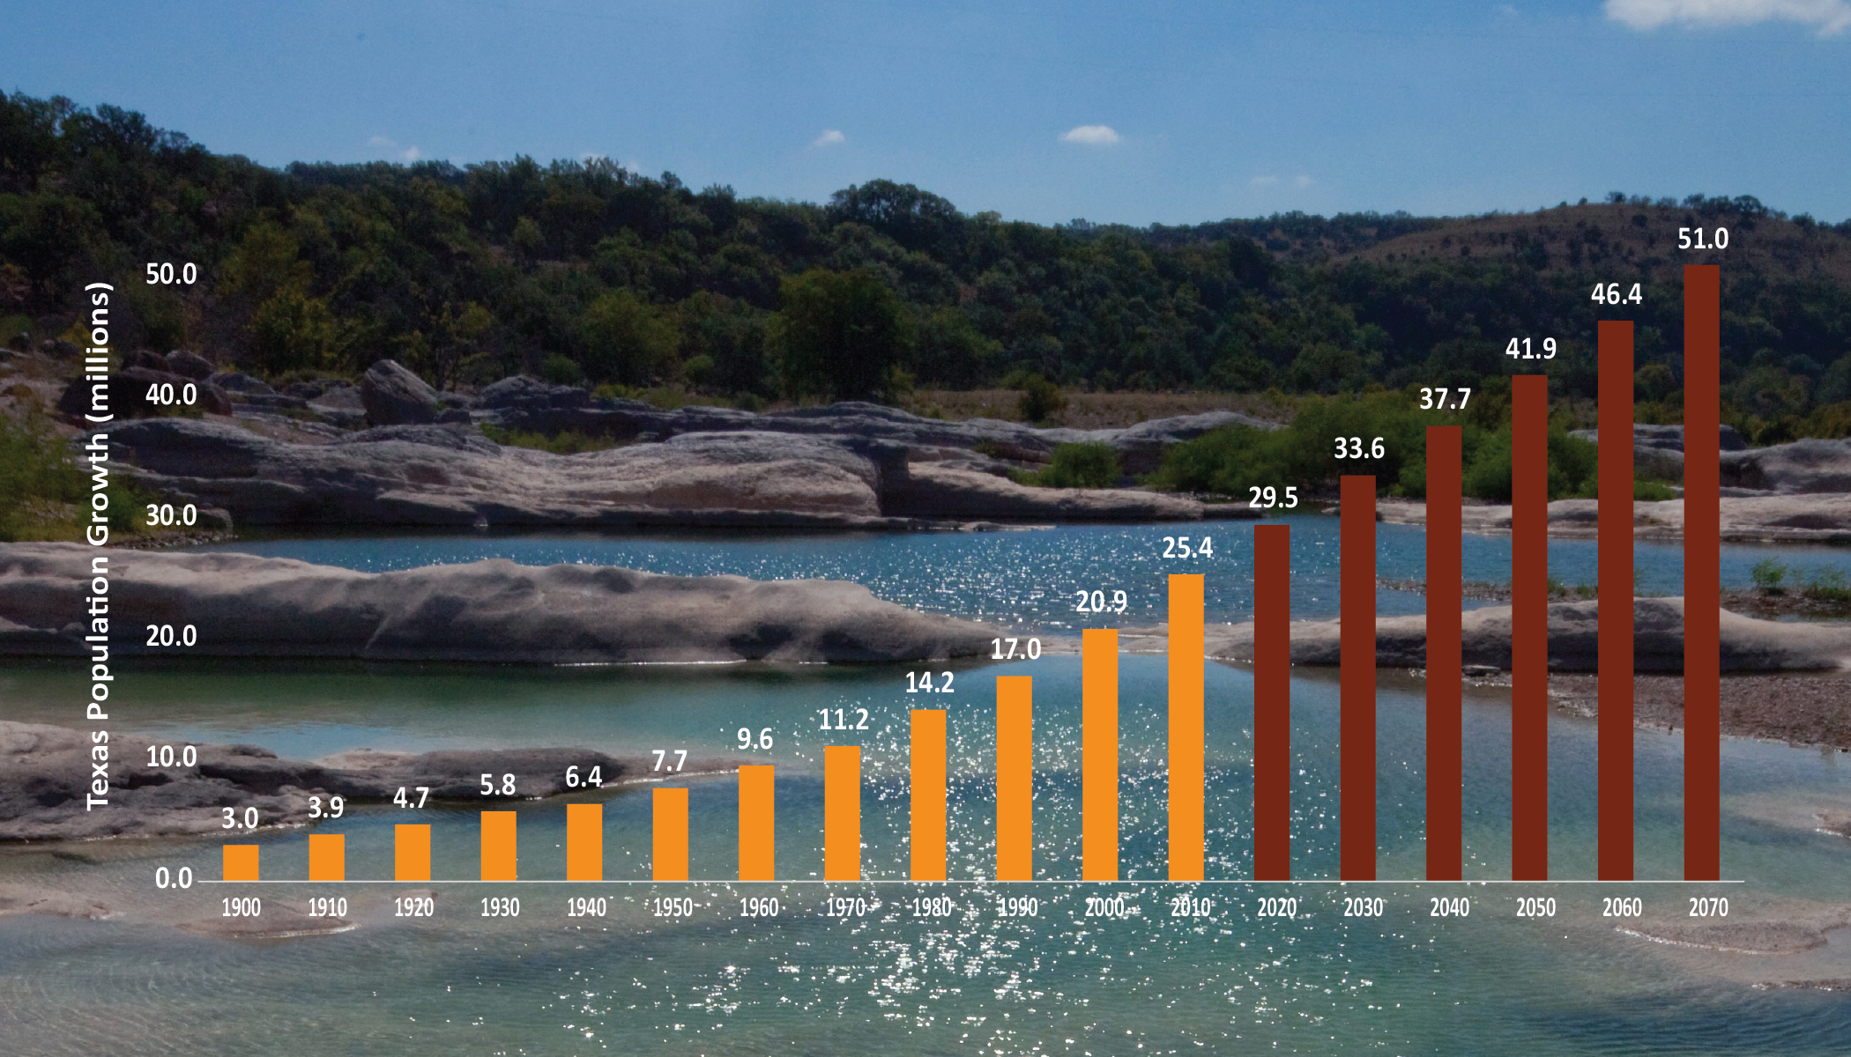
HISTORIC AND PROJECTED TEXAS POPULATION GROWTH
Texas Population (Millions)
Decade

Slide 4
HOW CAN WE RESPOND TO DROUGHT & GROWTH?
Conservation
Reuse
Brackish groundwater desal
Seawater desal
Aquifer storage and recovery
Aquifers
Reservoirs

Slide 5
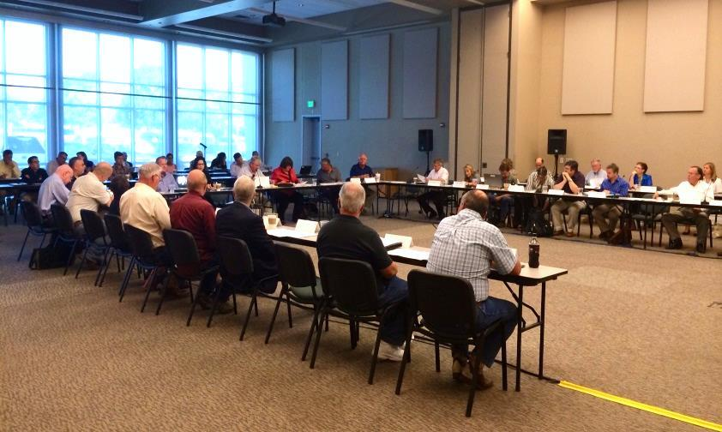
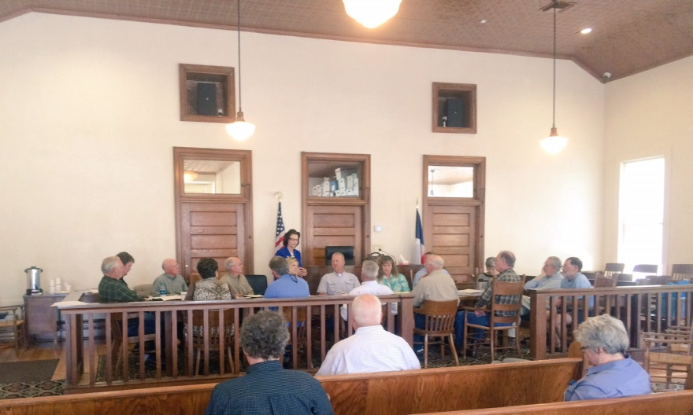
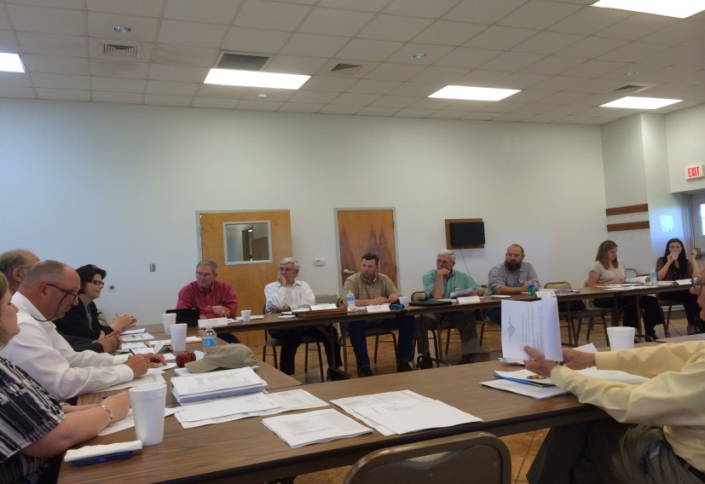
REGIONAL WATER PLANNING GROUPS
Region K
Region J
Local Political Subdivision serves as administrator
Public, consensus-driven
Local/regional decision making process
Region P

Slide 6
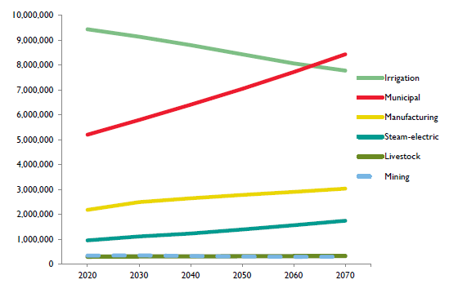
Water Demand Projections
2017 State Water Plan
Notes:
The TWDB projects water demand for municipal and non-municipal sectors of the Texas economy, including manufacturing, mining, steam-electric, livestock, and irrigation. Water demand in all water use categories is projected to increase by 17 percent, from 18.4 million acre-feet in 2020 to 21.6 million acre-feet in 2070 (Figure 5.4).
Steam-electric, municipal, and manufacturing categories show the greatest projected increases in water demand, ranging from approximately 83 percent to 39 percent. Mining is expected to decline, and livestock is expected to grow slightly. While irrigation is the largest water demand category for 2020, it is expected to decrease 18 percent by 2070. Municipal demand is projected to exceed irrigation demand in that decade (Table 5.2, Figure 5.5).

Slide 7
Irrigation Water Use and Demand Projections

Slide 8
Manufacturing Water Use & Demand Projections

Slide 9
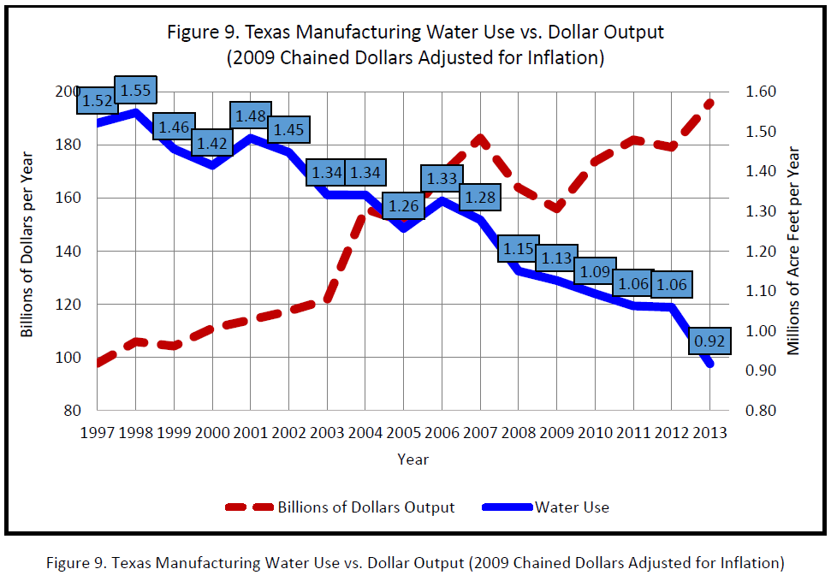
Manufacturing
Notes:
3. Long-term industrial output ≠ water use
In drafting water demand projections constant, we want to emphasize that we are not projecting that Texas manufacturing is not going to continue to grow. It will grow, and if the past is any indication, manufacturing facilities will continue to be more efficient with water.
Bill Hoffman, former Conservation Director at the TWDB, now in private consulting and a member of the WCAC, has a great report posted on the WCAC website regarding manufacturing water use. I pulled this chart from his report as it nicely illustrates the point.
Manufacturing and Electric Power Water Use in Texas by H.W. (Bill) Hoffman
http://www.savetexaswater.org/resources/doc/Hoffman_Manufacturing_2016.pdf

Slide 10
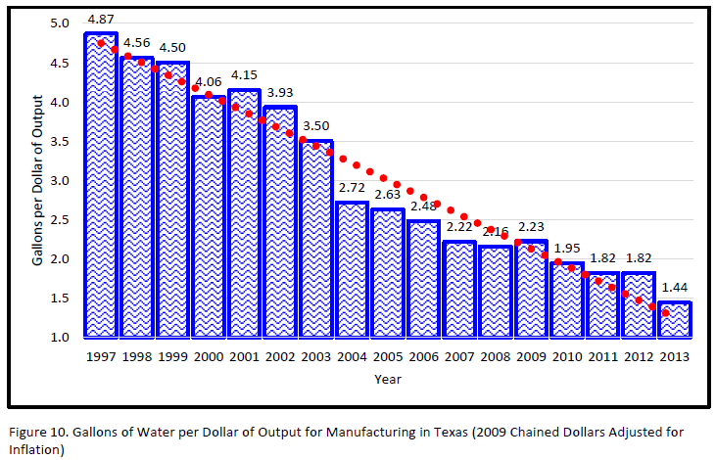
Manufacturing
Long-term assumption of efficiency:
Notes:
Manufacturing and Electric Power Water Use in Texas by H.W. (Bill) Hoffman
http://www.savetexaswater.org/resources/doc/Hoffman_Manufacturing_2016.pdf

Slide 11
Steam-Electric Power Water Use &
Demand Projections

Slide 12
Reuse in Water Use Estimates and
Demand Projections
Irrigation
  2009-2014 average ≈ 8,959,000 acre-feet
Manufacturing
  2009-2014 average ≈ 21,900 acre-feet
Mining
  2014 estimate = 2,835 acre-feet
Steam-Electric Power
  2009-2014 average ≈ 31,000 acre-feet

Slide 13
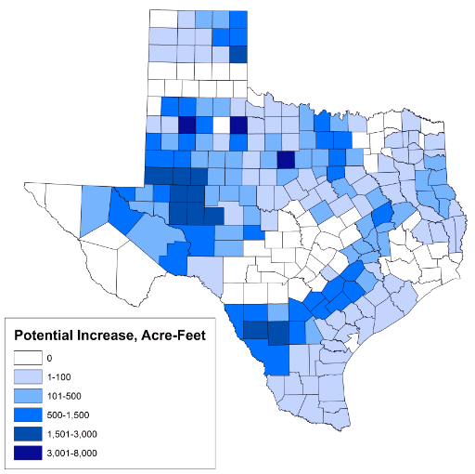
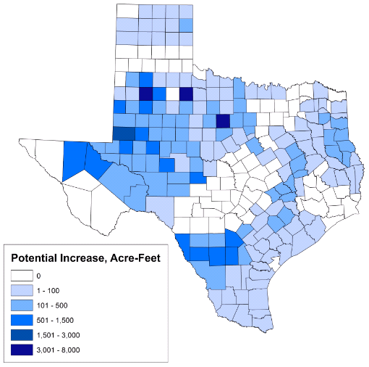
BRACKISH GROUNDWATER
POTENTIAL INCREASE IN MINING DEMANDS
2020
2060
Notes:
Similar to Reuse, brackish GW has gotten a lot of attention as a water source in the future. Because of this staff are recommending that water demand projections incorporate brackish GW.
Of all of the water demand categories, only mining is know to have significant volumes of historical brackish gw use that is not included in the annual water use estimates and water demand projections.
In the 2012, UT-BEG Update Study develop projections of freshwater use in HF and projections for Total Use in HF (including reuse and brackish gw). The projections presented as draft to the RWPGs were the freshwater projections.
2014 Estimate of Brackish GW = 41,700 acre-feet
Potential Statewide Demand Projections Increase due to Reuse & Brackish:
2020 – 86,619 acre-feet
2060 – 41,617 acre-feet

Slide 14
strategies by type in 2070

Slide 15
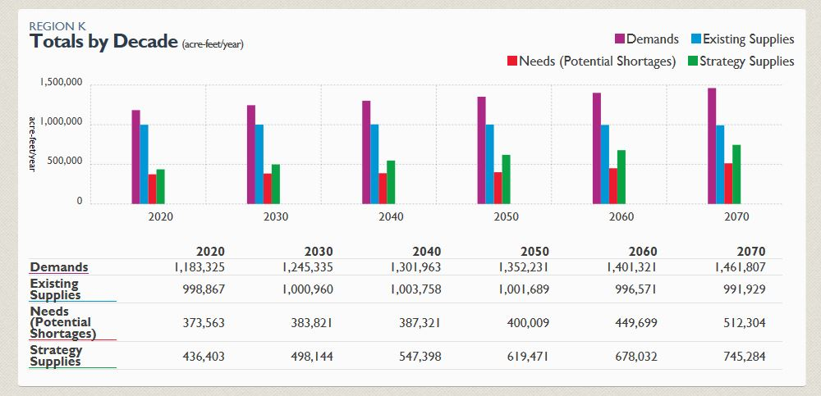
ONLINE 2017 state water plan
http://texasstatewaterplan.org

Slide 16
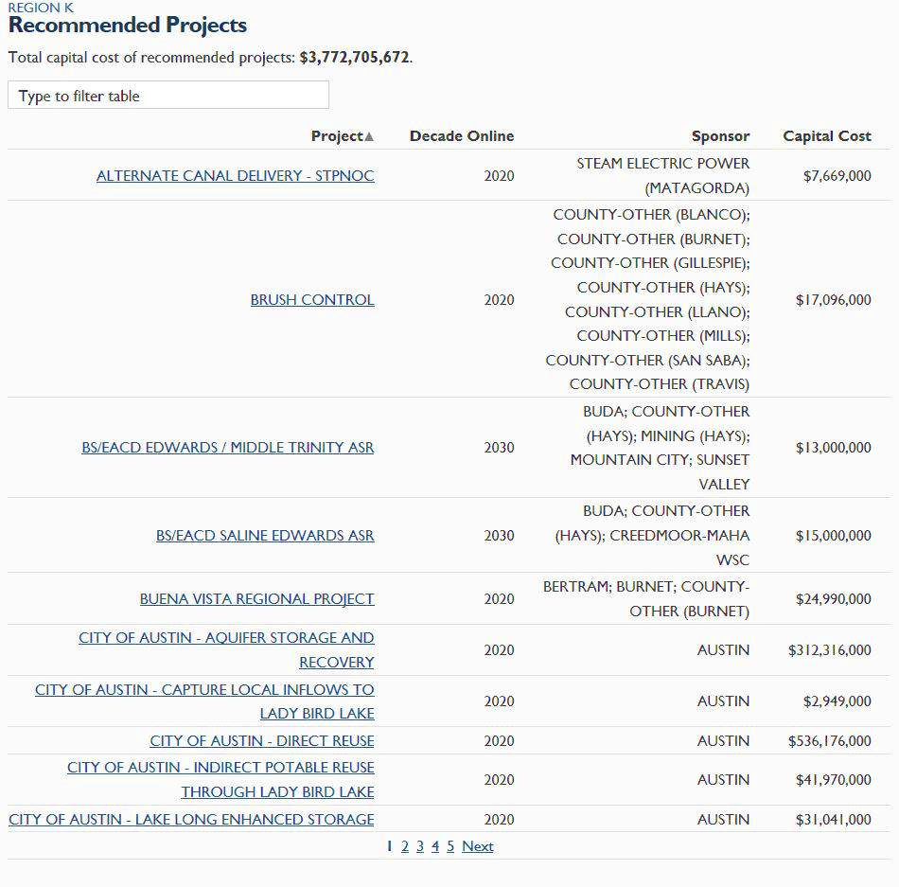
EXAMPLES OF PROJECTS REGION K IDENTIFIED
TO ADDRESS POTENTIAL NEEDS

Slide 17



STRATEGIES, PROJECTS, AND COST OF THE PLAN
5,500 strategies
2,500 projects
Capital cost of $63 billion

Slide 18

PROGRAM YEARS 2015 & 2016
 | 2015 | 2016
Current Financial Assistance | $900 million | $698 million
Estimated Savings | $106 million | $70 million
Total # of Project Sponsors | 20 | 16
SWIRFT Rating (Current SWIRFT revenue bond ratings of AAA/AAA by Fitch and S&P) | AAA/AAA | AAA/AAA
New Multi-Year Commitments | $3.8 billion | $760 million
Total Commitments = $4.5 billion
Total Savings = $175 million
Notes:
TWDB True-Interest-Cost
2015 - 3.63%
2016 - 3.28%
Avg. Cost to Borrowers
2015 - 2.83%
2016 - 2.635%

Slide 19
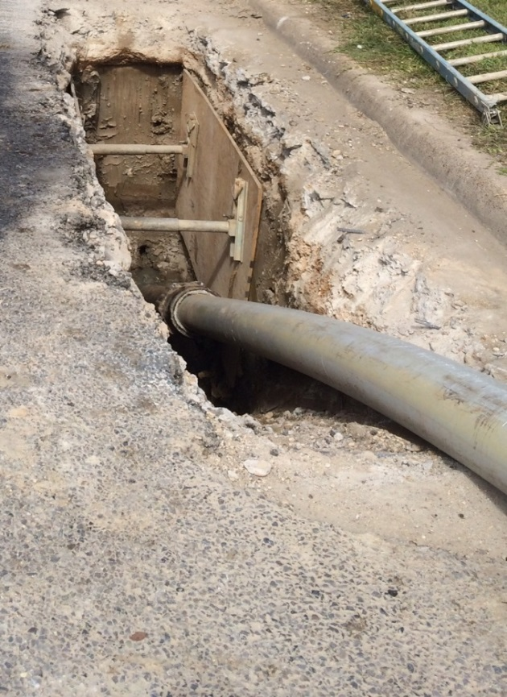
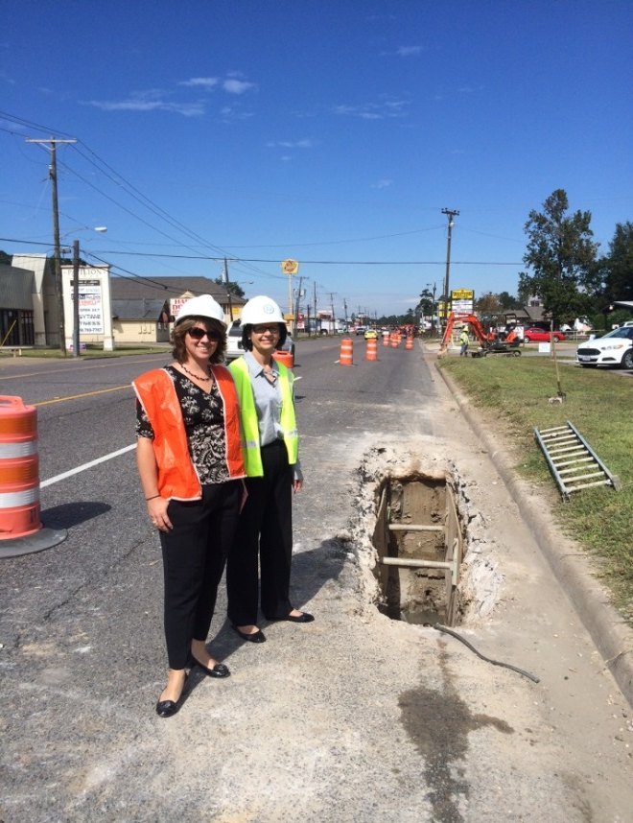
INFRASTRUCTURE REHAB & REPLACEMENT
Have you developed a Capital Improvement Plan (CIP)?
Are you aware of existing infrastructure needs?
Are you replacing infrastructure pro-actively rather than re-actively?

Slide 20
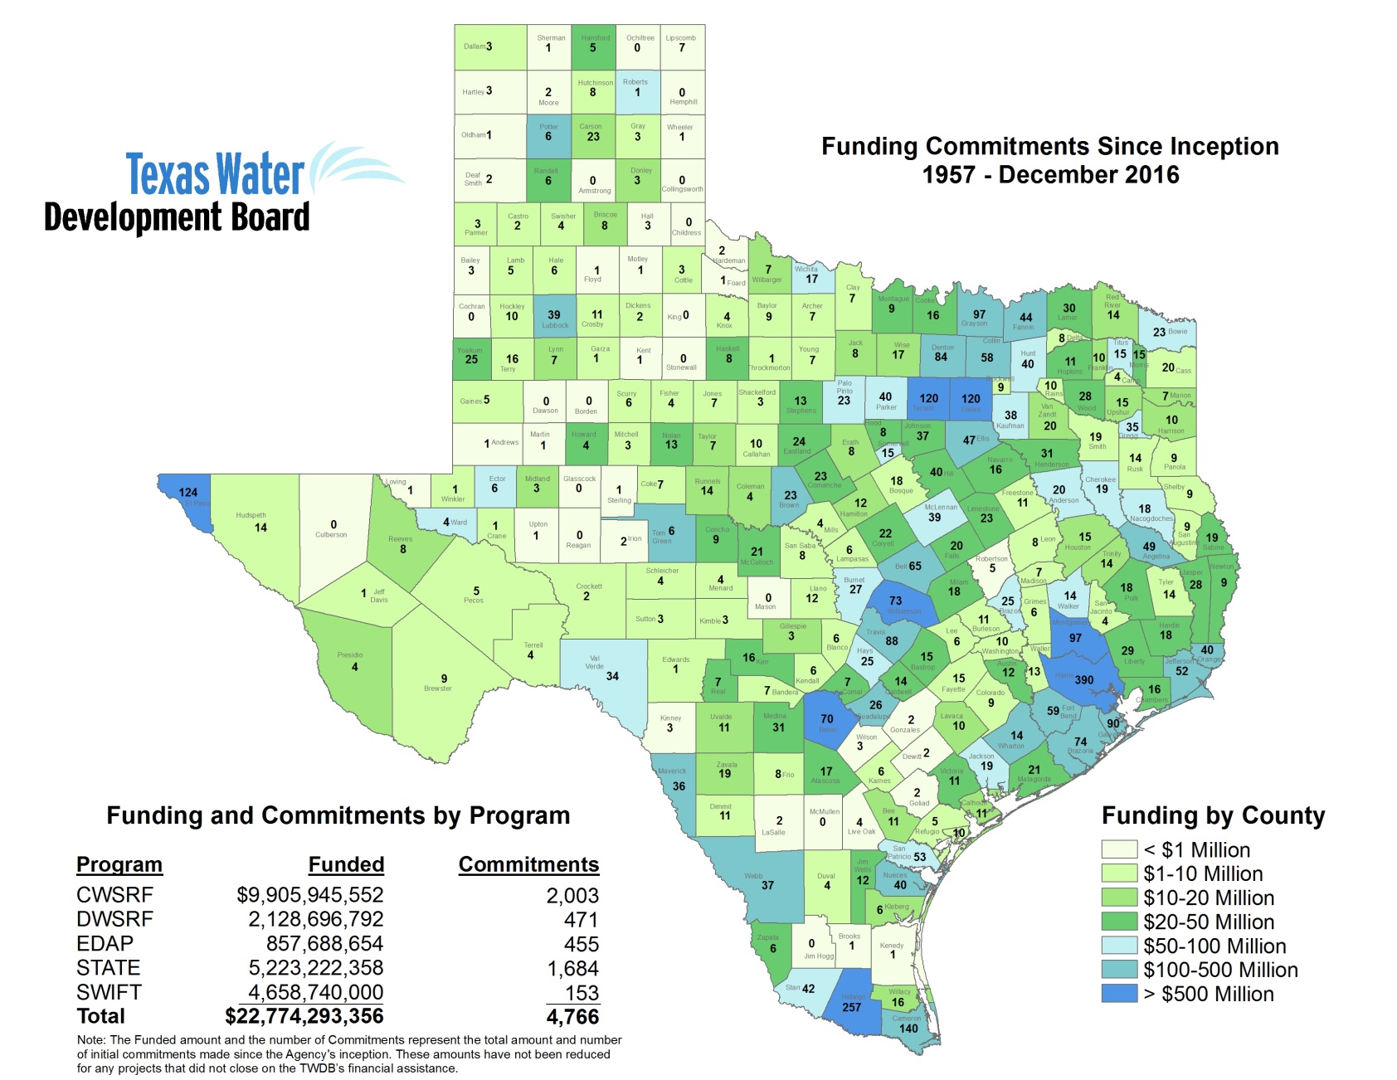

COMMUNITIES FUNDED
TWDB has committed over $22.7 BILLION in loans and grants since inception (1957)
TWDB has committed over $1 BILLION TO RURAL ENTITIES (population<10,000) in loans and grants in the last 10 years

Slide 21
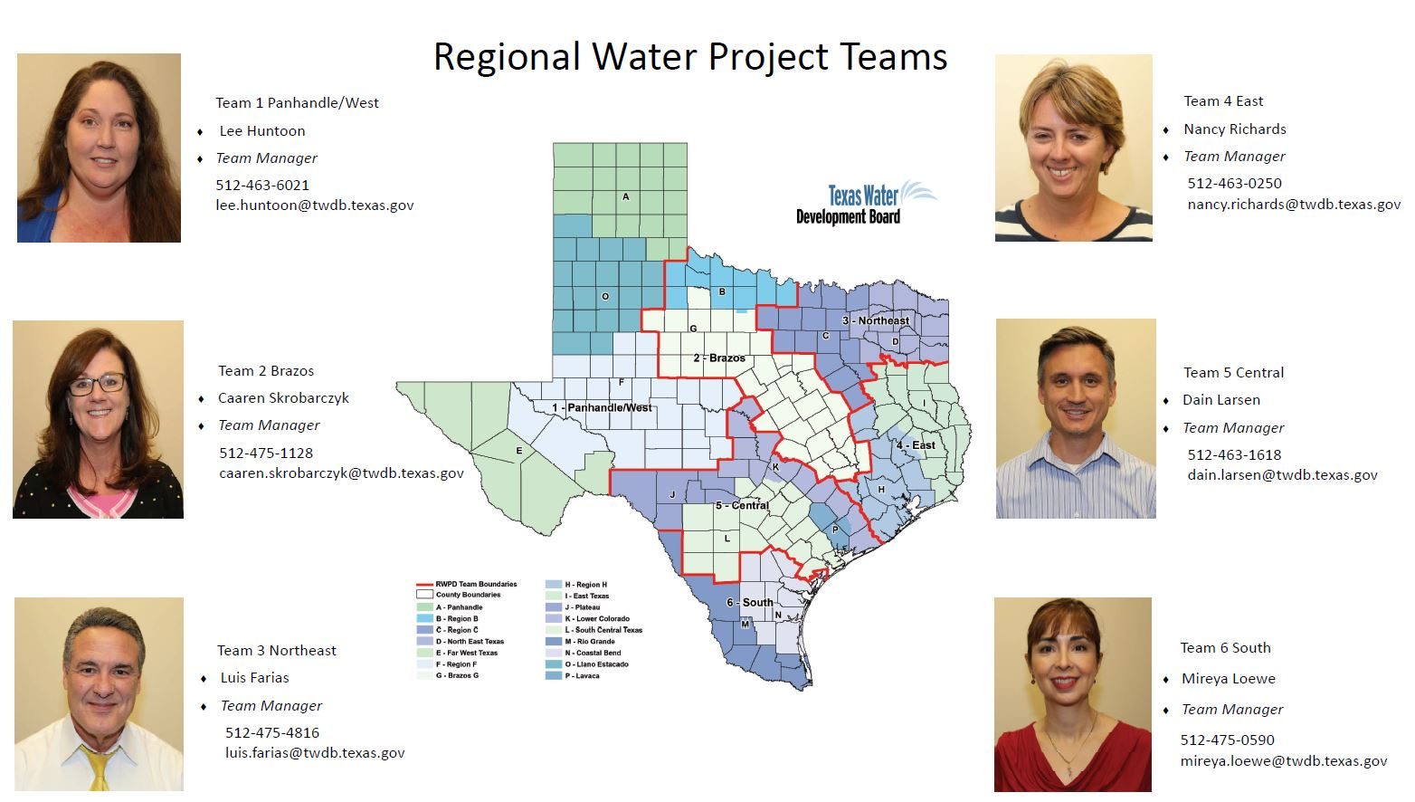
twdb regional TEAMs

Slide 22
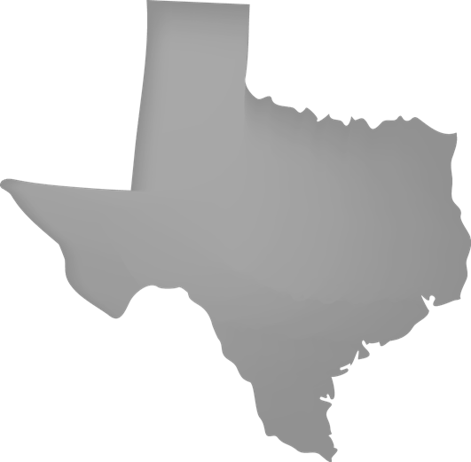

TWDB Funded project
City of Marfa
Additional Water Well
Drill and equip a new water well to replace existing well that has reached the end of its projected useful life
$705,000 through first round of State Water Implementation Fund for Texas (SWIFT) funding
City currently operates 2 water wells
Rural project
Marfa
TX
Team 1

Slide 23

TWDB Funded project
Lee County Fresh Water Supply District No. 1
New Ground Storage & Pump Station
Construct new storage tanks to replace those not meeting TCEQ criteria
Drinking Water State Revolving Fund (DWSRF) $525,000 and $351,839 Loan Forgiveness (Very Small Systems)
Provides service to Dime Box, TX
Qualified for very small systems funding
Service population of 390
Lee County
TX
Team 2

Slide 24

TWDB Funded project
City of Arlington
Replacement of Sanitary Sewer Lines
Replacing approx. 19,075 linear feet of water lines with 4 to 24 inch piping
Clean Water State Revolving Fund $4,775,000 and $826,861 Loan Forgiveness for Green Project Funding
Replacing existing sanitary sewer lines in targeted areas that have the most deteriorated lines
Arlington
TX
Team 3

Slide 25
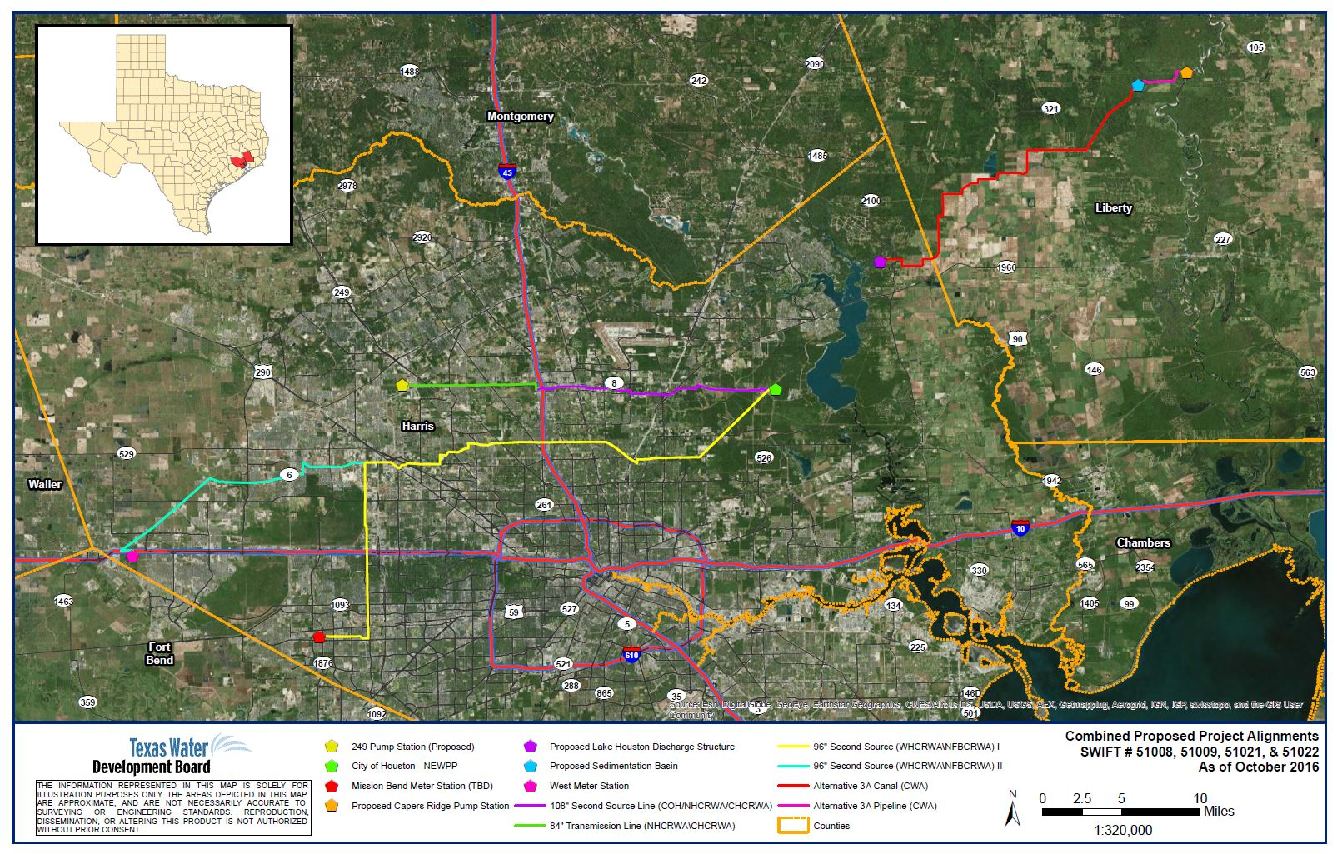
Luce Bayou Interbasin Transfer project
Houston Area
Combined SWIFT Projects
Total Project Cost = $3,200,310,000
Team 4
Notes:
Program: SWIFT Program; $3,200,310,000 (total project costs)
$300,000,000 (Coastal Water Authority’s share for the intake and canals from the Trinity River to Lake Houston – aka Luce Bayou Interbasin Transfer project)
$296,125,000 (City of Houston’s total for its share of the plant expansion and 108-in transmission line
$ 1,179,080,000 (North Harris County Regional Water Authority’s total for its share of the plant expansion, 108-in transmission line, 84-in transmission line, and internal distribution lines)
$ 57,120,000 (Central Harris County Regional Water Authority’s total for its share of the plant expansion, 108-in transmission line, 84-in transmission line, and internal distribution lines)
$555,845,000 (North Fort Bend Water Authority’s total for its share of the plant expansion and 96-inch transmission line)
$812,140,000 (West Harris County Regional Water Authority’s total for its share of the plant expansion, 96-inch transmission line, and internal distribution lines)

Slide 26
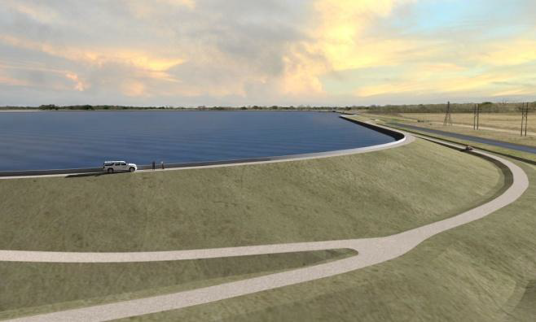
LCRA Lane city Off-Channel reservoir
DFund loan = $255,000,000
Firm yield is expected to increase
600,000 acre-feet ➔ 690,000 acre-feet per year
Team 5

Slide 27
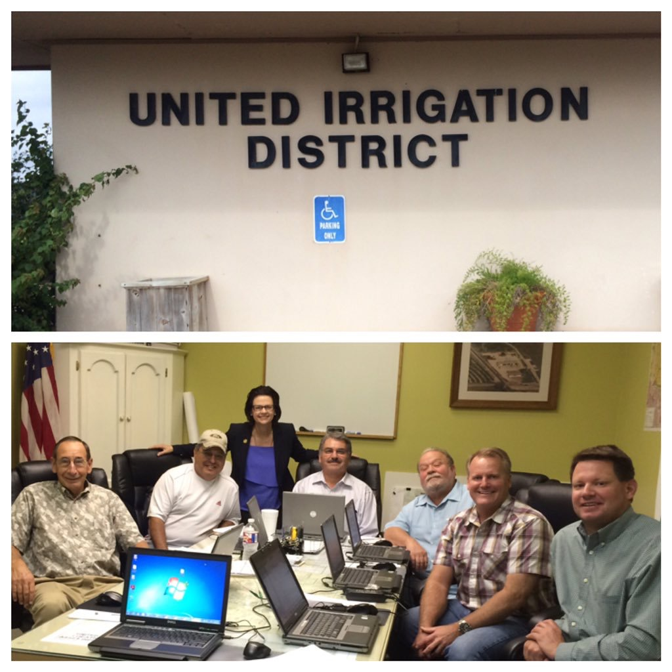
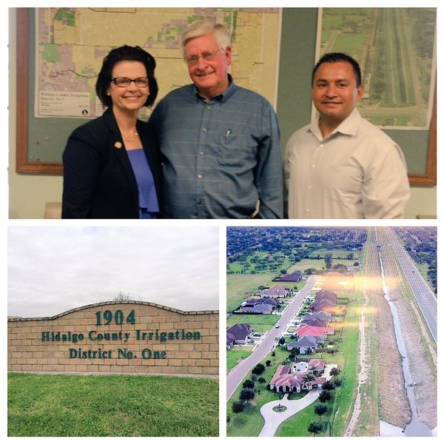
TWDB Funded projects
Hidalgo County Irrigation District #1
SWIFT - $7,100,000
Ag Irrigation Conveyance System Improvements
United Irrigation District
SWIFT - $8,100,000
Off Channel Storage Facility
Team 6

Slide 28
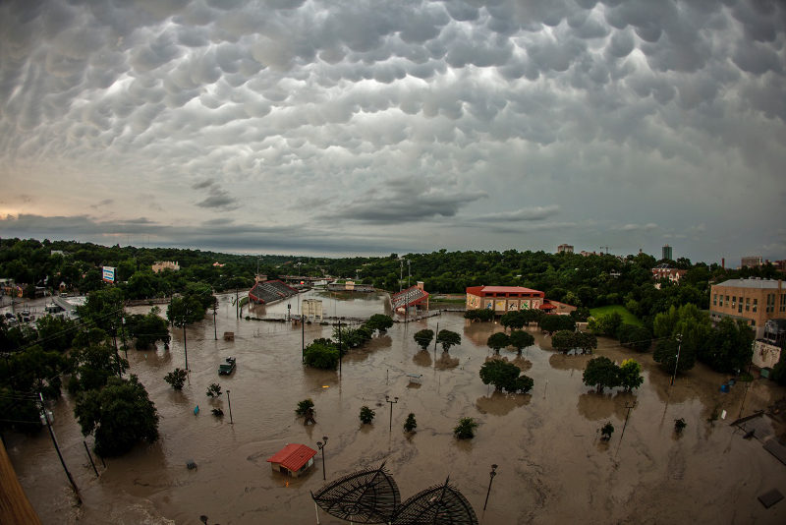

TEXASFLOOD.ORG

Slide 29
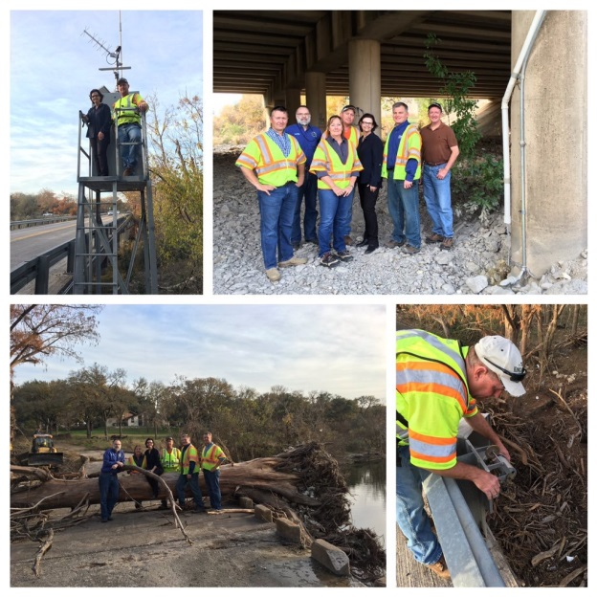
TWDB priorities
on flood:
More flood gages
More outreach
More flood grants
More flood modeling
More weather stations
More functionality to TexasFlood.org
More functionality to TexMesonet.org
Collect LIDAR data for flood modeling
Install sonar gages for flood monitoring

Slide 30
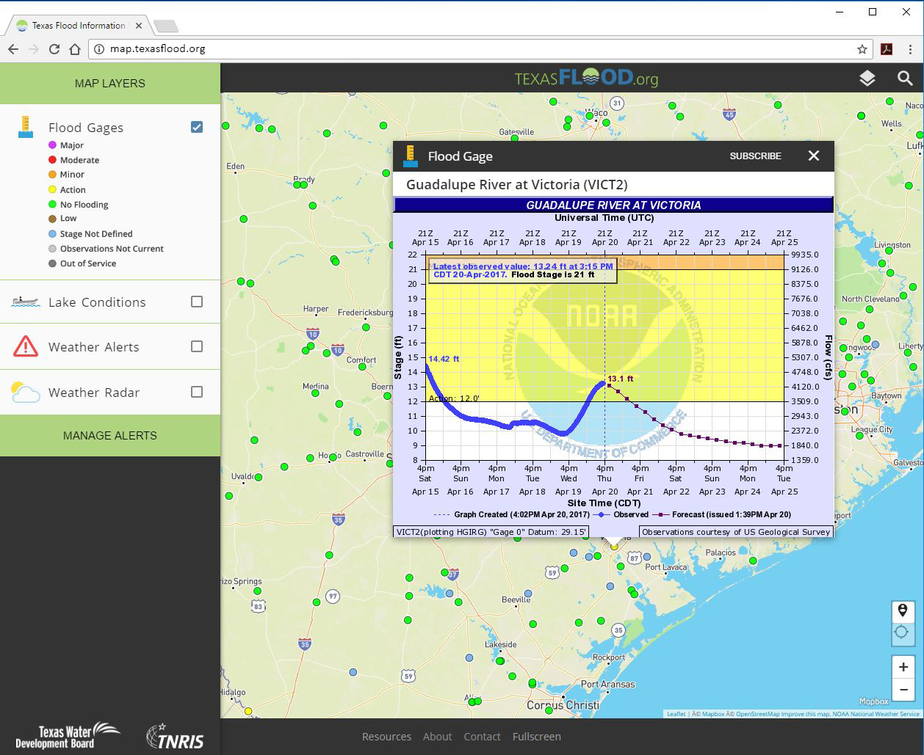
TEXASFLOOD.ORG

Slide 31
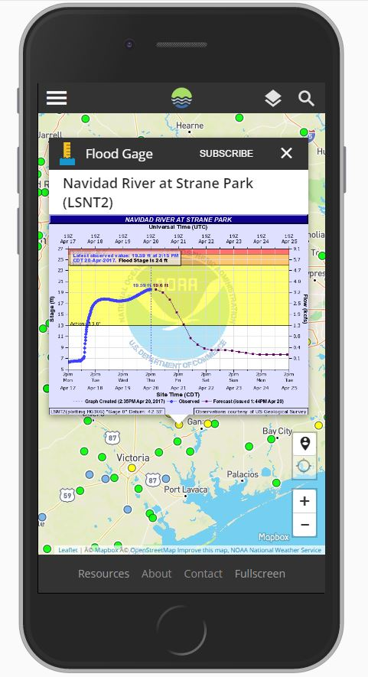
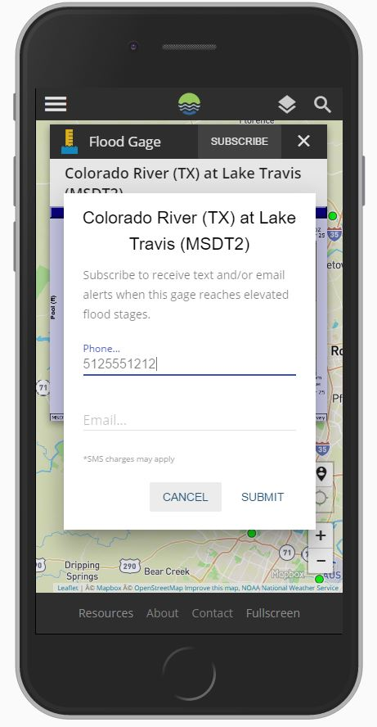
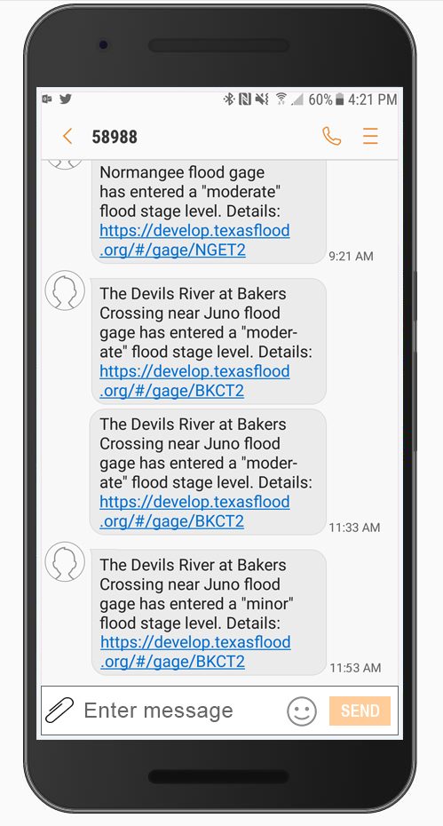
Subscribe TO RECEIVE TEXT OR EMAIL ALERTS
COMING SOON!
Kathleen.Jackson@twdb.texas.gov

Slide 32
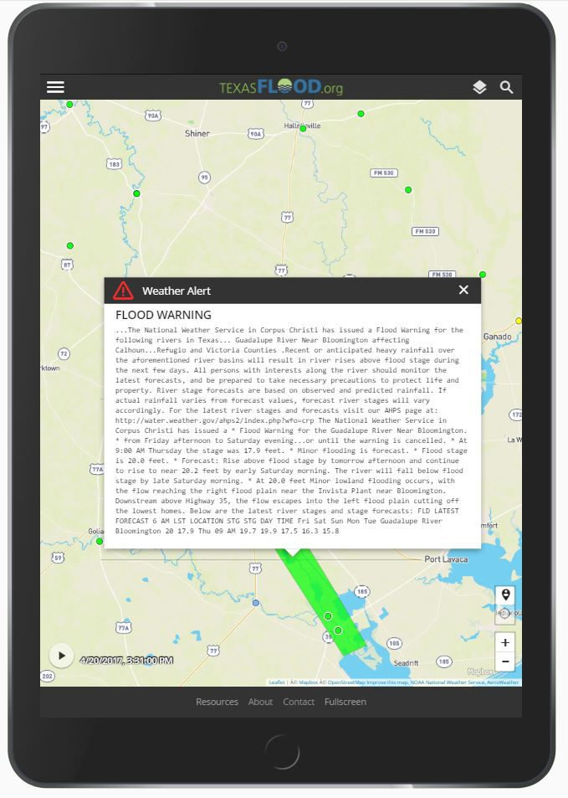
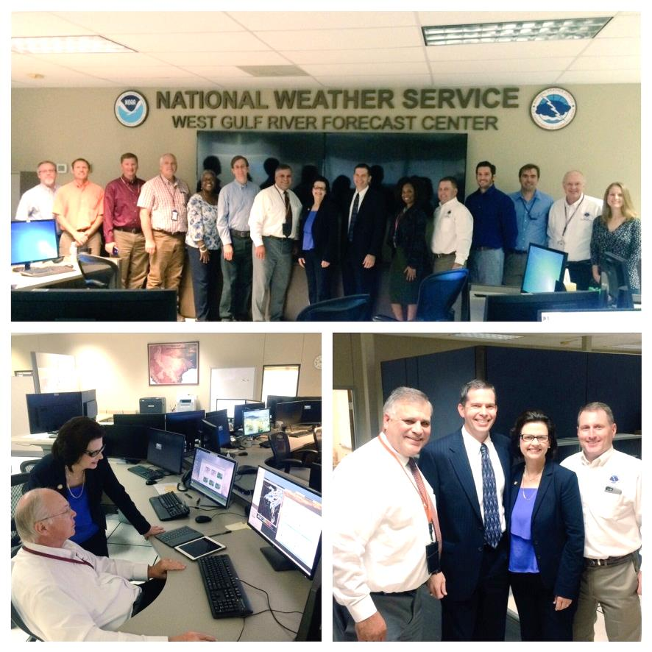
COORDINATION WITH NATIONAL WEATHER SERVICE
National Weather Service
West Gulf Coast Forecast Center

Slide 33
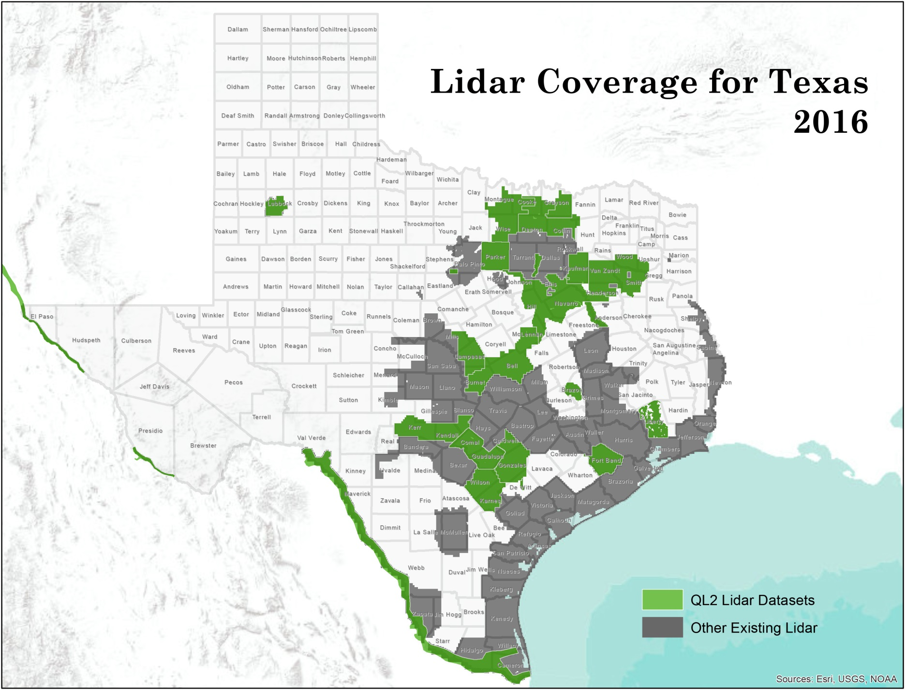
EXISTING LiDAR COVERAGE

Slide 34
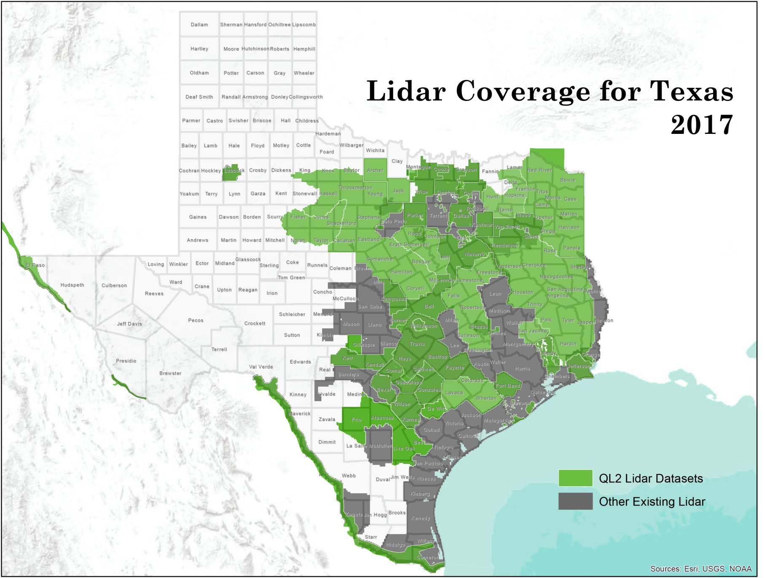
PROJECTED LIDAR COVERAGE

Slide 35
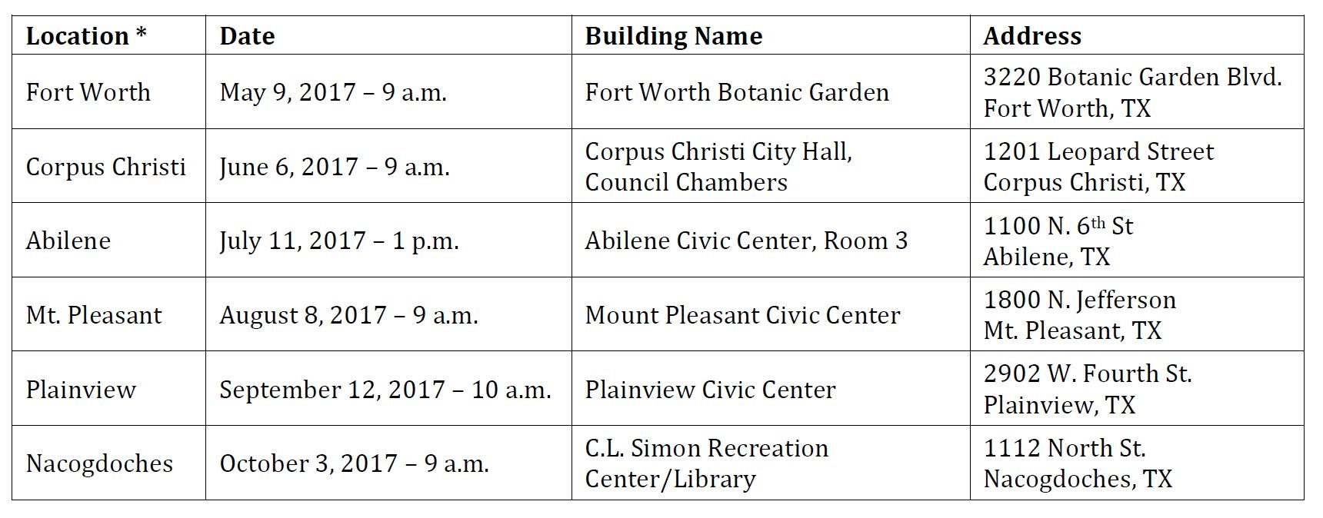
TWDB Regional Financial assistance workshops

Slide 36

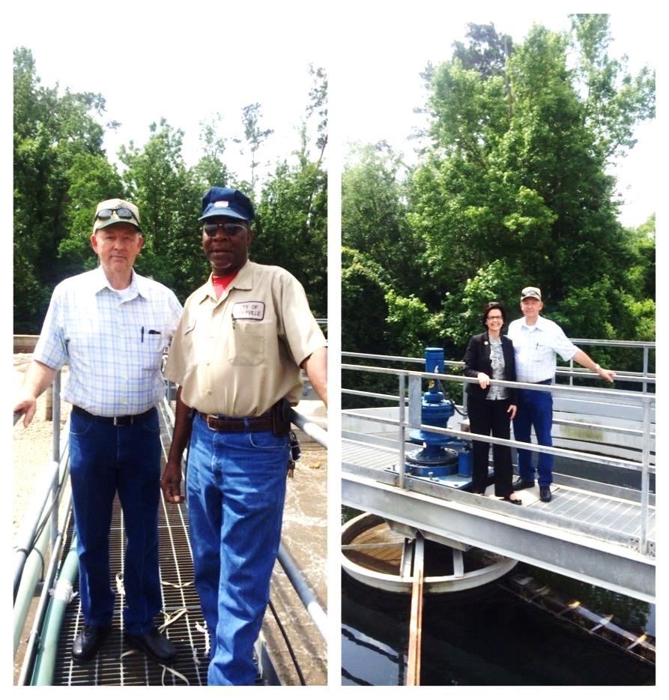
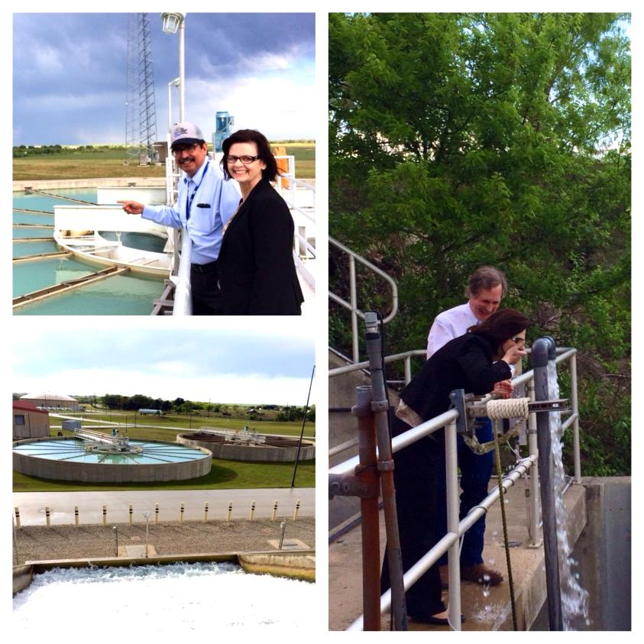
BUILDING A STRONGER TEXAS
San Antonio Water System (SAWS)
City of Kirbyville
Jasper County

Slide 37
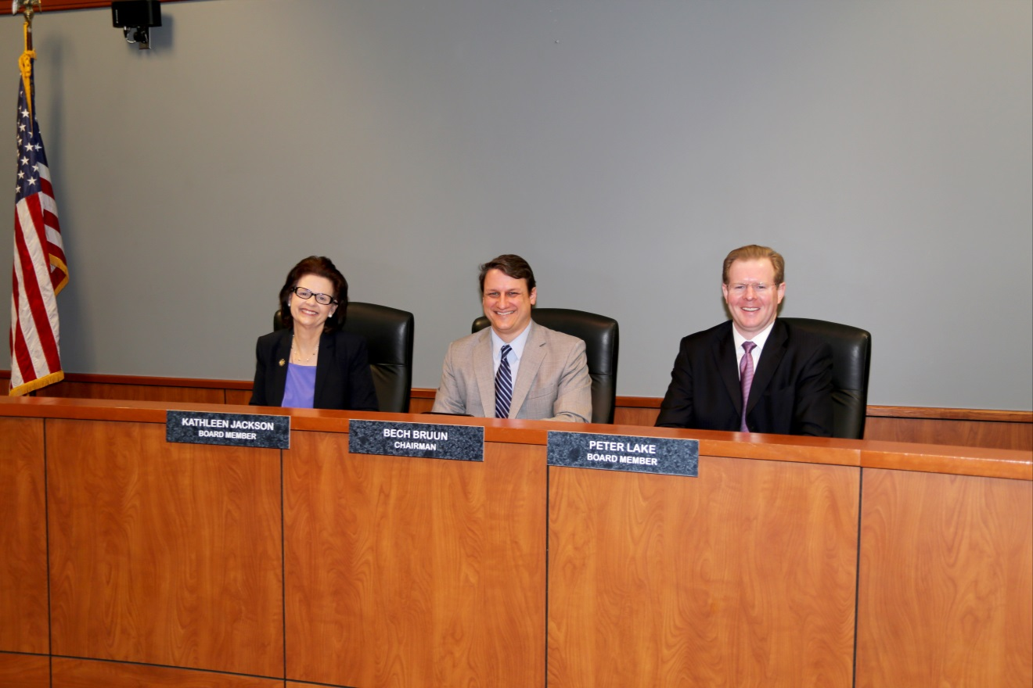
HOW TO CONTACT ME
Kathleen Jackson, P.E.
@twdb_kathleen
512.463.7847
Kathleen.Jackson@twdb.texas.gov
www.twdb.texas.gov

