Slide 1
OnTheMap and OnTheMap for Emergency Management:
Essential Census Data Tools during Natural Disasters

Slide 2
What are LEHD and LED?
LEHD (Longitudinal Employer-Household Dynamics)
  The LEHD Program at the US Census Bureau has constructed unique linked employer-employee data for the United States.
  It connects administrative records with census and survey data to produce new public-use data products as well as microdata for research.
LED (Local Employment Dynamics) Partnership
  LEHD accesses state data through the LED Partnership - a cooperative partnership with states and DC, PR, and USVI
  State-provided data:
    Unemployment Insurance (jobs/workers)
    Quarterly Census of Employment and Wages (firms)
  Other data available to the Census Bureau
    Censuses, Surveys, and Tax Information

Slide 3
Data Products
Quarterly Workforce Indicators (QWI)
  32 indicators by
    Ownership, Industry (NAICS 4-digit), Firm Age, Firm Size
    Worker Age, Race, Ethnicity, Sex, Education
    State, County, CBSA, WIB Area
  >150 Million job records processed each quarter
  Longitudinal series starts in 1990 for some states
LEHD Origin-Destination Emp. Statistics (LODES)
  Connects employment and residential locations
  Data at census block detail
  Less characteristic detail than QWI
Job-to-Job Flows (Beta)
  Flows between jobs as well as into/out of nonemployment
Innovative Confidentiality Protection

Slide 4
LEHD Data Infrastructure
QCEW = Quarterly Census of Employment and Wages
UI = Unemployment Insurance
OPM = Office of Personnel Management
UI* Wage Records
OPM*
Economic Survey Data
Business Register
Federal Records
Linked National Jobs Data
Firm Data
Jobs Data
Person Data
Demographic Census/Survey Data
QCEW*
Job data cover over 96% of private employment and most state, local, and federal jobs
Data availability: 1990-2016, start year varies by state, rolling end date
Ongoing Research
Confidentiality Protection
Public-Use
Data Products…
Notes:
The Firm Data gives us employer, establishment, geography, industry, ownership and firm age, firm size
Jobs data gives us employer-worker, establishment-worker, earnings and job history
Person data gives us demographics and place of residence
How the data are used:
Public-use data products
Internal research projects
Research projects conducted through Federal Statistical Research Data Centers (FSRDC)
Both public-use tables and research work product must be approved for release
Quality:
Issues that affect data quality/utility:
Non-reporting (firms/establishments/jobs/workers)
Item missingness
Edit/imputation methods
Confidentiality protection

Slide 5
Choosing Among LED Data Products
What do you want? | Potential Drawbacks | Data Product
Employment, hires, separations, turnover, or earnings by detailed firm and person characteristics; quarterly time resolution; relatively short data lag | No geography below county; no residential information | QWI
Employment for detailed or customized geography; residential patterns of the workforce; relationship between worker employment and home locations | Annual time resolution; less detailed firm/person characteristics | LODES
Transitions between jobs by timing and firm or worker characteristics; transitions to/from nonemployment | No worker characteristics by firm characteristics (except geography), no geography below states | J2J

Slide 6

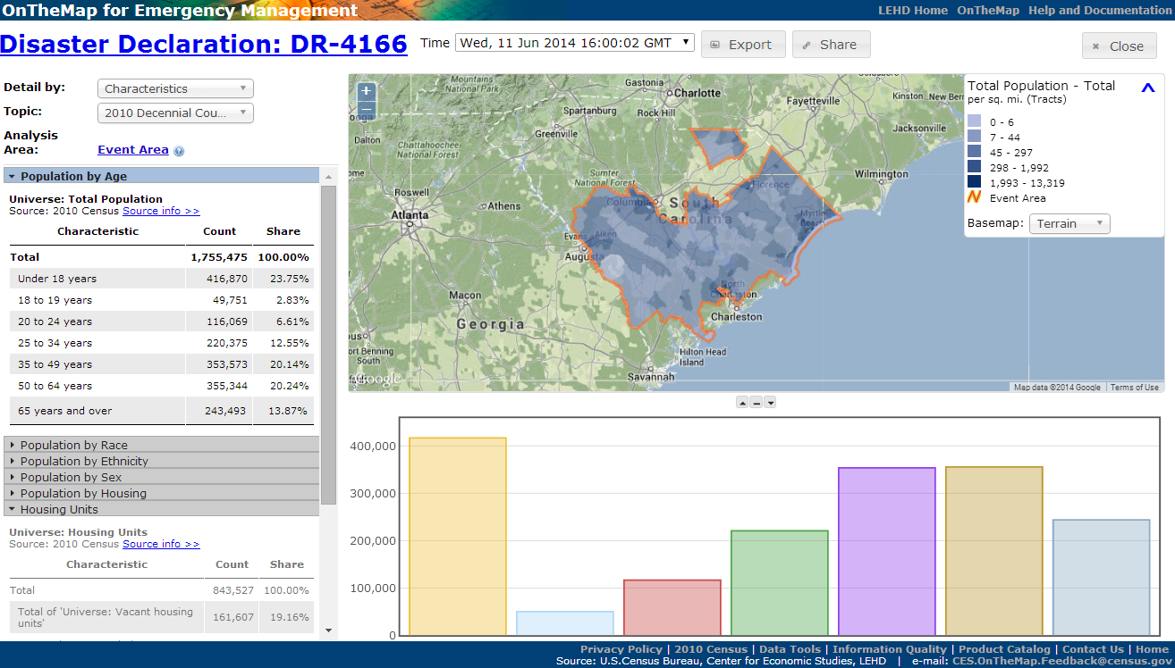



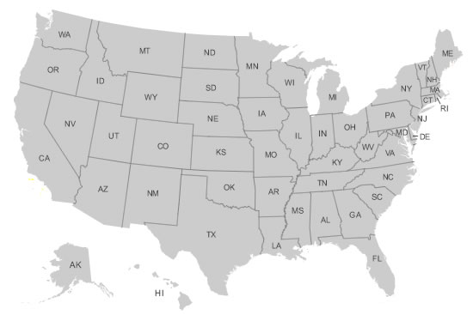

OnTheMap for Emergency Management
Hurricanes, Floods,
Winter Storms
Disaster Areas
Wildfires
Demographic & Economic Data
New Public Data Service for Emergency Preparedness & Response
Comprehensive Reports
Real-time Data Updates
Easy-to-use & Interoperable
Historical Event Archive
Flexible Analyses & Visualizations
Notes:
Because of disasters such as Harvey, LEHD created OnTheMap for Emergency Management for:
Assessing Workforce Impacts by
Identifying the number and location of affected workers
Examining workforce demographics
Identifying affected Industries
Visualizing where affected workers live
It can also Assess Population & Housing Impacts by
Identifying the number and location of affected residents
Examining population demographics of affected areas
Identifying vulnerable population groups
Examining housing characteristics of affected areas
And take part in Emergency Preparedness & Response Planning such as answering questions like…
Where should response efforts concentrate?
Are there special or vulnerable population segments? or
Uncover surrounding communities with secondary affects to workforce

Slide 7
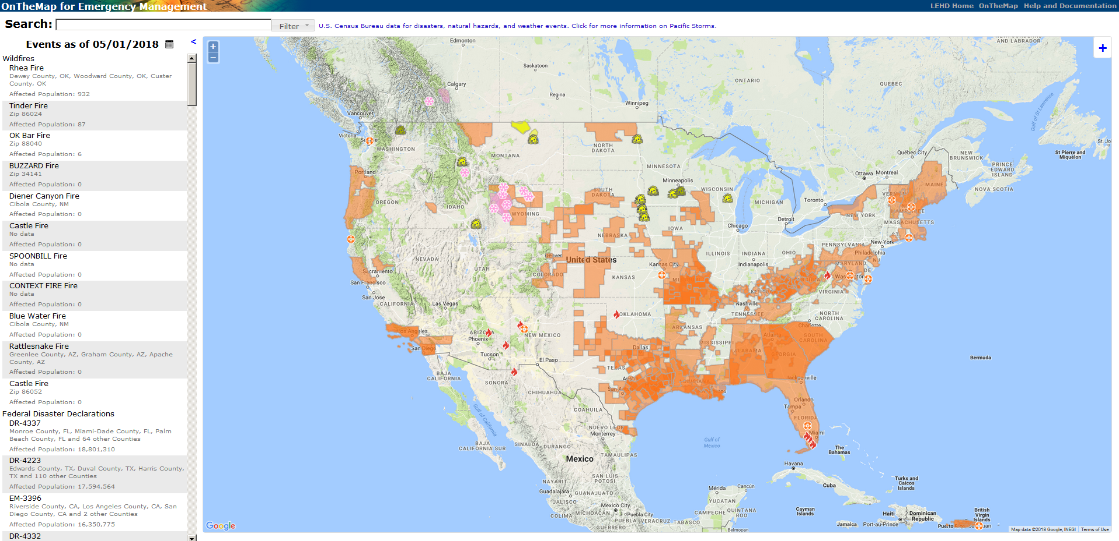
Real Time
Notes:
Here in real time with this Screen shot taken on May 1, 2018.
We can see:
Orange areas – FEMA Disaster Declaration Areas
Yellow Houses – Flooding
Pink Snowflakes – Snow fall
Red Flames – wildfires
We also have green wind swaths for hurricanes and tropical storms
And blue snow flakes for freezing temperature

Slide 8
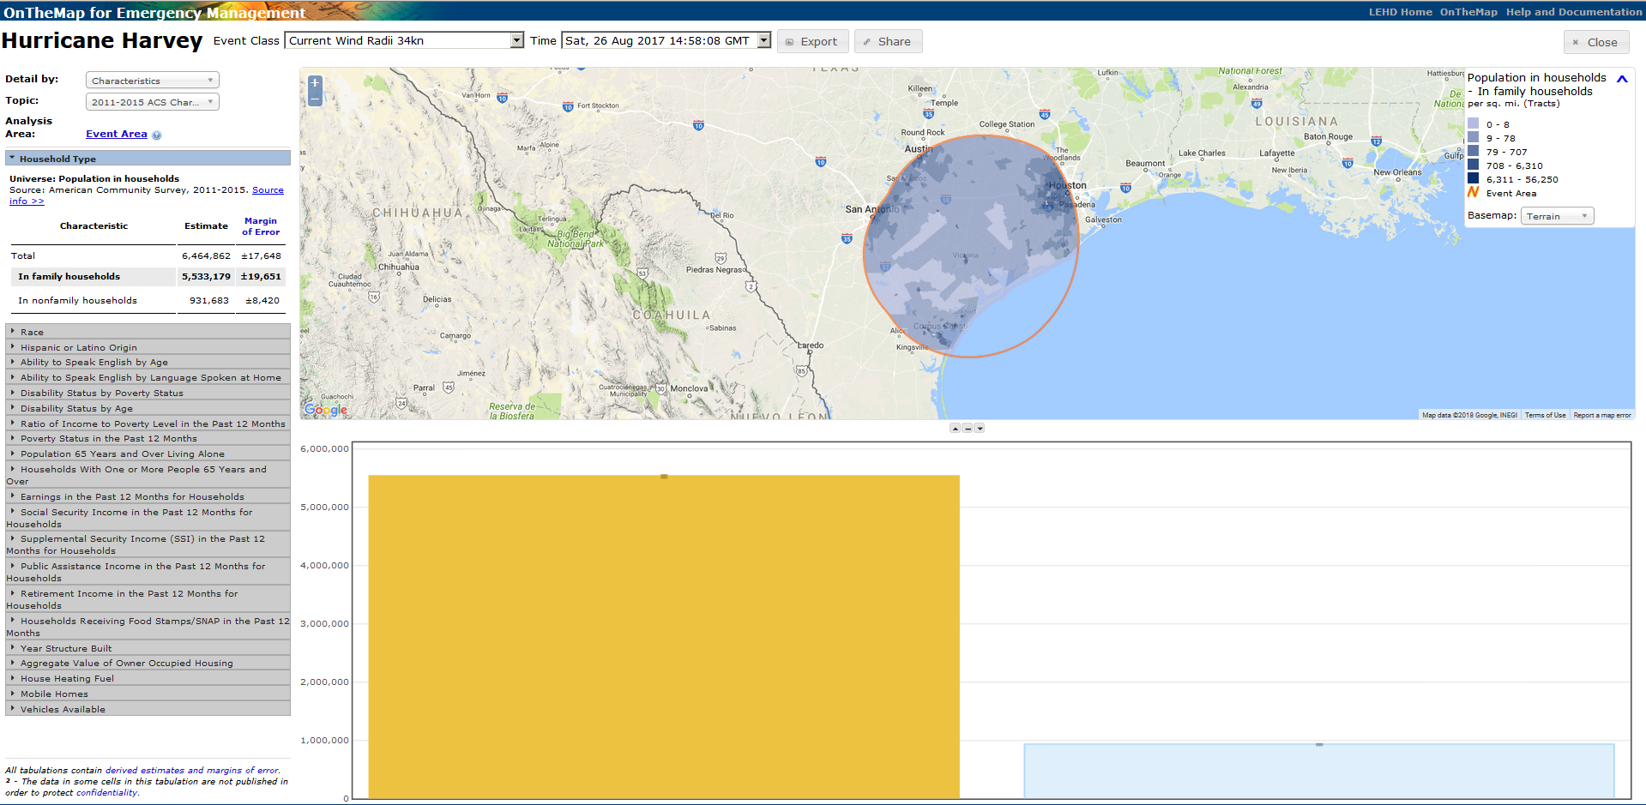
Hurricane Harvey and
OnTheMap for Emergency Management
Notes:
OnTheMap for Emergency Management is user friendly and quick.
Once you click on the event or type in Harvey in the search box, it takes you directly into the data.
In this screenshot,
Under Detailed by:
Choose between Characteristics, Geography, or Origin-Destination
Under Topic: Choose between 2010 Decennial Counts, ACS, and LODES
Using the 2011-2015 ACS data set we can see…
The population that was affected by Hurricane Harvey was 6,464,862
Total homes in the affected area equaled 2,558,204

Slide 9
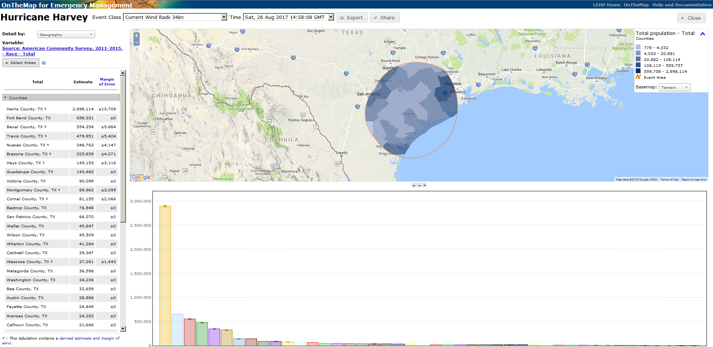
Affected Areas by County

Slide 10
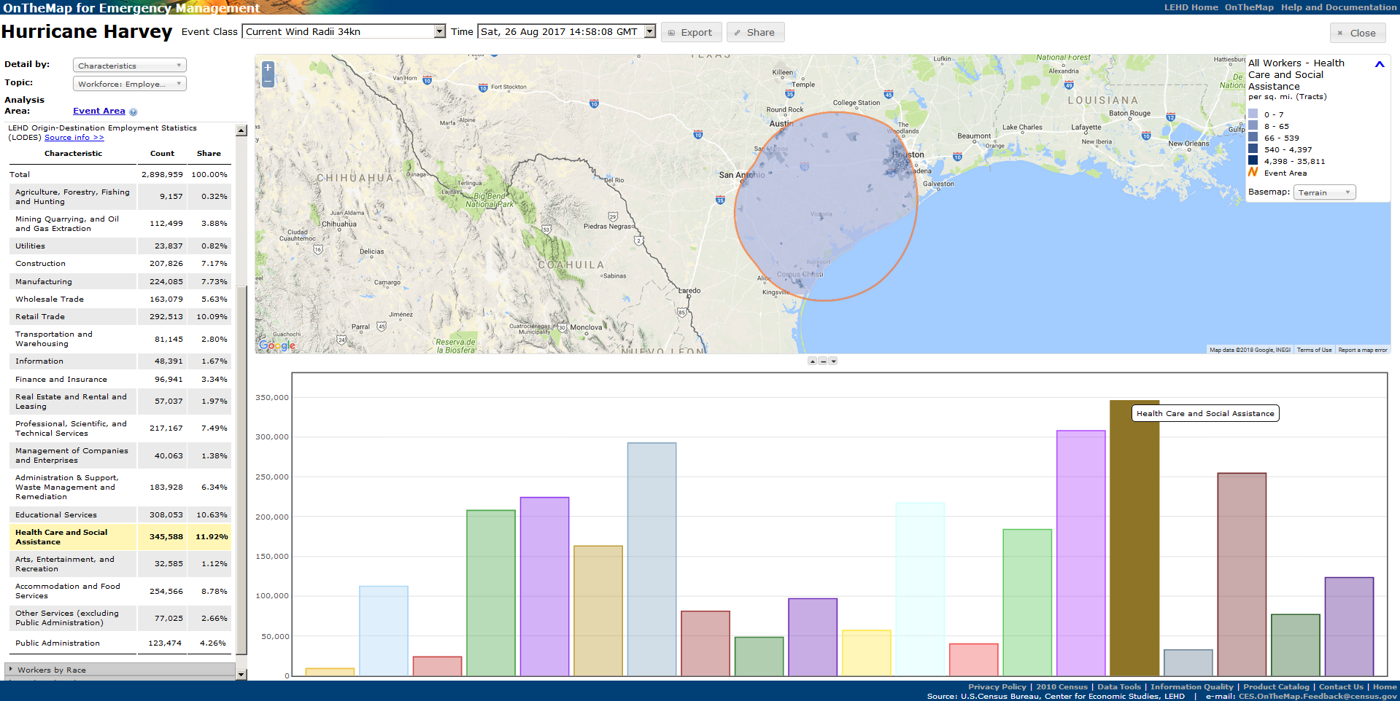
Industries Affected by Harvey
Notes:
Health care and social assistance most affected.

Slide 11
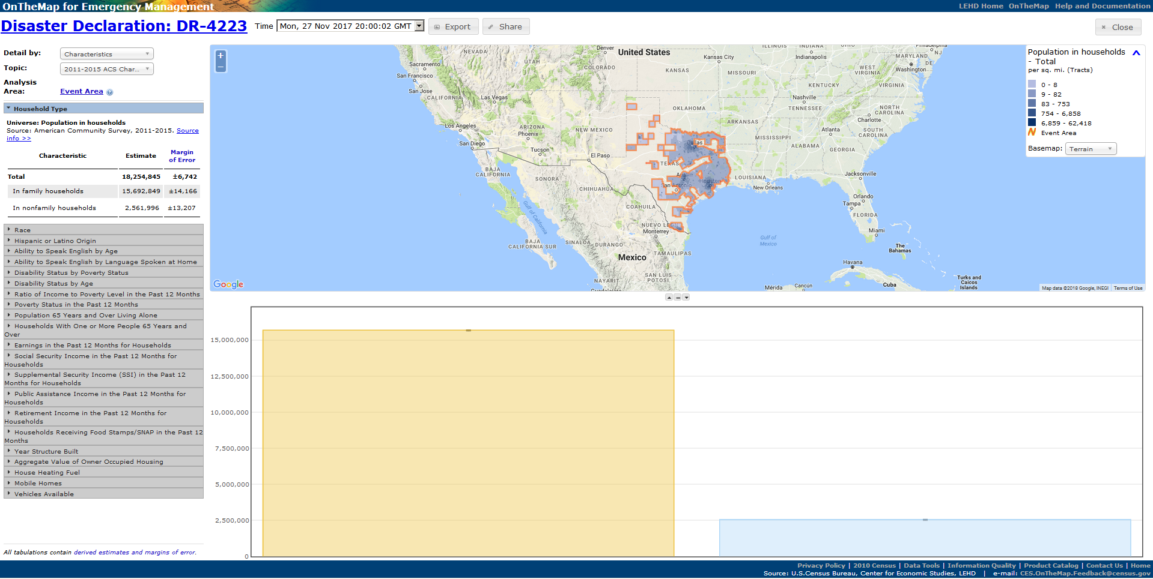
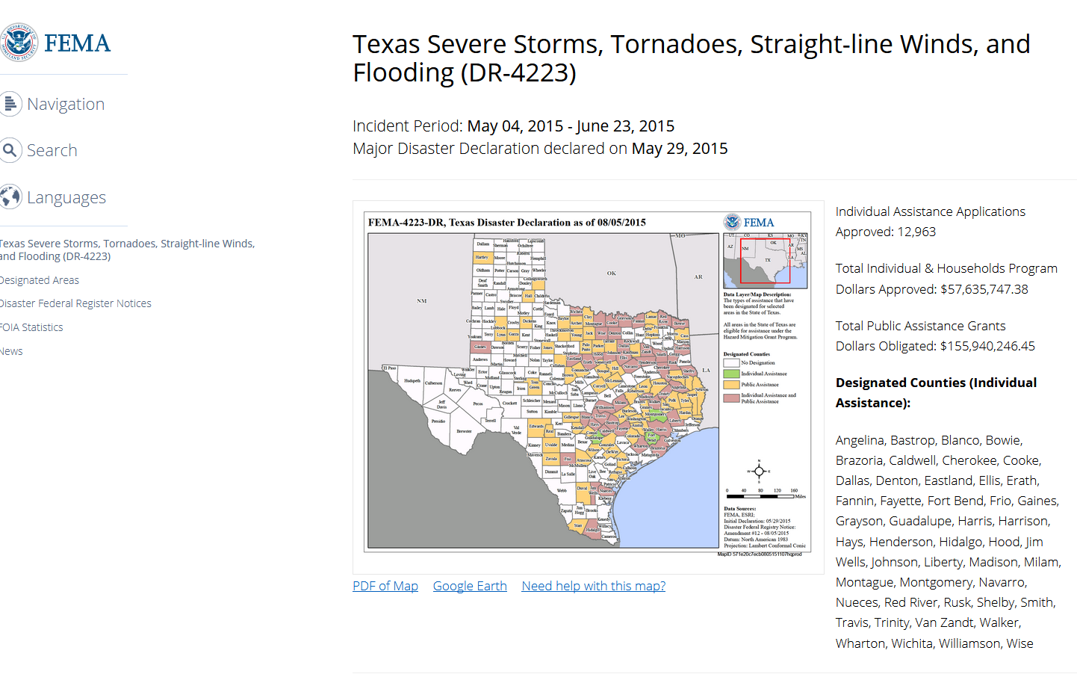
DR-4223
FEMA – Texas Severe Storms

Slide 12
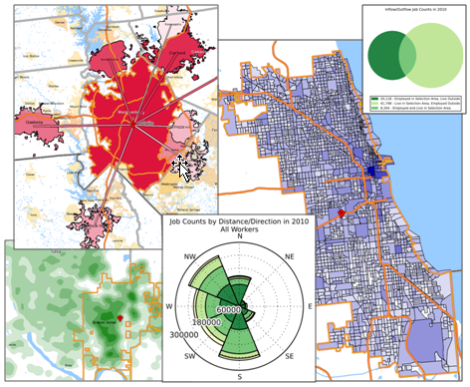
OnTheMap
Recognized by United Nations as a major U.S. statistical innovation
Where do workers live?
Where do residents work?
What are the commuter flows of a particular area?
Analyze/report by worker demographics: age, earnings, race, ethnicity, educational attainment, and sex
Analyze/report by firm characteristics: NAICS Sector, firm age, and firm size
2002-2015 annual data
50 states available (plus DC)
User-selected areas
Based on Census Blocks
Disclosure protection
Flexible Inputs/Outputs
Notes:
In order to dive deeper into the workforce, we can turn to OnTheMap, OnTheMap for Emergency Management’s sister application.
OnTheMap tells the user…

Slide 13
J2J Explorer
40 Measures of Worker Reallocation
Six Visualization Modules with a flexible dashboard interface
Export reports to Excel or CSV
Trace worker movements through industries, geographic labor markets, and to/from employment
Analyze/report by origin and
destination geographies:
national and state-level tabulations
Analyze/report by origin and
destination firm characteristics:
NAICS Sector, firm age, and firm size
Analyze/report by worker demographics: age, earnings, race, ethnicity, educational attainment, and sex
Data updated every quarter
Notes:
Since the J2J data product is a new and incredibly unique data product, we created an application called J2J Explorer to help users interact with the data.
There are 40 different measures of worker reallocation and users can visualize one or a set of these through six different modules, all of which have flexible dashboard interfaces to help them look at the exact type of job flows they’re interested in.
Any visualization they create through the application can also be exported in a report to Excel or CSV.
The data is available at great levels of detail. Users can look at breakdowns of flows by geography, industry, and/or firm characteristics for not only the jobs that workers left but also for the jobs that workers started or both. We call these origin and destination jobs, respectively. They can also look at breakdown of flows by worker demographics, such as sex by age, sex by education, or race by ethnicity.
And the data is updated quarterly.

Slide 14
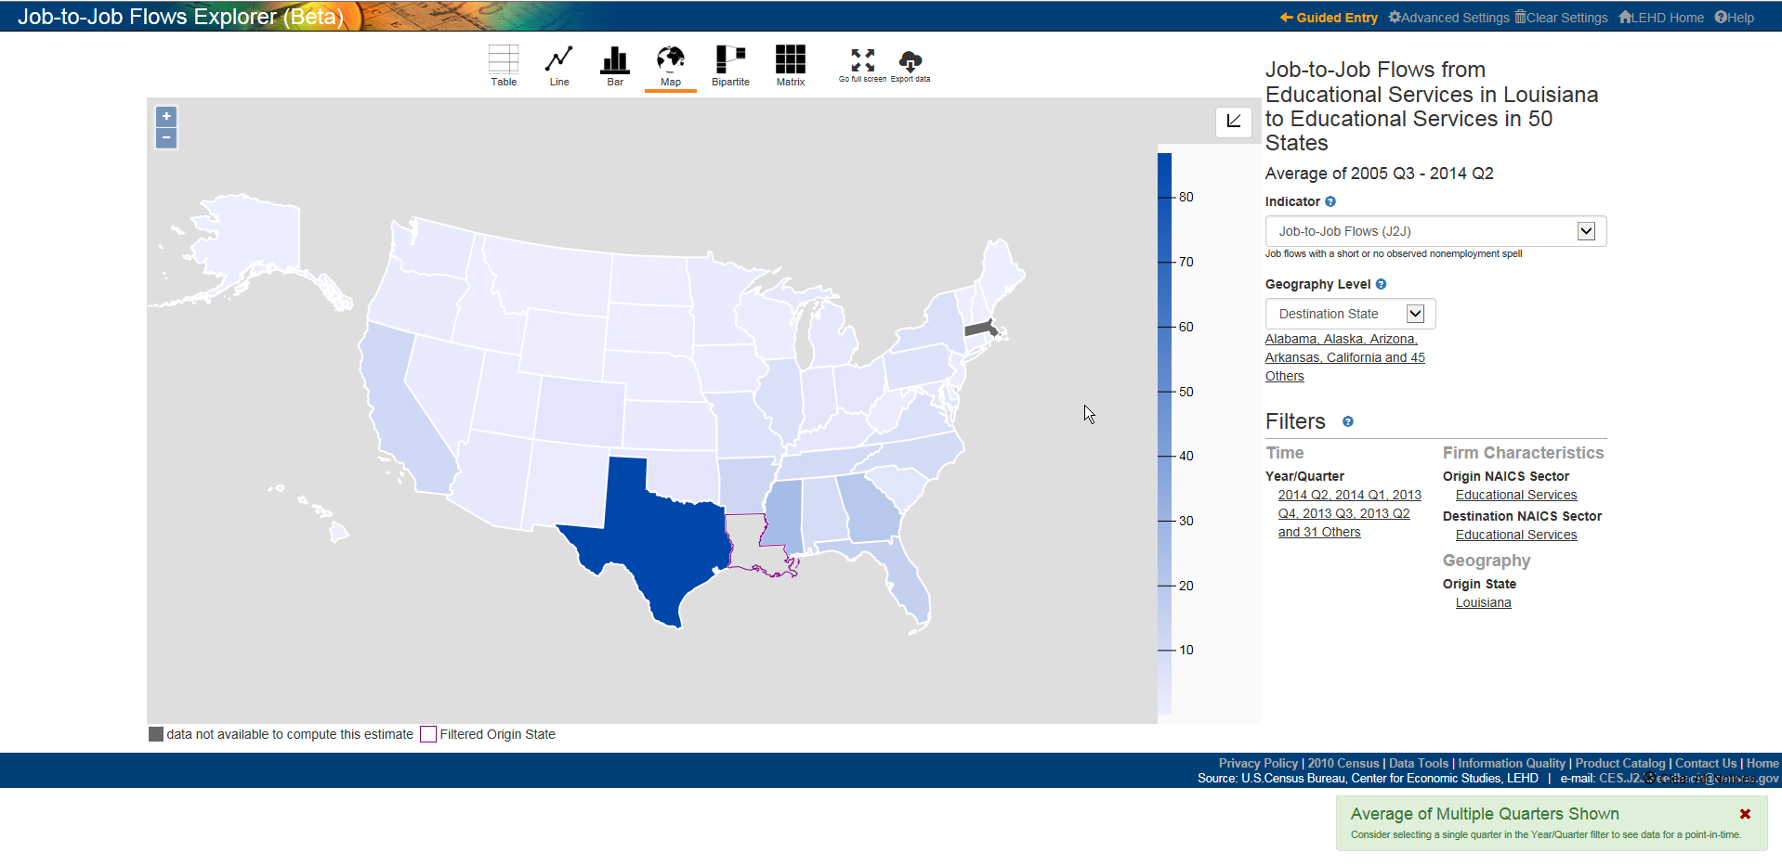
Louisiana education workers leaving to take education jobs out-of-state: 2005.3-2014.2
Notes:
This map shows on average how many workers in Education left Louisiana and started education jobs in other states. The largest outflows are going to neighbors, Texas and Mississippi, but Georgia and Florida are also popular destinations.

Slide 15
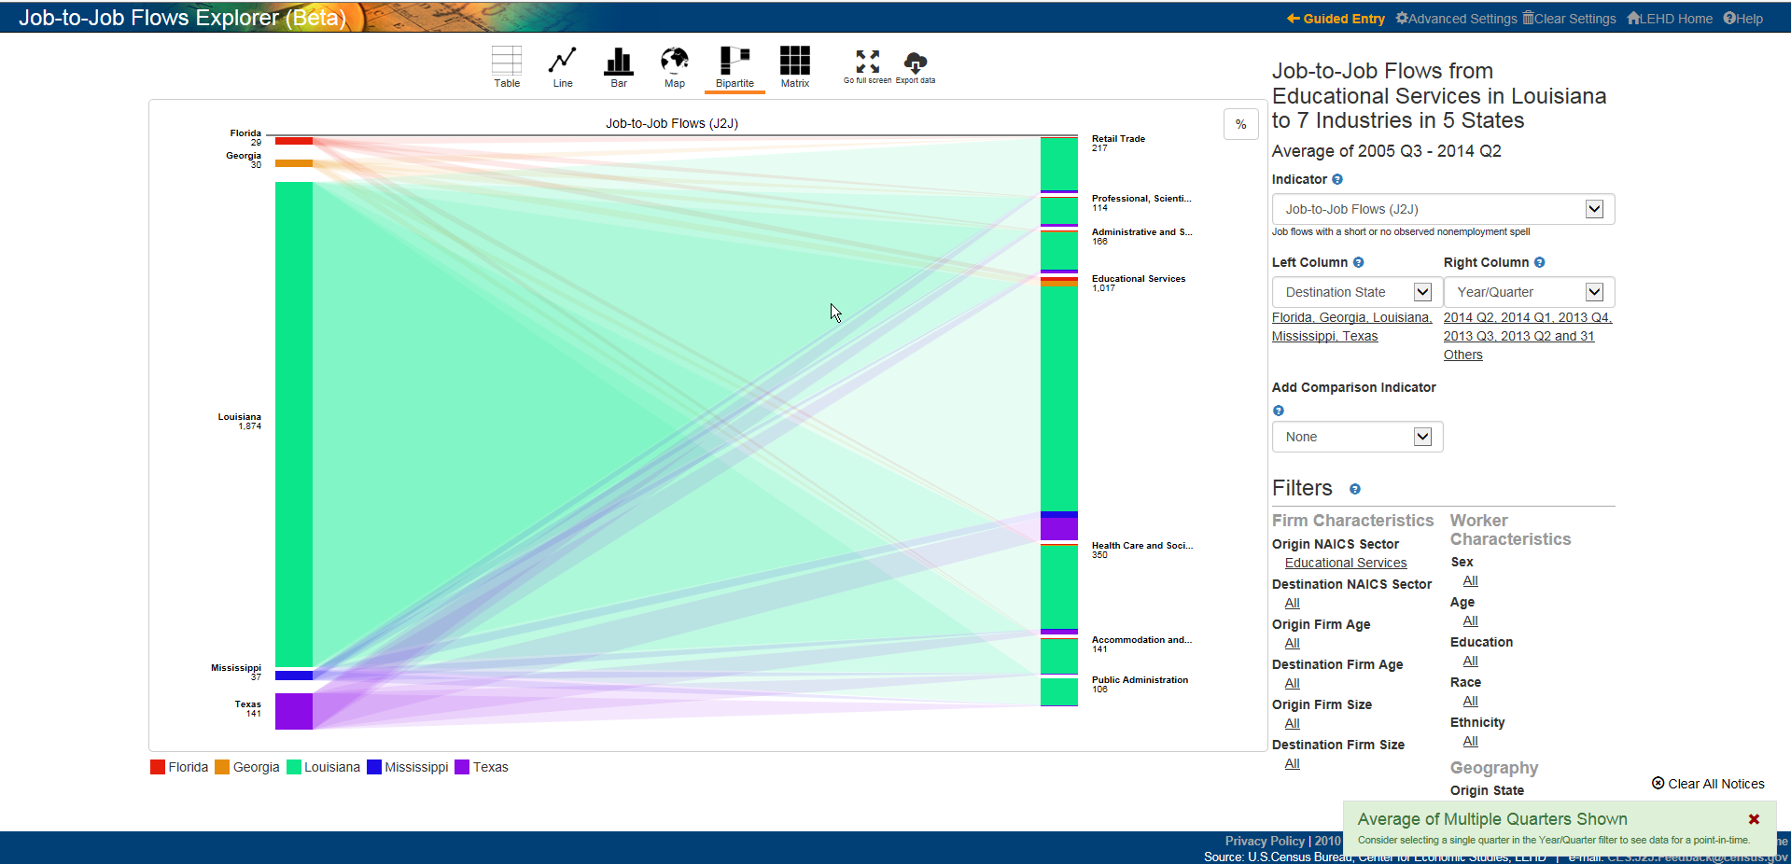
Job-to-Job Flows from Educational Services in Louisiana to 7 industries in 5 states
Notes:
One of the most exciting features of J2J Explorer is the bipartite chart. The bipartite chart allows users to compare many parts of the data in one visualization. For example, with our analysis of Education workers in Louisiana, you can compare how many Education workers stay in Louisiana with how many leave for other popular destinations. You can also compare how many stay in Education with how many leave Education altogether. More interestingly, you can even compare how many stay in Education in Louisiana with how many stay in Education but leave for another state. This gives you a better idea of how large different job-to-job flows are.

Slide 16
Takeaways
The LED Partnership provides unique workforce information and analysis tools at a relatively low cost
LED data products (QWI, LODES, J2J) can give insight into local and regional economies and labor markets
LED’s web tools provide free, 24/7 access to a basic analytical platform for the data

Slide 17
Contacts
LEHD
  lehd.ces.census.gov
  robert.sienkiewicz@census.gov
  matthew.graham@census.gov
Data/Applications
  lehd.ces.census.gov/data
  lehd.ces.census.gov/applications

