Slide 1
The 2018 TDC State and County Population Projections
Helen You
Texas Demographic Conference
May 2018
Austin, Texas

Slide 2
Texas Population Projections Program
TDC produces
projections of the population of the STATE and all COUNTIES in the state by age, sex and race/ethnicity
The Cohort Component Model
Population_{(t)} = Population₀
+ Natrual Increase_{t} (Births_{t} – Deaths_{t} )
+ Net Migrants_{t} (In-mig_{t} – Out-mig_{t})
The components of population change (fertility, mortality, and net migration) are projected separately for each birth cohort (persons born in a given year)

Slide 3
TDC Population Projection Illustration
Population 2010 (Ages 0 to 95+)
-
DEATHS [= Base Population * Projected Death Rates]
+
NET MIGRANTS [= Base Population * Constant Migration Rates]
AGE +1
+
BIRTHS [= Women 15 -49 * Projected Fertility rates]
Projected Population for 2011
(Base population for 2012 projection)

Slide 4
Changes in the 2018 Population Projections
Current: single age for ages 0 to 85+
New: single age for ages 0 to 95+
Current: 4 race/ethnic groups – Non-Hispanic White, Non-Hispanic Black, Hispanics and Non-Hispanic Other
New: 5 race/ethnic groups – separating Asians from Other (now includes Two or more Races, American Indian, Pacific Islander, and some other races)
Current: 3 migration scenarios based on 2000 -2010 migration trends – 0, 0.5, 1.0
New: an additional migration scenario based on 2010 – 2015 migration trends
Current: projecting the race/ethnicity based on the mother’s race
New: an additional step to “re-allocate” a child’s race/ethnicity

Slide 5
Preliminary Projection Results

Slide 6
Race/Ethnic Composition

Slide 7
Age Composition
2010
2050
Age | NH White | NH Black | Hispanic | Asian | Other | Total
00 - 04 | 5.4% | 7.5% | 10.3% | 6.9% | 13.1% | 7.7%
05 - 09 | 5.6% | 7.6% | 10.0% | 7.2% | 11.5% | 7.7%
10 - 14 | 5.8% | 7.9% | 9.3% | 6.5% | 10.4% | 7.5%
15 - 19 | 6.1% | 8.5% | 8.9% | 6.3% | 9.1% | 7.5%
20 - 24 | 6.3% | 7.8% | 8.2% | 7.2% | 7.6% | 7.2%
25 - 29 | 6.6% | 7.5% | 8.2% | 8.7% | 7.1% | 7.4%
30 - 34 | 6.1% | 7.2% | 7.8% | 9.0% | 6.4% | 7.0%
35 - 39 | 6.4% | 7.3% | 7.5% | 9.8% | 5.9% | 7.0%
40 - 44 | 6.7% | 7.1% | 6.6% | 8.4% | 5.3% | 6.7%
45 - 49 | 7.8% | 7.5% | 5.9% | 7.3% | 5.5% | 7.0%
50 - 54 | 8.1% | 7.0% | 4.9% | 6.3% | 5.1% | 6.7%
55 - 59 | 7.3% | 5.5% | 3.8% | 5.3% | 4.2% | 5.7%
60 - 64 | 6.4% | 4.0% | 2.9% | 4.2% | 3.2% | 4.7%
65 - 69 | 4.9% | 2.7% | 1.9% | 2.8% | 2.1% | 3.4%
70 - 74 | 3.6% | 1.8% | 1.4% | 1.9% | 1.4% | 2.5%
75 - 79 | 2.9% | 1.4% | 1.0% | 1.1% | 0.9% | 1.9%
80 - 84 | 2.1% | 0.9% | 0.7% | 0.7% | 0.6% | 1.4%
85 - 89 | 1.3% | 0.5% | 0.4% | 0.3% | 0.3% | 0.8%
90 - 94 | 0.5% | 0.2% | 0.1% | 0.1% | 0.1% | 0.3%
95+ | 0.1% | 0.1% | 0.0% | 0.0% | 0.0% | 0.1%
Age | NH White | NH Black | Hispanic | Asian | Other | Total
00 - 04 | 4.8% | 5.9% | 7.5% | 5.7% | 9.8% | 6.4%
05 - 09 | 4.9% | 5.9% | 7.3% | 5.7% | 9.3% | 6.3%
10 - 14 | 5.0% | 5.9% | 7.2% | 5.6% | 8.8% | 6.3%
15 - 19 | 5.1% | 6.1% | 7.1% | 5.7% | 8.3% | 6.3%
20 - 24 | 5.5% | 6.5% | 7.1% | 6.6% | 8.2% | 6.6%
25 - 29 | 6.0% | 6.9% | 7.0% | 7.6% | 8.1% | 6.8%
30 - 34 | 6.2% | 7.1% | 6.7% | 8.1% | 7.6% | 6.8%
35 - 39 | 6.2% | 7.0% | 6.4% | 8.3% | 6.9% | 6.7%
40 - 44 | 6.3% | 7.1% | 6.6% | 7.8% | 6.8% | 6.7%
45 - 49 | 6.5% | 6.9% | 6.3% | 7.5% | 5.8% | 6.5%
50 - 54 | 6.6% | 6.7% | 5.7% | 6.4% | 5.1% | 6.2%
55 - 59 | 6.6% | 6.7% | 5.3% | 5.5% | 4.2% | 5.8%
60 - 64 | 6.2% | 5.4% | 4.6% | 4.8% | 3.1% | 5.1%
65 - 69 | 5.8% | 4.4% | 4.2% | 4.2% | 2.5% | 4.6%
70 - 74 | 4.9% | 3.6% | 3.6% | 3.3% | 1.9% | 3.9%
75 - 79 | 4.4% | 3.0% | 3.0% | 2.9% | 1.5% | 3.3%
80 - 84 | 3.7% | 2.2% | 2.2% | 2.0% | 1.0% | 2.5%
85 - 89 | 3.0% | 1.6% | 1.4% | 1.3% | 0.7% | 1.8%
90 - 94 | 1.7% | 0.8% | 0.6% | 0.7% | 0.4% | 1.0%
95+ | 0.6% | 0.3% | 0.2% | 0.4% | 0.1% | 0.4%

Slide 8
Age Composition-continued
Changes from 2010 to 2050
Age | NH White | NH Black | Hispanic | Asian | Other | Total
00 - 04 | -0.6% | -1.6% | -2.8% | -1.2% | -3.3% | -1.3%
05 - 09 | -0.7% | -1.7% | -2.7% | -1.5% | -2.1% | -1.3%
10 - 14 | -0.8% | -1.9% | -2.2% | -0.9% | -1.6% | -1.2%
15 - 19 | -1.0% | -2.4% | -1.8% | -0.6% | -0.9% | -1.2%
20 - 24 | -0.7% | -1.3% | -1.1% | -0.6% | 0.6% | -0.7%
25 - 29 | -0.6% | -0.6% | -1.2% | -1.1% | 0.9% | -0.6%
30 - 34 | 0.1% | -0.1% | -1.1% | -0.8% | 1.2% | -0.2%
35 - 39 | -0.1% | -0.3% | -1.1% | -1.4% | 1.0% | -0.3%
40 - 44 | -0.4% | 0.0% | 0.0% | -0.6% | 1.6% | 0.0%
45 - 49 | -1.4% | -0.6% | 0.4% | 0.2% | 0.2% | -0.5%
50 - 54 | -1.5% | -0.3% | 0.8% | 0.1% | -0.1% | -0.5%
55 - 59 | -0.7% | 1.2% | 1.5% | 0.1% | 0.0% | 0.2%
60 - 64 | -0.3% | 1.3% | 1.7% | 0.6% | -0.1% | 0.4%
65 - 69 | 0.9% | 1.8% | 2.3% | 1.5% | 0.3% | 1.2%
70 - 74 | 1.3% | 1.8% | 2.2% | 1.4% | 0.5% | 1.4%
75 - 79 | 1.5% | 1.6% | 2.0% | 1.7% | 0.6% | 1.4%
80 - 84 | 1.6% | 1.3% | 1.5% | 1.3% | 0.4% | 1.2%
85 - 89 | 1.7% | 1.1% | 1.0% | 1.0% | 0.4% | 1.0%
90 - 94 | 1.2% | 0.6% | 0.5% | 0.6% | 0.2% | 0.7%
95+ | 0.5% | 0.2% | 0.2% | 0.4% | 0.1% | 0.3%

Slide 9
County Projections
Deaths
Projecting age-sex-race specific mortality/survival rates
Net Migrants
Calculating migration rates 2010-2015 for each county
For smaller population groups (NHB, NHA, Other), collapse age groups
Births
Projecting age – race specific fertility rates for women at risk (female 15 to 49) by rural/urban status
Projecting race of the newborns
“Special” Population
Group quarter population, college and military population

Slide 10
Projecting Fertility Rates

Slide 11
Projecting Race/Ethnicity of the Newborns
Child's (under 17) Race by Mother's Race, 2000 IPUMS
Child's (under 17) Race by Mother's Race, 2010 IPUMS
Mom/Child | ChdWhite | ChdBlack | ChdHispanic | ChdAsian | ChdOther
White | 92.8% | 0.6% | 4.8% | 0.3% | 1.6%
Black | 0.3% | 97.8% | 0.9% | 0.0% | 1.0%
Hispanic | 2.3% | 0.3% | 97.3% | 0.0% | 0.1%
Asian | 2.4% | 1.6% | 3.2% | 83.6% | 9.2%
Other | 29.5% | 0.8% | 15.2% | 1.9% | 52.6%
Mom/Child | ChdWhite | ChdBlack | ChdHispanic | ChdAsian | ChdOther
White | 87.6% | 0.9% | 8.4% | 0.3% | 2.9%
Black | 0.2% | 96.3% | 1.7% | 0.0% | 1.7%
Hispanic | 2.2% | 0.4% | 97.1% | 0.0% | 0.3%
Asian | 1.7% | 0.2% | 1.9% | 87.4% | 8.8%
Other | 12.5% | 7.3% | 14.2% | 1.9% | 64.2%

Slide 12
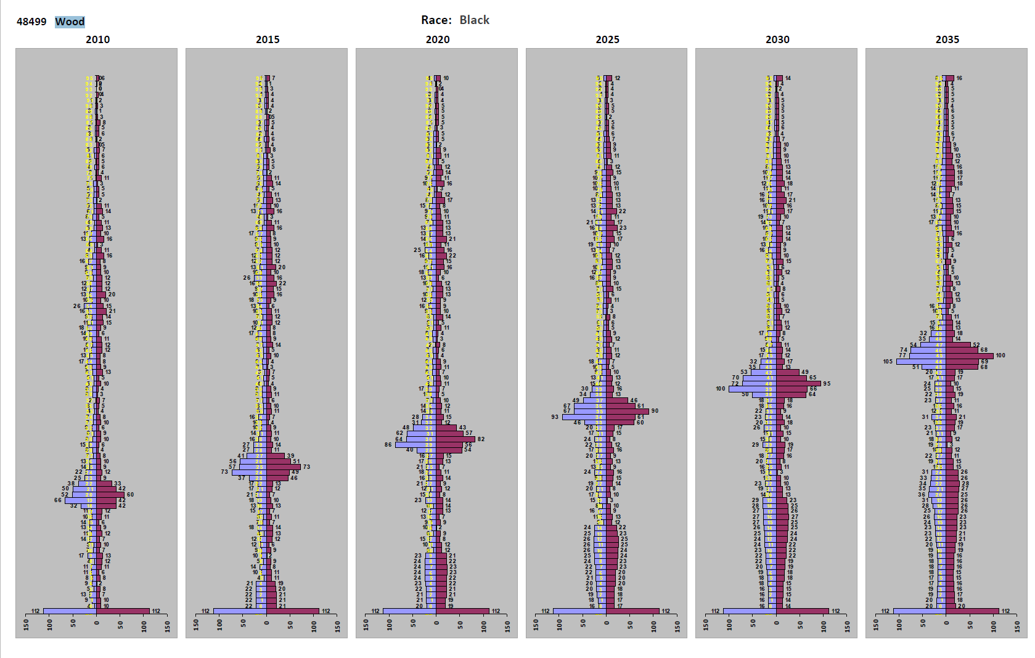
“Special” Populations – An Example

Slide 13
Texas Population Projections Program
Two ways to access projection products
Data available for downloads at http://txsdc.utsa.edu/Data/TPEPP/Projections/
Can be customized using the Population Projections Tool

Slide 14
Future Plans
No new population projections until after 2020
Potential specialized projections that we could renew
Household, work force, enrollment, educational attainment
Poverty, disability, vehicle ownership
Obesity, diabetes, cardiovascular disease, physician need
Collaborations

Slide 15
Thank you!
Questions and comments?
helen.you@utsa.edu

