Slide 1
The Texas Water Development Board’s
New Application to Display Water Service Boundaries
Presented to
2018 Texas Demographic conference
May 24, 2018
Taylor Christian
Texas Water Development Board

Slide 2
The following presentation is based upon professional research and analysis within the scope of the Texas Water Development Board’s statutory responsibilities and priorities but, unless specifically noted, does not necessarily reflect official Board positions or decisions.
Notes:
[ No Animation ]
Required disclaimer

Slide 3
Overview
Background
What is a water service boundary
Why is a water service boundary viewer needed
  Better population estimates
Future plans
Beta viewer demo

Slide 4
Background
Original service area map was produced in 2009 through a TWDB research grant.
Received a grant from USGS Water Use Data and Research Program
  Provides grants for the state’s benefit, but also to align with plans for USGS priorities
Project composed of 3 applications
  Public Site: display service boundaries and linked reports
  Editor Site: allows utility representatives to update or verify boundaries
  Admin Site: review and provide customer support
Notes:
-talk a little about the original layer and how it was created- However I will explain a little more about that in the next slide
-discuss USGS grant
-project components
Over 4,000 public water systems in texas

Slide 5
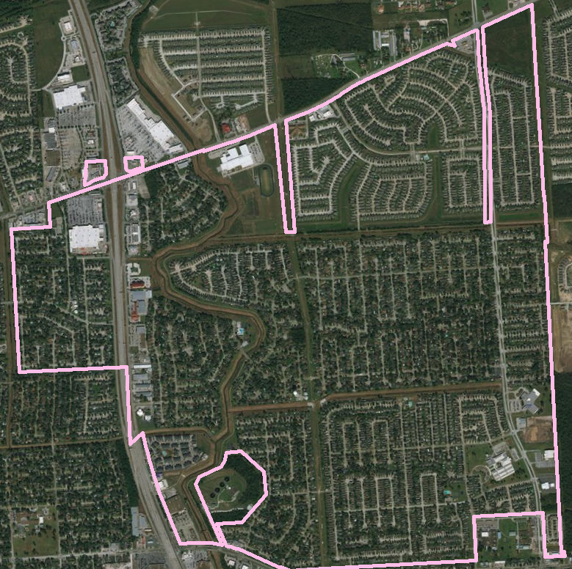
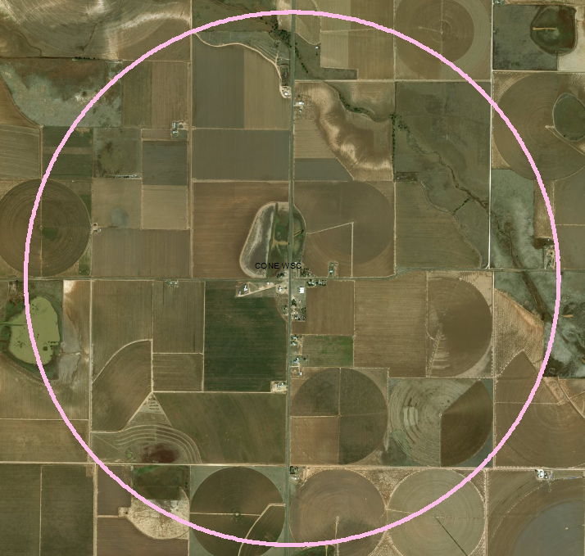
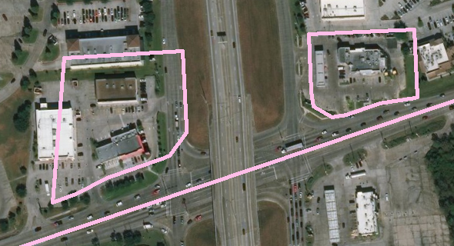
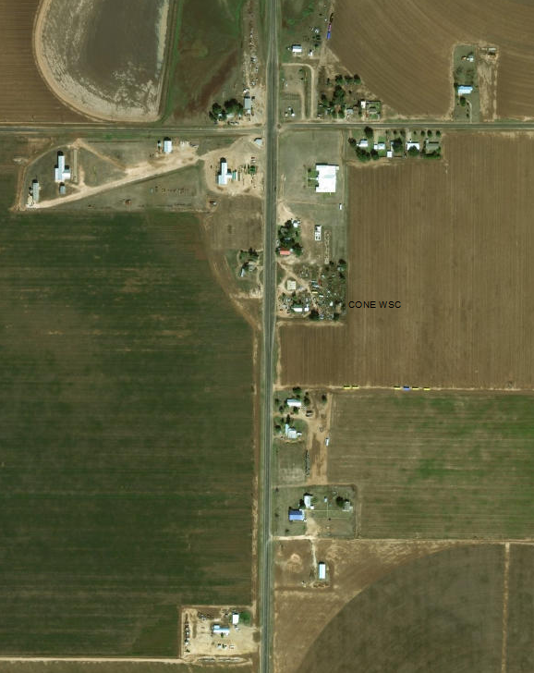
What is a Water Service Boundary?
Where a utility serves customers. Boundary that encompasses all of the resident locations the utility serves
Notes:
-We are trying to gather actual service boundaries, which as it turns out is harder than one might think.
-several agencies regulate different kind of water boundaries, and they all have different definitions for their boundaries
*click in animation-
Harris county MUD 53 is a good example of a boundary. It clearly serves these subdivisions, as well as the added detail of commercial locations they serve
Click in animation
Conse WSC an example of a boundary that was created off a well. The WSC has a well location in the middle of town and a buffer was applied- however if you look at the zoomed in detail its mostly all agg land and they probably only serve the residents in town.

Slide 6
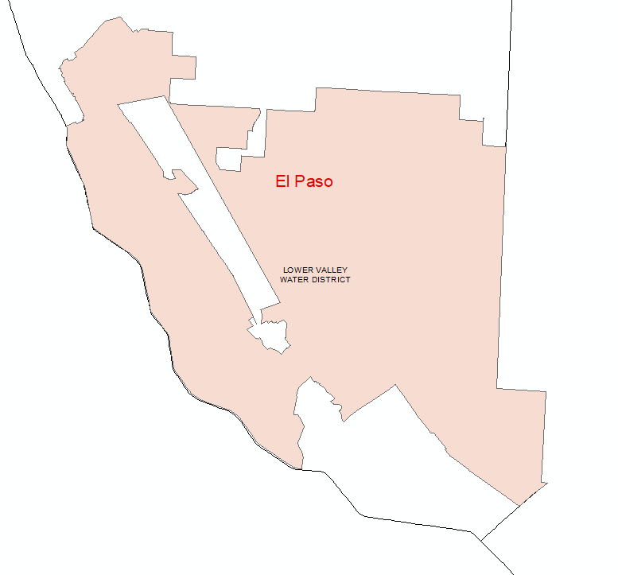
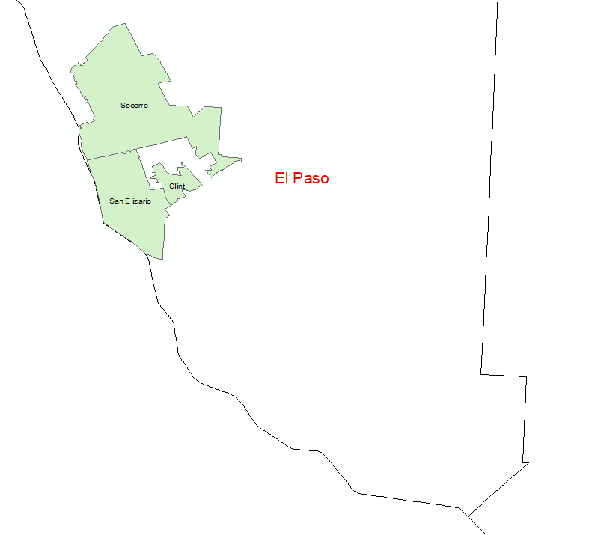
Better Boundaries, Better Population Estimates
2017 State Water Plan
  Water User Groups aligned with political boundaries, such as city limits
2022 State Water Plan
  Water User Groups aligned with water utility service area
Notes:
In the 2017 example, the cities of Socorro, San Elizario, and Clint were all WUGs in the 2017 state plant.
However In 2022 example they are all served by the Lower Valley Water District

Slide 7
Why is the Water Service Boundary Viewer Needed?
Utility boundaries can change annually
Geographically display data related to water systems to the public
Better population estimates and projections for the State Water Plan

Slide 8
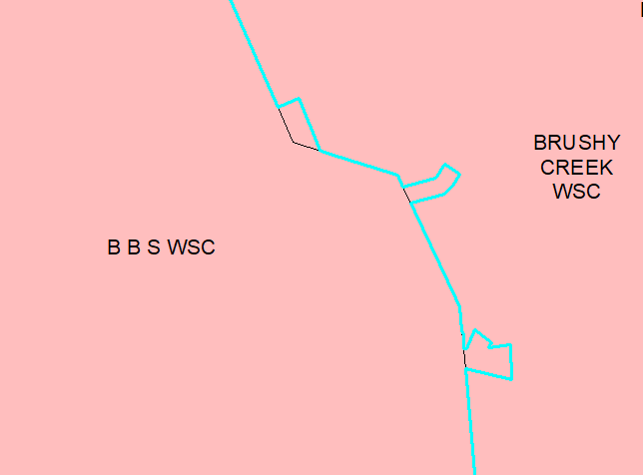
Which water system is responsible for these overlapped areas?
Notes:
Common examples of overlaps in area due to different boundary sources

Slide 9
Source | Explanation | Citation
CAD | Boundary was drawn based on information provided by the PWS using a Computer Aided Design system.
CCNBND | Certified service areas where a system has a Certificate of Convenience and Necessity (CCN) which gives the holder the exclusive right to provide retail water services to an identified geographic area. Please note the CCN boundary does not necessarily corresponded to the service area. | Public Utility Commission of Texas
CCNFAC | Certified service area that is represented by lines; however, it may also include a buffer of usually 200 feet. The lines can, but may not correspond to distribution lines or facilities in the ground and normally follow along roads. The CCNFAC is granted for a ‘point of use’ that covers only customers connections, and may not include the service area. | Public Utility Commission of Texas
CITYBND | Created using the Census city boundaries as related to the water system. Please note the city boundary may not include all of the service area for the water system. | United Stated Census Bureau
DISTRICTBND | A political subdivision whose boundaries are created by either a TCEQ order or Texas Statute. Boundaries can include fifteen different types of districts such as: Municipal Utility District, Water Control and Improvement District or Fresh Water Supply District to name a few. Please note that District boundaries may not necessarily correspond to the service area. | Texas Commission on Environmental Quality
OTHER | Polygons without clear boundary may have been created using a combination of boundaries or a placeholder for the well location. The boundaries were created using the best available data, but may not correspond to the service area.
PWS | Boundary was created by a PWS shapefile provided by the water system in 2009. Please note the boundaries may be out of date and have not been updated since 2009.
SYSTEM-VERIFIED | A representative of the water system has either updated the boundary or verified this is the correct service boundary for the water system.
Notes:
-in 2009 we began collecting PWS boundaries and combining them into a statewide layer. There is not one entity in the state that is responsible for all water service areas, so a conglomerate of different sources was combine to make a state wide layer.
-as you can see each type of boundary has a slightly different definition for example:
A CCN boundary gives the water system exclusive right to serve customers within that boundary- however that does not mean they serve everyone in the boundary, just that they have the exclusive right.
-A city has the right to serve customers within the city’s boundary, however a lot of cities serve communities or subdivisions within their Extra territorial jurisdiction- aka areas likely to be annexed by the city in the future.

Slide 10
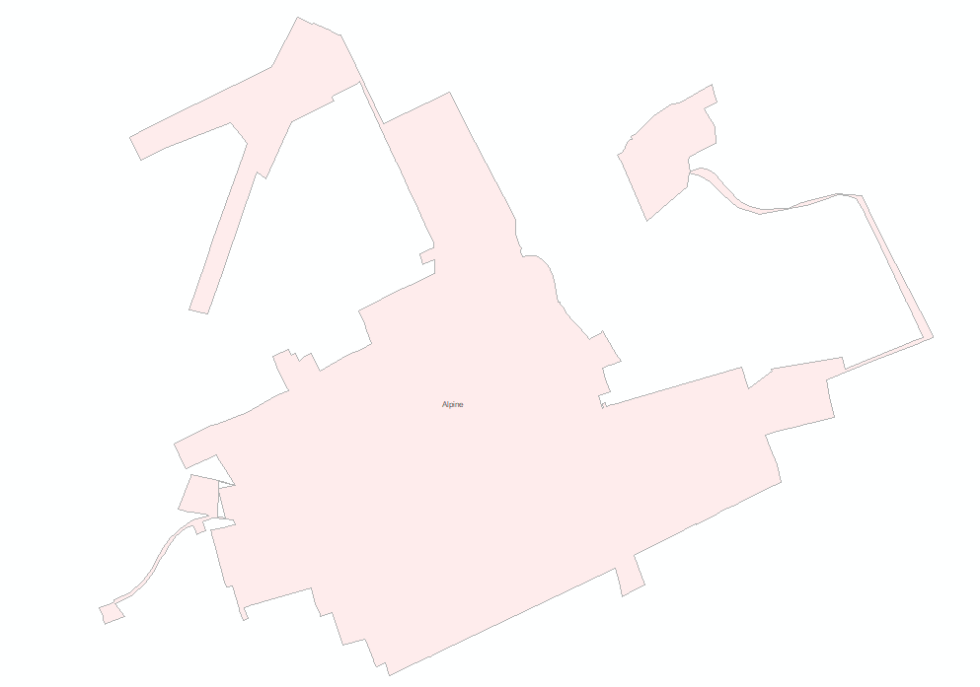
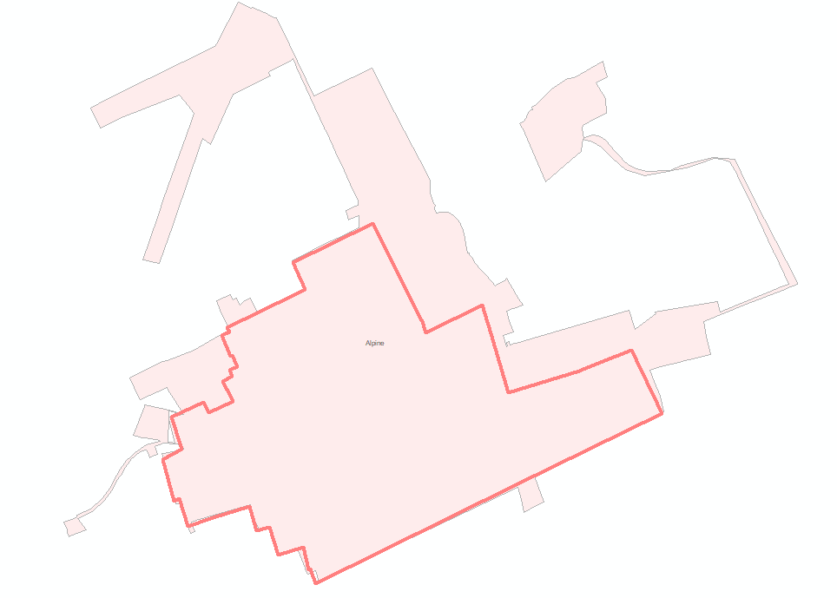
Notes:
1: The city boundary of Alpine
2: the CCN of Alpine- so while the city boundary is much larger, the utility only has the exclusive right to serve in the dark outline area

Slide 11
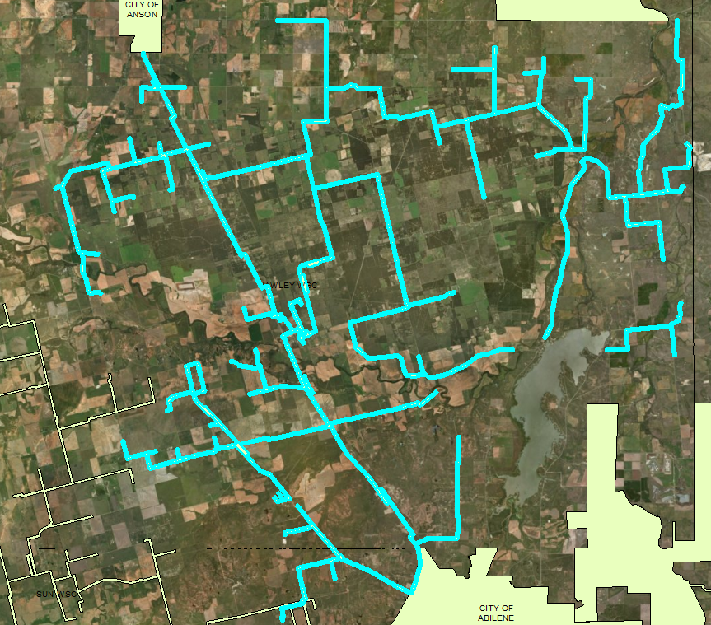
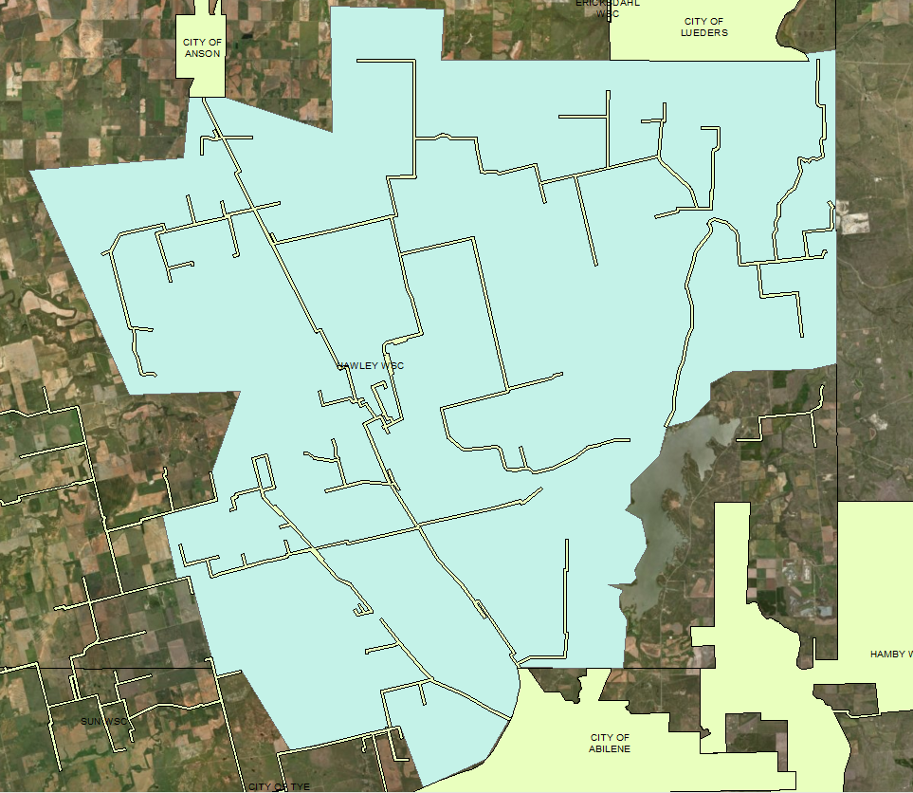
Notes:
3: CCN Facility of Hawley- These boundaries are similar to CCN but are generally service lines, or follow along roads and represent the point of connections. However the service lines may supply several areas off the lines- that would not be included in the boundary.
4: this is more realistic of where the service actually is for Hawley

Slide 12
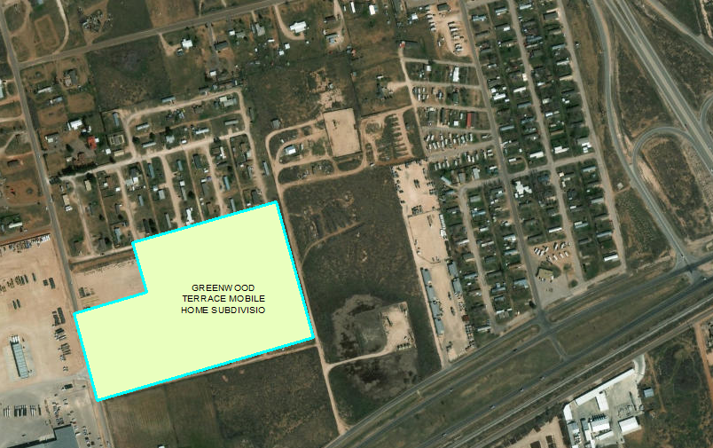
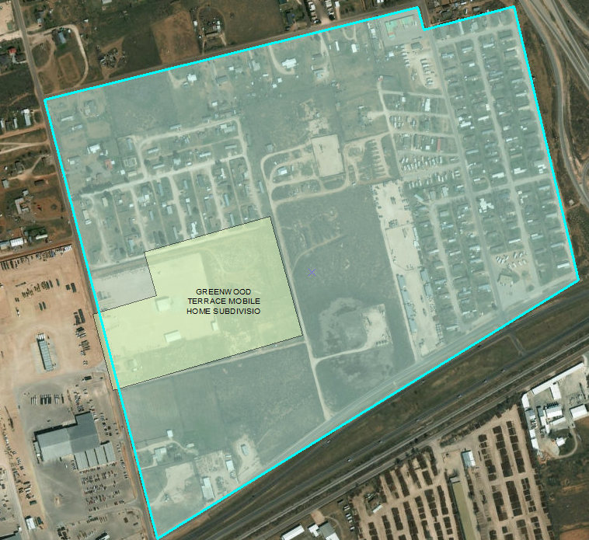
Notes:
5: Greenwood terrace mobile home: you can see that the boundary is currently in a industrial park and does not appear to have population. Just outside of the boundary you can see the actual mobile home park
6: updated boundary to include the mobile home park

Slide 13
Texas Water Service Boundary Viewer
Editors
  Current users of the Water Use Survey
  Representatives authorized through the Water Use Survey
  Allowed to edit, add, clip, delete, or verify water system boundary annually
Public
  Can view, create a map, or download a shapefile of the water system boundaries
  Reporting links to Water Use Survey, Water Loss Audit, Water Quality Data, and demographic information

Slide 14
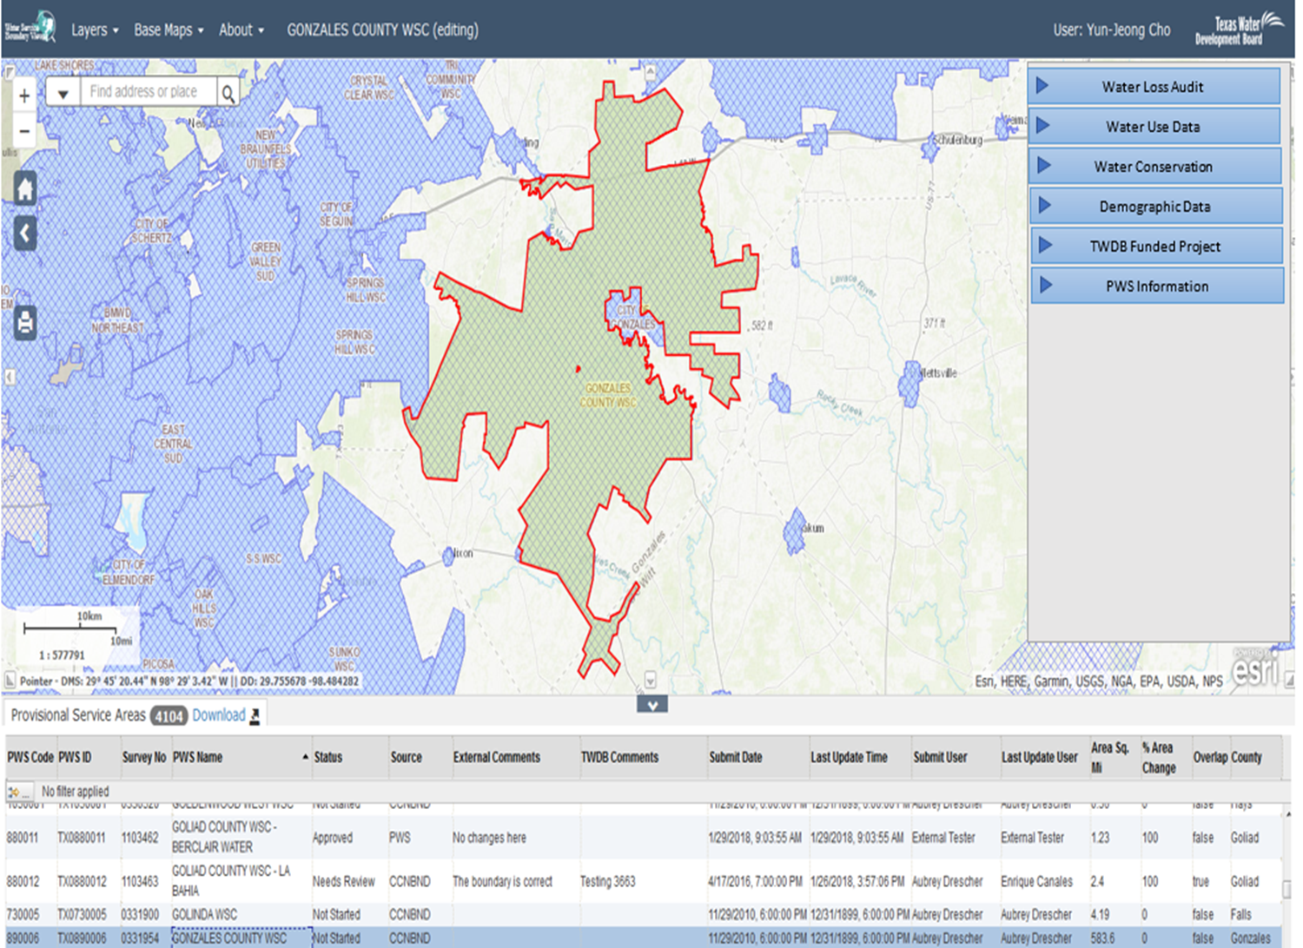
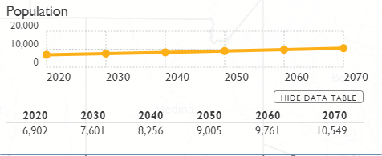
Future Plans
Create a public view dashboard
  Ideas for additional information or reports, talk to me!
Notes:
So much information is available at the PWS level. Such as Violation and other important system information from DWW- population projections, WUS reported information, just to name a few.

Slide 15
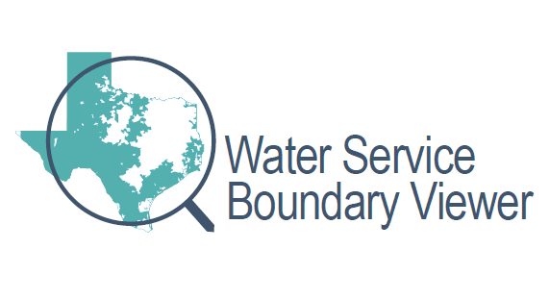
DEMO
https://www2.twdb.texas.gov/appsStage/WaterServiceBoundaries/

Slide 16

Questions?
Taylor Christian
Office: 512-463-8430
Email: Taylor.Christian@twdb.texas.gov
Texas Water Development Board

