Slide 1
Hurricane Harvey Damage Assessment for the Houston-Galveston Area
Texas Demographic Conference 2018
May 24, 2018
Austin, TX
David Dang
Data Analyst
Houston-Galveston Area Council

Slide 2
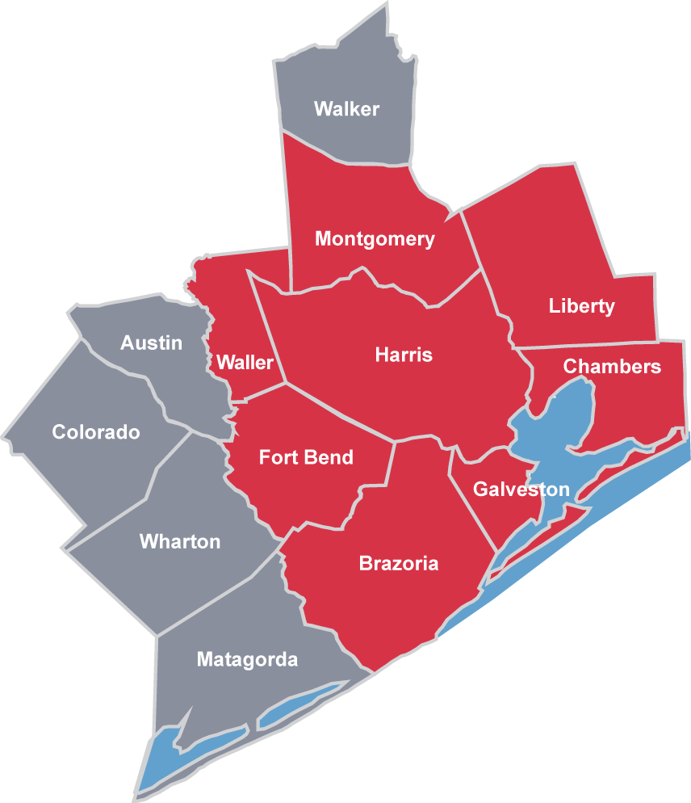
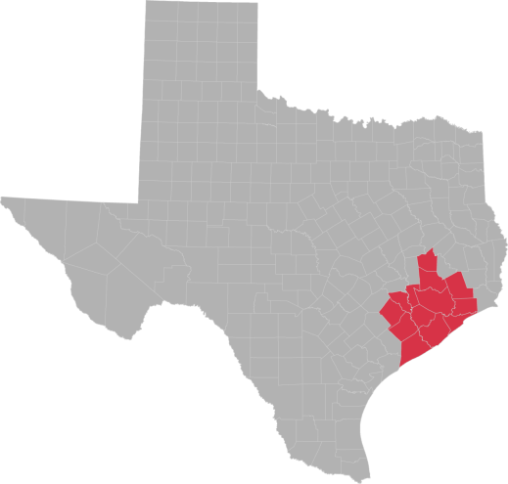
Houston-Galveston Area Council (H-GAC)
H-GAC Serves:
13 counties
134 cities
8 MPOs
6.5 million people
3 million jobs
Notes:
The HGAC is like other council of governments, a regional voluntary association of local governments.
13 counties, 134 cities and census places and 8 metropolitan planning organizations
6.5 million people

Slide 3
Houston-Galveston Area Council (H-GAC)
Forecast Group
Manage regional databases (census, economic, and real estate)
Perform regional growth forecast on regional population, employments and commute patterns
Develop interactive tools and online applications
Notes:
In the CE Department
Manage regional databases, provide regular updates and respond to internal requests, as well as data requests from different levels of governments.
Annual forecast for population, employments and commute patterns. Base for regional perspective transportation plans.
Interactive tools and online applications, story cascades, tools can be used for data visualization for the public, private sectors and government officials, to assist better decision makings.

Slide 4
Hurricane Harvey
Struck coastal Texas in August 2017
Dumped 50 inches of rain in the Houston-Galveston Area
Up to 30% of Harris County were flooded
More than 203,300 homes were damaged
Notes:
Dumped more than 50 inches of rainfall in a 4-day span, bare in mind that the annual precipitation in the Houston area is 49 inches
30% of HC flooded, more than 440 sqmi were submerged, 6 times the size of DC

Slide 5
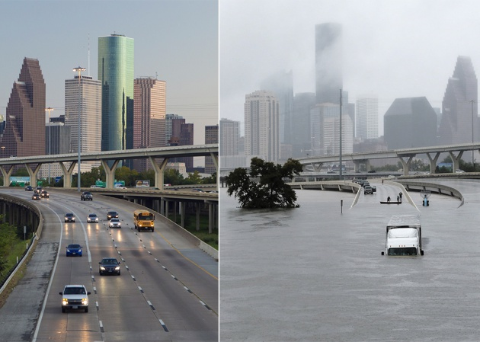
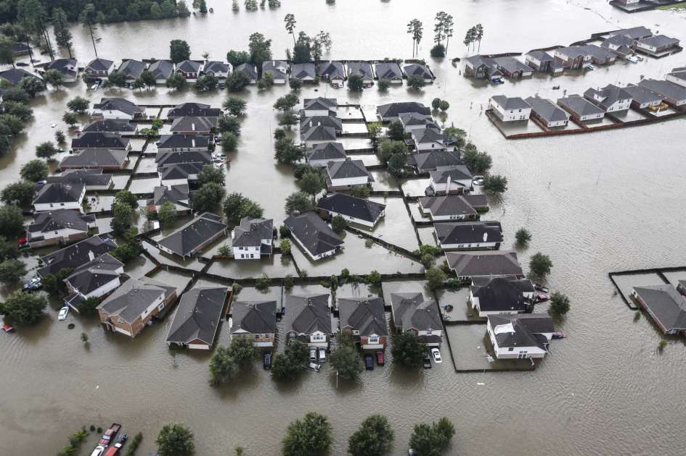
Hurricane Harvey
Photo Sources: The New York Times; Houston Chronicle
Notes:
This famous picture shows the landscape before and after Hurricane Harvey; highway submerged
Residential community are flooded, with single-family units and vehicles severely damaged.
Needless to say, the hurricane has brought substantial damage to the region.

Slide 6
H-GAC post-Harvey efforts
Interactive mapping & data visualization
Damage assessment
Vulnerable population identification
Notes:
My presentation today is going to focus on three aspects of the Harvey-related efforts from our agency, the demonstration of the online regional flood application out team has developed.
the assessment of hurricane Harvey damages, the identification of vulnerable population for future hazard mitigation processes,

Slide 7
Interactive Application: The Regional Flood Information Tool
http://www.h-gac.com/community/interactive-web-applications/default.aspx
http://arcgis02.h-gac.com/flood
Notes:
http://gis.h-gac.com/arcgis/rest/services/Socioeconomic_Modeling/Housing_suburban/MapServer

Slide 8
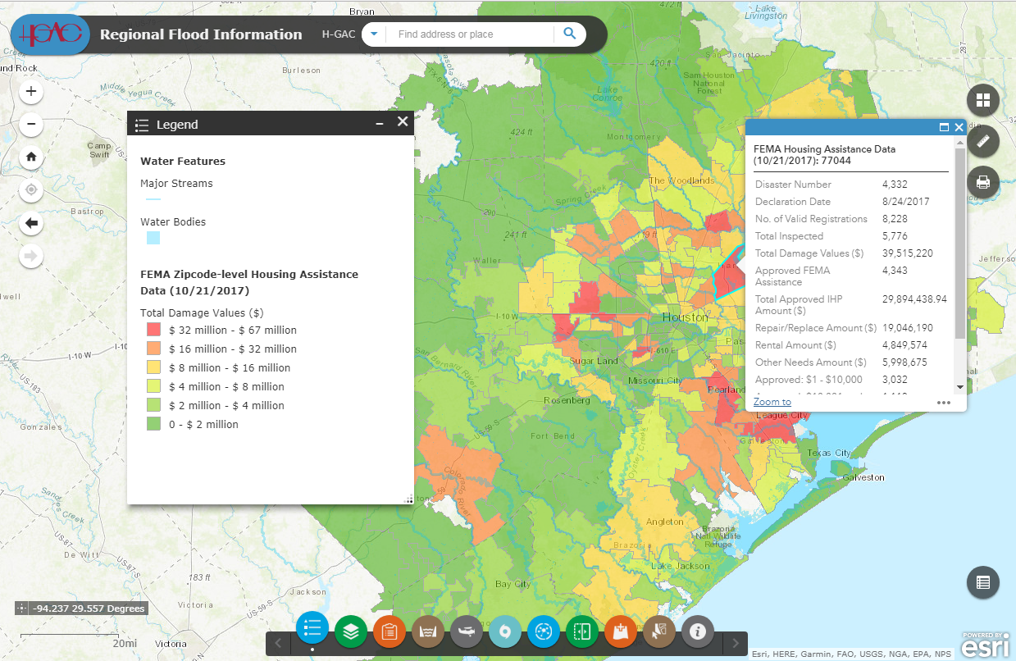
Hurricane Harvey: Regional Flood Information

Slide 9
Regional Flood Information
Development
-Based on ESRI web GIS
-JavaScript, portable-device-friendly
-Up to date database
Functions
-Input
-Display
-Analyze
-Share
Notes:
Based on ESRI web GIS, so from the core it’s a GIS tool.
JavaScript developed, which makes it feasible to be launched on any device, including portable devices.
Many data layers are directly linked to online map server. This makes the data up-to-date.
As we said, essentially a GIS tool, it possesses all four fundamental functions that any GIS platform should have, just with a specific function.
Input-to add external data in which you are interested .
Display-to display the data and visualize them on the map.
Analyze: simple locational and spatial analysis; Simplified query and filter.
Share- Export data/map features

Slide 10
Damage Assessment
FEMA Housing Assistance Data:
-Total claims
-Total population in claimed household
-Real property damage
-Personal property damage
-Insurance status
(Available at the census block level)
Notes:
Damage assessment are mostly based on FEMA data-FEMA housing assistance data, most recent updates are from March 2018
A comprehensive housing damage claim data available at census block level: following information
Also contains-foundation damage, roof damage, ownership status, renter assistance availability, repair assistance availability, replacement assistance availability.
From block level data we aggregated the data into city, county (both incorporated and unincorporated) and zip code level so that the data could be useful to the respective level of governmental officials.

Slide 11
Damage Assessment
FEMA Individual Assistance Data:
-Total number of valid registrations
-Total number of home damages
-Total number of utilities-out
-Total number of auto damages
-Total number of emergencies
-Food/Shelter assistance requirements
(Available at the zip code level)
Notes:
FEMA Individual assistance data, are records of housing-related individual level assistance data.
Records the claims/registrations of the following damage and requests.
A more direct picture of population impacted during hurricane Harvey
Useful for population-level post-disaster planning and resource allocations

Slide 12
Damage Assessment
City of Houston Building Damage Data:
Total number of damaged
-all structures
-single-family residentials
-multi-family residentials
-commercial buildings
-industry buildings
(Available at the census block level)
Notes:
It’s a property counts in each census block, the data com from several damage assessment sources:
311 service request calls
911 calls
Solid waste management department debris pickup locations
Floodplain management office high water mark data
And of course from FEMA/National flood insurance program

Slide 13
Vulnerable Population Index (VPI)
Identify minority or low-income populations that are prone to disproportionately high and adverse health or environmental effects
Used for better and more effective resource allocation and hazard mitigation
Contain the following eight populations:
Poverty
Non-Hispanic, Non-White minority
Hispanic minority
Limited English proficiency
Disability in household
Single female householder with child/children in the household
Car-less
Elderly
Notes:
Vulnerable population identification is a vital process, stated in the civil right act of 1964 saying that no person or group shall be excluded from participation in, or denied the benefits of any program or activity utilizing federal funds.
Part of the H-GAC hazard mitigation plan, to highlight the area that would potentially require more assistance, attention or allocated resources in terms of disaster relief or post-event management.
The construction of vulnerable population index (VPI), are mostly based on census-based demographic and socio-economic characteristics. These characteristics are somehow related to the decreased ability of actions, or mobility when it comes to disaster response, such as evacuation, seeking for help or rebuilt process.

Slide 14
Vulnerable Population Index (VPI)
Step 1: Extract the demographic and socio-economic data from 2016 ACS and calculate the proportion of each vulnerable population group for each block group and the H-GAC region.
BG_Var% =BG_Population_Var/BG_Total_Population
Region_Var%= Region_Population_Var/Region_Total_Population
Step 2: Calculate the vulnerability quotient for each vulnerable population category.
Quotient_Var=(BG_Var%)/(Region_Var%)
Notes:
Calculate the location quotient for each vulnerable population group.
In some cases, the vulnerable population index is calculated as the count of quotients that are above 1. Example: if there are two vulnerable population groups that have a higher proportion compared to regional proportion, the index would be 2. So for an index that consists of 8 population groups, they will be integers from 0 to 8.
The drawbacks of this method is that it doesn’t account for the severity of the vulnerability in a population. Example: regional average of 10%, 11% and 20% are both considered 1.

Slide 15
Vulnerable Population Index (VPI)
Step 3: Sum up all vulnerability quotients of all vulnerability categories for each block group. Quotient_Sum=sum(Quotient_vars) (for all categories in a block group)
Step 4: Rank all block groups in ascending order of quotient summary and then calculate the cumulative percentage. The vulnerable population index (VPI) is the cumulative percentage divided by the total quotients of all block groups in the region.
Quotient_Total=sum(Quotient_Sum) (for all block groups)
VPI=(Cumulative % of Quotient_Sum)/Quotient_Total
Notes:
We constructed the index based on cumulative percentage of summarized quotients.
The final calculated VPI will be distributed from 0 to 100%, with 100% suggesting a block group with the most vulnerable population in the region.
The distribution of the VPI and the damage assessment will be shown later in the application.

Slide 16
Post-Harvey Actions
House elevation
-Increase to 2 feet above the floodplain
-Extend to 500-year floodplain
Buyouts
Zoning debate
Flood detention
-Require both new developments and redevelopments to provide detention
Notes:
Focus not on policy or implementation
Harris County and City of Houston passed housing elevation regulations-increase the foundation of the house to 2 feet above the floodplain, previously was 1 foot. And they extended the policy to 500 year floodplain, with previous being only 100 year floodplain.
Buyouts program: a voluntary program that allows the Harris county flood control district to buy out the flooded houses and restore natural floodplain. Studies have found out there have been houses that have experienced all major floodings in the past few years so the buyout program could potentially prevent future damages. The program was initiated in 1985, and since then they have purchased more than 3000 houses and more than 1000 acres of land have been restored as natural flood plain.
Zoning debate- whether lack of zoning has contributed to the severity of the flood this time.
Flood detention and drainage- provide detention for more effective drainages. And also the flood control district have started the county-wide drainage repair project to clean debris and repair the system. Previously the city of Houston only require new developments to provide detention. From now on, if you for example build a building out of a parking lot, you also bare responsibility for providing detention.

Slide 17
THANK YOU!
Acknowledgements
Pramod Sambidi, PhD
Sungmin Lee; Lei Zhou; Entire Forecast Team; C &E Department
Forecast Group at H-GAC (www.h-gac.com) Regional Growth Forecast 2040:
http://www.h-gac.com/community/socioeconomic/2040-regional-growth-forecast/default.aspx
More online applications:
http://www.h-gac.com/community/interactive-web-applications/default.aspx
For any questions feel free to contact
cegis@h-gac.com
Notes:
Pramod Sambidi-Manager
Team members-collective efforts to pull the application together
More about the group and about the agency-a lot of information
Question feel free to reach out/
Questions before proceed to the web application

