Slide 1
Ripple Effect: Migration from Sea Level Rise Projected to Impact Texas
Mathew E. Hauer, PhD
Carl Vinson Institute of Government
University of Georgia
@thehauer

Slide 2
Motivations
Climate change, and sea level rise in particular, is one of the most pressing issues of the 21st century.
What do we really know about the impact of sea level rise on society?
I argue that sea level rise will eventually force people from coastal areas causing a reordering of the U.S. population landscape.
@thehauer

Slide 3
Motivations
This anticipated migration from sea level rise is unique for three reasons:
1) This migration will be larger than the Great Migration.
2) We largely know this migration is going to happen.
3) We are equipped to understand how this migration will likely unfold.
Despite the anticipation of this migration, there is a severe lack of consistent findings on sea level rise induced migration over the past 30-40 years.
@thehauer

Slide 4
Motivations
Hauer, ME, Evans J, & Mishra, D. “Millions projected to be at risk from sea level rise in the Continental United State.” Nature Climate Change (2016).
Hauer, ME. “Migration induced by sea level rise could reshape the US population landscape.” Nature Climate Change (2017).
@thehauer

Slide 5
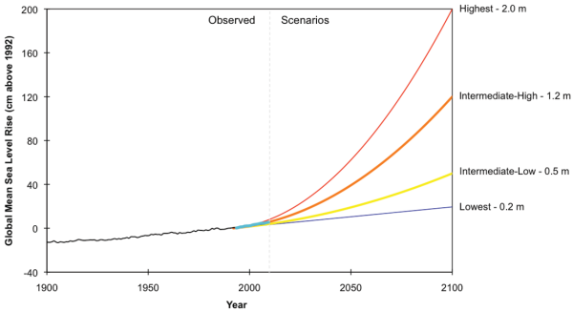
Sea Level Rise
Sea levels have risen by approximately eight inches since 1900.
Sea levels are expected to rise between 1m and 2m+ by 2100.
Multi-centennial projections show total sea level rise could be up to 7m by 2300.
@thehauer

Slide 6
Sea Level Rise
How many people could be displaced by sea level rise?
Where will they go?
@thehauer

Slide 7
Overview
Sea Level Rise Migration
Migration Framework
Magnitude of Flows
@thehauer

Slide 8
How Many? Two problems
Use of Current Population creates Temporal Mismatch.
Current Estimates likely underestimate impacts.
@thehauer

Slide 9
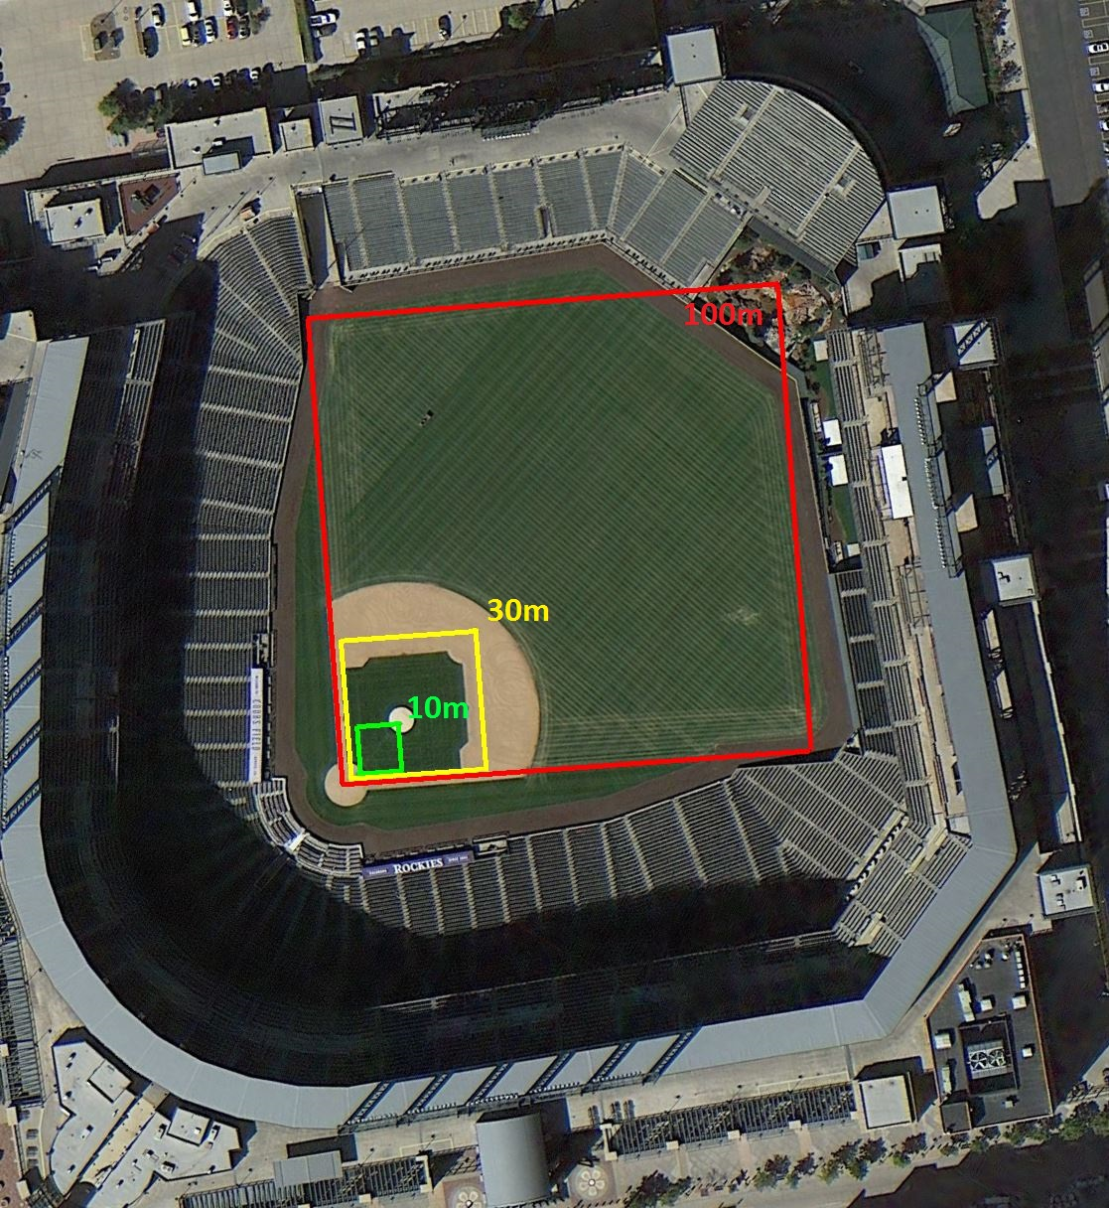
How Many?
Use of Current Population creates Temporal Mismatch.
Current Estimates likely underestimate impacts.
Scale issues create Spatial Mismatch.
@thehauer

Slide 10
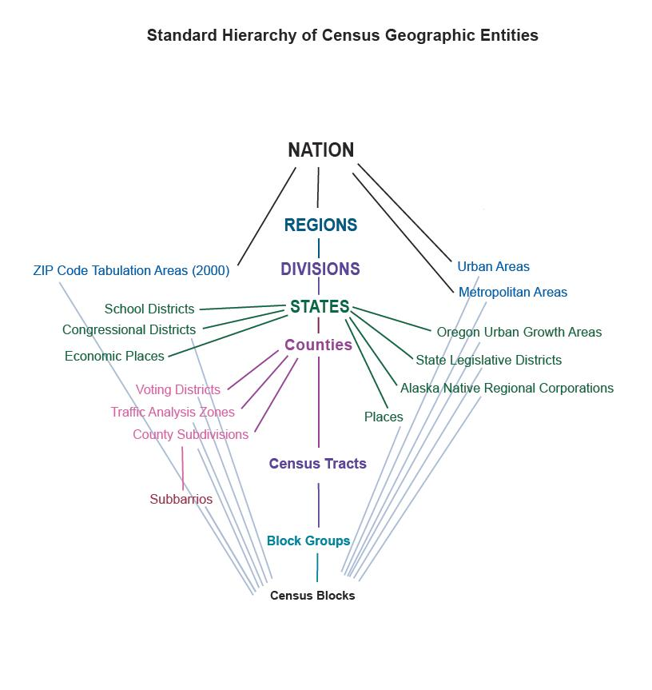
U.S. Sea Level Rise
Projected Total Population for 70,000+ Census Block Groups.
Linear/Exponential regression-based extrapolation approach for the period 1940-2010.
Area approach to assess populations at risk from future sea level rise scenarios
Assess the 3ft (0.9m) and 6ft (1.8m) scenarios.
@thehauer

Slide 11
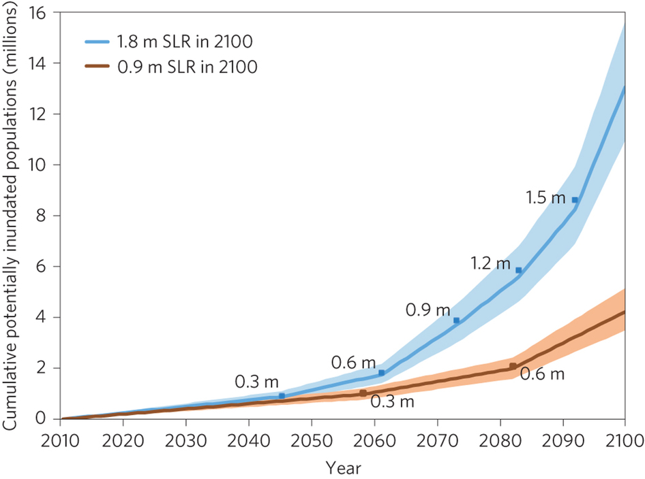
U.S. Sea Level Rise
13.1 million
Hauer, ME, Evans J, & Mishra, D. “Millions projected to be at risk from sea level rise in the Continental United State.” Nature Climate Change (2016).
@thehauer

Slide 12
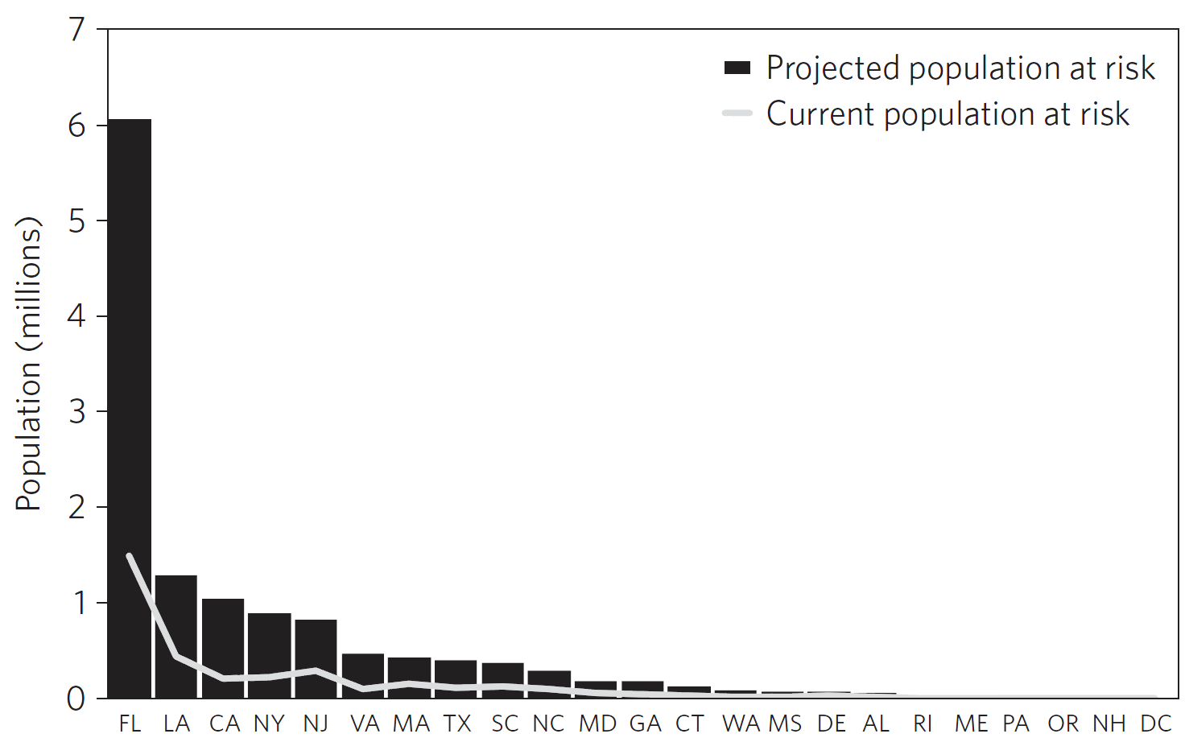
U.S. Sea Level Rise
13.1 million
@thehauer

Slide 13
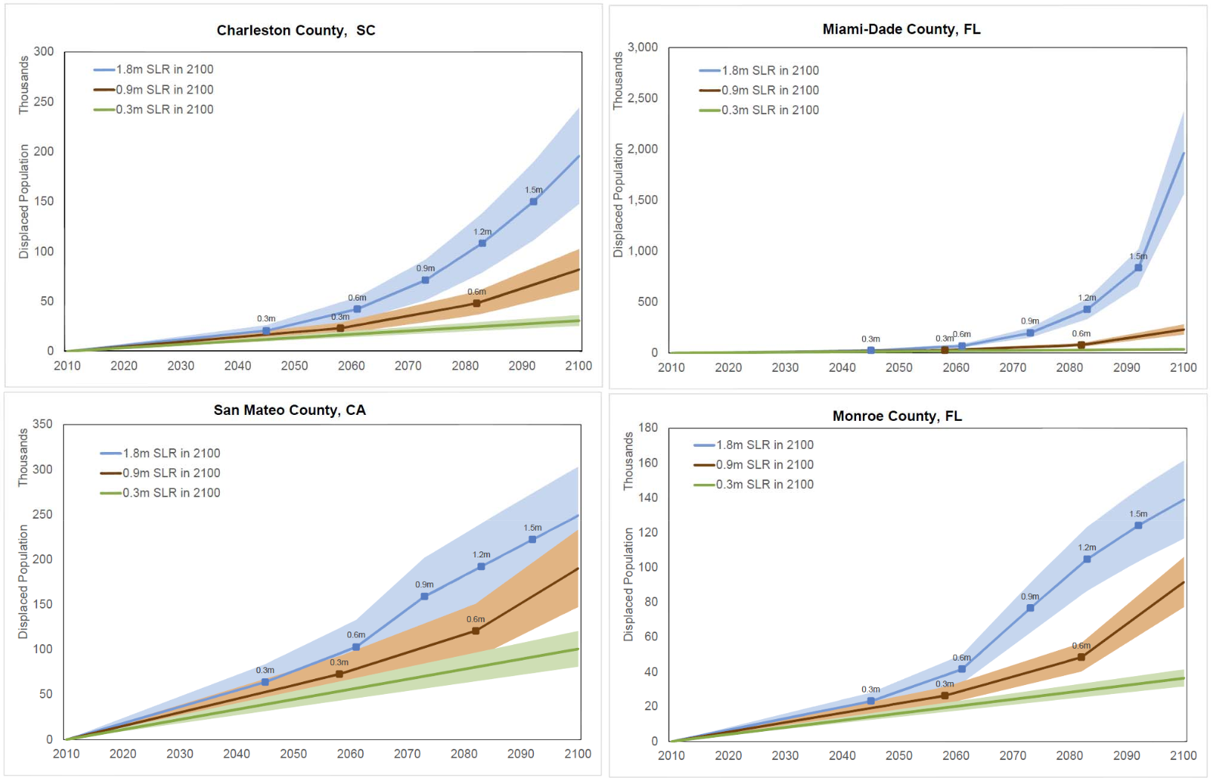
U.S. Sea Level Rise
@thehauer

Slide 14
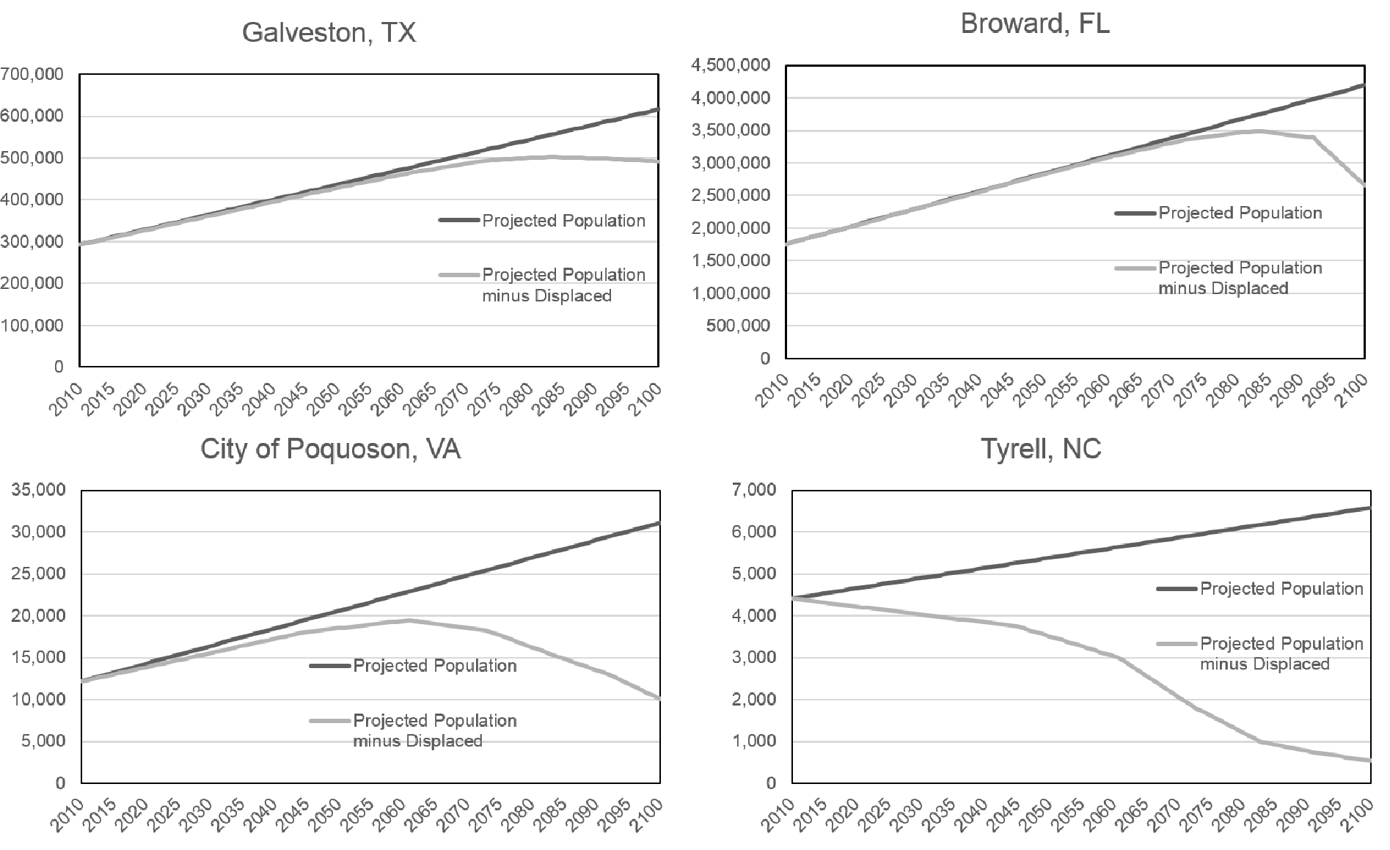
U.S. Sea Level Rise – Feedback Loops
@thehauer

Slide 15
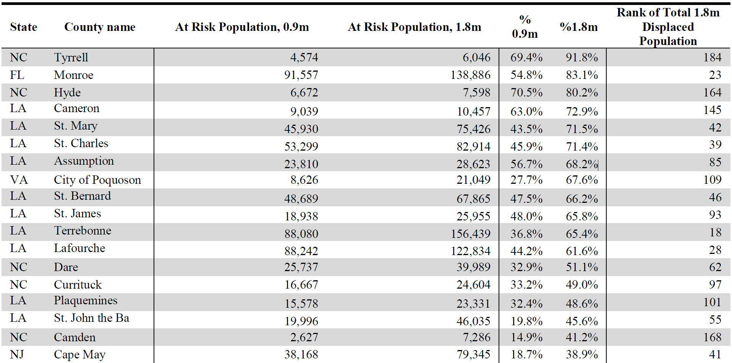
U.S. Sea Level Rise – Extended Results
@thehauer

Slide 16
U.S. Sea Level Rise – Texas
Galveston – 124k
Jefferson – 109k
Brazoria – 42k
Harris – 30k
Orange – 26k
Nueces – 18k
Cameron – 16k
Chambers – 12k
Aransas – 12k
San Patricio – 5k
Matagorda – 4k
Calhoun – 4k
Willacy – 0.5k
Kleberg – 0.5k
Jackson – 0.4k
Victoria – 0.2k
Refugio – 0.1k
Kenedy – 0.1k
@thehauer

Slide 17
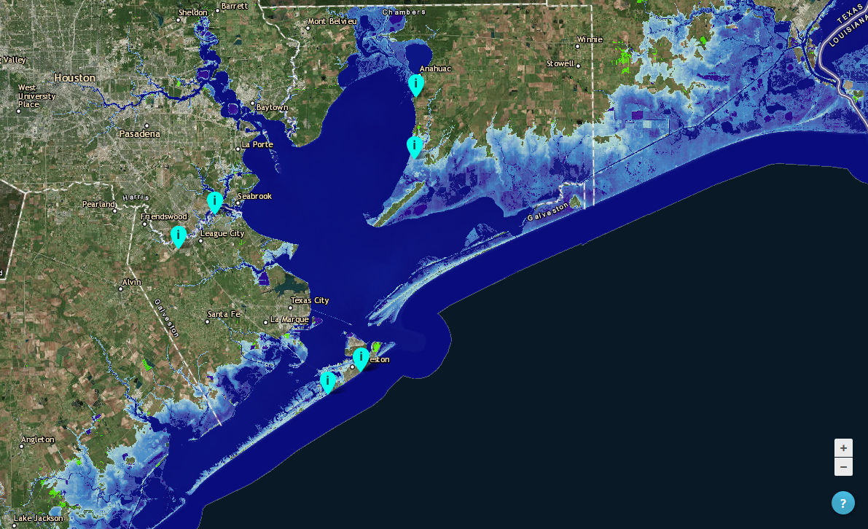
@thehauer

Slide 18
U.S. Sea Level Rise – Extended Results
Catastrophic Impacts - Tyrell NC, Monroe FL, and Hyde NC (80%+ displaced).
6 counties with 100k+ impacted with less than 0.9m.
31 counties with 100k+ impacted with 1.8m.
2 Texas counties with over 100k+ impacted with 1.8m.
Miami-Dade and Broward counties = 1 in 4 persons impacted.
$1 million per resident to relocate = up to $15 trillion.
@thehauer

Slide 19
Sea Level Rise Assessments
SLR assessments that identify the number and locations of potentially displaced persons are common in the literature.
Where will the millions of potentially displaced persons go?
General hypotheses, but there are no studies modeling SLR induced migration.
By focusing on coastal communities, we likely oversimplify SLR impacts and underestimate the scale and magnitude of these impacts.
@thehauer

Slide 20
Environmental Migration
Migration destination decisions tend to be driven by established networks of social capital and kin networks.
Environmental stressors act independently of the “pull factors” associated with migration.
Thus, climate migrants will likely constitute “enhanced,” or extra, normal out-migration.
@thehauer

Slide 21
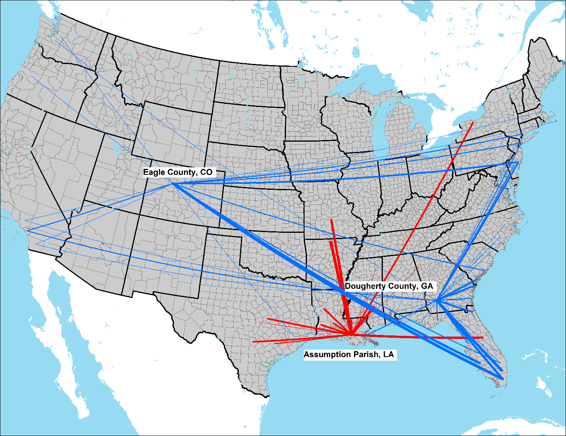
Sea level Rise Migration
“Displacement” comes from Hauer et al 2016¹.
Migration information come from origin-destination matrices of simulated migration systems for all coastal counties affected by SLR (n=319) and all possible destinations (n=3,113).
Data comes from the IRS’ annual series of county-to-county migration flow data for the years 1990-2013.
¹Hauer et al. 2016. “Millions projected to be at risk from sea-level rise in the continental United States.” Nature Climate Change
@thehauer

Slide 22
Sea level Rise Migration
To capture temporal variability, I used unobserved components modeling (UCM) for each origin-destination pair.
@thehauer

Slide 23
Sea level Rise Migration
Two additional considerations:
Some people could migrate to coastal areas unaffected by SLR.
Projected migrants adjusted based on the unaffected populations remaining
Some communities will deploy a wide variety of adaptation measures.
I assume households earning more than $100k/year are likely to adapt in some manner. This is approximately the top quartile and double the US median HH income.
@thehauer

Slide 24
Bi-Lateral Migration, 1.8m & No Adaptation
@thehauer

Slide 25
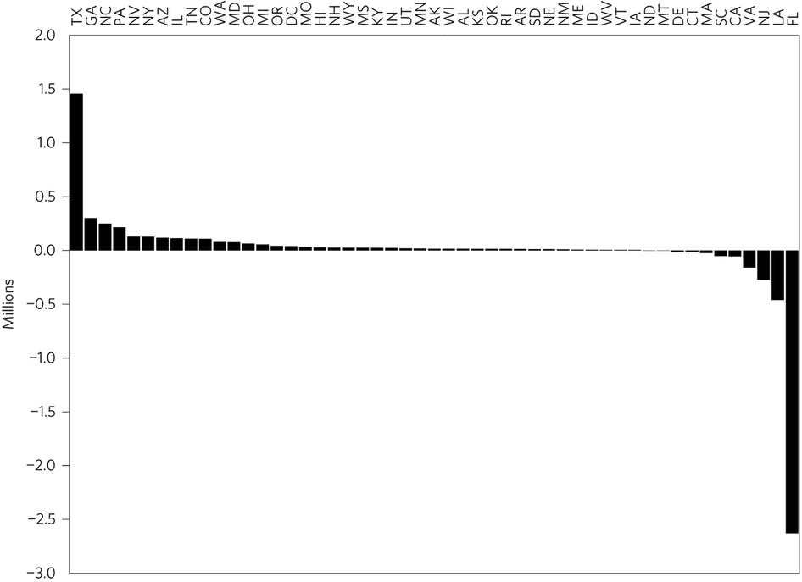
Net change due to 1.8m of Sea Level Rise
@thehauer

Slide 26
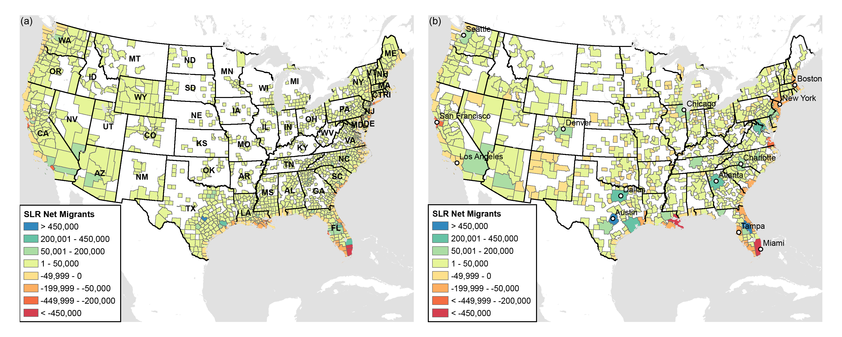
Sea Level Rise Migration
@thehauer

Slide 27
Sea Level Rise Migration
@thehauer

Slide 28
Sea Level Rise Migration
County | In-Migrants | Out-Migrants | Net-Migrants | Rank
Travis | 778k | - | 778k | 1
Harris | 330k | 30k | 300k | 2
Fort Bend | 90k | - | 90k | 15
Dallas | 89k | - | 89k | 16
Tarrant | 80k | - | 80k | 19
Cameron | 5k | 16k | (11k) | 1,673
Orange | 13k | 27k | (14k) | 1,679
Brazoria | 27k | 43k | (15k) | 1,685
Jefferson | 13k | 109k | (96k) | 1,730
Galveston | 16k | 125k | (109k) | 1,732
@thehauer

Slide 29
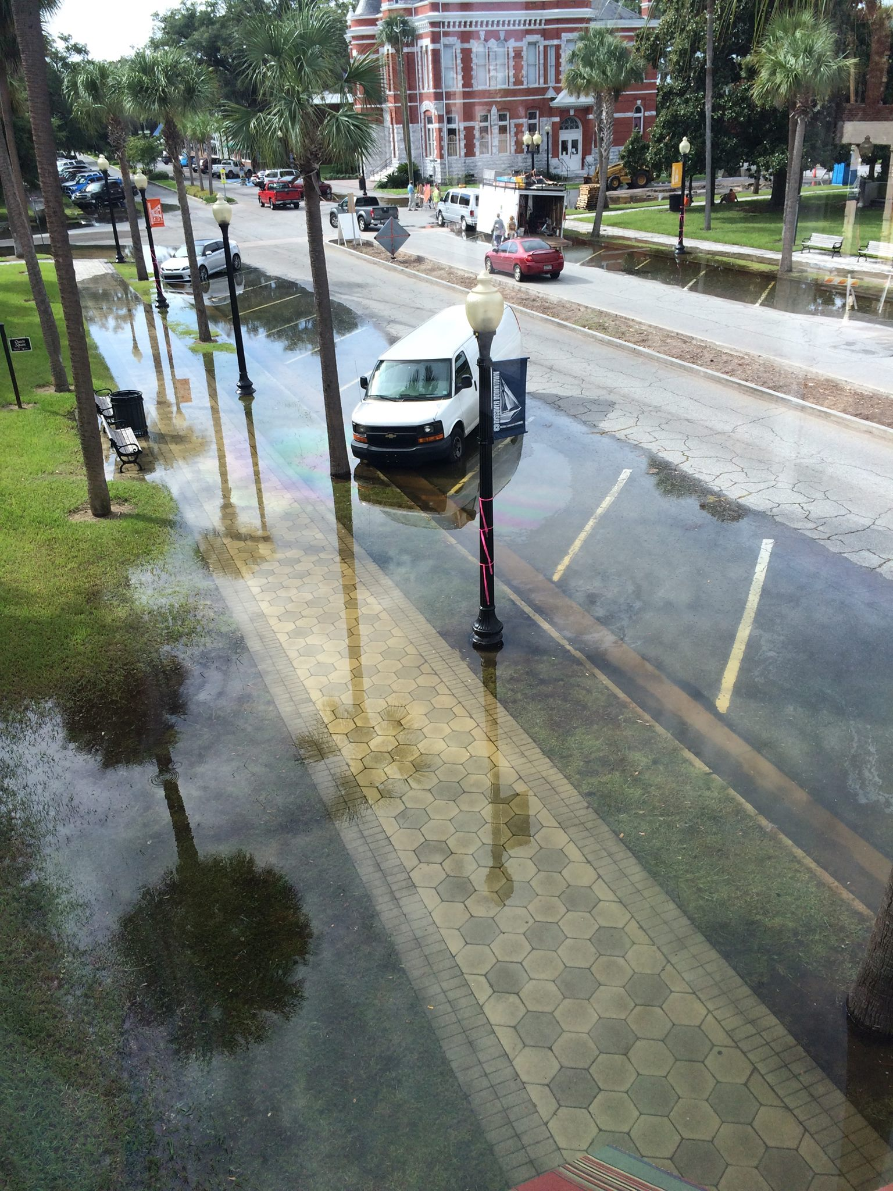
Conclusion
Millions of people will be exposed to sea level rise by the end of the century.
Sea level rise is not just a coastal hazard but will have ripple effects across the entire continent.
The sheer magnitude of SLR induced migration could alter the U.S. population distribution.
@thehauer

Slide 30
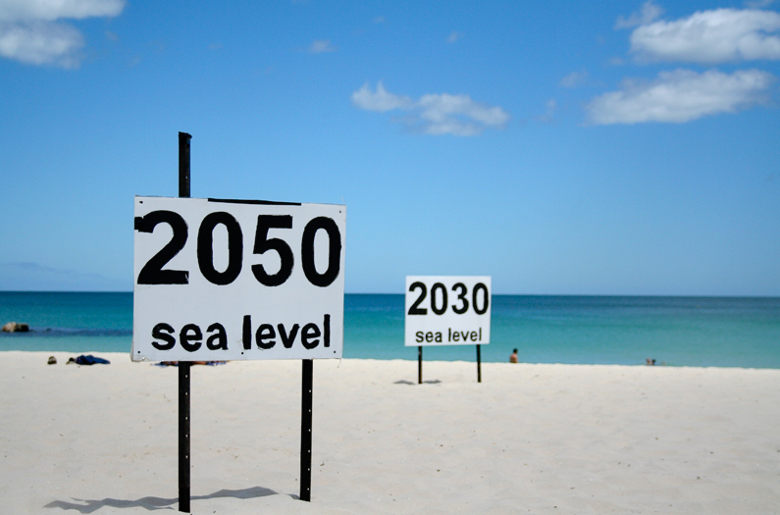
Thank you!
Mathew E. Hauer
University of Georgia
hauer@uga.edu
706.542.9369
www.vinsoninstitute.org
@thehauer

