Slide 1
The Changing Population of Texas and West Texas Counties
10th Annual West Texas Legislative Summit
Immigration Issues:
Our Future Texas Workforce
August 8, 2013
San Angelo, TX
Notes:
Lila Valencia is Legislative Liaison and Special Research Associate at the Office of the State Demographer.

Slide 2
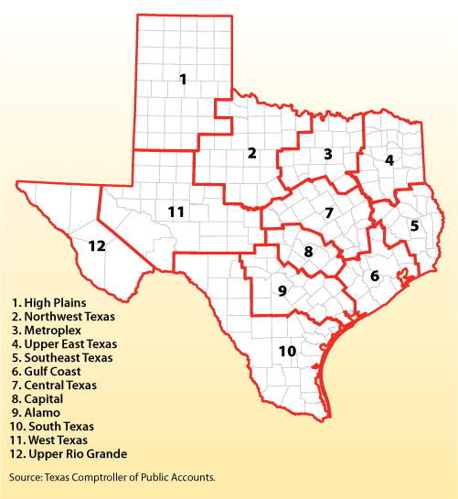
Notes:
This presentation will focus on the counties in Region 11, labeled as West Texas, of the Texas Comptroller of Public Accounts Economic Regions.

Slide 3
Select Growing Areas, 2000-2010
 | 2000 Population* | 2010 Population* | Numerical Change 2000-2010 | Percent Change 2000-2010
United States | 281,421,906 | 308,745,538 | 27,323,632 | 9.7%
Texas | 20,851,820 | 25,145,561 | 4,293,741 | 20.6%
California | 33,871,648 | 37,253,956 | 3,382,308 | 10.0%
Florida | 15,982,378 | 18,801,310 | 2,818,932 | 17.6%
Georgia | 8,186,453 | 9,687,653 | 1,501,200 | 18.3%
North Carolina | 8,049,313 | 9,535,483 | 1,486,170 | 18.5%
Arizona | 5,130,632 | 6,392,017 | 1,261,385 | 24.6%
West Texas | 524,884 | 571,871 | 46,987 | 9.0%
Ector County | 121,123 | 137,130 | 16,007 | 13.2%
Midland County | 116,009 | 136,872 | 20,863 | 18.0%
Tom Green County | 104,010 | 110,224 | 6,214 | 6.0%
Note: Population values are decennial census counts for April 1, 2000 and April 1, 2010.
Source: U.S. Census Bureau. 2000 and 2010 Census Counts.
Notes:
Texas is the second largest state in terms of population (2nd to CA) and area (2nd to AK). In terms of number of people, Texas’ growth exceeds that of all other states between 2000 and 2010.
The fastest growing counties in West Texas include: Loving (albeit with a very small population), Gaines, Midland, Schleicher, Andrews, and Ector Counties.

Slide 4
Total Population by County, 2010
Total Population
Population % Change, 2000 to 2010
Source: U.S. Census Bureau. 2000 and 2010 P.L. 94-171 Redistricting Data.
Maps produced by the Office of the State Demographer.
Notes:
Texas population growth is not occurring uniformly across counties. The map on the left shows the counties of Harris, Bexar, Dallas, Tarrant, and Travis are the most populated in the State. Collin, Denton, Fort Bend, Hidalgo, and El Paso counties also have significant population concentrations. Many counties west of Interstate 35 are more sparsely populated.
The darker blue colors on the map on the right indicate counties with greater percentage change. The counties that are shaded in tan and red mostly experienced negative change, or population decline. Thus, many of the more rural, less populated counties have experienced declines in population over the past ten years. Most counties experienced increases within 10% to 25%, while a smaller number of counties surrounding urbanized areas experienced significant growth beyond 25%.

Slide 5
Total Estimated Population by County, 2012
Along and east of I-35:
40% of land
85% of population
92% of population growth (2011-2012)
Source: U.S. Census Bureau 2012 Population Estimates
Notes:
The counties of Harris, Bexar, Dallas, Tarrant, and Travis are the most populated in the State. Collin, Denton, Fort Bend, Hidalgo, and El Paso counties also have significant population concentrations. Many counties west of Interstate 35 are more sparsely populated.

Slide 6
The 10 Fastest Growing Metro Areas
Increase from July 1, 2011, to July 1, 2012
 |  | Percent Increase
1. | Midland, Texas | 4.6
2. | Clarksville, Tenn.-Ky. | 3.7
3. | Crestview-Fort Walton Beach-Destin, Fla. | 3.6
4. | The Villages, Fla. | 3.4
5. | Odessa, Texas | 3.4
6. | Jacksonville, N.C. | 3.3
7. | Austin-Round Rock, Texas | 3.0
8. | Casper, Wyo. | 3.0
9. | Columbus, Ga.-Ala. | 2.9
10. | Manhattan, Kan. | 2.8
Source: U.S. Census Bureau, 2012

Slide 7
Total Population and Components of Population Change in Texas, 1950-2012
 |  |  |  | Percent Change Due to
Year* | Population | Numerical Change** | Percent Change | Natural Increase | Net Migration
1950 | 7,711,194 | -- | -- | -- | --
1960 | 9,579,677 | 1,868,483 | 24.2 | 93.91 | 6.09
1970 | 11,196,730 | 1,617,053 | 16.9 | 86.74 | 13.26
1980 | 14,229,191 | 3,032,461 | 27.1 | 41.58 | 58.42
1990 | 16,986,510 | 2,757,319 | 19.9 | 65.85 | 34.15
2000 | 20,851,820 | 3,865,310 | 22.8 | 49.65 | 50.35
2009 | 24,782,302 | 3,930,484 | 18.8 | 54.04 | 45.33
2010 | 25,145,561 | 4,293,741 | 20.6
2011 | 25,674,681 | 529,120 | 2.1 | 54.79 | 44.99
2012 | 26,102,106 | 427,425 | 1.7 | 50.31 | 49.27
* All values for the decennial dates are for April 1st of the indicated census year. Values for 2009, 2011, and 2012 are for July 1, as estimated by the U.S. Census Bureau. ** Change is from previous decade/time period
Note: Residual values are not presented in this table.
Source: Derived from U.S. Census Bureau Estimates for dates indicated by the Texas State Data Center.
Notes:
The components of change include natural increase (births-deaths) and net migration (in-out migration). In recent years, natural increase and net migration have contributed almost equally to Texas’ growth. Natural increase is much more predictable and stable than net migration. Net migration tends to fluctuate with economic factors. Between 2010 and 2012, Texas’ growth continues, but appears to have slowed some between 2011 and 2012.

Slide 8
Total Population and Components of Change for Midland County, 2010-2012
 |  |  |  | Percent of Change Due to
Year | Population | Numerical Change | Percent Change | Natural Increase | Net Migration
2010 | 136,872 | -- | -- | -- | --
2011 | 140,034 | 9,773 | 7.1 | 29.2 | 68.9
2012 | 146,645 | 6,611 | 4.7 | 19.1 | 79.3
Value for 2010 is for the decennial census conducted April 1, 2010. Values for 2011 are for July 1, as estimated by the U.S. Census Bureau. ** Change is from previous time period
Note: Residual values are not presented in this table.
Source: Derived from U.S. Census Bureau Estimates for dates indicated by the Texas State Data Center.
Notes:
Midland County is experiencing more growth due to net migration rather than natural increase. Additionally, net migration is overwhelmingly due to domestic migration.

Slide 9
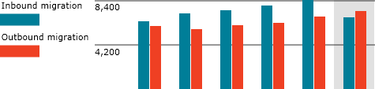
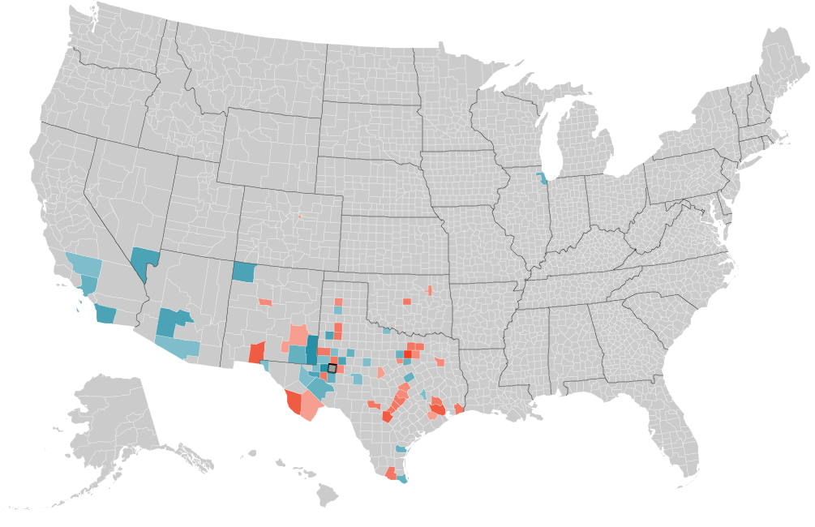
Source: Internal Revenue Service, as cited by Forbes.com
Notes:
Midland County is gaining population from within the state as well as from other states including, California, New Mexico, Arizona, Nevada, and Illinois. Outbound migration is leaving Midland County for the large urban counties including, Bexar, Harris, Travis, Dallas, and Denton, as well as other surrounding counties. New Mexico and Oklahoma have also received domestic migrants from Midland County.

Slide 10
Texas Racial and Ethnic Composition,
2010
Source: U.S. Census Bureau. 1990, 2000, and 2010 Census counts.
Notes:
As of the 2000 Census, about 53% of Texas’ population was non-Hispanic Anglo, about 32% where of Hispanic descent, about 11% where non-Hispanic African American, and about 4% were non-Hispanic Other.
In 2010, it is estimated that about 45% of the Texas population was non-Hispanic Anglo, 38% of Hispanic descent, 11% were non-Hispanic African American, and about 6% were non-Hispanic Other (largely of Asian descent).

Slide 11
Texas Population Pyramids by Race/Ethnicity, 2010
Median age
Source: Derived from U.S. Census Bureau 2010 Summary File 1 data by the Office of the State Demographer.
Notes:
The trends suggested in our State Data Center projections can be better understood when we examine the age distribution by race/ethnicity.
Texas is young. Approximately 27% of Texas are under 18, and 10% of the population is over 65 years. However, this age distribution varies by race/ethnicity. This Texas population pyramid indicates that the portion of the population that is non-Hispanic White is generally older than the other racial/ethnic groups. The portion of the population that is of Hispanic descent is comparatively young. This is also true for the African American portion of the population.
The median age of Hispanic males in Texas is 26.3 and 27.6 for Hispanic females in Texas. This compares to a median age of 40.3 for non-Hispanic White males and 42.4 for non-Hispanic White females in Texas.

Slide 12
Texas Population Pyramid, 2010
Median age
Source: Derived from U.S. Census Bureau 2010 Summary File 1 data by the Office of the State Demographer.
Notes:
The median age for Texas males is 32.6 years of age, while the median for Texas women is 34.6 years of age.

Slide 13
Midland County Population Pyramid, 2010
Source: Derived from U.S. Census Bureau 2010 Summary File 1 data by the Office of the State Demographer.

Slide 14
Projected Population Growth in Texas, 2010-2050
Source: Texas State Data Center 2012 Population Projections

Slide 15
Projected Population Growth for West Texas,
2000-2050
Migration Scenarios
Source: Texas State Data Center. 2008 Population Projections, 2000-2007 Migration Scenario.
Notes:
In Smith County, it is projected the Hispanic population will not exceed the NH White population until about a decade later than the State as a whole. Here again we see a more rapid decline in the NH Black population and a slight increase in the NH Other population.

Slide 16
Projected Racial and Ethnic Percent, Texas, 2010-2050
Source: Texas State Data Center 2012 Population Projections , 2000-2010 Migration Scenario

Slide 17
Projected Racial and Ethnic Percent, West Texas, 2010-2050

Slide 18
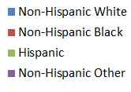
Race/Ethnic Composition by Education Level in the Labor Force (aged 25 years and more), Texas, 2009
College and Greater
Less Than High School
Source: Derived from 2009 American Community Survey 1-Year Estimates by the Office of the State Demographer.

Slide 19
Percent of Population with a High School Degree by Race/Ethnicity, 2010 to 2050
 | Trend Assumption |  |  | Constant Rates
 | 2010 | 2050 | Change 2010-50 | 2010 | 2050 | Change 2010-50
Mig 0.5
White | 93.0% | 98.2% | 5.2 | 93.0% | 93.1% | 0.1
Black | 88.0% | 96.7% | 8.8 | 88.0% | 87.7% | -0.3
Hispanics | 64.3% | 88.7% | 24.4 | 64.3% | 63.7% | -0.7
Other | 88.7% | 95.7% | 7.0 | 88.7% | 88.3% | -0.3
Mig 1.0
White | 93.0% | 98.2% | 5.2 | 93.0% | 93.1% | 0.1
Black | 88.0% | 96.7% | 8.8 | 88.0% | 87.7% | -0.3
Hispanics | 64.3% | 88.7% | 24.3 | 64.3% | 63.6% | -0.7
Other | 88.7% | 95.7% | 0.1 | 88.7% | 88.4% | -0.3

Slide 20
Percent of Population with Bachelor’s Degrees or Higher by Race/Ethnicity, 2010 to 2050
 | Trend Assumption |  |  | Constant Rate
 | 2010 | 2050 | Change 2010-50 | 2010 | 2050 | Change 2010-50
Mig 0.5
White | 32.7% | 42.0% | 9.3 | 32.7% | 33.1% | 0.4
Black | 17.9% | 29.3% | 11.5 | 17.9% | 18.0% | 0.2
Hispanics | 10.4% | 19.4% | 9.0 | 10.4% | 10.6% | 0.3
Other | 47.6% | 66.9% | 19.2 | 47.6% | 47.1% | -0.5
Mig 1.0
White | 32.7% | 42.0% | 9.3 | 32.7% | 33.1% | 0.4
Black | 17.9% | 29.3% | 11.5 | 17.9% | 18.0% | 0.1
Hispanics | 10.4% | 19.4% | 9.1 | 10.4% | 10.6% | 0.3
Other | 47.6% | 66.9% | 19.3 | 47.6% | 47.2% | -0.4

Slide 21

Demographics & Destiny
Notes:
Texas is growing, becoming more urban and more diverse. Texas is also young but it’s aging. Parts of West Texas, especially Midland, Ector, and Tom Green Counties, are experiencing some of these same demographic trends, albeit at a different pace. Among other variables, the increasing diversification and aging of the population in this area should be carefully considered when planning for county and city growth, such as improvements to infrastructure, economic development, and access to health care and transportation, among other public policy areas.

Slide 22
Contact
  Office: (512) 463-8390 or (210) 458-6530
  E-mail: State.Demographer@osd.state.tx.us
  Website: http://osd.state.tx.us
Office of the State Demographer
Notes:
The Office of the State Demographer and the Texas State Data Center are committed to supporting your work through providing you with the best, most accurate, and objective information we can identify about our greatest asset, the people of Texas.

