Slide 1
Texas Demographic Characteristics and Trends and Health Issues
Texas Indigent
Healthcare Association
State Conference
October 31, 2013
Austin, Texas
Notes:
Lloyd Potter is the Texas State Demographer and the Director of the Texas State Data Center based at the University of Texas at San Antonio.

Slide 2
Growing States, 2000-2010
 | 2000 Population* | 2010 Population* | Numerical Change 2000-2010 | Percent Change 2000-2010
United States | 281,421,906 | 308,745,538 | 27,323,632 | 9.7%
Texas | 20,851,820 | 25,145,561 | 4,293,741 | 20.6%
California | 33,871,648 | 37,253,956 | 3,382,308 | 10.0%
Florida | 15,982,378 | 18,801,310 | 2,818,932 | 17.6%
Georgia | 8,186,453 | 9,687,653 | 1,501,200 | 18.3%
North Carolina | 8,049,313 | 9,535,483 | 1,486,170 | 18.5%
Arizona | 5,130,632 | 6,392,017 | 1,261,385 | 24.6%
Population values are decennial census counts for April 1 for 2000 and 2010.
65% (2.8 million) of this change can be attributed to growth
of the Hispanic population
Source: U.S. Census Bureau. 2000 and 2010 Census Count.
Notes:
Texas is the second largest state in terms of population (2nd to CA) and area (2nd to AK). In terms of number of people, Texas’ growth exceeds that of all other states between 2000 and 2010.

Slide 3
Total Population and Components of Population Change in Texas, 1950-2012
Percent Change Due to
Year* | Population | Numerical Change | Percent Change | Natural Increase | Net Migration
1950 | 7,711,194 | -- | -- | -- | --
1960 | 9,579,677 | 1,868,483 | 24.2 | 93.91 | 6.09
1970 | 11,196,730 | 1,617,053 | 16.9 | 86.74 | 13.26
1980 | 14,229,191 | 3,032,461 | 27.1 | 41.58 | 58.42
1990 | 16,986,510 | 2,757,319 | 19.9 | 65.85 | 34.15
2000 | 20,851,820 | 3,865,310 | 22.8 | 49.65 | 50.35
2010 | 25,145,561 | 4,293,741 | 20.6 | 54.94 | 45.06
2012 | 26,059,203 | 913,642 | 3.6 | 52.05 | 47.95
* All values for the decennial dates are for April 1st of the indicated census year. Values for 2011 are for July 1 as estimated by the U.S. Census Bureau. Source: Derived from U.S. Census Bureau Estimates for dates indicated by the Texas State Data Center, University of Texas at San Antonio. Note: Residual values are not presented in this table.
Notes:
The components of change include natural increase (births-deaths) and net migration (in-out migration). In recent years, natural increase and net migration have contributed almost equally to Texas’ growth. Natural increase is much more predictable and stable than net migration. Net migration tends to fluctuate with economic factors. Between 2010 and 2012, Texas’ growth continues, but appears to have slowed some between 2011 and 2012.

Slide 4
Total Estimated Population by County, 2012
Along and east of I-35:
40% of land
86% of population
92% of population growth (2011-2012)
Source: U.S. Census Bureau 2012 Population Estimates
Notes:
The counties of Harris, Bexar, Dallas, Tarrant, and Travis are the most populated in the State. Collin, Denton, Fort Bend, Hidalgo, and El Paso counties also have significant population concentrations. Many counties west of Interstate 35 are more sparsely populated.

Slide 5
Change of the Total Population by County, 2000 to 2010
79 counties lost population over the decade
Source: U.S. Census Bureau 2000 and 2010 Census Counts
Notes:
175 counties gained population while 79 lost population over the decade.

Slide 6
Change of the Total Population by County, 2010 to 2012
96 counties lost population over the two year period
Of counties that lost population
90% had net out migration
47% had natural decline
Source: U.S. Census Bureau Population Estimates, 2012 Vintage.
Notes:
Population change over the decade has been greatest in the urban and suburban population triangle counties. Counties in the lower Rio Grande Valley also had significant growth as did El Paso county. Overall, 175 counties gained population while 79 lost population over the decade.

Slide 7
The 10 Fastest Growing Metro Areas
Increase from July 1, 2011, to July 1, 2012
 |  | Percent Increase
1. | Midland, Texas | 4.6
2. | Clarksville, Tenn.-Ky. | 3.7
3. | Crestview-Fort Walton Beach-Destin, Fla. | 3.6
4. | The Villages, Fla. | 3.4
5. | Odessa, Texas | 3.4
6. | Jacksonville, N.C. | 3.3
7. | Austin-Round Rock, Texas | 3.0
8. | Casper, Wyo. | 3.0
9. | Columbus, Ga.-Ala. | 2.9
10. | Manhattan, Kan. | 2.8
Source: U.S. Census Bureau, 2012
Notes:
Eight Texas counties were among the top largest growth counties in the country. Harris country grew more than any other county in the country.

Slide 8
The 10 Counties with the Largest Numeric Increase from July 1, 2011, to July 1, 2012
 |  | Numeric Increase
1. | Harris, Texas | 80,005
2. | Los Angeles, Calif. | 73,764
3. | Maricopa, Ariz. | 73,644
4. | Dallas, Texas | 45,827
5. | San Diego, Calif. | 38,880
6. | King, Wash. | 35,838
7. | Travis, Texas | 34,381
8. | Orange, Calif. | 34,017
9. | Tarrant, Texas | 32,997
10. | Clark, Nev. | 32,833
Source: U.S. Census Bureau, 2013
Notes:
Eight Texas counties were among the top largest growth counties in the country. Harris country grew more than any other county in the country.

Slide 9
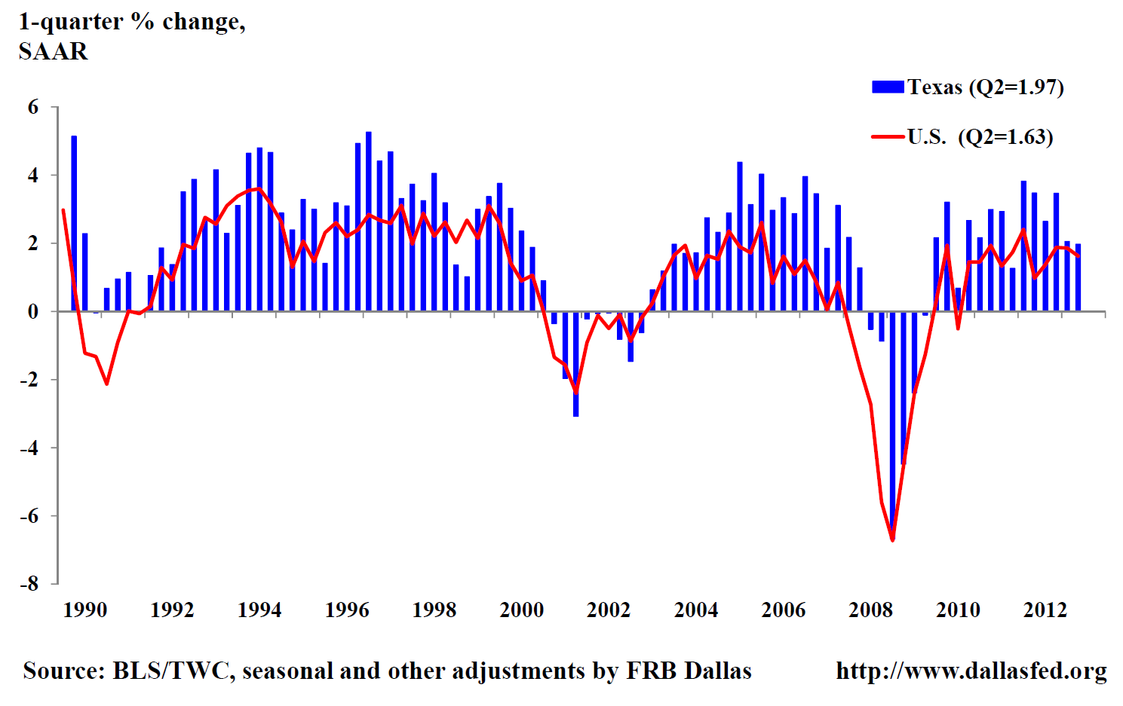
Texas Total Nonfarm Employment
Quarterly Growth
SAAR - Seasonally Adjusted Annual Rate

Slide 10
Estimated domestic migration by county, 2000-2010
Source: Population Division, U.S. Census Bureau, 2012. Map produced by the Texas State Data Center
Notes:
This map demonstrates DOMESTIC, or internal, migration made up largely of persons who are citizens or legal residents of the United States. International migrants are not included on this map. Generally, western counties had U.S. residents and citizens moving out and the areas around urban cores had U.S. residents and citizens moving in. Note that Dallas and Harris county have net out domestic migration indicating that persons from these counties may be moving to more suburban adjacent counties.

Slide 11
Estimated international migration by county, 2000-2010
Source: Population Division, U.S. Census Bureau, March 19, 2009. Map produced by the Texas State Data Center
Notes:
This map demonstrates in migration of international migrants. Domestic migrants are not included on this map. It is estimated that international migrants made significant contributions to population growth in large urban counties and along the border. Note that Dallas and Harris counties experienced substantial international migration resulting in a positive net in-migration to those counties.

Slide 12
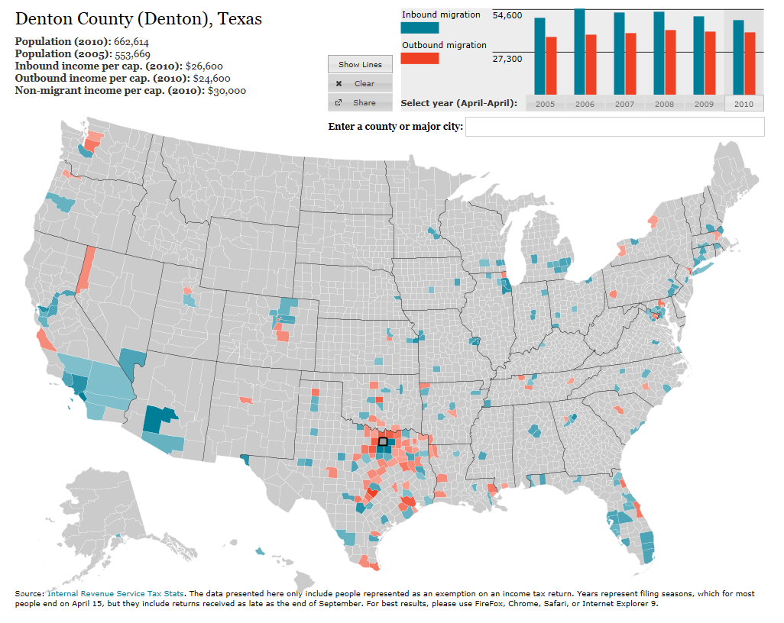
http://www.forbes.com/special-report/2011/migration.html
Notes:
This map from Forbes.com (www.forbes.com/special-report/2011/migration.html) illustrates migration flows for the selected county.

Slide 13
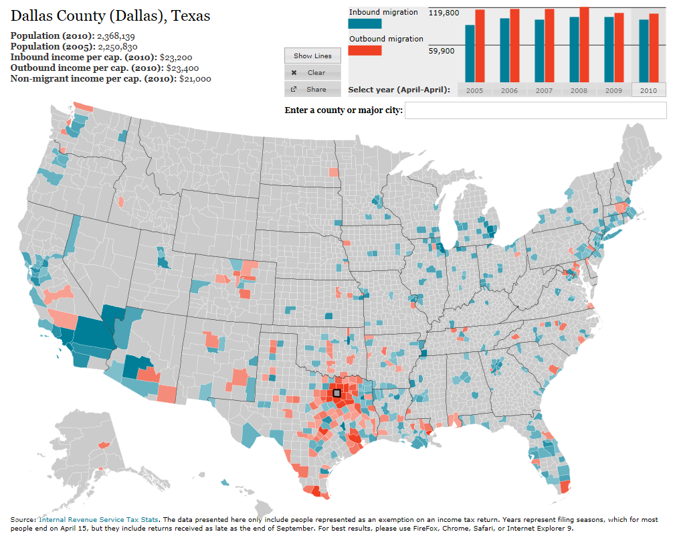
http://www.forbes.com/special-report/2011/migration.html
Notes:
This map from Forbes.com (www.forbes.com/special-report/2011/migration.html) illustrates migration flows for the selected county.

Slide 14
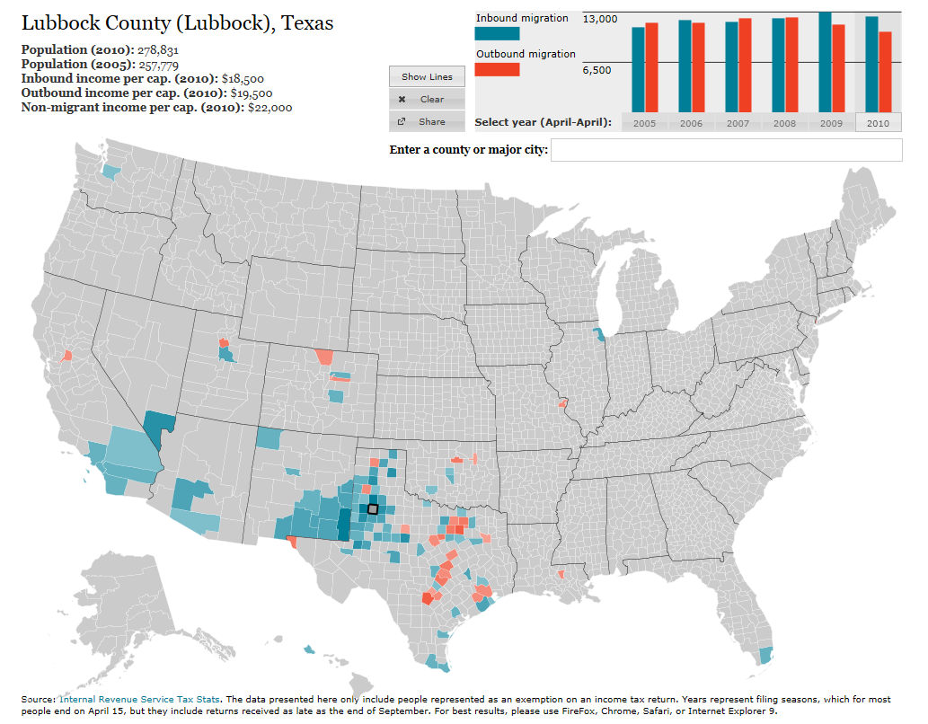
http://www.forbes.com/special-report/2011/migration.html
Notes:
This map from Forbes.com (www.forbes.com/special-report/2011/migration.html) illustrates migration flows for the selected county.

Slide 15
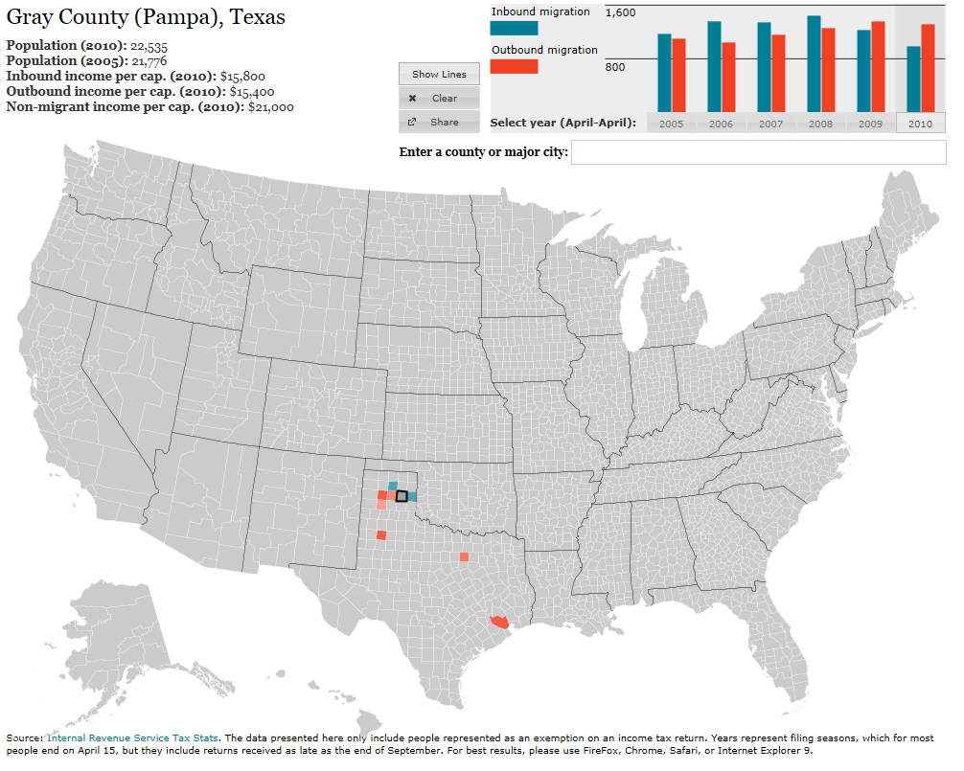
http://www.forbes.com/special-report/2011/migration.html
Notes:
This map from Forbes.com (www.forbes.com/special-report/2011/migration.html) illustrates migration flows for the selected county.

Slide 16
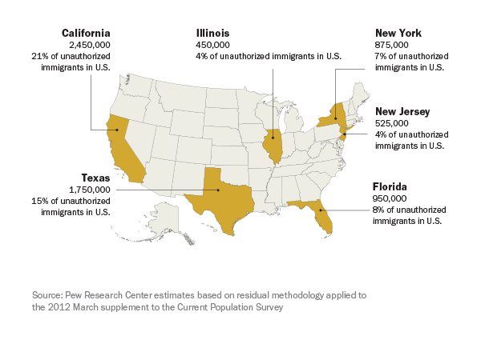
Six states account for 60% of unauthorized immigrants in 2012

Slide 17
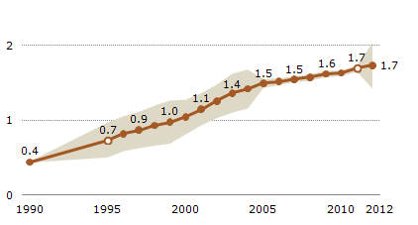
Estimates of the Unauthorized Immigrant Population in Texas, 1990-2012
millions
Population Decline of Unauthorized Immigrants Stalls, May Have Reversed, www.pewresearch.org/hispanic

Slide 18
Texas Racial and Ethnic Composition,
2000 and 2010
Source: U.S. Census Bureau. 2000 and 2010 Census count
Notes:
As of the 2000 Census, about 53% of Texas’ population was non-Hispanic Anglo, about 32% where of Hispanic descent, about 11% where non-Hispanic African American, and about 4% were non-Hispanic Other.
In 2010, it is estimated that about 45% of the Texas population was non-Hispanic Anglo, 38% of Hispanic descent, 11% were non-Hispanic African American, and about 6% were non-Hispanic Other (largely of Asian descent).

Slide 19
Texas White (non-Hispanic) and Hispanic Populations by Age, 2010
Source: U.S. Census Bureau 2010 Decennial Census, SF1
Notes:
The age distribution of the non-Hispanic white population in Texas is weighted heavily with the “baby boom” generation. Largely the result of lower fertility and less net in-migration, the non-Hispanic white population has relatively fewer young persons relative to those in the middle-age years. In 2010, at ages 37 and younger, the Hispanic population exceeds the non-Hispanic white population.

Slide 20
Texas Population Pyramid by Race/Ethnicity, 2010
Source: U.S. Census Bureau 2010 Decennial Census, SF1
Notes:
This population pyramid represents the age, sex, race and ethnic composition of the Texas population. Blue represents males, red females, rows are single years of age, and shades represent specified race/ethnic groups as indicated in the legend. Note the “inverted” pyramid for the non-Hispanic White population and the presence of the “baby boom” while the Hispanic and African American population pyramids are characterized with wider bases (the young) relative to the peak (the old).

Slide 21
Texas Population Pyramid by Race/Ethnicity, 2010
Source: U.S. Census Bureau 2010 Decennial Census, SF1
Notes:
This population pyramid represents the age, sex, race and ethnic composition of the Texas population. Blue represents males, red females, rows are single years of age, and shades represent specified race/ethnic groups as indicated in the legend. Note the “inverted” pyramid for the non-Hispanic White population and the presence of the “baby boom” while the Hispanic and African American population pyramids are characterized with wider bases (the young) relative to the peak (the old).

Slide 22
Texas Population Pyramid by Race/Ethnicity, 2010
Source: U.S. Census Bureau 2010 Decennial Census, SF1
Notes:
This population pyramid represents the age, sex, race and ethnic composition of the Texas population. Blue represents males, red females, rows are single years of age, and shades represent specified race/ethnic groups as indicated in the legend. Note the “inverted” pyramid for the non-Hispanic White population and the presence of the “baby boom” while the Hispanic and African American population pyramids are characterized with wider bases (the young) relative to the peak (the old).

Slide 23
Median Household Income by County, 2005-2009
Source: U.S. Census Bureau, American Community Survey, 5-Year Sample 2005-2009

Slide 24
Percent of population aged 25 years and older with Bachelors degree or higher. 2005-2009
Source: U.S. Census Bureau, American Community Survey, 5-Year Sample 2005-2009

Slide 25
Educational Attainment in Texas, 2011
Level of Educational Attainment | Percent of persons aged 25 years and older | State Ranking
High school diploma or equivalency or greater | 81.1% | 48/49/50 (tied with CA and MS)
Bachelors or greater | 26.4% | 29
Source: U.S. Census Bureau, American Community Survey, One-year Sample, 2011.

Slide 26
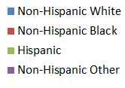
Race/Ethnic Composition by Education Level in the Labor Force (aged 25 years and more), Texas, 2009
College and Greater
Less Than High School
Source: Derived from 2009 American Community Survey 1-Year Estimates by the Office of the State Demographer.

Slide 27
Projected Population Growth in Texas, 2010-2050
Source: Texas State Data Center 2012 Population Projections

Slide 28
Projected Racial and Ethnic Percent, Texas, 2010-2050
Source: Texas State Data Center 2012 Population Projections , 2000-2010 Migration Scenario

Slide 29
Projected Population Change, Texas Counties, 2010-2050
Source: Texas State Data Center 2012 Population Projections . 2000-2010 Migration Scenario

Slide 30
Projected Percent Population Change, Texas Counties, 2010-2050
Source: Texas State Data Center 2012 Population Projections . 2000-2010 Migration Scenario

Slide 31
Teen Birth Rate by State, 2010
Rank | State | Birth rate per 1,000 women ages 15-19
1 | Mississippi | 55
2 | New Mexico | 52.9
3 | Arkansas | 52.5
4 | Texas | 52.2
5 | Oklahoma | 50.4
6 | Louisiana | 47.7
7 | Kentucky | 46.2
8 | District of Columbia | 45.4
9 | West Virginia | 44.8
10 | Alabama | 43.6
Source: National Center for Health Statistics at the Centers for Disease Control and Prevention
Notes:
Texas had the 3rd highest teen birth rate in 2006.

Slide 32
Of all births to females under 20 years of age, percent by race/ethnicity, 2011
Mother's race/ethnicity¹ | Texas | United States
Non-Hispanic white | 21% | 39%
Non-Hispanic black | 14% | 24%
American Indian or Alaska Native^{2,3} | 0% | 2%
Asian or Pacific Islander^{2,3} | 1% | 2%
Hispanic⁴ | 64% | 33%
1 Includes all births, including those with Hispanic origin not stated and not shown separately.
2 Race and Hispanic origin are reported separately on birth certificates. Persons of Hispanic origin may be of any race. Race categories are consistent with the 1977 Office of Management and Budget (OMB) standards.
3 Includes persons of Hispanic origin according to mother’s reported race.
4 Includes all persons of Hispanic origin of any race.
http://www.hhs.gov/ash/oah/adolescent-health-topics/reproductive-health/states/tx.html

Slide 33
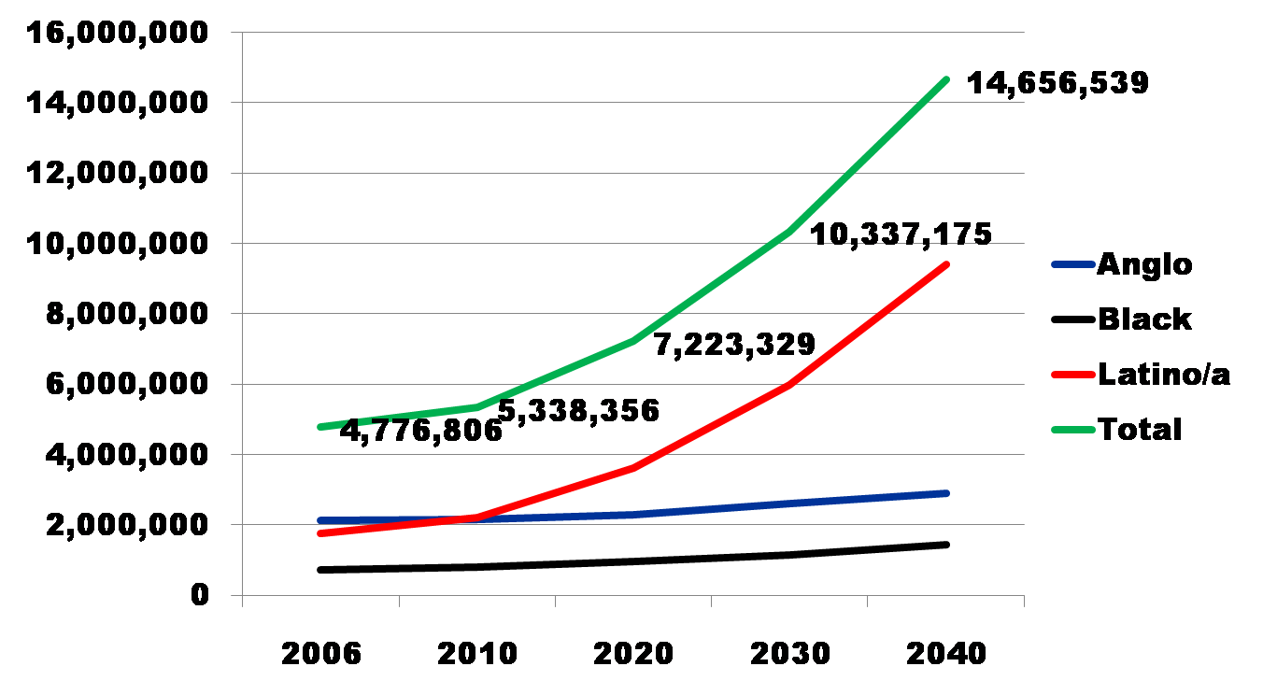
Projected Increase in Obesity in Texas by Ethnicity, 2006 to 2040
Source: Office of the State Demographer projections, using 2000-2004 migration scenario population projections

Slide 34
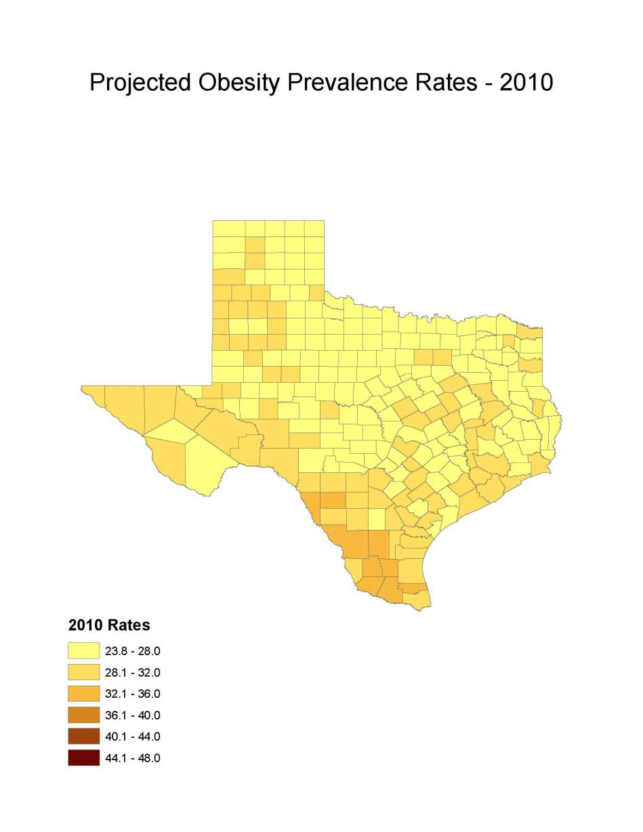
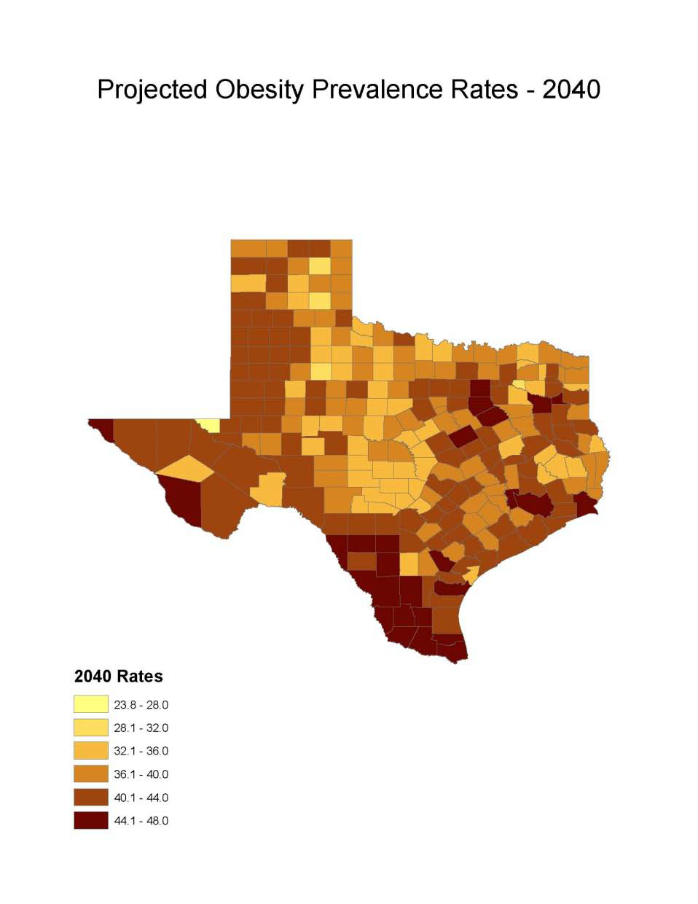
Obesity Prevalence
% adults with obesity: Office of the State Demographer, 2000-2004 Projection

Slide 35
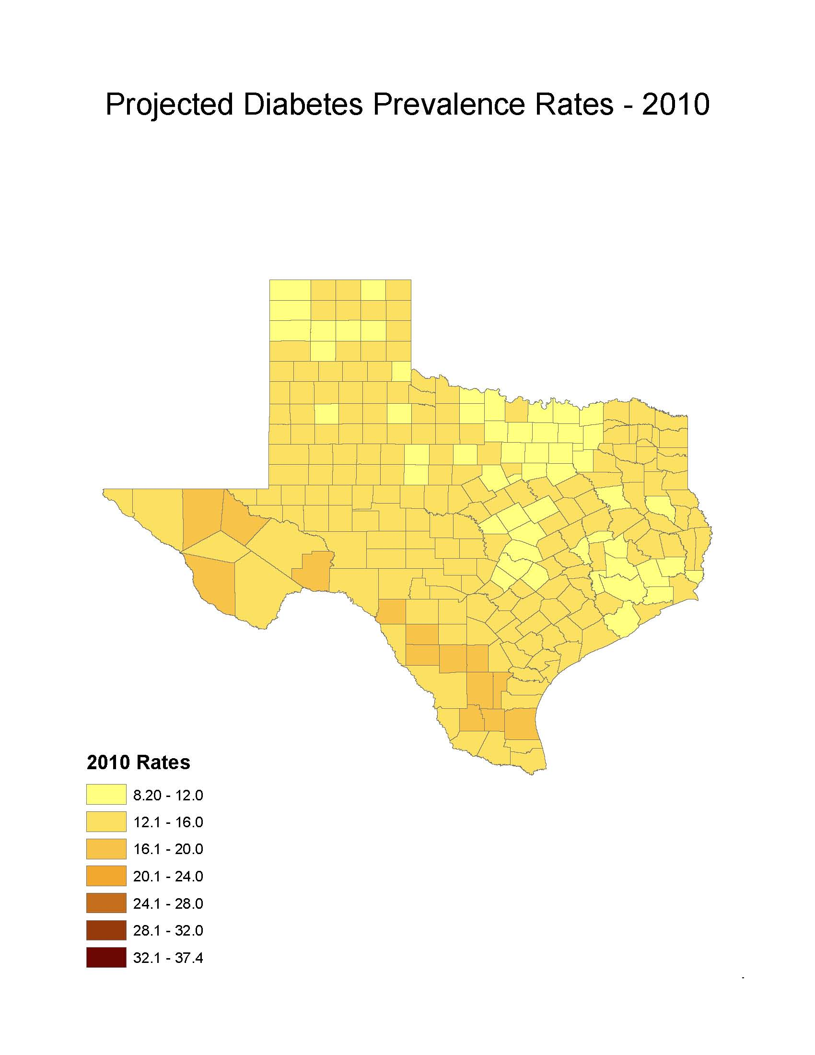
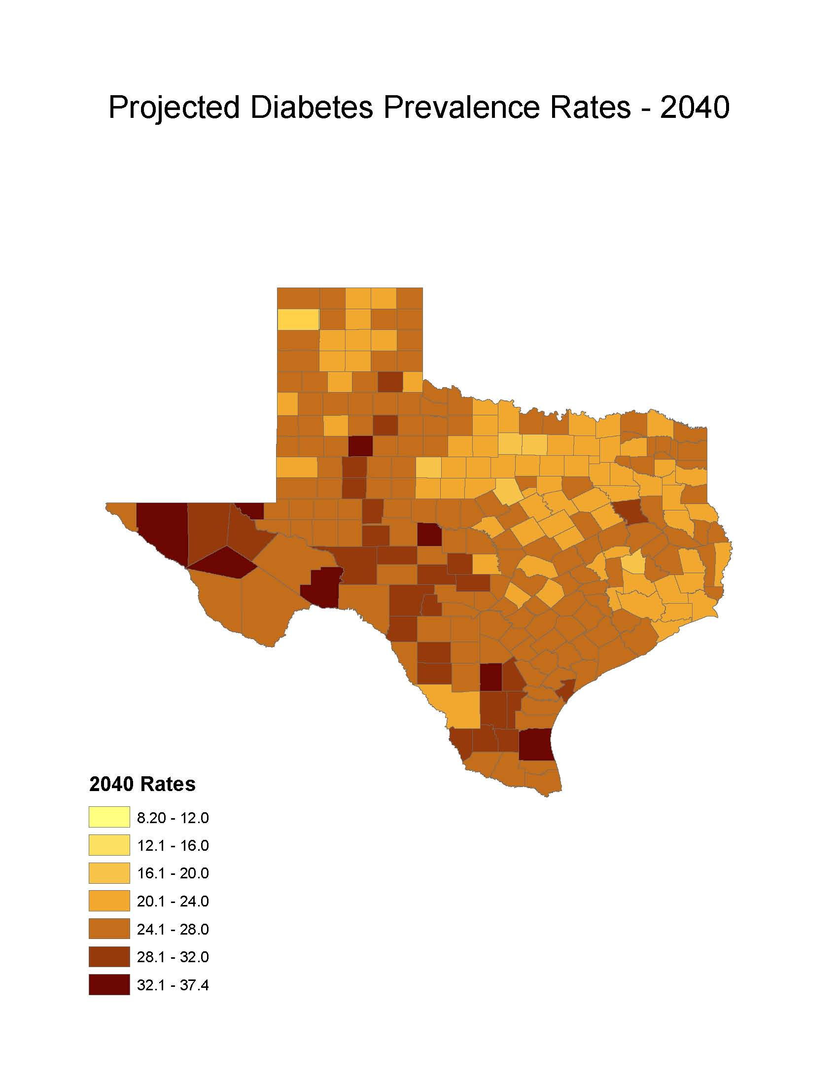
Diabetes Prevalence
% adults with diabetes: Office of the State Demographer, 2000-2004 Projection

Slide 36
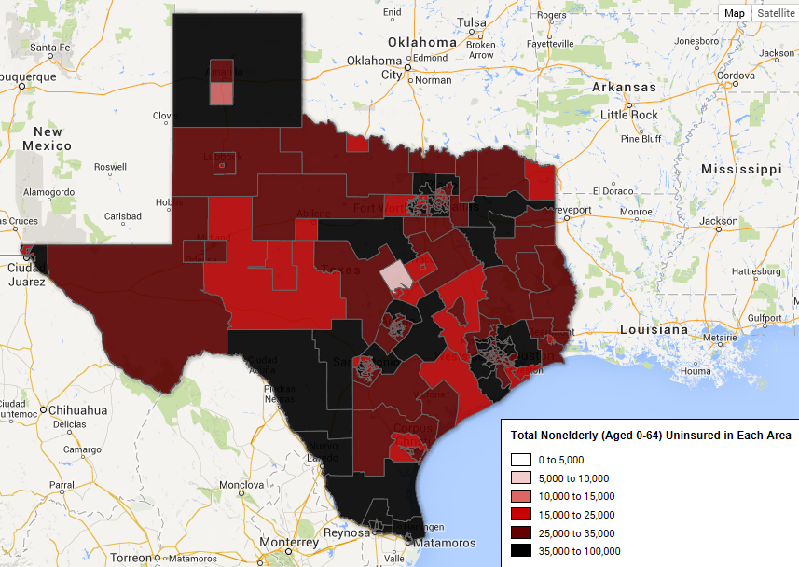
http://www.enrollamerica.org/maps

Slide 37





Demographics and Destiny
Notes:
Texas is growing – with more people being added than in any other state we added 4 additional seats to our representation in the U.S. Congress.
Texas is becoming more urban. Many rural counties are losing population. Urbanized metropolitan areas have been growing dramatically over the decade.
Texas is becoming more diverse – much of our growth is attributable to growth of the Hispanic population.

Slide 38
Contact
  Office: (512) 463-8390 or (210) 458-6530
  Email: Lloyd.Potter@osd.state.tx.us
  Internet: http://osd.state.tx.us
Lloyd Potter, Ph.D.
Notes:
The Office of the State Demographer and the Texas State Data Center are committed to supporting your work through providing you with the best, most accurate, and objective information we can identify about our greatest asset, the people of Texas.

