Slide 1
Texas
Population Estimates and Projections
2014 ERCOT Long-Term System Assessment (LTSA) Stakeholder Workshop
January 13, 2014
Austin, TX
Notes:
Lloyd Potter is the Texas State Demographer and the Director of the Texas State Data Center based at the University of Texas at San Antonio.

Slide 2
Total Estimated Population by County, 2012
Along and east of I-35:
40% of land
86% of population
92% of population growth (2011-2012)
Source: U.S. Census Bureau 2012 Population Estimates
Notes:
The counties of Harris, Bexar, Dallas, Tarrant, and Travis are the most populated in the State. Collin, Denton, Fort Bend, Hidalgo, and El Paso counties also have significant population concentrations. Many counties west of Interstate 35 are more sparsely populated.

Slide 3
Change of the Total Population by County, 2000 to 2010
79 counties lost population over the decade
Source: U.S. Census Bureau 2000 and 2010 Census Counts
Notes:
175 counties gained population while 79 lost population over the decade.

Slide 4
Change of the Total Population by County, 2010 to 2012
96 counties lost population over the two year period
Of counties that lost population
90% had net out migration
47% had natural decline
Source: U.S. Census Bureau Population Estimates, 2012 Vintage.
Notes:
Population change over the decade has been greatest in the urban and suburban population triangle counties. Counties in the lower Rio Grande Valley also had significant growth as did El Paso county. Overall, 175 counties gained population while 79 lost population over the decade.

Slide 5
The 10 Fastest Growing Metro Areas
Increase from July 1, 2011, to July 1, 2012
 |  | Percent Increase
1. | Midland, Texas | 4.6
2. | Clarksville, Tenn.-Ky. | 3.7
3. | Crestview-Fort Walton Beach-Destin, Fla. | 3.6
4. | The Villages, Fla. | 3.4
5. | Odessa, Texas | 3.4
6. | Jacksonville, N.C. | 3.3
7. | Austin-Round Rock, Texas | 3.0
8. | Casper, Wyo. | 3.0
9. | Columbus, Ga.-Ala. | 2.9
10. | Manhattan, Kan. | 2.8
Source: U.S. Census Bureau, 2012
Notes:
Eight Texas counties were among the top largest growth counties in the country. Harris country grew more than any other county in the country.

Slide 6
The 10 Counties with the Largest Numeric Increase from July 1, 2011, to July 1, 2012
 |  | Numeric Increase
1. | Harris, Texas | 80,005
2. | Los Angeles, Calif. | 73,764
3. | Maricopa, Ariz. | 73,644
4. | Dallas, Texas | 45,827
5. | San Diego, Calif. | 38,880
6. | King, Wash. | 35,838
7. | Travis, Texas | 34,381
8. | Orange, Calif. | 34,017
9. | Tarrant, Texas | 32,997
10. | Clark, Nev. | 32,833
Source: U.S. Census Bureau, 2013
Notes:
Eight Texas counties were among the top largest growth counties in the country. Harris country grew more than any other county in the country.

Slide 7
Estimated domestic migration by county, 2000-2010
Source: Population Division, U.S. Census Bureau, 2012. Map produced by the Texas State Data Center
Notes:
This map demonstrates DOMESTIC, or internal, migration made up largely of persons who are citizens or legal residents of the United States. International migrants are not included on this map. Generally, western counties had U.S. residents and citizens moving out and the areas around urban cores had U.S. residents and citizens moving in. Note that Dallas and Harris county have net out domestic migration indicating that persons from these counties may be moving to more suburban adjacent counties.

Slide 8
Estimated population change 2010-2012, Select Central Texas Counties
Source: U.S. Census Bureau, Population Estimates

Slide 9
Estimated population change 2010-2012, Select Central Texas Counties
Source: U.S. Census Bureau, Population Estimates

Slide 10
Estimated population change 2010-2012, Select Central Texas Counties
Scale on previous slide went to 80,000
Source: U.S. Census Bureau, Population Estimates

Slide 11
Projected population change 2010-2030, Select Central Texas Counties, 0.5 Migration Scenario
Source: Texas State Data Center, 2012 Vintage Population Projections

Slide 12
Projected population change 2010-2030, Select Central Texas Counties, 1.0 Migration Scenario
Source: Texas State Data Center, 2012 Vintage Population Projections

Slide 13
Projected percent population change 2010-2030, Select Central Texas Counties, 0.5 Migration Scenario
Source: Texas State Data Center, 2012 Vintage Population Projections

Slide 14
Projected percent population change 2010-2030, Select Central Texas Counties, 1.0 Migration Scenario
Source: Texas State Data Center, 2012 Vintage Population Projections

Slide 15
Projected percent population change 2010-2030, Select Central Texas Counties, 0.5 and 1.0 migration scenarios
Source: Texas State Data Center, 2012 Vintage Population Projections

Slide 16
Projected population change 2010-2030, Select Central Texas Counties, 0.5 and 1.0 migration scenarios

Slide 17
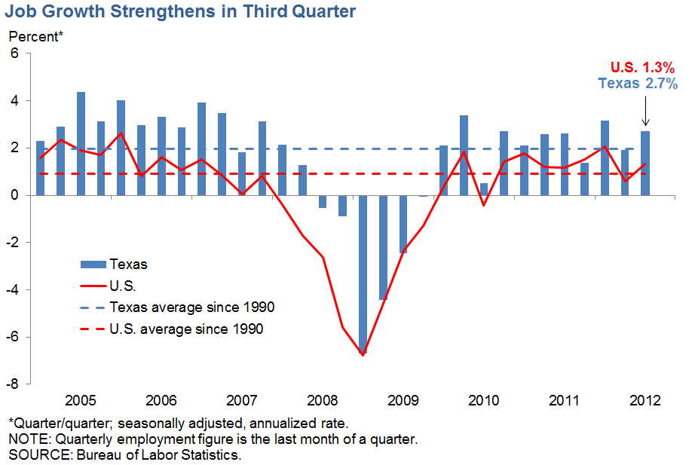
Job Growth

Slide 18
Percent of labor force employed in professional, scientific, and management, and administrative and waste management services, census tracts, 2006-2010
Source: U.S. Census Bureau, American Community Survey, 5-Year Sample, 2006-2010
Notes:
Geographic variation in the types and concentrations of industry is wide within Texas. Urban core areas and surrounding suburban areas have greater concentrations of higher skilled, higher paying types of jobs than more rural areas.

Slide 19
Percent of labor force employed in agriculture, forestry, fishing and hunting, and mining, census tracts, 2006-2010
Source: U.S. Census Bureau, American Community Survey, 5-Year Sample, 2006-2010
Notes:
Rural areas have labor force that is more concentrated in agriculture and extractive industries than urban and suburban areas.

Slide 20


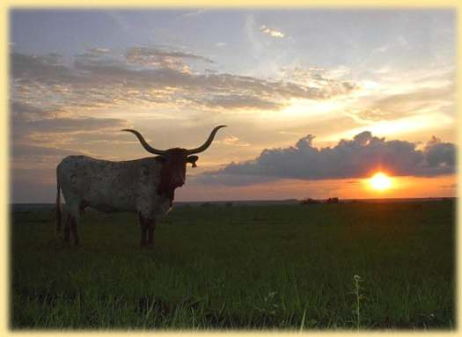

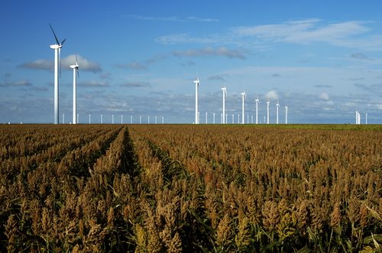
Demographics and Destiny
Notes:
Texas is growing – with more people being added than in any other state we added 4 additional seats to our representation in the U.S. Congress.
Texas is becoming more urban. Many rural counties are losing population. Urbanized metropolitan areas have been growing dramatically over the decade.
Texas is becoming more diverse – much of our growth is attributable to growth of the Hispanic population.

Slide 21
Contact
  Office: (512) 463-8390 or (210) 458-6530
  Email: Lloyd.Potter@osd.state.tx.us
  Internet: http://osd.state.tx.us
Lloyd Potter, Ph.D.
Notes:
The Office of the State Demographer and the Texas State Data Center are committed to supporting your work through providing you with the best, most accurate, and objective information we can identify about our greatest asset, the people of Texas.

