Slide 1
Texas Population Characteristics, Trends, and Projections
Wimberley Rotary Club
March 4, 2014
Wimberley, Texas
Notes:
Lloyd Potter is the Texas State Demographer and the Director of the Texas State Data Center based at the University of Texas at San Antonio.

Slide 2
Growing States, 2000-2010
 | 2000 Population* | 2010 Population* | Numerical Change 2000-2010 | Percent Change 2000-2010
United States | 281,421,906 | 308,745,538 | 27,323,632 | 9.7%
Texas | 20,851,820 | 25,145,561 | 4,293,741 | 20.6%
California | 33,871,648 | 37,253,956 | 3,382,308 | 10.0%
Florida | 15,982,378 | 18,801,310 | 2,818,932 | 17.6%
Georgia | 8,186,453 | 9,687,653 | 1,501,200 | 18.3%
North Carolina | 8,049,313 | 9,535,483 | 1,486,170 | 18.5%
Arizona | 5,130,632 | 6,392,017 | 1,261,385 | 24.6%
Population values are decennial census counts for April 1 for 2000 and 2010.
65% (2.8 million) of this change can be attributed to growth
of the Hispanic population
Source: U.S. Census Bureau. 2000 and 2010 Census Count.
Notes:
Texas is the second largest state in terms of population (2nd to CA) and area (2nd to AK). In terms of number of people, Texas’ growth exceeds that of all other states between 2000 and 2010.

Slide 3
Total Population and Components of Population Change in Texas, 1950-2012
Percent Change Due to
Year* | Population | Numerical Change | Annual Percent Change | Natural Increase | Net Migration
1950 | 7,711,194 | -- | -- | -- | --
1960 | 9,579,677 | 1,868,483 | 2.4 | 93.91 | 6.09
1970 | 11,196,730 | 1,617,053 | 1.7 | 86.74 | 13.26
1980 | 14,229,191 | 3,032,461 | 2.7 | 41.58 | 58.42
1990 | 16,986,510 | 2,757,319 | 2.0 | 65.85 | 34.15
2000 | 20,851,820 | 3,865,310 | 2.3 | 49.65 | 50.35
2010 | 25,145,561 | 4,293,741 | 2.1 | 54.94 | 45.06
2012 | 26,060,796 | 915,235 | 1.8 | 52.05 | 47.95
2013 | 26,448,193 | 387,397 | 1.4
* All values for the decennial dates are for April 1st of the indicated census year. Values for 2012 and 2013 are for July 1 as estimated by the U.S. Census Bureau. Source: Derived from U.S. Census Bureau Estimates for dates indicated by the Texas State Data Center, University of Texas at San Antonio. Note: Residual values are not presented in this table.
Notes:
The components of change include natural increase (births-deaths) and net migration (in-out migration). In recent years, natural increase and net migration have contributed almost equally to Texas’ growth. Natural increase is much more predictable and stable than net migration. Net migration tends to fluctuate with economic factors. Between 2010 and 2012, Texas’ growth continues, but appears to have slowed some between 2011 and 2012.

Slide 4
Total Estimated Population by County, 2012
Along and east of I-35:
40% of land
86% of population
92% of population growth (2011-2012)
Source: U.S. Census Bureau 2012 Population Estimates
Notes:
The counties of Harris, Bexar, Dallas, Tarrant, and Travis are the most populated in the State. Collin, Denton, Fort Bend, Hidalgo, and El Paso counties also have significant population concentrations. Many counties west of Interstate 35 are more sparsely populated.

Slide 5
Change of the Total Population by County, 2010 to 2012
96 counties lost population over the two year period
Of counties that lost population
90% had net out migration
47% had natural decline
Source: U.S. Census Bureau Population Estimates, 2012 Vintage.
Notes:
Population change over the decade has been greatest in the urban and suburban population triangle counties. Counties in the lower Rio Grande Valley also had significant growth as did El Paso county. Overall, 175 counties gained population while 79 lost population over the decade.

Slide 6
The 10 Fastest Growing Metro Areas
Increase from July 1, 2011, to July 1, 2012
 |  | Percent Increase
1. | Midland, Texas | 4.6
2. | Clarksville, Tenn.-Ky. | 3.7
3. | Crestview-Fort Walton Beach-Destin, Fla. | 3.6
4. | The Villages, Fla. | 3.4
5. | Odessa, Texas | 3.4
6. | Jacksonville, N.C. | 3.3
7. | Austin-Round Rock, Texas | 3.0
8. | Casper, Wyo. | 3.0
9. | Columbus, Ga.-Ala. | 2.9
10. | Manhattan, Kan. | 2.8
Source: U.S. Census Bureau, 2012
Notes:
Eight Texas counties were among the top largest growth counties in the country. Harris country grew more than any other county in the country.

Slide 7
The 10 Counties with the Largest Numeric Increase from July 1, 2011, to July 1, 2012
 |  | Numeric Increase
1. | Harris, Texas | 80,005
2. | Los Angeles, Calif. | 73,764
3. | Maricopa, Ariz. | 73,644
4. | Dallas, Texas | 45,827
5. | San Diego, Calif. | 38,880
6. | King, Wash. | 35,838
7. | Travis, Texas | 34,381
8. | Orange, Calif. | 34,017
9. | Tarrant, Texas | 32,997
10. | Clark, Nev. | 32,833
Source: U.S. Census Bureau, 2013
Notes:
Eight Texas counties were among the top largest growth counties in the country. Harris country grew more than any other county in the country.

Slide 8
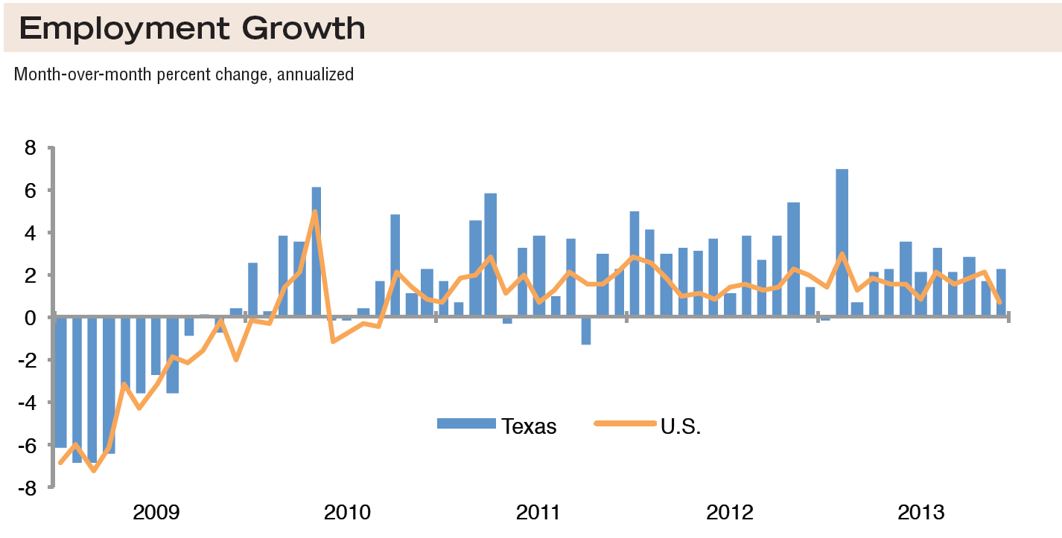
Source: Federal Reserve Bank of Dallas, Texas Economic Indicators, February 2014

Slide 9
Estimated Net Migration Between States and Texas, 2011
Source: U.S. Census Bureau, American Community Survey, 2011One-year Sample

Slide 10
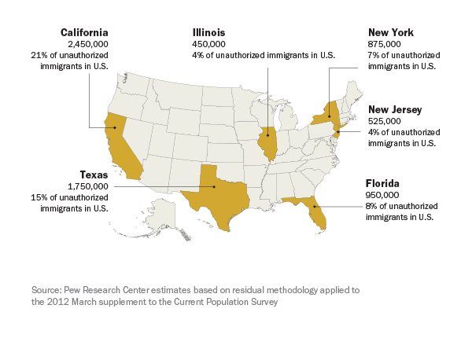
Six states account for 60% of unauthorized immigrants in 2012

Slide 11
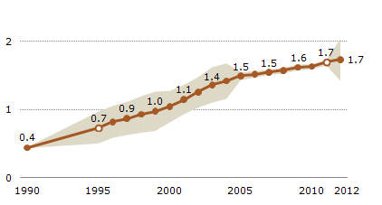
Estimates of the Unauthorized Immigrant Population in Texas, 1990-2012
millions
Population Decline of Unauthorized Immigrants Stalls, May Have Reversed, www.pewresearch.org/hispanic

Slide 12
Resident Characteristics of
Hays County, Texas, 2008-2012
Source: U.S. Census Bureau, American Community Survey, 5 Year Sample 2008-2012

Slide 13
Percent of population aged 25 years and older with high school or greater, census tracts, Texas, 2007-2011
Source: U.S. Census Bureau, American Community Survey, Five-Year Sample, 2007-2011.

Slide 14
Percent of the labor force working in management, business, science, and arts occupations, census tracts, Texas, 2007-2011
Source: U.S. Census Bureau, American Community Survey, Five-Year Sample, 2007-2011.

Slide 15
Percent of households that are female headed with children less than 18 years of age present, no husband present, census tracts, Texas, 2007-2011
Source: U.S. Census Bureau, American Community Survey, Five-Year Sample, 2007-2011.

Slide 16
Texas White (non-Hispanic) and Hispanic Populations by Age, 2010
Source: U.S. Census Bureau 2010 Decennial Census, SF1
Notes:
The age distribution of the non-Hispanic white population in Texas is weighted heavily with the “baby boom” generation. Largely the result of lower fertility and less net in-migration, the non-Hispanic white population has relatively fewer young persons relative to those in the middle-age years. In 2010, at ages 37 and younger, the Hispanic population exceeds the non-Hispanic white population.

Slide 17
Texas Population Pyramid by Race/Ethnicity, 2010
Source: U.S. Census Bureau 2010 Decennial Census, SF1
Notes:
This population pyramid represents the age, sex, race and ethnic composition of the Texas population. Blue represents males, red females, rows are single years of age, and shades represent specified race/ethnic groups as indicated in the legend. Note the “inverted” pyramid for the non-Hispanic White population and the presence of the “baby boom” while the Hispanic and African American population pyramids are characterized with wider bases (the young) relative to the peak (the old).

Slide 18
Texas Population Pyramid by Race/Ethnicity, 2010
Source: U.S. Census Bureau 2010 Decennial Census, SF1
Notes:
This population pyramid represents the age, sex, race and ethnic composition of the Texas population. Blue represents males, red females, rows are single years of age, and shades represent specified race/ethnic groups as indicated in the legend. Note the “inverted” pyramid for the non-Hispanic White population and the presence of the “baby boom” while the Hispanic and African American population pyramids are characterized with wider bases (the young) relative to the peak (the old).

Slide 19
Texas Population Pyramid by Race/Ethnicity, 2010
Source: U.S. Census Bureau 2010 Decennial Census, SF1
Notes:
This population pyramid represents the age, sex, race and ethnic composition of the Texas population. Blue represents males, red females, rows are single years of age, and shades represent specified race/ethnic groups as indicated in the legend. Note the “inverted” pyramid for the non-Hispanic White population and the presence of the “baby boom” while the Hispanic and African American population pyramids are characterized with wider bases (the young) relative to the peak (the old).

Slide 20
Percent Hispanic and Non-Hispanic White, Hays County, Texas, 2012

Slide 21
Projected Population Growth in Texas, 2010-2050
Source: Texas State Data Center 2012 Population Projections

Slide 22
Projected Racial and Ethnic Percent, Texas, 2010-2050
Source: Texas State Data Center 2012 Population Projections , 2000-2010 Migration Scenario

Slide 23
Percent of the Civilian Labor Force (ages 25-64) by Educational Attainment for 2011, 2030 Using Constant Rates, and 2030 Using Trended Rates, Texas
Sources: Texas State Data Center, 2012 Vintage Population Projections, 0.5 Migration Scenario
U.S. Census Bureau, American Community Survey, Public Use Micro Sample, 2001-2011

Slide 24
Birth rates for teenagers aged 15–19, by race and Hispanic origin of mother: United States and each and state, 2011
Rank | Area | All races and origins | Non- Hispanic white | Non- Hispanic black | Hispanic
 | United States | 31.3 | 21.8 | 47.4 | 49.4
1 | Arkansas | 50.7 | 45.4 | 66.4 | 60.4
2 | Mississippi | 50.2 | 40.8 | 61.4 | 42.9
3 | New Mexico | 48.8 | 28.5 | 28.4 | 58.2
4 | Oklahoma | 47.8 | 41.1 | 58.6 | 68.6
5 | Texas | 46.9 | 27.4 | 47.4 | 65.7
6 | Louisiana | 45.1 | 34.5 | 60.2 | 50.7
7 | Kentucky | 43.5 | 42.4 | 51.5 | 57.6
8 | West Virginia | 43.5 | 44.6 | 40.5 | 22.5
SOURCE: CDC/NCHS, Division of Vital Statistics. Preliminary data.

Slide 25
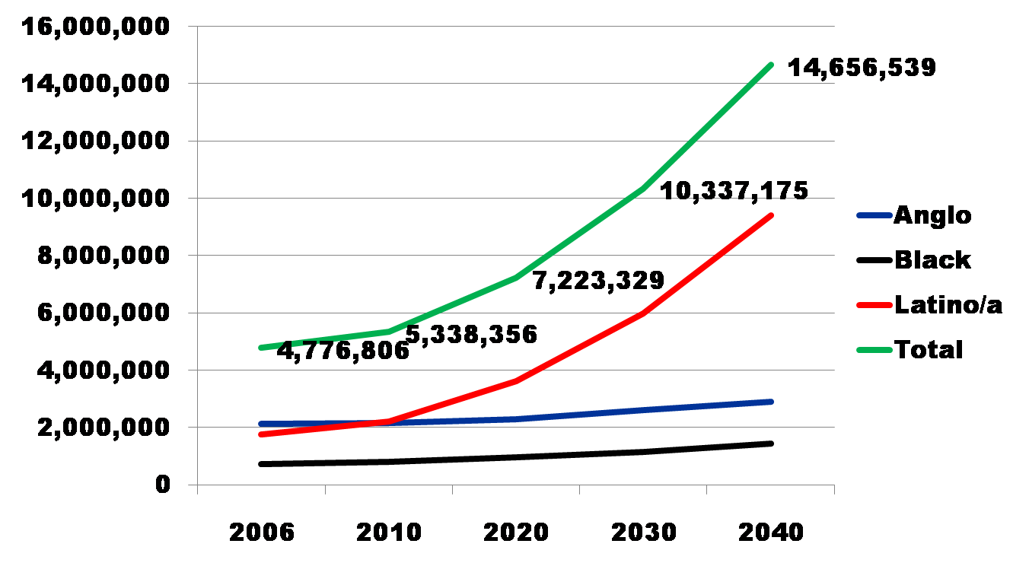
Projected Increase in Obesity in Texas by Ethnicity, 2006 to 2040
Source: Office of the State Demographer projections, using 2000-2004 migration scenario population projections

Slide 26
Percent without health insurance, Texas counties, 2007-2012
Source: U.S. Census Bureau, American Community Survey, 5-year sample, 2007-2012

Slide 27


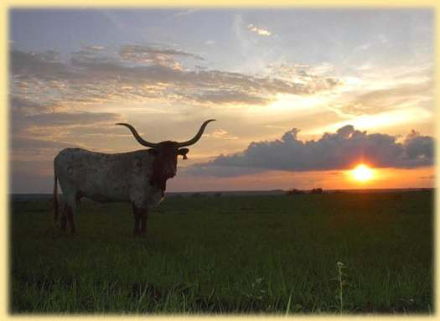


Demographics and Destiny
Notes:
Texas is growing – with more people being added than in any other state we added 4 additional seats to our representation in the U.S. Congress.
Texas is becoming more urban. Many rural counties are losing population. Urbanized metropolitan areas have been growing dramatically over the decade.
Texas is becoming more diverse – much of our growth is attributable to growth of the Hispanic population.

Slide 28
Contact
  Office: (512) 463-8390 or (210) 458-6530
  Email: Lloyd.Potter@osd.state.tx.us
  Internet: http://osd.state.tx.us
Lloyd Potter, Ph.D.
Notes:
The Office of the State Demographer and the Texas State Data Center are committed to supporting your work through providing you with the best, most accurate, and objective information we can identify about our greatest asset, the people of Texas.

