Slide 1
Texas’ Demographic Characteristics, Trends, and Projections
CPA Single Audit and Governmental Conference
October 7, 2014
Austin, Texas
Notes:
Lloyd Potter is the Texas State Demographer and the Director of the Texas State Data Center based at the University of Texas at San Antonio.

Slide 2
Topic Overview
Population growth and geographic variation of population growth
Migration patterns
Race/ethnic composition and change
Projected population growth
Projected educational attainment

Slide 3
Total Population and Components of Population Change in Texas, 1950-2013
Year* | Population | Numeric Change | Annual Percent Change
1950 | 7,711,194 | -- | --
1960 | 9,579,677 | 1,868,483 | 2.4
1970 | 11,196,730 | 1,617,053 | 1.7
1980 | 14,229,191 | 3,032,461 | 2.7
1990 | 16,986,510 | 2,757,319 | 2.0
2000 | 20,851,820 | 3,865,310 | 2.3
2010 | 25,145,561 | 4,293,741 | 2.1
2012 | 26,060,796 | 915,235 | 1.8
2013 | 26,448,193 | 387,397 | 1.4
* All values for the decennial dates are for April 1st of the indicated census year. Values for 2012 and 2013 are for July 1 as estimated by the U.S. Census Bureau.
Source: U.S. Census Bureau, Census Counts and Population Estimates
Notes:
Since 1950, Texas has grown substantially with some variation over the years in the speed of growth.

Slide 4
Texas Population 1950-2010
Source: U.S. Census Bureau, Census Counts
Notes:
Population growth in Texas has been geometric in nature. Over the past two decades there have been three 20 year periods where the numeric growth has increased. We have no indication that the population growth in Texas will slow in coming years.

Slide 5
Components of Population Change by Percent in Texas, 1950-2010
Source: U.S. Census Bureau, Population Estimates
Notes:
Prior to the 1970s decade, most of Texas’ population growth was driven by natural increase (births-deaths). During the 1970s net in-migration became a significant element of Texas’ population growth and now accounts for about half of our population growth. Of the net in-migration, about half can be attributed to net in domestic migration and about half to international migration.

Slide 6
One third of the top 40 fastest growing counties in the United States are in Texas, 2012 to 2013
U.S. Rank | Geography | Population Estimate |  | Change, 2012 to 2013
 |  | 2012 | 2013 | Number | Percent
5 | Kendall County, Texas | 35,968 | 37,766 | 1,798 | 5.0
9 | Fort Bend County, Texas | 625,853 | 652,365 | 26,512 | 4.2
10 | Hays County, Texas | 169,013 | 176,026 | 7,013 | 4.1
11 | Andrews County, Texas | 16,137 | 16,799 | 662 | 4.1
13 | Dimmit County, Texas | 10,481 | 10,897 | 416 | 4.0
22 | Comal County, Texas | 114,590 | 118,480 | 3,890 | 3.4
23 | Ector County, Texas | 144,609 | 149,378 | 4,769 | 3.3
25 | Ward County, Texas | 10,887 | 11,244 | 357 | 3.3
28 | Williamson County, Texas | 456,359 | 471,014 | 14,655 | 3.2
32 | Montgomery County, Texas | 484,790 | 499,137 | 14,347 | 3.0
35 | Denton County, Texas | 708,050 | 728,799 | 20,749 | 2.9
39 | Gaines County, Texas | 18,393 | 18,921 | 528 | 2.9
Counties in bold had growth associated with oil and gas extraction.
Source: U.S. Census Bureau, 2013 Vintage Population Estimates
Notes:
One-third of the fastest growing counties in the United States from 2012 to 2013 were in Texas. A substantial number of these counties were small and in counties that have seen increases in oil and gas extraction activity.

Slide 7
One fourth of U.S. counties in the top 40 for numeric growth are in Texas, 2012-2013
U.S. Rank | Geography | Population Estimate |  | Change, 2012 to 2013
 |  | 2012 | 2013 | Number | Percent
1 | Harris County, Texas | 4,253,963 | 4,336,853 | 82,890 | 1.9
6 | Bexar County, Texas | 1,785,787 | 1,817,610 | 31,823 | 1.8
8 | Tarrant County, Texas | 1,881,445 | 1,911,541 | 30,096 | 1.6
11 | Fort Bend County, Texas | 625,853 | 652,365 | 26,512 | 4.2
12 | Dallas County, Texas | 2,453,907 | 2,480,331 | 26,424 | 1.1
15 | Travis County, Texas | 1,096,246 | 1,120,954 | 24,708 | 2.3
22 | Denton County, Texas | 708,050 | 728,799 | 20,749 | 2.9
24 | Collin County, Texas | 834,674 | 854,778 | 20,104 | 2.4
33 | Williamson County, Texas | 456,359 | 471,014 | 14,655 | 3.2
35 | Montgomery County, Texas | 484,790 | 499,137 | 14,347 | 3.0
Source: U.S. Census Bureau, 2013 Vintage Population Estimates
Notes:
One-fourth of the counties in the United States that were growing the most numerically between 2012 and 2013 were in Texas. These counties are the larger ones in the State and are all counties that have experienced continued growth.

Slide 8
Total Estimated Population by County, Texas, 2013
Source: U.S. Census Bureau, 2013 Vintage Population Estimates
Notes:
The counties of Harris, Dallas, Tarrant, Bexar, and Travis make up the points of the “population triangle” in Texas and are the most populated in the State. Collin, Denton, Fort Bend, Hidalgo, and El Paso counties also have significant population concentrations. Many counties west of Interstate 35 are more sparsely populated. Approximately 86% of Texas’ population is along or east of Interstate 35.

Slide 9
Estimated Change of the Total Population by
County, Texas, 2010 to 2013
99 counties lost population over the three year period.
Source: U.S. Census Bureau, 2013 Vintage Population Estimates.
Notes:
Population change so far this decade has been greatest in the urban and suburban population triangle counties. Counties in the lower Rio Grande Valley also had significant growth as did El Paso county. Overall, 155 counties gained population while 99 (39%) lost population over the decade. Those counties that are losing population are doing so largely as a function of net out migration of younger persons (entering the labor force). The result is a trend for the age structure of the populations in these more rural counties toward becoming older.

Slide 10
Estimated Percent Change of the Total Population by County, Texas, 2010 to 2013
Source: U.S. Census Bureau, 2013 Vintage Population Estimates.
Notes:
Percent change is an indicator of the speed of population change void of information about the volume of population change. Percent change in the population over the past few years has been greatest in the urban and suburban population triangle counties. Notably counties in the Eagle Ford Shale area (south east of San Antonio) and the Cline Shale area (Midland and Odessa), have been growing quickly. Overall, 155 counties gained population while 99 lost population over the decade.

Slide 11
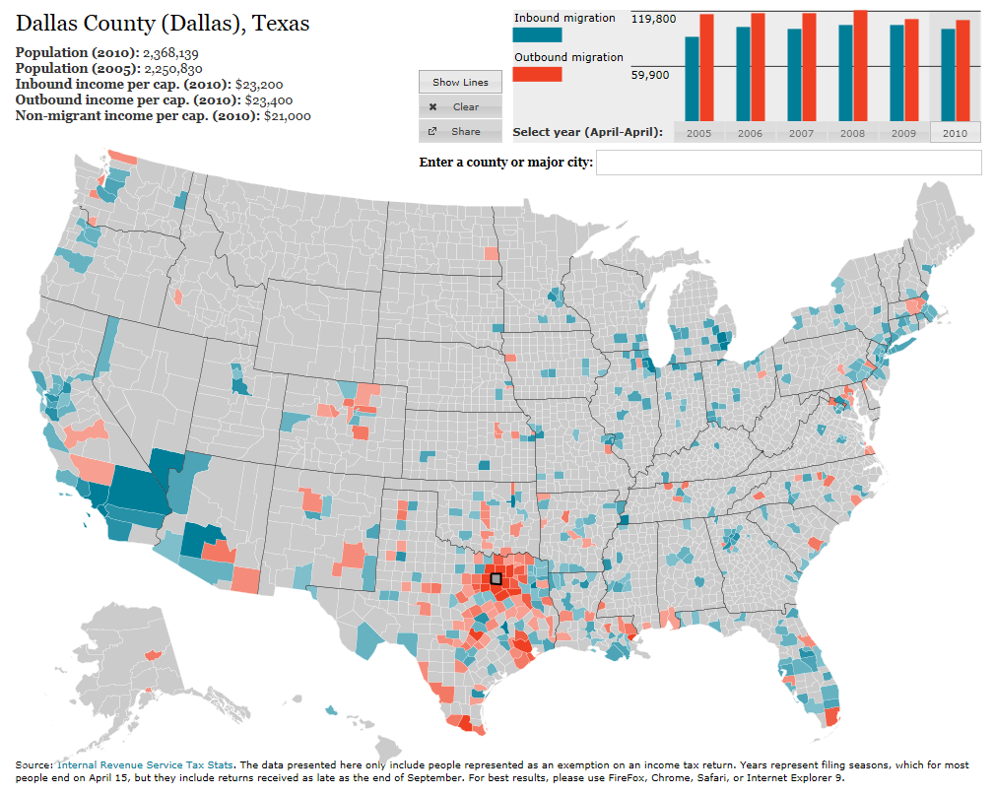
Source: http://www.forbes.com/special-report/2011/migration.html
Notes:
Dallas has been receiving migrants from around the country but losing migrants to surrounding counties. Much of the in-migration in Dallas and Harris Counties is international migration. Much of the out-migration are non-Hispanic white persons.

Slide 12
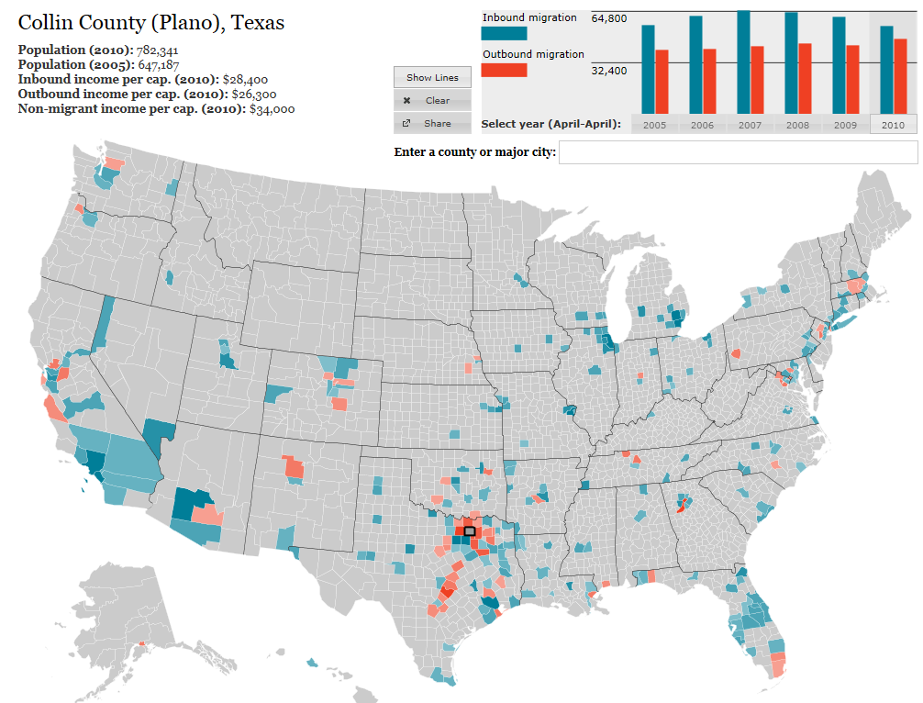
Source: http://www.forbes.com/special-report/2011/migration.html
Notes:
Suburban ring counties, such as Collin County, are receiving many migrants from the urban core counties and from other counties around the State and Country.

Slide 13
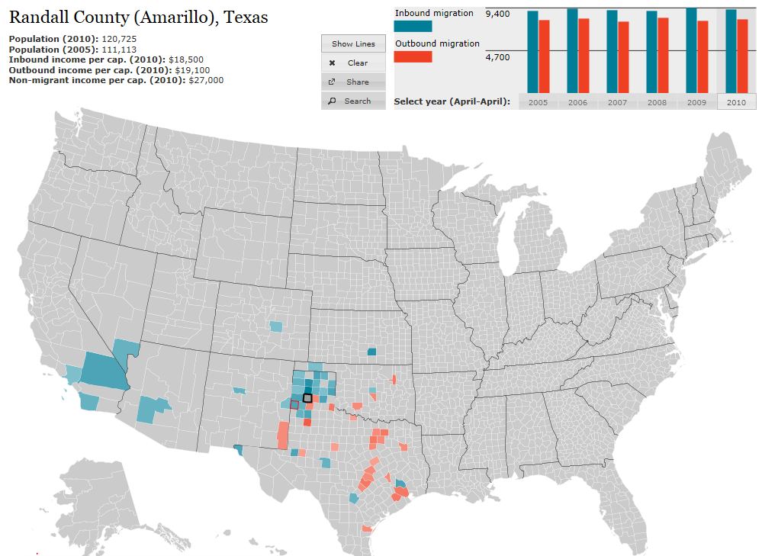
Source: http://www.forbes.com/special-report/2011/migration.html
Notes:
Urban areas in the western part of the State continue to receive net migrants from rural parts of the State. They also are sending migrants to the I-35 corridor and population triangle point areas.

Slide 14
Percent of Population 65 Years of Age and Older, Texas Counties, 2013
Source: U.S. Census Bureau, Population Estimates, 2013
Notes:
Many of the more rural counties are developing age structures weighted more toward the older ages. Many of these are counties with limited access to health care. At the same time, the demand for health care is likely to be increasing.

Slide 15
Texas Racial and Ethnic Composition,
2000 and 2010
Source: U.S. Census Bureau. 2000 and 2010 Census count
Notes:
As of the 2000 Census, about 53% of Texas’ population was non-Hispanic Anglo, about 32% where of Hispanic descent, about 11% were non-Hispanic African American, and about 4% were non-Hispanic Other.
In 2010, it is estimated that about 45% of the Texas population was non-Hispanic Anglo, 38% of Hispanic descent, 11% were non-Hispanic African American, and about 6% were non-Hispanic Other (largely of Asian descent).

Slide 16
Texas White (non-Hispanic) and Hispanic Populations by Age, 2010
Source: U.S. Census Bureau 2010 Decennial Census, SF1
Notes:
The age distribution of the non-Hispanic white population in Texas is weighted heavily with the “baby boom” generation. Largely the result of lower fertility and less net in-migration, the non-Hispanic white population has relatively fewer young persons relative to those in the middle-age years. In 2010, at ages 37 and younger, the Hispanic population exceeds the non-Hispanic white population. As the young Hispanic population ages, the population in Texas will increasingly trend toward Hispanics becoming the majority race/ethnic group.

Slide 17
Texas Population Pyramid by Race/Ethnicity, 2010
Source: U.S. Census Bureau 2010 Decennial Census, SF1
Notes:
This population pyramid represents the age, sex, race and ethnic composition of the Texas population. Blue represents males, red females, rows are single years of age, and shades represent specified race/ethnic groups as indicated in the legend. Note the “inverted” pyramid for the non-Hispanic White population and the presence of the “baby boom.”

Slide 18
Texas Population Pyramid by Race/Ethnicity, 2010
Source: U.S. Census Bureau 2010 Decennial Census, SF1
Notes:
This population pyramid represents the age, sex, race and ethnic composition of the Texas population. Blue represents males, red females, rows are single years of age, and shades represent specified race/ethnic groups as indicated in the legend. Note the Hispanic and African American population pyramids are characterized with wider bases (the young) relative to the peak (the old).

Slide 19
Texas Population Pyramid by Race/Ethnicity, 2010
Source: U.S. Census Bureau 2010 Decennial Census, SF1
Notes:
This population pyramid represents the age, sex, race and ethnic composition of the Texas population. Blue represents males, red females, rows are single years of age, and shades represent specified race/ethnic groups as indicated in the legend. Note the “inverted” pyramid for the non-Hispanic White population and the presence of the “baby boom” while the Hispanic and African American population pyramids are characterized with wider bases (the young) relative to the peak (the old).

Slide 20
Projected Population Growth in Texas, 2010-2050
Source: Texas State Data Center 2012 Population Projections
Notes:
The projected population of Texas is produced using three different migration scenarios. The blue line represents the assumption that there is no in or out migration for Texas. The result is a population that is growing only from natural increase (births-deaths). Under this unlikely scenario, Texas will maintain a health pace of population growth. The other two scenarios assume that 1) the migration rate will be the same as we observed between 2000 and 2010 and 2) the migration rate will be half of what we observed between 2000 and 2010. Under the first assumption Texas will add another 5 million persons this decade, another 7 million the following, 8 or 9 million between 2030 and 2040 and almost 10 million between 2040 and 2050. The half migration scenario also projects significant growth but more modest than the assumption of full migration.

Slide 21
Projected Population Change, Texas Counties, 2010-2050
Source: Texas State Data Center 2012 Population Projections . 2000-2010 Migration Scenario
Notes:
Projected population growth suggests increased numbers and density in the points of Texas’ population triangle, the lower Rio Grande valley with continued growth of El Paso and the urbanized areas in the west of the State. Many rural counties will continue to lose population.

Slide 22
Projected Percent Population Change, Texas Counties, 2010-2050
Source: Texas State Data Center 2012 Population Projections . 2000-2010 Migration Scenario
Notes:
The speed of growth is projected to be greatest in counties surrounding the urban core counties of the points of the Texas’ population triangle.

Slide 23
Projected Racial and Ethnic Percent, Texas, 2010-2050
Source: Texas State Data Center 2012 Population Projections , 2000-2010 Migration Scenario
Notes:
The projected population of Texas by race/ethnicity suggests that the Hispanic population will be a major driver in the population growth of the state. The non-Hispanic white population will grow very slowly and then start to decline as the Baby-Boom generation ages into high mortality years. The non-Hispanic other group is largely composed of persons of Asian descent and this group is projected to exceed the non-Hispanic black population by 2038. This graph assumes migration patterns observed between 2000 and 2010.

Slide 24
Trends in Educational Attainment of Persons in the Labor Force (25-64 Years of Age) in Texas by Race/Ethnicity – High School Graduates and Above
Source: U.S. Census Bureau, American Community Survey, Public Use Micro Sample, 2001-2011
Notes:
Educational attainment by race/ethnicity in Texas suggests that adults of Hispanic descent are much less likely to have completed high school compared to other race/ethnic groups. Over time, the percent of persons of Hispanic descent who have completed high school has been increasing more rapidly than for other groups but even at this pace of change it will take numerous decades for Hispanics to achieve parity with non-Hispanics in the percent with a high school degree or greater.

Slide 25
Percent of the Civilian Labor Force (ages 25-64) by Educational Attainment for 2011, 2030 Using Constant Rates, and 2030 Using Trended Rates, Texas
These should be going DOWN
These should be going UP
Sources: U.S. Census Bureau, American Community Survey, 1-Year PUMS.
Texas State Data Center, 2012 Vintage Population Projections, 0.5 Migration Scenario
Notes:
The educational attainment of the Texas labor force was projected using two assumptions.
1) The first assumption (represented by the red columns) is that educational attainment by race/ethnicity and sex would remain the same as it was in 2011. Thus the changes we see in educational attainment in this projection are due only to changes in the racial/ethnic composition of the population (driven by increasing Hispanic population and a leveling of growth among the non-Hispanic white population). Under this scenario, we would see increases of the percent of the labor force with lower levels of education and declines in the percent of the labor force with higher levels.
2) Under the second assumption (green columns) the trends observed in improving educational attainment are projected forward and applied to the projected population by race/ethnicity and sex. Thus the generally positive trends we have noted in improving educational attainment are assumed to continue into the future. The result of this projection suggests that we will see declines in the percent of the labor force with lower levels of education and increases in the percent of the labor force with higher levels of education.

Slide 26
Contact
  Office: (512) 463-8390 or (210) 458-6530
  Email: Lloyd.Potter@osd.state.tx.us
  Internet: http://osd.state.tx.us
Lloyd Potter, Ph.D.
Notes:
The Office of the State Demographer and the Texas State Data Center are committed to supporting your work through providing you with the best, most accurate, and objective information we can identify about our greatest asset, the people of Texas.

