Slide 1
Texas Demographic Characteristics, Trends, and Projections
Southwest Practice Management Group
October 27, 2014
Charleston, SC
Notes:
Lloyd Potter is the Texas State Demographer and the Director of the Texas State Data Center based at the University of Texas at San Antonio.

Slide 2
Topic Overview
Texas is experiencing relatively constant population growth.
This growth is not geographically evenly distributed.
This growth is not racially/ethnically evenly distributed.
Texas has a significant aging population.
The future Texas workforce will be largely Hispanic.
Hispanics tend to have lower levels of educational attainment than other groups and are less represented in higher skilled occupations.
A well-educated labor force can bolster a diverse economy, making it more resilient to economic downturns.

Slide 3
Total Population and Components of Population Change in Texas, 1950-2013
Year* | Population | Numeric Change | Annual Percent Change
1950 | 7,711,194 | -- | --
1960 | 9,579,677 | 1,868,483 | 2.4
1970 | 11,196,730 | 1,617,053 | 1.7
1980 | 14,229,191 | 3,032,461 | 2.7
1990 | 16,986,510 | 2,757,319 | 2.0
2000 | 20,851,820 | 3,865,310 | 2.3
2010 | 25,145,561 | 4,293,741 | 2.1
2012 | 26,060,796 | 915,235 | 1.8
2013 | 26,448,193 | 387,397 | 1.4
* All values for the decennial dates are for April 1st of the indicated census year. Values for 2012 and 2013 are for July 1 as estimated by the U.S. Census Bureau.
Source: U.S. Census Bureau, Census Counts and Population Estimates
Notes:
Since 1950, Texas has grown substantially with some variation over the years in the speed of growth.

Slide 4
Texas Population 1950-2010
Source: U.S. Census Bureau, Census Counts
Notes:
Population growth in Texas has been geometric in nature. Over the past two decades there have been three 20 year periods where the numeric growth has increased. We have no indication that the population growth in Texas will slow in coming years.

Slide 5
Components of Population Change by Percent in Texas, 1950-2010
Source: U.S. Census Bureau, Population Estimates
Notes:
Prior to the 1970s decade, most of Texas’ population growth was driven by natural increase (births-deaths). During the 1970s net in-migration became a significant element of Texas’ population growth and now accounts for about half of our population growth. Of the net in-migration, about half can be attributed to net in domestic migration and about half to international migration.

Slide 6
One third of the top 40 fastest growing counties in the United States are in Texas, 2012 to 2013
U.S. Rank | Geography | Population Estimate |  | Change, 2012 to 2013
 |  | 2012 | 2013 | Number | Percent
5 | Kendall County, Texas | 35,968 | 37,766 | 1,798 | 5.0
9 | Fort Bend County, Texas | 625,853 | 652,365 | 26,512 | 4.2
10 | Hays County, Texas | 169,013 | 176,026 | 7,013 | 4.1
11 | Andrews County, Texas | 16,137 | 16,799 | 662 | 4.1
13 | Dimmit County, Texas | 10,481 | 10,897 | 416 | 4.0
22 | Comal County, Texas | 114,590 | 118,480 | 3,890 | 3.4
23 | Ector County, Texas | 144,609 | 149,378 | 4,769 | 3.3
25 | Ward County, Texas | 10,887 | 11,244 | 357 | 3.3
28 | Williamson County, Texas | 456,359 | 471,014 | 14,655 | 3.2
32 | Montgomery County, Texas | 484,790 | 499,137 | 14,347 | 3.0
35 | Denton County, Texas | 708,050 | 728,799 | 20,749 | 2.9
39 | Gaines County, Texas | 18,393 | 18,921 | 528 | 2.9
Counties in bold had growth associated with oil and gas extraction.
Source: U.S. Census Bureau, 2013 Vintage Population Estimates
Notes:
One-third of the fastest growing counties in the United States from 2012 to 2013 were in Texas. A substantial number of these counties were small and in counties that have seen increases in oil and gas extraction activity.

Slide 7
One fourth of U.S. counties in the top 40 for numeric growth are in Texas, 2012-2013
U.S. Rank | Geography | Population Estimate |  | Change, 2012 to 2013
 |  | 2012 | 2013 | Number | Percent
1 | Harris County, Texas | 4,253,963 | 4,336,853 | 82,890 | 1.9
6 | Bexar County, Texas | 1,785,787 | 1,817,610 | 31,823 | 1.8
8 | Tarrant County, Texas | 1,881,445 | 1,911,541 | 30,096 | 1.6
11 | Fort Bend County, Texas | 625,853 | 652,365 | 26,512 | 4.2
12 | Dallas County, Texas | 2,453,907 | 2,480,331 | 26,424 | 1.1
15 | Travis County, Texas | 1,096,246 | 1,120,954 | 24,708 | 2.3
22 | Denton County, Texas | 708,050 | 728,799 | 20,749 | 2.9
24 | Collin County, Texas | 834,674 | 854,778 | 20,104 | 2.4
33 | Williamson County, Texas | 456,359 | 471,014 | 14,655 | 3.2
35 | Montgomery County, Texas | 484,790 | 499,137 | 14,347 | 3.0
Source: U.S. Census Bureau, 2013 Vintage Population Estimates
Notes:
One-fourth of the counties in the United States that were growing the most numerically between 2012 and 2013 were in Texas. These counties are the larger ones in the State and are all counties that have experienced continued growth.

Slide 8
Total Estimated Population by County, Texas, 2013
Source: U.S. Census Bureau, 2013 Vintage Population Estimates
Notes:
The counties of Harris, Dallas, Tarrant, Bexar, and Travis make up the points of the “population triangle” in Texas and are the most populated in the State. Collin, Denton, Fort Bend, Hidalgo, and El Paso counties also have significant population concentrations. Many counties west of Interstate 35 are more sparsely populated. Approximately 86% of Texas’ population is along or east of Interstate 35.

Slide 9
Estimated Numeric Population Change by
County, Texas, 2010 to 2013
99 counties lost population over the three year period.
Source: U.S. Census Bureau, 2013 Vintage Population Estimates.
Notes:
Population change so far this decade has been greatest in the urban and suburban population triangle counties. Counties in the lower Rio Grande Valley also had significant growth as did El Paso county. Overall, 155 counties gained population while 99 (39%) lost population over the decade. Those counties that are losing population are doing so largely as a function of net out migration of younger persons (entering the labor force). The result is a trend for the age structure of the populations in these more rural counties toward becoming older.

Slide 10
Estimated Percent Change of the Total Population by County, Texas, 2010 to 2013
Source: U.S. Census Bureau, 2013 Vintage Population Estimates.
Notes:
Percent change is an indicator of the speed of population change void of information about the volume of population change. Percent change in the population over the past few years has been greatest in the urban and suburban population triangle counties. Notably counties in the Eagle Ford Shale area (south east of San Antonio) and the Cline Shale area (Midland and Odessa), have been growing quickly. Overall, 155 counties gained population while 99 lost population over the decade.

Slide 11
Estimated Number of Net Migrants by
County, Texas, 2012 to 2013
Source: U.S. Census Bureau Population Estimates, 2013 Vintage.
Notes:
The estimated number of net migrants was greatest in the points of the Texas population triangle and surrounding counties. Population change in suburban counties with high migration is largely driven by migration. Population change in the urban core counties of the population triangle is more driven by natural increase than by net migration. Net in-migration to urban core counties at the points of the population triangle is dominated by international in-migration.

Slide 12
Percent of Population 65 Years of Age and Older, Texas Counties, 2013
Source: U.S. Census Bureau, Population Estimates, 2013
Notes:
Many of the more rural counties are developing age structures weighted more toward the older ages. Many of these are counties with limited access to health care. At the same time, the demand for health care is likely to be increasing.

Slide 13
Components of Population Change for Select Texas Counties, 2010-2013
Source: U.S. Census Bureau, Population Estimates, Components of Change Vintage 2013
Notes:
Higher proportion of growth due to natural increase (Angelina, Bell, Dallas, El Paso, Smith, Taylor, Wichita)
Higher proportion of growth due to net migration (Travis & Tom Green)
These counties have negative net domestic migration (Angelina, Bell, El Paso, Taylor, Wichita)
None of these counties have negative net international migration

Slide 14
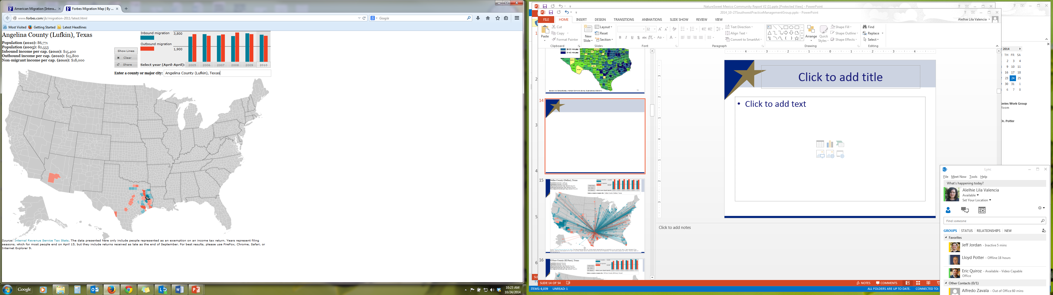

Slide 15
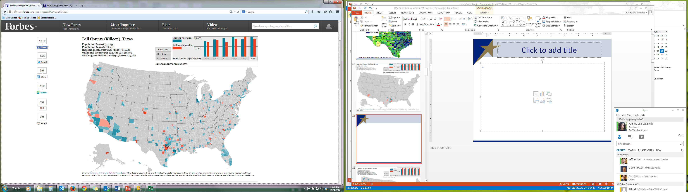

Slide 16
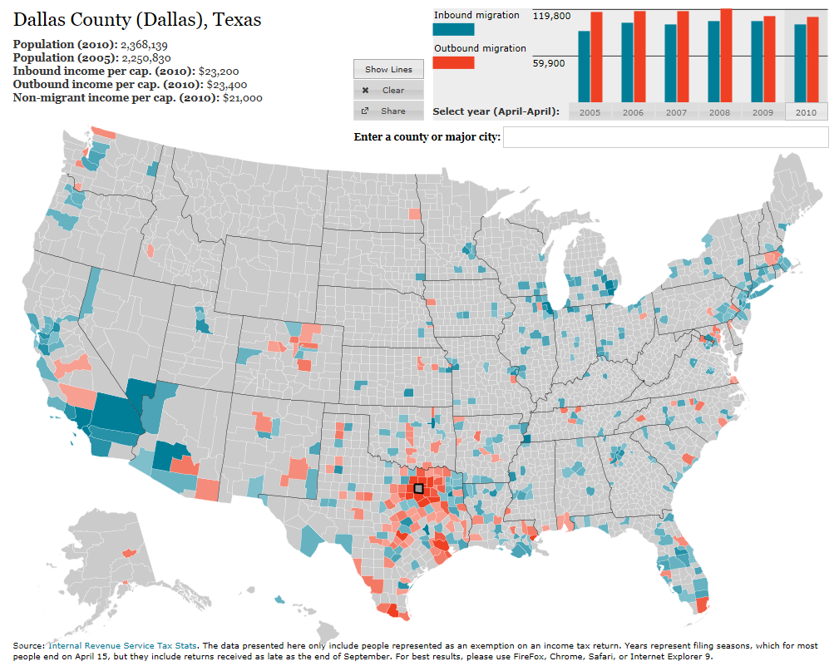
http://www.forbes.com/special-report/2011/migration.html
Notes:
This map from Forbes.com (www.forbes.com/special-report/2011/migration.html) illustrates migration flows for the selected county.

Slide 17
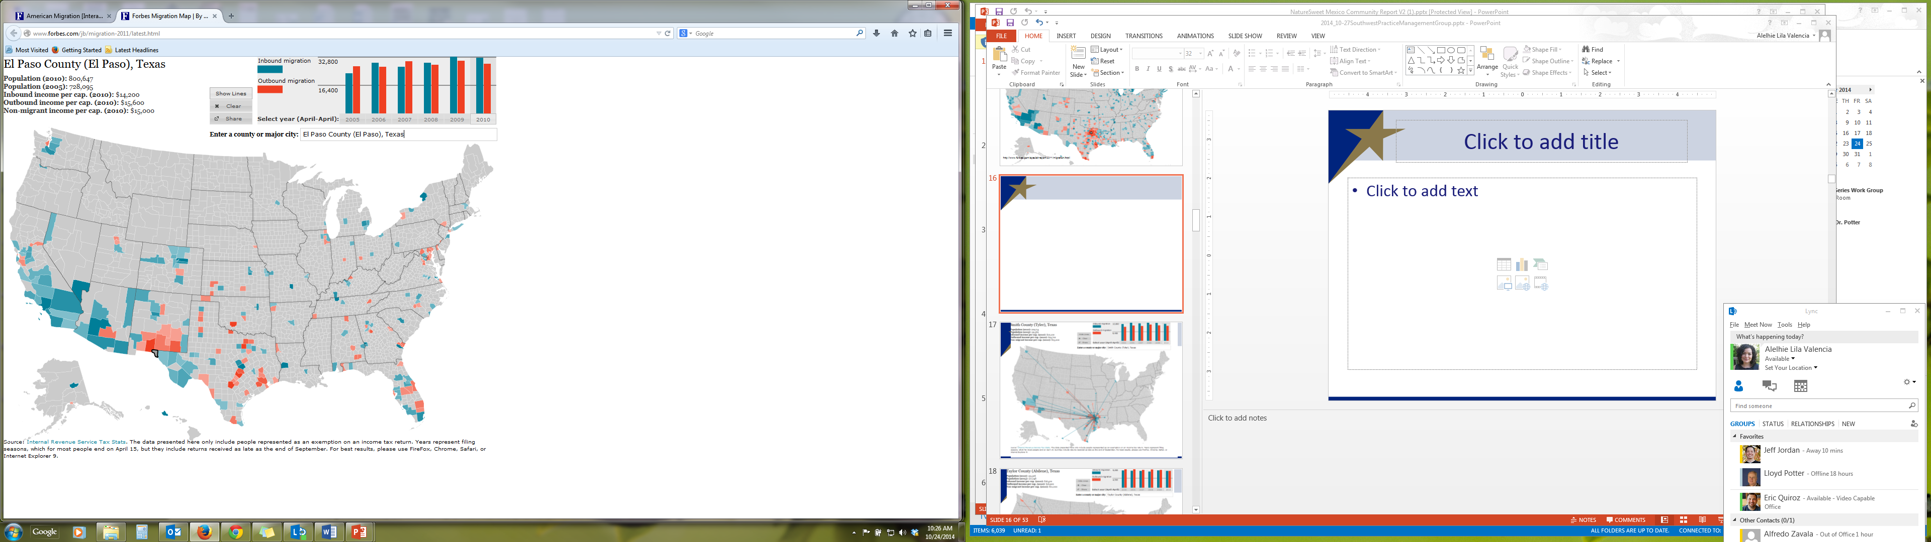

Slide 18
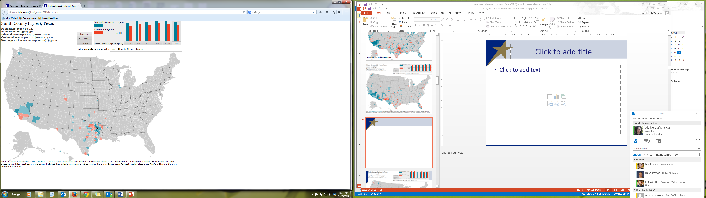

Slide 19
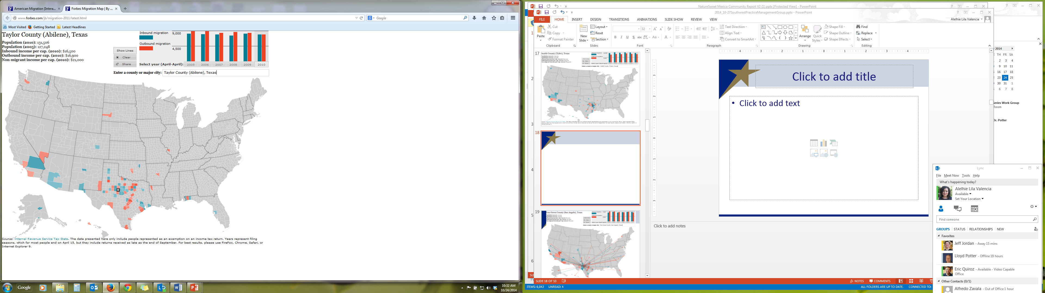

Slide 20
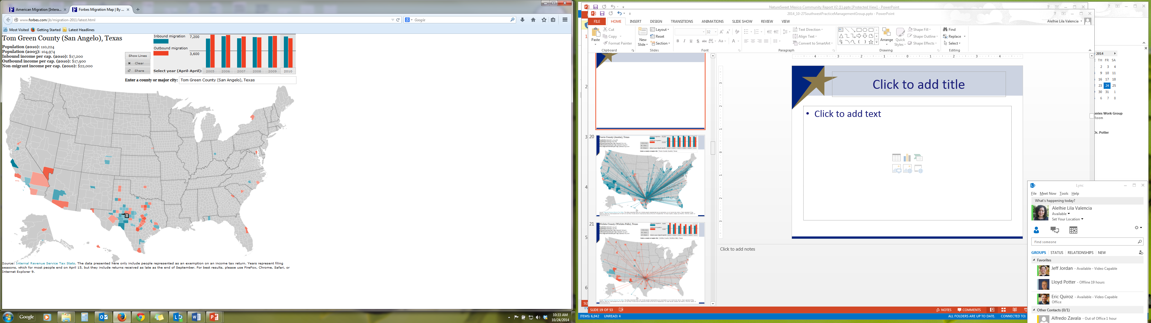

Slide 21
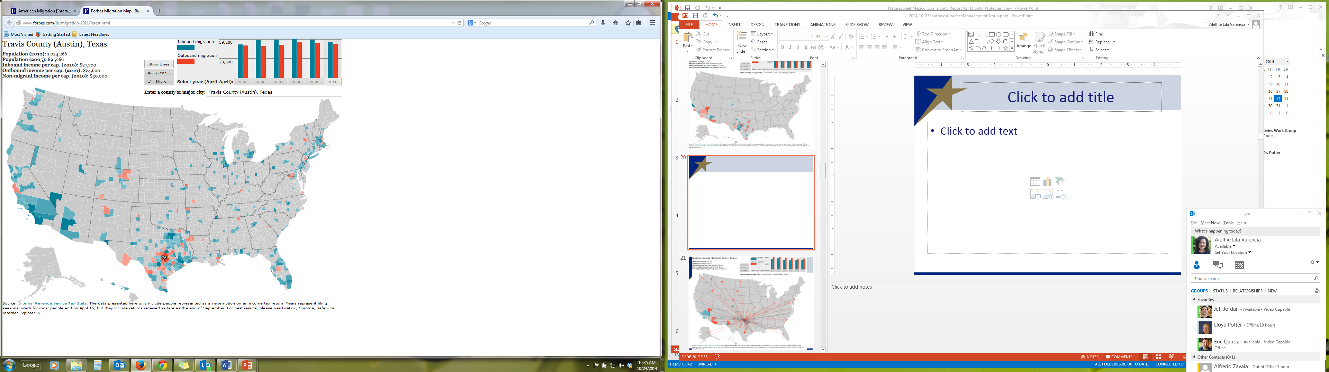

Slide 22
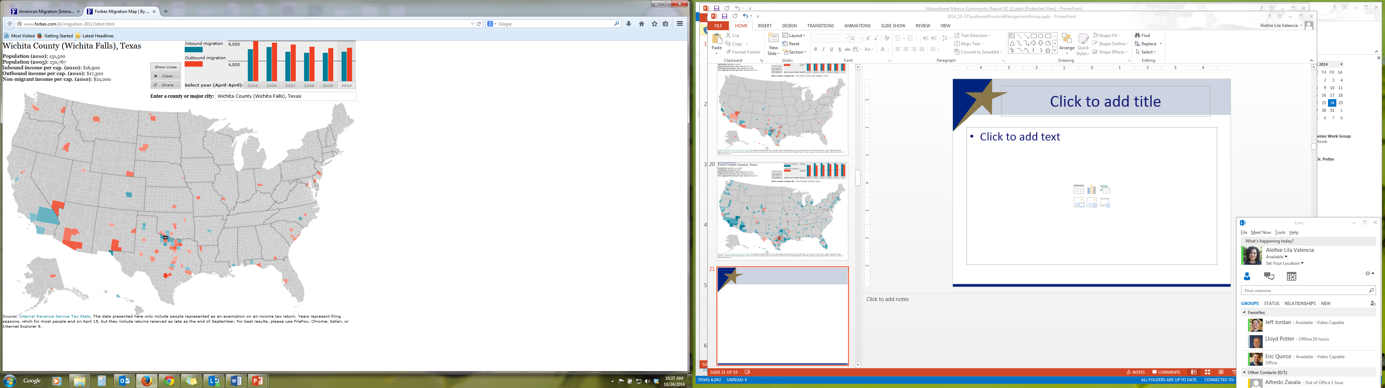

Slide 23
Texas Racial and Ethnic Composition,
2000 and 2010
Source: U.S. Census Bureau. 2000 and 2010 Census count
Notes:
As of the 2000 Census, about 53% of Texas’ population was non-Hispanic Anglo, about 32% where of Hispanic descent, about 11% were non-Hispanic African American, and about 4% were non-Hispanic Other.
In 2010, it is estimated that about 45% of the Texas population was non-Hispanic Anglo, 38% of Hispanic descent, 11% were non-Hispanic African American, and about 6% were non-Hispanic Other (largely of Asian descent).

Slide 24
Texas White (non-Hispanic) and Hispanic Populations by Age, 2010
Source: U.S. Census Bureau 2010 Decennial Census, SF1
Notes:
The age distribution of the non-Hispanic white population in Texas is weighted heavily with the “baby boom” generation. Largely the result of lower fertility and less net in-migration, the non-Hispanic white population has relatively fewer young persons relative to those in the middle-age years. In 2010, at ages 37 and younger, the Hispanic population exceeds the non-Hispanic white population. As the young Hispanic population ages, the population in Texas will increasingly trend toward Hispanics becoming the majority race/ethnic group.

Slide 25
Texas Population Pyramid by Race/Ethnicity, 2010
Source: U.S. Census Bureau 2010 Decennial Census, SF1
Notes:
This population pyramid represents the age, sex, race and ethnic composition of the Texas population. Blue represents males, red females, rows are single years of age, and shades represent specified race/ethnic groups as indicated in the legend. Note the “inverted” pyramid for the non-Hispanic White population and the presence of the “baby boom.”

Slide 26
Texas Population Pyramid by Race/Ethnicity, 2010
Source: U.S. Census Bureau 2010 Decennial Census, SF1
Notes:
This population pyramid represents the age, sex, race and ethnic composition of the Texas population. Blue represents males, red females, rows are single years of age, and shades represent specified race/ethnic groups as indicated in the legend. Note the Hispanic and African American population pyramids are characterized with wider bases (the young) relative to the peak (the old).

Slide 27
Texas Population Pyramid by Race/Ethnicity, 2010
Source: U.S. Census Bureau 2010 Decennial Census, SF1
Notes:
This population pyramid represents the age, sex, race and ethnic composition of the Texas population. Blue represents males, red females, rows are single years of age, and shades represent specified race/ethnic groups as indicated in the legend. Note the “inverted” pyramid for the non-Hispanic White population and the presence of the “baby boom” while the Hispanic and African American population pyramids are characterized with wider bases (the young) relative to the peak (the old).

Slide 28
The Texas Economy

Slide 29
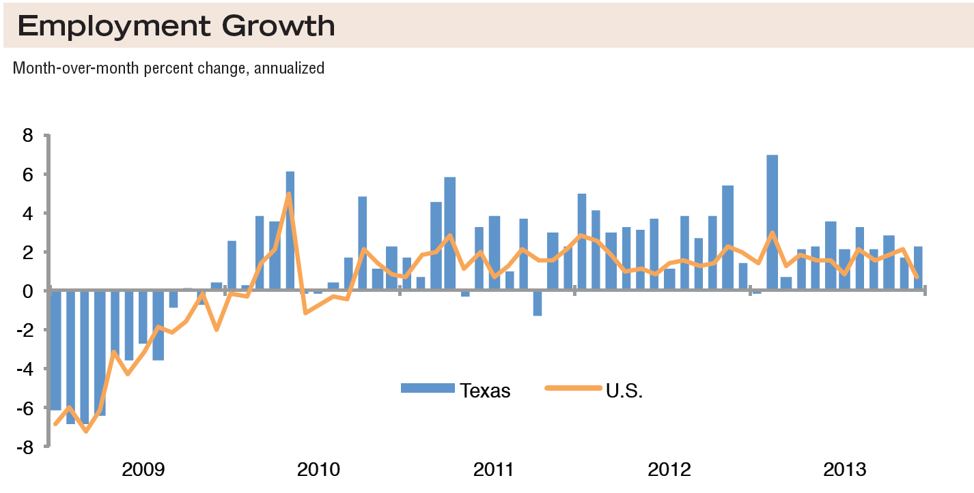
Source: Federal Reserve Bank of Dallas, Texas Economic Indicators, February 2014
Notes:
Texas average since 1990 = 2.0%
U.S. average since 1990 = 1.0%

Slide 30
Unemployment Rate, 2010 to 2014
Source: Texas Workforce Commission, U.S. Bureau of Labor Statistics
Notes:
Change from previous year:
Texas unemployment is down 1.1 percentage points.
U.S. unemployment is down 1.3 percentage points.

Slide 31
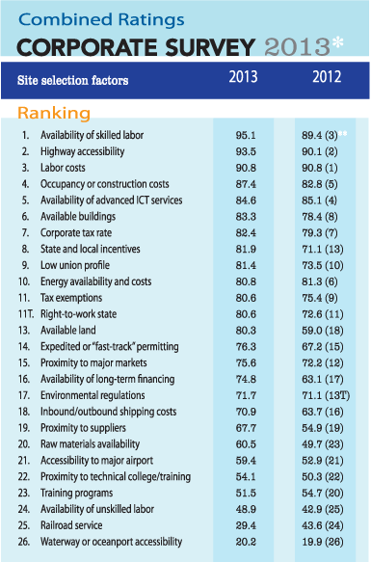
Top States for Doing Business, 2014
1.GEORGIA
2.TEXAS
3.SOUTH CAROLINA
4.ALABAMA
5.TENNESSEE
6.LOUISIANA
7.INDIANA
8.NORTH CAROLINA
9.OHIO
10.MISSISSIPPI
Source: Area Development Online www.areadevelopment.com
Notes:
Area Development conducts an annual survey of site consultants, ranking states based on their number of mentions by these consultants in 3 general categories (business environment, labor climate, and infrastructure and global access) and 18 subcategories.
This study found the list to be dominated by many Southern and mid-South states, but also included Ohio and Indiana in the Midwest.

Slide 32
Leading Locations, 2014
Midland, TX (3)
Odessa, TX (9)
Austin-Round Rock-San Marcos, TX (15)
Houston-Sugar Land-Baytown, TX (16)
Corpus Christi, TX (19)
Fort Worth-Arlington, TX (24)
College Station-Bryan, TX (40)
Dallas-Plano-Irving, TX (47)
Source: Area Development Online www.areadevelopment.com
Notes:
Area Development analyzed economic and workforce data for 379 MSAs. Domestic manufacturing, fracking, and high-tech industries are big drivers.

Slide 33
Employment Status and Characteristics of Texas Labor Force, 2009 to 2013
 | 2013 | 2012 | 2011 | 2010 | 2009
Population 16 years and over | 20,168,039 | 19,828,118 | 19,455,689 | 19,123,208 | 18,606,350 | *
In labor force | 64.9% | 64.8% | 64.9% | 65.2% | 66.2% | *
Civilian labor force | 64.4% | 64.3% | 64.4% | 64.7% | 65.6% | *
Employed | 59.9% | 59.2% | 58.9% | 58.9% | 60.3% | *
Unemployed | 4.5% | 5.1% | 5.5% | 5.7% | 5.4% | *
Armed Forces | 0.4% | 0.5% | 0.5% | 0.5% | 0.6% | *
Not in labor force | 35.1% | 35.2% | 35.1% | 34.8% | 33.8% | *
Percent of civilian labor force unemployed | 7.1% | 8.0% | 8.5% | 8.8% | 8.2% | *
Percent females in civilian labor force | 58.1% | 57.8% | 58.0% | 58.7% | 59.1% | *
Working parents with children under 6 years | 59.6% | 59.8% | 58.4% | 59.4% | 59.5%
Working parents with children 6 to 17 years | 67.0% | 67.1% | 67.3% | 68.1% | 68.1% | *
*2013 to 2009 Statistical Significance
Source: U.S. Census Bureau, 2013 American Community Survey 1-Year Estimates, Comparative Economic Characteristics

Slide 34
Employment Status by Nativity, Texas, 2013
 | Total | Native | Foreign Born | Foreign Born: Naturalized | Foreign Born: Not a U.S. Citizen
Population 16 years and over | 20,168,039 | 16,030,156 | 4,137,883 | 1,457,369 | 2,680,514
In labor force | 64.9% | 64.2% | 67.5% | 68.8% | 66.7%
Civilian labor force | 64.4% | 63.7% | 67.3% | 68.5% | 66.7%
Employed | 59.9% | 59.0% | 63.4% | 65.5% | 62.2%
Unemployed | 4.5% | 4.7% | 4.0% | 3.1% | 4.4%
Armed Forces | 0.4% | 0.5% | 0.1% | 0.3% | 0.0%
Not in labor force | 35.1% | 35.8% | 32.5% | 31.2% | 33.3%
Percent of civilian labor force unemployed | 7.1% | 7.4% | 5.9% | 4.5% | 6.7%
Source: U.S. Census Bureau, 2013 American Community Survey 1-Year Estimates

Slide 35
Industry by Nativity, Texas, 2013
 | Total | Native | Foreign Born | Foreign Born: Naturalized | Foreign Born: Not a U.S. Citizen
Agriculture, forestry, fishing & hunting, mining | 3.5% | 3.5% | 3.5% | 3.2% | 3.7%
Construction | 7.8% | 5.8% | 14.9% | 7.0% | 19.4%
Manufacturing | 9.3% | 8.7% | 11.4% | 12.3% | 10.9%
Wholesale trade | 3.1% | 3.1% | 2.9% | 3.0% | 2.9%
Retail trade | 11.6% | 12.2% | 9.5% | 10.4% | 9.0%
Transportation & warehousing, utilities | 5.2% | 5.5% | 4.3% | 5.7% | 3.6%
Information | 1.8% | 1.9% | 1.2% | 1.7% | 0.9%
Finance & insurance, real estate & rental & leasing | 6.6% | 7.4% | 3.7% | 5.4% | 2.8%
Professional, scientific, & management, administrative & waste management services | 11.1% | 10.8% | 12.3% | 11.3% | 12.9%
Educational services, health care & social assistance | 21.3% | 22.9% | 15.8% | 23.4% | 11.5%
Arts, entertainment, & recreation, accommodation & food services | 9.0% | 8.3% | 11.5% | 7.3% | 13.9%
Other services (except public administration) | 5.4% | 4.8% | 7.6% | 6.9% | 8.0%
Public administration | 4.3% | 5.1% | 1.3% | 2.5% | 0.7%
Source: U.S. Census Bureau, 2013 American Community Survey 1-Year Estimates

Slide 36
Mean travel time to work, Texas Counties, 2008-2012
Source: U.S. Census Bureau, American Community Survey, 5-year sample, 2008-2012
Notes:
Mean travel time to work is an indicator of the efficiency of the transportation system as well as an indirect indicator of housing availability and affordability. Workers in suburban ring counties (those surrounding urban core counties) tend have longer commute times.

Slide 37
Race and Ethnic Differences in Employment in Health Occupations, Females, Texas, 2012
 |  | Females
 | Total Employed CLF 16 Years and Older | Employed CLF 16 Years and Older | Health diagnosing and treating practitioners and other technical occupations (SOC 29-1000) | Health technologists and technicians (SOC 29-2000) | Healthcare support occupations (SOC 31-0000)
Ethnicity*
Non-Hispanic White | 57.6% | 59.3% | 80.4% | 66.5% | 41.2%
Hispanic | 42.4% | 40.7% | 19.6% | 33.5% | 58.8%
Total | 100.0% | 100.0% | 100.0% | 100.0% | 100.0%
Race**
Black Alone | 10.1% | 12.0% | 13.0% | 14.6% | 23.2%
Asian Alone | 4.1% | 4.1% | 10.7% | 3.7% | 1.9%
Other Alone | 7.7% | 7.1% | 3.2% | 6.8% | 8.7%
Total | 100.0% | 100.0% | 100.0% | 100.0% | 100.0%
Compare this column to these three.
The difference suggests an over or under representation of the sex-race/ethnic group in each occupational category.
Ethnicity here only includes persons who classified themselves as white and non-Hispanic and “Hispanic’ includes all persons, regardless of race, who classified themselves as Hispanic. Other non-Hispanic race groups are not included here.
** Race categories also include persons of Hispanic descent although the race categories presented have only a small percentage of persons of Hispanic descent. White Alone is not presented because that category contains sizeable percentages of both of persons of Hispanic descent and non-Hispanic White.
Source: U.S. Census Bureau, American Community Survey, 1-Year Sample, 2012
(note: data presented are from a sample survey and sampling error is associated with each estimate but is not presented in this table)
Notes:
This table demonstrates differences by race and ethnicity in the distribution of females in health related occupations. Three broad categories of health occupations are presented. The first, health diagnosing and treating practitioners, includes occupations that tend to require higher levels of education (physicians, dentists, chiropractors, pharmacists, nurses, etc.). The second category, health technologists and technicians (lab technicians, dental hygienists, emergency medical technicians, medical records technicians, etc.), are occupations that require some education but generally less than the health diagnosing and treating practitioners. Finally, the third group are health care support occupations (home health aids, physical therapy assistants, occupational therapy aides, etc.) which also require some education but less than the other two categories of occupations mentioned.
When we compare the percent distribution of the civilian labor force by race and ethnicity (Employed CLF) to the percent distribution in each of the occupations, the extent to which the percentages differ suggests differential distribution by race and ethnicity in the health occupations. If the percent in the Employed CLF column is smaller than in the occupation column, that race or ethnic group is over-represented in that occupation and if it is larger, the race or ethnic group is under-represented in that occupation.
Ethnicity among females:
The non-Hispanic white labor force is over-represented in the health diagnosing and the health technologist groups and under-represented in the healthcare support group. The Hispanic labor force is under-represented in the health diagnosing and health technologist groups and over-represented in the healthcare support group.
Race among females:
The black alone labor force is over-represented in the healthcare support group. The Asian alone group is over-represented in the health diagnosing group and under-represented in the other two groups. The other alone group (American Indians, Pacific Islanders, two or more races, etc.) is under-represented in the health diagnosing group and slightly over-represented in the healthcare support group.
In sum, among females, the white and Asian labor force are more likely to be in health occupations requiring higher levels of education. African Americans and Hispanics in the labor force are more likely to be in health occupations that require less education.

Slide 38
Race and Ethnic Differences in Employment in Health Occupations, Males, Texas, 2012
 |  | Males
 | Total Employed CLF 16 Years and Older | Employed CLF 16 Years and Older | Health diagnosing and treating practitioners and other technical occupations (SOC 29-1000) | Health technologists and technicians (SOC 29-2000) | Healthcare support occupations (SOC 31-0000)
Ethnicity*
Non-Hispanic White | 57.6% | 56.2% | 76.1% | 56.6% | 42.4%
Hispanic | 42.4% | 43.8% | 23.9% | 43.4% | 57.6%
Total | 100.0% | 100.0% | 100.0% | 100.0% | 100.0%
Race**
Black Alone | 10.1% | 8.6% | 8.2% | 10.5% | 26.4%
Asian Alone | 4.1% | 4.1% | 12.3% | 9.5% | 5.2%
Other Alone | 7.7% | 8.2% | 5.1% | 5.7% | 6.9%
Total | 100.0% | 100.0% | 100.0% | 100.0% | 100.0%
Compare this column to these three.
The difference suggests an over or under representation of the sex-race/ethnic group in each occupational category.
Ethnicity here only includes persons who classified themselves as white and non-Hispanic and “Hispanic’ includes all persons, regardless of race, who classified themselves as Hispanic. Other non-Hispanic race groups are not included here.
** Race categories also include persons of Hispanic descent although the race categories presented have only a small percentage of persons of Hispanic descent. White Alone is not presented because that category contains sizeable percentages of both of persons of Hispanic descent and non-Hispanic White.
Source: U.S. Census Bureau, American Community Survey, 1-Year Sample, 2012
(note: data presented are from a sample survey and sampling error is associated with each estimate but is not presented in this table)
Notes:
This table demonstrates differences by race and ethnicity in the distribution of males in health related occupations. Three broad categories of health occupations are presented. The first, health diagnosing and treating practitioners, includes occupations that tend to require higher levels of education (physicians, dentists, chiropractors, pharmacists, nurses, etc.). The second category, health technologists and technicians (lab technicians, dental hygienists, emergency medical technicians, medical records technicians, etc.), are occupations that require some education but generally less than the health diagnosing and treating practitioners. Finally, the third group are health care support occupations (home health aids, physical therapy assistants, occupational therapy aides, etc.) which also require some education but less than the other two categories of occupations mentioned.
When we compare the percent distribution of the civilian labor force by race and ethnicity (Employed CLF) to the percent distribution in each of the occupations, the extent to which the percentages differ suggests differential distribution by race and ethnicity in the health occupations. If the percent in the Employed CLF column is smaller than in the occupation column, that race or ethnic group is over-represented in that occupation and if it is larger, the race or ethnic group is under-represented in that occupation.
Ethnicity among males:
The non-Hispanic white labor force is over-represented in the health diagnosing group and under-represented in the healthcare support group. The Hispanic labor force is under-represented in the health diagnosing group and over-represented in the healthcare support group.
Race among males:
The black alone labor force is over-represented in the health technologist and the healthcare support groups. The Asian alone group is over-represented in the health diagnosing and the health technologist groups and under-represented in the healthcare support group. The other alone group (American Indians, Pacific Islanders, two or more races, etc.) is under-represented in all of the groups.
In sum, among males, the non-Hispanic white and Asian labor force are more likely to be in health occupations requiring higher levels of education. African Americans and Hispanics in the labor force are more likely to be in health occupations that require less education.

Slide 39
Direct Patient Care Physicians by County of Practice per 100,000 Population - September, 2013
Data Source: Texas Medical Board - September 2013
Excludes: Federal and military physicians, residents and fellows.
Prepared by: Texas Department of State Health Services, Center for Health Statistics, Health Professions Resource Center, December 3, 2013
Notes:
The distribution of direct care physicians per population is uneven through-out the State. There are many (about 27), more rural, counties that do not have any direct care physicians and others, also mainly rural, that have very low ratios of physicians per population.

Slide 40
Registered Nurses by County of Practice per 100,000 Population - September, 2013
Data Source: Texas Board of Nursing - September 2013
Prepared by: Texas Department of State Health Services, Center for Health Statistics, Health Professions Resource Center, December 3, 2013
Notes:
The distribution of registered nurses per population is uneven across the State. Only a few counties have no RNs, while many of the more rural counties have a sparse number.

Slide 41
Projections

Slide 42
Projected Population Growth in Texas, 2010-2050
Source: Texas State Data Center 2012 Population Projections
Notes:
The projected population of Texas is produced using three different migration scenarios. The blue line represents the assumption that there is no in or out migration for Texas. The result is a population that is growing only from natural increase (births-deaths). Under this unlikely scenario, Texas will maintain a health pace of population growth. The other two scenarios assume that 1) the migration rate will be the same as we observed between 2000 and 2010 and 2) the migration rate will be half of what we observed between 2000 and 2010. Under the first assumption Texas will add another 5 million persons this decade, another 7 million the following, 8 or 9 million between 2030 and 2040 and almost 10 million between 2040 and 2050. The half migration scenario also projects significant growth but more modest than the assumption of full migration.

Slide 43
Projected Population Change, Texas Counties, 2010-2050
Source: Texas State Data Center 2012 Population Projections . 2000-2010 Migration Scenario
Notes:
Projected population growth suggests increased numbers and density in the points of Texas’ population triangle, the lower Rio Grande valley with continued growth of El Paso and the urbanized areas in the west of the State. Many rural counties will continue to lose population.

Slide 44
Projected Percent Population Change, Texas Counties, 2010-2050
Source: Texas State Data Center 2012 Population Projections . 2000-2010 Migration Scenario
Notes:
The speed of growth is projected to be greatest in counties surrounding the urban core counties of the points of the Texas’ population triangle.

Slide 45
Projected Racial and Ethnic Percent, Texas, 2010-2050
Source: Texas State Data Center 2012 Population Projections , 2000-2010 Migration Scenario
Notes:
The projected population of Texas by race/ethnicity suggests that the Hispanic population will be a major driver in the population growth of the state. The non-Hispanic white population will grow very slowly and then start to decline as the Baby-Boom generation ages into high mortality years. The non-Hispanic other group is largely composed of persons of Asian descent and this group is projected to exceed the non-Hispanic black population by 2038. This graph assumes migration patterns observed between 2000 and 2010.

Slide 46
Trends in Educational Attainment of Persons in the Labor Force (25-64 Years of Age) in Texas by Race/Ethnicity – High School Graduates and Above
Source: U.S. Census Bureau, American Community Survey, Public Use Micro Sample, 2001-2011
Notes:
Educational attainment by race/ethnicity in Texas suggests that adults of Hispanic descent are much less likely to have completed high school compared to other race/ethnic groups. Over time, the percent of persons of Hispanic descent who have completed high school has been increasing more rapidly than for other groups but even at this pace of change it will take numerous decades for Hispanics to achieve parity with non-Hispanics in the percent with a high school degree or greater.

Slide 47
Percent of the Civilian Labor Force (ages 25-64) by Educational Attainment for 2011, 2030 Using Constant Rates, Texas
These should be going DOWN
These should be going UP
Sources: U.S. Census Bureau, American Community Survey, 1-Year PUMS.
Texas State Data Center, 2012 Vintage Population Projections, 0.5 Migration Scenario
Notes:
The educational attainment of the Texas labor force was projected using two assumptions.
1) The first assumption (represented by the red columns) is that educational attainment by race/ethnicity and sex would remain the same as it was in 2011. Thus the changes we see in educational attainment in this projection are due only to changes in the racial/ethnic composition of the population (driven by increasing Hispanic population and a leveling of growth among the non-Hispanic white population). Under this scenario, we would see increases of the percent of the labor force with lower levels of education and declines in the percent of the labor force with higher levels.
2) Under the second assumption (green columns) the trends observed in improving educational attainment are projected forward and applied to the projected population by race/ethnicity and sex. Thus the generally positive trends we have noted in improving educational attainment are assumed to continue into the future. The result of this projection suggests that we will see declines in the percent of the labor force with lower levels of education and increases in the percent of the labor force with higher levels of education.

Slide 48
Percent of the Civilian Labor Force (ages 25-64) by Educational Attainment for 2011, and 2030 Using Trended Rates, Texas
These should be going DOWN
These should be going UP
Sources: U.S. Census Bureau, American Community Survey, 1-Year PUMS.
Texas State Data Center, 2012 Vintage Population Projections, 0.5 Migration Scenario
Notes:
The educational attainment of the Texas labor force was projected using two assumptions.
1) The first assumption (represented by the red columns) is that educational attainment by race/ethnicity and sex would remain the same as it was in 2011. Thus the changes we see in educational attainment in this projection are due only to changes in the racial/ethnic composition of the population (driven by increasing Hispanic population and a leveling of growth among the non-Hispanic white population). Under this scenario, we would see increases of the percent of the labor force with lower levels of education and declines in the percent of the labor force with higher levels.
2) Under the second assumption (green columns) the trends observed in improving educational attainment are projected forward and applied to the projected population by race/ethnicity and sex. Thus the generally positive trends we have noted in improving educational attainment are assumed to continue into the future. The result of this projection suggests that we will see declines in the percent of the labor force with lower levels of education and increases in the percent of the labor force with higher levels of education.

Slide 49
Educational Attainment of the Civilian Labor Force (ages 25-64) by Race/Ethnicity in 2011, and Projected for 2030 Using Constant Rates and Using Trended Rates of Educational Attainment, Texas
Sources: U.S. Census Bureau, American Community Survey, 2011 1-Year PUMS.
Texas State Data Center, 2012 Vintage Population Projections, 0.5 Migration Scenario
Notes:
Among persons in the labor force, the racial/ethnic composition of levels of educational attainment are presented for 2011 and for two assumptions about projections of educational attainment by race/ethnicity and sex.
1) The first assumption (represented by Panel 2) is that educational attainment by race/ethnicity and sex would remain the same as it was in 2011. In the first two columns of this set (<HS and Hi-Eq) the persons of Hispanic descent dominate. In the last two (Bachelor and Grad/Prof) Hispanic representation is very limited.
2) Under the second assumption (Panel 3) the trends observed between 2001 and 2011 in improving educational attainment are projected forward and applied to the projected population by race/ethnicity and sex. Under this assumption Hispanics still dominate the lower to educational attainment groups, but the numbers are smaller than we observed under the constant assumption (Panel 1 above). There is a clear shift of Hispanics into the some college and associate degree level of educational attainment and notable increases in the number of Hispanics with bachelors degrees.

Slide 50
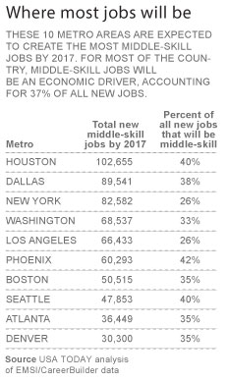
Projections of Middle Skill Jobs by Metro Area, 2017

Slide 51
Occupational Projections, 2012 to 2022
Dallas WDA
Capital Area WDA
Concho Valley WDA (San Angelo)
Upper Rio Grande WDA (El Paso)
North Texas WDA (Wichita Falls)
West Central Texas WDA (Abilene)
Deep East WDA (Lufkin)
East Texas WDA (Tyler)
Central Texas WDA (Killeen)
Sources: Texas Workforce Commission, WDA Projections Overview, 2012-2022
Notes:
http://www.lmci.state.tx.us/shared/PDFs/GrowthAbounds.pdf

Slide 52
Summary
Population continues to grow quickly though growth is geographically unequal.
Population growth is being driven by Hispanic population.
The future Texas labor force will be largely Hispanic.
Hispanics tend to have lower levels of educational attainment than other groups.
Geographic distribution of industries and occupations is variable.
Demographic and infrastructure challenges may have serious implications for future Texas economy.

Slide 53
Contact
  Office: (512) 463-8390 or (210) 458-6530
  Email: State.Demographer@osd.state.tx.us
  Internet: http://osd.state.tx.us
Office of the State Demographer
Notes:
The Office of the State Demographer and the Texas State Data Center are committed to supporting your work through providing you with the best, most accurate, and objective information we can identify about our greatest asset, the people of Texas.

