Slide 1
Demographic and Economic Characteristics, Trends, and Challenges for the Southwest States
Southwest Region Executive Directors Association
November 13, 2014
San Antonio, Texas
Notes:
Lloyd Potter is the Texas State Demographer and the Director of the Texas State Data Center based at the University of Texas at San Antonio.

Slide 2
Total Estimated Population by County, Texas, 2013
Source: U.S. Census Bureau, 2013 Vintage Population Estimates
Notes:
The counties of Harris, Dallas, Tarrant, Bexar, and Travis make up the points of the “population triangle” in Texas and are the most populated in the State. Collin, Denton, Fort Bend, Hidalgo, and El Paso counties also have significant population concentrations. Many counties west of Interstate 35 are more sparsely populated. Approximately 86% of Texas’ population is along or east of Interstate 35.

Slide 3
Estimated Numeric Population Change by
County, Texas, 2010 to 2013
99 counties lost population over the three year period.
Source: U.S. Census Bureau, 2013 Vintage Population Estimates.
Notes:
Population change so far this decade has been greatest in the urban and suburban population triangle counties. Counties in the lower Rio Grande Valley also had significant growth as did El Paso county. Overall, 155 counties gained population while 99 (39%) lost population over the decade. Those counties that are losing population are doing so largely as a function of net out migration of younger persons (entering the labor force). The result is a trend for the age structure of the populations in these more rural counties toward becoming older.

Slide 4
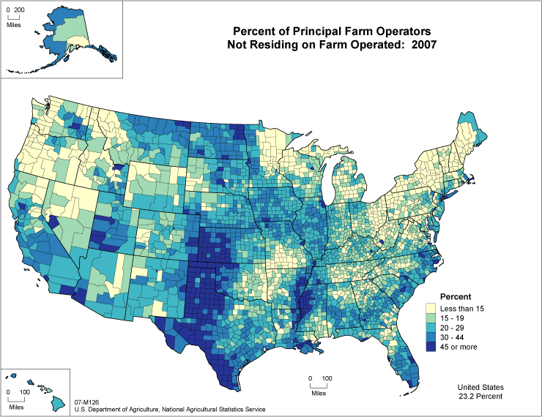
Notes:
Many of the farms in West Texas are more likely to have operators that do not live on the farm they operate. In East Texas, farm operators are more likely to live on the farms they operate.

Slide 5
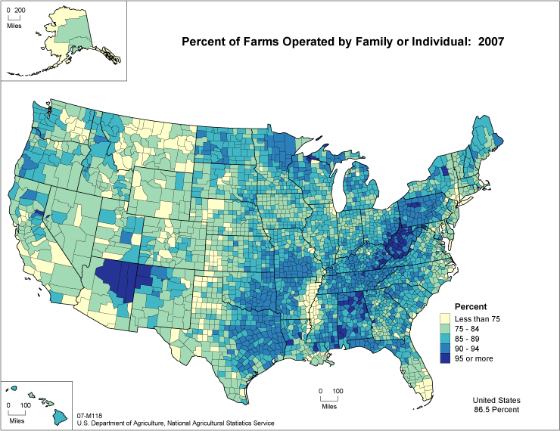
Notes:
A higher percentage of farms in Texas are family farms in the eastern part of the state while farms in the west and panhandle are more likely to be corporate farms.

Slide 6
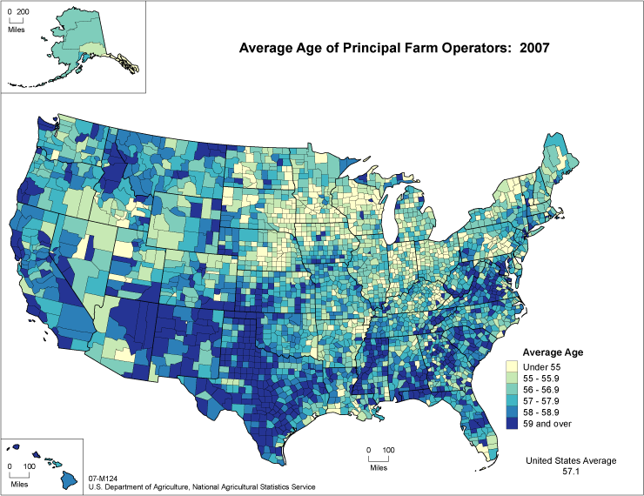
Notes:
The average age of operators on Texas farms tends to be over 59 years.

Slide 7
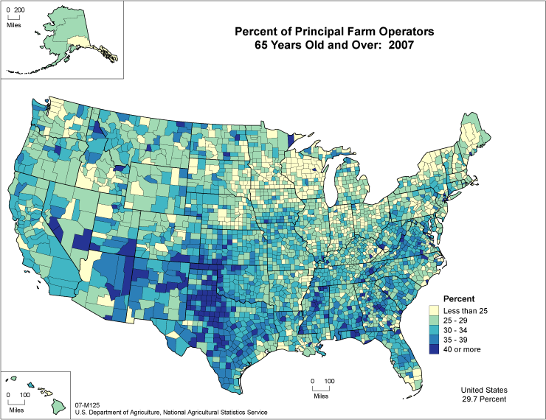
Notes:
The percent of farm operateders that are

Slide 8
Number of Annual Immigrants Admitted to the United States, FY 1820-2012

Slide 9
Number of Non-Citizen Immigrants by World Area of Birth in the Top 5 Immigration Receiving States, 2007-2011
Source: 5-Year ACS PUMS 2007-2011

Slide 10
Shares of Recent Non-Citizen Immigrants to Texas from Mexico, India, China, and All Other Countries, 2005-2012
Source: 1-Year ACS PUMS 2005-2012

Slide 11
Texas White (non-Hispanic) and Hispanic Populations by Age, 2010
Source: U.S. Census Bureau 2010 Decennial Census, SF1
Notes:
The age distribution of the non-Hispanic white population in Texas is weighted heavily with the “baby boom” generation. Largely the result of lower fertility and less net in-migration, the non-Hispanic white population has relatively fewer young persons relative to those in the middle-age years. In 2010, at ages 37 and younger, the Hispanic population exceeds the non-Hispanic white population. As the young Hispanic population ages, the population in Texas will increasingly trend toward Hispanics becoming the majority race/ethnic group.

Slide 12
Texas Population Pyramid by Race/Ethnicity, 2010
Source: U.S. Census Bureau 2010 Decennial Census, SF1
Notes:
This population pyramid represents the age, sex, race and ethnic composition of the Texas population. Blue represents males, red females, rows are single years of age, and shades represent specified race/ethnic groups as indicated in the legend. Note the “inverted” pyramid for the non-Hispanic White population and the presence of the “baby boom.”

Slide 13
Texas Population Pyramid by Race/Ethnicity, 2010
Source: U.S. Census Bureau 2010 Decennial Census, SF1
Notes:
This population pyramid represents the age, sex, race and ethnic composition of the Texas population. Blue represents males, red females, rows are single years of age, and shades represent specified race/ethnic groups as indicated in the legend. Note the Hispanic and African American population pyramids are characterized with wider bases (the young) relative to the peak (the old).

Slide 14
Texas Population Pyramid by Race/Ethnicity, 2010
Source: U.S. Census Bureau 2010 Decennial Census, SF1
Notes:
This population pyramid represents the age, sex, race and ethnic composition of the Texas population. Blue represents males, red females, rows are single years of age, and shades represent specified race/ethnic groups as indicated in the legend. Note the “inverted” pyramid for the non-Hispanic White population and the presence of the “baby boom” while the Hispanic and African American population pyramids are characterized with wider bases (the young) relative to the peak (the old).

Slide 15
Estimated and Projected Total Population Growth, Natural Increase, and Immigration Rates for the United States, 1950-2050
http://www.fas.org/sgp/crs/misc/RL32701.pdf

Slide 16
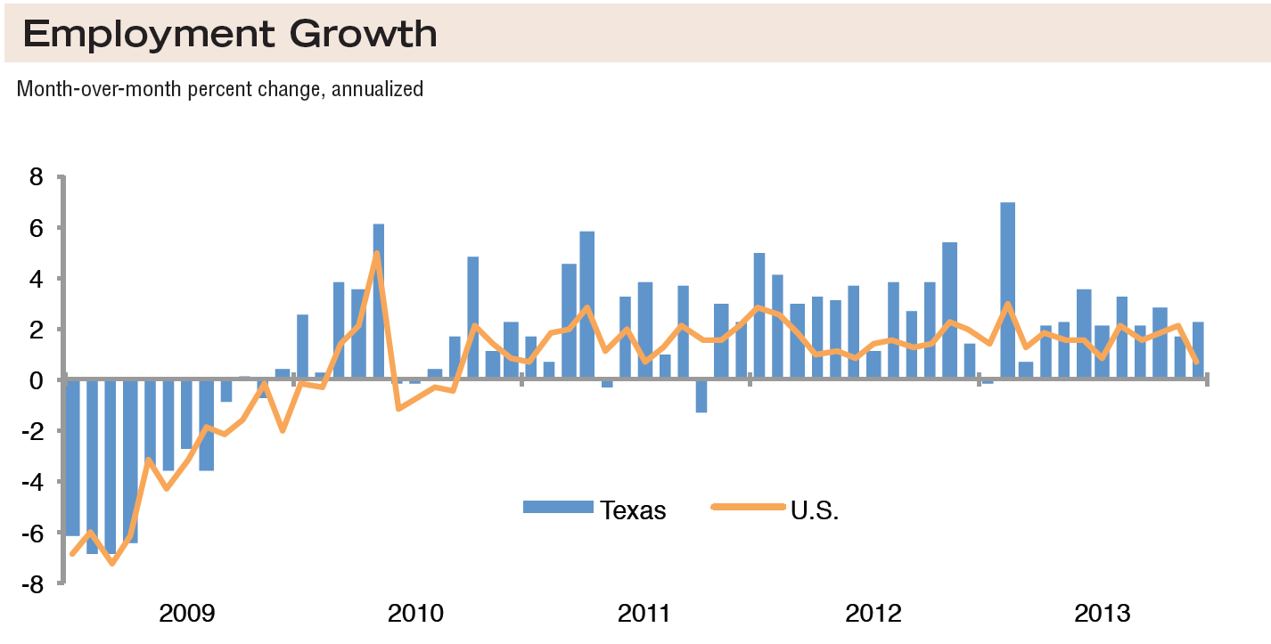
Source: Federal Reserve Bank of Dallas, Texas Economic Indicators, February 2014
Notes:
Texas average since 1990 = 2.0%
U.S. average since 1990 = 1.0%

Slide 17
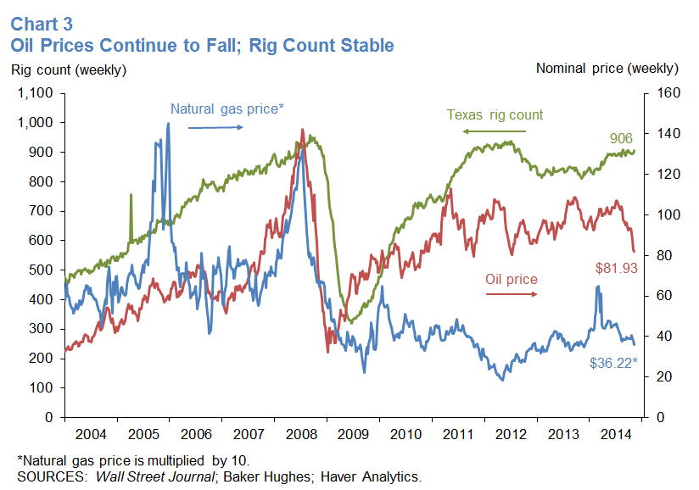

Slide 18
Estimated Percent Change of the Total Population by County, Texas, 2010 to 2013
Source: U.S. Census Bureau, 2013 Vintage Population Estimates.
Notes:
Percent change is an indicator of the speed of population change void of information about the volume of population change. Percent change in the population over the past few years has been greatest in the urban and suburban population triangle counties. Notably counties in the Eagle Ford Shale area (south east of San Antonio) and the Cline Shale area (Midland and Odessa), have been growing quickly. Overall, 155 counties gained population while 99 lost population over the decade.

Slide 19
Unemployment Rate, 2010 to 2014
Source: Texas Workforce Commission, U.S. Bureau of Labor Statistics
Notes:
Change from previous year:
Texas unemployment is down 1.1 percentage points.
U.S. unemployment is down 1.3 percentage points.

Slide 20
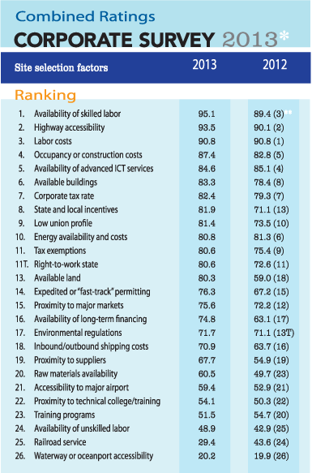
Top States for Doing Business, 2014
1.GEORGIA
2.TEXAS
3.SOUTH CAROLINA
4.ALABAMA
5.TENNESSEE
6.LOUISIANA
7.INDIANA
8.NORTH CAROLINA
9.OHIO
10.MISSISSIPPI
Source: Area Development Online www.areadevelopment.com
Notes:
Area Development conducts an annual survey of site consultants, ranking states based on their number of mentions by these consultants in 3 general categories (business environment, labor climate, and infrastructure and global access) and 18 subcategories.
This study found the list to be dominated by many Southern and mid-South states, but also included Ohio and Indiana in the Midwest.

Slide 21
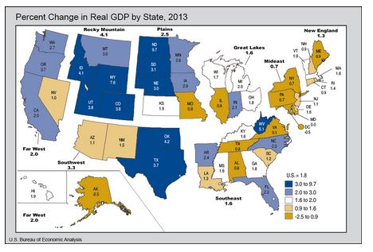

Slide 22
Total U.S. Exports (Origin of Movement) by State
Based on 2013 Dollar Value
 | 2013 Value (1,000s Dollars) | 2013 % Share of U.S. Exports | % Change, 2012 - 2013
Arkansas | 7,154 | 0.5 % | -6.1
Louisiana | 63,339 | 4.0 % | 0.7
Oklahoma | 6,919 | 0.4 % | 5.2
New Mexico | 2,728 | 0.2 % | -7.8
Texas | 279,491 | 17.7 % | 5.6
Source: U.S. Census Bureau. https://www.census.gov/foreign-trade/statistics/state/data/tx.html

Slide 23
Total U.S. Exports (Origin of Movement) by Country Ranking by State
Based on 2013 Dollar Value
 | Arkansas | Louisiana | Oklahoma | New Mexico | Texas
1 | Canada | China | Canada | Mexico | Mexico
2 | Mexico | Mexico | Mexico | Israel | Canada
3 | China | Canada | China | Canada | Brazil
4 | France | Japan | Japan | China | China
5 | Hong Kong | Singapore | Germany | Germany | Netherlands
6 | Brazil | Netherlands | Singapore | Ireland | Korea, South
7 | Germany | Brazil | Brazil | Belgium | Colombia
8 | Japan | France | Saudi Arabia | Brazil | Singapore
9 | Belgium | Colombia | Australia | Japan | Venezuela
10 | Korea, South | Panama | Russia | Australia | Japan
Source: U.S. Census Bureau. https://www.census.gov/foreign-trade/statistics/state/data/tx.html

Slide 24
Projected Racial and Ethnic Percent, Texas, 2010-2050
Source: Texas State Data Center 2012 Population Projections , 2000-2010 Migration Scenario
Notes:
The projected population of Texas by race/ethnicity suggests that the Hispanic population will be a major driver in the population growth of the state. The non-Hispanic white population will grow very slowly and then start to decline as the Baby-Boom generation ages into high mortality years. The non-Hispanic other group is largely composed of persons of Asian descent and this group is projected to exceed the non-Hispanic black population by 2038. This graph assumes migration patterns observed between 2000 and 2010.

Slide 25
Trends in Educational Attainment of Persons in the Labor Force (25-64 Years of Age) in Texas by Race/Ethnicity – High School Graduates and Above
Source: U.S. Census Bureau, American Community Survey, Public Use Micro Sample, 2001-2011
Notes:
Educational attainment by race/ethnicity in Texas suggests that adults of Hispanic descent are much less likely to have completed high school compared to other race/ethnic groups. Over time, the percent of persons of Hispanic descent who have completed high school has been increasing more rapidly than for other groups but even at this pace of change it will take numerous decades for Hispanics to achieve parity with non-Hispanics in the percent with a high school degree or greater.

Slide 26
Percent of the Civilian Labor Force (ages 25-64) by Educational Attainment for 2011, 2030 Using Constant Rates, Texas
These should be going DOWN
These should be going UP
Sources: U.S. Census Bureau, American Community Survey, 1-Year PUMS.
Texas State Data Center, 2012 Vintage Population Projections, 0.5 Migration Scenario
Notes:
The first assumption (represented by the red columns) is that educational attainment by race/ethnicity and sex would remain the same as it was in 2011. Thus the changes we see in educational attainment in this projection are due only to changes in the racial/ethnic composition of the population (driven by increasing Hispanic population and a leveling of growth among the non-Hispanic white population). Under this scenario, we would see increases of the percent of the labor force with lower levels of education and declines in the percent of the labor force with higher levels.

Slide 27
Percent of the Civilian Labor Force (ages 25-64) by Educational Attainment for 2011, and 2030 Using Trended Rates, Texas
These should be going DOWN
These should be going UP
Sources: U.S. Census Bureau, American Community Survey, 1-Year PUMS.
Texas State Data Center, 2012 Vintage Population Projections, 0.5 Migration Scenario
Notes:
Under the second assumption (green columns) the trends observed in improving educational attainment are projected forward and applied to the projected population by race/ethnicity and sex. Thus the generally positive trends we have noted in improving educational attainment are assumed to continue into the future. The result of this projection suggests that we will see declines in the percent of the labor force with lower levels of education and increases in the percent of the labor force with higher levels of education.

Slide 28
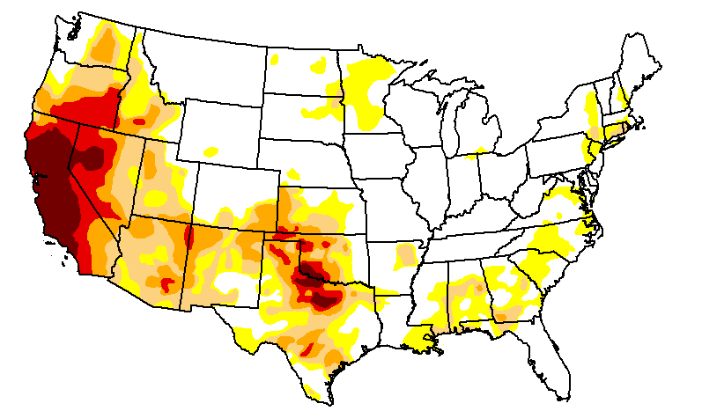

U.S. Drought Monitor Contiguous U.S. November 4, 2014
Source: The National Drought Mitigation Center: http://droughtmonitor.unl.edu/Home/RegionalDroughtMonitor.aspx

Slide 29
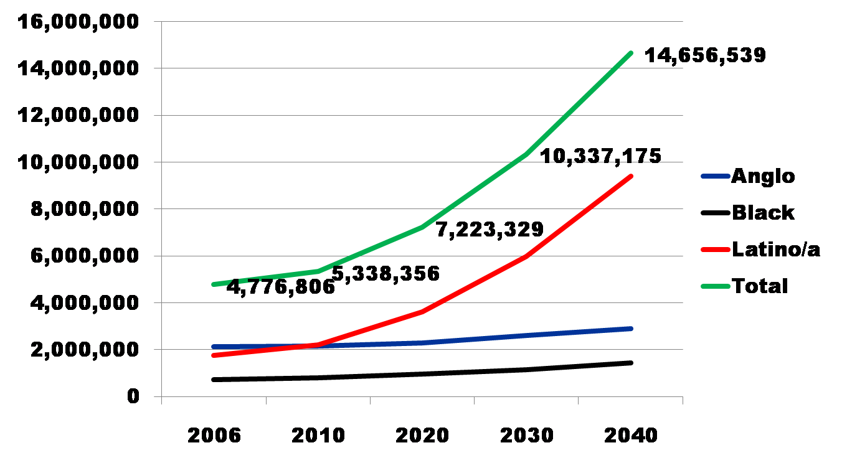
Projected Increase of Obesity in Texas by Ethnicity, 2006-2040
Source: Texas State Data Center. Population Projections, 2000-2004 Migration Scenario.

Slide 30
Projected Number of Adults with Diabetes by Race and Ethnicity for Texas, 2010-2040
Projected Persons with Diabetes
Source: Office of the State Demographer. 2006 Population Projections, 2000-2004 Migration Scenario.
Notes:
The projected number of cases of diabetes in Texas suggests that Texas may be entering a period of sustained and significant growth in the number of diabetes cases.

Slide 31
Physicians per 100,000 by
Metro & Border Status of Counties, 2009
Sources: U.S. Census Bureau. 2009 Estimates.
Department of State Health Services. Health Professions Resource Center Database.
Notes:
Estimates of physicians per 100,000 by metropolitan and border status indicate the availability of physicians is greatest in non-border metropolitan areas and least in non-metropolitan border counties.

Slide 32
Direct Patient Care Physicians by County of Practice per 100,000 Population - September, 2013
Data Source: Texas Medical Board - September 2013
Excludes: Federal and military physicians, residents and fellows.
Prepared by: Texas Department of State Health Services, Center for Health Statistics, Health Professions Resource Center, December 3, 2013
Notes:
The distribution of direct care physicians per population is uneven through-out the State. There are many (about 27), more rural, counties that do not have any direct care physicians and others, also mainly rural, that have very low ratios of physicians per population.

Slide 33
Registered Nurses by County of Practice per 100,000 Population - September, 2013
Data Source: Texas Board of Nursing - September 2013
Prepared by: Texas Department of State Health Services, Center for Health Statistics, Health Professions Resource Center, December 3, 2013
Notes:
The distribution of registered nurses per population is uneven across the State. Only a few counties have no RNs, while many of the more rural counties have a sparse number.

Slide 34
General Dentists by County of Practice per 100,000 Population - September, 2013
Data Source: Texas State Board of Dental Examiners - September 2013
General (Primary Care) Dentists: Includes: Dentists with a status code of "active" or "expired," and, a practice type of general dentistry, pediatric dentistry or dental public health. Excludes: Dentists with a status code as "retired," "revoked," "suspended," "cancelled," "surrendered," or "deceased," and those who are non-primary care, federal or military dentists, dental residents, or faculty.
Prepared by: Texas Department of State Health Services, Center for Health Statistics, Health Professions Resource Center, December 3, 2013
Notes:
Many counties in the western part of the State do not have any dentists. The greatest ratio of dentists per population is in central Texas and is generally greater in the eastern part of the State.

Slide 35
Percent of the Population that Speaks a Language Other than English at Home and Speaks English Less than Very Well, Texas Counties, 2007-2011
Source: U.S. Census Bureau, American Community Survey, 5-Year Sample, 2007-2011
Notes:
Persons who speak English less than well are likely to face barriers in access to health care compared to English speakers. The State has substantial geographic variation in the percent of the population who speak English less than very well. The extent to which health care providers are able interface with patients in the language the patients are most comfortable will influence their access to quality health care.

Slide 36
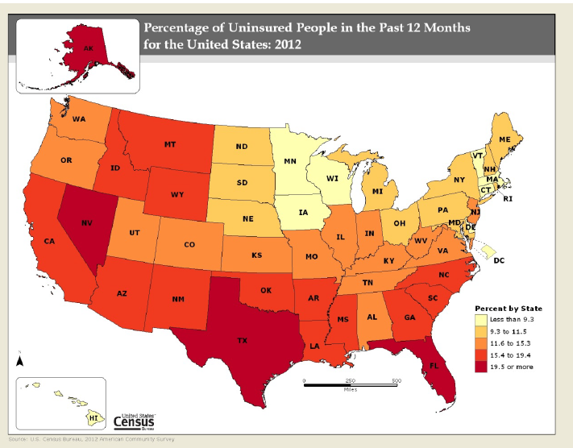

Slide 37
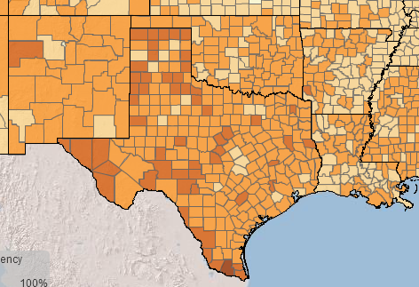
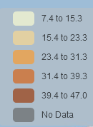
Estimated Percent Uninsured Under 65 Years of Age by County, 2012
Source: U.S. Census Bureau, Small Area Health Insurance Estimates (SAHIE)

Slide 38
State Rank for Teen Birth Rates per 1,000 Women Aged 15-19 Years, U.S. and Top 9 States, 2012, 2011, and Difference
Rank | Geography | 2012 | 2011 | % Change 2011-12
 | United States | 29.4 | 31.3 | -6
1 | New Mexico | 47.5 | 48.8 | †
2 | Oklahoma | 47.3 | 47.8 | †
3 | Mississippi | 46.1 | 50.2 | -8
4 | Arkansas | 45.7 | 50.7 | -10
5 | Texas | 44.4 | 46.9 | -5
6 | West Virginia | 44.1 | 43.5 | †
7 | Louisiana | 43.1 | 45.1 | -4
8 | Kentucky | 41.5 | 43.5 | -5
9 | Alabama | 39.2 | 40.5 | †
Source: Centers for Disease Control and Prevention, Births: Final Data for 2012, Volume 62, number 9, December 30, 2013

Slide 39
Contact
  Office: (512) 463-8390 or (210) 458-6530
  Email: State.Demographer@osd.state.tx.us
  Internet: http://osd.state.tx.us
Office of the State Demographer
Notes:
The Office of the State Demographer and the Texas State Data Center are committed to supporting your work through providing you with the best, most accurate, and objective information we can identify about our greatest asset, the people of Texas.

