Slide 1

Texas Growth
Past, Present & Future
Dr. Lloyd Potter, Texas State Demographer

Slide 2
Population Growth 1950-2010
Notes:
In 2014 we estimate that Texas had just under 27 million residents, while in the 2010 Census we had just over 25 million residents.
Population growth in Texas has been geometric in nature. Over the past two decades there have been three 20 year periods where the numeric growth has increased. We have no indication that the population growth in Texas will slow in coming years

Slide 3
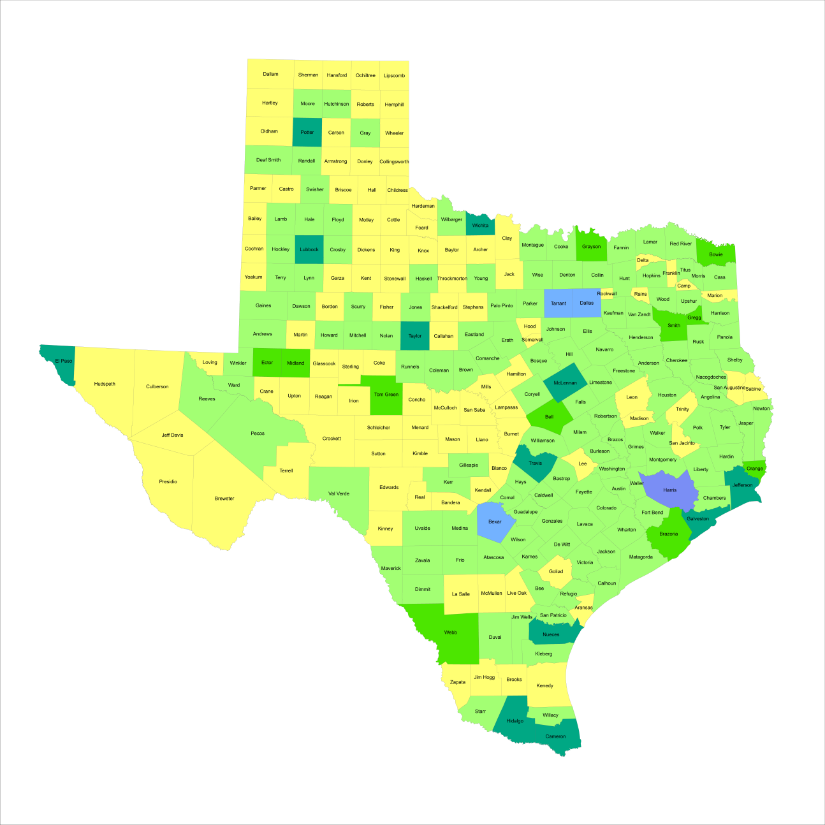
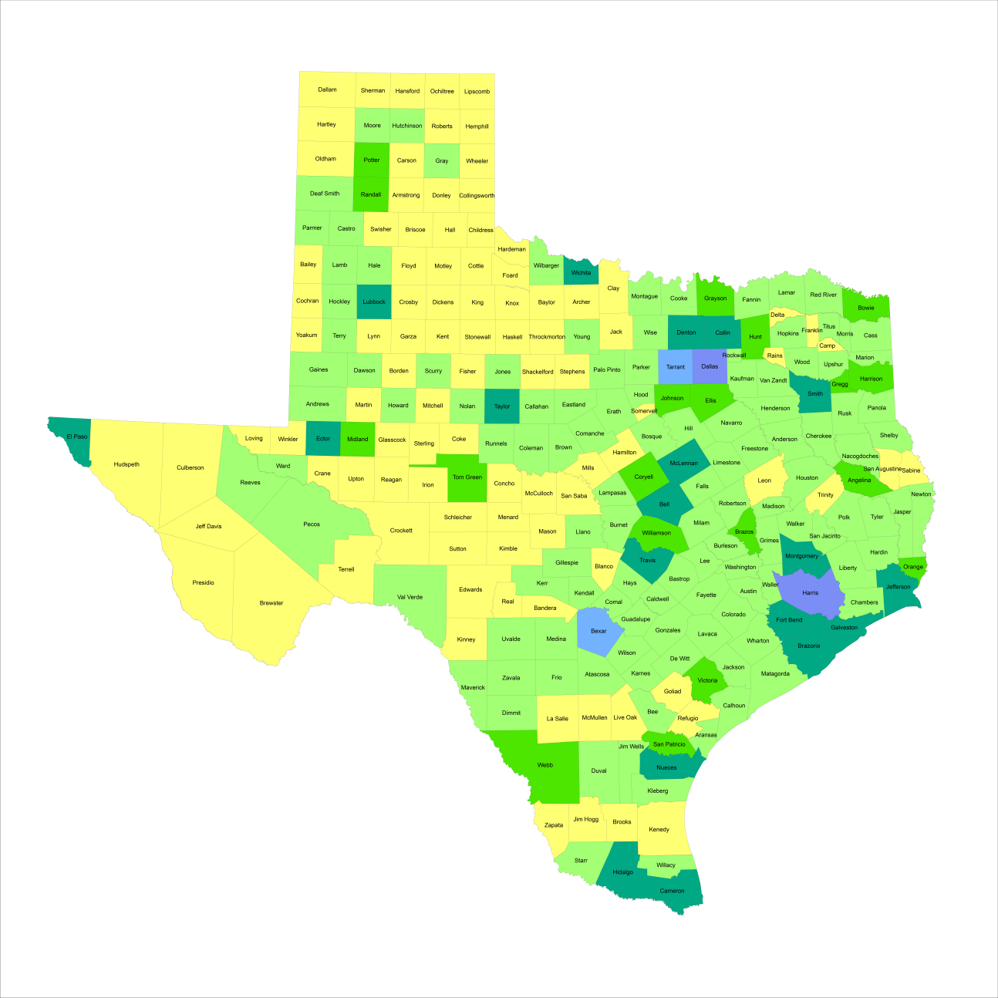
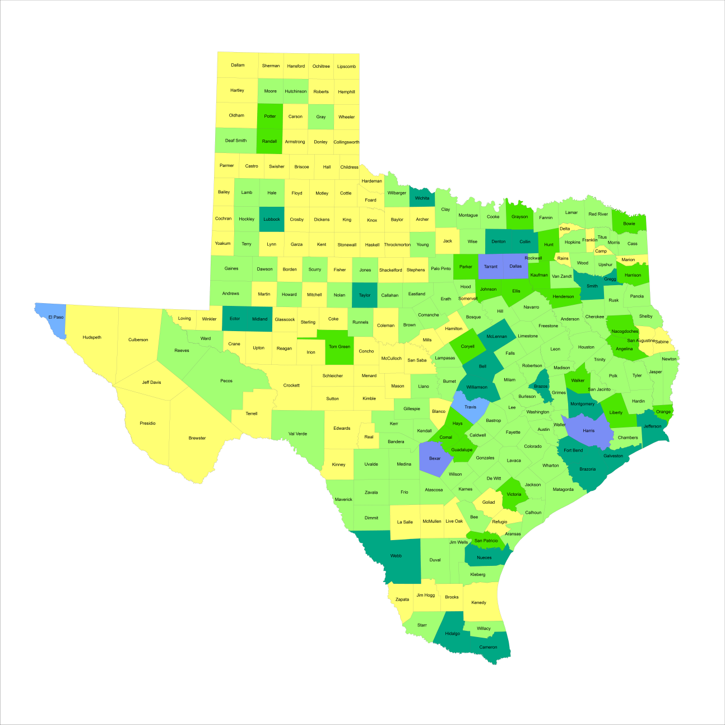
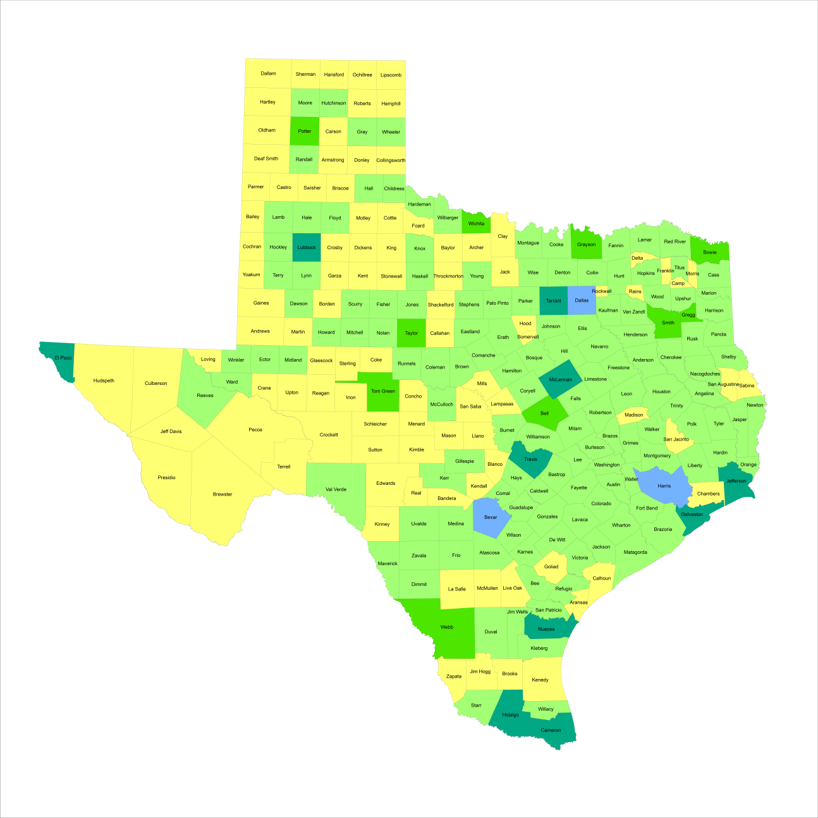

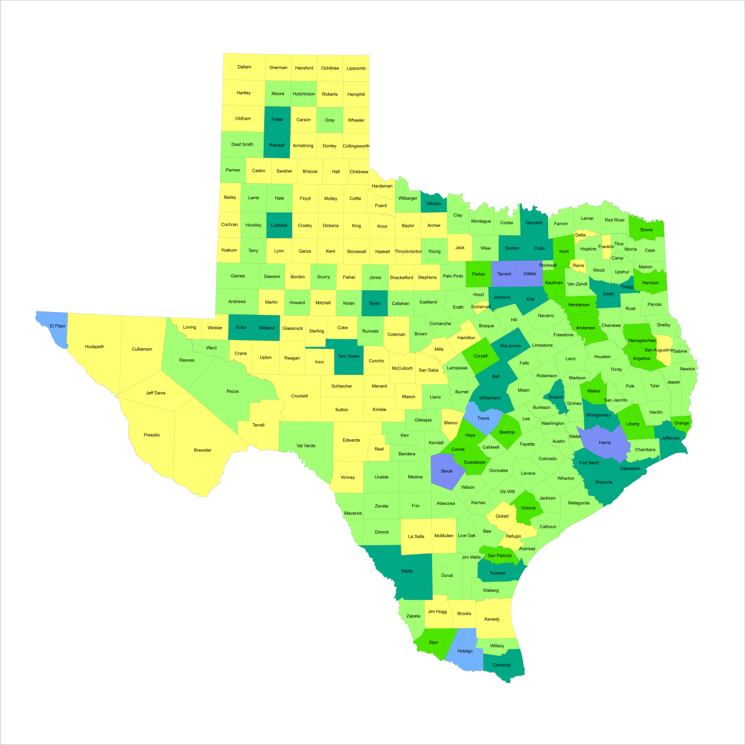
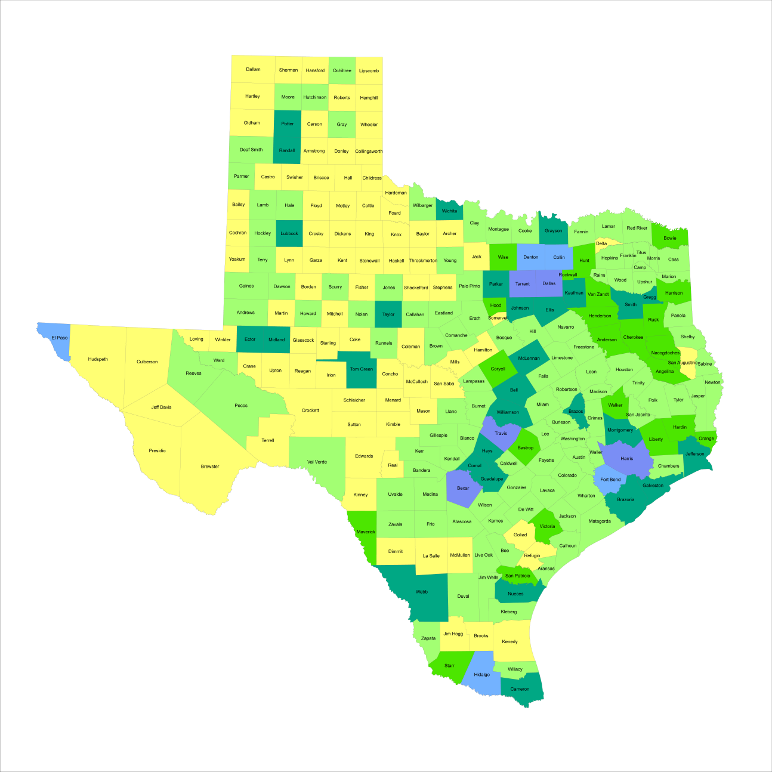
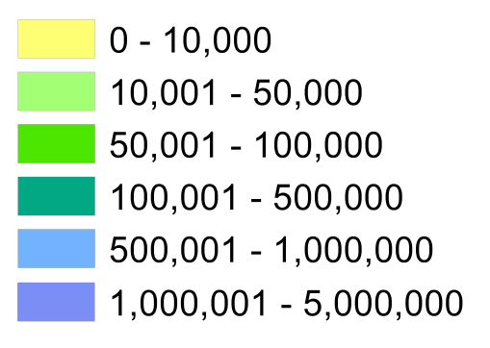
Population Growth
1950-2010
1960
1970
1950
2010
1980
1990
2000
Total Population by County
Notes:
When we look at the geographic distribution of the population of Texas over time we see continually increasing population in the counties along the I-35 corridor, the Houston area, and the lower Rio Grand Valley. Urbanized areas out west have grown but most counties west have experienced limited growth and some population decline. Approximately 86% of the population is along I-35 and east. This area with the 3 major metropolitan areas at the points is often described as the Texas population triangle.

Slide 4
Recent Growth Trends
Estimated Percent Change of Population by County, 2010-2013
-11.0% - 0%
0.1% - 2.5%
2.5% - 5.0%
5.1% - 8.0%
8.1% - 14.7%
Notes:
This image illustrates percent growth, so information about the size of the population is not represented. The counties in yellow, 99 of them out of 254, lost population over this period. There are a couple of points to notice from this map. One is that the Eagle Ford and Cline Shale oil extraction counties are growing fast. Their population bases may be small, but they are growing fast. The second point is that the suburban ring counties (Fort Bend, Hayes, Williamson, Kendall, Denton, Collin) are growing faster than the urban core counties (Dallas, Harris, Travis and Bexar).

Slide 5
Of the 40 fastest growing counties in the U.S., one third are in Texas
National Rank | County | Population Estimate |  | Percent Change
 |  | 2012 | 2013
5 | Kendall County | 35,968 | 37,766 | 5.0%
9 | Fort Bend County | 625,853 | 652,365 | 4.2%
10 | Hays County | 169,013 | 176,026 | 4.1%
11 | Andrews County | 16,137 | 16,799 | 4.1%
13 | Dimmit County | 10,481 | 10,897 | 4.0%
22 | Comal County | 114,590 | 118,480 | 3.4%
23 | Ector County | 144,609 | 149,378 | 3.3%
25 | Ward County | 10,887 | 11,244 | 3.3%
28 | Williamson County | 456,359 | 471,014 | 3.2%
32 | Montgomery County | 484,790 | 499,137 | 3.0%
35 | Denton County | 708,050 | 728,799 | 2.9%
39 | Gaines County | 18,393 | 18,921 | 2.9%
Notes:
Many of our counties are growing faster relative to many counties in the U.S.. Between 2012 and 2013, 12 of the 40 fastest growing counties in the country were in Texas. Of those, 5 of them were counties that have growth being driven by the oil extraction industry. The other fast growing counties are what we might call suburban ring counties.

Slide 6
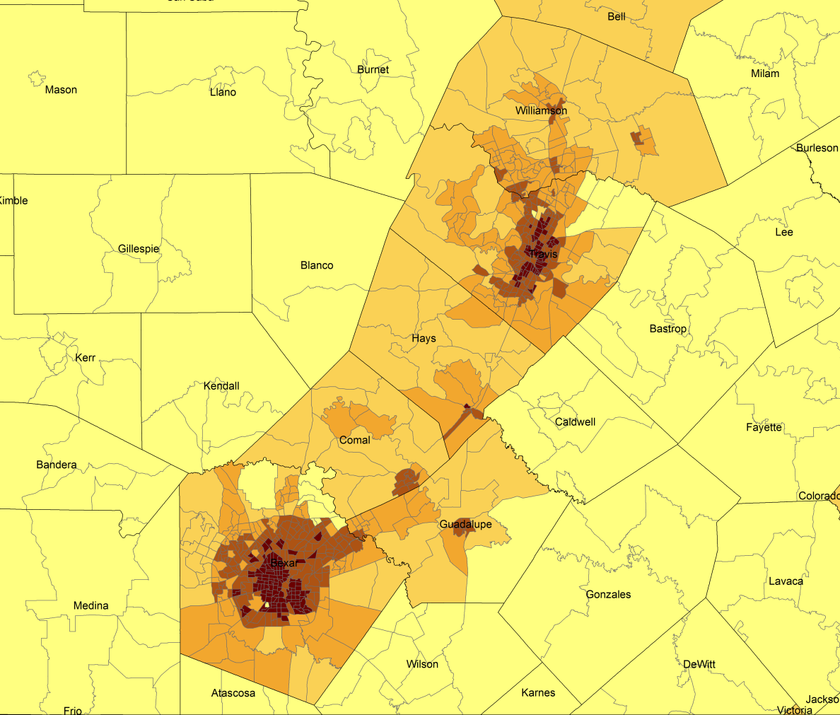
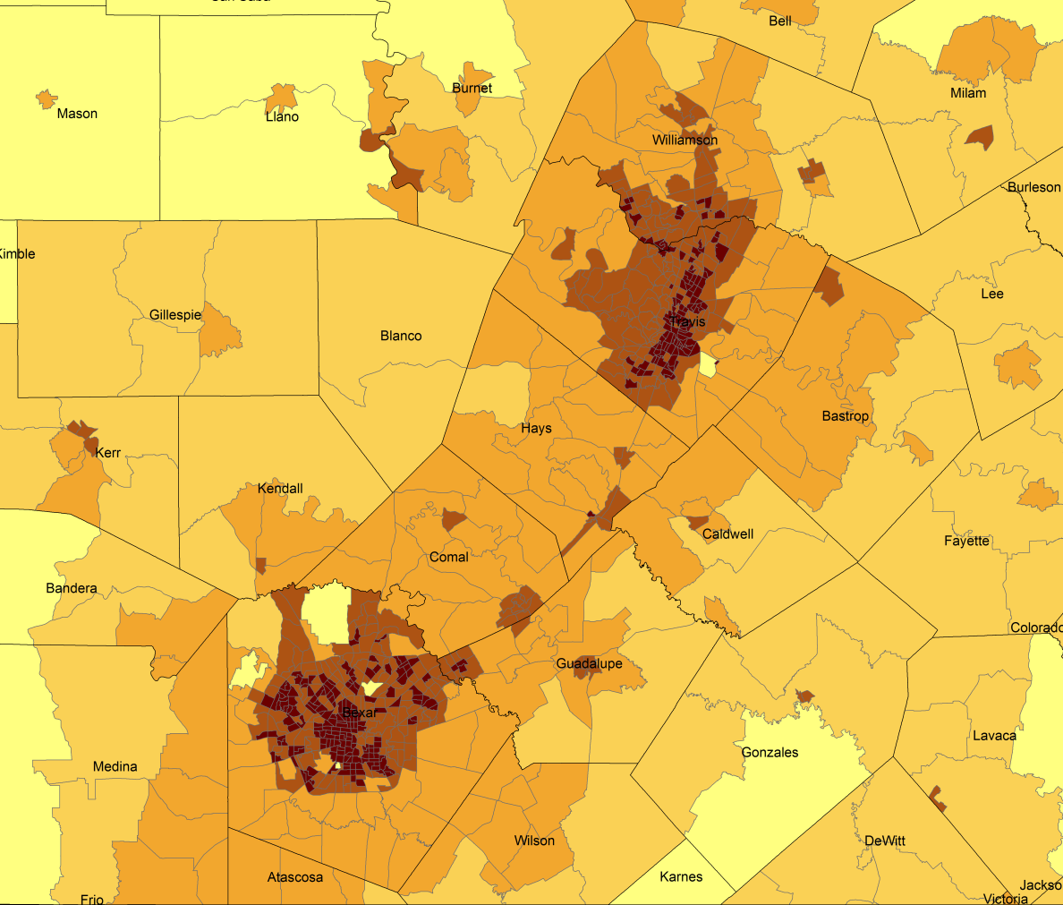
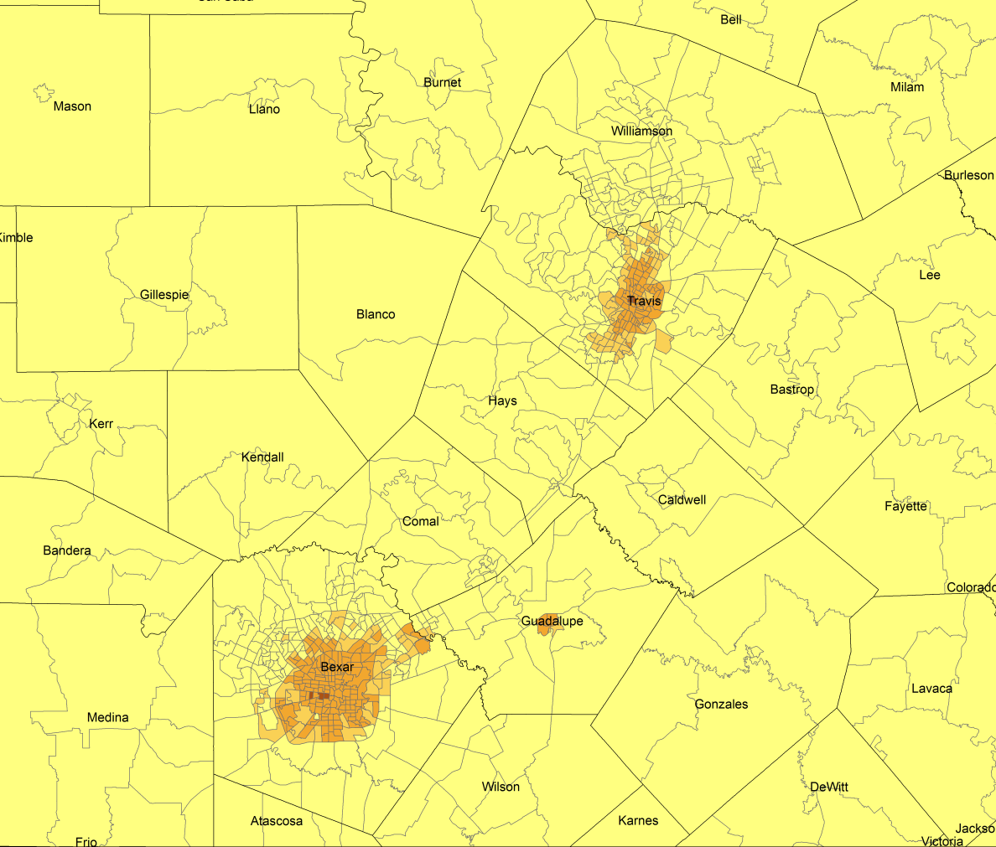
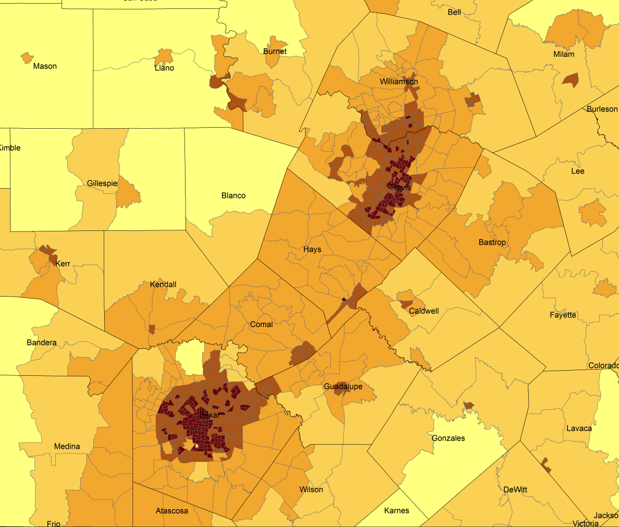
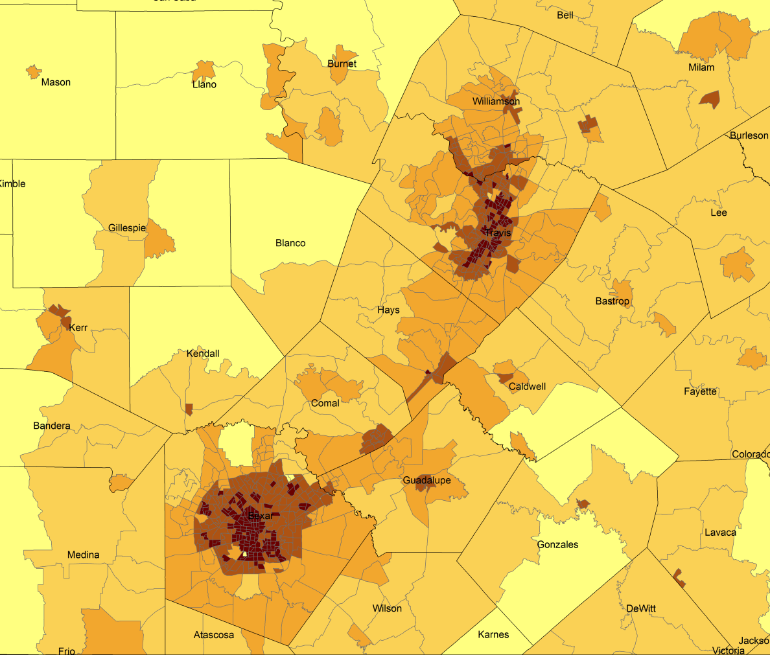
Density by Census Tract, 1970-2010
1990
2010
1980
1970
2000
Persons per Sq. Mile in the Austin-San Antonio Corridor
0 – 10
11 – 50
51 – 500
501 – 4,000
4,001 – 56,000
Notes:
As more and more people move into our counties and communities, there are more and more persons per square mile. The sequence of images here show how from 1970 to 2010 the urban areas of San Antonio and Austin have become very dense in terms of population and how the are in-between these two cities has become more and more dense. This increasing density is happening in other urban areas of the State and the stress put on the transportation infrastructure from this increasing density creates challenges for our commuting residents and for businesses who are providing services and moving goods.

Slide 7
Drivers of Population Change
Notes:
It is important to understand a couple of very basic element of population change to think about how growing population may impact our transportation system. Population changes from two factors, one is natural increase which is simply births minus deaths over time. Essentially population added from natural increase are babies who are unlikely to be driving their own vehicle on our roads before age 16. Combine this with the fact that as people die, there are fewer drivers on the road. So the effect of population growth from natural increase on our transportation infrastructure is both lightening, from people dying, and delayed until babies reach the age where they can drive. The second way population changes is from net-migration, which is simply in-minus out migrants. In Texas, the balance has been for us to have more in than out migrants. Migrants, are usually adults who are drivers (though yes, some do have non-driving children) and the may be compounded by the fact that many of the in-migrants may also take a job that requires them to drive. Essentially, migrants immediately contribute to adding stress to the transportation infrastructure.
When we look at population change in Texas, from 1950 to present we can see that before 1970, most of our growth was from natural increase. Starting in the 1970s a much larger percent of our growth is attributed to net migration and this continues to today where approaching half of our population change is from migration.

Slide 8
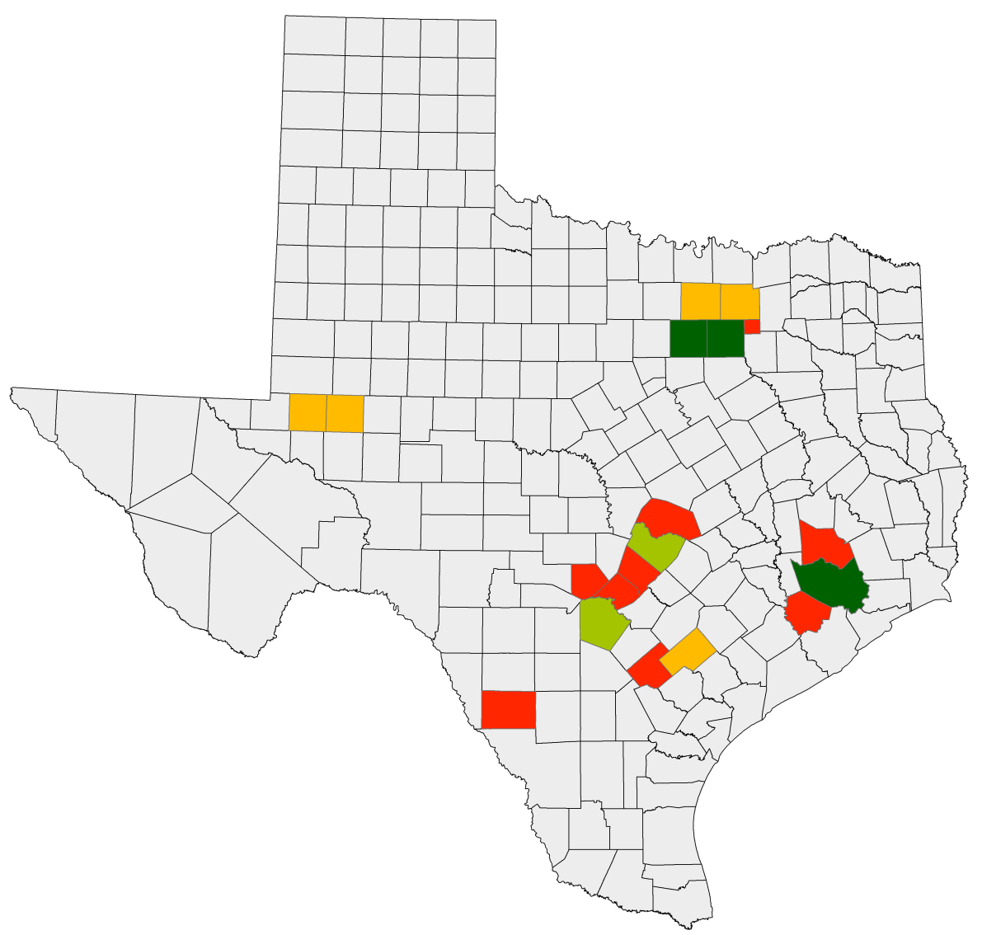
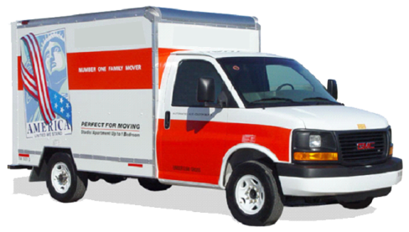
Net Migration
Percent of 2010-2013 Population Change from Net Migration
Ft. Worth
Dallas
Midland
Austin
Houston
San Antonio
12.1% – 50%
50.1% – 60%
60.1% – 70%
70.1% – 99%
Notes:
A few counties have been selected to illustrate how population change contributions vary by geography. The urban core counties in the population triangle have a smaller percent of population change from net migration. The suburban ring counties and the fracking counties have a very high percentage of their population change from net migration. This these counties are experiencing more rapid increases in demand for transportation infrastructure compared to those counties where population increase is being driven more from natural increase.

Slide 9
Population Change by Age Group
Notes:
This image represents population pyramids for Texas in 2010 and then our projected population in 2030. Population pyramids provide a visual representation of the age structure of a population. In comparing 2010 and 2030 in terms of the impact on our transportation infrastructure, look at the lighter shaded areas from 15 years and above. The lighter shaded areas below 15 suggest what’s coming in the future. Also, while there isn’t a mandatory age to stop driving, those people aging into retirement are likely to reduce stress on the infrastructure. Thus as the Baby Boomers retire, they’re likely to spend less time on the road and may offset to some degree, the increases were expecting among younger adults.

Slide 10
Pop. Projections by Race/Ethnicity, 2010-2050
Hispanic
NH White
NH Other
NH Black
Notes:
When we project population by race and ethnicity, we see that growth of the Hispanic population is Texas is the driver of population growth in the State. Shifts like this have potential implications for transportation going forward.

Slide 11
Means of Transportation to Work, 2013
Employed, 16 and older, by race and ethnicity
Notes:
For example, Hispanics are almost twice as likely, compared to non-Hispanic whites, to carpool and more likely to use public transportation. Thus, with a growing Hispanic population and with an eventually declining non-Hispanic white population, its possible that we’d see a larger percent of workers carpooling, fewer driving alone, and more using public transportation.

Slide 12
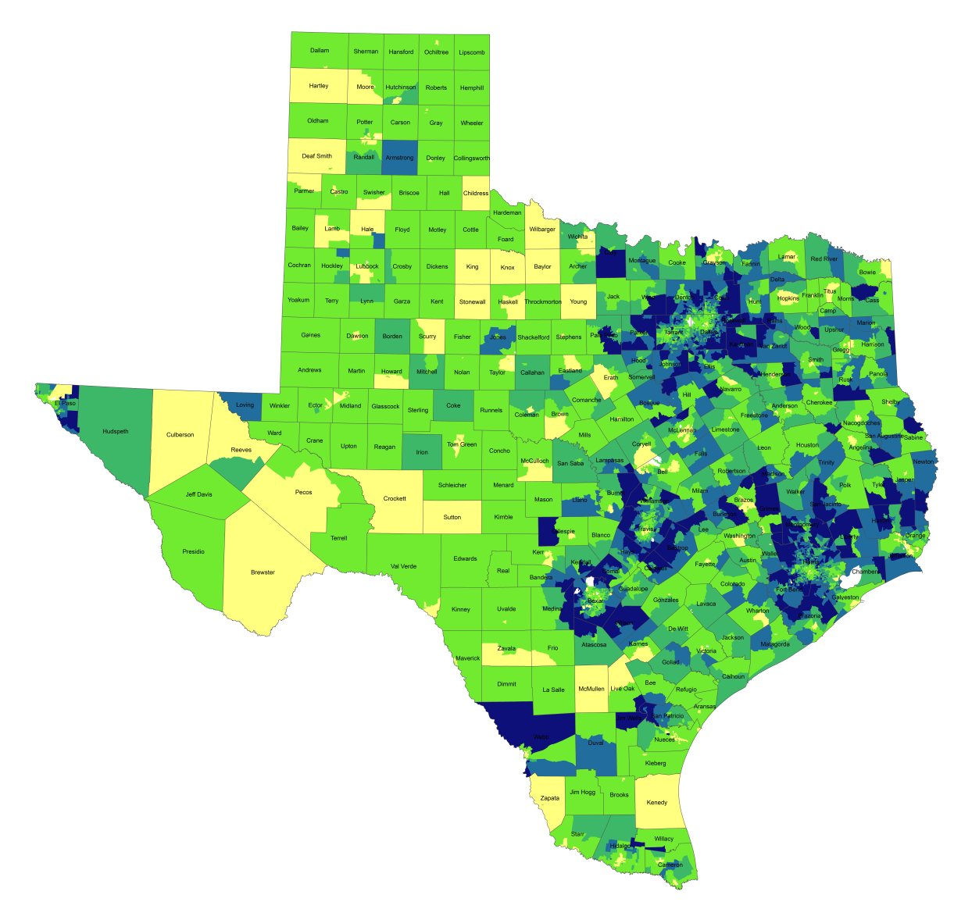
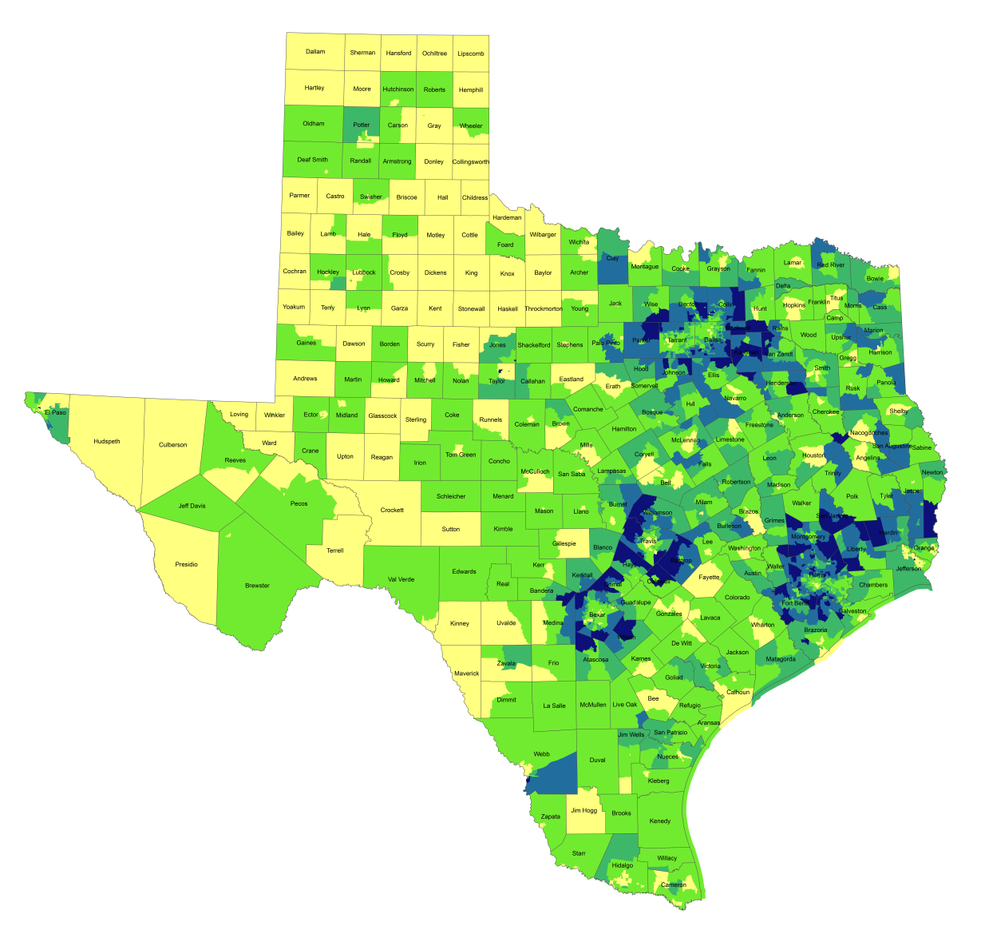
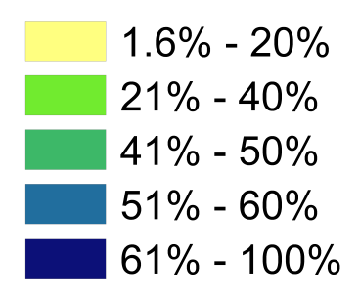
Travel Time to Work
1990
2012
Percentage of Population with Drive Times
Longer than 25 Mins.
Notes:
One indicator of quality of life is how much time spent commuting to and from work. Commuting takes away time from family and leisure activities and may have an impact on work productivity as well. When we look at the percent of workers who commute longer than 25 minutes by census tract, you can see how increasing population and resulting density, perhaps combined with lagging infrastructure has resulted in increasing commuting times for suburban residents in the more densely populated parts of the state. Commuting time is a factor that some potential business will examine when considering moving operations to a place and one that most can agree is something we want to be as small as possible within reason.

Slide 13
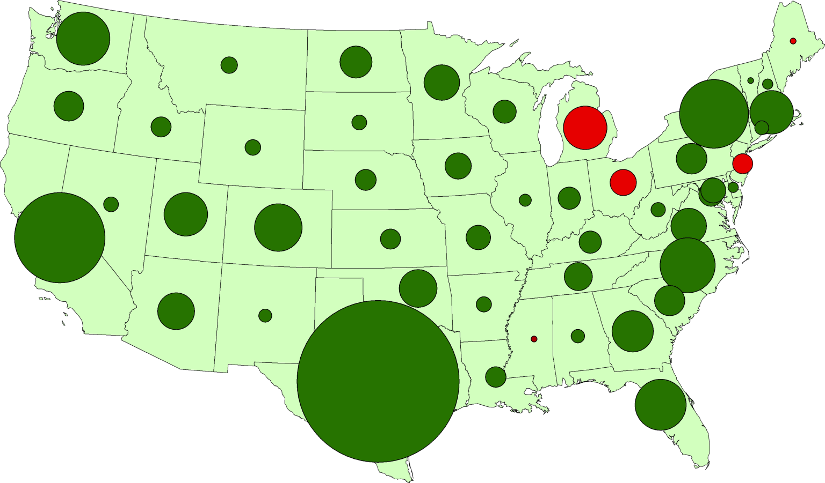
Texas Leads U.S. Job Growth, 2004-2014
Washington
320,000
New York
550,000
California
810,000
North Carolina
340,000
Texas
2,180,000
Notes:
Why are so many people moving to Texas? It’s the economy. Texas has consistently out-performed the rest of the country in job creation for well over a decade. Even through the recession and certainly coming out of the recession.

Slide 14
Texas Leads U.S. Job Growth, 2004-2014
Percentage of Total U.S. Job Gains Attributable to each State
Texas
29%
11%
California
7%
4%
4%
New York
All Others
North Carolina
Washington
Notes:
Over the last decade, Texas created almost 30% of the jobs in the United States. That’s quite amazing. If we were a country, we’d be something like the 14th or 15th largest economy. By many measures Texas has been performing very well. One of the critical questions we have an obligation to continually ask is “what might happen to slow us down or set us back?” Can we keep on the roll we’ve been on?

Slide 15
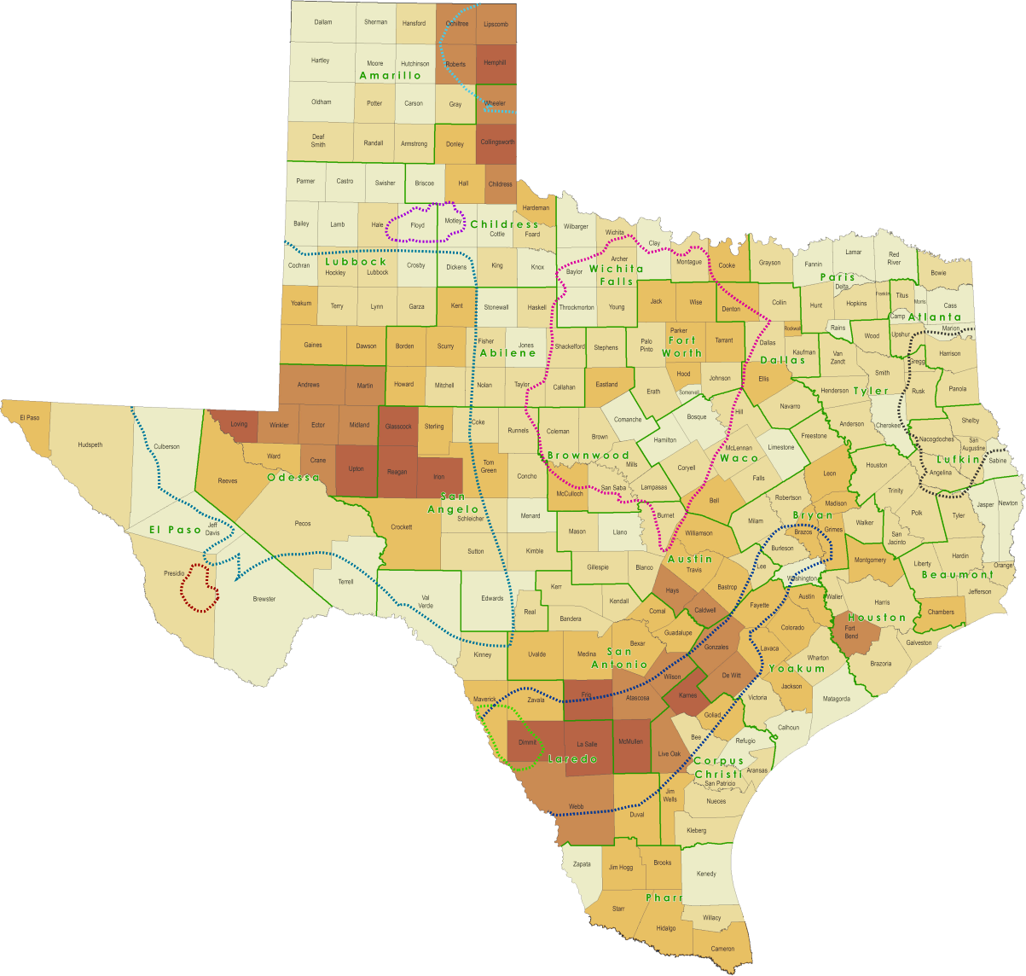
Energy Sector Growth
Change in Vehicle Miles Traveled
by County,
2000-2013
-41% – -4%
-3% – 11%
12% – 34%
35% – 85%
86% – 506%
Notes:
Recently, the growth of the oil extraction industry has fueled substantial job growth in the state and that has resulted in more vehicle miles grinding away at our transportation infrastructure in places where the infrastructure was not developed to handle the kind of truck vehicle miles we’ve been experiencing.

Slide 16
Border Crossing Growth
Total Truck Entries, 1995-2013
Total Loaded Rail Car Entries, 1995-2013
Notes:
One significant element of Texas’ economy and certainly an indicator of our strong economic growth is the issue of freight. Over the past two decades the amount of freight moving in and through Texas has been steadily increasing. Limits to freight transportation capacity are likely impose limits on our continued economic growth. Many businesses who are dependent on sending and receiving freight have been expressing concerns about transportation infrastructure in Texas and how it’s limits create costs for them. Much of our movement of goods is international in nature. The volume of trucks and trains crossing the U.S. Mexico border has been increasing and the more our two economies grow and are more intertwined, the more demand their will be to move freight back and forth across the border.

Slide 17
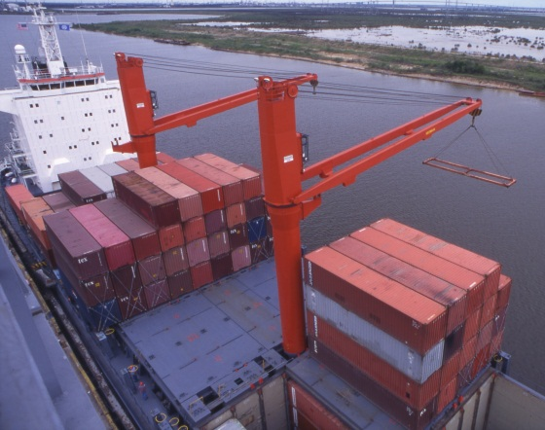
Container Volume at Texas Ports
Total Number of TEUs Unloaded Annually, 2003-2013
Notes:
Texas also has increasing volume of shipping freight both domestic and international moving through our ports. Limitations on getting freight to or from our ports and the capacity of our ports to increase the volume of freight have potential to impose limits on our economic growth.

Slide 18
Population Projections, 2010-2050
2000-2010 rate
0.5 of 2000-2010 rate
Zero
Notes:
Looking forward, we expect our population to continue to grow in a similar geometric pattern to what we’ve seen in decades past. The top projection line is the population growth we’re projected to see if people migrate to Texas as they did last decade. Under that scenario, Texas is likely to add 5 million new Texans between 2010 and 2020, another 6 or 7 million the decade after that, another 8 or 9 million between 2030 and 40 and perhaps another 10 million between 2040 and 50.
The second scenario has Texas growing a bit slower, as if we experience half the migration we did last decade. This scenario would be consistent with somewhat of an economic downturn relative to what we have been experiencing.

Slide 19

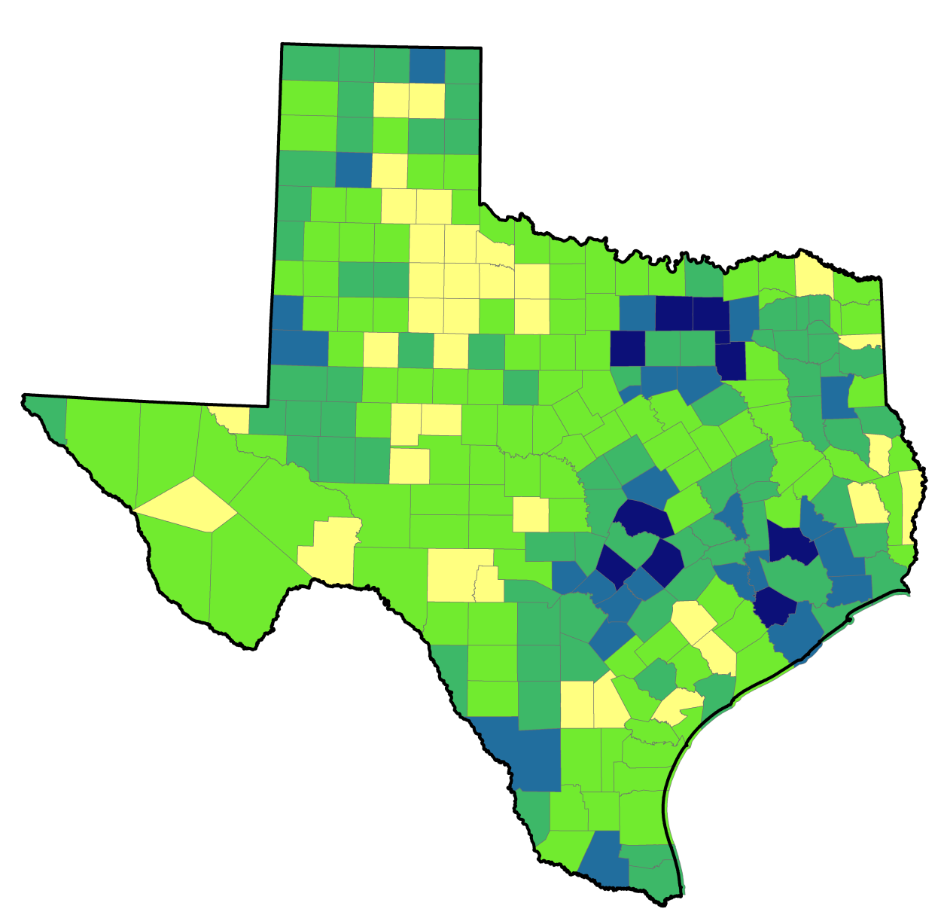
Projected Population Growth Rate by County,
2010-2050
-41% – -4%
-3% – 11%
12% – 34%
35% – 85%
86% – 506%
Notes:
When we look at were the projected growth is likely to be, much if it is in the suburban ring counties. While urban core counties will continue to have needs for transportation infrastructure development and maintenance, the suburban ring counties are adding new drivers and businesses at a greater pace compared to the urban core counties and in some cases the transportation infrastructure is already substantially behind the needs of people and businesses.

Slide 20
Conclusions
Population in Texas continues to grow rapidly – yet growth is geographically unequal.
Texas’ population growth is being driven by the Hispanic population.
Economic growth in Texas continues to be healthy with significant growth in international economic activity.
Demographic and infrastructure challenges have serious implications for the future Texas economy.

