Slide 1
Demographic Trends in Texas: Wimberley Texas
Wimberley Chamber of Commerce
January 21, 2015
Wimberley, Texas
Notes:
Lloyd Potter is the Texas State Demographer and the Director of the Texas State Data Center based at the University of Texas at San Antonio.

Slide 2
Total Population and Components of Population Change in Texas, 1950-2013
Year* | Population | Numeric Change | Annual Percent Change
1950 | 7,711,194 | -- | --
1960 | 9,579,677 | 1,868,483 | 2.4
1970 | 11,196,730 | 1,617,053 | 1.7
1980 | 14,229,191 | 3,032,461 | 2.7
1990 | 16,986,510 | 2,757,319 | 2.0
2000 | 20,851,820 | 3,865,310 | 2.3
2010 | 25,145,561 | 4,293,741 | 2.1
2012 | 26,060,796 | 915,235 | 1.8
2013 | 26,448,193 | 387,397 | 1.4
2014 | 26,956,958 | 451,321 | 1.7
* All values for the decennial dates are for April 1st of the indicated census year. Values for 2012 and 2013 are for July 1 as estimated by the U.S. Census Bureau. Source: U.S. Census Bureau, Census Counts and Population Estimates Note: Residual values are not presented in this table.

Slide 3
Texas Population 1950-2010
Source: U.S. Census Bureau, Census Counts

Slide 4
Components of Population Change by Percent in Texas, 1950-2010
Source: U.S. Census Bureau, Population Estimates

Slide 5
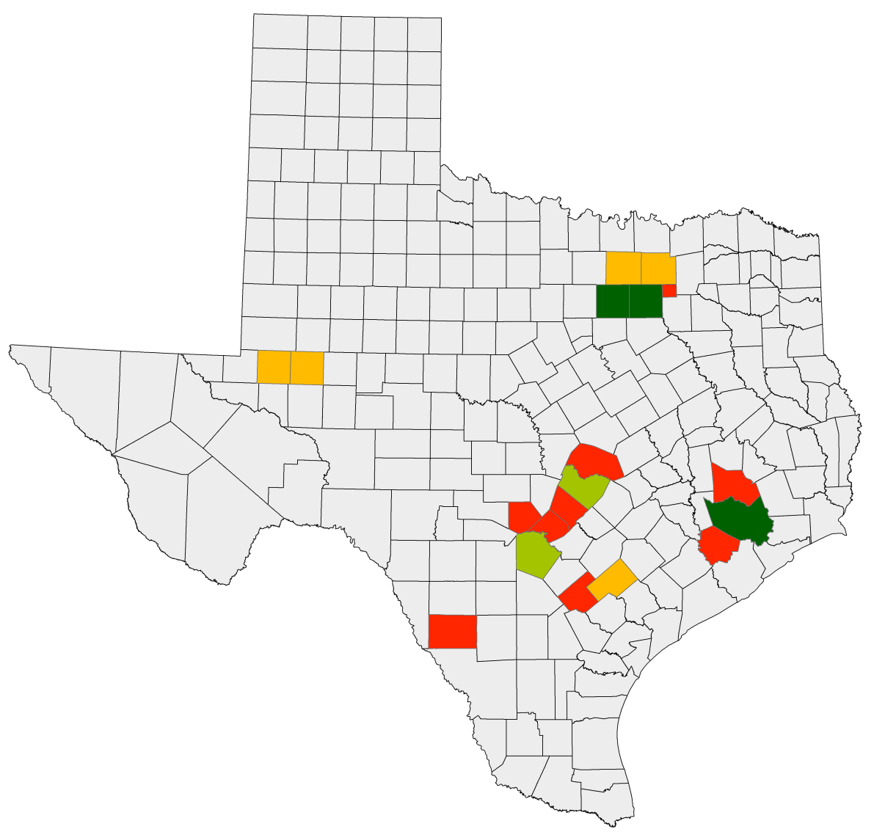

Net Migration
Percent of 2010-2013 Population Change from Net Migration
Ft. Worth
Dallas
Midland
Austin
Houston
San Antonio
12.1% – 50%
50.1% – 60%
60.1% – 70%
70.1% – 99%
Notes:
I’ve selected a few counties to illustrate how population change contributions vary by geography. The urban core counties in the population triangle have a smaller percent of population change from net migration. The suburban ring counties and the fracking counties have a very high percentage of their population change from net migration. This these counties are experiencing more rapid increases in demand for transportation infrastructure compared to those counties where population increase is being driven more from natural increase.

Slide 6
Wimberley Population
 | April 1-2010 | Population Estimate (as of July 1)
 | Census | 2010 | 2011 | 2012 | 2013
Wimberley | 2,626 | 2,632 | 2,627 | 2,588 | 2,582
Source: U.S. Census Bureau, 2010 Census and Population Estimates

Slide 7
One third of the top 40 fastest growing counties in the United States are in Texas, 2012 to 2013
U.S. Rank | Geography | Population Estimate |  | Change, 2012 to 2013
 |  | 2012 | 2013 | Number | Percent
5 | Kendall County, Texas | 35,968 | 37,766 | 1,798 | 5.0
9 | Fort Bend County, Texas | 625,853 | 652,365 | 26,512 | 4.2
10 | Hays County, Texas | 169,013 | 176,026 | 7,013 | 4.1
11 | Andrews County, Texas | 16,137 | 16,799 | 662 | 4.1
13 | Dimmit County, Texas | 10,481 | 10,897 | 416 | 4.0
22 | Comal County, Texas | 114,590 | 118,480 | 3,890 | 3.4
23 | Ector County, Texas | 144,609 | 149,378 | 4,769 | 3.3
25 | Ward County, Texas | 10,887 | 11,244 | 357 | 3.3
28 | Williamson County, Texas | 456,359 | 471,014 | 14,655 | 3.2
32 | Montgomery County, Texas | 484,790 | 499,137 | 14,347 | 3.0
35 | Denton County, Texas | 708,050 | 728,799 | 20,749 | 2.9
39 | Gaines County, Texas | 18,393 | 18,921 | 528 | 2.9
Counties in bold had growth associated with oil and gas extraction
Source: U.S. Census Bureau, 2013
Notes:
One-third of the fastest growing counties in the United States from 2012 to 2013 were in Texas.

Slide 8
One fourth of U.S. counties in the top 40 for numeric growth are in Texas, 2012-2013
U.S. Rank | Geography | Population Estimate |  | Change, 2012 to 2013
 |  | 2012 | 2013 | Number | Percent
1 | Harris County, Texas | 4,253,963 | 4,336,853 | 82,890 | 1.9
6 | Bexar County, Texas | 1,785,787 | 1,817,610 | 31,823 | 1.8
8 | Tarrant County, Texas | 1,881,445 | 1,911,541 | 30,096 | 1.6
11 | Fort Bend County, Texas | 625,853 | 652,365 | 26,512 | 4.2
12 | Dallas County, Texas | 2,453,907 | 2,480,331 | 26,424 | 1.1
15 | Travis County, Texas | 1,096,246 | 1,120,954 | 24,708 | 2.3
22 | Denton County, Texas | 708,050 | 728,799 | 20,749 | 2.9
24 | Collin County, Texas | 834,674 | 854,778 | 20,104 | 2.4
33 | Williamson County, Texas | 456,359 | 471,014 | 14,655 | 3.2
35 | Montgomery County, Texas | 484,790 | 499,137 | 14,347 | 3.0
Notes:
One-fourth of the counties in the United States that were growing the most numerically between 2012 and 2013 were in Texas. These counties are the larger ones in the State and are all counties that have experienced continued growth.

Slide 9
Total Estimated Population by County, Texas, 2013
Source: U.S. Census Bureau 2013 Population Estimates
Notes:
The counties of Harris, Bexar, Dallas, Tarrant, and Travis are the most populated in the State. Collin, Denton, Fort Bend, Hidalgo, and El Paso counties also have significant population concentrations. Many counties west of Interstate 35 are more sparsely populated.

Slide 10
Estimated Change of the Total Population by
County, Texas, 2010 to 2013
99 counties lost population over the three year period
Source: U.S. Census Bureau Population Estimates, 2013 Vintage.
Notes:
Population change over the decade has been greatest in the urban and suburban population triangle counties. Counties in the lower Rio Grande Valley also had significant growth as did El Paso county. Overall, 155 counties gained population while 99 (39%) lost population over the decade.

Slide 11
Estimated Percent Change of the Total Population by County, Texas, 2010 to 2013
Source: U.S. Census Bureau Population Estimates, 2013 Vintage.
Notes:
Percent change is an indicator of the speed of population change void of information about the volume of population change. Percent change in the population over the past few years has been greatest in the urban and suburban population triangle counties. Notably counties in the Eagle Ford Shale area (south east of San Antonio) and the Cline Shale area (Midland and Odessa) area, have been growing quickly. Overall, 155 counties gained population while 99 lost population over the decade.

Slide 12
Estimated Number of Net Migrants by
County, Texas, 2012 to 2013
Source: U.S. Census Bureau Population Estimates, 2013 Vintage.
Notes:
The estimated number of net migrants was greatest in the points of the Texas population triangle and surrounding counties. Population change in suburban counties with high migration is largely driven by migration. Population change in the urban core counties of the population triangle is more driven by natural increase than by net migration. Net in-migration to urban core counties at the points of the population triangle is dominated by international in-migration.

Slide 13
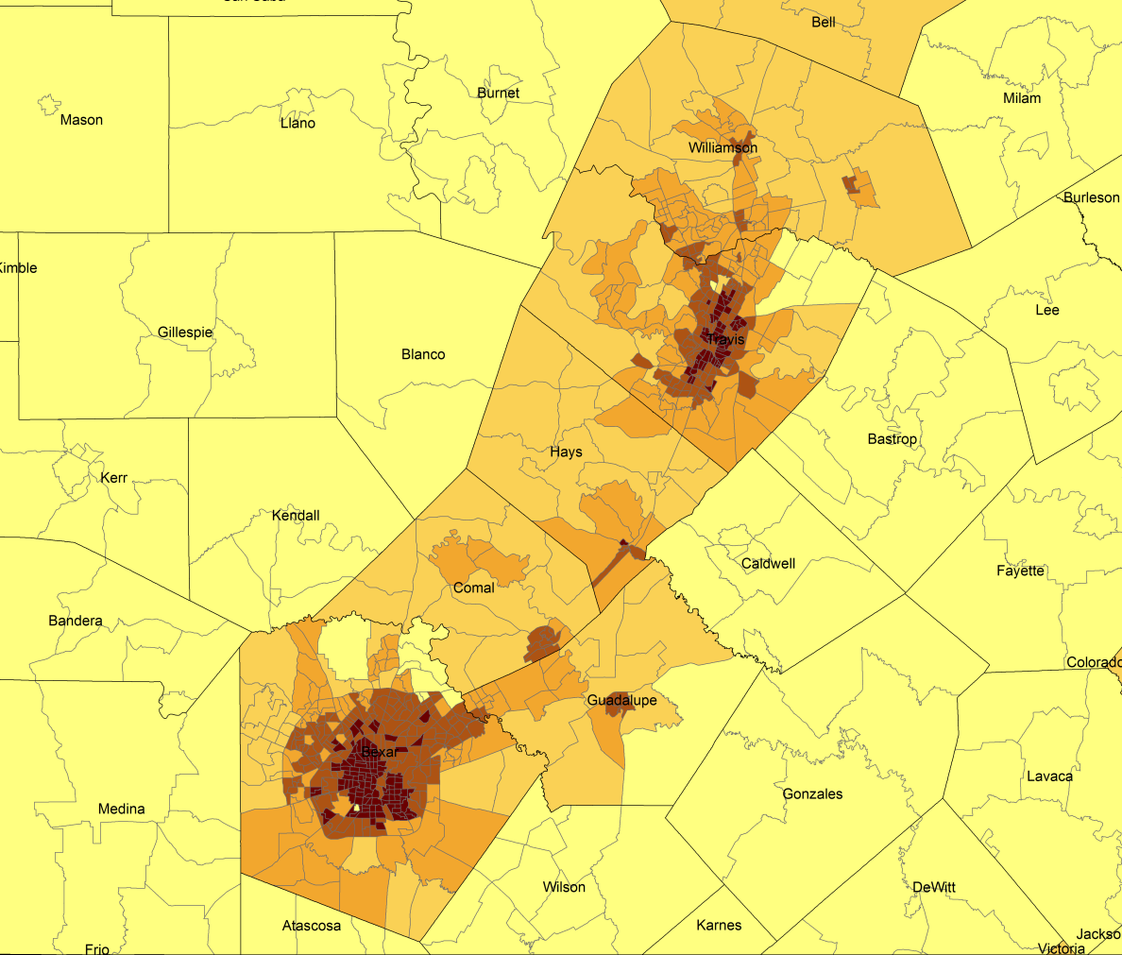
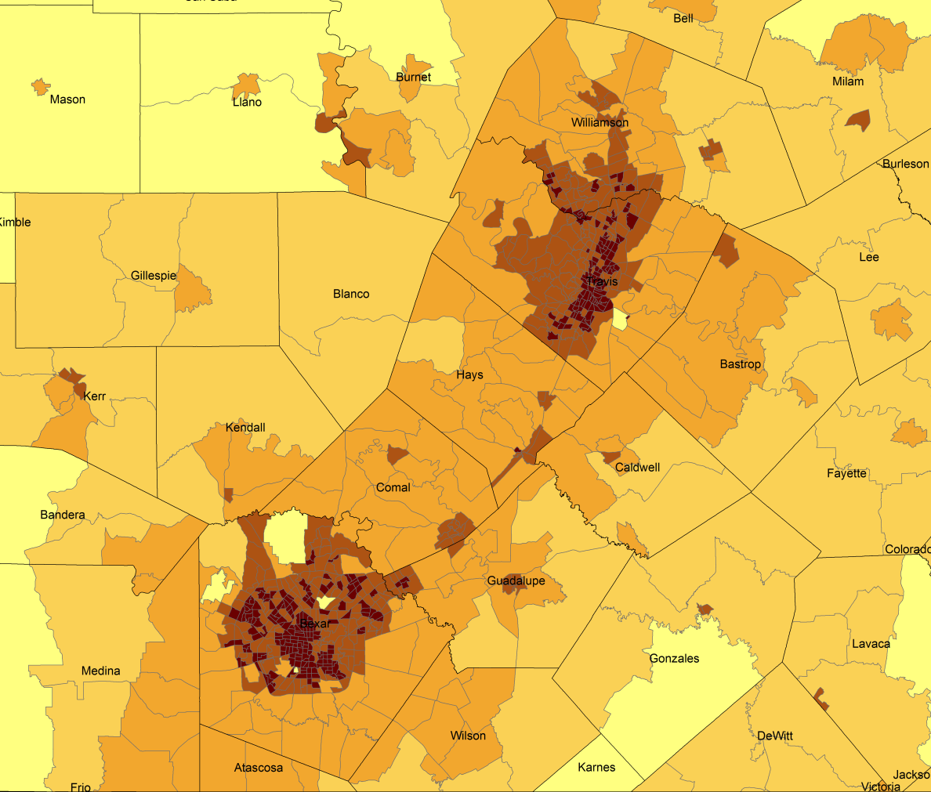
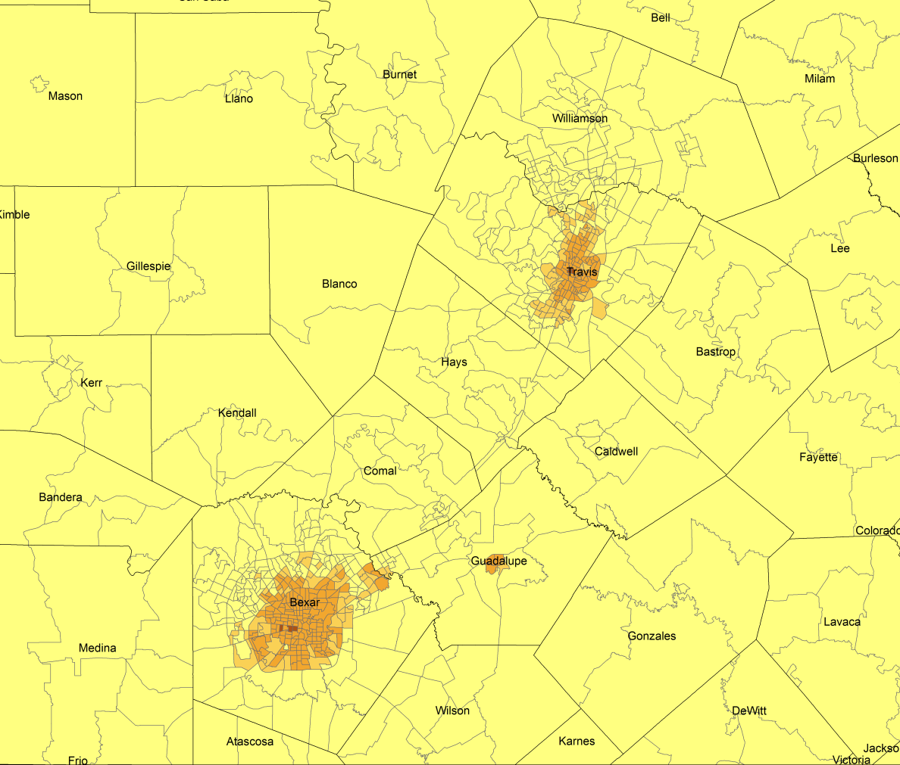
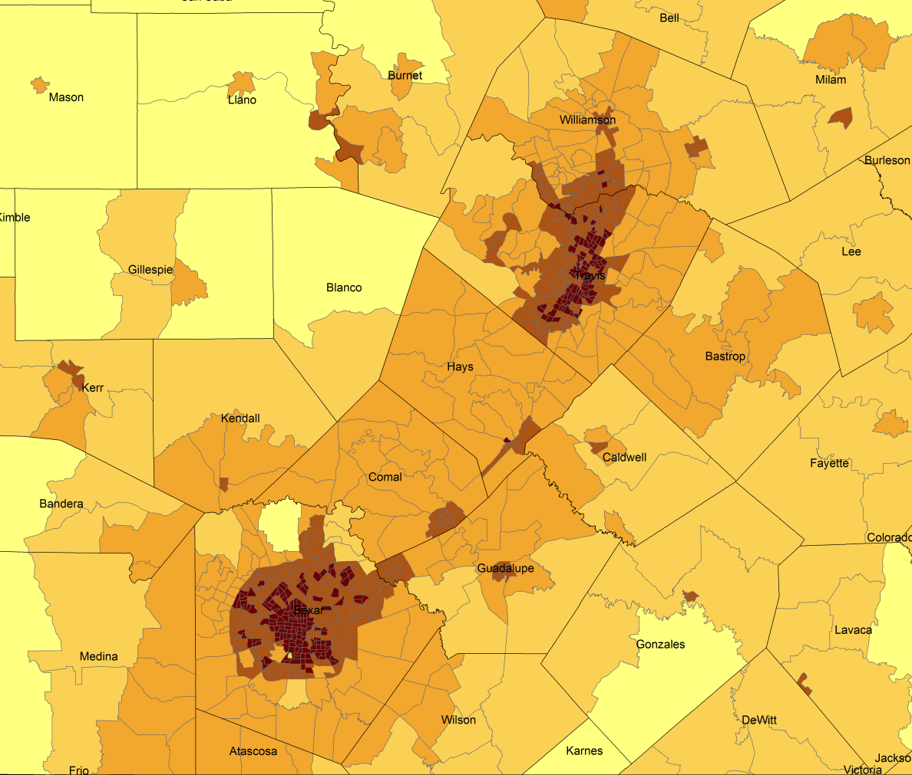
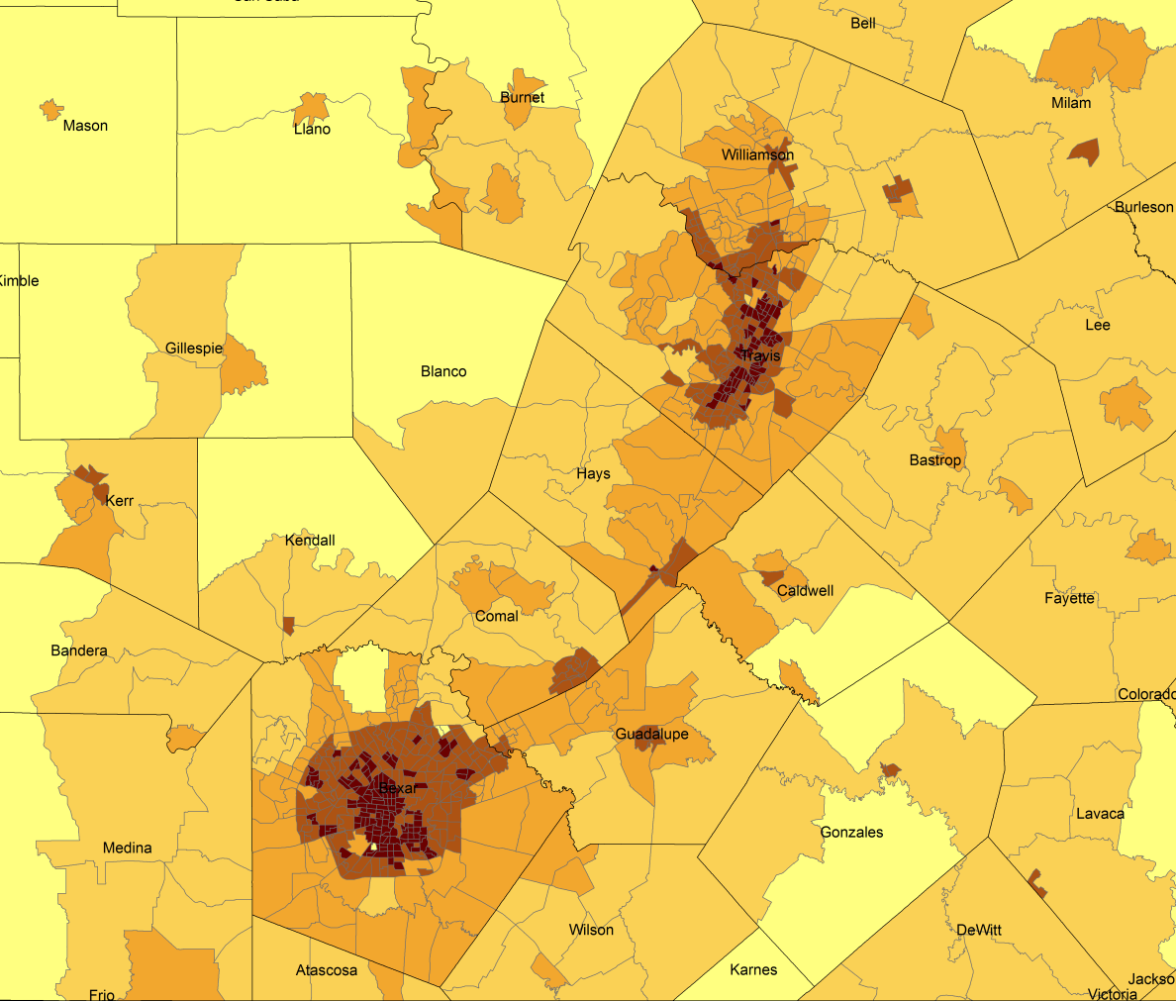
Population Density by Census Tract, 1970-2010
1970
1980
1990
2000
2010
Persons per Sq. Mile in the Austin-San Antonio Corridor
0 – 10
11 – 50
51 – 500
501 – 4,000
4,001 – 56,000
Notes:
As more and more people move into our counties and communities, there are more and more persons per square mile. The sequence of images here show how from 1970 to 2010 the urban areas of San Antonio and Austin have become very dense in terms of population and how the are in-between these two cities has become more and more dense. This increasing density is happening in other urban areas of the State and the stress put on the transportation infrastructure from this increasing density creates challenges for our commuting residents and for businesses who are providing services and moving goods.

Slide 14
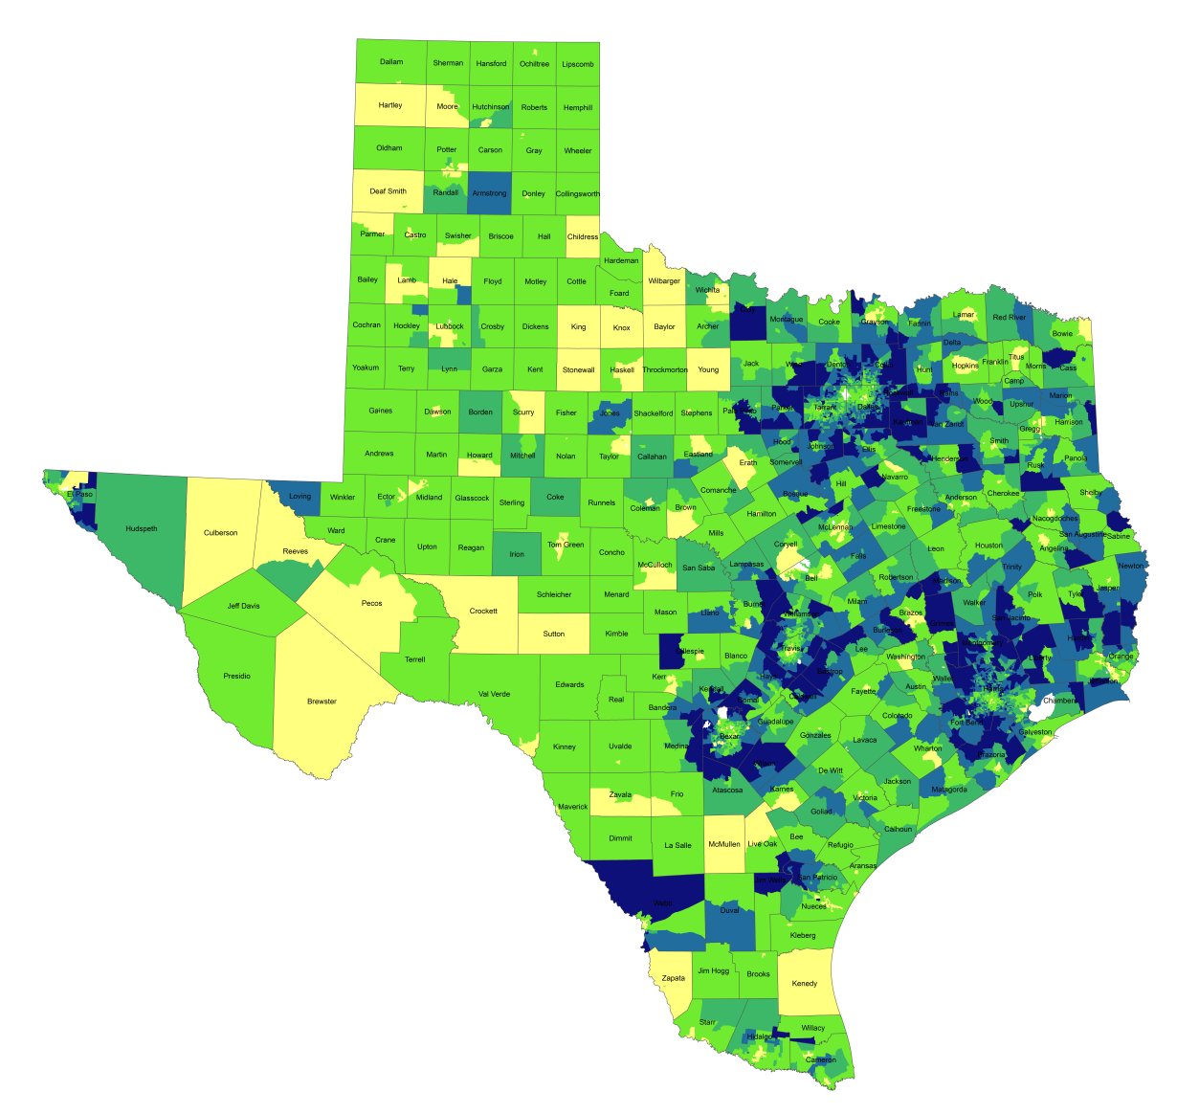
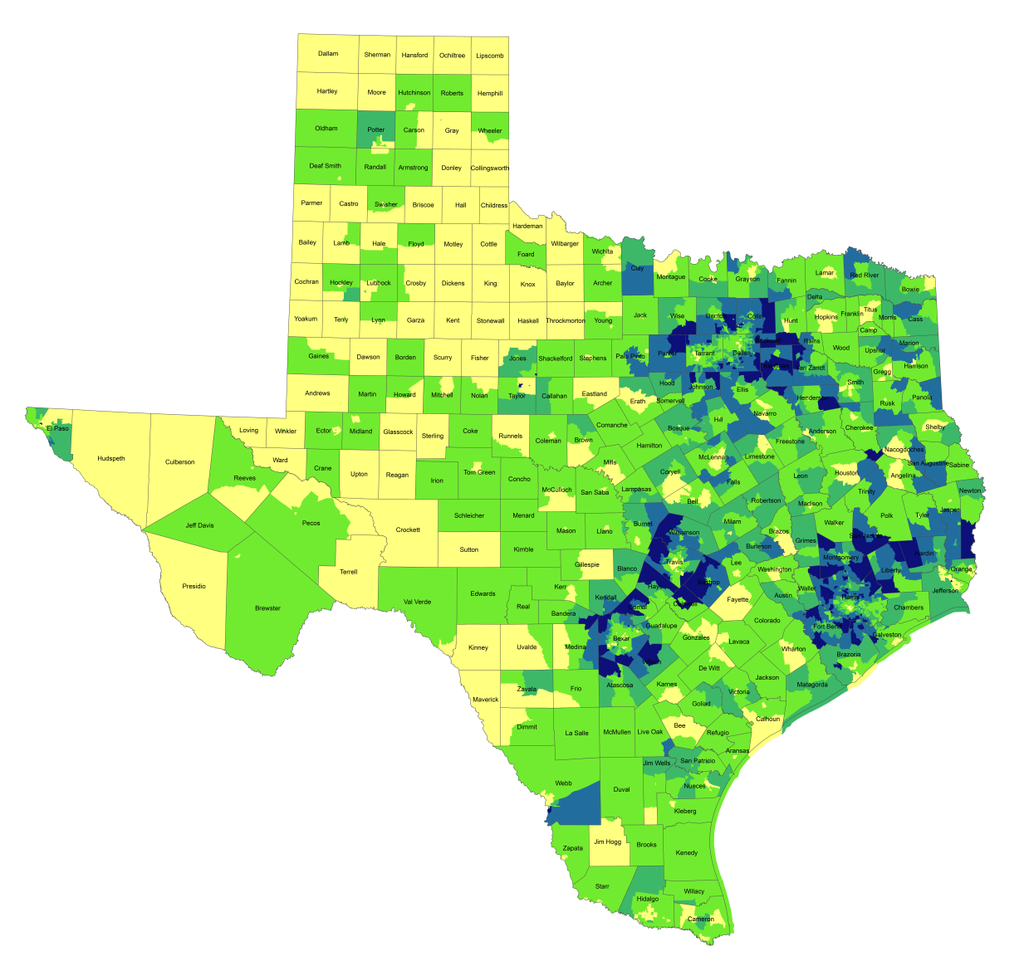
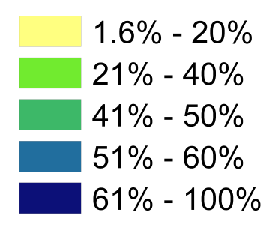
Travel Time to Work
1990
2012
Percentage of Workers with Drive Times
Longer than 25 Mins.
Notes:
One indicator of quality of life is how much time spent commuting to and from work. Commuting takes away time from family and leisure activities and may have an impact on work productivity as well. When we look at the percent of workers who commute longer than 25 minutes by census tract, you can see how increasing population and resulting density, perhaps combined with lagging infrastructure has resulted in increasing commuting times for suburban residents in the more densely populated parts of the state. Commuting time is a factor that some potential business will examine when considering moving operations to a place and one that most can agree is something we want to be as small as possible within reason.

Slide 15
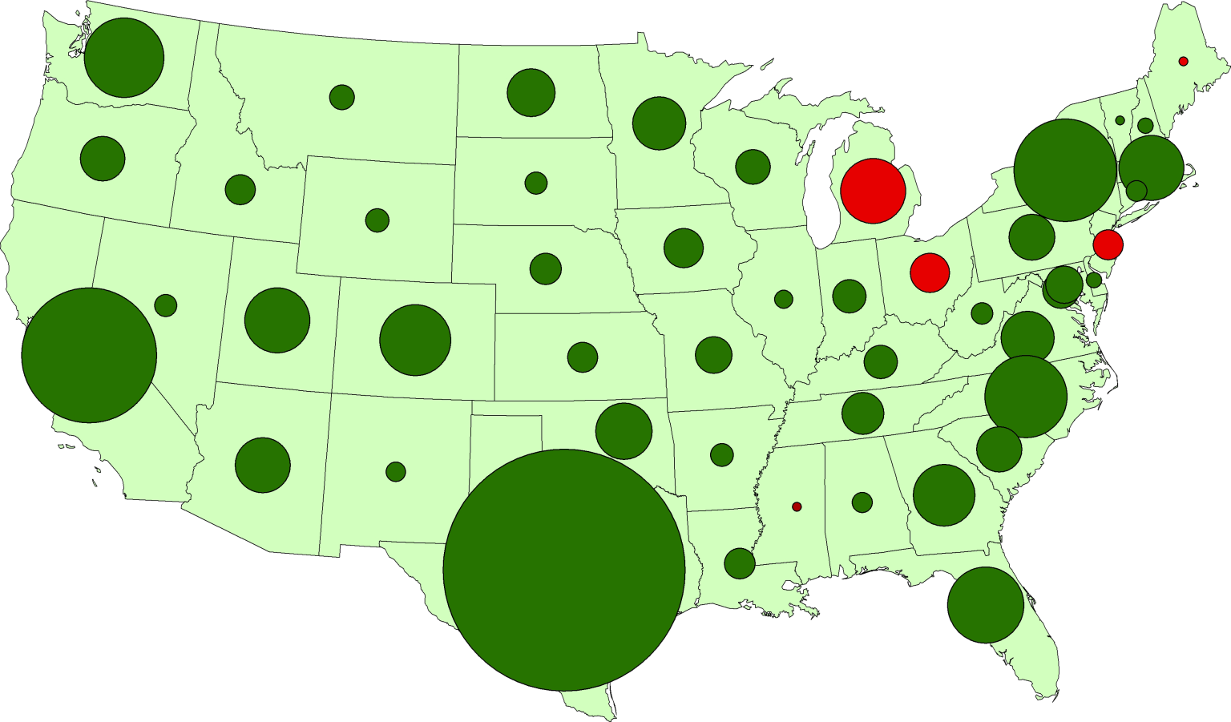
Texas Leads U.S. Job Growth, 2004-2014
Washington
320,000
New York
550,000
California
810,000
North Carolina
340,000
Texas
2,180,000
Notes:
Why are so many people moving to Texas? It’s the economy. Texas has consistently out-performed the rest of the country in job creation for well over a decade. Even through the recession and certainly coming out of the recession.

Slide 16
Texas Leads U.S. Job Growth, 2004-2014
Percentage of Total U.S. Job Gains Attributable to each State
Texas
29%
11%
California
7%
4%
4%
All Others
New York
North Carolina
Washington
Notes:
Over the last decade, Texas created almost 30% of the jobs in the United States. That’s quite amazing. If we were a country, we’d be something like the 14th or 15th largest economy. By many measures Texas has been performing very well. One of the critical questions we have an obligation to continually ask is “what might happen to slow us down or set us back?” Can we keep on the roll we’ve been on?

Slide 17
Texas Racial and Ethnic Composition,
2000 and 2010
Source: U.S. Census Bureau. 2000 and 2010 Census count
Notes:
As of the 2000 Census, about 53% of Texas’ population was non-Hispanic Anglo, about 32% where of Hispanic descent, about 11% where non-Hispanic African American, and about 4% were non-Hispanic Other.
In 2010, it is estimated that about 45% of the Texas population was non-Hispanic Anglo, 38% of Hispanic descent, 11% were non-Hispanic African American, and about 6% were non-Hispanic Other (largely of Asian descent).

Slide 18
Texas White (non-Hispanic) and Hispanic Populations by Age, 2010
Source: U.S. Census Bureau 2010 Decennial Census, SF1
Notes:
The age distribution of the non-Hispanic white population in Texas is weighted heavily with the “baby boom” generation. Largely the result of lower fertility and less net in-migration, the non-Hispanic white population has relatively fewer young persons relative to those in the middle-age years. In 2010, at ages 37 and younger, the Hispanic population exceeds the non-Hispanic white population.

Slide 19
Texas Population Pyramid by Race/Ethnicity, 2010
Source: U.S. Census Bureau 2010 Decennial Census, SF1
Notes:
This population pyramid represents the age and sex composition of the Texas non-Hispanic white population. Blue represents males, red females, rows are single years of age.

Slide 20
Texas Population Pyramid by Race/Ethnicity, 2010
Source: U.S. Census Bureau 2010 Decennial Census, SF1
Notes:
This population pyramid represents the age, and sex composition of the minority population in Texas. Blue represents males, red females, rows are single years of age, and shades represent specified race/ethnic groups as indicated in the legend.

Slide 21
Texas Population Pyramid by Race/Ethnicity, 2010
Source: U.S. Census Bureau 2010 Decennial Census, SF1
Notes:
This population pyramid represents the age, sex, race and ethnic composition of the Texas population. Blue represents males, red females, rows are single years of age, and shades represent specified race/ethnic groups as indicated in the legend.

Slide 22
Percent of population aged 25 years and older with high school or greater, census tracts, Texas,2007-2011
Source: U.S. Census Bureau, American Community Survey, Five-Year Sample, 2007-2011.

Slide 23
Percent of the labor force working in management, business, science, and arts occupations, census tracts, Texas, 2007-2011
Source: U.S. Census Bureau, American Community Survey, Five-Year Sample, 2007-2011.

Slide 24
Percent of households that are female headed with children less than 18 years of age present, no husband present, census tracts, Texas, 2007-2011
Source: U.S. Census Bureau, American Community Survey, Five-Year Sample, 2007-2011.

Slide 25
Percent of population aged 25 years and older with high school or greater, census tracts, Texas,2007-2011
Source: U.S. Census Bureau, American Community Survey, Five-Year Sample, 2007-2011.

Slide 26
Percent of households with income of $200,000 or more, census tracts, Texas, 2007-2011
Source: U.S. Census Bureau, American Community Survey, Five-Year Sample, 2007-2011.

Slide 27
Annual Median Real Estate Taxes Paid, Austin San Antonio Area, Census Tracts, 2006-2010
Source: U.S. Census Bureau, American Community Survey, 5 Year Sample 2006-2010.

Slide 28
Projected Population Growth in Texas, 2010-2050
Source: Texas State Data Center 2012 Population Projections
Notes:
The projected population of Texas is produced using three different migration scenarios. The blue line represents the assumption that there is no in or out migration for Texas. The result is a population that is growing only from natural increase (births-deaths). Under this unlikely scenario, Texas will maintain a health pace of population growth. The other two scenarios assume that 1) the migration rate will be the same as we observed between 2000 and 2010 and 2) the migration rate will be half of what we observed between 2000 and 2010. Under the first assumption Texas will add another 5 million persons this decade, another 7 million the following, 8 or 9 million between 2030 and 2040 and almost 10 million between 2040 and 2050. The half migration scenario also projects significant growth but more modest than the assumption of full migration.

Slide 29
Projected Racial and Ethnic Percent, Texas, 2010-2050
Source: Texas State Data Center 2012 Population Projections , 2000-2010 Migration Scenario
Notes:
The projected population of Texas by race/ethnicity suggests that the Hispanic population will be a major driver in the population growth of the state. The non-Hispanic white population will grow very slowly and then start to decline as the Baby-Boom generation ages into high mortality years. The non-Hispanic other group is largely composed of persons of Asian descent and this group is projected to exceed the non-Hispanic black population by 2038. This graph assumes migration patterns observed between 2000 and 2010.

Slide 30
Trends in Educational Attainment of Persons in the Labor Force (25-64 Years of Age) in Texas by Race/Ethnicity – High School Graduates and Above
Source: U.S. Census Bureau, American Community Survey, Public Use Micro Sample, 2001-2011
Notes:
Educational attainment by race/ethnicity in Texas suggests that adults of Hispanic descent are much less likely to have completed high school compared to other race/ethnic groups. Over time, the percent of persons of Hispanic descent who have completed high school has been increasing more rapidly than for other groups but even at this pace of change it will take numerous decades for Hispanics to achieve parity with non-Hispanics in the percent with a high school degree or greater.

Slide 31
Percent of the Civilian Labor Force (ages 25-64) by Educational Attainment for 2011, 2030 Using Constant Rates, Texas
These should be going DOWN
These should be going UP
Sources: U.S. Census Bureau, American Community Survey, 1-Year PUMS.
Texas State Data Center, 2012 Vintage Population Projections, 0.5 Migration Scenario
Notes:
The first assumption (represented by the red columns) is that educational attainment by race/ethnicity and sex would remain the same as it was in 2011. Thus the changes we see in educational attainment in this projection are due only to changes in the racial/ethnic composition of the population (driven by increasing Hispanic population and a leveling of growth among the non-Hispanic white population). Under this scenario, we would see increases of the percent of the labor force with lower levels of education and declines in the percent of the labor force with higher levels.

Slide 32
Percent of the Civilian Labor Force (ages 25-64) by Educational Attainment for 2011, and 2030 Using Trended Rates, Texas
These should be going DOWN
These should be going UP
Sources: U.S. Census Bureau, American Community Survey, 1-Year PUMS.
Texas State Data Center, 2012 Vintage Population Projections, 0.5 Migration Scenario
Notes:
Under the second assumption (green columns) the trends observed in improving educational attainment are projected forward and applied to the projected population by race/ethnicity and sex. Thus the generally positive trends we have noted in improving educational attainment are assumed to continue into the future. The result of this projection suggests that we will see declines in the percent of the labor force with lower levels of education and increases in the percent of the labor force with higher levels of education.

Slide 33





Demographics and Destiny
Notes:
Texas is growing – with more people being added than in any other state we added 4 additional seats to our representation in the U.S. Congress.
Texas is becoming more urban. Many rural counties are losing population. Urbanized metropolitan areas have been growing dramatically over the decade.
Texas is becoming more diverse – much of our growth is attributable to growth of the Hispanic population.
Educational attainment of the labor force is an important aspect in the economic well being of the Staet.

Slide 34
Contact
  Office: (512) 463-8390 or (210) 458-6530
  Email: Lloyd.Potter@osd.state.tx.us
  Internet: http://osd.state.tx.us
Lloyd Potter, Ph.D., M.P.H.
Notes:
The Office of the State Demographer and the Texas State Data Center are committed to supporting your work through providing you with the best, most accurate, and objective information we can identify about our greatest asset, the people of Texas.

