Slide 1
Texas Demographic Characteristics and Trends: Diabetes
American Diabetes Association
March 24, 2015
San Antonio, Texas
Notes:
Lila Valencia is the legislative liaison and a demographer at the Office of the State Demographer.

Slide 2
Total Population and Components of Population Change in Texas, 1950-2013
Year* | Population | Numeric Change | Annual Percent Change
1950 | 7,711,194 | -- | --
1960 | 9,579,677 | 1,868,483 | 2.4
1970 | 11,196,730 | 1,617,053 | 1.7
1980 | 14,229,191 | 3,032,461 | 2.7
1990 | 16,986,510 | 2,757,319 | 2.0
2000 | 20,851,820 | 3,865,310 | 2.3
2010 | 25,145,561 | 4,293,741 | 2.1
2012 | 26,060,796 | 915,235 | 1.8
2013 | 26,448,193 | 387,397 | 1.4
* All values for the decennial dates are for April 1st of the indicated census year. Values for 2012 and 2013 are for July 1 as estimated by the U.S. Census Bureau.
Source: U.S. Census Bureau, Census Counts and Population Estimates
Notes:
Since 1950, Texas has grown substantially with some variation over the years in the speed of growth.

Slide 3
Population Growth 1950-2010
Source: U.S. Census Bureau, Census Counts
Notes:
In 2014 we estimate that Texas had just under 27 million residents, while in the 2010 Census we had just over 25 million residents.
Population growth in Texas has been geometric in nature. Over the past six decades there have been three 20 year periods where the numeric growth has increased. We have no indication that the population growth in Texas will slow in coming years

Slide 4
Total Estimated Population by County, Texas, 2013
Source: U.S. Census Bureau 2013 Population Estimates
Notes:
The counties of Harris, Dallas, Tarrant, Bexar, and Travis make up the points of the “population triangle” in Texas and are the most populated in the State. Collin, Denton, Fort Bend, Hidalgo, and El Paso counties also have significant population concentrations. Many counties west of Interstate 35 are more sparsely populated. Approximately 86% of Texas’ population is along or east of Interstate 35.

Slide 5
Estimated Change of the Total Population by
County, Texas, 2010 to 2013
99 counties lost population over the three year period.
Source: U.S. Census Bureau Population Estimates, 2013 Vintage.
Notes:
Population change so far this decade has been greatest in the urban and suburban population triangle counties. Counties in the lower Rio Grande Valley also had significant growth as did El Paso county. Overall, 155 counties gained population while 99 (39%) lost population over the decade. Those counties that are losing population are doing so largely as a function of net out migration of younger persons (entering the labor force). The result is a trend for the age structure of the populations in these more rural counties toward becoming older.

Slide 6
Estimated Percent Change of the Total Population by County, Texas, 2010 to 2013
Source: U.S. Census Bureau Population Estimates, 2013 Vintage.
Notes:
Percent change is an indicator of the speed of population change void of information about the volume of population change. Percent change in the population over the past few years has been greatest in the urban and suburban population triangle counties. Notably counties in the Eagle Ford Shale area (south east of San Antonio) and the Cline Shale area (Midland and Odessa), have been growing quickly. Overall, 155 counties gained population while 99 lost population over the decade.

Slide 7
Percent of Population 65 Years of Age and Older, Texas Counties, 2013
Source: U.S. Census Bureau, Population Estimates, 2013
Notes:
Many of the more rural counties are developing age structures weighted more toward the older ages. Many of these are counties with limited access to health care. At the same time, the demand for health care is likely to be increasing.

Slide 8
Texas Racial and Ethnic Composition,
2000 and 2010
Source: U.S. Census Bureau. 2000 and 2010 Census count
Notes:
As of the 2000 Census, about 53% of Texas’ population was non-Hispanic Anglo, about 32% where of Hispanic descent, about 11% were non-Hispanic African American, and about 4% were non-Hispanic Other.
In 2010, it is estimated that about 45% of the Texas population was non-Hispanic Anglo, 38% of Hispanic descent, 11% were non-Hispanic African American, and about 6% were non-Hispanic Other (largely of Asian descent).

Slide 9
Texas White (non-Hispanic) and Hispanic Populations by Age, 2010
Source: U.S. Census Bureau 2010 Decennial Census, SF1
Notes:
The age distribution of the non-Hispanic white population in Texas is weighted heavily with the “baby boom” generation. Largely the result of lower fertility and less net in-migration, the non-Hispanic white population has relatively fewer young persons relative to those in the middle-age years. In 2010, at ages 37 and younger, the Hispanic population exceeds the non-Hispanic white population. As the young Hispanic population ages, the population in Texas will increasingly trend toward Hispanics becoming the majority race/ethnic group.

Slide 10
Texas Population Pyramid by Race/Ethnicity, 2010
Source: U.S. Census Bureau 2010 Decennial Census, SF1
Notes:
This population pyramid represents the age, sex, race and ethnic composition of the Texas population. Blue represents males, red females, rows are single years of age, and shades represent specified race/ethnic groups as indicated in the legend. Note the “inverted” pyramid for the non-Hispanic White population and the presence of the “baby boom.”

Slide 11
Texas Population Pyramid by Race/Ethnicity, 2010
Source: U.S. Census Bureau 2010 Decennial Census, SF1
Notes:
This population pyramid represents the age, sex, race and ethnic composition of the Texas population. Blue represents males, red females, rows are single years of age, and shades represent specified race/ethnic groups as indicated in the legend. Note the Hispanic and African American population pyramids are characterized with wider bases (the young) relative to the peak (the old).

Slide 12
Texas Population Pyramid by Race/Ethnicity, 2010
Source: U.S. Census Bureau 2010 Decennial Census, SF1
Notes:
This population pyramid represents the age, sex, race and ethnic composition of the Texas population. Blue represents males, red females, rows are single years of age, and shades represent specified race/ethnic groups as indicated in the legend. Note the “inverted” pyramid for the non-Hispanic White population and the presence of the “baby boom” while the Hispanic and African American population pyramids are characterized with wider bases (the young) relative to the peak (the old).

Slide 13
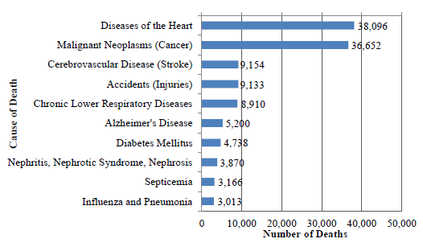
Leading Causes of Death in Texas, 2010
Source: Texas Vital Statistics Unit, DSHS. Figure produced entirely by the Office of Surveillance, Evaluation, and Research Health Promotion and Chronic Disease Prevention Section, Texas Department of State Health services for the Burden of Diabetes in Texas Report (April 1, 2013).
Notes:
According to the department of state health services, the top two leading causes of death have remained unchanged since 1950. Diabetes was the seventh cause of deaths in Texas, resulting in 4,738 deaths in 2010 (down from 4,866 deaths in 2009).

Slide 14
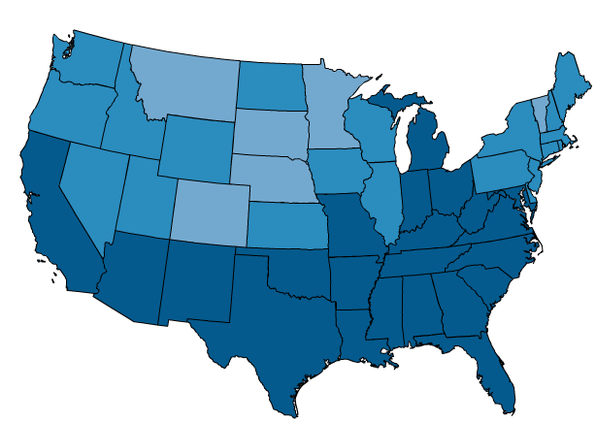


Diagnosed Diabetes, Age Adjusted Rate (per 100), Adults - Total, 2012
Texas has the 8th highest rate in the U.S. at 8.6 (per 100).
Source: National Center for Chronic Disease Prevention and Health Promotion, Division of Diabetes Translation, www.cdc.gov/diabetes
Notes:
Texas has the 8th highest diagnosed diabetes rate in the U.S. in 2012.

Slide 15
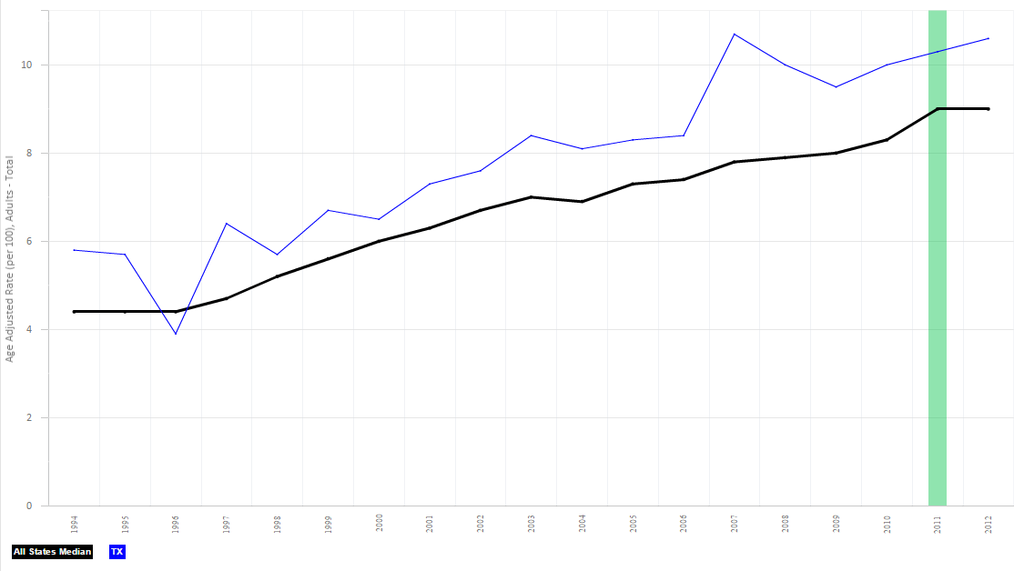

Diagnosed Diabetes, Age Adjusted Rate
(per 100) for Texas, Adults - Total
Source: National Center for Chronic Disease Prevention and Health Promotion, Division of Diabetes Translation, www.cdc.gov/diabetes
Green vertical bar indicates major changes to the survey methods. www.cdc.gov/surveillancepractice/reports/brfss/brfss.html

Slide 16
Age-adjusted Prevalence of Diagnosed Diabetes, 1994-2010 Among U.S. Adults
Aged 18 Years or Older
2000
1994
2010
No Data <4.5% 4.5%–5.9% 6.0%–7.4% 7.5%–8.9% >9.0%
Source: CDC’s Division of Diabetes Translation. National Diabetes Surveillance System available at http://www.cdc.gov/diabetes/statistics

Slide 17
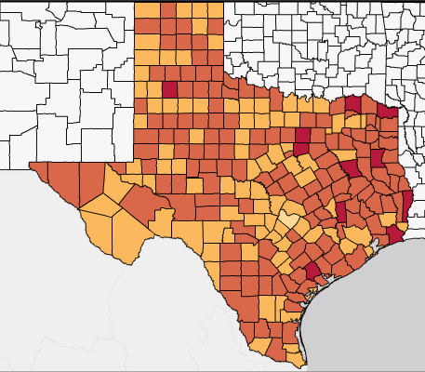

Age Adjusted Diagnosed Diabetes Percentage by County, 2012
Source: National Center for Chronic Disease Prevention and Health Promotion, Division of Diabetes Translation, www.cdc.gov/diabetes
Notes:
The lowest percentage can be found in Travis County at 7.1% and the highest percentage in Lamar County at 11.6%. Almost 1 in 10 adults in Bexar County have received a diabetes diagnosis.

Slide 18
Age Adjusted Diagnosed Diabetes Percentage, 2004 to 2011
Source: National Center for Chronic Disease Prevention and Health Promotion, Division of Diabetes Translation, www.cdc.gov/diabetes

Slide 19
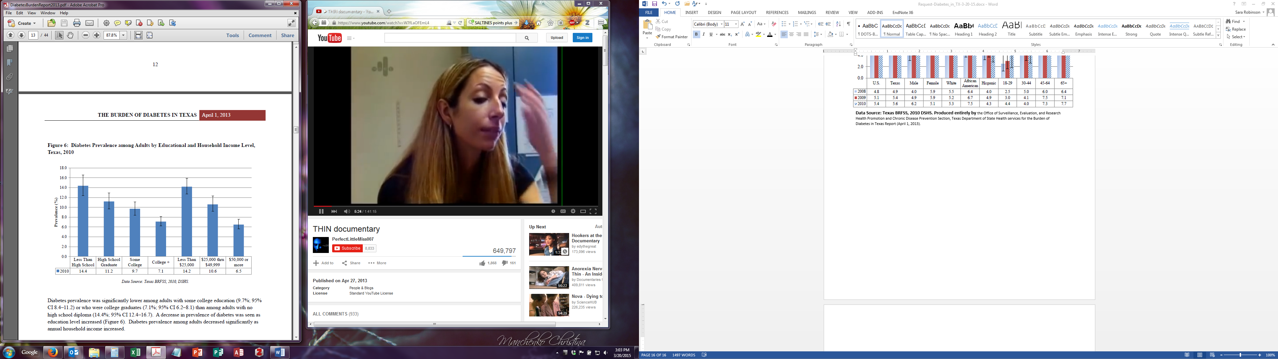
Diabetes Prevalence among Adults by Educational and Household Income Level, Texas, 2010
Source: Texas BRFSS, 2010 DSHS. Figure produced entirely by the Office of Surveillance, Evaluation, and Research Health Promotion and Chronic Disease Prevention Section, Texas Department of State Health services for the Burden of Diabetes in Texas Report (April 1, 2013).
Notes:
Respondents 18 years and older who report that they have been diagnosed with diabetes. Does not include gestational diabetes.
More than twice as many African-Americans (16.5) report diabetes diagnosis when compared to whites (8.2). 11% of Hispanics report this diagnosis.

Slide 20
Projected Population Growth in Texas,
2010-2050
Source: Texas State Data Center 2014 Population Projections
Notes:
The projected population of Texas is produced using three different migration scenarios. The blue line represents the assumption that there is no in or out migration for Texas. The result is a population that is growing only from natural increase (births-deaths). Under this unlikely scenario, Texas will maintain a health pace of population growth. The other two scenarios assume that 1) the migration rate will be the same as we observed between 2000 and 2010 and 2) the migration rate will be half of what we observed between 2000 and 2010. Under the first assumption Texas will add another 5 million persons this decade, another 7 million the following, 8 or 9 million between 2030 and 2040 and almost 10 million between 2040 and 2050. The half migration scenario also projects significant growth but more modest than the assumption of full migration.

Slide 21
Projected Racial and Ethnic Percent, Texas, 2010-2050
Source: Texas State Data Center 2014 Population Projections , Half 2000-2010 Migration Scenario
Notes:
The projected population of Texas by race/ethnicity suggests that the Hispanic population will be a major driver in the population growth of the state. The non-Hispanic white population will grow very slowly and then start to decline as the Baby-Boom generation ages into high mortality years. The non-Hispanic other group is largely composed of persons of Asian descent, and this group is projected to reach near parity with the non-Hispanic black population. This graph assumes migration patterns observed between 2000 and 2010.

Slide 22
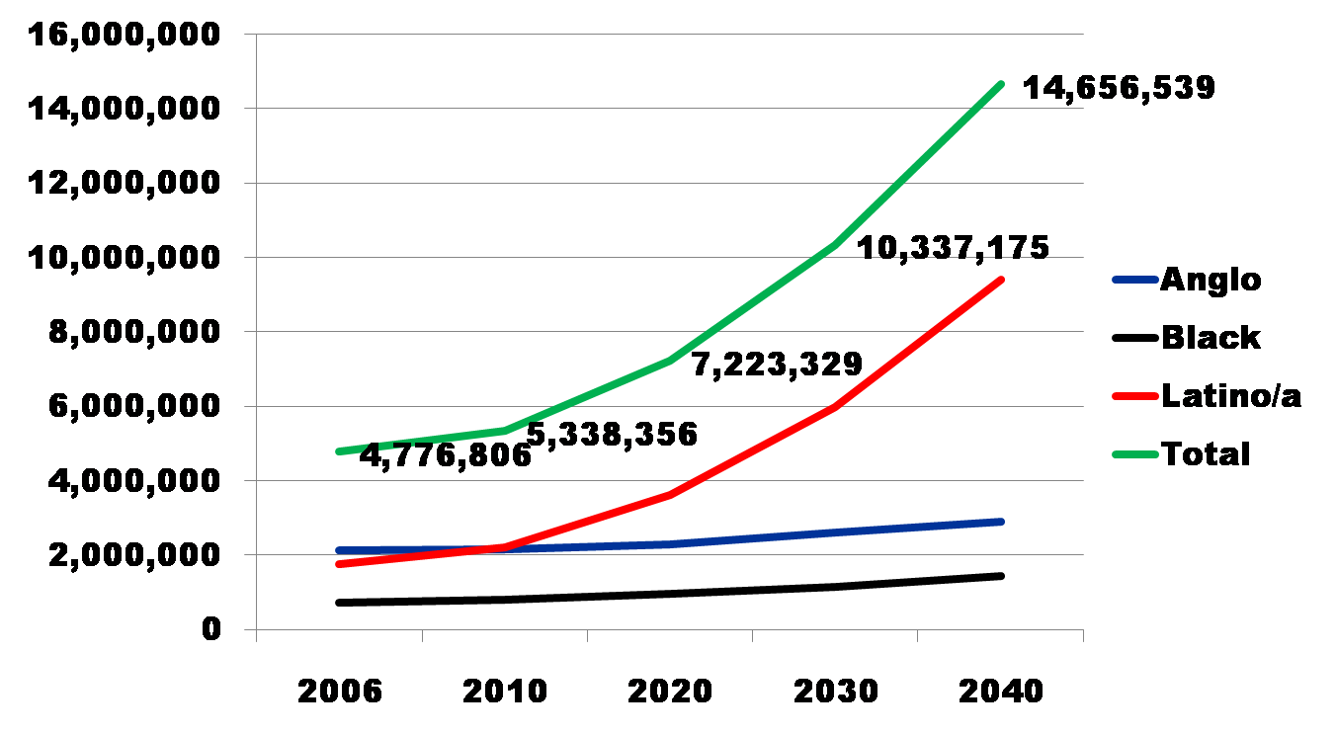
Projected Increase in Obesity in Texas by Ethnicity, 2006 to 2040
Source: Office of the State Demographer projections, using 2000-2004 migration scenario population projections

Slide 23
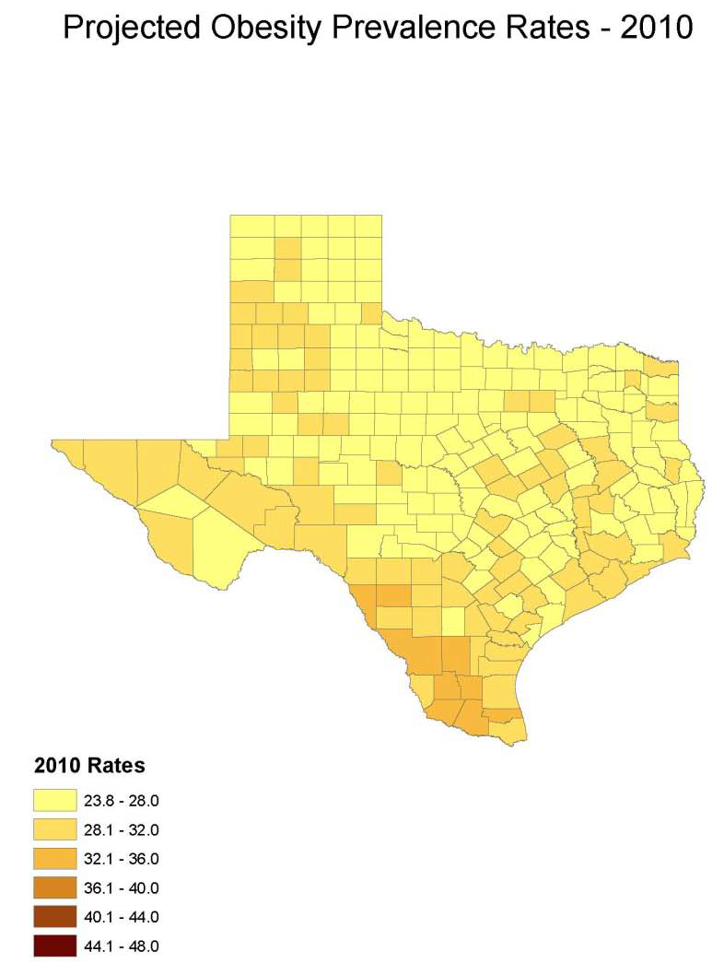
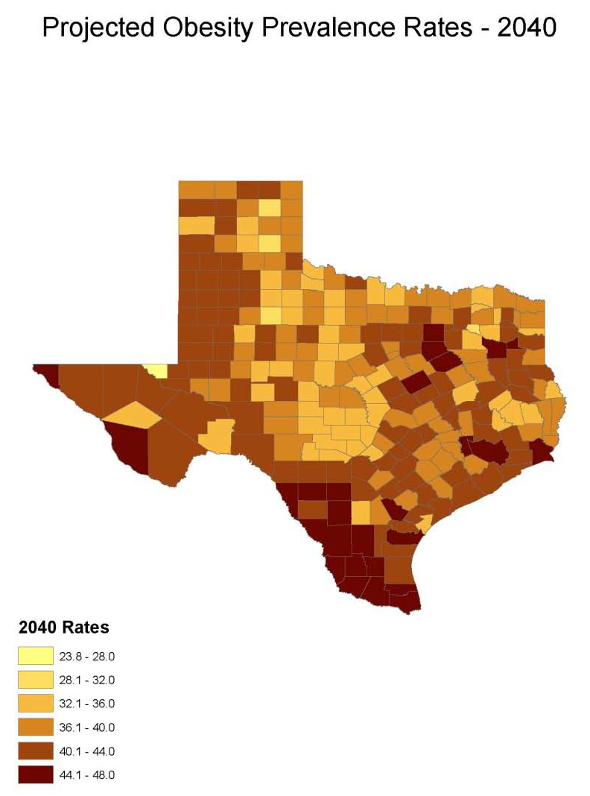
Obesity Prevalence Projections
% adults with obesity: Office of the State Demographer

Slide 24
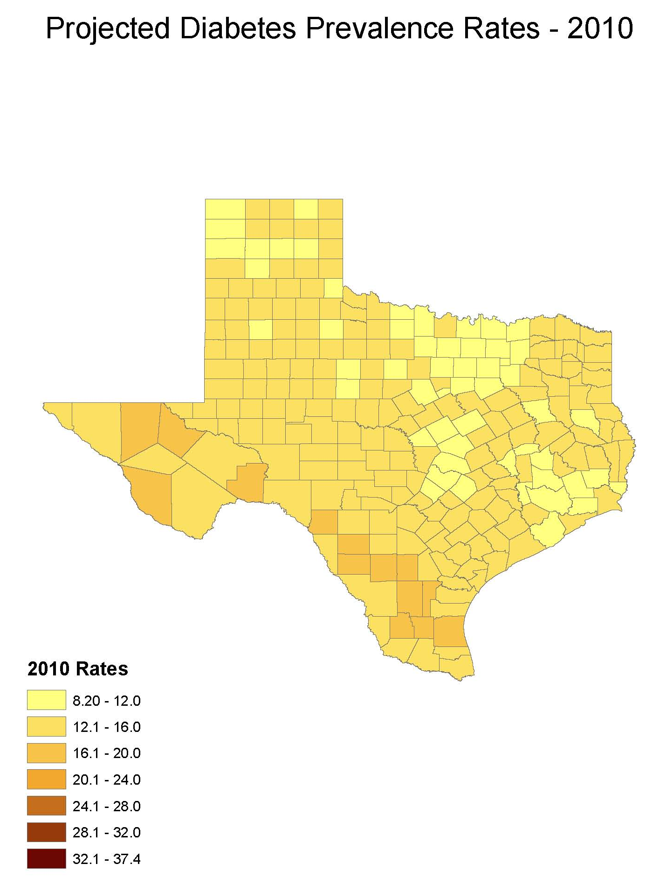
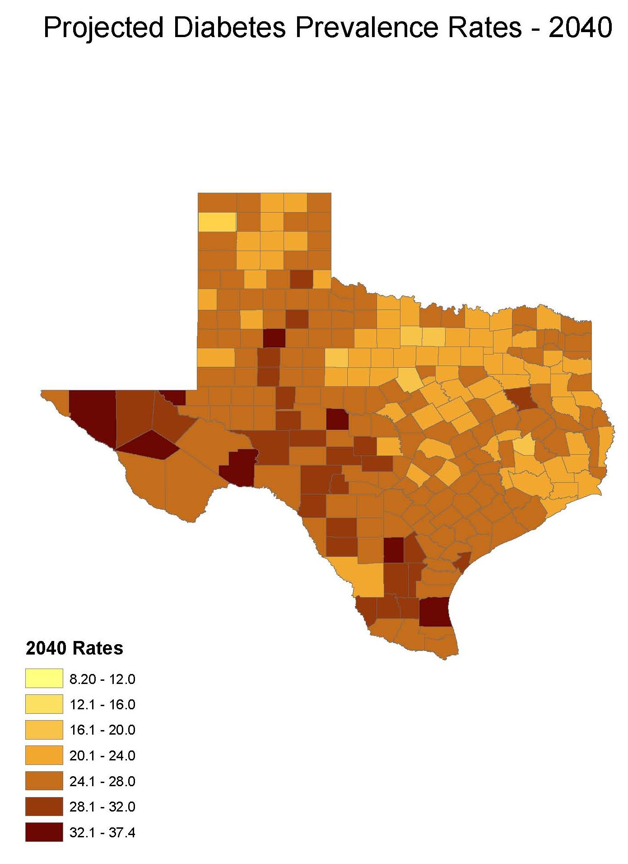
Diabetes Prevalence Projections
% adults with diabetes: Office of the State Demographer

Slide 25
Trends in Educational Attainment of Persons in the Labor Force (25-64 Years of Age) in Texas by Race/Ethnicity – High School Graduates and Above
Source: U.S. Census Bureau, American Community Survey, Public Use Micro Sample, 2001-2011
Notes:
Educational attainment by race/ethnicity in Texas suggests that adults of Hispanic descent are much less likely to have completed high school compared to other race/ethnic groups. Over time, the percent of persons of Hispanic descent who have completed high school has been increasing more rapidly than for other groups but even at this pace of change it will take numerous decades for Hispanics to achieve parity with non-Hispanics in the percent with a high school degree or greater.

Slide 26
Percent of the Civilian Labor Force (ages 25-64) by Educational Attainment for 2011, 2030 Using Constant Rates, Texas
These should be going DOWN
These should be going UP
Sources: U.S. Census Bureau, American Community Survey, 1-Year PUMS.
Texas State Data Center, 2012 Vintage Population Projections, 0.5 Migration Scenario
Notes:
The first assumption (represented by the red columns) is that educational attainment by race/ethnicity and sex would remain the same as it was in 2011. Thus the changes we see in educational attainment in this projection are due only to changes in the racial/ethnic composition of the population (driven by increasing Hispanic population and a leveling of growth among the non-Hispanic white population). Under this scenario, we would see increases of the percent of the labor force with lower levels of education and declines in the percent of the labor force with higher levels.

Slide 27
Percent of the Civilian Labor Force (ages 25-64) by Educational Attainment for 2011, and 2030 Using Trended Rates, Texas
These should be going DOWN
These should be going UP
Sources: U.S. Census Bureau, American Community Survey, 1-Year PUMS.
Texas State Data Center, 2012 Vintage Population Projections, 0.5 Migration Scenario
Notes:
Under the second assumption (green columns) the trends observed in improving educational attainment are projected forward and applied to the projected population by race/ethnicity and sex. Thus the generally positive trends we have noted in improving educational attainment are assumed to continue into the future. The result of this projection suggests that we will see declines in the percent of the labor force with lower levels of education and increases in the percent of the labor force with higher levels of education.

Slide 28
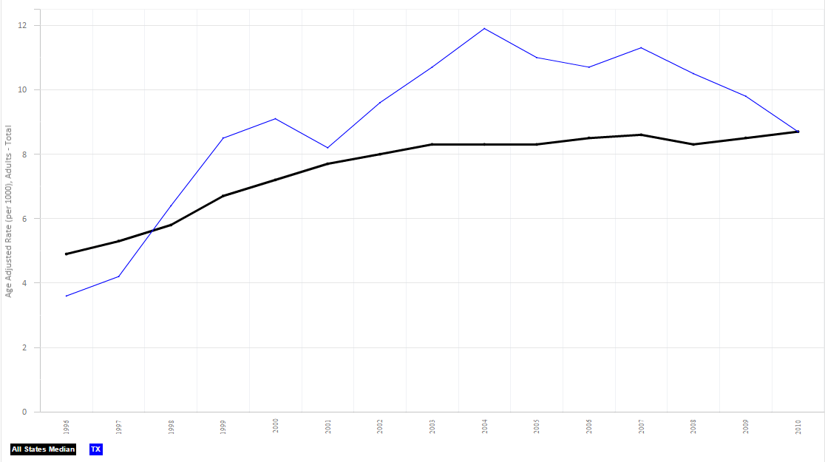
New Cases of Diagnosed Diabetes, Age Adjusted Rate (per 1000), Adults, 2010

Slide 29
Contact
  Lila Valencia, Ph.D.
  Office: (512) 936-3542
  Email: Lila.Valencia@osd.state.tx.us
  Internet: http://osd.state.tx.us
  Twitter: @TexasDemography
Notes:
The Office of the State Demographer and the Texas State Data Center are committed to supporting your work through providing you with the best, most accurate, and objective information we can identify about our greatest asset, the people of Texas.

