Slide 1
Demographic Characteristics and Trends in Texas
Texas Farm Bureau
April 13, 2015
Austin, Texas
Notes:
Lloyd Potter is the Texas State Demographer and the Director of the Texas State Data Center based at the University of Texas at San Antonio.

Slide 2
Total Population and Components of Population Change in Texas, 1950-2014
Year* | Population | Numeric Change | Annual Percent Change
1950 | 7,711,194 | -- | --
1960 | 9,579,677 | 1,868,483 | 2.4
1970 | 11,196,730 | 1,617,053 | 1.7
1980 | 14,229,191 | 3,032,461 | 2.7
1990 | 16,986,510 | 2,757,319 | 2.0
2000 | 20,851,820 | 3,865,310 | 2.3
2010 | 25,145,561 | 4,293,741 | 2.1
2012 | 26,060,796 | 915,235 | 1.8
2013 | 26,448,193 | 387,397 | 1.4
2014 | 26,895,688 | 447,495 | 1.7
* All values for the decennial dates are for April 1st of the indicated census year. Values for 2012-2014 are for July 1 as estimated by the U.S. Census Bureau.
Source: U.S. Census Bureau, Census Counts and Population Estimates
Notes:
Since 1950, Texas has grown substantially with some variation over the years in the speed of growth.

Slide 3
Population Growth, Texas, 1950-2010
Source: U.S. Census Bureau, Decennial Censuses
Notes:
In 2014 we estimate that Texas had just under 27 million residents, while in the 2010 Census we had just over 25 million residents.
Population growth in Texas has been geometric or compounding in nature. Over the past two decades there have been three 20 year periods where the numeric growth has increased. We have no indication that the population growth in Texas will slow dramatically in coming years.

Slide 4
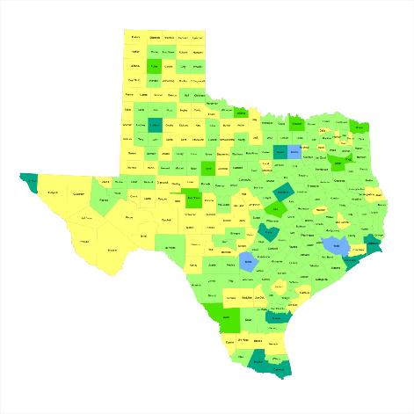
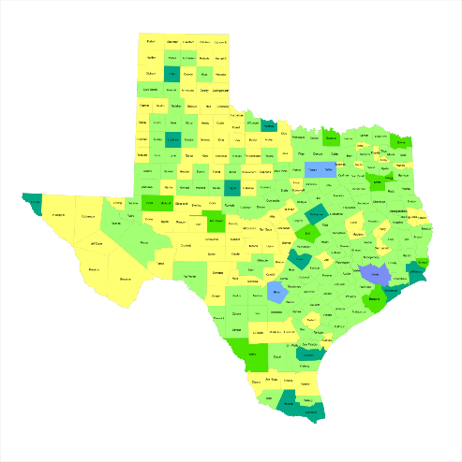
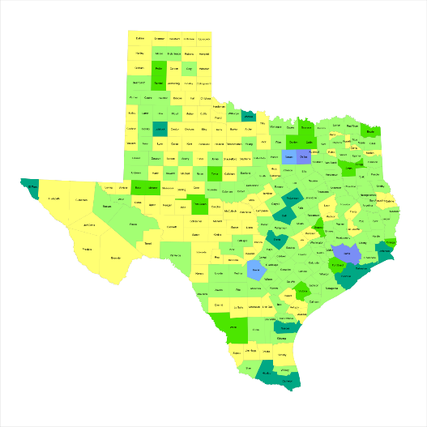

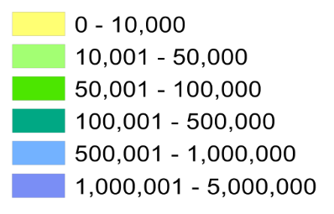
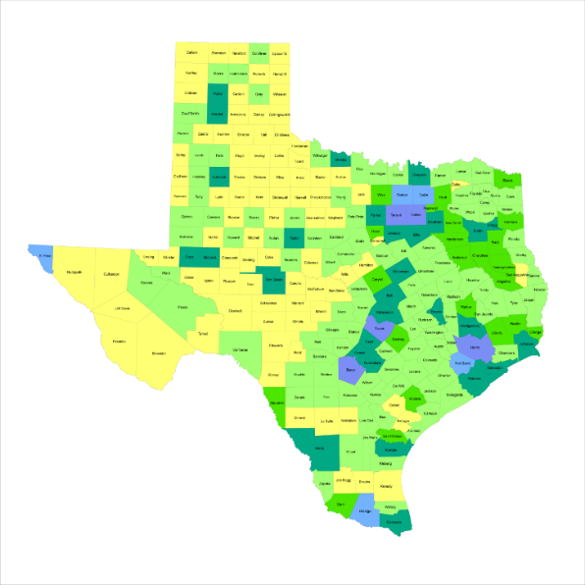
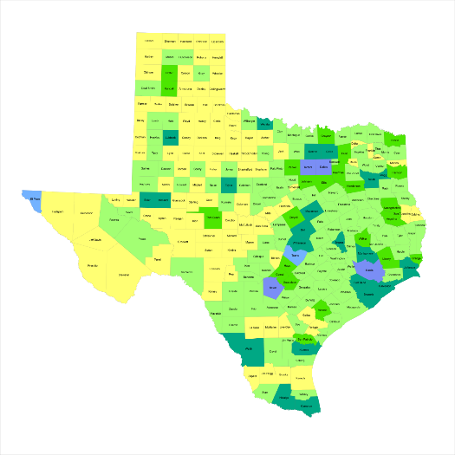
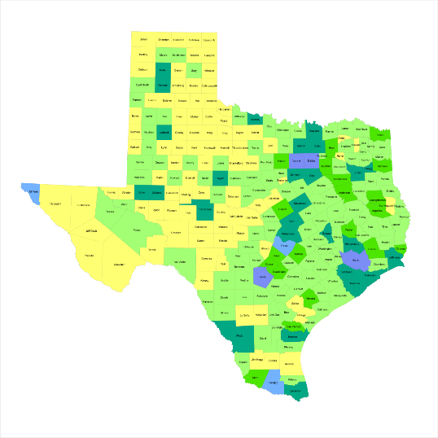
Historic Population, Texas Counties, 1950-2010
1950
1960
1970
1980
2010
1990
2000
Source: U.S. Census Bureau, decennial censuses
Notes:
Texas growth has been steady but not geographically even over the past seven decades. As the population in the major urban areas and surrounding suburban areas has grown dramatically, areas the more rural western part of the state that were populated earlier have become less populated in recent decades.

Slide 5
Total Estimated Population, Texas Counties, 2014
Source: U.S. Census Bureau, 2014 Vintage Population Estimates
Notes:
When we look at the geographic distribution of the population of Texas over time we see continually increasing population in the counties along the I-35 corridor, the Houston area, and the lower Rio Grand Valley. Urbanized areas out west have grown but most counties west have experienced limited growth and some population decline. Approximately 86% of the population is along I-35 and east. This area with the 3 major metropolitan areas at the points is often described as the Texas population triangle.
The counties of Harris, Dallas, Tarrant, Bexar, and Travis make up the points of the “population triangle” in Texas and are the most populated in the State. Collin, Denton, Fort Bend, Hidalgo, and El Paso counties also have significant population concentrations. Many counties west of Interstate 35 are more sparsely populated.

Slide 6
Estimated Population Change, Texas Counties, 2010 to 2014
102 counties lost population over the four year period.
95 counties lost population between 2013-14
Of these:
36 (38%) had natural decline
89 (94%) had net out migration
30 (32%) had both natural decline and net out migration
Source: U.S. Census Bureau Population Estimates, 2014 Vintage.
Notes:
Population change over the decade has been greatest in the urban and suburban population triangle counties. Counties in the lower Rio Grande Valley also had significant growth as did El Paso . Overall, 155 counties gained population while 99 (39%) lost population over the decade.

Slide 7
Estimated Percent Population Change, Texas Counties, 2010 to 2014
Source: U.S. Census Bureau Population Estimates, 2014 Vintage.
Notes:
Percent change is an indicator of the speed of population change void of information about the volume of population change. Percent change in the population over the past few years has been greatest in the urban and suburban population triangle counties. Notably counties in the Eagle Ford Shale area (south east of San Antonio) and the Cline Shale area (Midland and Odessa area), have been growing quickly.

Slide 8
Percent Components of Population Change in Texas, 1950-2010
Source: U.S. Census Bureau, Population Estimates
Notes:
Population changes from two factors, one is natural increase which is simply births minus deaths over time and the other is net migration which is in-migrants minus out-migrants over time. Population added from natural increase are babies joining an already existing household. So the effect of population growth from natural increase on infrastructure demands is both lightening, from people dying, and delayed until babies reach the age where they have infrastructure requirements. Net-migration, in Texas, has been positive for most of our history. Migrants, are usually adults in a household, thus migrants immediately add new households and have instant infrastructure needs, such as housing, transportation, etc.
When we look at population change in Texas, from 1950 to present we can see that before 1970, most of our growth was from natural increase. Starting in the 1970s a much larger percent of our growth is attributed to net migration and this continues to today where approaching half of our population change is from migration.

Slide 9
Top Counties for Numeric Growth in Texas, 2013-2014
 | U.S. Rank Population Change | Population Change | Percent of Change from Natural Increase | Percent Change from Migration | Percent of Migration that is international
Harris | 1 | 88,618 | 48.6% | 51.4% | 54.0%
Bexar | 6 | 33,712 | 42.8% | 57.2% | 23.2%
Dallas | 8 | 32,555 | 69.6% | 30.4% | 116.3%*
Tarrant | 10 | 31,417 | 50.8% | 49.2% | 38.5%
Fort Bend | 11 | 30,784 | 19.4% | 80.6% | 17.3%
Travis | 12 | 28,397 | 38.2% | 61.8% | 29.7%
Collin | 14 | 26,530 | 26.1% | 73.8% | 20.1%
Denton | 16 | 24,211 | 27.2% | 72.8% | 14.0%
Montgomery | 27 | 19,129 | 17.9% | 82.1% | 10.4%
Williamson | 31 | 18,025 | 23.2% | 76.8% | 7.8%
*Dallas had net out domestic migration over this period.
Source: U.S. Census Bureau, 2014 Vintage Population Estimates

Slide 10
Top Counties for Percent Growth* in Texas, 2013-2014
 | U.S. Rank | 2013-2014 Percent Population Change | Percent Change from Migration | Percent of Migration that is International
Hays | 5 | 4.8% | 83.89% | 2.62%
Fort Bend | 6 | 4.7% | 80.6% | 17.27%
Comal | 9 | 4.0% | 90.1% | 3.04%
Andrews | 12 | 4.0% | 62.8% | 3.57%
Montgomery | 13 | 3.8% | 82.1% | 10.39%
Williamson | 14 | 3.8% | 76.8% | 7.84%
Kendall | 15 | 3.8% | 98.0% | 5.02%
Ward | 21 | 3.4% | 72.0% | 1.49%
Denton | 23 | 3.3% | 72.8% | 14.2%
Collin | 31 | 3.1% | 73.9% | 20.1%
Aransas | 32 | 3.1% | 110.8% | 4.3%
Rockwall | 35 | 3.0% | 78.3% | 7.8%
Waller | 36 | 2.9% | 77.2% | 5.3%
Ector | 37 | 2.9% | 59.9% | 2.0%
Guadalupe | 42 | 2.8% | 78.6% | 4.9%
Source: U.S. Census Bureau, 2014 Vintage Population Estimates
*Among Counties with 10,000 or more population in 2013

Slide 11
Estimated Number of Net Migrants, Texas Counties, 2013 to 2014
Source: U.S. Census Bureau Population Estimates, 2014 Vintage.
Notes:
The estimated number of net migrants was greatest in the points of the Texas population triangle and surrounding counties. Population change in suburban counties with high migration is largely driven by migration. Population change in the urban core counties of the population triangle is more driven by natural increase than by net migration. Net in-migration to urban core counties at the points of the population triangle is dominated by international in-migration.

Slide 12
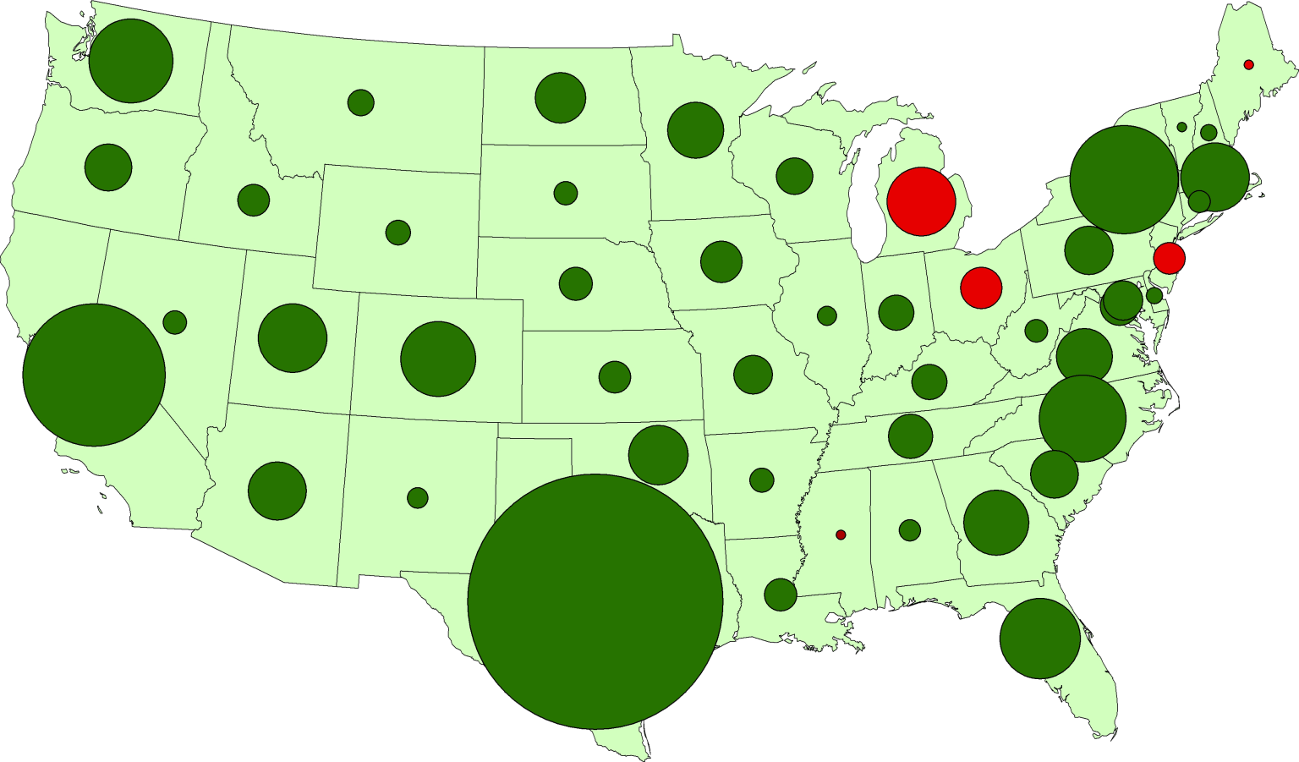
Texas Leads U.S. Job Growth, 2004-2014
Washington
320,000
New York
550,000
California
810,000
North Carolina
340,000
Texas
2,180,000
Notes:
Why are so many people moving to Texas? It’s the economy. Texas has consistently out-performed the rest of the country in job creation for well over a decade. Even through the recession and certainly coming out of the recession.

Slide 13
Texas Leads U.S. Job Growth, 2004-2014
Percentage of Total U.S. Job Gains Attributable to each State
Texas
29%
11%
California
7%
4%
4%
All Others
New York
North Carolina
Washington
Notes:
Over the last decade, Texas created almost 30% of the jobs in the United States. That’s quite amazing. If we were a country, we’d be something like the 14th or 15th largest economy. By many measures Texas has been performing very well. One of the critical questions we have an obligation to continually ask is “what might happen to slow us down or set us back?” Can we keep on the roll we’ve been on?

Slide 14
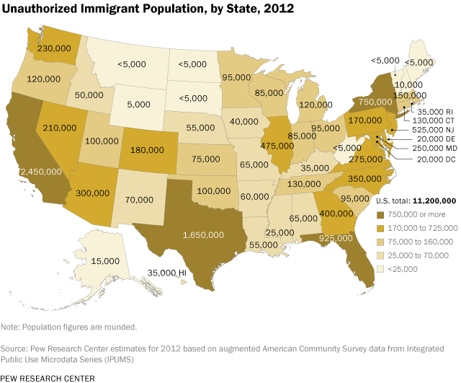

Slide 15


Slide 16
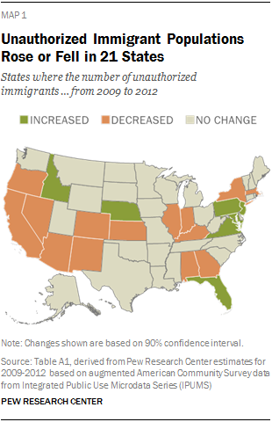

Slide 17
Texas Racial and Ethnic Composition,
2000 and 2010
Source: U.S. Census Bureau. 2000 and 2010 Census count
Notes:
As of the 2000 Census, about 53% of Texas’ population was non-Hispanic Anglo, about 32% where of Hispanic descent, about 11% where non-Hispanic African American, and about 4% were non-Hispanic Other.
In 2010, it is estimated that about 45% of the Texas population was non-Hispanic Anglo, 38% of Hispanic descent, 11% were non-Hispanic African American, and about 6% were non-Hispanic Other (largely of Asian descent).

Slide 18
Texas White (non-Hispanic) and Hispanic Populations by Age, 2010
Source: U.S. Census Bureau 2010 Decennial Census, SF1
Notes:
The age distribution of the non-Hispanic white population in Texas is weighted heavily with the “baby boom” generation. Largely the result of lower fertility and less net in-migration, the non-Hispanic white population has relatively fewer young persons relative to those in the middle-age years. In 2010, at ages 37 and younger, the Hispanic population exceeds the non-Hispanic white population.

Slide 19
Texas Population Pyramid by Race/Ethnicity, 2010
Source: U.S. Census Bureau 2010 Decennial Census, SF1
Notes:
This population pyramid represents the age and sex composition of the Texas non-Hispanic white population. Blue represents males, red females, rows are single years of age.

Slide 20
Texas Population Pyramid by Race/Ethnicity, 2010
Source: U.S. Census Bureau 2010 Decennial Census, SF1
Notes:
This population pyramid represents the age, and sex composition of the minority population in Texas. Blue represents males, red females, rows are single years of age, and shades represent specified race/ethnic groups as indicated in the legend.

Slide 21
Texas Population Pyramid by Race/Ethnicity, 2010
Source: U.S. Census Bureau 2010 Decennial Census, SF1
Notes:
This population pyramid represents the age, sex, race and ethnic composition of the Texas population. Blue represents males, red females, rows are single years of age, and shades represent specified race/ethnic groups as indicated in the legend.

Slide 22
Percent of the Population that is of Hispanic Descent, Texas Counties, 2009-2013
Source: U.S. Census Bureau, American Community Survey, 2009-2013 5 Year Sample

Slide 23
Percent of the Population that is Non-Hispanic Black, Texas Counties, 2009-2013
Source: U.S. Census Bureau, American Community Survey, 2009-2013 5 Year Sample

Slide 24
Percent of the Population that is of Asian Descent, Texas Counties, 2009-2013
Source: U.S. Census Bureau, American Community Survey, 2009-2013 5 Year Sample

Slide 25
Percent of the Labor Force Employed in Agriculture, Forestry, Fishing, Mining, Texas Counties,2009-2013
Source: U.S. Census Bureau, American Community Survey, 2009-2013 5 Year Sample

Slide 26
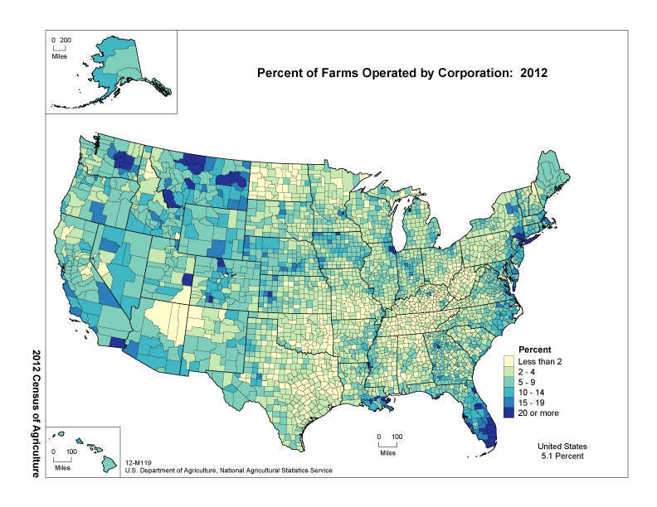

Slide 27
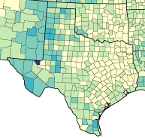
Percent of Farms Operated by Corporations, 2007 and 2012
2007
2012

Slide 28
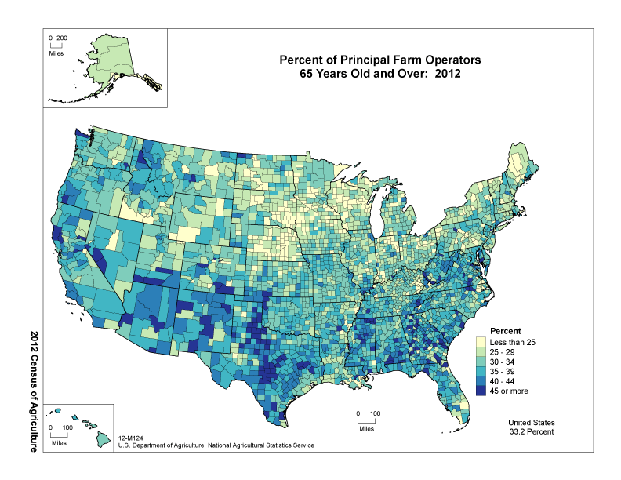

Slide 29
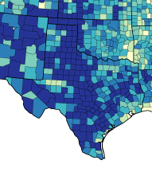
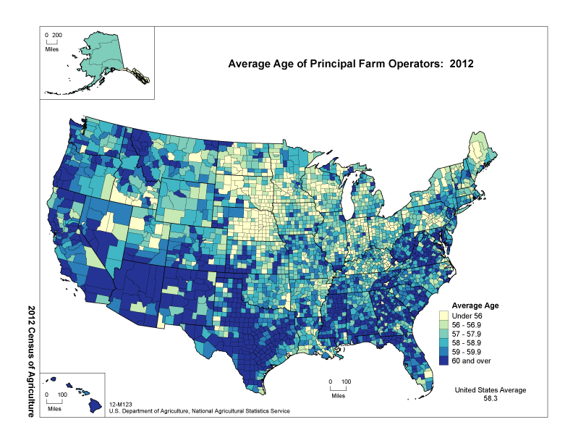
Average age of Operators by County, 2007 and 2012
2007
2012

Slide 30
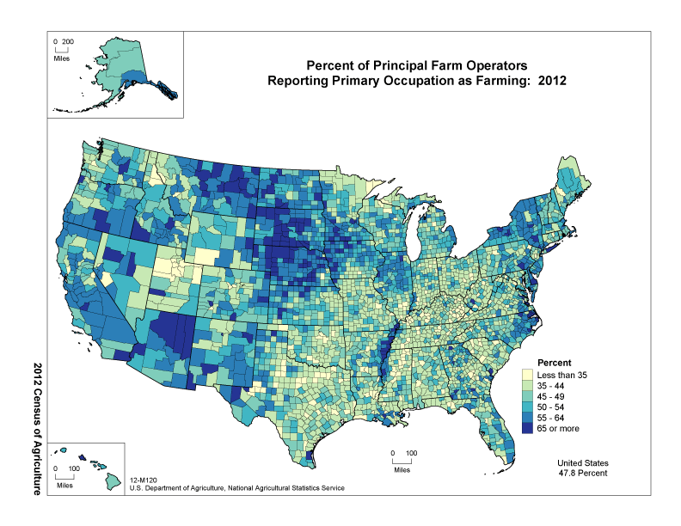

Slide 31
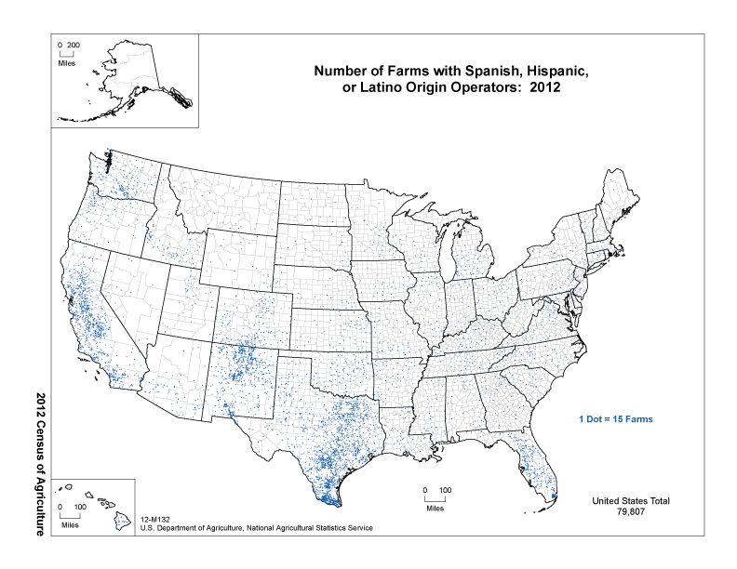

Slide 32
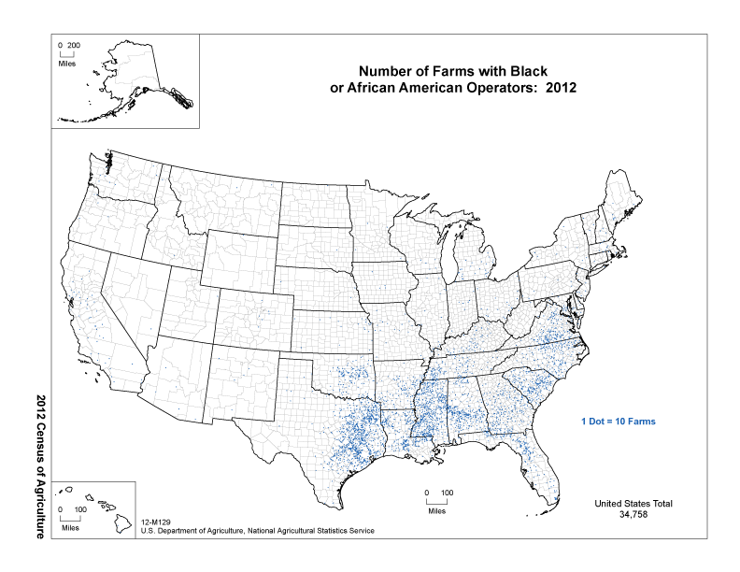

Slide 33
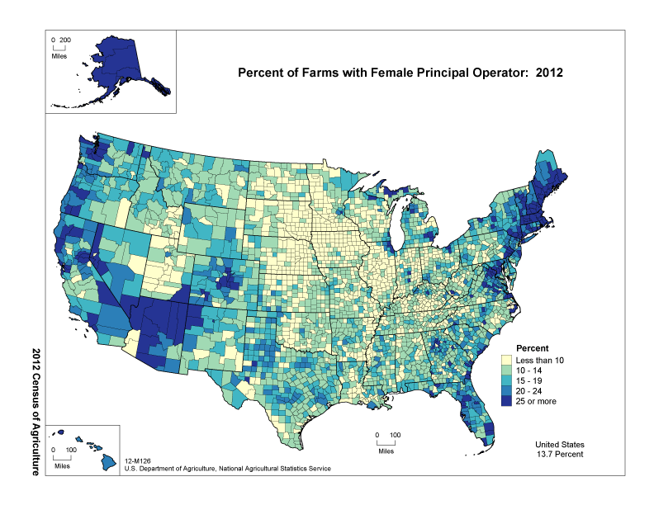

Slide 34
Percent of the Population Born in Texas, Texas Counties, 2009-2013
Source: U.S. Census Bureau, American Community Survey, 2009-2013 5 Year Sample

Slide 35
Mean Travel Time to Work, Texas Counties, 2009-2013
Source: U.S. Census Bureau, American Community Survey, 2009-2013 5 Year Sample

Slide 36
Percent of Households with Income of $150,000 or More, Texas Counties, 2009-2013
Source: U.S. Census Bureau, American Community Survey, 2009-2013 5 Year Sample

Slide 37
Median Age, Texas Counties, 2009-2013
Source: U.S. Census Bureau, American Community Survey, 2009-2013 5 Year Sample

Slide 38
Projected Population Growth in Texas, 2010-2050
Source: Texas State Data Center 2012 Population Projections
Notes:
The projected population of Texas is produced using three different migration scenarios. The blue line represents the assumption that there is no in or out migration for Texas. The result is a population that is growing only from natural increase (births-deaths). Under this unlikely scenario, Texas will maintain a health pace of population growth. The other two scenarios assume that 1) the migration rate will be the same as we observed between 2000 and 2010 and 2) the migration rate will be half of what we observed between 2000 and 2010. Under the first assumption Texas will add another 5 million persons this decade, another 7 million the following, 8 or 9 million between 2030 and 2040 and almost 10 million between 2040 and 2050. The half migration scenario also projects significant growth but more modest than the assumption of full migration.

Slide 39
Projected Population Change, Texas Counties, 2010-2050
Source: Texas State Data Center 2012 Population Projections . 2000-2010 Migration Scenario
Notes:
Projected population growth suggests increased numbers and density in the points of Texas’ population triangle, the lower Rio Grande valley with continued growth of El Paso and the urbanized areas in the west of the State. Many rural counties will continue to lose population.

Slide 40
Projected Percent Population Change, Texas Counties, 2010-2050
Source: Texas State Data Center 2012 Population Projections . 2000-2010 Migration Scenario
Notes:
The speed of growth is projected to be greatest in counties surrounding the urban core counties of the points of the Texas’ population triangle.

Slide 41
Texas Population Change by Age Group, 2010-2030
Source: Texas State Data Center 2012 Population Projections
Notes:
This image represents population pyramids for Texas in 2010 and then our projected population in 2030. Population pyramids provide a visual representation of the age structure of a population. In comparing 2010 and 2030 in terms of the impact on our education system, look at the lighter shaded areas from 15 years and above to 25-29. Some proportion of this increased population in these ages will be going to college in Texas. The lighter shaded areas below 15 suggest what’s coming in the future.

Slide 42
Projected Racial and Ethnic Percent, Texas, 2010-2050
Source: Texas State Data Center 2012 Population Projections , 2000-2010 Migration Scenario
Notes:
The projected population of Texas by race/ethnicity suggests that the Hispanic population will be a major driver in the population growth of the state. The non-Hispanic white population will grow very slowly and then start to decline as the Baby-Boom generation ages into high mortality years. The non-Hispanic other group is largely composed of persons of Asian descent and this group is projected to exceed the non-Hispanic black population by 2038. This graph assumes migration patterns observed between 2000 and 2010.

Slide 43




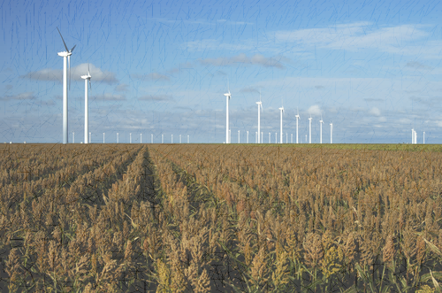
Demographics and Destiny
Notes:
Texas is growing – with more people being added than in any other state we added 4 additional seats to our representation in the U.S. Congress.
Texas is becoming more urban. Many rural counties are losing population. Urbanized metropolitan areas have been growing dramatically over the decade.
Texas is becoming more diverse – much of our growth is attributable to growth of the Hispanic population.
Educational attainment of the labor force is an important aspect in the economic well being of the Staet.

Slide 44
Contact
  Office: (512) 463-8390 or (210) 458-6530
  Email: Lloyd.Potter@osd.state.tx.us
  Internet: http://osd.state.tx.us
  Twitter: @TexasDemography
Lloyd Potter, Ph.D.
Notes:
The Office of the State Demographer and the Texas State Data Center are committed to supporting your work through providing you with the best, most accurate, and objective information we can identify about our greatest asset, the people of Texas.

