Slide 1
Texas Population Characteristics, Trends, and Projections
Texas
Electric Cooperatives Human Resources Conference
May 19, 2015
Dallas, Texas
Notes:
Lila Valencia is the legislative liaison and a demographer with the Office of the State Demographer.

Slide 2
Total Population and Components of Population Change in Texas, 1950-2014
Year* | Population | Numeric Change | Annual Percent Change
1950 | 7,711,194 | -- | --
1960 | 9,579,677 | 1,868,483 | 2.4
1970 | 11,196,730 | 1,617,053 | 1.7
1980 | 14,229,191 | 3,032,461 | 2.7
1990 | 16,986,510 | 2,757,319 | 2.0
2000 | 20,851,820 | 3,865,310 | 2.3
2010 | 25,145,561 | 4,293,741 | 2.1
2012 | 26,060,796 | 915,235 | 1.8
2013 | 26,448,193 | 387,397 | 1.4
2014 | 26,956,958 | 451,321 | 1.7
* All values for the decennial dates are for April 1st of the indicated census year. Values for 2012 and 2014 are for July 1 as estimated by the U.S. Census Bureau. Source: U.S. Census Bureau, Census Counts and Population Estimates Note: Residual values are not presented in this table.
3
Notes:
Between 2000 and 2010 Texas added over 4 million residents. In just 4 short years, it is estimated Texas has added nearly 2 million more, placing the Texas population just under 27 million.

Slide 3
Texas Population Growth 1950-2010
Source: U.S. Census Bureau, Census Counts
Notes:
Population growth in Texas has been geometric in nature. Over the past six decades there have been three 20 year periods where the numeric growth has increased. We have no indication that the population growth in Texas will slow in coming years.

Slide 4
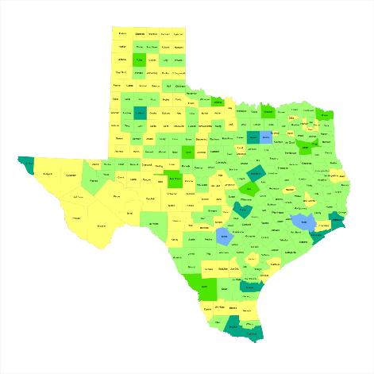
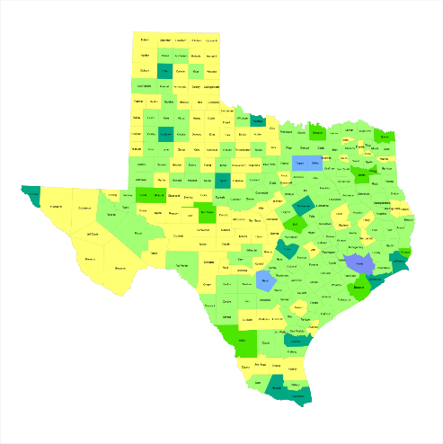
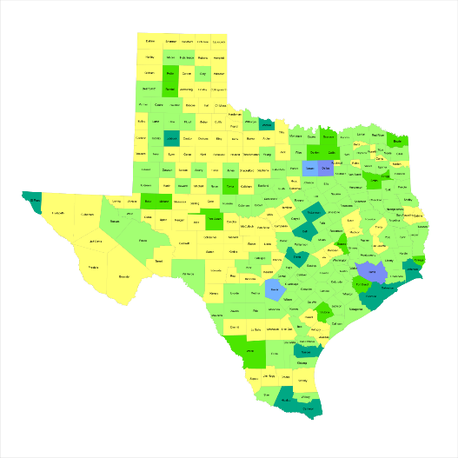

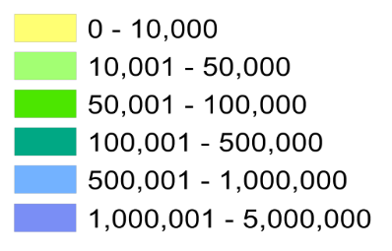
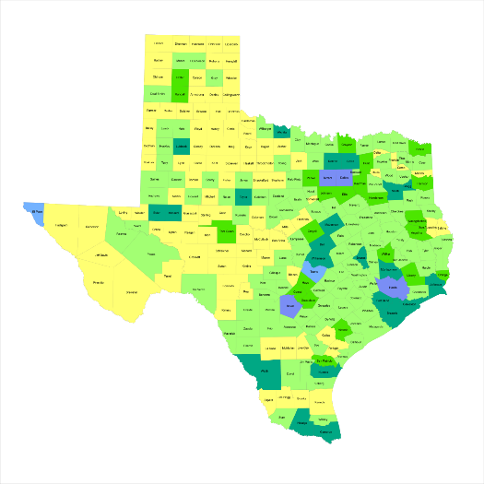
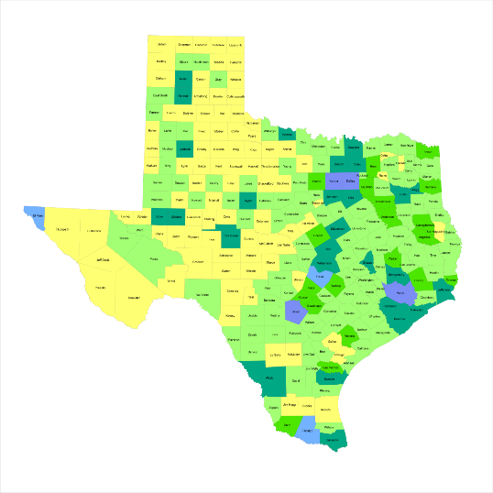
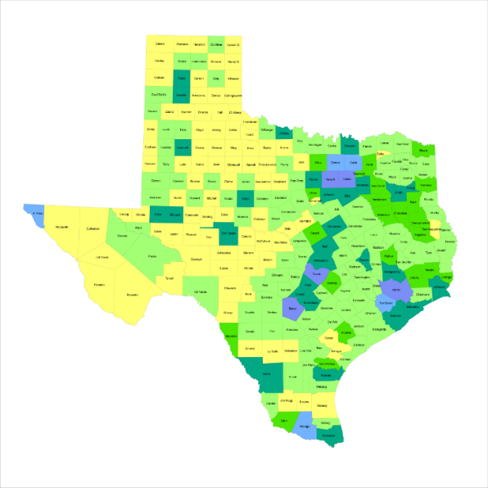
Historic County Population, Texas
1950
1960
1970
1980
1990
2000
2010
4
Source: U.S. Census Bureau, decennial censuses
Notes:
Texas growth has been steady but not geographically even over the past seven decades. As the population in the major urban areas and surrounding suburban areas has grown dramatically, areas in the more rural western part of the state that were populated earlier have become less populated in recent decades.
When we look at the geographic distribution of the population of Texas over time we see continually increasing population in the counties along the I-35 corridor, the Houston area, and the lower Rio Grand Valley. Urbanized areas out west have grown but most counties west have experienced limited growth and some population decline. Approximately 86% of the population is along I-35 and east. This area with the 3 major metropolitan areas at the points is often described as the Texas population triangle.

Slide 5
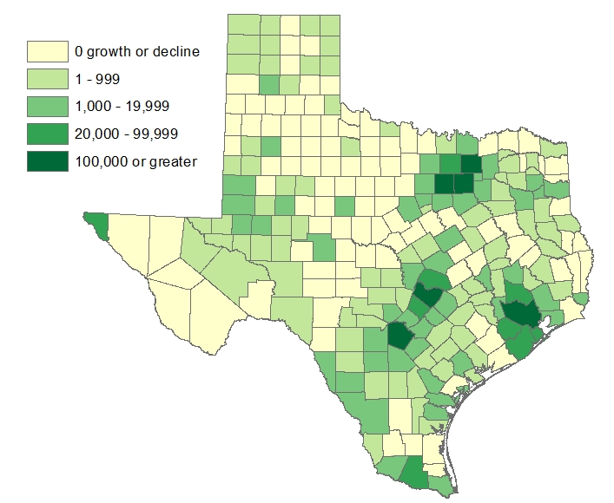
Estimated Change of the Total Population by
County, Texas, 2010 to 2014
Source: U.S. Census Bureau Population Estimates, 2014 Vintage.
Notes:
Population change over the decade has been greatest in the urban and suburban population triangle counties. Counties in the lower Rio Grande Valley also had significant growth as did El Paso county. Overall, 152 counties gained population while 102 (40%) lost population since 2010.

Slide 6
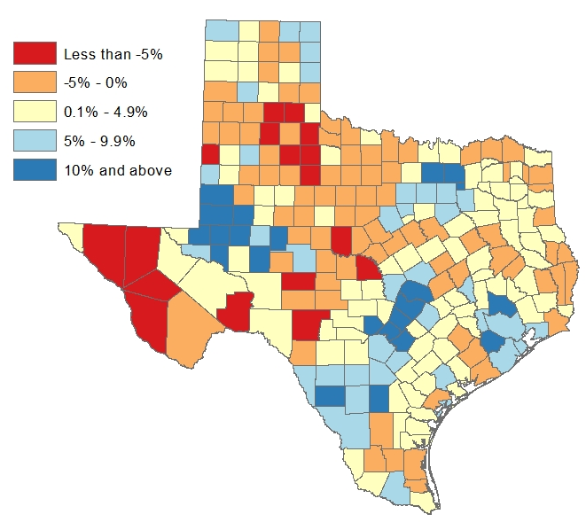
Estimated Percent Change of the Total Population by County, Texas, 2010 to 2014
Source: U.S. Census Bureau Population Estimates, 2014 Vintage.
Notes:
Percent change is an indicator of the speed of population change void of information about the volume of population change. Percent change in the population over the past few years has been greatest in the urban and suburban population triangle counties. Notably counties in the Eagle Ford Shale area (south east of San Antonio) and the Cline Shale area (Midland and Odessa) area, have been growing quickly. Overall, 152 counties gained population while 102 lost population over the decade.

Slide 7
30% of the top 40 fastest growing counties in the United States are in Texas, 2013 to 2014
U.S. Rank | Geography | Population Estimate |  | Change, 2013 to 2014
 |  | 2013 | 2014 | Number | Percent
5 | Hays County, Texas | 176,483 | 185,025 | 8,542 | 4.8
6 | Fort Bend County, Texas | 654,561 | 685,345 | 30,784 | 4.7
9 | Comal County, Texas | 118,891 | 123,694 | 4,803 | 4.0
12 | Andrews County, Texas | 16,808 | 17,477 | 669 | 4.0
13 | Montgomery County, Texas | 499,818 | 518,947 | 19,129 | 3.8
14 | Williamson County, Texas | 471,225 | 489,250 | 18,025 | 3.8
15 | Kendall County, Texas | 37,469 | 38,880 | 1,411 | 3.8
21 | Ward County, Texas | 11,245 | 11,625 | 380 | 3.4
23 | Denton County, Texas | 729,152 | 753,363 | 24,211 | 3.3
31 | Collin County, Texas | 858,711 | 885,241 | 26,530 | 3.1
32 | Aransas County, Texas | 24,299 | 24,972 | 743 | 3.1
35 | Rockwall County, Texas | 85,290 | 87,809 | 2,519 | 3.0
36 | Waller, County | 45,484 | 46,820 | 1,336 | 2.9
37 | Ector County, Texas | 149,522 | 153,904 | 4,382 | 2.9
Counties in bold had growth associated with oil and gas extraction.
Source: U.S. Census Bureau, 2014 Population Estimates
Notes:
Thirty percent of the fastest growing counties in the United States from 2013 to 2014 were in Texas. Some of the fastest growing counties in the country continue to be suburban ring counties, such as Hays, Fort Bend, and Comal counties. Fewer shale area counties were among the fastest growing counties between 2013 and 2014, perhaps indicative of a leveling off in growth due to the gas and oil extraction industry.

Slide 8
More than 1/4 of U.S. counties in the top 40 for numeric growth are in Texas, 2013-2014
U.S. Rank | Geography | Population Estimate |  | Change, 2013 to 2014
 |  | 2013 | 2014 | Number | Percent
1 | Harris County, Texas | 4,352,752 | 4,441,370 | 88,618 | 2.0
6 | Bexar County, Texas | 1,822,154 | 1,855,866 | 33,712 | 1.9
8 | Dallas County, Texas | 2,486,083 | 2,518,638 | 32,555 | 1.3
10 | Tarrant County, Texas | 1,913,943 | 1,945,360 | 31,417 | 1.6
11 | Fort Bend County, Texas | 654,561 | 685,345 | 30,784 | 4.7
12 | Travis County, Texas | 1,122,748 | 1,151,145 | 28,397 | 2.5
14 | Collin County, Texas | 858,711 | 885,241 | 26,530 | 3.1
16 | Denton County, Texas | 729,152 | 753,363 | 24,211 | 3.3
27 | Montgomery County, Texas | 499,818 | 518,947 | 19,129 | 3.8
31 | Williamson County, Texas | 471,225 | 489,250 | 18,025 | 3.8
39 | Hidalgo County | 818,942 | 831,073 | 12,060 | 1.5
6
Source: U.S. Census Bureau, 2014 Population Estimates
Notes:
One-fourth of the counties in the United States that were growing the most numerically between 2012 and 2013 were in Texas. These counties are the larger ones in the State and are all counties that have experienced continued growth.

Slide 9
Components of Population Change by Percent in Texas, 1950-2010
Source: U.S. Census Bureau, Population Estimates
Notes:
Population changes from two factors, one is natural increase which is simply births minus deaths over time and the other is net migration which is in-migrants minus out-migrants over time. Population added from natural increase are babies joining an already existing household. So the effect of population growth from natural increase on infrastructure demands is both lightening, from people dying, and delayed until babies reach the age where they have infrastructure requirements. Net-migration, in Texas, has been positive for most of our history. Migrants, are usually adults in a household, thus migrants immediately add new households and have instant infrastructure needs, such as housing, transportation, etc.
When we look at population change in Texas, from 1950 to present we can see that before 1970, most of our growth was from natural increase. Starting in the 1970s a much larger percent of our growth is attributed to net migration and this continues to today where approaching half of our population change is from migration.

Slide 10
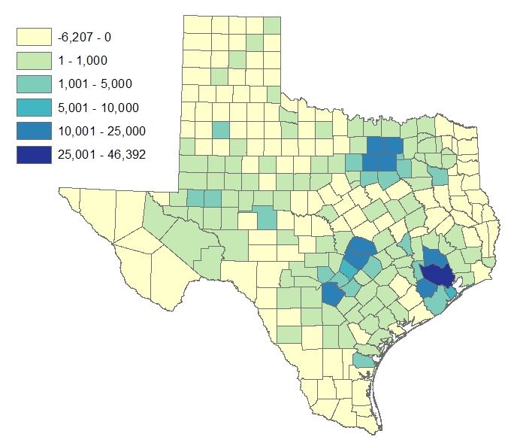
Estimated Number of Net Migrants by
County, Texas, 2013 to 2014
Source: U.S. Census Bureau Population Estimates, 2014 Vintage.
Notes:
The estimated number of net migrants was greatest in the points of the Texas population triangle and surrounding counties. Population change in suburban counties with high migration is largely driven by migration. Population change in the urban core counties of the population triangle is more driven by natural increase than by net migration. Net in-migration to urban core counties at the points of the population triangle is dominated by international in-migration.

Slide 11
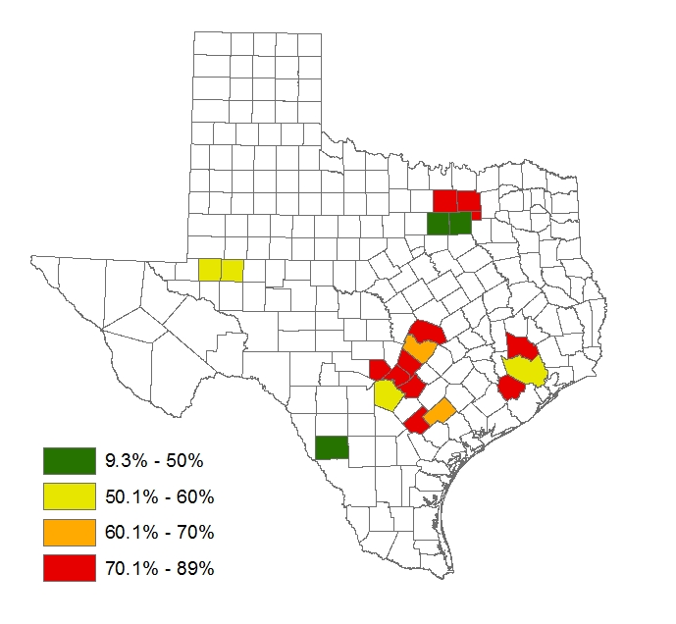

Net Migration
Percent of 2013-2014 Population Change from Net Migration
Ft. Worth
Dallas
Midland
Austin
Houston
San Antonio
Notes:
I’ve selected a few counties to illustrate how population change contributions vary by geography. The urban core counties in the population triangle have a smaller percent of population change from net migration. The suburban ring counties and the fracking counties have a very high percentage of their population change from net migration. These counties are experiencing more rapid increases in demand for transportation infrastructure compared to those counties where population increase is being driven more from natural increase.

Slide 12
Number of Annual Immigrants Admitted to the United States, FY 1820-2012

Slide 13
Number of Non-Citizen Immigrants by World Area of Birth in the Top 5 Immigration Receiving States, 2007-2011
Source: 5-Year ACS PUMS 2007-2011

Slide 14
Shares of Recent Non-Citizen Immigrants to Texas from Mexico, India, China, and All Other Countries, 2005-2012
Source: 1-Year ACS PUMS 2005-2012

Slide 15
Inflows to Texas from Top 10 Sending States, 2013
Top 10 Senders, Numerically |  |  | Top 10 Senders, Percentage-wise
California | 66,318 |  | New Mexico | 30%
Florida | 32,619 |  | Louisiana | 29%
Oklahoma | 29,169 |  | Oklahoma | 29%
Louisiana | 29,042 |  | Arkansas | 22%
Illinois | 28,900 |  | Wyoming | 17%
New Mexico | 22,695 |  | Colorado | 11%
Georgia | 19,988 |  | California | 11%
New York | 19,935 |  | Arizona | 11%
Arizona | 19,224 |  | Kansas | 10%
Colorado | 18,979 |  | Mississippi | 10%
Source: U.S. Census Bureau, State to State Flows 2013; Inflows to Texas

Slide 16
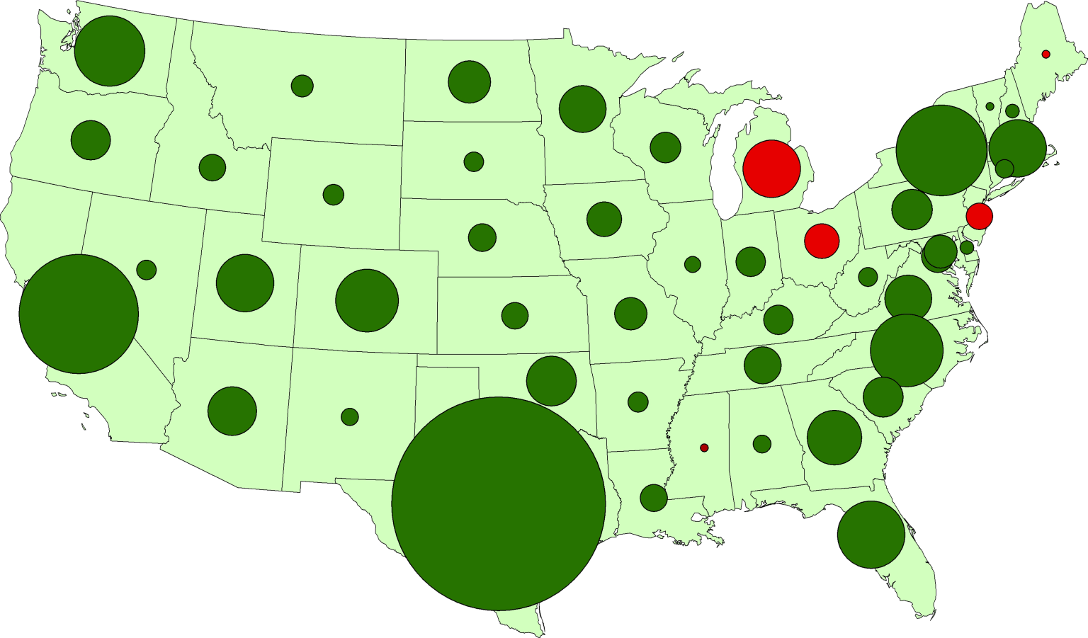
Texas Leads U.S. Job Growth, 2004-2014
Washington
320,000
New York
550,000
California
810,000
North Carolina
340,000
Texas
2,180,000
Notes:
Why are so many people moving to Texas? It’s the economy. Texas has consistently out-performed the rest of the country in job creation for well over a decade. Even through the recession and certainly coming out of the recession.

Slide 17
Texas Leads U.S. Job Growth, 2004-2014
Percentage of Total U.S. Job Gains Attributable to each State
Texas
29%
11%
California
7%
4%
4%
All Others
New York
North Carolina
Washington
Notes:
Over the last decade, Texas created almost 30% of the jobs in the United States. That’s quite amazing. If we were a country, we’d be something like the 14th or 15th largest economy. By many measures Texas has been performing very well. One of the critical questions we have an obligation to continually ask is “what might happen to slow us down or set us back?” Can we keep on the roll we’ve been on?

Slide 18
Percent of the Population Born in Texas, Texas Counties, 2009-2013
Source: U.S. Census Bureau, American Community Survey, 2009-2013 5 Year Sample

Slide 19
Texas Racial and Ethnic Composition,
2000 and 2010
Source: U.S. Census Bureau. 2000 and 2010 Census count
Notes:
As of the 2000 Census, about 53% of Texas’ population was non-Hispanic Anglo, about 32% where of Hispanic descent, about 11% where non-Hispanic African American, and about 4% were non-Hispanic Other.
In 2010, it is estimated that about 45% of the Texas population was non-Hispanic Anglo, 38% of Hispanic descent, 11% were non-Hispanic African American, and about 6% were non-Hispanic Other (largely of Asian descent).

Slide 20
Texas White (non-Hispanic) and Hispanic Populations by Age, 2010
Source: U.S. Census Bureau 2010 Decennial Census, SF1
Notes:
The age distribution of the non-Hispanic white population in Texas is weighted heavily with the “baby boom” generation. Largely the result of lower fertility and less net in-migration, the non-Hispanic white population has relatively fewer young persons relative to those in the middle-age years. In 2010, at ages 37 and younger, the Hispanic population exceeds the non-Hispanic white population.

Slide 21
Texas Population Pyramid by Race/Ethnicity, 2010
Source: U.S. Census Bureau 2010 Decennial Census, SF1
Notes:
This population pyramid represents the age, sex, race and ethnic composition of the Texas population. Blue represents males, red females, rows are single years of age, and shades represent specified race/ethnic groups as indicated in the legend. Note the “inverted” pyramid for the non-Hispanic White population and the presence of the “baby boom” while the Hispanic and African American population pyramids are characterized with wider bases (the young) relative to the peak (the old).

Slide 22
Texas Population Pyramid by Race/Ethnicity, 2010
Source: U.S. Census Bureau 2010 Decennial Census, SF1
Notes:
This population pyramid represents the age, sex, race and ethnic composition of the Texas population. Blue represents males, red females, rows are single years of age, and shades represent specified race/ethnic groups as indicated in the legend. Note the “inverted” pyramid for the non-Hispanic White population and the presence of the “baby boom” while the Hispanic and African American population pyramids are characterized with wider bases (the young) relative to the peak (the old).

Slide 23
Texas Population Pyramid by Race/Ethnicity, 2010
Source: U.S. Census Bureau 2010 Decennial Census, SF1
Notes:
This population pyramid represents the age, sex, race and ethnic composition of the Texas population. Blue represents males, red females, rows are single years of age, and shades represent specified race/ethnic groups as indicated in the legend. Note the “inverted” pyramid for the non-Hispanic White population and the presence of the “baby boom” while the Hispanic and African American population pyramids are characterized with wider bases (the young) relative to the peak (the old).

Slide 24
Percent of Households with at Least One Person Over the Age of 64 Years, Texas Counties, 2008-2012
Source: U.S. Census Bureau, American Community Survey, 5-year sample, 2008-2012

Slide 25
Median Age, Texas Counties, 2009-2013
Source: U.S. Census Bureau, American Community Survey, 2009-2013 5 Year Sample

Slide 26
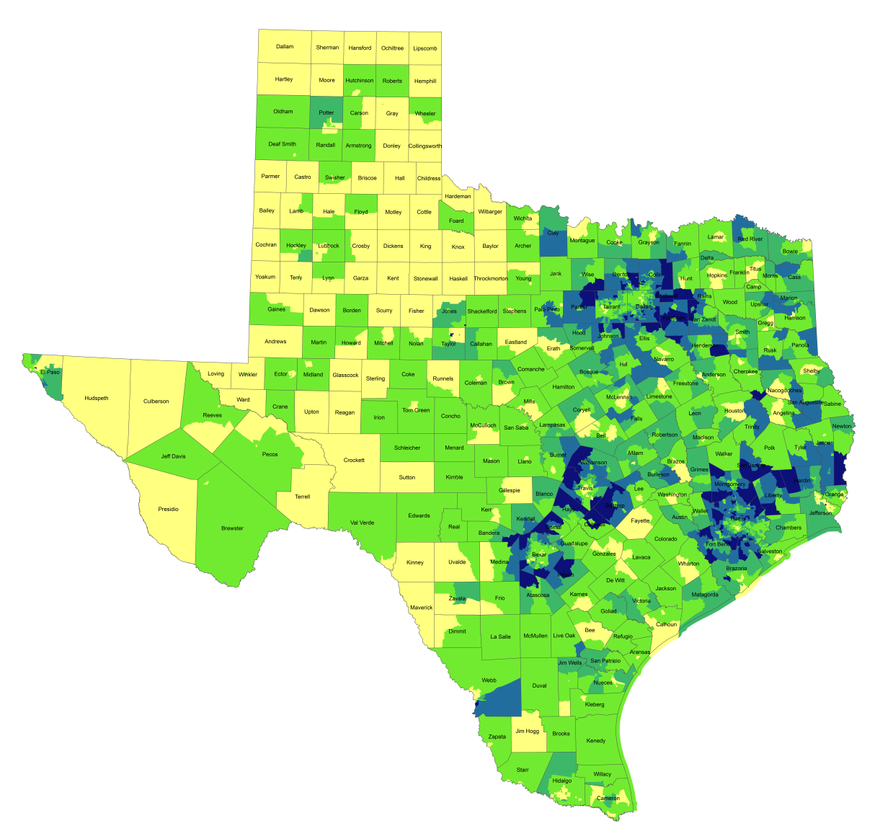
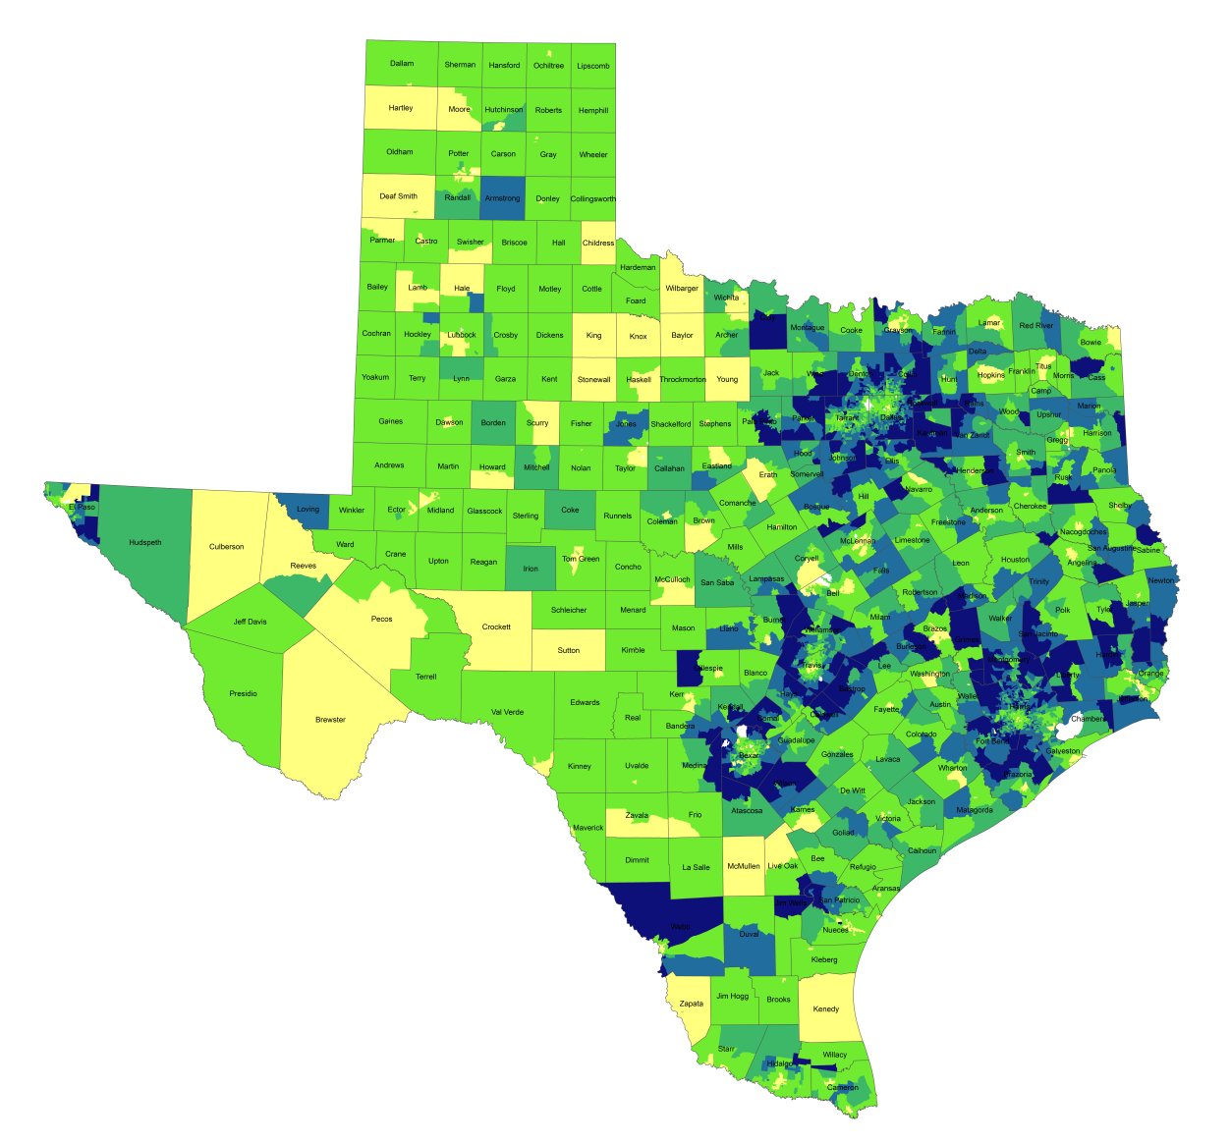
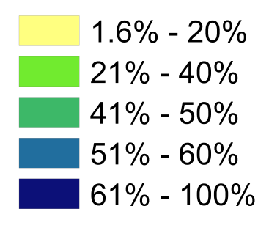
Percentage of Population with Drive Times Longer than 25 Minutes, Texas Census Tracts, 1990 and 2010*
1990
2010*
12
Source: U.S. Census Bureau, 1990 decennial census and *American Community Survey, 2008-2012 5 Year Sample.
Notes:
One indicator of quality of life is how much time spent commuting to and from work. Commuting takes away time from family and leisure activities and may have an impact on work productivity as well. When we look at the percent of workers who commute longer than 25 minutes by census tract, you can see how increasing population and resulting density, perhaps combined with lagging infrastructure has resulted in increasing commuting times for suburban residents in the more densely populated parts of the state. Commuting time is a factor that some potential business will examine when considering moving operations to a place and one that most can agree is something we want to be as small as possible within reason.

Slide 27
Percentage of Families Whose Income in the Past 12 Months is Below the Poverty Level, Texas 2006-2012
Source: U.S. Census Bureau, American Community Survey, 1-year sample, 2006-2012

Slide 28
Projected Population Growth in Texas,
2010-2050
Source: Texas State Data Center 2014 Population Projections
Notes:
The projected population of Texas is produced using three different migration scenarios. The blue line represents the assumption that there is no in or out migration for Texas. The result is a population that is growing only from natural increase (births-deaths). Under this unlikely scenario, Texas will maintain a health pace of population growth. The other two scenarios assume that 1) the migration rate will be the same as we observed between 2000 and 2010 and 2) the migration rate will be half of what we observed between 2000 and 2010. Under the first assumption Texas will add another 5 million persons this decade, another 7 million the following, 8 or 9 million between 2030 and 2040 and almost 10 million between 2040 and 2050. The half migration scenario also projects significant growth but more modest than the assumption of full migration.

Slide 29
Projected Racial and Ethnic Percent, Texas, 2010-2050
Source: Texas State Data Center 2014 Population Projections , Half 2000-2010 Migration Scenario
Notes:
The projected population of Texas by race/ethnicity suggests that the Hispanic population will be a major driver in the population growth of the state. The non-Hispanic white population will grow very slowly and then start to decline as the Baby-Boom generation ages into high mortality years. The non-Hispanic other group is largely composed of persons of Asian descent, and this group is projected to reach near parity with the non-Hispanic black population. This graph assumes half of the migration patterns observed between 2000 and 2010.

Slide 30
Projected Population Change, Texas Counties, 2010-2050
15
Source: Texas State Data Center 2012 Population Projections . 2000-2010 Migration Scenario
Notes:
Projected population growth suggests increased numbers and density in the points of Texas’ population triangle, the lower Rio Grande valley with continued growth of El Paso and the urbanized areas in the west of the State. Many rural counties will continue to lose population.
The speed of growth is projected to be greatest in counties surrounding the urban core counties of the points of the Texas’ population triangle.

Slide 31
Texas Population Change by Age Group,
2010-2050
Source: Texas State Data Center 2014 Population Projections, Half 2000 to 2010 Migration Scenario
Notes:
This image represents population pyramids for Texas in 2010 and then our projected population in 2050. Population pyramids provide a visual representation of the age structure of a population. In comparing 2010 and 2050 in terms of the impact on our education system, look at the lighter shaded areas from 15 years and above to 25-29. Some proportion of this increased population in these ages will be going to college in Texas. The lighter shaded areas below 15 suggest what’s coming in the future.

Slide 32
Percent of the Civilian Labor Force (ages 25-64) by Educational Attainment for 2011, 2030 Using Constant Rates, Texas
These should be going DOWN
These should be going UP
Sources: U.S. Census Bureau, American Community Survey, 1-Year PUMS.
Texas State Data Center, 2012 Vintage Population Projections, 0.5 Migration Scenario
Notes:
The first assumption (represented by the red columns) is that educational attainment by race/ethnicity and sex would remain the same as it was in 2011. Thus the changes we see in educational attainment in this projection are due only to changes in the racial/ethnic composition of the population (driven by increasing Hispanic population and a leveling of growth among the non-Hispanic white population). Under this scenario, we would see increases of the percent of the labor force with lower levels of education and declines in the percent of the labor force with higher levels.

Slide 33
Percent of the Civilian Labor Force (ages 25-64) by Educational Attainment for 2011, and 2030 Using Trended Rates, Texas
These should be going DOWN
These should be going UP
Sources: U.S. Census Bureau, American Community Survey, 1-Year PUMS.
Texas State Data Center, 2012 Vintage Population Projections, 0.5 Migration Scenario
Notes:
Under the second assumption (green columns) the trends observed in improving educational attainment are projected forward and applied to the projected population by race/ethnicity and sex. Thus the generally positive trends we have noted in improving educational attainment are assumed to continue into the future. The result of this projection suggests that we will see declines in the percent of the labor force with lower levels of education and increases in the percent of the labor force with higher levels of education.

Slide 34
Summary
Population continues to grow quickly though growth is geographically unequal.
Population growth is being driven by Hispanic population.
The future Texas labor force will be largely Hispanic.
Hispanics tend to have lower levels of educational attainment than other groups.
Geographic distribution of industries and occupations is variable.
Demographic and infrastructure challenges may have serious implications for future Texas economy.

Slide 35

Demographics & Destiny
Notes:
Texas is growing – with more people being added than in any other state we added 4 additional seats to our representation in the U.S. Congress.
Texas is becoming more urban. Many rural counties are losing population. Urbanized metropolitan areas have been growing dramatically over the decade.
Texas is becoming more diverse – much of our growth is attributable to growth of the Hispanic population.
Educational attainment of the labor force is an important aspect in the economic well being of the State.

Slide 36
Contact
  Office: (512) 463-8390
  Email: Lila.Valencia@osd.state.tx.us
  Internet: http://osd.state.tx.us
  Twitter: @TexasDemography
Lila Valencia, Ph.D.
Notes:
The Office of the State Demographer and the Texas State Data Center are committed to supporting your work through providing you with the best, most accurate, and objective information we can identify about our greatest asset, the people of Texas.

