Slide 1

Demographic Characteristics and Trends in Texas and South Central Texas
Mass Comm Week
San Marcos, Texas
October 21, 2015
@TexasDemography

Slide 2
Total Population and Components of Population Change in Texas, 1950-2014
All values for the decennial dates are for April 1st of the indicated census year. Values for 2012-2014 are for July 1 as estimated by the U.S. Census Bureau.
Source: U.S. Census Bureau, Census Counts and Population Estimates

Slide 3
Population Growth, Texas, 1950-2010
Source: U.S. Census Bureau, Decennial Censuses
Notes:
In 2014 we estimate that Texas had just under 27 million residents, while in the 2010 Census we had just over 25 million residents.
Population growth in Texas has been geometric or compounding in nature. Over the past two decades there have been three 20 year periods where the numeric growth has increased. We have no indication that the population growth in Texas will slow dramatically in coming years.

Slide 4
Components of Population Change by Percent in Texas, 1950-2010
Source: U.S. Census Bureau, Population Estimates
Notes:
It is important to understand a couple of very basic element of population change to think about how growing population may impact our transportation system. Population changes from two factors, one is natural increase which is simply births minus deaths over time. Essentially population added from natural increase are babies who are unlikely to be driving their own vehicle on our roads before age 16. Combine this with the fact that as people die, there are fewer drivers on the road. So the effect of population growth from natural increase on our transportation infrastructure is both lightening, from people dying, and delayed until babies reach the age where they can drive. The second way population changes is from net-migration, which is simply in-minus out migrants. In Texas, the balance has been for us to have more in than out migrants. Migrants, are usually adults who are drivers (though yes, some do have non-driving children) and the may be compounded by the fact that many of the in-migrants may also take a job that requires them to drive. Essentially, migrants immediately contribute to adding stress to the transportation infrastructure.
When we look at population change in Texas, from 1950 to present we can see that before 1970, most of our growth was from natural increase. Starting in the 1970s a much larger percent of our growth is attributed to net migration and this continues to today where approaching half of our population change is from migration.

Slide 5
Total Estimated Population by County, Texas, 2014
Source: U.S. Census Bureau, 2014 Vintage Population Estimates
Notes:
When we look at the geographic distribution of the population of Texas over time we see continually increasing population in the counties along the I-35 corridor, the Houston area, and the lower Rio Grand Valley. Urbanized areas out west have grown but most counties west have experienced limited growth and some population decline. Approximately 86% of the population is along I-35 and east. This area with the 3 major metropolitan areas at the points is often described as the Texas population triangle.
The counties of Harris, Dallas, Tarrant, Bexar, and Travis make up the points of the “population triangle” in Texas and are the most populated in the State. Collin, Denton, Fort Bend, Hidalgo, and El Paso counties also have significant population concentrations. Many counties west of Interstate 35 are more sparsely populated.

Slide 6
Estimated Population Change, Texas Counties, 2010 to 2014
102 counties lost population over the four year period.
95 counties lost population between 2013-14
Of these:
36 (38%) had natural decline
89 (94%) had net out migration
30 (32%) had both natural decline and net out migration
Source: U.S. Census Bureau Population Estimates, 2014 Vintage.
Notes:
Population change over the decade has been greatest in the urban and suburban population triangle counties. Counties in the lower Rio Grande Valley also had significant growth as did El Paso . Overall, 155 counties gained population while 99 (39%) lost population over the decade.

Slide 7
Estimated Percent Change of the Total Population by County, Texas, 2010 to 2014
Source: U.S. Census Bureau Population Estimates, 2014 Vintage.
Notes:
Percent change is an indicator of the speed of population change void of information about the volume of population change. Percent change in the population over the past few years has been greatest in the urban and suburban population triangle counties. Notably counties in the Eagle Ford Shale area (south east of San Antonio) and the Cline Shale area (Midland and Odessa area), have been growing quickly.

Slide 8
Estimated Number of Net Migrants by
County, Texas, 2013 to 2014
Source: U.S. Census Bureau Population Estimates, 2014 Vintage.
Notes:
The estimated number of net migrants was greatest in the points of the Texas population triangle and surrounding counties. Population change in suburban counties with high migration is largely driven by migration. Population change in the urban core counties of the population triangle is more driven by natural increase than by net migration. Net in-migration to urban core counties at the points of the population triangle is dominated by international in-migration.

Slide 9
Percent of the Population Born in Texas, Texas Counties, 2009-2013
Source: U.S. Census Bureau, American Community Survey, 2009-2013 5 Year Sample

Slide 10
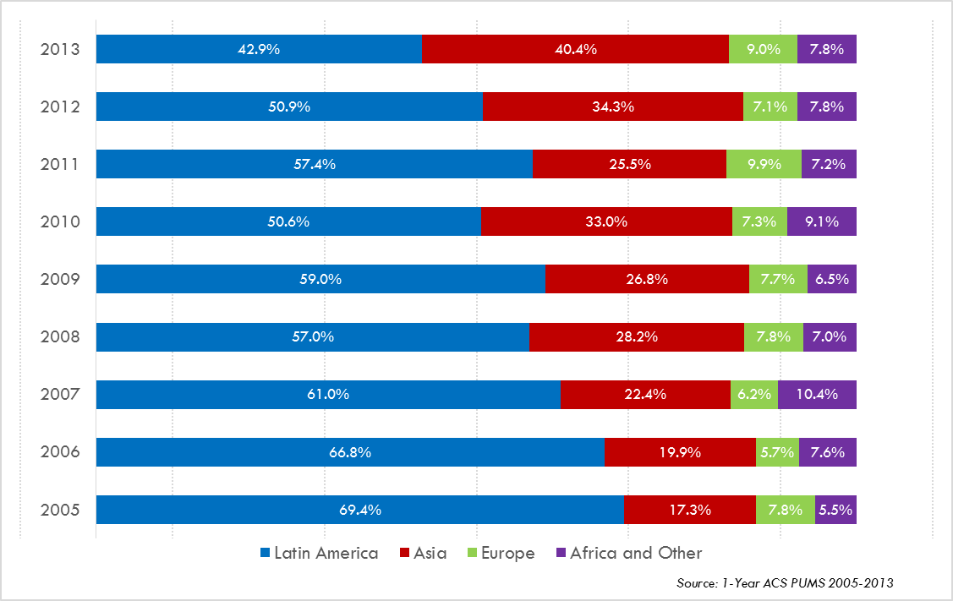
Annual Shares of Recent Non-Citizen Immigrants to Texas by World Area of Birth, 2005-2013

Slide 11
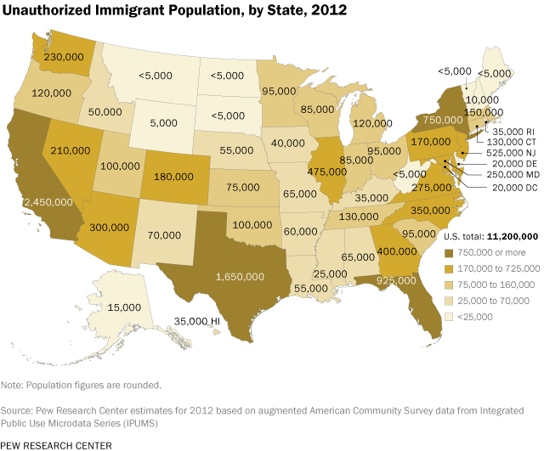

Slide 12


Slide 13
Percent of population speaking a language other than English at home and speak English less than very well, Census Tracts, Metroplex Area, Texas, 2009-2013
Source: U.S. Census Bureau, American Community Survey, 2009-2013 5-Year Sample

Slide 14
Top Counties for Numeric Growth in Texas, 2013-2014
 | U.S. Rank Population Change | Population Change | Percent of Change from Natural Increase | Percent Change from Migration | Percent of Migration that is international
Harris | 1 | 88,618 | 48.6% | 51.4% | 54.0%
Bexar | 6 | 33,712 | 42.8% | 57.2% | 23.2%
Dallas | 8 | 32,555 | 69.6% | 30.4% | 116.3%*
Tarrant | 10 | 31,417 | 50.8% | 49.2% | 38.5%
Fort Bend | 11 | 30,784 | 19.4% | 80.6% | 17.3%
Travis | 12 | 28,397 | 38.2% | 61.8% | 29.7%
Collin | 14 | 26,530 | 26.1% | 73.8% | 20.1%
Denton | 16 | 24,211 | 27.2% | 72.8% | 14.0%
Montgomery | 27 | 19,129 | 17.9% | 82.1% | 10.4%
Williamson | 31 | 18,025 | 23.2% | 76.8% | 7.8%
*Dallas had net out domestic migration over this period.
Source: U.S. Census Bureau, 2014 Vintage Population Estimates

Slide 15
Top Counties for Percent Growth* in Texas, 2013-2014
 | U.S. Rank | 2013-2014 Percent Population Change | Percent Change from Migration | Percent of Migration that is International
Hays | 5 | 4.8% | 83.9% | 2.62%
Fort Bend | 6 | 4.7% | 80.6% | 17.3%
Comal | 9 | 4.0% | 90.1% | 3.0%
Andrews | 12 | 4.0% | 62.8% | 3.6%
Montgomery | 13 | 3.8% | 82.1% | 10.5%
Williamson | 14 | 3.8% | 76.8% | 7.8%
Kendall | 15 | 3.8% | 98.0% | 5.0%
Ward | 21 | 3.4% | 72.0% | 1.5%
Denton | 23 | 3.3% | 72.8% | 14.2%
Collin | 31 | 3.1% | 73.9% | 20.1%
Aransas | 32 | 3.1% | 110.8% | 4.3%
Rockwall | 35 | 3.0% | 78.3% | 7.8%
Waller | 36 | 2.9% | 77.2% | 5.3%
Ector | 37 | 2.9% | 59.9% | 2.0%
Guadalupe | 42 | 2.8% | 78.6% | 4.9%
Source: U.S. Census Bureau, 2014 Vintage Population Estimates
*Among Counties with 10,000 or more population in 2013

Slide 16
Texas Racial and Ethnic Composition,
2000 and 2010
Source: U.S. Census Bureau. 2000 and 2010 Census count
Notes:
As of the 2000 Census, about 53% of Texas’ population was non-Hispanic Anglo, about 32% where of Hispanic descent, about 11% where non-Hispanic African American, and about 4% were non-Hispanic Other.
In 2010, it is estimated that about 45% of the Texas population was non-Hispanic Anglo, 38% of Hispanic descent, 11% were non-Hispanic African American, and about 6% were non-Hispanic Other (largely of Asian descent).

Slide 17
Texas White (non-Hispanic) and Hispanic Populations by Age, 2010
Source: U.S. Census Bureau 2010 Decennial Census, SF1
Notes:
The age distribution of the non-Hispanic white population in Texas is weighted heavily with the “baby boom” generation. Largely the result of lower fertility and less net in-migration, the non-Hispanic white population has relatively fewer young persons relative to those in the middle-age years. In 2010, at ages 37 and younger, the Hispanic population exceeds the non-Hispanic white population.

Slide 18
Texas Population Pyramid by Race/Ethnicity, 2010
Source: U.S. Census Bureau 2010 Decennial Census, SF1
Notes:
This population pyramid represents the age and sex composition of the Texas non-Hispanic white population. Blue represents males, red females, rows are single years of age.

Slide 19
Texas Population Pyramid by Race/Ethnicity, 2010
Source: U.S. Census Bureau 2010 Decennial Census, SF1
Notes:
This population pyramid represents the age, and sex composition of the minority population in Texas. Blue represents males, red females, rows are single years of age, and shades represent specified race/ethnic groups as indicated in the legend.

Slide 20
Texas Population Pyramid by Race/Ethnicity, 2010
Source: U.S. Census Bureau 2010 Decennial Census, SF1
Notes:
This population pyramid represents the age, sex, race and ethnic composition of the Texas population. Blue represents males, red females, rows are single years of age, and shades represent specified race/ethnic groups as indicated in the legend.

Slide 21
Percent of the Population that is of Hispanic Descent, Texas Counties, 2009-2013
Source: U.S. Census Bureau, American Community Survey, 2009-2013 5 Year Sample

Slide 22
Percent of the population that is Hispanic,
Census Tracts, Metroplex Area, Texas, 2009-2013
Source: U.S. Census Bureau, American Community Survey, 5 Year Sample 2009-2013.

Slide 23
Percent of the Population that is Non-Hispanic Black, Texas Counties, 2009-2013
Source: U.S. Census Bureau, American Community Survey, 2009-2013 5 Year Sample

Slide 24
Percent of the population that is Black/African American,
Census Tracts, Brazoria County Area, Texas, 2009-2013
Source: U.S. Census Bureau, American Community Survey, 5 Year Sample 2009-2013.

Slide 25
Percent of the population that is Asian, Census Tracts, Metroplex Area, Texas, 2009-2013
Source: U.S. Census Bureau, American Community Survey, 5 Year Sample 2009-2013.

Slide 26
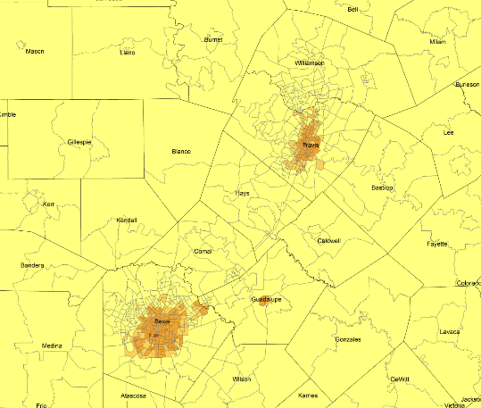
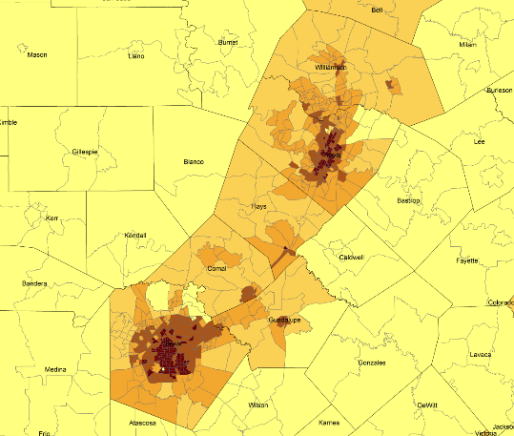
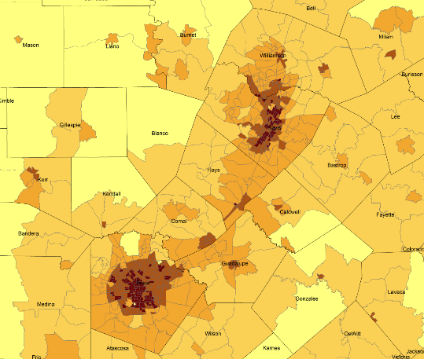
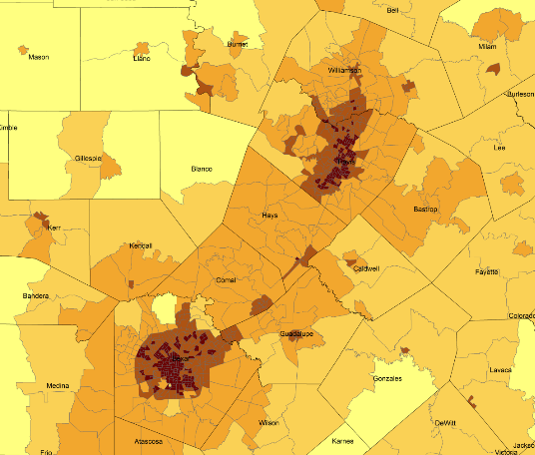
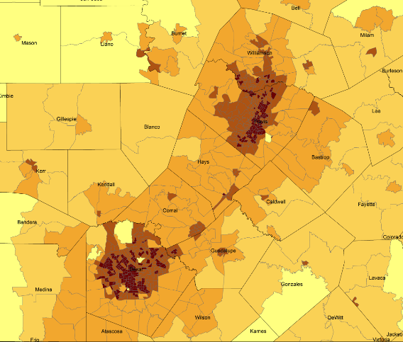
Density by Census Tract, Austin/San Antonio Corridor, 1970-2010
1970
1980
1990
2000
2010
Persons per Square Mile
0 – 10
11 – 50
51 – 500
501 – 4,000
4,001 – 56,000
Source: U.S. Census Bureau, decennial censuses. Geolytics, Neighborhood Change Database Tract Data from 1970-2010
Notes:
As more and more people move into our counties and communities, there are more and more persons per square mile. The sequence of images here show how from 1970 to 2010 the urban areas of San Antonio and Austin have become very dense in terms of population and how the are in-between these two cities has become more and more dense. This increasing density is happening in other urban areas of the State and the stress put on the transportation infrastructure from this increasing density creates challenges for our commuting residents and for businesses who are providing services and moving goods.

Slide 27
Median Household Income, Census Tracts, Texas, 2009-2013
Source: U.S. Census Bureau, American Community Survey, 2009-2013 5 Year Sample

Slide 28
Percent of population living below poverty, Census Tracts, Texas, 2009-2013
Source: U.S. Census Bureau, American Community Survey, 2009-2013 5 Year Sample

Slide 29
Percent of population 25 years and older without a high school degree, Census Tracts, Texas 2009-2013
Source: U.S. Census Bureau, American Community Survey, 2009-2013 5 Year Sample

Slide 30
Percent of Housing Units Built After 2010, Census Tracts, Texas
Source: U.S. Census Bureau, American Community Survey, 2009-2013 5 Year Sample

Slide 31
Projected Population Growth in Texas,
2010-2050
Source: Texas State Data Center 2014 Population Projections
Notes:
The projected population of Texas is produced using three different migration scenarios. The blue line represents the assumption that there is no in or out migration for Texas. The result is a population that is growing only from natural increase (births-deaths). Under this unlikely scenario, Texas will maintain a health pace of population growth. The other two scenarios assume that 1) the migration rate will be the same as we observed between 2000 and 2010 and 2) the migration rate will be half of what we observed between 2000 and 2010. Under the first assumption Texas will add another 5 million persons this decade, another 7 million the following, 8 or 9 million between 2030 and 2040 and almost 10 million between 2040 and 2050. The half migration scenario also projects significant growth but more modest than the assumption of full migration.

Slide 32
Projections, 2010-2020, and Estimates, 2010-2014 for Select Counties, Texas
Source: Texas State Data Center 2012 Population Projections , 2000-2010 Migration Scenario and U.S. Census Bureau, 2014 Vintage Population Estimates

Slide 33
Projected Racial and Ethnic Percent, Texas, 2010-2050
Source: Texas State Data Center 2012 Population Projections , 2000-2010 Migration Scenario
Notes:
The projected population of Texas by race/ethnicity suggests that the Hispanic population will be a major driver in the population growth of the state. The non-Hispanic white population will grow very slowly and then start to decline as the Baby-Boom generation ages into high mortality years. The non-Hispanic other group is largely composed of persons of Asian descent and this group is projected to exceed the non-Hispanic black population by 2038. This graph assumes migration patterns observed between 2000 and 2010.

Slide 34
Trends in Educational Attainment of Persons in the Labor Force (25-64 Years of Age) in Texas by Race/Ethnicity – High School Graduates and Above
Source: U.S. Census Bureau, American Community Survey, Public Use Micro Sample, 2001-2011
Notes:
Educational attainment by race/ethnicity in Texas suggests that adults of Hispanic descent are much less likely to have completed high school compared to other race/ethnic groups. Over time, the percent of persons of Hispanic descent who have completed high school has been increasing more rapidly than for other groups but even at this pace of change it will take numerous decades for Hispanics to achieve parity with non-Hispanics in the percent with a high school degree or greater.

Slide 35
Percent of the Civilian Labor Force (ages 25-64) by Educational Attainment for 2011, 2030 Using Constant Rates, Texas
These should be going DOWN
These should be going UP
Sources: U.S. Census Bureau, American Community Survey, 1-Year PUMS.
Texas State Data Center, 2012 Vintage Population Projections, 0.5 Migration Scenario
Notes:
The first assumption (represented by the red columns) is that educational attainment by race/ethnicity and sex would remain the same as it was in 2011. Thus the changes we see in educational attainment in this projection are due only to changes in the racial/ethnic composition of the population (driven by increasing Hispanic population and a leveling of growth among the non-Hispanic white population). Under this scenario, we would see increases of the percent of the labor force with lower levels of education and declines in the percent of the labor force with higher levels.

Slide 36
Percent of the Civilian Labor Force (ages 25-64) by Educational Attainment for 2011, and 2030 Using Trended Rates, Texas
These should be going DOWN
These should be going UP
Sources: U.S. Census Bureau, American Community Survey, 1-Year PUMS.
Texas State Data Center, 2012 Vintage Population Projections, 0.5 Migration Scenario
Notes:
Under the second assumption (green columns) the trends observed in improving educational attainment are projected forward and applied to the projected population by race/ethnicity and sex. Thus the generally positive trends we have noted in improving educational attainment are assumed to continue into the future. The result of this projection suggests that we will see declines in the percent of the labor force with lower levels of education and increases in the percent of the labor force with higher levels of education.

Slide 37
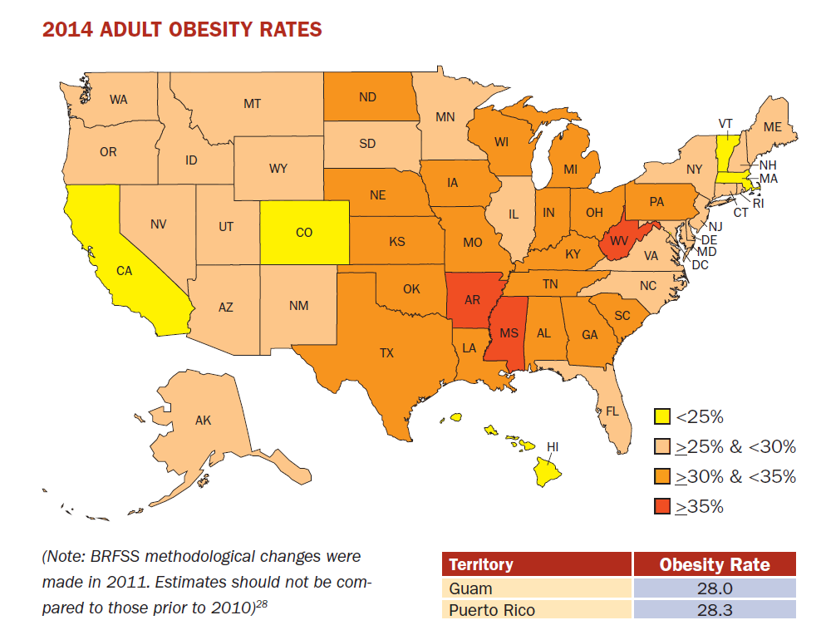
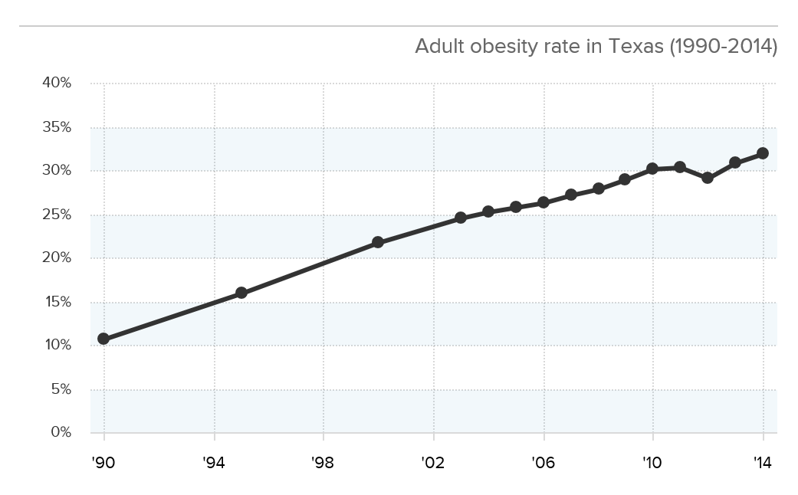
Adult Obesity
Source: http://stateofobesity.org/files/stateofobesity2015.pdf

Slide 38
Teen Birth Rates (ages 15-19) by State, 2013
Rank | Location | Teen Birth Rate per 1,000
 | United States | 26.5
1 | Arkansas | 43.5
2 | New Mexico | 43.3
3 | Oklahoma | 42.9
4 | Mississippi | 42.6
5 | Texas | 41.0
6 | West Virginia | 40.1
7 | Kentucky | 39.5
8 | Louisiana | 39.2
9 | Tennessee | 34.7
10 | Alabama | 34.3
The Centers for Disease Control and Prevention (CDC), National Vital Statistics Reports (NVSR), Vol. 64, No. 1: Births: Final Data for 2013, January 15, 2015.

Slide 39
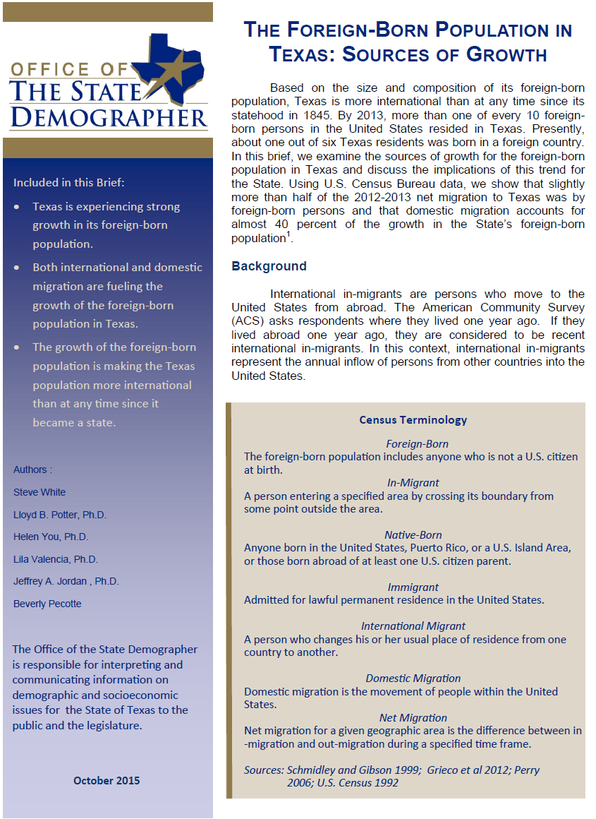

Slide 40
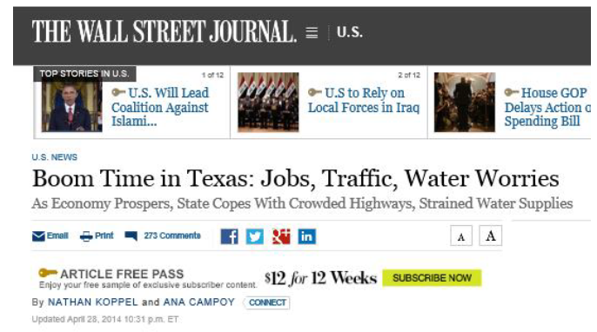
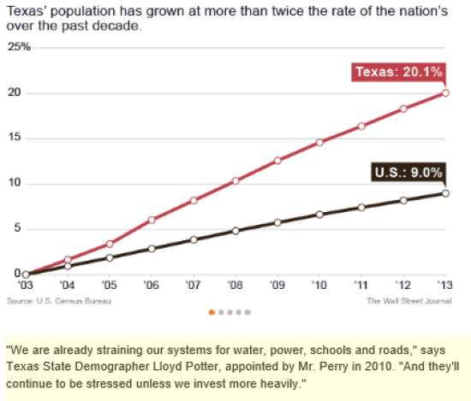

Slide 41
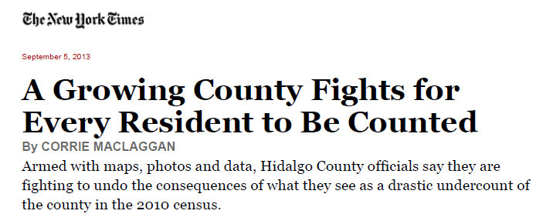
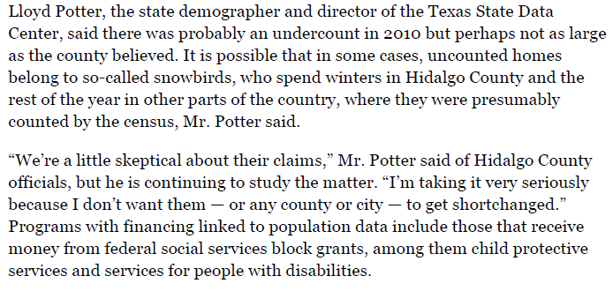

Slide 42
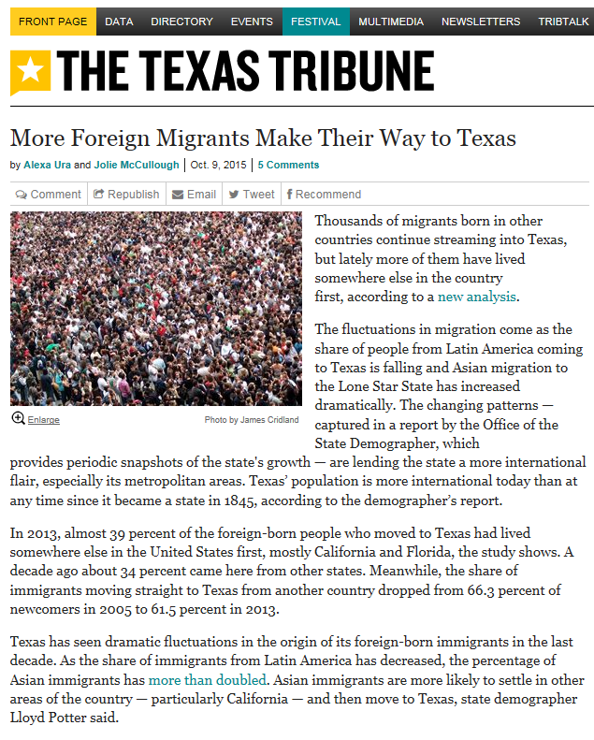

Slide 43
Contact
  Office: (210) 458-6530
  Email: Lloyd.Potter@UTSA.edu
  Internet: http://osd.texas.gov
  Twitter: @TexasDemography
Lloyd B. Potter, Ph.D.
Notes:
The Office of the State Demographer and the Texas State Data Center are committed to supporting your work through providing you with the best, most accurate, and objective information we can identify about our greatest asset, the people of Texas.

