Slide 1

The Aging Population in Texas
Texas House Human Services Committee
December 15, 2015
Austin, Texas
@TexasDemography
Notes:
Lloyd Potter is the Texas State Demographer and the Director of the Texas State Data Center based at the University of Texas at San Antonio.

Slide 2
Total Population and Components of Population Change in Texas, 1950-2014
All values for the decennial dates are for April 1st of the indicated census year. Values for 2012-2014 are for July 1 as estimated by the U.S. Census Bureau.
Source: U.S. Census Bureau, Census Counts and Population Estimates
Notes:
Texas’ population has grown steadily over the past seven decades and continues to grow. Texas’ population is now (in 2015) over 27 million.

Slide 3
Total Estimated Population by County, Texas, 2014
Source: U.S. Census Bureau, 2014 Vintage Population Estimates
Notes:
When we look at the geographic distribution of the population of Texas over time we see continually increasing population in the counties along the I-35 corridor, the Houston area, and the lower Rio Grand Valley. Urbanized areas out west have grown but most counties west have experienced limited growth and some population decline. Approximately 86% of the population is along I-35 and east. This area with the 3 major metropolitan areas at the points is often described as the Texas population triangle.
The counties of Harris, Dallas, Tarrant, Bexar, and Travis make up the points of the “population triangle” in Texas and are the most populated in the State. Collin, Denton, Fort Bend, Hidalgo, and El Paso counties also have significant population concentrations. Many counties west of Interstate 35 are more sparsely populated.

Slide 4
Estimated Population Change, Texas Counties, 2010 to 2014
102 counties lost population over the four year period.
95 counties lost population between 2013-14
Of these:
36 (38%) had natural decline
89 (94%) had net out migration
30 (32%) had both natural decline and net out migration
Source: U.S. Census Bureau Population Estimates, 2014 Vintage.
Notes:
Population change over the decade has been greatest in the urban and suburban population triangle counties. Counties in the lower Rio Grande Valley also had significant growth as did El Paso . Overall, 155 counties gained population while 99 (39%) lost population over the decade.

Slide 5
Median Age by State, 2008-2013
Source: U.S. Census Bureau, American Community Survey, 5 Year Sample 2009-2013.
Notes:
The median age of Texas’ population is young compared to most states.

Slide 6
Percent of the Population Aged 65 Years and Older by State, 2010-2014
Source: U.S. Census Bureau, American Community Survey, 5 Year Sample 2010-2014

Slide 7
Top 10 States with the Largest Older Populations, 2000, 2010, 2014
 | 2000 |  |  |  | 2010 |  |  |  | 2014
Rank | State | Total | Aged 65 and Older | Percent of those Aged 65 and Older in the US | State | Total | Aged 65 and Older | Percent of those Aged 65 and Older in the US | State | Total | Aged 65 and Older | Percent of those Aged 65 and Older in the US
1 | CA | 33,871,648 | 3,595,658 | 10.3% | CA | 37,253,956 | 4,246,514 | 10.5% | CA | 38,802,500 | 4,993,047 | 10.8%
2 | FL | 15,982,378 | 2,807,597 | 8.0% | FL | 18,801,310 | 3,259,602 | 8.1% | FL | 19,893,297 | 3,791,544 | 8.2%
3 | NY | 18,976,457 | 2,448,352 | 7.0% | NY | 19,378,102 | 2,617,943 | 6.5% | TX | 26,956,958 | 3,099,081 | 6.7%
4 | TX | 20,851,820 | 2,072,532 | 5.9% | TX | 25,145,561 | 2,601,886 | 6.5% | NY | 19,746,227 | 2,898,094 | 6.3%
5 | PA | 12,281,054 | 1,919,165 | 5.5% | PA | 12,702,379 | 1,959,307 | 4.9% | PA | 12,787,209 | 2,134,521 | 4.6%
6 | OH | 11,353,140 | 1,507,757 | 4.3% | OH | 11,536,504 | 1,622,015 | 4% | OH | 11,594,163 | 1,799,169 | 3.9%
7 | IL | 12,419,293 | 1,500,025 | 4.3% | IL | 12,830,632 | 1,609,213 | 4% | IL | 12,880,580 | 1,788,533 | 3.9%
8 | MI | 9,938,444 | 1,219,018 | 3.5% | MI | 9,883,640 | 1,361,530 | 3.4% | MI | 9,909,877 | 1,530,052 | 3.3%
9 | NJ | 8,414,350 | 1,113,136 | 3.2% | NC | 9,535,483 | 1,234,079 | 3.1% | NC | 9,943,964 | 1,463,362 | 3.2%
10 | NC | 8,049,313 | 969,048 | 2.8% | NJ | 8,791,894 | 1,185,993 | 2.9% | NJ | 8,938,175 | 1,313,503 | 2.8%
- | US | 281,421,906 | 34,991,753 | 100% | US | 308,745,538 | 40,267,984 | 100% | US | 318,857,056 | 46,243,211 | 100%
Source: US Census Bureau, 2000 and 2010 Decennial Censuses US Census Bureau, 2014 Population Estimate by State

Slide 8
States with the Greatest and Least Percent of the Population Aged 65 and Older, 2000, 2010, 2014
 | 2000 |  |  |  | 2010 |  |  |  | 2014
Rank | State | Total | Aged 65 and Older | Percent of Total | State | Total | Aged 65 and Older | Percent of Total | State | Total | Aged 65 and Older | Percent of Total
1 | FL | 15,982,378 | 2,807,597 | 17.6% | FL | 18,801,310 | 3,259,602 | 17.3% | FL | 19,893,297 | 3,791,544 | 19.1%
2 | PA | 12,281,054 | 1,919,165 | 15.6% | WV | 1,852,994 | 297,404 | 16.0% | ME | 1,330,089 | 243,507 | 18.3%
3 | WV | 1,808,344 | 276,895 | 15.3% | ME | 1,328,361 | 211,080 | 15.9% | WV | 1,850,326 | 328,612 | 17.8%
4 | IA | 2,926,324 | 436,213 | 14.9% | PA | 12,702,379 | 1,959,307 | 15.4% | VT | 626,562 | 106,199 | 16.9%
5… | ND | 642,200 | 94,478 | 14.7% | IA | 3,046,355 | 452,888 | 14.9% | MT | 1,023,579 | 171,155 | 16.7%
…46 | TX | 20,851,820 | 2,072,532 | 9.9% | CO | 5,029,196 | 549,625 | 10.9% | CO | 5,355,866 | 680,015 | 12.7%
47 | CO | 4,301,261 | 416,073 | 9.7% | GA | 9,687,653 | 1,032,035 | 10.7% | GA | 10,097,343 | 1,251,538 | 12.4%
48 | GA | 8,186,453 | 785,275 | 9.6% | TX | 25,145,561 | 2,601,886 | 10.3% | TX | 26,956,958 | 3,099,081 | 11.5%
49 | UT | 2,233,169 | 190,222 | 8.5% | UT | 2,763,885 | 249,462 | 9.0% | UT | 2,942,902 | 295,260 | 10.0%
50 | AK | 626,932 | 35,699 | 5.7% | AK | 710,231 | 54,938 | 7.7% | AK | 736,732 | 69,413 | 9.4%
- | US | 281,421,906 | 34,991,753 | 12.4% | US | 308,745,538 | 40,267,984 | 13.0% | US | 318,857,056 | 46,243,211 | 14.5%
Source: US Census Bureau, 2000 and 2010 Decennial Censuses US Census Bureau, 2014 Population Estimate by State

Slide 9
Ranking of States by Median Age, 2000, 2010, 2014
2000 |  |  | 2010 |  | 2014
Rank | State | Med Age | State | Median Age | State | Median Age
1 | West Virginia | 38.9 | Maine | 42.7 | Maine | 44.2
2 | Florida | 38.7 | Vermont | 41.5 | New Hampshire | 42.6
3 | Maine | 38.6 | West Virginia | 41.3 | Vermont | 42.6
4 | Pennsylvania | 38 | New Hampshire | 41.1 | West Virginia | 42.0
5… | Vermont | 37.7 | Florida | 40.7 | Florida | 41.8
…46 | California | 33.3 | California | 35.2 | Idaho | 35.7
47 | Idaho | 33.2 | Idaho | 34.6 | North Dakota | 34.9
48 | Alaska | 32.4 | Alaska | 33.8 | Texas | 34.2
49 | Texas | 32.3 | Texas | 33.6 | Alaska | 33.3
50 | Utah | 27.1 | Utah | 29.2 | Utah | 30.5
- | United States | 35.3 | United States | 37.2 | United States | 37.7
Source: US Census Bureau, 2000 and 2010 Decennial Censuses US Census Bureau, 2014 Population Estimate by State

Slide 10
Texas Population by Age Groups, 2000-2014
 | 2000 |  | 2010 |  | 2014 |  | 2000-2014
 | Population | Percent | Population | Percent | Estimate | Percent | Absolute Change | Percent Change
Under 18 | 5,886,759 | 28.2 | 6,865,824 | 27.3 | 7,115,614 | 26.4 | 1,228,855 | 20.9
18 to 64 | 12,892,529 | 61.8 | 15,677,851 | 62.3 | 16,742,263 | 62.1 | 3,849,734 | 29.9
65 and Older | 2,072,532 | 9.9 | 2,601,886 | 10.3 | 3,099,081 | 11.5 | 1,026,549 | 49.5
Total | 20,851,820 | 100 | 25,145,561 | 100 | 26,956,958 | 100 | 6,105,138 | 29.3
Source: US Census Bureau, 2000 and 2010 Censuses and 2014 Population Estimates

Slide 11
Five Highest and Lowest Counties by Median Age, 2014
Rank | County | Highest Median Ages | Type of County | Rank | County | Lowest Median Ages | Type of County
1 | Llano | 56.3 | Nonmetro | 250 | Hidalgo | 29 | Metro
2 | Jeff Davis | 55.8 | Nonmetro | 251 | Gaines | 28.6 | Nonmetro
3 | Menard | 53.1 | Nonmetro | 252 | Webb | 28.3 | Metro
4 | Real | 52.1 | Nonmetro | 253 | Kleberg | 27.9 | Nonmetro
5 | Sabine | 51.6 | Nonmetro | 254 | Brazos | 25.6 | Metro
- | Texas | 34.2 | - | - | Texas | 34.2 | -
Source: *US Census Bureau, County Population Estimates, 2014 ** US Census Bureau, Population Division; Office of Management and Budget, February 2013 delineations **Note: Each Metropolitan Area must contain at least one urbanized area of 50,000 or greater inhabitants. Nonmetropolitan areas do not meet this population size criteria.

Slide 12
Five Highest and Lowest Metro Counties by Median Age, 2014
Rank | County | Highest Median Ages | Rank | County | Lowest Median Ages
1 | Bandera | 51.5 | 250 | Ector | 30.4
2 | Aransas | 49.1 | 251 | Waller | 30.4
3 | Hood | 46.9 | 252 | Hidalgo | 29
4 | Clay | 46.1 | 253 | Webb | 28.3
5 | Goliad | 45.2 | 254 | Brazos | 25.6
- | Texas | 34.2 | - | Texas | 34.2
Source: *US Census Bureau, County Population Estimates, 2014 ** US Census Bureau, Population Division; Office of Management and Budget, February 2013 delineations **Note: Each Metropolitan Area must contain at least one urbanized area of 50,000 or greater inhabitants. Nonmetropolitan areas do not meet this population size criteria.

Slide 13
Median Age, Texas Counties, 2010-2014
Source: U.S. Census Bureau, American Community Survey, 2010-2014 5 Year Sample

Slide 14
Change in Median Age, Texas Counties, 2000-2014
Source: US Census Bureau US Census Bureau, 2000
Decennial Census, SF-1, Population Estimates 2014 Vintage.

Slide 15
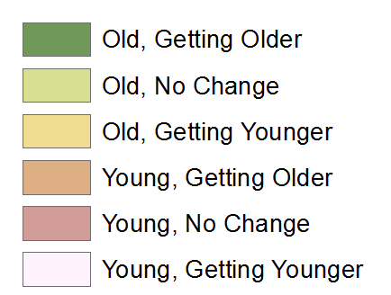
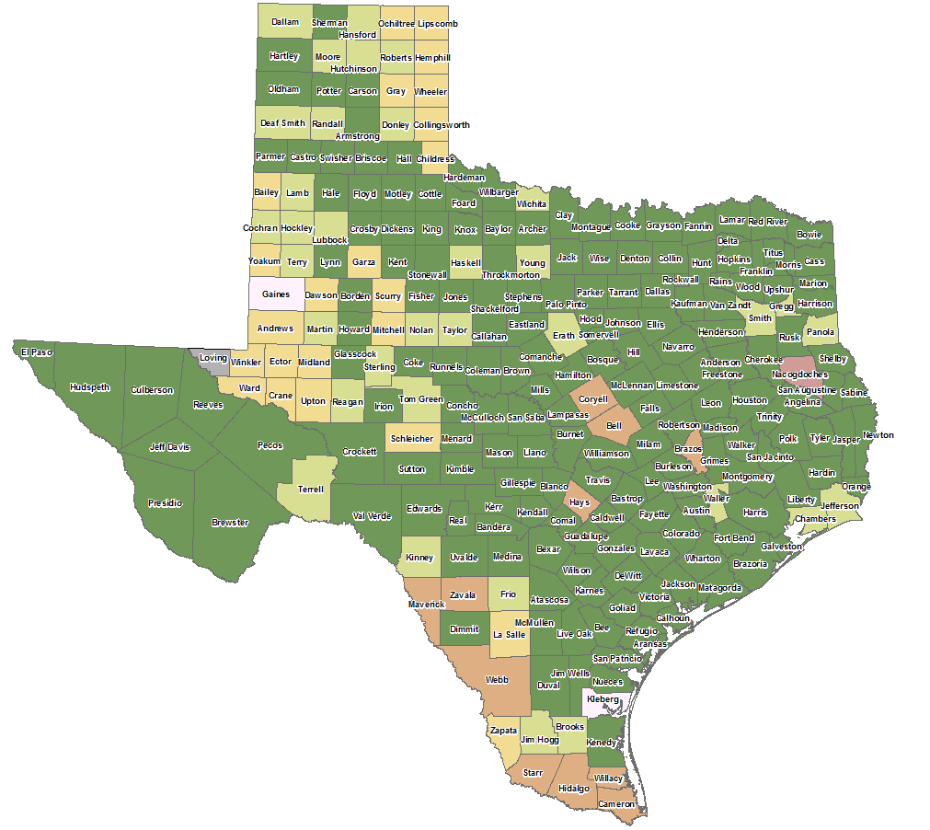
Trends in Aging* by County, Texas, 2000-2014
*2000 median age 30 and greater = old. 2000 to 2014 determines aging.
Source: U.S. Census Bureau, 2000 decennial census and 2014 American Community Survey 5-Yr estimates.

Slide 16
Population Change by Age Group, Texas, 1950-2050
Source: US Census Bureau, 1950-2010 Censuses
US Census Bureau, State Population Estimates
Texas State Data Center, 2014 Population Projections, 1.0 Migration Scenario

Slide 17
Population Projections, Texas, 2010-2050,
Percent Over and Under 65
Source: Texas State Data Center 2014 Population Projections , Half 2000-2010 Migration Scenario

Slide 18
Texas Population Pyramid, 2010
Source: U.S. Census Bureau 2010 Decennial Census, SF1
Notes:
This population pyramid represents the age, sex of the Texas population. Blue represents males, red females, rows are single years of age.

Slide 19
Pyramid for the Non-Hispanic White Population, Texas, 2010
Source: U.S. Census Bureau 2010 Decennial Census, SF1
Notes:
This population pyramid represents the age and sex composition of the Texas non-Hispanic white population. Blue represents males, red females, rows are single years of age.

Slide 20
Pyramid for Hispanic Population, Texas, 2010
Source: U.S. Census Bureau 2010 Decennial Census, SF1
Notes:
This population pyramid represents the age, and sex composition of the Hispanic population in Texas. Blue represents males, red females, rows are single years of age.

Slide 21
Pyramid for the Non-Hispanic Black Population, Texas, 2010
Source: U.S. Census Bureau 2010 Decennial Census, SF1
Notes:
This population pyramid represents the age, and sex composition of the Non-Hispanic Black population in Texas. Blue represents males, red females, rows are single years of age.

Slide 22
Pyramid for Asian and Other Populations, Texas, 2010
Source: U.S. Census Bureau 2010 Decennial Census, SF1

Slide 23
Texas Population Pyramid by Race/Ethnicity, 2010
Source: U.S. Census Bureau 2010 Decennial Census, SF1
Notes:
This population pyramid represents the age, sex, race and ethnic composition of the Texas population. Blue represents males, red females, rows are single years of age, and shades represent specified race/ethnic groups as indicated in the legend.

Slide 24
Population Projections 65 Years and Over by Race/Ethnicity, Texas, 2010-2050
Source: Texas State Data Center 2014 Population Projections , Half 2000-2010 Migration Scenario

Slide 25
Percent of Population by Race/Ethnicity for Age Groups, 2010 and 2050
2010 2050
Source: US Census Bureau, State Population Estimates, 2014
Source: Texas State Data Center, 2014 Projections, 1.0 Migration Scenario

Slide 26
Percent of the Population Aged 65 Years and Older without Health Insurance, Texas Counties, 2010-2014

Slide 27
Percent of the Population Aged 65 Years and Older with Independent Living Disability, Texas Counties, 2010-2014

Slide 28
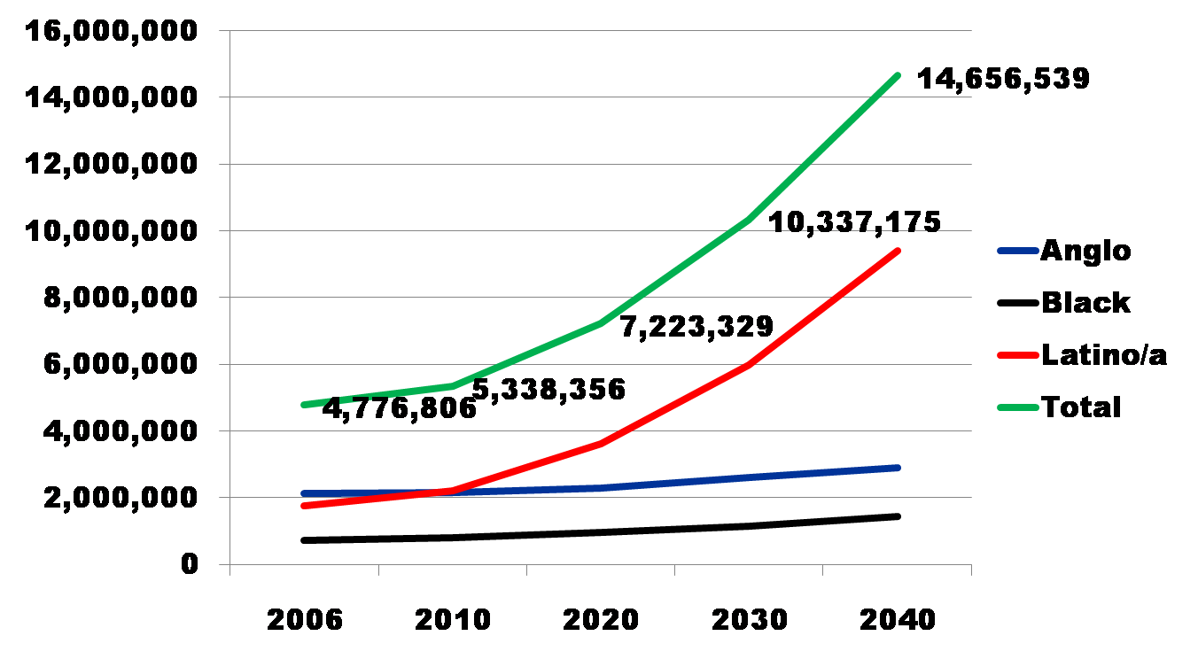
Projected Increase in Obesity in Texas by Ethnicity, 2006 to 2040
Source: Office of the State Demographer projections, using 2000-2004 migration scenario population projections

Slide 29
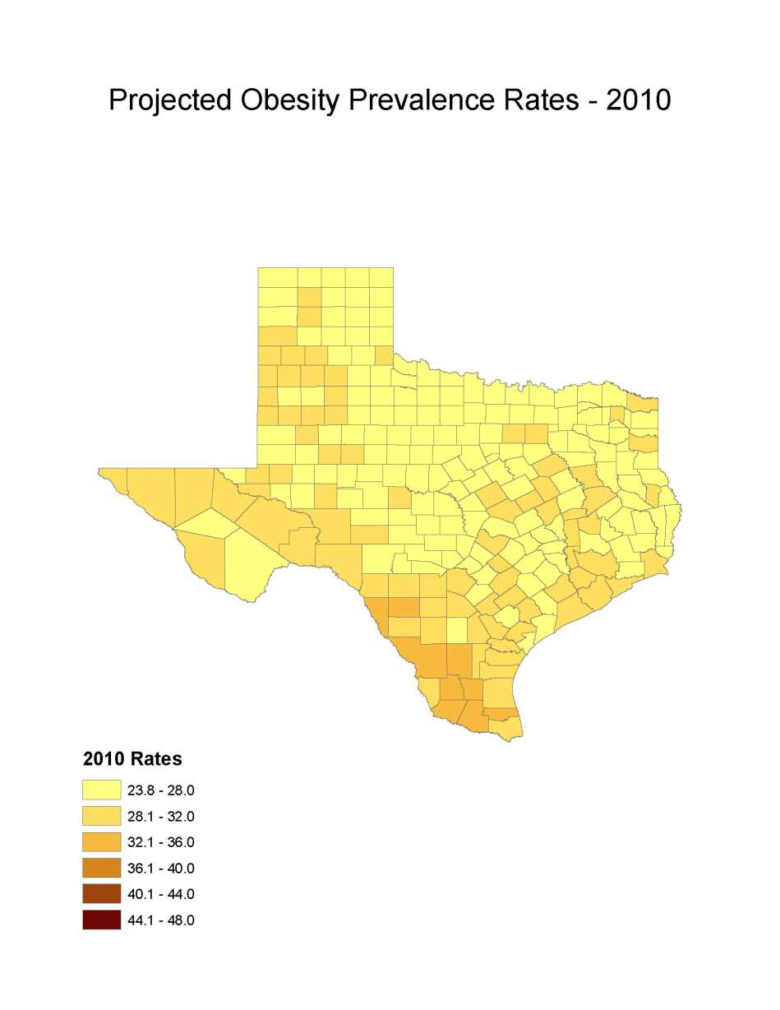
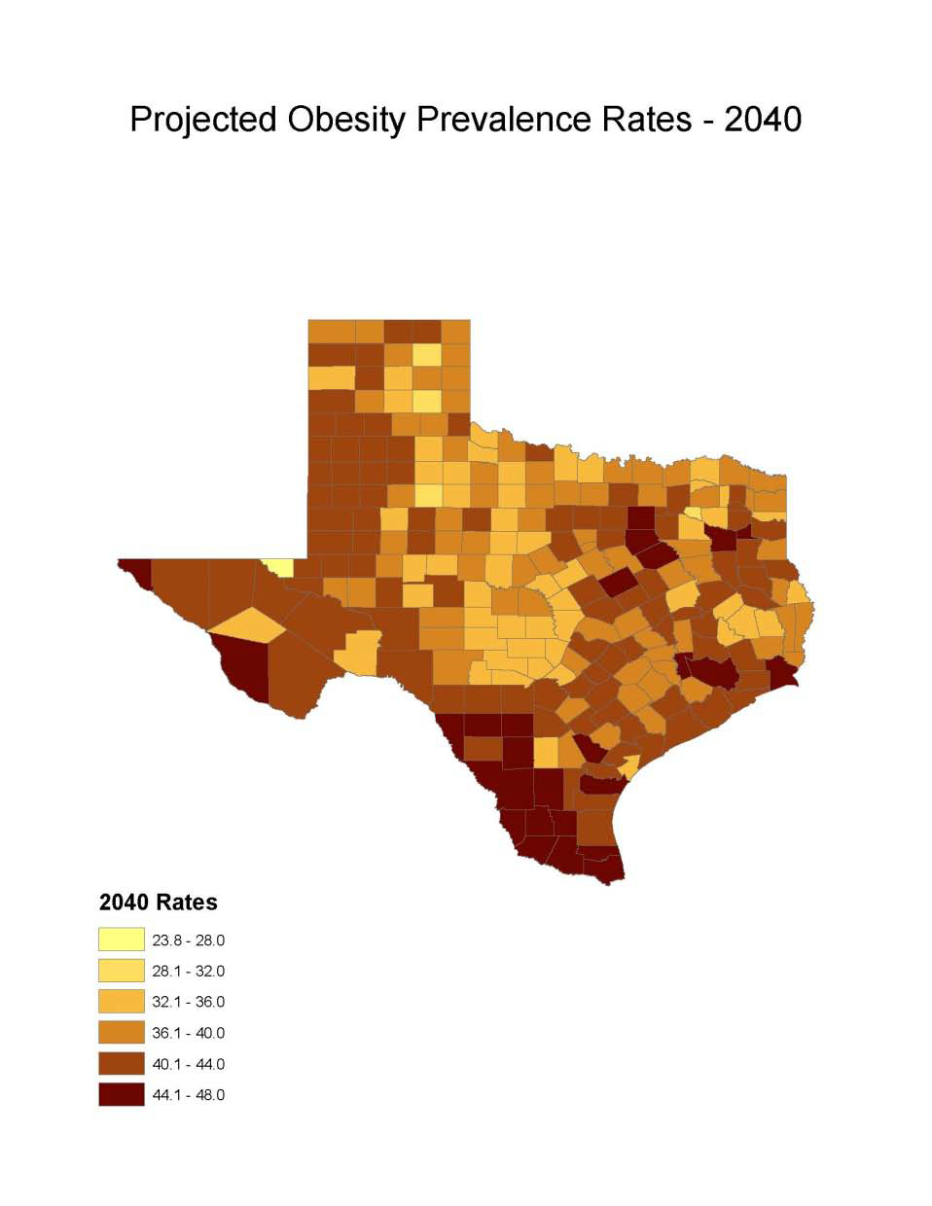
Obesity Prevalence
% adults with obesity: Office of the State Demographer, 2000-2004 Projection

Slide 30
Projected Number of Adults with Diabetes by Race and Ethnicity, Texas, 2010-2040

Slide 31
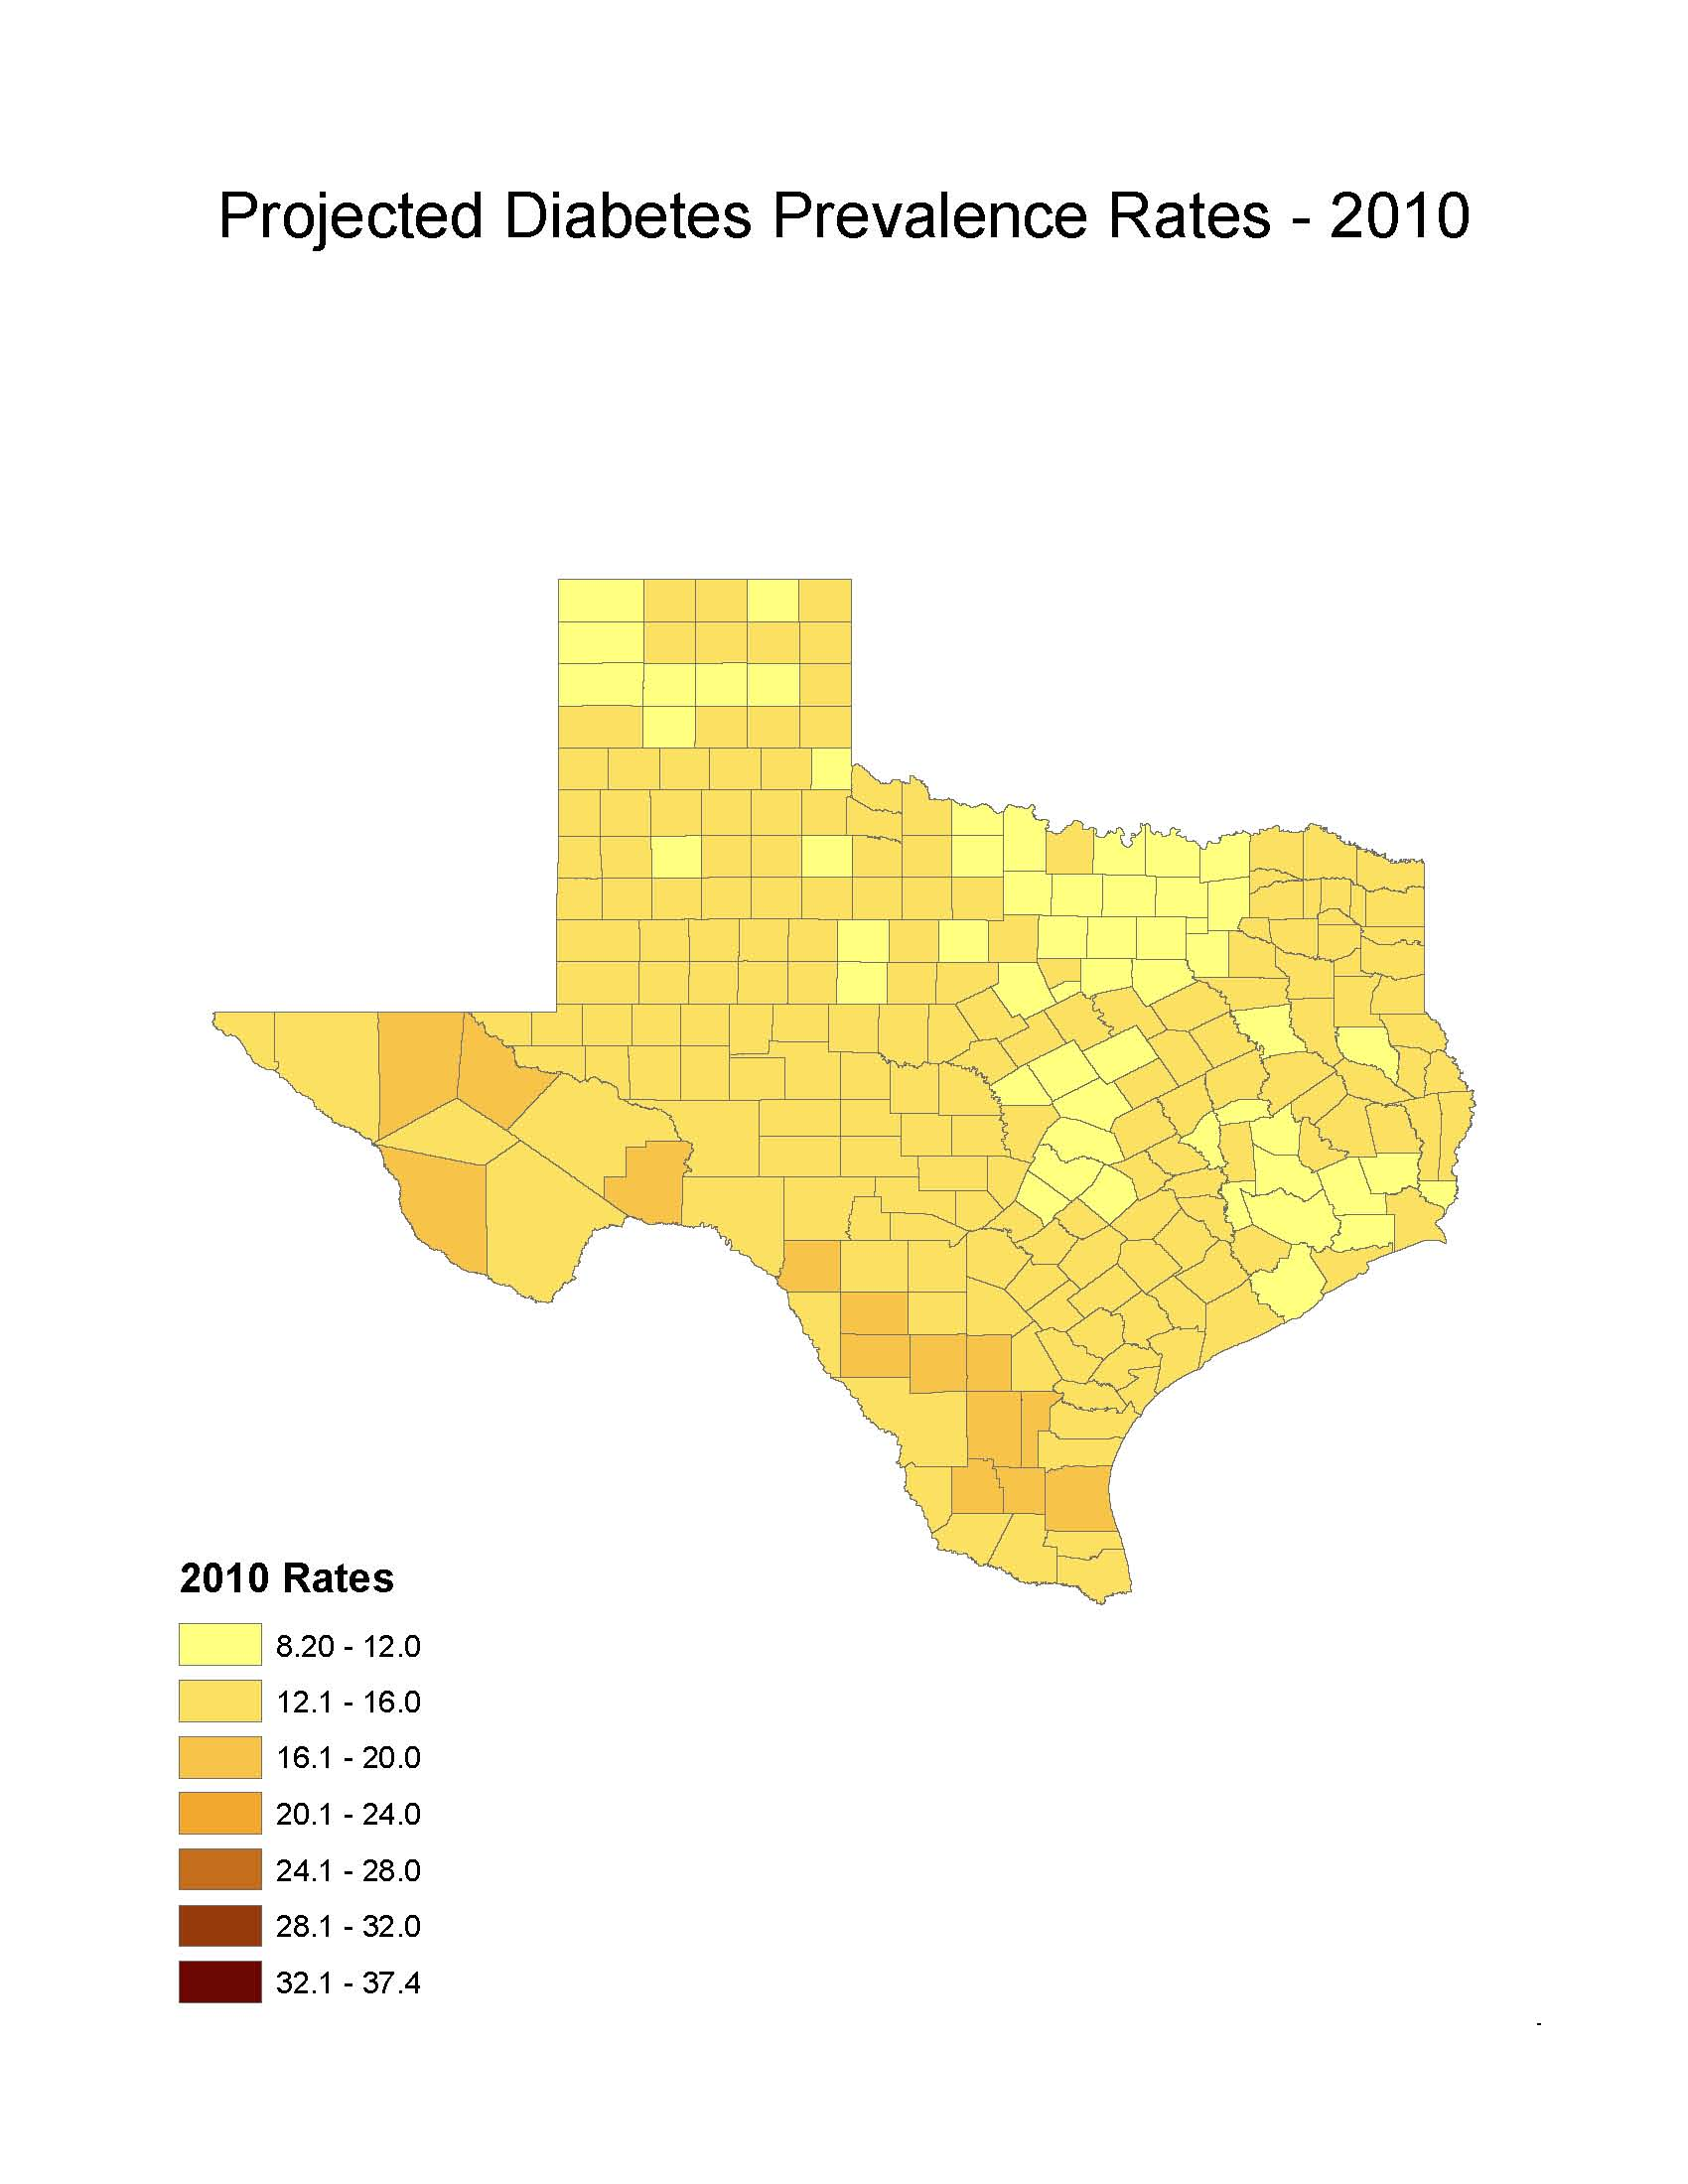
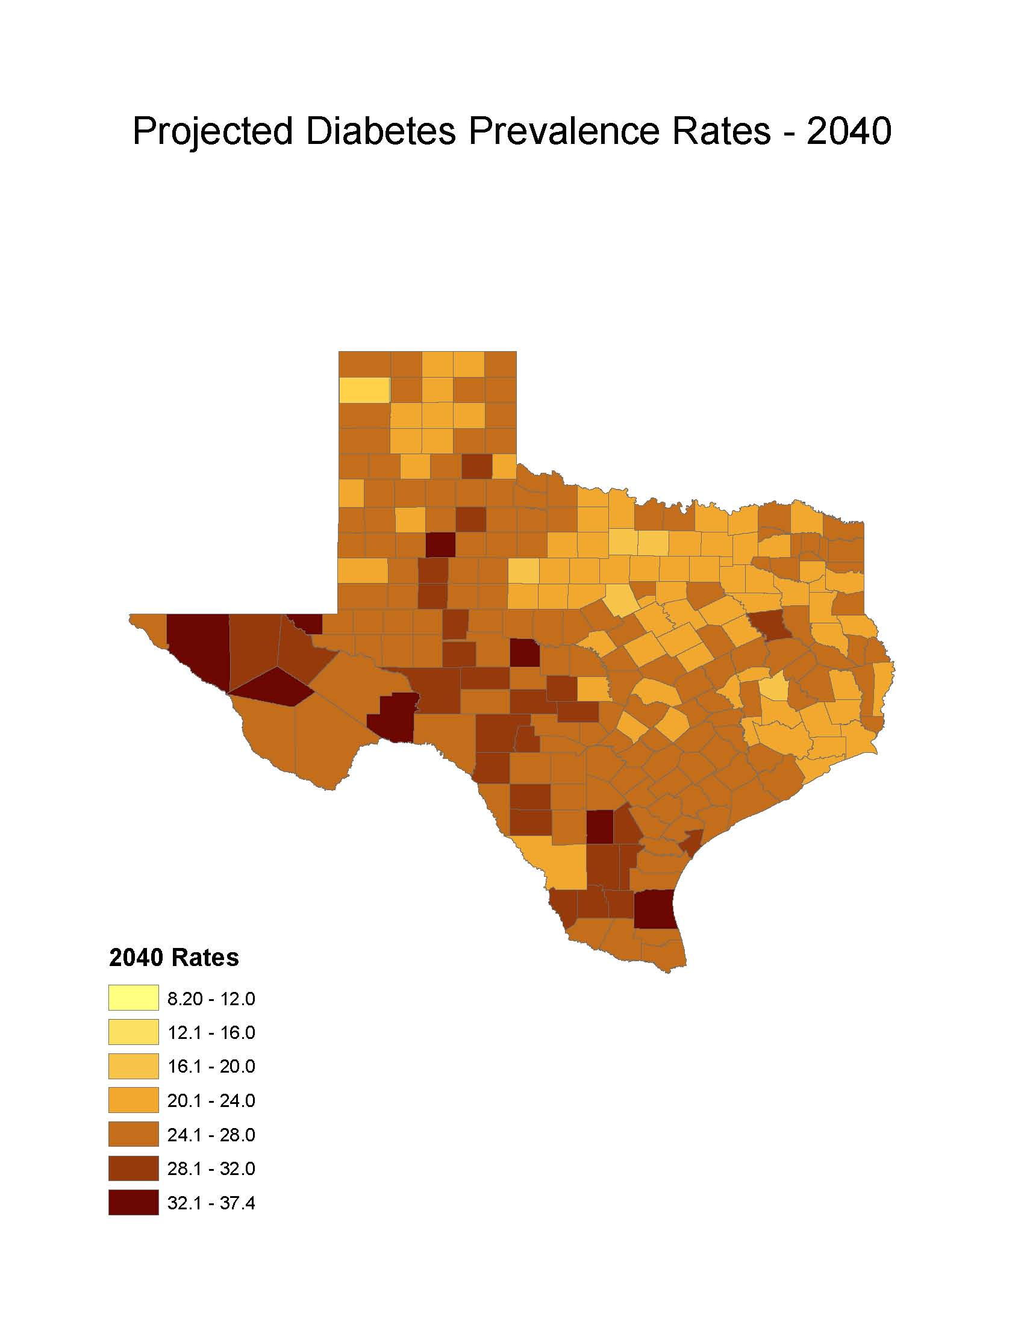
Diabetes Prevalence
% adults with diabetes: Office of the State Demographer, 2000-2004 Projection

Slide 32
Physicians per 1,000 Population Aged 65 Years and Older by County, 2011
Source: U.S. Census Bureau. 2010 Census and Texas Medical Board (2011 physicians).
Notes:
Data on this map about physicians licensed to practice in Texas are from the Texas Medical Board. Some rural counties do not have any practicing physicians. The more urban counties appear to have relatively high ratios of physicians to population aged 65+. This map does not provide information about the type/specialty of physicians.

Slide 33
Contact
  Office: (210) 458-6530
  Email: Lloyd.Potter@osd.state.tx.us
  Internet: http://osd.texas.gov
Lloyd Potter, Ph.D., M.P.H.
@TexasDemography
Notes:
The Office of the State Demographer and the Texas State Data Center are committed to supporting your work through providing you with the best, most accurate, and objective information we can identify.

