Slide 1
Demographics and Education in Texas and San Antonio
NISD Annual Staff Training
San Antonio, Texas
August 5, 2016

Slide 2
Total Population and Population Change in Texas, 1950-2014
All values for the decennial dates are for April 1st of the indicated census year. Values for 2012-2014 are for July 1 as estimated by the U.S. Census Bureau.
Source: U.S. Census Bureau, Census Counts and Population Estimates

Slide 3
Components of Population Change by Percent in Texas, 1950-2010
Source: U.S. Census Bureau, Population Estimates
Notes:
It is important to understand a couple of very basic element of population change to think about how growing population may impact our transportation system. Population changes from two factors, one is natural increase which is simply births minus deaths over time. Essentially population added from natural increase are babies who are unlikely to be driving their own vehicle on our roads before age 16. Combine this with the fact that as people die, there are fewer drivers on the road. So the effect of population growth from natural increase on our transportation infrastructure is both lightening, from people dying, and delayed until babies reach the age where they can drive. The second way population changes is from net-migration, which is simply in-minus out migrants. In Texas, the balance has been for us to have more in than out migrants. Migrants, are usually adults who are drivers (though yes, some do have non-driving children) and the may be compounded by the fact that many of the in-migrants may also take a job that requires them to drive. Essentially, migrants immediately contribute to adding stress to the transportation infrastructure.
When we look at population change in Texas, from 1950 to present we can see that before 1970, most of our growth was from natural increase. Starting in the 1970s a much larger percent of our growth is attributed to net migration and this continues to today where approaching half of our population change is from migration.

Slide 4
Total Estimated Population by County, Texas, 2015
Source: U.S. Census Bureau, 2015 Vintage Population Estimates
Notes:
When we look at the geographic distribution of the population of Texas over time we see continually increasing population in the counties along the I-35 corridor, the Houston area, and the lower Rio Grand Valley. Urbanized areas out west have grown but most counties west have experienced limited growth and some population decline. Approximately 86% of the population is along I-35 and east. This area with the 3 major metropolitan areas at the points is often described as the Texas population triangle.
The counties of Harris, Dallas, Tarrant, Bexar, and Travis make up the points of the “population triangle” in Texas and are the most populated in the State. Collin, Denton, Fort Bend, Hidalgo, and El Paso counties also have significant population concentrations. Many counties west of Interstate 35 are more sparsely populated.

Slide 5
Estimated Population Change, Texas Counties, 2010 to 2015
99 counties lost population over the five year period.
Source: U.S. Census Bureau Population Estimates, 2015 Vintage.
Notes:
Population change over the decade has been greatest in the urban and suburban population triangle counties. Counties in the lower Rio Grande Valley also had significant growth as did El Paso . Overall, 155 counties gained population while 99 (39%) lost population over the decade.

Slide 6
Estimated Percent Change of the Total Population by County, Texas, 2010 to 2015
Source: U.S. Census Bureau Population Estimates, 2015 Vintage.
Notes:
Percent change is an indicator of the speed of population change void of information about the volume of population change. Percent change in the population over the past few years has been greatest in the urban and suburban population triangle counties. Notably counties in the Eagle Ford Shale area (south east of San Antonio) and the Cline Shale area (Midland and Odessa area), have been growing quickly.

Slide 7
Top Counties for Numeric Growth in Texas (U.S. Rank) by Components of Change, 2013-2014
Source: U.S. Census Bureau, 2014 Vintage Population Estimates

Slide 8
Top Counties for Percent Growth* in Texas, 2013-2014
 | U.S. Rank | 2013-2014 Percent Population Change | Percent Change from Migration | Percent of Migration that is International
Hays | 5 | 4.8% | 83.89% | 2.6%
Fort Bend | 6 | 4.7% | 80.6% | 17.37%
Comal | 9 | 4.0% | 90.1% | 3.0%
Andrews | 12 | 4.0% | 62.8% | 3.7%
Montgomery | 13 | 3.8% | 82.1% | 10.4%
Williamson | 14 | 3.8% | 76.8% | 7.8%
Kendall | 15 | 3.8% | 98.0% | 5.0%
Ward | 21 | 3.4% | 72.0% | 1.5%
Denton | 23 | 3.3% | 72.8% | 14.2%
Collin | 31 | 3.1% | 73.9% | 20.1%
Aransas | 32 | 3.1% | 110.8% | 4.3%
Rockwall | 35 | 3.0% | 78.3% | 7.8%
Waller | 36 | 2.9% | 77.2% | 5.3%
Ector | 37 | 2.9% | 59.9% | 2.0%
Guadalupe | 42 | 2.8% | 78.6% | 4.9%
Source: U.S. Census Bureau, 2014 Vintage Population Estimates
*Among Counties with 10,000 or more population in 2013

Slide 9
Percent Population by Race and Ethnicity, Texas, 2000 and 2010
2000
2010
Source: U.S. Census Bureau 2000 and 2010 Decennial Census, SF1

Slide 10
Percent of the Population by Race and Ethnicity, San Antonio and Texas, 2010
Source: U.S. Census Bureau, 2010 Census

Slide 11
Texas White (non-Hispanic) and Hispanic Populations by Age, 2010
Source: U.S. Census Bureau 2010 Decennial Census, SF1
Notes:
The age distribution of the non-Hispanic white population in Texas is weighted heavily with the “baby boom” generation. Largely the result of lower fertility and less net in-migration, the non-Hispanic white population has relatively fewer young persons relative to those in the middle-age years. In 2010, at ages 37 and younger, the Hispanic population exceeds the non-Hispanic white population.

Slide 12
Bexar County White (non-Hispanic) and Hispanic Populations by Age, 2013
Source: Texas State Data Center, 2013 Population Estimates
Notes:
The age distribution of the non-Hispanic white population in Texas is weighted heavily with the “baby boom” generation. Largely the result of lower fertility and less net in-migration, the non-Hispanic white population has relatively fewer young persons relative to those in the middle-age years. In 2010, at ages 37 and younger, the Hispanic population exceeds the non-Hispanic white population.

Slide 13
Housing and Household Characteristics, San Antonio and Texas
Characteristic | San Antonio | Texas
Homeownership rate | 55.7% | 63.3%
Percent Housing units in multi-unit structures | 31.6% | 24.2%
Median value - owner-occupied housing units | $113,800 | $128,900
Per capita money income in past 12 months | $22,619 | $26,019
Median household income | $45,722 | $51,900
Persons below poverty level | 19.9% | 17.6%
Source: U.S. Census Bureau, 2010 Census and the American Community Survey, 2009-2013 5-Year Sample

Slide 14
Population Characteristics, San Antonio and Texas
Characteristic | San Antonio | Texas
Living in same house 1 year & over | 80.6% | 82.8%
Foreign born persons | 14.0% | 16.3%
Language other than English spoken at home | 45.4% | 34.7%
High school graduate or higher, persons age 25+ | 80.7% | 81.2%
Bachelor's degree or higher, persons age 25+ | 24.6% | 26.7%
Source: U.S. Census Bureau, American Community Survey, 2009-2013 5-Year Sample

Slide 15
Percent of population that is Hispanic, Census Tracts, San Antonio, Texas, 2009-2013
Source: U.S. Census Bureau, American Community Survey, 2009-2013 5 Year Sample

Slide 16
Percent of population speaking a language other than English at home and speak English less than very well, Census Tracts, San Antonio, Texas, 2009-2013
Source: U.S. Census Bureau, American Community Survey, 2009-2013 5-Year Sample

Slide 17
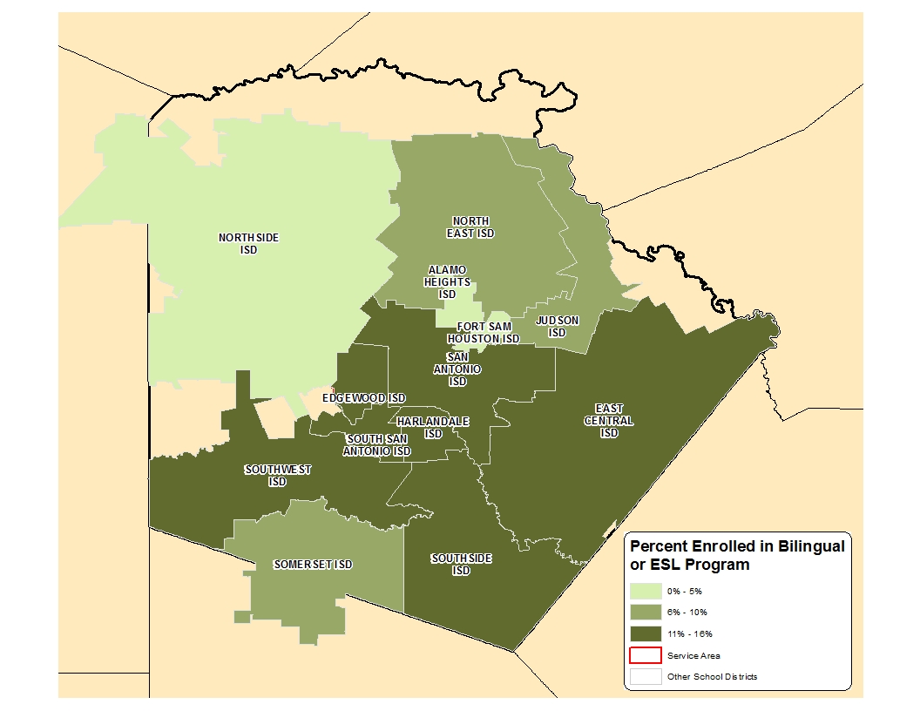
Percent of Students Participating in Bilingual or ESL Programs for School Districts in Bexar County, 2014-2015
Source: Texas Education Agency, Student Program Reports, 2014-2015

Slide 18
Percent of population 25 years and older without a high school degree, Census Tracts, Texas 2009-2013
Source: U.S. Census Bureau, American Community Survey, 2009-2013 5-Year Sample

Slide 19
Percent of population earning $75,000 per year or more, Census Tracts, San Antonio, Texas, 2009-2013
Source: U.S. Census Bureau, American Community Survey, 2009-2013 5-Year Sample

Slide 20
Percent of population living below poverty, Census Tracts, San Antonio, Texas, 2009-2013
Source: U.S. Census Bureau, American Community Survey, 2009-2013 5-Year Sample

Slide 21
Percent of Housing Units Build Before1960, Census Tracts, San Antonio, Texas, 2009-2013
Source: U.S. Census Bureau, American Community Survey, 2009-2013 5-Year Sample

Slide 22
Percent of Housing Units Build After 1999, Census Tracts, San Antonio, Texas, 2009-2013
Source: U.S. Census Bureau, American Community Survey, 2009-2013 5-Year Sample

Slide 23
Projected Population Growth in Bexar County, Texas, 2010-2050
Source: Texas State Data Center 2014 Population Projections

Slide 24
Projected and Estimated Population in Bexar County, Texas, 2010-2015
Sources: Texas State Data Center 2014 Population Projections. U.S. Census Bureau, Population Estimates.

Slide 25
Projected Racial and Ethnic Percent, Bexar County, Texas, 2010-2050
Source: Texas State Data Center 2014 Population Projections , 2000-2010 Migration Scenario

Slide 26
Projected population of 15-29 year old persons by race/ethnicity, Bexar County, Texas 2010-2015
Source: Texas State Data Center 2014 Population Projections , 2000-2010 Migration Scenario

Slide 27
Educational Attainment of Persons Aged 25 Years and Older, NH White, Texas, Bexar County, San Antonio, 2014
Source: U.S. Census Bureau, American Community Survey, 2014 1-Year Sample

Slide 28
Educational Attainment of Persons Aged 25 Years and Older, Hispanic for Texas, Bexar County, and San Antonio, 2014
Source: U.S. Census Bureau, American Community Survey, 2014 1-Year Sample

Slide 29
Percent of Persons by Age Group with at a Bachelors Degree or Higher, Texas, Bexar County, and San Antonio, 2014
Source: U.S. Census Bureau, American Community Survey, 2014 1-Year Sample

Slide 30
Percent of Hispanic Students Graduating from Bexar County High Schools by Year, 2011-2014
Source: Texas Education Agency

Slide 31
Percent of children less than 18 years living in poverty by school district, 2010-2014
San Antonio ISDs | %
Alamo Heights ISD | 8.1
East Central ISD | 18.8
Edgewood ISD | 15.3
Fort Sam Houston ISD | 9.5
Harlandale ISD | 41.7
Judson ISD | 21.1
Lackland ISD | 15.2
North East ISD | 16.7
Northside ISD | 16.8
Randolph ISD | 3.2
San Antonio ISD | 44.7
South San Antonio ISD | 36.6
Somerset ISD | 24.4
Southside ISD | 35.7
Southwest ISD | 37.2
Source: U.S. Census Bureau, 2010-2014 American Community Survey, DP03

Slide 32
Births per ZIP Code in Bexar County, 2013
Source: San Antonio Metropolitan Health District, 2013 Health Profile

Slide 33
Births Occurring by School District, Bexar County, 2013
School District | Total Births | Birth rate per 1,000 women aged 15-19 | Percent of births to single mothers | Percent of births to mothers with less than HS/GED | Percent of births to mothers with BMI greater than 30 | Percent of births that were low birth weight
Alamo Heights | 281 | 3.43 | 17 | 6 | 32 | 7
Boerne | 82 | 6.67 | 10 | 0 | 30 | 9
Comal | 348 | 8.67 | 13 | 5 | 33 | 7
East Central | 664 | 35.66 | 46 | 16 | 30 | 9
Edgewood | 988 | 60.20 | 71 | 39 | 29 | 10
Fort Sam Houston | 63 | 7.18 | 8 | 6 | 32 | 0
Harlandale | 916 | 58.47 | 68 | 35 | 30 | 9
Judson | 19,03 | 38.53 | 42 | 12 | 28 | 9
Medina Valley | 83 | 27.52 | 40 | 12 | 29 | 7
North East | 5,289 | 29.35 | 39 | 14 | 29 | 9
Northside | 8,131 | 27.41 | 36 | 11 | 29 | 9
San Antonio | 4,910 | 60.80 | 65 | 35 | 28 | 10
Schertz-Cibolo-Universal City | 97 | 50.21 | 53 | 14 | 27 | 10
Somerset | 144 | 55.90 | 60 | 24 | 27 | 13
South San Antonio | 793 | 62.50 | 63 | 29 | 31 | 9
Southside | 365 | 52.48 | 60 | 25 | 30 | 9
Southwest | 997 | 52.80 | 24 | 24 | 28 | 8
Source: San Antonio Metropolitan Health District, Maternal Health Indicators: 2013 Report, 2014. Note: In 2013, a total of 26,590 births occurred in Bexar County.

Slide 34
Percent of children immunized by ZIP code, Bexar County, TX, 2014

Slide 35
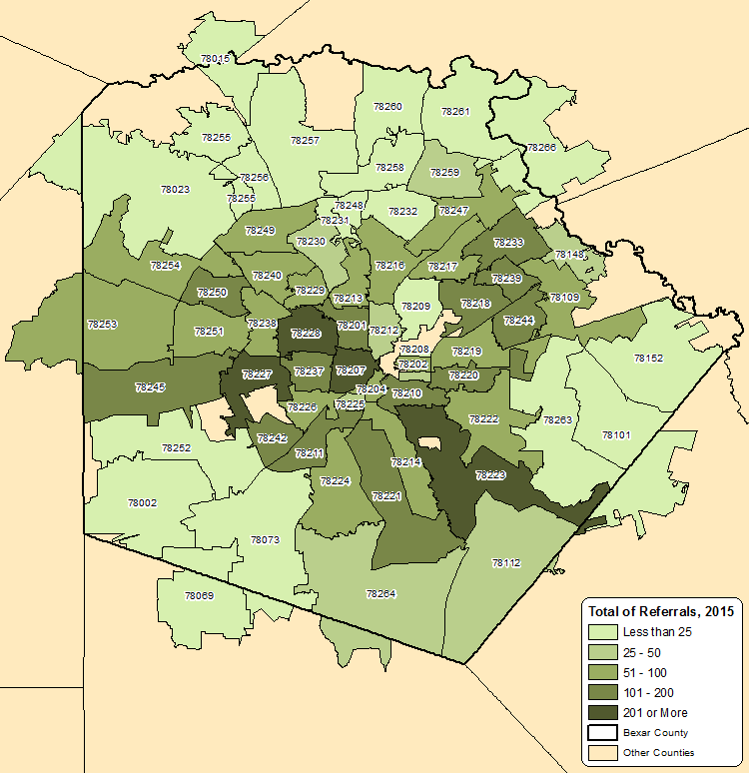
Juvenile Referrals by Zip Code for Bexar County, FY 2015
Source: Texas Juvenile Justice Department, Custom Request, 2016.

Slide 36
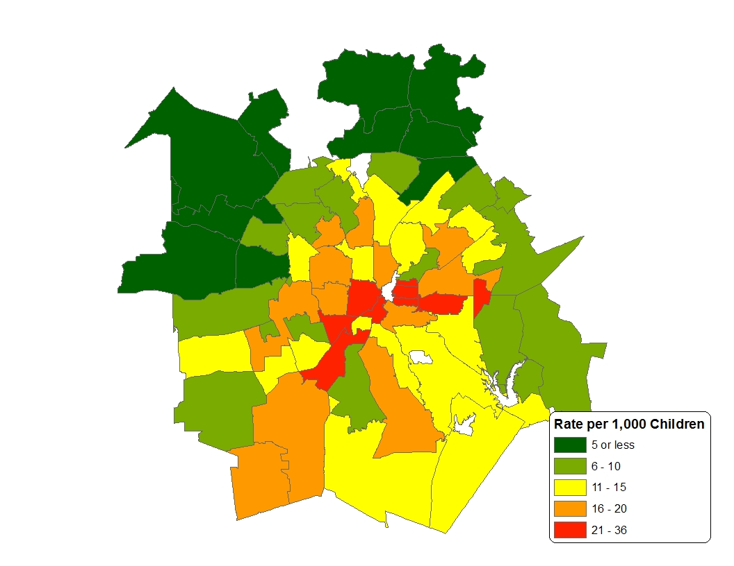
Confirmed Victims of Child Abuse/Neglect by Zip Code, Bexar County, 2012
Source: Texas Department of Protective and Regulatory Services, Management Reporting and Statistics

Slide 37
Public High School Graduates' Six-Year Texas Public and Independent Higher Education Outcomes
Results of a Combined Cohort Graduating High School AY 2005-2007
For High School Campuses with More Than 10 Graduates
Northside ISD Campuses
District Name |  | Campus | HS Grads | % Graduates Enrolled Immediately | % Graduates Who Earned a Certificate, Associates, or Bachelors Degree | % of Graduates who Enrolled Immediately and earned a Certificate, Associates, or Bachelors Degree
NORTHSIDE ISD |  |  | 12,764 | 62.3% | 29.4% | 47.2%
 | ALTERNATIVE HS |  | 14 | 78.6% | 14.3% | 18.2%
 | CLARK HS |  | 1,661 | 66.8% | 35.9% | 53.8%
 | EXCEL ACADEMY |  | 630 | 29.5% | 3.5% | 11.8%
 | HEALTH CAREERS HS |  | 568 | 82.4% | 54.8% | 66.5%
 | HOLMES HS |  | 1,039 | 59.0% | 20.4% | 34.6%
 | HOLMGREEN CENTER |  | 17 | 41.2% | 5.9% | 14.3%
 | JAY HS |  | 1,621 | 50.3% | 16.3% | 32.4%
 | MARSHALL HS |  | 1,580 | 65.6% | 31.1% | 47.4%
 | O'CONNOR HS |  | 2,031 | 73.3% | 40.1% | 54.7%
 | SPECIAL EDUCATION NIGHT SCHOOL |  | 24 | 8.3% | 0.0% | 0.0%
 | STEVENS HS |  | 345 | 55.1% | 19.1% | 34.7%
 | TAFT HS |  | 1,595 | 64.7% | 33.5% | 51.7%
 | VOCATIONAL TRANSITION PROGRAM |  | 92 | 0.0% | 0.0% | 0.0%
 | WARREN HS |  | 1,547 | 64.0% | 28.3% | 44.2%
Source: Texas Higher Education Coodinating Board

Slide 38
Dropout (7-12th grades) Rates by District, Bexar County, 2014-15
District | Dropouts | Students | Rate (%)
Alamo Heights | - | <2,400 | 0.3
East Central | 62 | 4,833 | 1.3
Edgewood | 91 | 4,618 | 2
Harlandale | 94 | 6,567 | 1.4
Judson | 193 | 10,914 | 1.8
Northeast | 444 | 33,656 | 1.3
Northside | 278 | 47,686 | 0.6
San Antonio | 687 | 21,411 | 3.2
Somerset | 22 | <1,900 | 1.2
South San Antonio | 167 | 4,474 | 3.7
Southside | 47 | 2,418 | 1.9
Soutwest | 57 | 6,302 | 0.9
Source: Texas Education Agency

Slide 39

Contact
  Office: (210) 458-6530
  Email: Lloyd.Potter@utsa.edu
  Internet: demographics.texas.gov
Lloyd Potter, Ph.D.
@TexasDemography
Notes:
The Office of the State Demographer and the Texas State Data Center are committed to supporting your work through providing you with the best, most accurate, and objective information we can identify about our greatest asset, the people of Texas.

