Slide 1
Aging in Texas and Bexar County
Successful Aging and Living in San Antonio
San Antonio Area Foundation
September 21, 2016
San Antonio, Texas
Notes:
Lloyd Potter is the Texas State Demographer and the Director of the Texas State Data Center based at the University of Texas at San Antonio.

Slide 2
Texas Population Pyramid by Race/Ethnicity, 2014
Source: Texas Demographic Center, 2014 Population Estimates
Notes:
This population pyramid represents the age, sex, race and ethnic composition of the Texas population. Blue represents males, red females, rows are single years of age, and shades represent specified race/ethnic groups as indicated in the legend.

Slide 3
Texas Population Pyramid by Race/Ethnicity, 2014
Source: Texas Demographic Center, 2014 Population Estimates
Notes:
This population pyramid represents the age, sex, race and ethnic composition of the Texas population. Blue represents males, red females, rows are single years of age, and shades represent specified race/ethnic groups as indicated in the legend.

Slide 4
Texas Population Pyramid by Race/Ethnicity, 2014
Source: Texas Demographic Center, 2014 Population Estimates
Notes:
This population pyramid represents the age, sex, race and ethnic composition of the Texas population. Blue represents males, red females, rows are single years of age, and shades represent specified race/ethnic groups as indicated in the legend.

Slide 5
Top 10 States with the Largest Older Populations, 2000, 2010, 2014
 | 2000 |  |  |  | 2010 |  |  |  | 2014
Rank | State | Total | Aged 65 and Older | Percent of those Aged 65 and Older in the US | State | Total | Aged 65 and Older | Percent of those Aged 65 and Older in the US | State | Total | Aged 65 and Older | Percent of those Aged 65 and Older in the US
1 | CA | 33,871,648 | 3,595,658 | 10.3% | CA | 37,253,956 | 4,246,514 | 10.5% | CA | 38,802,500 | 4,993,047 | 10.8%
2 | FL | 15,982,378 | 2,807,597 | 8.0% | FL | 18,801,310 | 3,259,602 | 8.1% | FL | 19,893,297 | 3,791,544 | 8.2%
3 | NY | 18,976,457 | 2,448,352 | 7.0% | NY | 19,378,102 | 2,617,943 | 6.5% | TX | 26,956,958 | 3,099,081 | 6.7%
4 | TX | 20,851,820 | 2,072,532 | 5.9% | TX | 25,145,561 | 2,601,886 | 6.5% | NY | 19,746,227 | 2,898,094 | 6.3%
5 | PA | 12,281,054 | 1,919,165 | 5.5% | PA | 12,702,379 | 1,959,307 | 4.9% | PA | 12,787,209 | 2,134,521 | 4.6%
6 | OH | 11,353,140 | 1,507,757 | 4.3% | OH | 11,536,504 | 1,622,015 | 4% | OH | 11,594,163 | 1,799,169 | 3.9%
7 | IL | 12,419,293 | 1,500,025 | 4.3% | IL | 12,830,632 | 1,609,213 | 4% | IL | 12,880,580 | 1,788,533 | 3.9%
8 | MI | 9,938,444 | 1,219,018 | 3.5% | MI | 9,883,640 | 1,361,530 | 3.4% | MI | 9,909,877 | 1,530,052 | 3.3%
9 | NJ | 8,414,350 | 1,113,136 | 3.2% | NC | 9,535,483 | 1,234,079 | 3.1% | NC | 9,943,964 | 1,463,362 | 3.2%
10 | NC | 8,049,313 | 969,048 | 2.8% | NJ | 8,791,894 | 1,185,993 | 2.9% | NJ | 8,938,175 | 1,313,503 | 2.8%
- | US | 281,421,906 | 34,991,753 | 100% | US | 308,745,538 | 40,267,984 | 100% | US | 318,857,056 | 46,243,211 | 100%
Source: US Census Bureau, 2000 and 2010 Decennial Censuses US Census Bureau, 2014 Population Estimate by State

Slide 6
States with the Greatest and Least Percent of the Population Aged 65 and Older, 2000, 2010, 2014
 | 2000 |  |  |  | 2010 |  |  |  | 2014
Rank | State | Total | Aged 65 and Older | Percent of Total | State | Total | Aged 65 and Older | Percent of Total | State | Total | Aged 65 and Older | Percent of Total
1 | FL | 15,982,378 | 2,807,597 | 17.6% | FL | 18,801,310 | 3,259,602 | 17.3% | FL | 19,893,297 | 3,791,544 | 19.1%
2 | PA | 12,281,054 | 1,919,165 | 15.6% | WV | 1,852,994 | 297,404 | 16.0% | ME | 1,330,089 | 243,507 | 18.3%
3 | WV | 1,808,344 | 276,895 | 15.3% | ME | 1,328,361 | 211,080 | 15.9% | WV | 1,850,326 | 328,612 | 17.8%
4 | IA | 2,926,324 | 436,213 | 14.9% | PA | 12,702,379 | 1,959,307 | 15.4% | VT | 626,562 | 106,199 | 16.9%
5… | ND | 642,200 | 94,478 | 14.7% | IA | 3,046,355 | 452,888 | 14.9% | MT | 1,023,579 | 171,155 | 16.7%
…46 | TX | 20,851,820 | 2,072,532 | 9.9% | CO | 5,029,196 | 549,625 | 10.9% | CO | 5,355,866 | 680,015 | 12.7%
47 | CO | 4,301,261 | 416,073 | 9.7% | GA | 9,687,653 | 1,032,035 | 10.7% | GA | 10,097,343 | 1,251,538 | 12.4%
48 | GA | 8,186,453 | 785,275 | 9.6% | TX | 25,145,561 | 2,601,886 | 10.3% | TX | 26,956,958 | 3,099,081 | 11.5%
49 | UT | 2,233,169 | 190,222 | 8.5% | UT | 2,763,885 | 249,462 | 9.0% | UT | 2,942,902 | 295,260 | 10.0%
50 | AK | 626,932 | 35,699 | 5.7% | AK | 710,231 | 54,938 | 7.7% | AK | 736,732 | 69,413 | 9.4%
- | US | 281,421,906 | 34,991,753 | 12.4% | US | 308,745,538 | 40,267,984 | 13.0% | US | 318,857,056 | 46,243,211 | 14.5%
Source: US Census Bureau, 2000 and 2010 Decennial Censuses US Census Bureau, 2014 Population Estimate by State

Slide 7
Ranking of States by Median Age, 2000, 2010, 2014
2000 |  |  | 2010 |  | 2014
Rank | State | Med Age | State | Median Age | State | Median Age
1 | West Virginia | 38.9 | Maine | 42.7 | Maine | 44.2
2 | Florida | 38.7 | Vermont | 41.5 | New Hampshire | 42.6
3 | Maine | 38.6 | West Virginia | 41.3 | Vermont | 42.6
4 | Pennsylvania | 38 | New Hampshire | 41.1 | West Virginia | 42.0
5… | Vermont | 37.7 | Florida | 40.7 | Florida | 41.8
…46 | California | 33.3 | California | 35.2 | Idaho | 35.7
47 | Idaho | 33.2 | Idaho | 34.6 | North Dakota | 34.9
48 | Alaska | 32.4 | Alaska | 33.8 | Texas | 34.2
49 | Texas | 32.3 | Texas | 33.6 | Alaska | 33.3
50 | Utah | 27.1 | Utah | 29.2 | Utah | 30.5
- | United States | 35.3 | United States | 37.2 | United States | 37.7
Source: US Census Bureau, 2000 and 2010 Decennial Censuses US Census Bureau, 2014 Population Estimate by State

Slide 8
Population Projections 65 Years and Over by Race/Ethnicity, Texas, 2010-2050
Source: Texas State Data Center 2014 Population Projections , Half 2000-2010 Migration Scenario

Slide 9
Percent of Population by Race/Ethnicity for Age Groups, 2010 and 2050
2010 2050
Source: US Census Bureau, State Population Estimates, 2014
Source: Texas State Data Center, 2014 Projections, 1.0 Migration Scenario

Slide 10
Percent of the Population Aged 65 Years and Older without Health Insurance, Texas Counties, 2010-2014

Slide 11
Percent of the Population Aged 65 Years and Older with Independent Living Disability, Texas Counties, 2010-2014

Slide 12
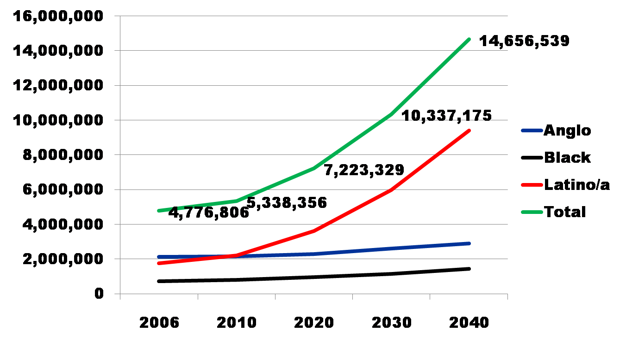
Projected Increase in Obesity in Texas by Ethnicity, 2006 to 2040
Source: Office of the State Demographer projections, using 2000-2004 migration scenario population projections

Slide 13
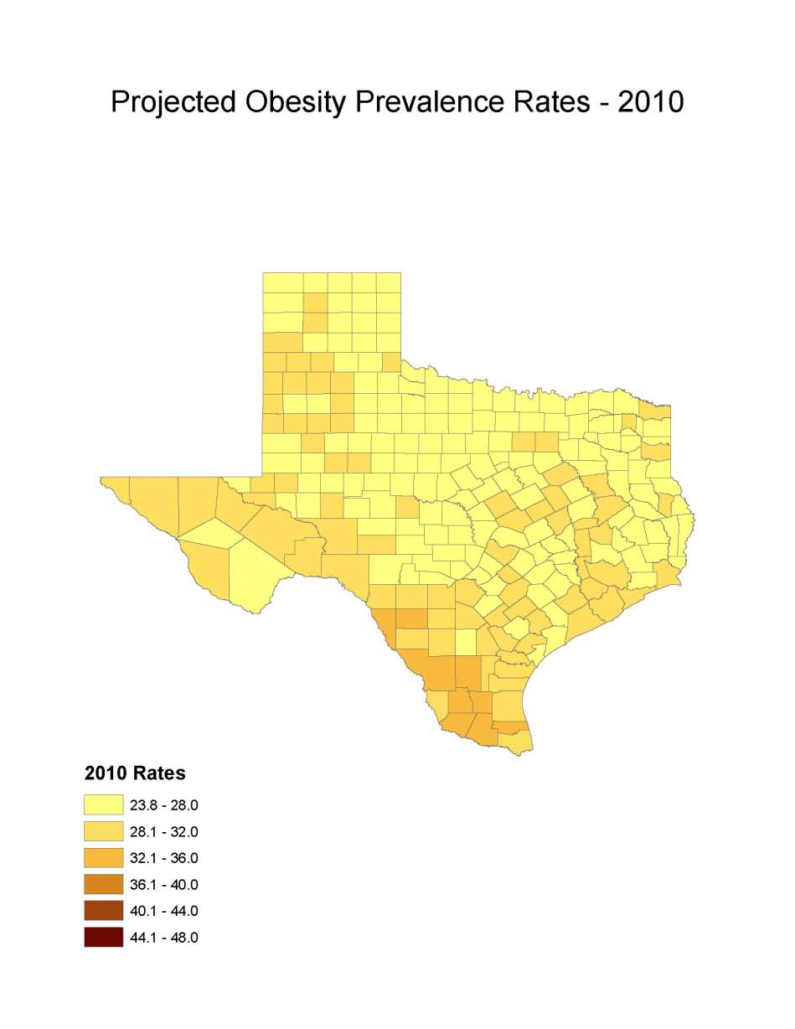
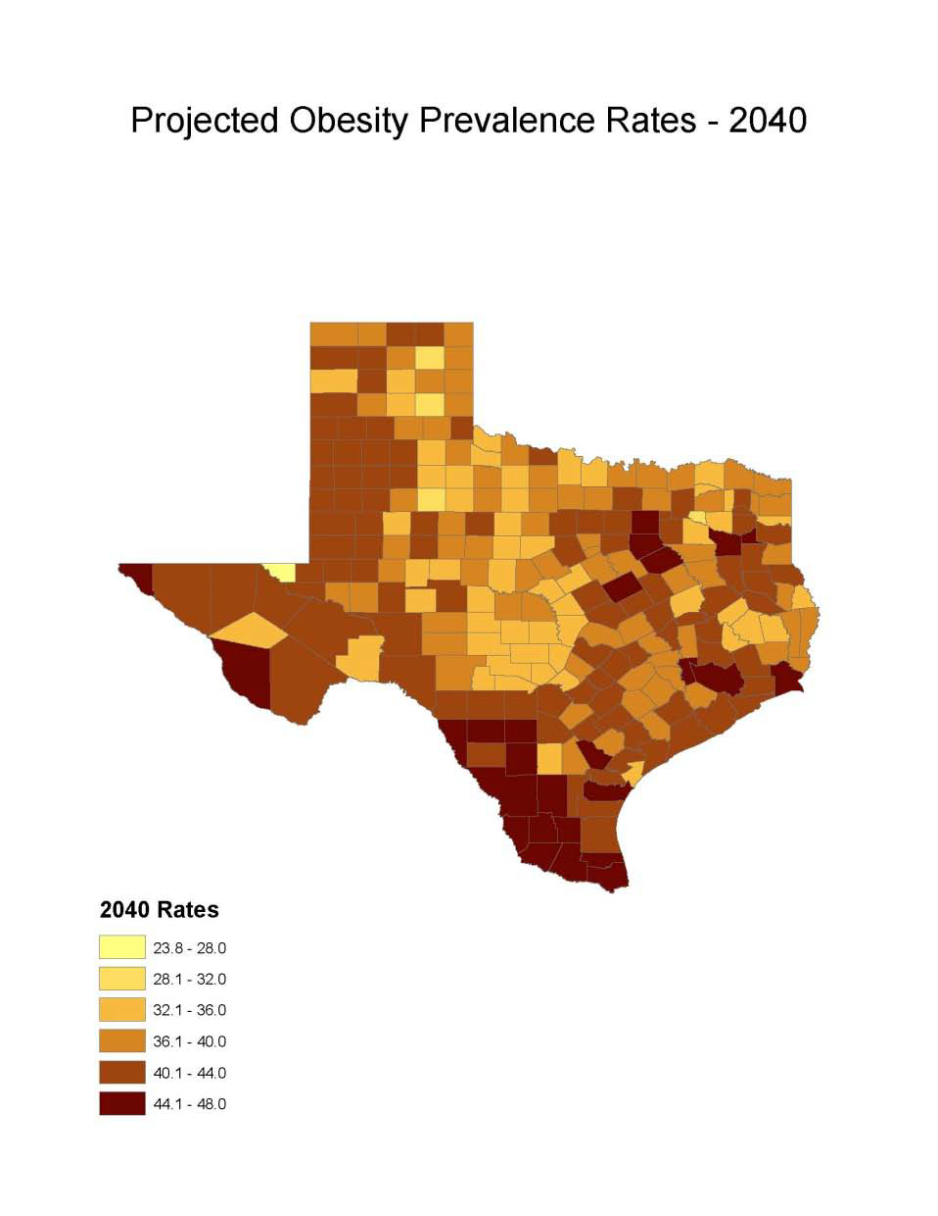
Obesity Prevalence
% adults with obesity: Office of the State Demographer, 2000-2004 Projection

Slide 14
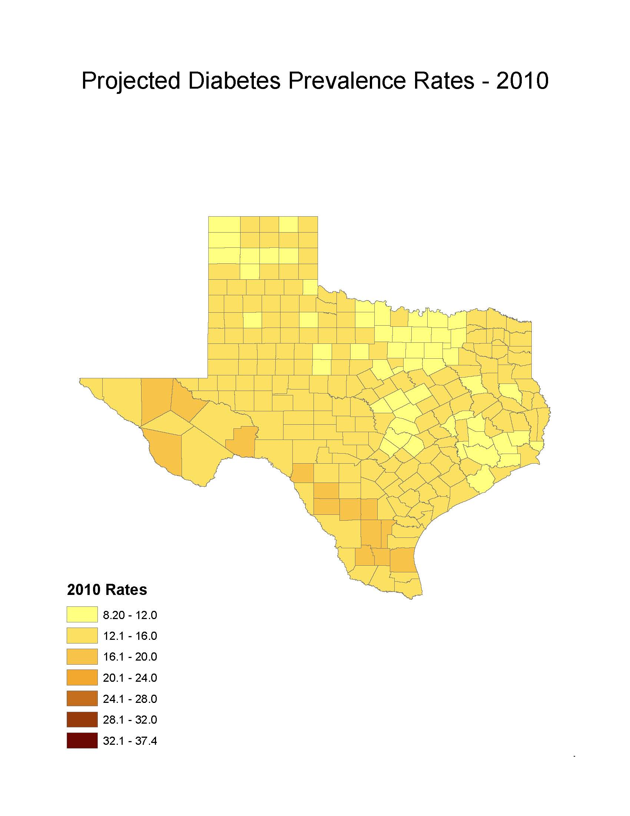
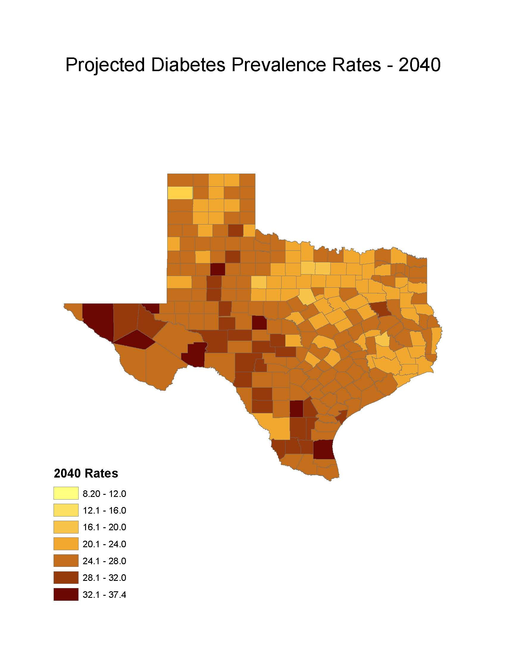
Diabetes Prevalence
% adults with diabetes: Office of the State Demographer, 2000-2004 Projection

Slide 15
Physicians per 1,000 Population Aged 65 Years and Older by County, 2011
Source: U.S. Census Bureau. 2010 Census and Texas Medical Board (2011 physicians).
Notes:
Data on this map about physicians licensed to practice in Texas are from the Texas Medical Board. Some rural counties do not have any practicing physicians. The more urban counties appear to have relatively high ratios of physicians to population aged 65+. This map does not provide information about the type/specialty of physicians.

Slide 16
Percent of population speaking a language other than English at home and speak English less than very well, Census Tracts, San Antonio, Texas, 2009-2013
Source: U.S. Census Bureau, American Community Survey, 2009-2013 5-Year Sample

Slide 17
Median age (years) of population, Census Tracts, Texas, 2009-2013
Source: U.S. Census Bureau, American Community Survey, 2009-2013 5 Year Sample

Slide 18
Number of Seniors, 60 Years of Age and Older, San Antonio and Bexar County, Texas, 2013
 | San Antonio |  | Bexar County
 | Estimate | % of Total | Estimate | % of Total Population
Total Population | 1,409,000 | 100% | 1,817,610 | 100%
60 and Older | 227,596 | 16.2% | 290,762 | 16.0%
60 to 64 years | 68,636 | 4.9% | 90,335 | 5.0%
65 to 74 years | 88,503 | 6.3% | 114,783 | 6.3%
75 to 84 years | 49,724 | 3.5% | 61,334 | 3.4%
85 years and older | 20,733 | 1.5% | 24,310 | 1.3%
Source: US Census Bureau, 2013 American Community Survey, DP05 and estimated from DP05.
Notes:
Seniors are 60+ here and throughout the PPT unless otherwise stated.

Slide 19
Estimated population of persons aged 60 years and more, Census Tracts, Bexar County, Texas,2009-2013
Source: U.S. Census Bureau, American Community Survey, 2009-2013 5 Year Sample

Slide 20
Percent of households that have at least one person aged 60 years or more, Census Tracts, Bexar County, Texas, 2009-2013
Source: U.S. Census Bureau, American Community Survey, 2009-2013 5 Year Sample

Slide 21
Percent of persons 60 years of age and older living with grandchildren (under 18 years), San Antonio and Bexar County, Texas, 2013
Source: US Census Bureau, 2013 American Community Survey, One-year Sample, DP03.
Notes:
For Total Population, Living with Grandchildren represents those 30 years and older. These percentages reflect overall population only. The table, Seniors Raising their Own Grandchildren, reflects percentages for those already living with grandchildren.

Slide 22
Persons aged 60 years and older raising their own grandchildren, San Antonio and Bexar County, Texas, 2013
 | San Antonio |  | Bexar County
 | Estimate | % | Estimate | %
Grandparents living with own grandchildren (under 18) | 46,673 | 100 | 61,762 | 100
Responsible for grandchildren | 18,448 | 39.5 | 24,680 | 40.0
Years responsible for grandchildren
Less than 1 year | 5,247 | 11.2 | 6,787 | 11.0
1 to 2 years | 4,231 | 9.1 | 5,287 | 8.6
3 to 4 years | 3,550 | 7.6 | 4,659 | 7.5
5 or more years | 5,420 | 11.6 | 7,947 | 12.9
Characteristics of Senior
Female | 11,443 | 62.0 | 15,353 | 62.2
Married | 13,042 | 70.7 | 17,708 | 71.8
Source: US Census Bureau, 2013 Year American Community Survey, One-year Sample, DP02.

Slide 23
Work status for adults and those aged 60 years and older, San Antonio and Bexar County, Texas, 2013
Source: US Census Bureau, 2013 American Census Survey, One-year Sample, S0102.

Slide 24
Percent of persons aged 65 years and older who are working, Census Tracts, Bexar County, Texas, 2009-2013
Source: U.S. Census Bureau, American Community Survey, 2009-2013 5-Year Sample

Slide 25
Percent of persons aged 65 years and older who’s income is below the poverty threshold, Census Tracts, Bexar County, Texas, 2011-2015
Source: US Census Bureau, 2015 American Community Survey, Five-year Sample.

Slide 26
Median household income for persons aged 60 years and older, San Antonio and Bexar County, Texas, 2013
Source: US Census Bureau, 2013 American Community Survey, One-year Sample, DP03.

Slide 27
Poverty characteristics of persons in San Antonio and Bexar County, Texas, 2013
Percentage of People Whose Income in the Past 12 Months is Below the Poverty Level
  San Antonio – 19.6% (all people)
    27.3% - Under 18 years
    17.7% - 18 to 64 years
    12.5% - 65 years and older
  Bexar County – 17.3% (all people)
    23.7 – Under 18 years
    15.7% - 65 years and older
    11.1% - 65 years and older
Source: US Census Bureau, 2013 American Community Survey, One-Year Sample, CP03.

Slide 28
Percent of households with at least one person aged 60 years or more that receive SNAP, Census Tracts, Bexar County, Texas, 2009-2013
Source: U.S. Census Bureau, American Community Survey, 2009-2013 5 Year Sample

Slide 29
Marital status of persons age 60 years and older, San Antonio and Bexar County, Texas, 2013
Source: US Census Bureau, 2013 American Community Survey, One-year Sample, DP05.

Slide 30
Householders age by type of household, San Antonio and Bexar County, Texas, 2013
Source: US Census Bureau, 2013 American Community Survey, One-year Sample, DP05.

Slide 31
Percent distribution of race/ethnicity of persons aged 60 years and older, San Antonio and Bexar County, Texas, 2013
Source: US Census Bureau, 2013 American Community Survey, One-year Sample, DP05.

Slide 32
Utilization of Senior Centers (national)
Demographics
  Average age = 75
  70% are women
  50% live alone
  Most often: 1) Caucasian; 2) African Americans; 3) Hispanics; 4) Asians
  Lower income
Usage
  75% visit 1-3x per week
  Average visit = 3.3 hours
Source: National Council on Aging (NCOA), Senior Center Fact Sheet. Accessed August 6, 2015.
Notes:
For the US, not just Texas or Bexar County. Couldn’t find enrollment for just those areas.

Slide 33
Housing Assistance
San Antonio Housing Authority (SAHA)
  Section 8/Housing Choice Voucher Program
    10 Communities for Elderly/1,507 total units
    5% (1,507 Units) of SAHA’s Total Inventory (27,736 Units)
  Public Housing for Elderly/Disabled
    35 Communities/2,355 total units
    8.4% (2,355 Units) of SAHA’s Total Inventory (27,736 Units)
Source: San Antonio Housing Authority (SAHA) Annual Report, 2014.
Notes:
Bexar County Housing Authority (BCHA) doesn’t produce publically available reports, so no info available for them.

Slide 34
Veteran status of persons age 60 years and older, San Antonio and Bexar County, Texas, 2013
Source: US Census Bureau, 2013 American Community Survey, One-year Sample, CP03.

Slide 35
Housing tenure among persons aged 60 years and older, San Antonio and Bexar County, Texas, 2013
Source: US Census Bureau, 2013 American Community Survey, One-year Sample, DP03.
Notes:
*60 years old

Slide 36
Projected Growth for persons aged 60 years and older, Bexar County, Texas
Source: Texas State Data Center, 2014 Projections for Bexar County.
Notes:
155%% growth in Seniors 60+ in Bexar County from 2010 to 2050

Slide 37

Contact
  Office: (210) 458-6530
  Email: Lloyd.Potter@utsa.edu
  Internet: demographics.texas.gov
Lloyd Potter, Ph.D.
@TexasDemography
Notes:
The Office of the State Demographer and the Texas State Data Center are committed to supporting your work through providing you with the best, most accurate, and objective information we can identify about our greatest asset, the people of Texas.

