Slide 1
Texas and Bexar County Demographic and Housing Characteristics and Trends
American Institute of Architects
San Antonio, Texas
September 26, 2016

Slide 2
Growing States, 2000-2015
 | 2000 Population | 2010 Population | 2015 Population | Numeric Change 2010-2015 | Percent Change 2000-2010
United States | 281,421,906 | 308,745,538 | 321,418,820 | 12,673,282 | 4.1%
Texas | 20,851,820 | 25,145,561 | 27,469,114 | 2,323,553 | 9.2%
California | 33,871,648 | 37,253,956 | 39,144,818 | 1,890,862 | 5.1%
Florida | 15,982,378 | 18,801,310 | 20,271,272 | 1,469,962 | 7.8%
Georgia | 8,186,453 | 9,687,653 | 10,214,860 | 527,207 | 5.4%
North Carolina | 8,049,313 | 9,535,483 | 10,042,802 | 507,319 | 5.3%
Arizona | 5,130,632 | 6,392,017 | 6,828,065 | 436,048 | 6.8%
Source: U.S. Census Bureau. 2000 and 2010 Census Count, 2015 Population Estimates.
Notes:
Texas is the second largest state in terms of population (2nd to CA) and area (2nd to AK). In terms of number of people, Texas’ growth exceeds that of all other states between 2010 and 2015.

Slide 3
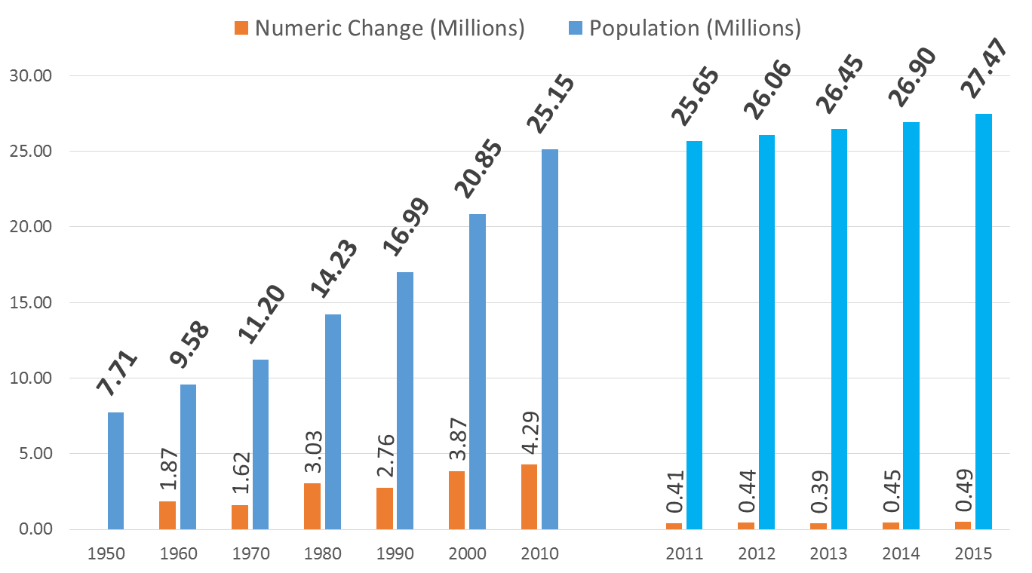
Total Population and Population Change in Texas, 1950-2014
All values for the decennial dates are for April 1st of the indicated census year. Values for 2012-2014 are for July 1 as estimated by the U.S. Census Bureau.
Source: U.S. Census Bureau, Census Counts and Population Estimates

Slide 4
Components of Population Change by Percent in Texas, 1950-2010
Source: U.S. Census Bureau, Population Estimates
5
Notes:
Population changes from two factors, one is natural increase which is simply births minus deaths over time and the other is net migration which is in-migrants minus out-migrants over time. Population added from natural increase are babies joining an already existing household. So the effect of population growth from natural increase on infrastructure demands is both lightening, from people dying, and delayed until babies reach the age where they have infrastructure requirements. Net-migration, in Texas, has been positive for most of our history. Migrants, are usually adults in a household, thus migrants immediately add new households and have instant infrastructure needs, such as housing, transportation, etc.
When we look at population change in Texas, from 1950 to present we can see that before 1970, most of our growth was from natural increase. Starting in the 1970s a much larger percent of our growth is attributed to net migration and this continues to today where approaching half of our population change is from migration.

Slide 5
Total Estimated Population by County, Texas, 2015
Source: U.S. Census Bureau, 2015 Vintage Population Estimates
Notes:
When we look at the geographic distribution of the population of Texas over time we see continually increasing population in the counties along the I-35 corridor, the Houston area, and the lower Rio Grand Valley. Urbanized areas out west have grown but most counties west have experienced limited growth and some population decline. Approximately 86% of the population is along I-35 and east. This area with the 3 major metropolitan areas at the points is often described as the Texas population triangle.
The counties of Harris, Dallas, Tarrant, Bexar, and Travis make up the points of the “population triangle” in Texas and are the most populated in the State. Collin, Denton, Fort Bend, Hidalgo, and El Paso counties also have significant population concentrations. Many counties west of Interstate 35 are more sparsely populated.

Slide 6
Estimated Population Change, Texas Counties, 2010 to 2015
99 counties lost population over the five year period.
Source: U.S. Census Bureau Population Estimates, 2015 Vintage.
Notes:
Population change over the decade has been greatest in the urban and suburban population triangle counties. Counties in the lower Rio Grande Valley also had significant growth as did El Paso . Overall, 155 counties gained population while 99 (39%) lost population over the decade.

Slide 7
Estimated Percent Change of the Total Population by County, Texas, 2010 to 2015
Source: U.S. Census Bureau Population Estimates, 2015 Vintage.
Notes:
Percent change is an indicator of the speed of population change void of information about the volume of population change. Percent change in the population over the past few years has been greatest in the urban and suburban population triangle counties. Notably counties in the Eagle Ford Shale area (south east of San Antonio) and the Cline Shale area (Midland and Odessa area), have been growing quickly.

Slide 8
Top Counties for Numeric Growth in Texas, 2014-2015
County | U.S. Rank Population Change | Population Change | Percent of Change from Natural Increase | Percent Change from Migration | Percent Change from International Migration
Harris | 1 | 90,451 | 49.3% | 50.7% | 32.0%
Bexar | 5 | 37,479 | 41.2% | 58.8% | 17.0%
Tarrant | 6 | 36,152 | 46.3% | 53.7% | 20.2%
Dallas | 9 | 33,760 | 68.1% | 31.9% | 39.0%
Fort Bend | 13 | 29,437 | 20.7% | 79.3% | 16.5%
Collin | 14 | 28,075 | 24.8% | 75.2% | 15.8%
Denton | 16 | 25,820 | 25.5% | 74.5% | 11.7%
Travis | 17 | 25,562 | 42.5% | 57.5% | 22.9%
Williamson | 27 | 19,086 | 20.9% | 79.1% | 6.7%
Montgomery | 29 | 18,505 | 19.2% | 80.8% | 9.9%
*Dallas had net out domestic migration over this period.
Source: U.S. Census Bureau, 2015 Vintage Population Estimates

Slide 9
Top Counties for Percent Growth* in Texas, 2014-2015
County | U.S. Rank | 2014-2015 Percent Population Change | Percent Change from Migration | Percent Change from International Migration
Hays | 1 | 5.2% | 85.5% | 1.9%
Comal | 2 | 4.5% | 90.7% | 2.1%
Fort Bend | 4 | 4.3% | 79.3% | 16.5%
Williamson | 7 | 3.9% | 79.1% | 6.7%
Montgomery | 10 | 3.6% | 80.8% | 9.9%
Denton | 12 | 3.4% | 74.5% | 11.7%
Ector | 18 | 3.3% | 63.1% | 3.1%
Midland | 19 | 3.3% | 66.2% | 3.2%
Collin | 23 | 3.2% | 75.2% | 15.8%
Kaufman | 25 | 3.1% | 79.8% | 3.2%
Parker | 29 | 2.8% | 89.8% | 2.2%
Brazos | 32 | 2.8% | 69.2% | 27.4%
Guadalupe | 38 | 2.7% | 78.8% | 4.6%
Ellis | 39 | 2.7% | 77.2% | 2.7%
*Among Counties with 10,000 or more population in 2014
Source: U.S. Census Bureau, 2015 Vintage Population Estimates

Slide 10
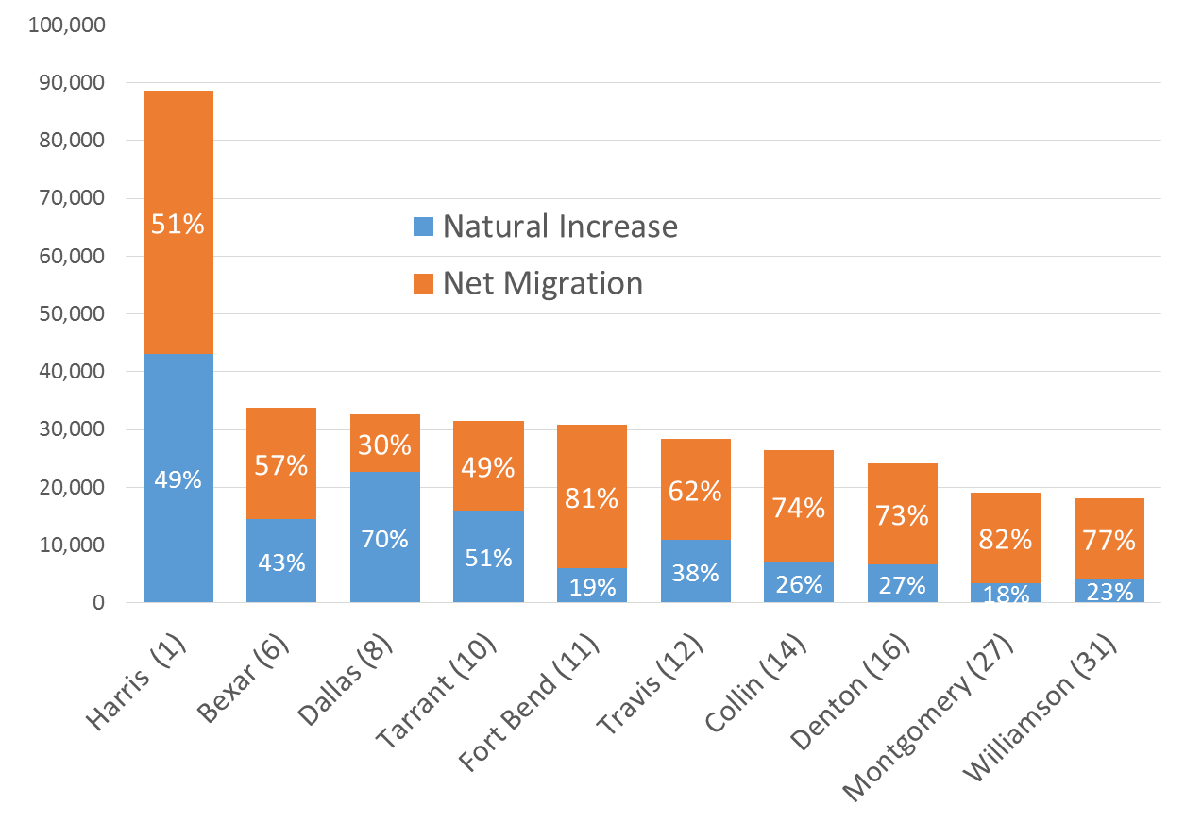
Top Counties for Numeric Growth in Texas (U.S. Rank) by Components of Change, 2013-2014
Source: U.S. Census Bureau, 2014 Vintage Population Estimates

Slide 11
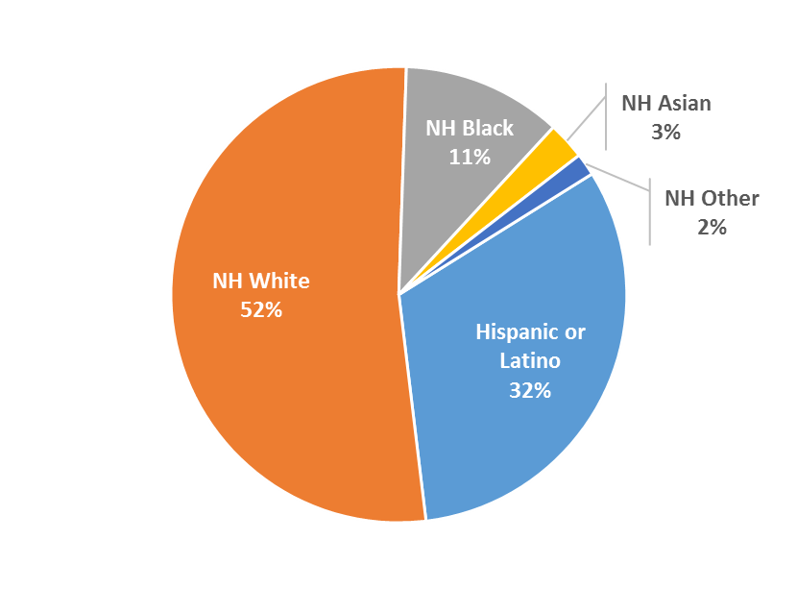
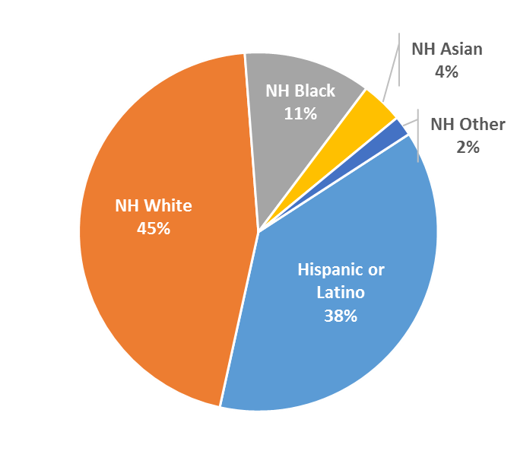
Percent Population by Race and Ethnicity, Texas, 2000 and 2010
2000
2010
Source: U.S. Census Bureau 2000 and 2010 Decennial Census, SF1

Slide 12
Percent of the Population by Race and Ethnicity, San Antonio and Texas, 2010
Source: U.S. Census Bureau, 2010 Census

Slide 13
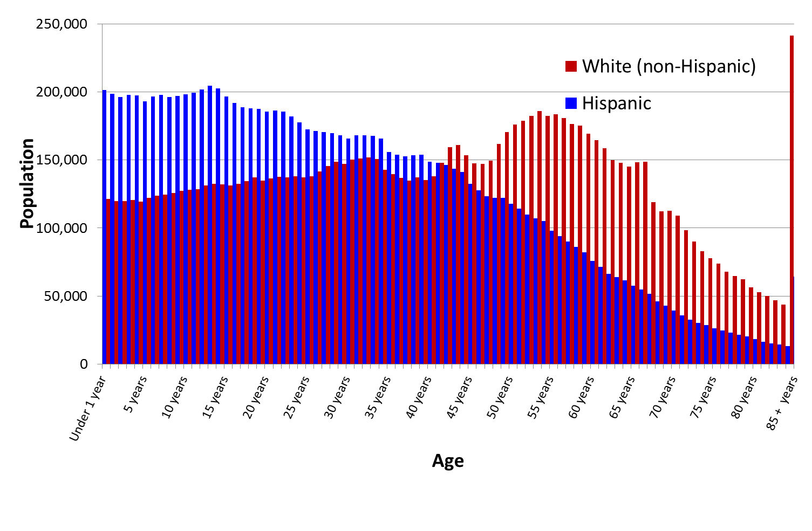
Texas White (non-Hispanic) and Hispanic Populations by Age, 2014
Source: U.S. Census Bureau 2010 Decennial Census, SF1
Notes:
The age distribution of the non-Hispanic white population in Texas is weighted heavily with the “baby boom” generation. Largely the result of lower fertility and less net in-migration, the non-Hispanic white population has relatively fewer young persons relative to those in the middle-age years. In 2010, at ages 37 and younger, the Hispanic population exceeds the non-Hispanic white population.

Slide 14
Bexar County White (non-Hispanic) and Hispanic Populations by Age, 2013
Source: Texas State Data Center, 2013 Population Estimates
Notes:
The age distribution of the non-Hispanic white population in Texas is weighted heavily with the “baby boom” generation. Largely the result of lower fertility and less net in-migration, the non-Hispanic white population has relatively fewer young persons relative to those in the middle-age years. In 2010, at ages 37 and younger, the Hispanic population exceeds the non-Hispanic white population.

Slide 15
Domestic and International Net Migration for the Top Five Growth States, 2013-14
Source: U.S. Census Bureau, Population Estimates, 2015

Slide 16
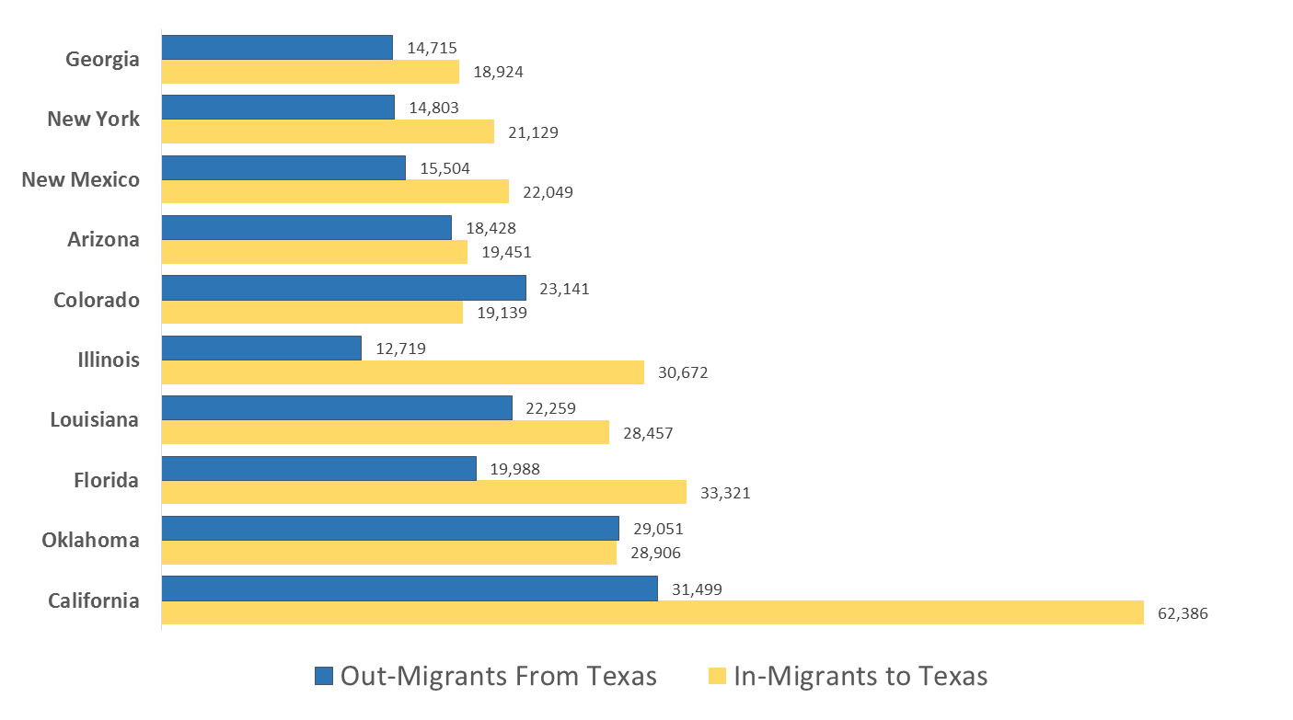
Top 10 Gross Migration States for Domestic Migration to Texas, 2013
U.S. Census Bureau ACS 1-Year PUMS,2013

Slide 17
Top 10 Destination Counties for Interstate Domestic Migration to Texas, 2009-2013
U.S. Census Bureau ACS 5-Year Summary Data, 2009-2013

Slide 18
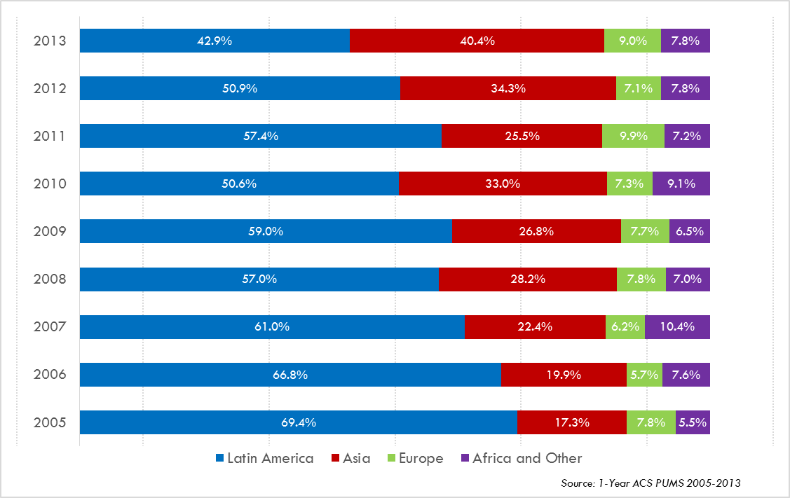
Annual Shares of Recent Non-Citizen Immigrants to Texas by World Area of Birth, 2005-2013

Slide 19
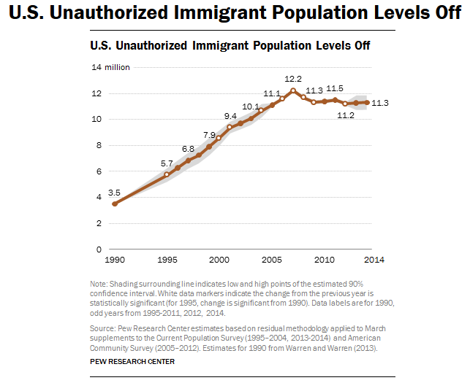

Slide 20
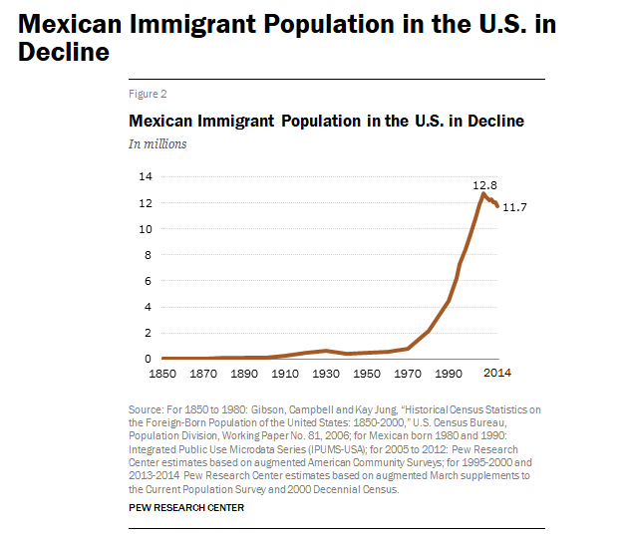

Slide 21
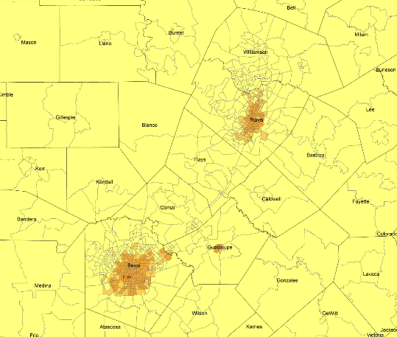
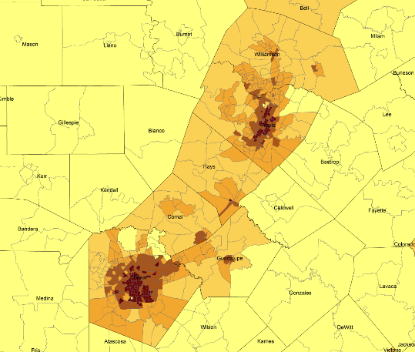
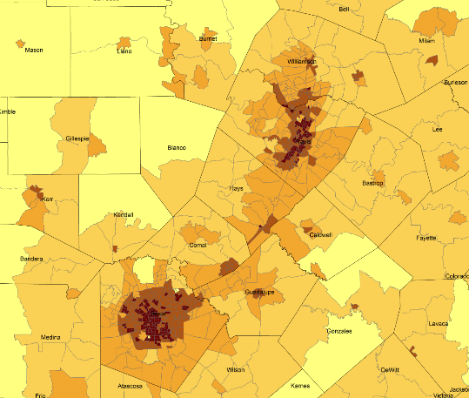
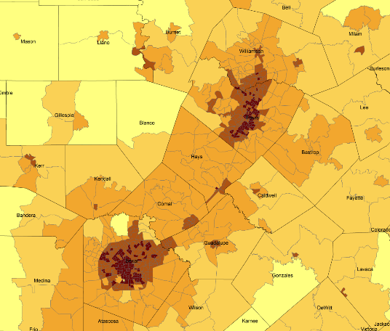
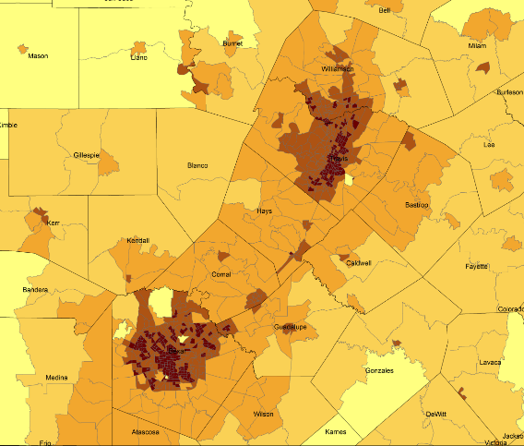
Density by Census Tract, Austin/San Antonio Corridor, 1970-2010
1970
1980
1990
2000
2010
Persons per Square Mile
0 – 10
11 – 50
51 – 500
501 – 4,000
4,001 – 56,000
Source: U.S. Census Bureau, decennial censuses. Geolytics, Neighborhood Change Database Tract Data from 1970-2010
Notes:
As more and more people move into our counties and communities, there are more and more persons per square mile. The sequence of images here show how from 1970 to 2010 the urban areas of San Antonio and Austin have become very dense in terms of population and how the are in-between these two cities has become more and more dense. This increasing density is happening in other urban areas of the State and the stress put on the transportation infrastructure from this increasing density creates challenges for our commuting residents and for businesses who are providing services and moving goods.

Slide 22
Percent of Housing Units Build Before1960, Census Tracts, San Antonio, Texas, 2009-2013
Source: U.S. Census Bureau, American Community Survey, 2009-2013 5-Year Sample

Slide 23
Percent of Housing Units Build After 1999, Census Tracts, San Antonio, Texas, 2009-2013
Source: U.S. Census Bureau, American Community Survey, 2009-2013 5-Year Sample

Slide 24
Housing and Household Characteristics, San Antonio and Texas
Characteristic | San Antonio | Texas
Homeownership rate | 55.7% | 63.3%
Percent Housing units in multi-unit structures | 31.6% | 24.2%
Median value - owner-occupied housing units | $113,800 | $128,900
Per capita money income in past 12 months | $22,619 | $26,019
Median household income | $45,722 | $51,900
Persons below poverty level | 19.9% | 17.6%
Source: U.S. Census Bureau, 2010 Census and the American Community Survey, 2009-2013 5-Year Sample

Slide 25
Population Characteristics, San Antonio and Texas
Characteristic | San Antonio | Texas
Living in same house 1 year & over | 80.6% | 82.8%
Foreign born persons | 14.0% | 16.3%
Language other than English spoken at home | 45.4% | 34.7%
High school graduate or higher, persons age 25+ | 80.7% | 81.2%
Bachelor's degree or higher, persons age 25+ | 24.6% | 26.7%
Source: U.S. Census Bureau, American Community Survey, 2009-2013 5-Year Sample

Slide 26
Percent of population 25 years and older without a high school degree, Census Tracts, Texas 2009-2013
Source: U.S. Census Bureau, American Community Survey, 2009-2013 5-Year Sample

Slide 27
Percent of population earning $75,000 per year or more, Census Tracts, San Antonio, Texas, 2009-2013
Source: U.S. Census Bureau, American Community Survey, 2009-2013 5-Year Sample

Slide 28
Percent of population living below poverty, Census Tracts, San Antonio, Texas, 2009-2013
Source: U.S. Census Bureau, American Community Survey, 2009-2013 5-Year Sample

Slide 29
Projected Population Growth in Bexar County, Texas, 2010-2050
Source: Texas State Data Center 2014 Population Projections

Slide 30
Projected and Estimated Population in Bexar County, Texas, 2010-2015
Sources: Texas State Data Center 2014 Population Projections. U.S. Census Bureau, Population Estimates.

Slide 31
Projected Racial and Ethnic Percent, Bexar County, Texas, 2010-2050
Source: Texas State Data Center 2014 Population Projections , 2000-2010 Migration Scenario

Slide 32
Educational Attainment of Persons Aged 25 Years and Older, NH White, Texas, Bexar County, San Antonio, 2014
Source: U.S. Census Bureau, American Community Survey, 2014 1-Year Sample

Slide 33
Educational Attainment of Persons Aged 25 Years and Older, Hispanic for Texas, Bexar County, and San Antonio, 2014
Source: U.S. Census Bureau, American Community Survey, 2014 1-Year Sample

Slide 34
Percent of Persons by Age Group with at a Bachelors Degree or Higher, Texas, Bexar County, and San Antonio, 2014
Source: U.S. Census Bureau, American Community Survey, 2014 1-Year Sample

Slide 35
Percent of Hispanic Students Graduating from Bexar County High Schools by Year, 2011-2014
Source: Texas Education Agency

Slide 36
Dropout (7-12th grades) Rates by District, Bexar County, 2014-15
District | Dropouts | Students | Rate (%)
Alamo Heights | - | <2,400 | 0.3
East Central | 62 | 4,833 | 1.3
Edgewood | 91 | 4,618 | 2
Harlandale | 94 | 6,567 | 1.4
Judson | 193 | 10,914 | 1.8
Northeast | 444 | 33,656 | 1.3
Northside | 278 | 47,686 | 0.6
San Antonio | 687 | 21,411 | 3.2
Somerset | 22 | <1,900 | 1.2
South San Antonio | 167 | 4,474 | 3.7
Southside | 47 | 2,418 | 1.9
Soutwest | 57 | 6,302 | 0.9
Source: Texas Education Agency

Slide 37

Contact
  Office: (210) 458-6530
  Email: Lloyd.Potter@utsa.edu
  Internet: Demographics.Texas.gov
Lloyd Potter, Ph.D.
@TexasDemography
Notes:
The Texas Demographic Center is committed to supporting your work through providing you with the best, most accurate, and objective information we can identify about our greatest asset, the people of Texas.

