Slide 1
Texas and San Antonio Population and Children
Congress on Children
San Antonio, Texas
September 30, 2016

Slide 2
Total Estimated Population by County, Texas, 2015
Source: U.S. Census Bureau, 2015 Vintage Population Estimates
Notes:
When we look at the geographic distribution of the population of Texas over time we see continually increasing population in the counties along the I-35 corridor, the Houston area, and the lower Rio Grand Valley. Urbanized areas out west have grown but most counties west have experienced limited growth and some population decline. Approximately 86% of the population is along I-35 and east. This area with the 3 major metropolitan areas at the points is often described as the Texas population triangle.
The counties of Harris, Dallas, Tarrant, Bexar, and Travis make up the points of the “population triangle” in Texas and are the most populated in the State. Collin, Denton, Fort Bend, Hidalgo, and El Paso counties also have significant population concentrations. Many counties west of Interstate 35 are more sparsely populated.

Slide 3
Estimated Population Change, Texas Counties, 2010 to 2015
99 counties lost population over the five year period.
Source: U.S. Census Bureau Population Estimates, 2015 Vintage.
Notes:
Population change over the decade has been greatest in the urban and suburban population triangle counties. Counties in the lower Rio Grande Valley also had significant growth as did El Paso . Overall, 155 counties gained population while 99 (39%) lost population over the decade.

Slide 4
Estimated Percent Change of the Total Population by County, Texas, 2010 to 2015
Source: U.S. Census Bureau Population Estimates, 2015 Vintage.
Notes:
Percent change is an indicator of the speed of population change void of information about the volume of population change. Percent change in the population over the past few years has been greatest in the urban and suburban population triangle counties. Notably counties in the Eagle Ford Shale area (south east of San Antonio) and the Cline Shale area (Midland and Odessa area), have been growing quickly.

Slide 5
Percent of the Population by Race and Ethnicity, San Antonio and Texas, 2010
Source: U.S. Census Bureau, 2010 Census

Slide 6
Bexar County White (non-Hispanic) and Hispanic Populations by Age, 2013
Source: Texas State Data Center, 2013 Population Estimates
Notes:
The age distribution of the non-Hispanic white population in Texas is weighted heavily with the “baby boom” generation. Largely the result of lower fertility and less net in-migration, the non-Hispanic white population has relatively fewer young persons relative to those in the middle-age years. In 2010, at ages 37 and younger, the Hispanic population exceeds the non-Hispanic white population.

Slide 7
Housing and Household Characteristics, San Antonio and Texas
Characteristic | San Antonio | Texas
Homeownership rate | 55.7% | 63.3%
Percent Housing units in multi-unit structures | 31.6% | 24.2%
Median value - owner-occupied housing units | $113,800 | $128,900
Per capita money income in past 12 months | $22,619 | $26,019
Median household income | $45,722 | $51,900
Persons below poverty level | 19.9% | 17.6%
Source: U.S. Census Bureau, 2010 Census and the American Community Survey, 2009-2013 5-Year Sample

Slide 8
Population Characteristics, San Antonio and Texas
Characteristic | San Antonio | Texas
Living in same house 1 year & over | 80.6% | 82.8%
Foreign born persons | 14.0% | 16.3%
Language other than English spoken at home | 45.4% | 34.7%
High school graduate or higher, persons age 25+ | 80.7% | 81.2%
Bachelor's degree or higher, persons age 25+ | 24.6% | 26.7%
Source: U.S. Census Bureau, American Community Survey, 2009-2013 5-Year Sample

Slide 9
Percent of population that is Hispanic, Census Tracts, San Antonio, Texas, 2009-2013
Source: U.S. Census Bureau, American Community Survey, 2009-2013 5 Year Sample

Slide 10
Percent of population speaking a language other than English at home and speak English less than very well, Census Tracts, San Antonio, Texas, 2009-2013
Source: U.S. Census Bureau, American Community Survey, 2009-2013 5-Year Sample

Slide 11
Percent of population 25 years and older without a high school degree, Census Tracts, Texas 2009-2013
Source: U.S. Census Bureau, American Community Survey, 2009-2013 5-Year Sample

Slide 12
Percent of population earning $75,000 per year or more, Census Tracts, San Antonio, Texas, 2009-2013
Source: U.S. Census Bureau, American Community Survey, 2009-2013 5-Year Sample

Slide 13
Percent of population living below poverty, Census Tracts, San Antonio, Texas, 2009-2013
Source: U.S. Census Bureau, American Community Survey, 2009-2013 5-Year Sample

Slide 14
Percent of Housing Units Build Before1960, Census Tracts, San Antonio, Texas, 2009-2013
Source: U.S. Census Bureau, American Community Survey, 2009-2013 5-Year Sample

Slide 15
Percent of Housing Units Build After 1999, Census Tracts, San Antonio, Texas, 2009-2013
Source: U.S. Census Bureau, American Community Survey, 2009-2013 5-Year Sample

Slide 16
Projected Population Growth in Bexar County, Texas, 2010-2050
Source: Texas State Data Center 2014 Population Projections

Slide 17
Projected and Estimated Population in Bexar County, Texas, 2010-2015
Sources: Texas State Data Center 2014 Population Projections. U.S. Census Bureau, Population Estimates.

Slide 18
Projected Racial and Ethnic Percent, Bexar County, Texas, 2010-2050
Source: Texas State Data Center 2014 Population Projections , 2000-2010 Migration Scenario

Slide 19
Educational Attainment of Persons Aged 25 Years and Older, NH White, Texas, Bexar County, San Antonio, 2014
Source: U.S. Census Bureau, American Community Survey, 2014 1-Year Sample

Slide 20
Educational Attainment of Persons Aged 25 Years and Older, Hispanic for Texas, Bexar County, and San Antonio, 2014
Source: U.S. Census Bureau, American Community Survey, 2014 1-Year Sample

Slide 21
Percent of Hispanic Students Graduating from Bexar County High Schools by Year, 2011-2014
Source: Texas Education Agency

Slide 22
Births per ZIP Code in Bexar County, 2013
Source: San Antonio Metropolitan Health District, 2013 Health Profile

Slide 23
Percent of children immunized by ZIP code, Bexar County, TX, 2014

Slide 24
Births Occurring by School District, Bexar County, 2013
School District | Total Births | Birth rate per 1,000 women aged 15-19 | Percent of births to single mothers | Percent of births to mothers with less than HS/GED
Alamo Heights | 281 | 3.43 | 17 | 6
Boerne | 82 | 6.67 | 10 | 0
Comal | 348 | 8.67 | 13 | 5
East Central | 664 | 35.66 | 46 | 16
Edgewood | 988 | 60.20 | 71 | 39
Fort Sam Houston | 63 | 7.18 | 8 | 6
Harlandale | 916 | 58.47 | 68 | 35
Judson | 19,03 | 38.53 | 42 | 12
North East | 5,289 | 29.35 | 39 | 14
Northside | 8,131 | 27.41 | 36 | 11
San Antonio | 4,910 | 60.80 | 65 | 35
Somerset | 144 | 55.90 | 60 | 24
South San Antonio | 793 | 62.50 | 63 | 29
Southside | 365 | 52.48 | 60 | 25
Southwest | 997 | 52.80 | 24 | 24
Source: San Antonio Metropolitan Health District, Maternal Health Indicators: 2013 Report, 2014. Note: In 2013, a total of 26,590 births occurred in Bexar County.

Slide 25
Fitness Gram Scores, Bexar County School Districts, 2013-14
District | Total Students Tested | Total at Unhealthy Weight | Percent at Unhealthy Weight
Edgewood | 9,820 | 5,608 | 57.2
Judson | 45,375 | 21,407 | 47.2
North East | 79,976 | 31,580 | 39.5
San Antonio | 46,552 | 25,154 | 54
South San Antonio | 5,261 | 2,830 | 53.8
Somerset | 1,981 | 1,059 | 53.5
TOTAL OF BEXAR COUNTY | 247,062 | 87,638 | 35.5
In 2013-2014 school year: a Healthy Weight equals BMIs ranging from 13.8 to 24.9 in boys and from 13.5-24.9 in girls (across age and from the low to the high end of the Healthy Fitness Zone). FITNESSGRAM includes data for students enrolled in kindergarten through college, but is limited by the grades serviced in each district, respectively. FERPA masked scores, which occur when there are fewer than 5 students in any category, have not been counted in these calculations. Bexar County total Fitnessgram scores contain only the districts listed in the table. Fitnessgram suggests that their scores not be compared across years, because of differences in methodology. Source: Fitnessgram for Bexar County and Selected Bexar County ISDs, 2013-2014

Slide 26
Income and Poverty in Texas, Bexar County, and Selected School Districts, 2009-2013
Geography | Percent of households with less than $ 10,000 income | Median household income | Percent of related children under five below the poverty threshold
Alamo Heights ISD | 7.6 | $78,266 | 6.3
East Central ISD | 4.9 | $53,871 | 20.0
Edgewood ISD | 14.4 | $26,831 | 55.1
Fort Sam Houston ISD | 1.7 | $59,665 | 8.0
Harlandale ISD | 11.7 | $33,485 | 41.1
Judson ISD | 4.5 | $58,676 | 20.7
Lackland ISD | 4.8 | $51,620 | 7.2
North East ISD | 5.4 | $57,649 | 20.8
Northside ISD | 6.9 | $58,951 | 19.3
Randolph Field ISD | 9.1 | $91,875 | 1.6
San Antonio ISD | 14.6 | $30,938 | 47.0
Somerset ISD | 10.4 | $34,930 | 33.2
South San Antonio ISD | 9.4 | $46,884 | 20.4
Southside ISD | 9.2 | $43,213 | 35.3
Southwest ISD | 6.4 | $42,014 | 31.3
Bexar County, Texas | 8 | $50,112 | 27.5
Texas | 7.4 | $51,900 | 28.3
Source: U.S. Census Bureau, 2009-2013 American Community Survey, DP03, B17001.

Slide 27
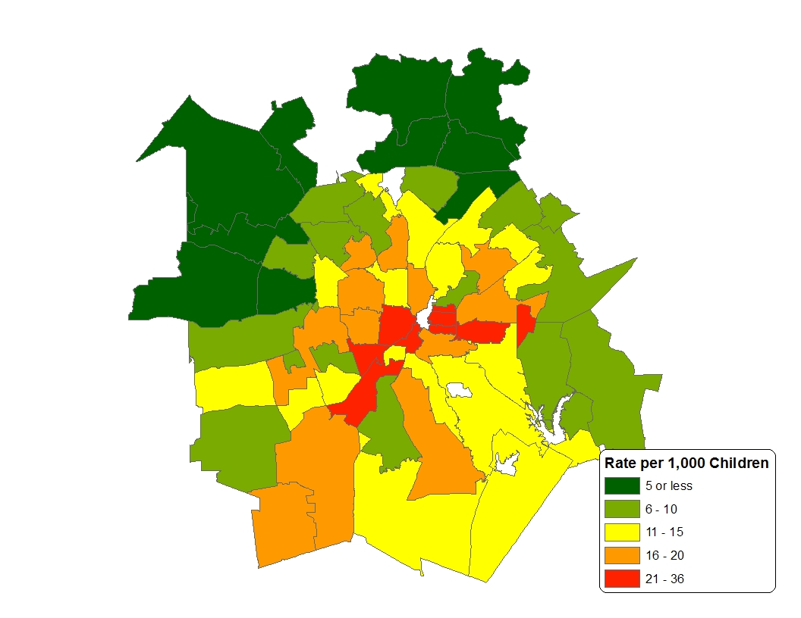
Confirmed Victims of Child Abuse/Neglect by Zip Code, Bexar County, 2012
Source: Texas Department of Protective and Regulatory Services, Management Reporting and Statistics

Slide 28

Contact
  Office: (210) 458-6530
  Email: Lloyd.Potter@utsa.edu
  Internet: demographics.texas.gov
Lloyd Potter, Ph.D.
@TexasDemography
Notes:
The Office of the State Demographer and the Texas State Data Center are committed to supporting your work through providing you with the best, most accurate, and objective information we can identify about our greatest asset, the people of Texas.

