Slide 1
Texas Demographic Trends and Water
Texas Leadership Roundtable
Austin, Texas
November 10, 2016

Slide 2
Growing States, 2000-2015
 | 2000 Population | 2010 Population | 2015 Population | Numeric Change 2010-2015 | Percent Change 2000-2010
United States | 281,421,906 | 308,745,538 | 321,418,820 | 12,673,282 | 4.1%
Texas | 20,851,820 | 25,145,561 | 27,469,114 | 2,323,553 | 9.2%
California | 33,871,648 | 37,253,956 | 39,144,818 | 1,890,862 | 5.1%
Florida | 15,982,378 | 18,801,310 | 20,271,272 | 1,469,962 | 7.8%
Georgia | 8,186,453 | 9,687,653 | 10,214,860 | 527,207 | 5.4%
North Carolina | 8,049,313 | 9,535,483 | 10,042,802 | 507,319 | 5.3%
Arizona | 5,130,632 | 6,392,017 | 6,828,065 | 436,048 | 6.8%
Source: U.S. Census Bureau. 2000 and 2010 Census Count, 2015 Population Estimates.
Notes:
Texas is the second largest state in terms of population (2nd to CA) and area (2nd to AK). In terms of number of people, Texas’ growth exceeds that of all other states between 2010 and 2015.

Slide 3
Total Population and Population Change in Texas, 1950-2014
All values for the decennial dates are for April 1st of the indicated census year. Values for 2012-2014 are for July 1 as estimated by the U.S. Census Bureau.
Source: U.S. Census Bureau, Census Counts and Population Estimates

Slide 4
Components of Population Change by Percent in Texas, 1950-2010
Source: U.S. Census Bureau, Population Estimates
Notes:
It is important to understand a couple of very basic element of population change to think about how growing population may impact our transportation system. Population changes from two factors, one is natural increase which is simply births minus deaths over time. Essentially population added from natural increase are babies who are unlikely to be driving their own vehicle on our roads before age 16. Combine this with the fact that as people die, there are fewer drivers on the road. So the effect of population growth from natural increase on our transportation infrastructure is both lightening, from people dying, and delayed until babies reach the age where they can drive. The second way population changes is from net-migration, which is simply in-minus out migrants. In Texas, the balance has been for us to have more in than out migrants. Migrants, are usually adults who are drivers (though yes, some do have non-driving children) and the may be compounded by the fact that many of the in-migrants may also take a job that requires them to drive. Essentially, migrants immediately contribute to adding stress to the transportation infrastructure.
When we look at population change in Texas, from 1950 to present we can see that before 1970, most of our growth was from natural increase. Starting in the 1970s a much larger percent of our growth is attributed to net migration and this continues to today where approaching half of our population change is from migration.

Slide 5
Total Estimated Population by County, Texas, 2015
Source: U.S. Census Bureau, 2015 Vintage Population Estimates
Notes:
When we look at the geographic distribution of the population of Texas over time we see continually increasing population in the counties along the I-35 corridor, the Houston area, and the lower Rio Grand Valley. Urbanized areas out west have grown but most counties west have experienced limited growth and some population decline. Approximately 86% of the population is along I-35 and east. This area with the 3 major metropolitan areas at the points is often described as the Texas population triangle.
The counties of Harris, Dallas, Tarrant, Bexar, and Travis make up the points of the “population triangle” in Texas and are the most populated in the State. Collin, Denton, Fort Bend, Hidalgo, and El Paso counties also have significant population concentrations. Many counties west of Interstate 35 are more sparsely populated.

Slide 6
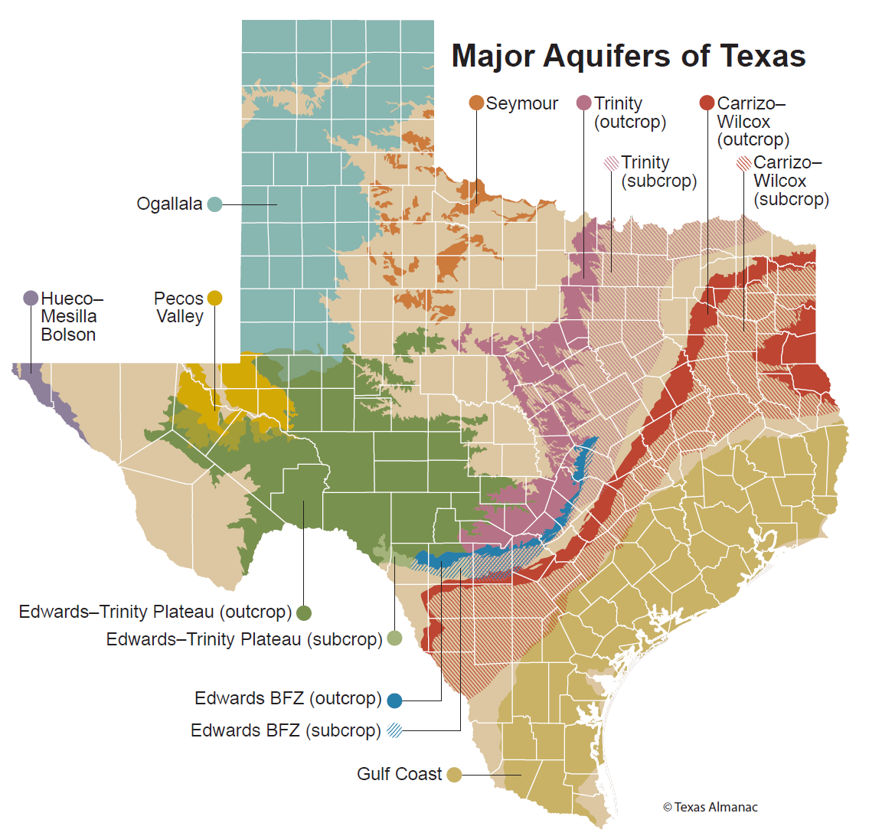
Major Texas Aquifers

Slide 7
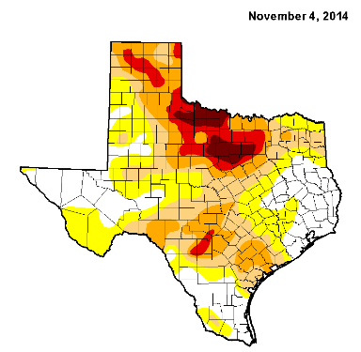
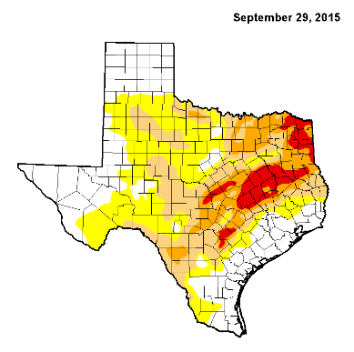
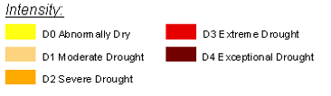
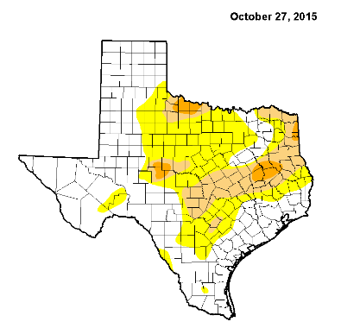
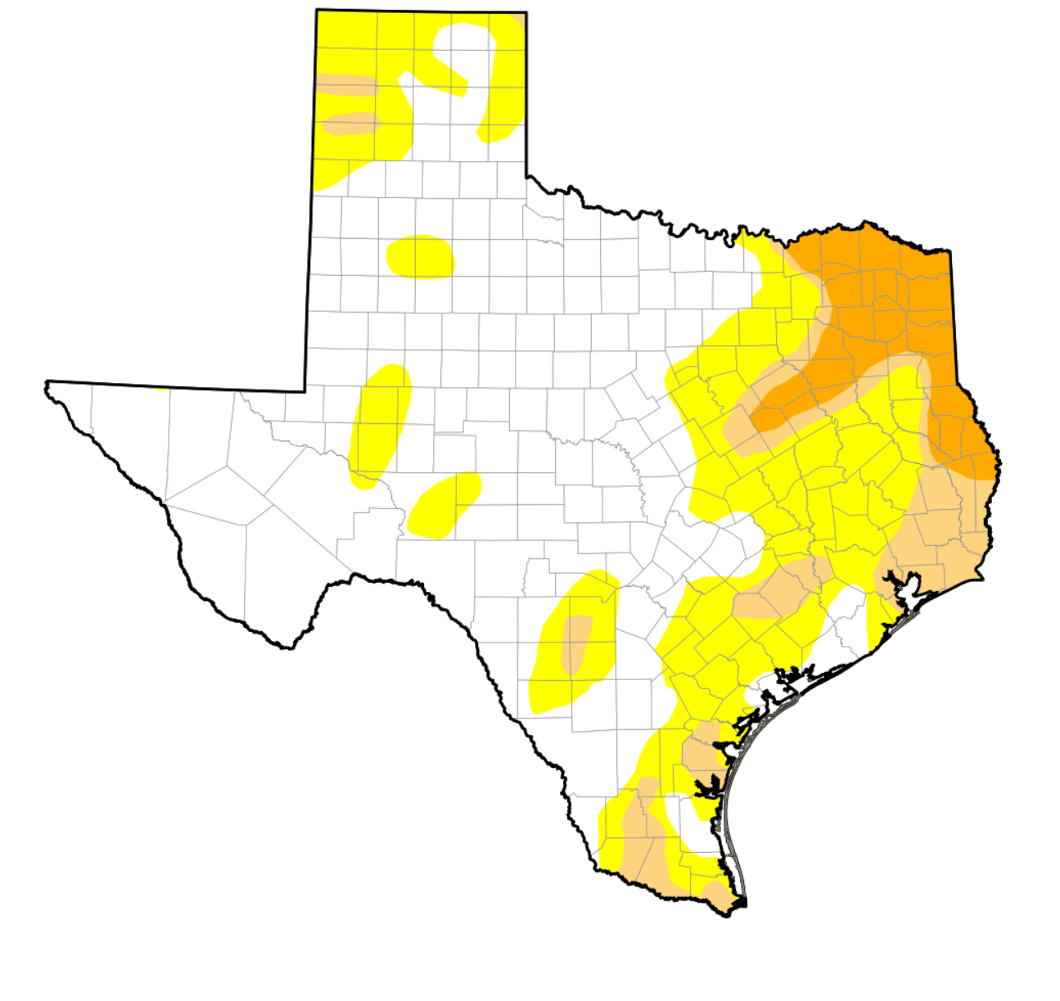
Drought Conditions in Texas
November 1, 2016
  https://waterdatafortexas.org/drought/drought-monitor

Slide 8
Estimated Population Change, Texas Counties, 2010 to 2015
99 counties lost population over the five year period.
Source: U.S. Census Bureau Population Estimates, 2015 Vintage.
Notes:
Population change over the decade has been greatest in the urban and suburban population triangle counties. Counties in the lower Rio Grande Valley also had significant growth as did El Paso . Overall, 155 counties gained population while 99 (39%) lost population over the decade.

Slide 9
Estimated Percent Change of the Total Population by County, Texas, 2010 to 2015
Source: U.S. Census Bureau Population Estimates, 2015 Vintage.
Notes:
Percent change is an indicator of the speed of population change void of information about the volume of population change. Percent change in the population over the past few years has been greatest in the urban and suburban population triangle counties. Notably counties in the Eagle Ford Shale area (south east of San Antonio) and the Cline Shale area (Midland and Odessa area), have been growing quickly.

Slide 10
Estimated Net-Migrants by County, Texas, 2014-2015
Source: U.S. Census Bureau Population Estimates, 2015 Vintage.

Slide 11
Top Counties for Numeric Growth in Texas, 2014-2015
County | U.S. Rank Population Change | Population Change | Percent of Change from Natural Increase | Percent Change from Migration | Percent Change from International Migration
Harris | 1 | 90,451 | 49.3% | 50.7% | 32.0%
Bexar | 5 | 37,479 | 41.2% | 58.8% | 17.0%
Tarrant | 6 | 36,152 | 46.3% | 53.7% | 20.2%
Dallas | 9 | 33,760 | 68.1% | 31.9% | 39.0%
Fort Bend | 13 | 29,437 | 20.7% | 79.3% | 16.5%
Collin | 14 | 28,075 | 24.8% | 75.2% | 15.8%
Denton | 16 | 25,820 | 25.5% | 74.5% | 11.7%
Travis | 17 | 25,562 | 42.5% | 57.5% | 22.9%
Williamson | 27 | 19,086 | 20.9% | 79.1% | 6.7%
Montgomery | 29 | 18,505 | 19.2% | 80.8% | 9.9%
*Dallas had net out domestic migration over this period.
Source: U.S. Census Bureau, 2015 Vintage Population Estimates

Slide 12
Top Counties for Percent Growth* in Texas, 2014-2015
County | U.S. Rank | 2014-2015 Percent Population Change | Percent Change from Migration | Percent Change from International Migration
Hays | 1 | 5.2% | 85.5% | 1.9%
Comal | 2 | 4.5% | 90.7% | 2.1%
Fort Bend | 4 | 4.3% | 79.3% | 16.5%
Williamson | 7 | 3.9% | 79.1% | 6.7%
Montgomery | 10 | 3.6% | 80.8% | 9.9%
Denton | 12 | 3.4% | 74.5% | 11.7%
Ector | 18 | 3.3% | 63.1% | 3.1%
Midland | 19 | 3.3% | 66.2% | 3.2%
Collin | 23 | 3.2% | 75.2% | 15.8%
Kaufman | 25 | 3.1% | 79.8% | 3.2%
Parker | 29 | 2.8% | 89.8% | 2.2%
Brazos | 32 | 2.8% | 69.2% | 27.4%
Guadalupe | 38 | 2.7% | 78.8% | 4.6%
Ellis | 39 | 2.7% | 77.2% | 2.7%
*Among Counties with 10,000 or more population in 2014
Source: U.S. Census Bureau, 2015 Vintage Population Estimates

Slide 13
Top 10 Gross Migration States for Domestic Migration to Texas, 2013
U.S. Census Bureau ACS 1-Year PUMS,2013

Slide 14
Top 10 Destination Counties for Interstate Domestic Migration to Texas, 2009-2013
U.S. Census Bureau ACS 5-Year Summary Data, 2009-2013

Slide 15
Projected Population Growth in Texas,
2010-2050
Source: Texas State Data Center 2014 Population Projections
Notes:
The projected population of Texas is produced using three different migration scenarios. The blue line represents the assumption that there is no in or out migration for Texas. The result is a population that is growing only from natural increase (births-deaths). Under this unlikely scenario, Texas will maintain a health pace of population growth. The other two scenarios assume that 1) the migration rate will be the same as we observed between 2000 and 2010 and 2) the migration rate will be half of what we observed between 2000 and 2010. Under the first assumption Texas will add another 5 million persons this decade, another 7 million the following, 8 or 9 million between 2030 and 2040 and almost 10 million between 2040 and 2050. The half migration scenario also projects significant growth but more modest than the assumption of full migration.

Slide 16
Projected and Estimated Population Growth in Texas, 2010-2015
Source: Texas State Data Center 2014 Population Projections and U.S. Census Bureau Population Estimates

Slide 17
Projected Population Change, Texas Counties, 2010-2050
Source: Texas State Data Center 2012 Population Projections . 2000-2010 Migration Scenario
Notes:
Projected population growth suggests increased numbers and density in the points of Texas’ population triangle, the lower Rio Grande valley with continued growth of El Paso and the urbanized areas in the west of the State. Many rural counties will continue to lose population.

Slide 18
Projected Percent Population Change, Texas Counties, 2010-2050
Source: Texas State Data Center 2012 Population Projections . 2000-2010 Migration Scenario
Notes:
The speed of growth is projected to be greatest in counties surrounding the urban core counties of the points of the Texas’ population triangle.

Slide 19

Contact
  State Demographer
  Office: (210) 458-6530
  Email: Lloyd.Potter@utsa.edu
  Internet: Demographics.Texas.gov
Lloyd Potter, Ph.D.
@TexasDemography
Notes:
The Office of the State Demographer and the Texas State Data Center are committed to supporting your work through providing you with the best, most accurate, and objective information we can identify about our greatest asset, the people of Texas.

