Slide 1
Demographic Characteristics and Trends in Texas and the San Antonio Area
San Antonio Breakfast Club
San Antonio, Texas
December 8, 2016

Slide 2
Growing States, 2000-2015
 | 2000 Population | 2010 Population | 2015 Population | Numeric Change 2010-2015 | Percent Change 2010-2015
United States | 281,421,906 | 308,745,538 | 321,418,820 | 12,673,282 | 4.1%
Texas | 20,851,820 | 25,145,561 | 27,469,114 | 2,323,553 | 9.2%
California | 33,871,648 | 37,253,956 | 39,144,818 | 1,890,862 | 5.1%
Florida | 15,982,378 | 18,801,310 | 20,271,272 | 1,469,962 | 7.8%
Georgia | 8,186,453 | 9,687,653 | 10,214,860 | 527,207 | 5.4%
North Carolina | 8,049,313 | 9,535,483 | 10,042,802 | 507,319 | 5.3%
Arizona | 5,130,632 | 6,392,017 | 6,828,065 | 436,048 | 6.8%
Source: U.S. Census Bureau. 2000 and 2010 Census Count, 2015 Population Estimates.
Notes:
Texas is the second largest state in terms of population (2nd to CA) and area (2nd to AK). In terms of number of people, Texas’ growth exceeds that of all other states between 2010 and 2015.

Slide 3
Total Population and Population Change in Texas, 1950-2014
All values for the decennial dates are for April 1st of the indicated census year. Values for 2012-2014 are for July 1 as estimated by the U.S. Census Bureau.
Source: U.S. Census Bureau, Census Counts and Population Estimates

Slide 4
Components of Population Change by Percent in Texas, 1950-2010
Source: U.S. Census Bureau, Population Estimates
Notes:
It is important to understand a couple of very basic element of population change to think about how growing population may impact our transportation system. Population changes from two factors, one is natural increase which is simply births minus deaths over time. Essentially population added from natural increase are babies who are unlikely to be driving their own vehicle on our roads before age 16. Combine this with the fact that as people die, there are fewer drivers on the road. So the effect of population growth from natural increase on our transportation infrastructure is both lightening, from people dying, and delayed until babies reach the age where they can drive. The second way population changes is from net-migration, which is simply in-minus out migrants. In Texas, the balance has been for us to have more in than out migrants. Migrants, are usually adults who are drivers (though yes, some do have non-driving children) and the may be compounded by the fact that many of the in-migrants may also take a job that requires them to drive. Essentially, migrants immediately contribute to adding stress to the transportation infrastructure.
When we look at population change in Texas, from 1950 to present we can see that before 1970, most of our growth was from natural increase. Starting in the 1970s a much larger percent of our growth is attributed to net migration and this continues to today where approaching half of our population change is from migration.

Slide 5
Total Estimated Population by County, Texas, 2015
Source: U.S. Census Bureau, 2015 Vintage Population Estimates
Notes:
When we look at the geographic distribution of the population of Texas over time we see continually increasing population in the counties along the I-35 corridor, the Houston area, and the lower Rio Grand Valley. Urbanized areas out west have grown but most counties west have experienced limited growth and some population decline. Approximately 86% of the population is along I-35 and east. This area with the 3 major metropolitan areas at the points is often described as the Texas population triangle.
The counties of Harris, Dallas, Tarrant, Bexar, and Travis make up the points of the “population triangle” in Texas and are the most populated in the State. Collin, Denton, Fort Bend, Hidalgo, and El Paso counties also have significant population concentrations. Many counties west of Interstate 35 are more sparsely populated.

Slide 6
Estimated Population Change, Texas Counties, 2010 to 2015
99 counties lost population over the five year period.
Source: U.S. Census Bureau Population Estimates, 2015 Vintage.
Notes:
Population change over the decade has been greatest in the urban and suburban population triangle counties. Counties in the lower Rio Grande Valley also had significant growth as did El Paso . Overall, 155 counties gained population while 99 (39%) lost population over the decade.

Slide 7
Estimated Percent Change of the Total Population by County, Texas, 2010 to 2015
Source: U.S. Census Bureau Population Estimates, 2015 Vintage.
Notes:
Percent change is an indicator of the speed of population change void of information about the volume of population change. Percent change in the population over the past few years has been greatest in the urban and suburban population triangle counties. Notably counties in the Eagle Ford Shale area (south east of San Antonio) and the Cline Shale area (Midland and Odessa area), have been growing quickly.

Slide 8
Top Counties for Numeric Growth in Texas, 2014-2015
County | U.S. Rank Population Change | Population Change | Percent of Change from Natural Increase | Percent Change from Migration | Percent Change from International Migration
Harris | 1 | 90,451 | 49.3% | 50.7% | 32.0%
Bexar | 5 | 37,479 | 41.2% | 58.8% | 17.0%
Tarrant | 6 | 36,152 | 46.3% | 53.7% | 20.2%
Dallas | 9 | 33,760 | 68.1% | 31.9% | 39.0%
Fort Bend | 13 | 29,437 | 20.7% | 79.3% | 16.5%
Collin | 14 | 28,075 | 24.8% | 75.2% | 15.8%
Denton | 16 | 25,820 | 25.5% | 74.5% | 11.7%
Travis | 17 | 25,562 | 42.5% | 57.5% | 22.9%
Williamson | 27 | 19,086 | 20.9% | 79.1% | 6.7%
Montgomery | 29 | 18,505 | 19.2% | 80.8% | 9.9%
*Dallas had net out domestic migration over this period.
Source: U.S. Census Bureau, 2015 Vintage Population Estimates

Slide 9
Top Counties for Percent Growth* in Texas, 2014-2015
County | U.S. Rank | 2014-2015 Percent Population Change | Percent Change from Migration | Percent Change from International Migration
Hays | 1 | 5.2% | 85.5% | 1.9%
Comal | 2 | 4.5% | 90.7% | 2.1%
Fort Bend | 4 | 4.3% | 79.3% | 16.5%
Williamson | 7 | 3.9% | 79.1% | 6.7%
Montgomery | 10 | 3.6% | 80.8% | 9.9%
Denton | 12 | 3.4% | 74.5% | 11.7%
Ector | 18 | 3.3% | 63.1% | 3.1%
Midland | 19 | 3.3% | 66.2% | 3.2%
Collin | 23 | 3.2% | 75.2% | 15.8%
Kaufman | 25 | 3.1% | 79.8% | 3.2%
Parker | 29 | 2.8% | 89.8% | 2.2%
Brazos | 32 | 2.8% | 69.2% | 27.4%
Guadalupe | 38 | 2.7% | 78.8% | 4.6%
Ellis | 39 | 2.7% | 77.2% | 2.7%
*Among Counties with 10,000 or more population in 2014
Source: U.S. Census Bureau, 2015 Vintage Population Estimates

Slide 10
Estimated Number of Net Migrants by
County, Texas, 2013 to 2014
Source: U.S. Census Bureau Population Estimates, 2014 Vintage.
Notes:
The estimated number of net migrants was greatest in the points of the Texas population triangle and surrounding counties. Population change in suburban counties with high migration is largely driven by migration. Population change in the urban core counties of the population triangle is more driven by natural increase than by net migration. Net in-migration to urban core counties at the points of the population triangle is dominated by international in-migration.

Slide 11
Estimated Population and Population Change, San Antonio and Select Texas Cities, 2010-2014
 | 2014 Estimate | Percent Change 2010-2014
San Antonio | 1,436,697 | 8.2%
Austin | 912,791 | 15.5%
Dallas | 1,281,047 | 6.9%
Fort Worth | 812,238 | 9.6%
Houston | 2,239,558 | 6.7%
Alamo Heights | 7,806 | 11.0%
Boerne | 12,835 | 22.6%
Castle Hills | 4,362 | 6.0%
China Grove | 1,273 | 8.0%
Fair Oaks Ranch | 6,914 | 15.5%
Helotes | 8,364 | 13.9%
Hollywood Park | 3,258 | 6.4%
Leon Valley | 11,015 | 8.5%
Live Oak | 15,116 | 15.1%
Olmos Park | 2,361 | 5.5%
Schertz | 36,896 | 17.3%
Seguin | 27,041 | 7.4%
Selma | 8,483 | 53.1%
Shavano Park | 3,416 | 12.6%
Terrell Hills | 5,214 | 6.9%
Windcrest | 5,717 | 6.6%
Bulverde | 4,847 | 4.7%
Castroville | 2,909 | 8.5%
Floresville | 7,149 | 10.9%
New Braunfels | 66,394 | 15.0%
Pleasanton | 9,638 | 7.9%
Poth | 2,103 | 10.2%
San Marcos | 58,892 | 31.2%
Source: U.S. Census Bureau, 2014 Vintage Population Estimâtes

Slide 12
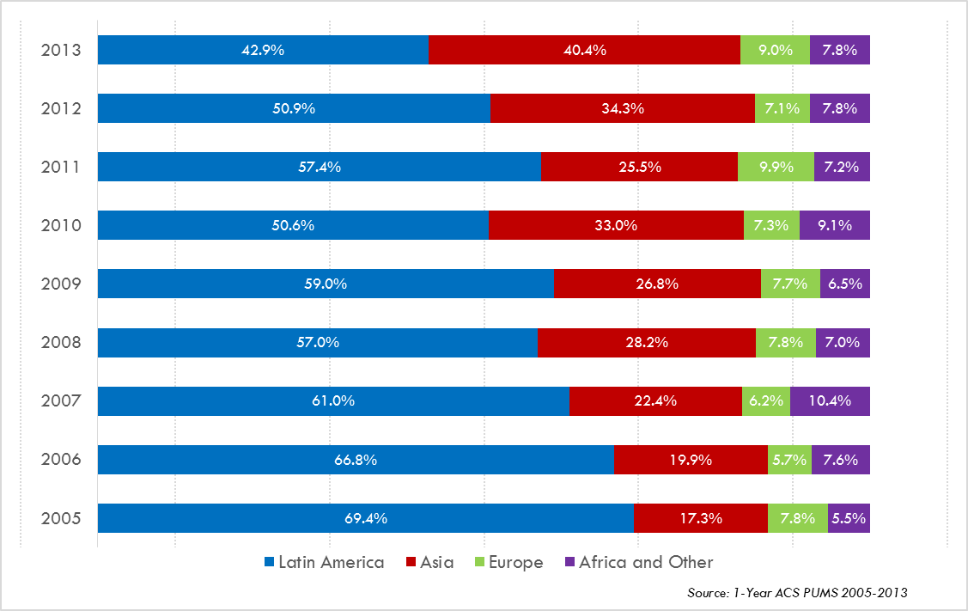
Annual Shares of Recent Non-Citizen Immigrants to Texas by World Area of Birth, 2005-2013

Slide 13
Top 10 Gross Migration States for Domestic Migration to Texas, 2013
U.S. Census Bureau ACS 1-Year PUMS,2013

Slide 14
Top 10 Destination Counties for Interstate Domestic Migration to Texas, 2009-2013
U.S. Census Bureau ACS 5-Year Summary Data, 2009-2013

Slide 15
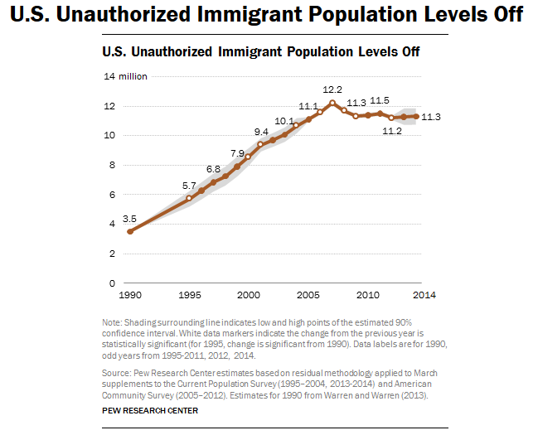

Slide 16
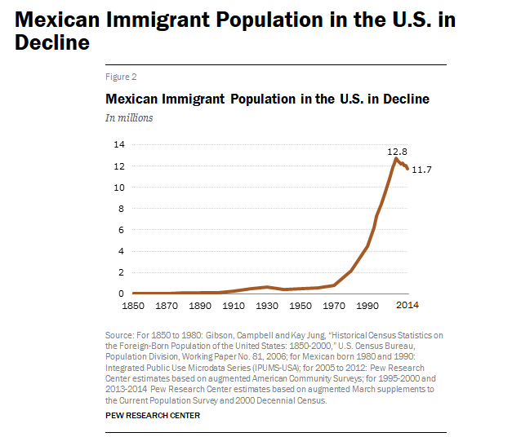

Slide 17
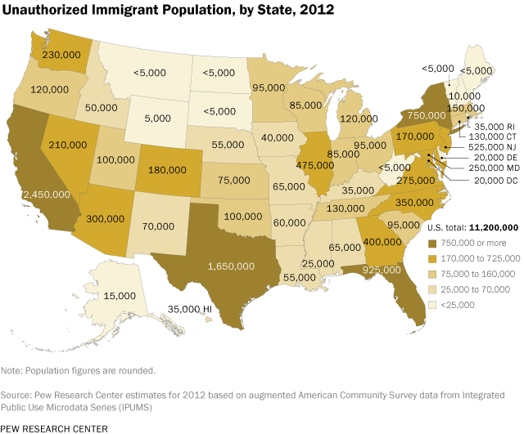

Slide 18


Slide 19
Percent Population by Race and Ethnicity, Texas, 2000 and 2010
2000
2010
Source: U.S. Census Bureau 2000 and 2010 Decennial Census, SF1

Slide 20
Percent of the Population that is of Hispanic Descent, Texas Counties, 2009-2013
Source: U.S. Census Bureau, American Community Survey, 2009-2013 5 Year Sample

Slide 21
Percent of the Population that is Non-Hispanic Black, Texas Counties, 2009-2013
Source: U.S. Census Bureau, American Community Survey, 2009-2013 5 Year Sample

Slide 22
Percent of the Population by Race and Ethnicity, San Antonio and Texas, 2010
Source: U.S. Census Bureau, 2010 Census

Slide 23
Texas White (non-Hispanic) and Hispanic Populations by Age, 2014
Source: U.S. Census Bureau 2010 Decennial Census, SF1
Notes:
The age distribution of the non-Hispanic white population in Texas is weighted heavily with the “baby boom” generation. Largely the result of lower fertility and less net in-migration, the non-Hispanic white population has relatively fewer young persons relative to those in the middle-age years. In 2010, at ages 37 and younger, the Hispanic population exceeds the non-Hispanic white population.

Slide 24
Texas Population Pyramid by Race/Ethnicity, 2014
Source: Texas Demographic Center, 2014 Population Estimates
Notes:
This population pyramid represents the age, sex, race and ethnic composition of the Texas population. Blue represents males, red females, rows are single years of age, and shades represent specified race/ethnic groups as indicated in the legend.

Slide 25
Texas Population Pyramid by Race/Ethnicity, 2014
Source: Texas Demographic Center, 2014 Population Estimates
Notes:
This population pyramid represents the age, sex, race and ethnic composition of the Texas population. Blue represents males, red females, rows are single years of age, and shades represent specified race/ethnic groups as indicated in the legend.

Slide 26
Texas Population Pyramid by Race/Ethnicity, 2014
Source: Texas Demographic Center, 2014 Population Estimates
Notes:
This population pyramid represents the age, sex, race and ethnic composition of the Texas population. Blue represents males, red females, rows are single years of age, and shades represent specified race/ethnic groups as indicated in the legend.

Slide 27
Income and Poverty, Select Counties, and Texas 2010-2014
 | County
 | Bexar | Travis | Harris | Dallas | Texas
Median household income (in 2014 dollars), 2010-2014 | $ 50,867 | $ 59,620 | $ 53,822 | $ 49,925 | $ 52,576
Per capita income in past 12 months (in 2014 dollars), 2010-2014 | $ 24,525 | $ 33,943 | $ 28,454 | $ 27,195 | $ 26,513
Persons in poverty, percent | 18.3 % | 16.7 % | 17.3 % | 19.3 % | 15.9 %
Source: U.S. Census Bureau, American Community Survey, 2010-2014 5-Year Sample
Notes:
For measures of household income and poverty, San Antonio appears a bit better than Dallas but below the State and other major urban counties. San Antonio has the lowest per capita income compare to the State and other urban counties.

Slide 28
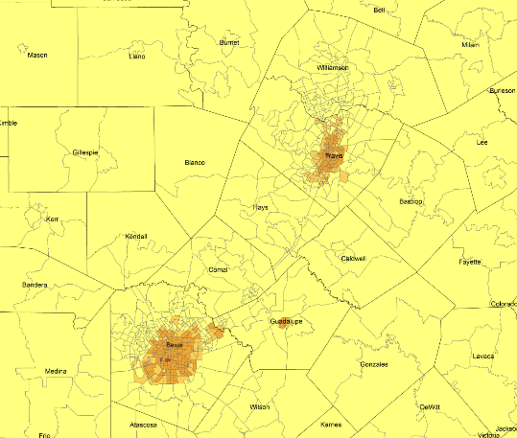
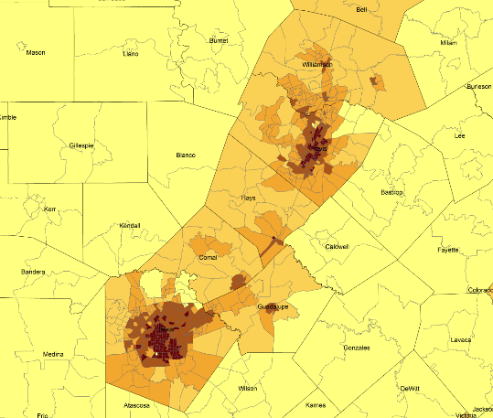
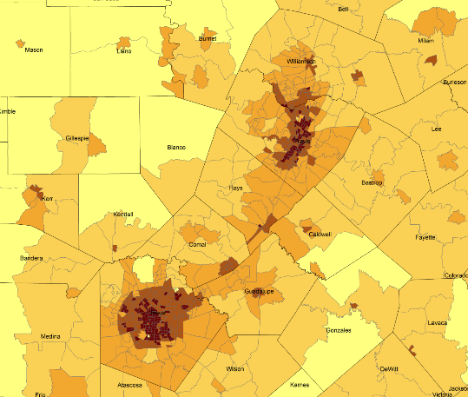
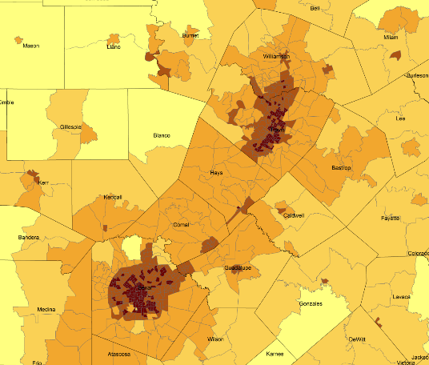
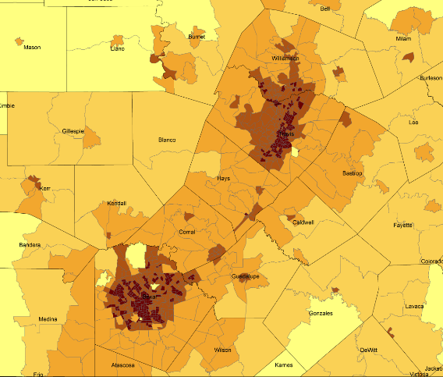
Density by Census Tract, Austin/San Antonio Corridor, 1970-2010
1970
1980
1990
2000
2010
Persons per Square Mile
0 – 10
11 – 50
51 – 500
501 – 4,000
4,001 – 56,000
Source: U.S. Census Bureau, decennial censuses. Geolytics, Neighborhood Change Database Tract Data from 1970-2010
Notes:
As more and more people move into our counties and communities, there are more and more persons per square mile. The sequence of images here show how from 1970 to 2010 the urban areas of San Antonio and Austin have become very dense in terms of population and how the area in-between these two cities has become more and more dense. This increasing density is happening in other urban areas of the State and the stress put on the transportation infrastructure from this increasing density creates challenges for our commuting residents and for businesses who are providing services and moving goods.

Slide 29
Percent of Housing Units Build Before1960, Census Tracts, San Antonio, Texas, 2009-2013
Source: U.S. Census Bureau, American Community Survey, 2009-2013 5-Year Sample
Notes:
Prior to 1960, most of the housing stock in San Antonio was at the urban core of the city.

Slide 30
Percent of Housing Units Build After 1999, Census Tracts, San Antonio, Texas, 2009-2013
Source: U.S. Census Bureau, American Community Survey, 2009-2013 5-Year Sample
Notes:
Most housing stock built in 2000 and more recently is in the suburban ring area of San Antonio.

Slide 31
Percent of population earning $75,000 per year or more, Census Tracts, San Antonio, Texas, 2009-2013
Source: U.S. Census Bureau, American Community Survey, 2009-2013 5-Year Sample
Notes:
In San Antonio, persons with higher levels of income tend to live in the suburban ring north of the city and a few small areas closer to the city center.

Slide 32
Percent of population that is of Hispanic descent, Census Tracts, San Antonio, Texas, 2009-2013
Source: U.S. Census Bureau, American Community Survey, 2009-2013 5 Year Sample

Slide 33
Percent of population speaking a language other than English at home and speak English less than very well, Census Tracts, San Antonio, Texas, 2009-2013
Source: U.S. Census Bureau, American Community Survey, 2009-2013 5-Year Sample

Slide 34
Percent of population 25 years and older without a high school degree, Census Tracts, Texas 2009-2013
Source: U.S. Census Bureau, American Community Survey, 2009-2013 5-Year Sample

Slide 35
Percent of population earning $75,000 per year or more, Census Tracts, San Antonio, Texas, 2009-2013
Source: U.S. Census Bureau, American Community Survey, 2009-2013 5-Year Sample

Slide 36
Percent of population living below poverty, Census Tracts, San Antonio, Texas, 2009-2013
Source: U.S. Census Bureau, American Community Survey, 2009-2013 5-Year Sample

Slide 37
Percent of Housing Units Valued at $300,000 or More, Census Tracts, San Antonio, Texas, 2009-2013
Source: U.S. Census Bureau, American Community Survey, 2009-2013 5-Year Sample

Slide 38
Projected Population Growth in Texas,
2010-2050
Source: Texas State Data Center 2014 Population Projections
Notes:
The projected population of Texas is produced using three different migration scenarios. The blue line represents the assumption that there is no in or out migration for Texas. The result is a population that is growing only from natural increase (births-deaths). Under this unlikely scenario, Texas will maintain a healthy pace of population growth. The other two scenarios assume that 1) the migration rate will be the same as we observed between 2000 and 2010 and 2) the migration rate will be half of what we observed between 2000 and 2010. Under the first assumption Texas will add another 5 million persons this decade, another 7 million the following, 8 or 9 million between 2030 and 2040 and almost 10 million between 2040 and 2050. The half migration scenario also projects significant growth but more modest than the assumption of full migration.

Slide 39
Projected and Estimated Population Growth in Texas, 2010-2015
Source: Texas State Data Center 2014 Population Projections and U.S. Census Bureau Population Estimates
Notes:
Comparing population projections to population estimates provides an indicate of which projection scenario appears to be most accurate. Currently the more aggressive (2000-2010 scenario) appears to be closest for Texas.

Slide 40
Projected Population Growth in Bexar County, Texas, 2010-2050
Source: Texas State Data Center 2014 Population Projections
Notes:
Population projections for Bexar County indicate the population could double from 2010 to 2050.

Slide 41
Projected and Estimated Population in Bexar County, Texas, 2010-2015
Sources: Texas State Data Center 2014 Population Projections. U.S. Census Bureau, Population Estimates.
Notes:
Population estimates for Bexar County indicate that population projections are slightly lower than the growth the county has experienced over the past few years.

Slide 42
Projected Racial and Ethnic Percent, Bexar County, Texas, 2010-2050
Source: Texas State Data Center 2014 Population Projections , 2000-2010 Migration Scenario

Slide 43

Contact
  State Demographer
  Office: (210) 458-6530
  Email: Lloyd.Potter@UTSA.edu
  Internet: Demographics.Texas.gov
Lloyd Potter, Ph.D.
@TexasDemography
Notes:
The Texas State Demographic Center is committed to supporting government, business, non-profit organizations and citizens with the best, most accurate, and objective information we can identify about our greatest asset, the people of Texas.

