Slide 1

Population Trends and Projections for Texas
Texas Association of Community Colleges
Corpus Christi, TX
June 1, 2017
@TexasDemography

Slide 2
Demographic Overview
Texas is experiencing significant growth.
Population continues to grow at a steady pace though growth is not geographically evenly distributed.
Growth is not racially/ethnically evenly distributed. Population growth is being driven largely by the Hispanic population.
The population of Texas, while relatively young, is also aging.
The components of population change have varying implications for infrastructure in Texas.
Demographic shifts may have serious implications for maintaining inclusive and equitable economic growth in the state.

Slide 3
Texas is experiencing fast and high growth.

Slide 4
Growing States, 2000-2016
 | 2000 Population | 2010 Population | 2016 Population | Numeric Change 2010-2016 | Percent Change 2010-2016
United States | 281,421,906 | 308,745,538 | 323,127,513 | 14,369,408 | 4.7%
Texas | 20,851,820 | 25,145,561 | 27,862,596 | 2,716,496 | 10.8%
California | 33,871,648 | 37,253,956 | 39,250,017 | 1,995,495 | 5.4%
Florida | 15,982,378 | 18,801,310 | 20,612,439 | 1,807,847 | 9.6%
Georgia | 8,186,453 | 9,687,653 | 10,310,371 | 621,691 | 6.4%
North Carolina | 8,049,313 | 9,535,483 | 10,146,788 | 611,100 | 6.4%
Washington | 5,894,121 | 6,724,540 | 7,288,000 | 563,455 | 8.4%
Arizona | 5,130,632 | 6,392,017 | 6,931,071 | 538,770 | 8.4%
Source: U.S. Census Bureau. 2000 and 2010 Census Count, 2016 Population Estimates.
Notes:
Texas is the second largest state in terms of population (2nd to CA) and area (2nd to AK). In terms of number of people, Texas’ growth exceeds that of all other states between 2010 and 2016.

Slide 5
Total Population in Texas, 1950-2016 (in millions)
Source: U.S. Census Bureau. 2000 and 2010 Census Counts and Population Estimates.
All values for decennial dates are for April 1st of the indicated census year. Values for 2011-2016 are for July 1 as estimated by the U.S. Census Bureau.
Notes:
Between 2000 and 2010 Texas added over 4 million residents. In 6 short years, it is estimated Texas has added over 2 million more, placing Texas population at 27.9 million, on pace to meet or surpass our gains since the last census. Population growth in Texas has been geometric or compounding in nature. Over the past six decades there have been three periods where the numeric growth has increased relative to previous years. We have no indication that the population growth in Texas will slow dramatically in coming years.

Slide 6
Components of Population Change
by Percent in Texas, 1950-2010
Source: U.S. Census Bureau, Population Estimates
Notes:
It is important to understand a couple of very basic element of population change to think about how growing population may impact our transportation system. Population changes from two factors, one is natural increase which is simply births minus deaths over time. Essentially population added from natural increase are babies who are unlikely to be driving their own vehicle on our roads before age 16. Combine this with the fact that as people die, there are fewer drivers on the road. So the effect of population growth from natural increase on our transportation infrastructure is both lightening, from people dying, and delayed until babies reach the age where they can drive. The second way population changes is from net-migration, which is simply in-minus out migrants. In Texas, the balance has been for us to have more in than out migrants. Migrants, are usually adults who are drivers (though yes, some do have non-driving children) and the may be compounded by the fact that many of the in-migrants may also take a job that requires them to drive. Essentially, migrants immediately contribute to adding stress to the transportation infrastructure.
When we look at population change in Texas, from 1950 to present we can see that before 1970, most of our growth was from natural increase. Starting in the 1970s a much larger percent of our growth is attributed to net migration and this continues to today where approaching half of our population change is from migration.

Slide 7

Total Estimated Population by County, Texas, 2016
Source: U.S. Census Bureau, 2016 Vintage Population Estimates
Notes:
When we look at the geographic distribution of the population of Texas over time we see continually increasing population in the counties along the I-35 corridor, the Houston area, and the lower Rio Grand Valley. Urbanized areas out west have grown but most counties west have experienced limited growth and some population decline. Approximately 86% of the population is along I-35 and east. This area with the 3 major metropolitan areas at the points is often described as the Texas population triangle.
The counties of Harris, Dallas, Tarrant, Bexar, and Travis make up the points of the “population triangle” in Texas and are the most populated in the State. Collin, Denton, Fort Bend, Hidalgo, and El Paso counties also have significant population concentrations. Many counties west of Interstate 35 are more sparsely populated.

Slide 8
Estimated Population Change, Texas Counties, 2010 to 2016
96 counties lost population over the 6 year period.
Source: U.S. Census Bureau, 2016 Vintage Population Estimates
Notes:
Population change over the decade has been greatest in the urban and suburban population triangle counties. Counties in the lower Rio Grande Valley also had significant growth as did El Paso. Overall, 158 counties gained population while 96 (38%) lost population over the decade.

Slide 9
Estimated Percent Change of the Total Population by County, Texas, 2010 to 2016
Source: U.S. Census Bureau, 2016 Vintage Population Estimates
Notes:
Percent change is an indicator of the speed of population change void of information about the volume of population change. Percent change in the population over the past few years has been greatest in the suburban population triangle counties, notably among counties between San Antonio and Austin. In the early part of the decade, counties in the Eagle Ford Shale area (south east of San Antonio) and the Cline Shale area (Midland and Odessa area), had been growing quickly. This is no longer the case.

Slide 10
Top Counties for Percent Growth* in Texas,
2015-2016
County | U.S. Rank | 2015-2016 Percent Population Change | Percent Change from Domestic Migration | Percent Change from International Migration
Kendall | 2 | 5.2% | 95.9% | 4.0%
Hays | 3 | 5.1% | 82.2% | 1.8%
Comal | 6 | 4.4% | 88.5% | 2.0%
Williamson | 14 | 4.1% | 74.1% | 5.6%
Fort Bend | 18 | 3.8% | 59.4% | 15.8%
Montgomery | 24 | 3.7% | 73.5% | 8.0%
Rockwall | 25 | 3.6% | 82.2% | 2.5%
Denton | 28 | 3.6% | 67.1% | 9.0%
Kaufman | 36 | 3.4% | 81.3% | 2.2%
Bastrop | 42 | 3.1% | 83.5% | 0.7%
Ellis | 50 | 3.1% | 78.1% | 2.6%
8
Source: U.S. Census Bureau, 2016 Vintage Population Estimates.
Notes:
Ten percent of the 50 fastest growing counties in the United States from 2015 to 2016 were in Texas. Some of the fastest growing counties in the country continue to be suburban ring counties, such as Kendall, Hays, and Comal counties. Growth among the fastest growing counties in the country stems more from migration than natural increase.

Slide 11
Top Counties for Numeric Growth in Texas,
2015-2016
County | U.S. Rank Population Change | Population Change | Percent of Change from Natural Increase | Percent Change from Domestic Migration | Percent Change from International Migration
Harris | 2 | 56,587 | 79.9% | -27.9% | 48.1%
Tarrant | 5 | 35,462 | 44.4% | 37.7% | 17.9%
Bexar | 7 | 33,198 | 44.6% | 39.3% | 16.1%
Dallas | 9 | 29,209 | 79.9% | -20.9% | 41.0%
Denton | 11 | 27,689 | 23.9% | 67.1% | 9.0%
Fort Bend | 13 | 27,388 | 24.8% | 59.4% | 15.8%
Collin | 14 | 26,506 | 25.8% | 58.7% | 15.5%
Travis | 17 | 24,505 | 44.2% | 33.3% | 22.5%
Williamson | 22 | 20,659 | 20.3% | 74.1% | 5.6%
Montgomery | 24 | 19,769 | 18.5% | 73.5% | 8.0%
Hidalgo* | 54 | 10,529 | 113.5% | -33.4% | 19.9%
Hidalgo County had negative net migration (-13.5% of total population growth).
Source: U.S. Census Bureau, 2016 Vintage Population Estimates
9
Source: U.S. Census Bureau, 2016 Vintage Population Estimates.
Notes:
Ten of the top 25 counties in the United States that were growing the most numerically between 2015 and 2016 were in Texas. These counties are the larger ones in the State and are all counties that have experienced continued growth. However, the components attributing to their population change varies. For instance, natural increase and international migration are playing a key role in population growth in Dallas County. Harris and Tarrant counties are growing about evenly from migration and natural increase. Whereas in the suburban ring counties migration (mostly domestic) is driving population growth. 2016 marked the first year in a few years that Harris County did not add the most people of any other county in the U.S. This drop can most likely be attributed to a decline in oil and gas industry in this region.

Slide 12
Top 10 Gross Migration States for Domestic Migration to Texas, 2013
U.S. Census Bureau ACS 1-Year PUMS,2013

Slide 13
Texas continues to racially/ethnically diversify.

Slide 14
Texas Racial and Ethnic Composition,
2000, 2010, and 2015
11
Source: U.S. Census Bureau. 2000, 2010 Decennial Census and 2015 Population Estimates
Notes:
As of the 2000 Census, about 53% of Texas’ population was non-Hispanic Anglo, about 32% where of Hispanic descent, about 11% where non-Hispanic African American, and about 4% were non-Hispanic Other.
In 2010, it is estimated that about 45% of the Texas population was non-Hispanic Anglo, 38% of Hispanic descent, 11% were non-Hispanic African American, and about 6% were non-Hispanic Other (largely of Asian descent).

Slide 15
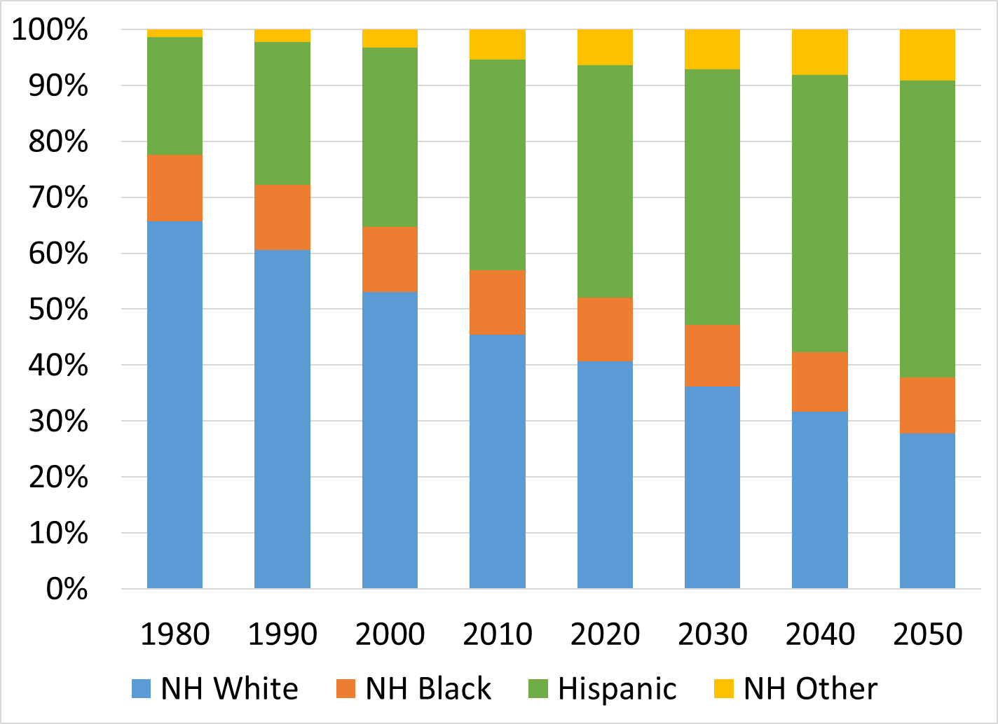
Texas Racial and Ethnic Composition, 1980 to 2050
Source: U.S. Census Bureau, 1980 to 2010 Decennial Censuses; Texas Demographic Center, 2014 Population Projections, Half Migration Scenario

Slide 16
Racial and Ethnic Composition of Texas and Top 10 Most Populous Counties, 2015
 | NH White | NH Black | Hispanic | NH Asian | NH Other
TEXAS | 43.0% | 11.8% | 38.8% | 4.6% | 1.8%
Denton County | 60.9% | 9.3% | 19.2% | 8.0% | 2.6%
Collin County | 59.4% | 9.4% | 15.2% | 13.4% | 2.7%
Travis County | 49.5% | 8.0% | 33.9% | 6.4% | 2.1%
Tarrant County | 48.6% | 15.6% | 28.2% | 5.3% | 2.4%
Fort Bend County | 34.6% | 20.1% | 24.1% | 19.2% | 1.9%
Harris County | 31.0% | 18.5% | 42.0% | 7.0% | 1.6%
Dallas County | 30.6% | 22.3% | 39.5% | 6.0% | 1.6%
Bexar County | 28.7% | 7.3% | 59.5% | 2.7% | 1.7%
El Paso County | 13.1% | 3.2% | 81.3% | 1.2% | 1.2%
Hidalgo County | 7.0% | 0.5% | 91.3% | 1.0% | 0.2%
12
Source: U.S. Census Bureau, 2015 Vintage Population Estimates

Slide 17
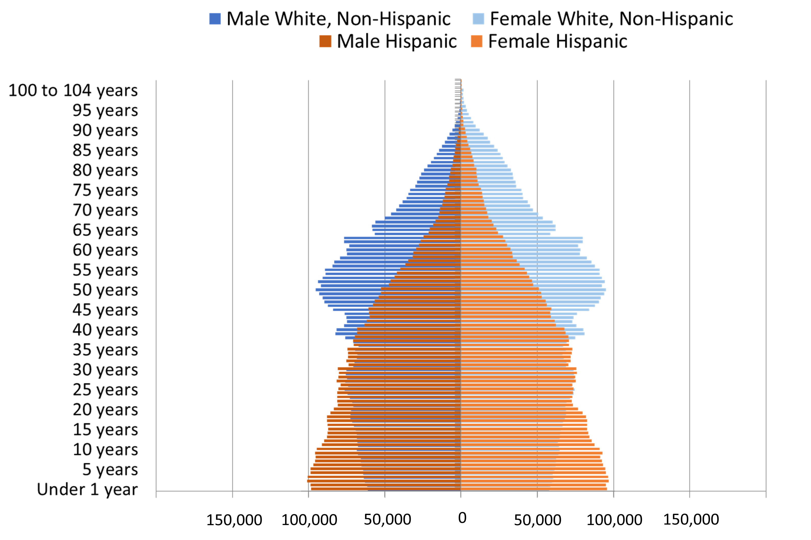
Population Pyramids for Hispanics and Non-Hispanic Whites in Texas, 2010
Notes:
The age distribution of the non-Hispanic white population in Texas is weighted heavily with the “baby boom” generation. Largely the result of lower fertility and less net in-migration, the non-Hispanic white population has relatively fewer young persons relative to those in the middle-age years. In 2010, at ages 37 and younger, the Hispanic population exceeds the non-Hispanic white population.

Slide 18
Annual Shares of Recent Non-Citizen Immigrants to Texas by World Area of Birth, 2005-2015
Source: U.S. Census Bureau, American Community Survey, 1-Year PUMS

Slide 19
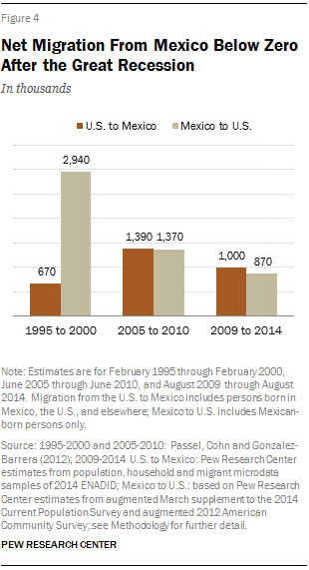
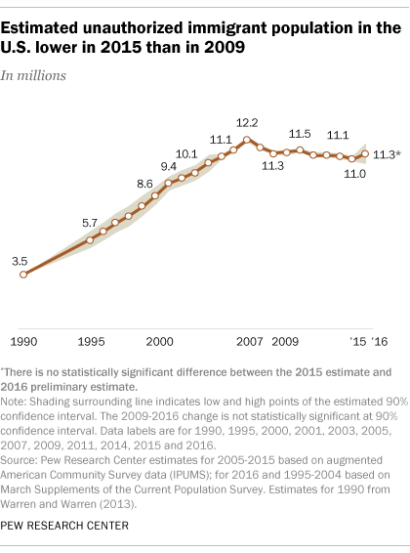
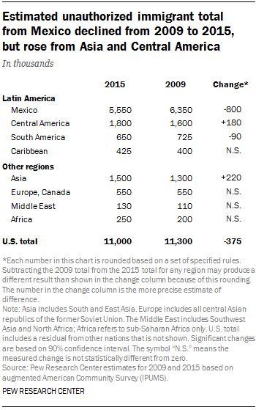
Unauthorized and Mexican Immigration, 2015

Slide 20
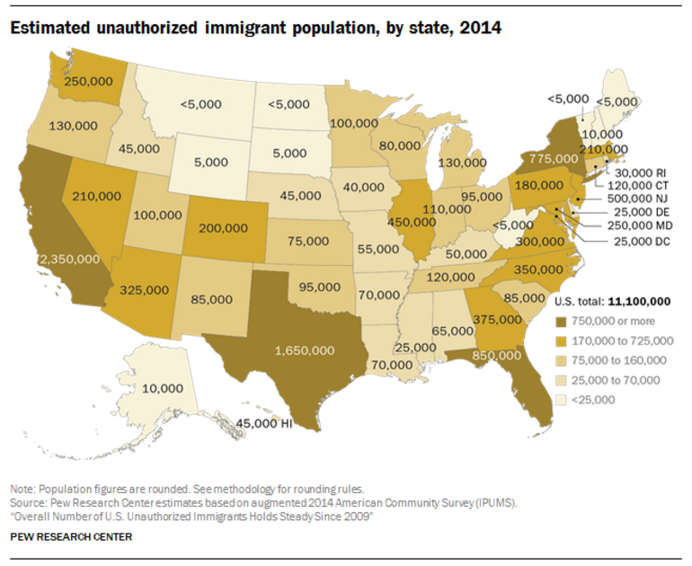

Slide 21


Slide 22
Texas is young, but aging.

Slide 23
States with the Oldest Median Ages, 2000, 2010, 2014
2000 |  |  | 2010 |  |  | 2014
Rank | State | Med Age | Rank | State | Median Age | Rank | State | Median Age
1 | West Virginia | 38.9 | 1 | Maine | 42.7 | 1 | Maine | 44.2
2 | Florida | 38.7 | 2 | Vermont | 41.5 | 2 | New Hampshire | 42.6
3 | Maine | 38.6 | 3 | West Virginia | 41.3 | 3 | Vermont | 42.6
4 | Pennsylvania | 38 | 4 | New Hampshire | 41.1 | 4 | West Virginia | 42.0
5… | Vermont | 37.7 | 5 | Florida | 40.7 | 5 | Florida | 41.8
…46 | California | 33.3 | 46 | California | 35.2 | 46 | Idaho | 35.7
47 | Idaho | 33.2 | 47 | Idaho | 34.6 | 47 | North Dakota | 34.9
48 | Alaska | 32.4 | 48 | Alaska | 33.8 | 48 | Texas | 34.2
49 | Texas | 32.3 | 49 | Texas | 33.6 | 49 | Alaska | 33.3
50 | Utah | 27.1 | 50 | Utah | 29.2 | 50 | Utah | 30.5
- | United States | 35.3 | - | United States | 37.2 | - | United States | 37.7
Source: US Census Bureau, 2000 and 2010 Decennial Censuses US Census Bureau, 2014 Population Estimate by State

Slide 24
Texas Population by Age Group, 2000 to 2014
 | 2000 |  | 2010 |  | 2014 |  | 2000-2014
 | Population | Percent | Population | Percent | Estimate | Percent | Absolute Change | Percent Change
Under 18 | 5,886,759 | 28.2 | 6,865,824 | 27.3 | 7,115,614 | 26.4 | 1,228,855 | 20.9
18 to 64 | 12,892,529 | 61.8 | 15,677,851 | 62.3 | 16,742,263 | 62.1 | 3,849,734 | 29.9
65 and Older | 2,072,532 | 9.9 | 2,601,886 | 10.3 | 3,099,081 | 11.5 | 1,026,549 | 49.5
Total | 20,851,820 | 100 | 25,145,561 | 100 | 26,956,958 | 100 | 6,105,138 | 29.3
Source: US Census Bureau, 2000 and 2010 Censuses, QT-P1 and derived from QT-P1

Slide 25
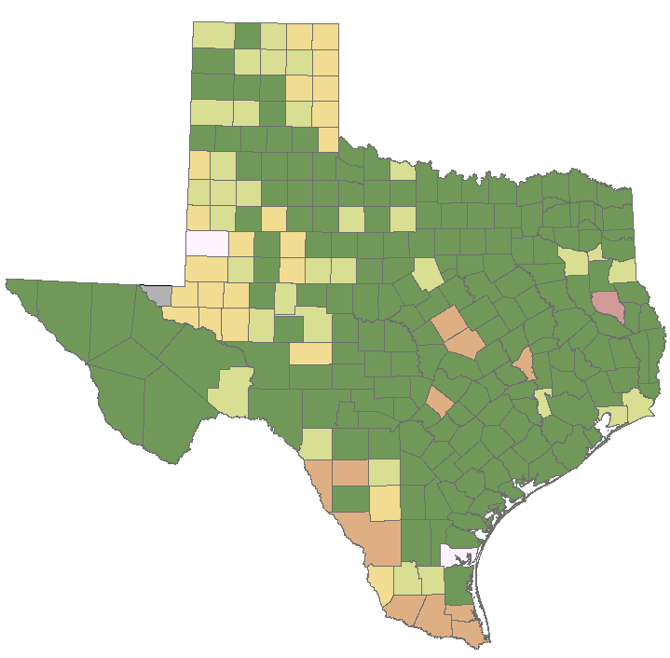
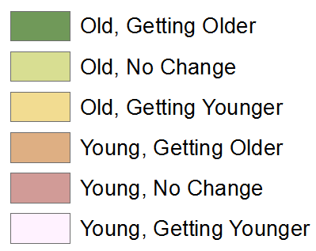
Median Age by Change in Median Age in Texas Counties, 2000-2014
Source: U.S. Census Bureau, 2000, 2010 Decennial Censuses and 2014 Population Estimates
Note: Old=Median Age>30 years; no data available for counties in gray.
30

Slide 26
Percent of Population 65 Years Plus, Texas Counties, 2011-2015
Source: U.S. Census Bureau, 2015 American Community Survey 5-Year Estimates
30

Slide 27
Population and Projected Share of Population by Age Group, Texas, 1950 to 2050
Source: U.S. Census Bureau, Decennial Censuses and 2015 Population Estimates; Texas Demographic Center, 2014 Vintage Population Projections, 0.5 Migration Scenario
Notes:
The older population of Texas is growing at an even faster rate than the state as a whole. Over 1 million of the people added to the Texas population between 2000 and 2015 were people aged 65 years and older. This significant increase is driven by the aging of the Baby Boom generation. In 2011, the oldest Baby Boomers turned 65. The older population in Texas is projected to continue its rapid growth, peaking in 2030 when the bulk of the Baby Boomers age into the elder population and leveling off as they age into higher mortality years. By 2050, the elder population and the youth population are projected to make up similar proportions of the state population, projected to be over 40 million.

Slide 28
Population Projections by Age Group,
2010 to 2050
Age Group | 2010 | 2020 | 2030 | 2040 | 2050 | 2010-2050 Percent Change
65 and Older | 2,601,886 | 4,014,083 | 5,929,471 | 7,583,385 | 9,442,865 | 262.9
65-69 | 853,100 | 1,375,699 | 1,779,930 | 2,019,401 | 2,519,575 | 195.3
70-74 | 619,156 | 1,081,697 | 1,569,556 | 1,747,404 | 2,136,439 | 245.1
75-79 | 477,245 | 714,641 | 1,181,376 | 1,568,513 | 1,830,330 | 283.5
80-84 | 347,206 | 440,399 | 794,965 | 1,186,724 | 1,365,653 | 293.3
85+ | 205,501 | 401,647 | 603,644 | 1,061,343 | 1,590,868 | 421.3
Total Population | 25,145,561 | 30,541,978 | 37,155,084 | 44,955,896 | 54,369,297 | 116.2
Source: US Census Bureau, 2010 Census Texas State Data Center, 2014 Projections, 1.0 Migration Scenario

Slide 29
Population Projections, Texas, 2010 - 2050
Source: Texas State Data Center, 2014 Population Projections, 0.5 Migration Scenario

Slide 30
Implications for education and the economy

Slide 31
Educational Attainment in Texas, 2015
Level of Educational Attainment | Percent of persons aged 25 years and older | State Ranking
High school diploma or equivalency or greater | 81.9 | 49
Bachelors or greater | 27.6 | 29
Source: U.S. Census Bureau, American Community Survey, 5-Year, 2015.

Slide 32
Educational Attainment, Population 25 Years and Older, Texas, 2015
Educational Attainment | NH White |  | Hispanic |  | Black Alone |  | Other Alone
 | Number | % | Number | % | Number | % | Number | %
Population 25 years and older | 8,320,573 | 100 | 5,545,721 | 100 | 1,934,324 | 100 | 2,020,467 | 100
High School Diploma or greater | 7,744,683 | 93.1 | 3,453,129 | 62.3 | 1,690,299 | 87.4 | 1,467,902 | 72.6
Bachelor’s Degree or greater | 2,999,091 | 36 | 710,949 | 12.8 | 420,618 | 21.7 | 601,136 | 29.8
Source: US Census Bureau, 2015 American Community Survey, 5-Year Estimates, S1501.

Slide 33

Public K-12 Enrollment
Source: Texas Education Agency. Enrollment in Texas Public Schools, 2015-16.

Slide 34
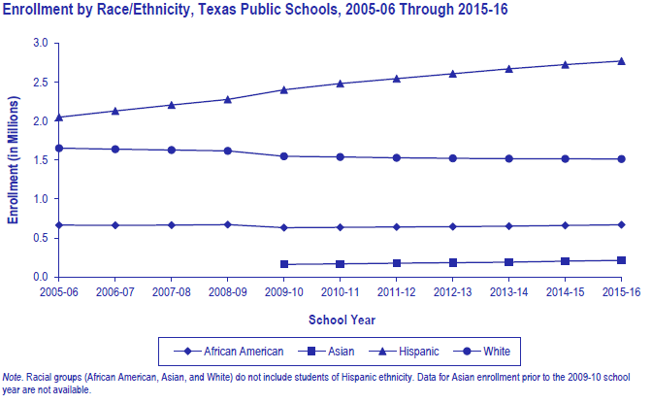
Public K-12 Enrollment
Source: Texas Education Agency. Enrollment in Texas Public Schools, 2015-16.

Slide 35
Community College Enrollment, 2008 to 2015
 | Fall 2008 | Fall 2009 | Fall 2010 | Fall 2011 | Fall 2012 | Fall 2013 | Fall 2014 | Fall 2015 (prelim)
Community College | 597,146 | 669,811 | 721,962 | 732,681 | 712,980 | 700,840 | 693,791 | 700,892
Lamar State Colleges | 7,017 | 7,578 | 8,266 | 7,954 | 7,740 | 7,668 | 7,045
Texas State Technical Colleges | 13,344 | 15,456 | 13,024 | 12,353 | 11,392 | 11,333 | 11,642
Texas 2-Year Colleges | 617,507 | 692,845 | 743,252 | 752,988 | 732,112 | 719,841 | 712,478
Source: Texas Higher Education Coordinating Board, compiled by Texas Association of Community Colleges.

Slide 36
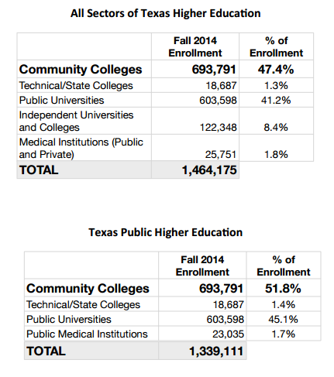
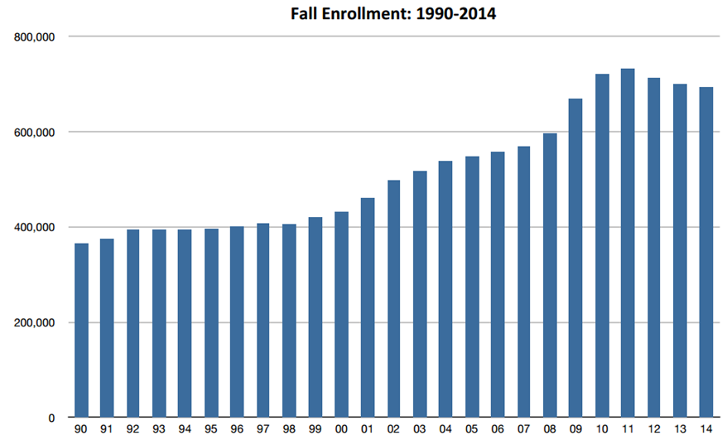
Higher Education by Sector in Texas, 2014
Source: Texas Higher Education Coordinating Board, compiled by Texas Association of Community Colleges.

Slide 37
Public Higher Education
Source: Texas Higher Education Coordinating Board.
Note: Not all race/ethnicity categories that were reported are included in table.

Slide 38
Earnings and Education
Source: US Census Bureau, American Community Survey, 5-Year, 2015, B20004.

Slide 39
Employment Status of the Labor Force by Educational Attainment, Texas
Source: U.S. Census Bureau. 2001 to 2011 American Community Survey 1-Year PUMS data
Notes:
Education and employment are positively related. Individuals with higher educational attainment are more likely to be employed. The trend over the past decade suggest this employment gap may be widening. In general, employment rates have decreased between 2001 and 2011, likely due to the economic downturn toward the end of the decade.

Slide 40
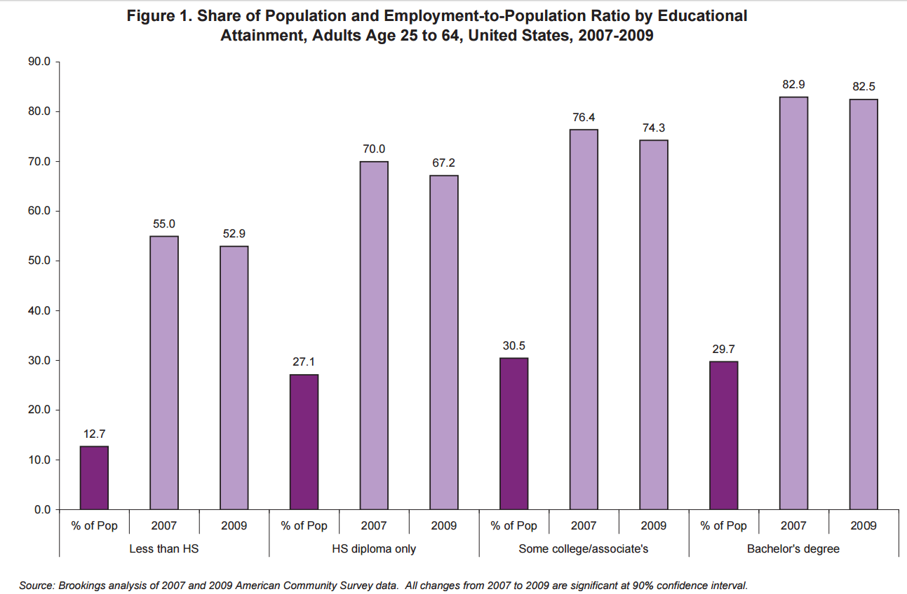

Slide 41
Percent of persons aged 25 years and older with a high school degree or higher, Texas, 2006-2011

Slide 42
Trends in Educational Attainment of Persons in the Labor Force (25-64 Years of Age) in Texas by Race/Ethnicity – High School Graduates and Above
Source: U.S. Census Bureau, American Community Survey, Public Use Micro Sample, 2001-2011
Notes:
Educational attainment by race/ethnicity in Texas suggests that adults of Hispanic descent are much less likely to have completed high school compared to other race/ethnic groups. Over time, the percent of persons of Hispanic descent who have completed high school has been increasing more rapidly than for other groups but even at this pace of change it will take numerous decades for Hispanics to achieve parity with non-Hispanics in the percent with a high school degree or greater.

Slide 43
Percent of the Civilian Labor Force (ages 25-64) by Educational Attainment for 2011, 2030 Using Constant Rates, Texas
These should be going DOWN
These should be going UP
Sources: U.S. Census Bureau, American Community Survey, 1-Year PUMS.
Texas State Data Center, 2012 Vintage Population Projections, 0.5 Migration Scenario
Notes:
The first assumption (represented by the red columns) is that educational attainment by race/ethnicity and sex would remain the same as it was in 2011. Thus the changes we see in educational attainment in this projection are due only to changes in the racial/ethnic composition of the population (driven by increasing Hispanic population and a leveling of growth among the non-Hispanic white population). Under this scenario, we would see increases of the percent of the labor force with lower levels of education and declines in the percent of the labor force with higher levels.

Slide 44
Percent of the Civilian Labor Force (ages 25-64) by Educational Attainment for 2011, and 2030 Using Trended Rates, Texas
These should be going DOWN
These should be going UP
Sources: U.S. Census Bureau, American Community Survey, 1-Year PUMS.
Texas State Data Center, 2012 Vintage Population Projections, 0.5 Migration Scenario
Notes:
Under the second assumption (green columns) the trends observed in improving educational attainment are projected forward and applied to the projected population by race/ethnicity and sex. Thus the generally positive trends we have noted in improving educational attainment are assumed to continue into the future. The result of this projection suggests that we will see declines in the percent of the labor force with lower levels of education and increases in the percent of the labor force with higher levels of education.

Slide 45


  Office: (512) 936-3542
  Lila.Valencia@utsa.edu
  www.texasdemographics.gov
Lila Valencia, Ph.D.
@TexasDemography
Notes:
The Office of the State Demographer and the Texas State Data Center are committed to supporting your work through providing you with the best, most accurate, and objective information we can identify about our greatest asset, the people of Texas.

