Slide 1
Texas and Waco Area Demographic Characteristics and Trends
Prosper Waco
Waco, Texas
October 10, 2017

Slide 2
Growing States, 2000-2016
 | 2000 Population (millions) | 2010 Population (millions) | 2016 Population (millions) | Numeric Change 2010-2016 (millions) | Percent Change 2010-2016
United States | 281.4 | 308.7 | 323.1 | 14.3 | 4.7%
Texas | 20.8 | 25.1 | 27.8 | 2.7 | 10.8%
California | 33.8 | 37.2 | 39.2 | 1.9 | 5.4%
Florida | 15.9 | 18.8 | 20.6 | 1.8 | 9.6%
Georgia | 8.2 | 9.7 | 10.3 | .6 | 6.4%
North Carolina | 8.0 | 9.5 | 10.1 | .6 | 6.4%
Washington | 5.8 | 6.7 | 7.3 | .6 | 8.4%
Arizona | 5.1 | 6.4 | 6.9 | .5 | 8.4%
Source: U.S. Census Bureau. 2000 and 2010 Census Count, 2016 Population Estimates.
Notes:
Texas is the second largest state in terms of population (2nd to CA) and area (2nd to AK). In terms of number of people, Texas’ growth exceeds that of all other states between 2010 and 205.

Slide 3

Total Estimated Population by County, Texas, 2016
Source: U.S. Census Bureau, 2016 Vintage Population Estimates
Notes:
When we look at the geographic distribution of the population of Texas over time we see continually increasing population in the counties along the I-35 corridor, the Houston area, and the lower Rio Grand Valley. Urbanized areas out west have grown but most counties west have experienced limited growth and some population decline. Approximately 86% of the population is along I-35 and east. This area with the 3 major metropolitan areas at the points is often described as the Texas population triangle.
The counties of Harris, Dallas, Tarrant, Bexar, and Travis make up the points of the “population triangle” in Texas and are the most populated in the State. Collin, Denton, Fort Bend, Hidalgo, and El Paso counties also have significant population concentrations. Many counties west of Interstate 35 are more sparsely populated.

Slide 4
Estimated Population Change, Texas Counties, 2010 to 2016
96 counties lost population over the 6 year period.
Source: U.S. Census Bureau, 2016 Vintage Population Estimates
Notes:
Population change over the decade has been greatest in the urban and suburban population triangle counties. Counties in the lower Rio Grande Valley also had significant growth as did El Paso. Overall, 158 counties gained population while 96 (38%) lost population over the decade.

Slide 5
Estimated Percent Change of the Total Population by County, Texas, 2010 to 2016
Source: U.S. Census Bureau, 2016 Vintage Population Estimates
Notes:
Percent change is an indicator of the speed of population change void of information about the volume of population change. Percent change in the population over the past few years has been greatest in the suburban population triangle counties, notably among counties between San Antonio and Austin. In the early part of the decade, counties in the Eagle Ford Shale area (south east of San Antonio) and the Cline Shale area (Midland and Odessa area), had been growing quickly. This is no longer the case.

Slide 6
Top Counties for Numeric Growth in Texas, 2015-2016
County | U.S. Rank Population Change | Population Change | Percent of Change from Natural Increase | Percent Change from Domestic Migration | Percent Change from International Migration
Harris | 2 | 56,587 | 79.9% | -27.9% | 48.1%
Tarrant | 5 | 35,462 | 44.4% | 37.7% | 17.9%
Bexar | 7 | 33,198 | 44.6% | 39.3% | 16.1%
Dallas | 9 | 29,209 | 79.9% | -20.9% | 41.0%
Denton | 11 | 27,689 | 23.9% | 67.1% | 9.0%
Fort Bend | 13 | 27,388 | 24.8% | 59.4% | 15.8%
Collin | 14 | 26,506 | 25.8% | 58.7% | 15.5%
Travis | 17 | 24,505 | 44.2% | 33.3% | 22.5%
Williamson | 22 | 20,659 | 20.3% | 74.1% | 5.6%
Montgomery | 24 | 19,769 | 18.5% | 73.5% | 8.0%
Hidalgo* | 54 | 10,529 | 113.5% | -33.4% | 19.9%
Hidalgo County had negative net migration (-13.5% of total population growth).
Source: U.S. Census Bureau, 2016 Vintage Population Estimates

Slide 7
Top Counties for Percent Growth* in Texas, 2015-2016
County | U.S. Rank | 2015-2016 Percent Population Change | Percent Change from Domestic Migration | Percent Change from International Migration
Kendall | 2 | 5.2% | 95.9% | 4.0%
Hays | 3 | 5.1% | 82.2% | 1.8%
Comal | 6 | 4.4% | 88.5% | 2.0%
Williamson | 14 | 4.1% | 74.1% | 5.6%
Fort Bend | 18 | 3.8% | 59.4% | 15.8%
Montgomery | 24 | 3.7% | 73.5% | 8.0%
Rockwall | 25 | 3.6% | 82.2% | 2.5%
Denton | 28 | 3.6% | 67.1% | 9.0%
Kaufman | 36 | 3.4% | 81.3% | 2.2%
Bastrop | 42 | 3.1% | 83.5% | 0.7%
Ellis | 50 | 3.1% | 78.1% | 2.6%
*Among Counties with 10,000 or more population in 2016
Source: U.S. Census Bureau, 2016 Vintage Population Estimates

Slide 8
Population change
 | Texas | McLennan County
Population estimates, July 1, 2016 | 27,862,596 | 247,934
Population estimates base, April 1, 2010, | 25,146,100 | 234,906
Percent population change - April 1, 2010 to July 1, 2016 | 10.80% | 5.50%
Source: U.S. Census Bureau, Population Estimates, Vintage 20162015

Slide 9
Estimated Percent Population Change, Texas Places, 2015-2016
Source: U.S. Census Bureau, 2016 Vintage Population Estimates

Slide 10
Estimated Percent of Total Net-Migrant Flows to and From Texas and Other States, 2015
Source: U.S. Census Bureau, 2016. ACS Migration Flows, 2015

Slide 11
Texas Racial and Ethnic Composition,
2000 and 2015
11
Source: U.S. Census Bureau. 2000, 2010 Decennial Census and 2015 Population Estimates
Notes:
As of the 2000 Census, about 53% of Texas’ population was non-Hispanic Anglo, about 32% where of Hispanic descent, about 11% where non-Hispanic African American, and about 4% were non-Hispanic Other.
In 2010, it is estimated that about 45% of the Texas population was non-Hispanic Anglo, 38% of Hispanic descent, 11% were non-Hispanic African American, and about 6% were non-Hispanic Other (largely of Asian descent).

Slide 12
Texas White (non-Hispanic) and Hispanic Populations by Age, 2014
Source: U.S. Census Bureau 2010 Decennial Census, SF1
Notes:
The age distribution of the non-Hispanic white population in Texas is weighted heavily with the “baby boom” generation. Largely the result of lower fertility and less net in-migration, the non-Hispanic white population has relatively fewer young persons relative to those in the middle-age years. In 2010, at ages 37 and younger, the Hispanic population exceeds the non-Hispanic white population.

Slide 13
Texas Population Pyramid by Race/Ethnicity, 2014
Source: Texas Demographic Center, 2014 Population Estimates
Notes:
This population pyramid represents the age, sex, race and ethnic composition of the Texas population. Blue represents males, red females, rows are single years of age, and shades represent specified race/ethnic groups as indicated in the legend.

Slide 14
Texas Population Pyramid by Race/Ethnicity, 2014
Source: Texas Demographic Center, 2014 Population Estimates
Notes:
This population pyramid represents the age, sex, race and ethnic composition of the Texas population. Blue represents males, red females, rows are single years of age, and shades represent specified race/ethnic groups as indicated in the legend.

Slide 15
Texas Population Pyramid by Race/Ethnicity, 2014
Source: Texas Demographic Center, 2014 Population Estimates
Notes:
This population pyramid represents the age, sex, race and ethnic composition of the Texas population. Blue represents males, red females, rows are single years of age, and shades represent specified race/ethnic groups as indicated in the legend.

Slide 16
Age
 | Texas | McLennan County
Persons under 5 years, percent, July 1, 2016 | 7.2% | 7.1%
Persons under 18 years, percent, July 1, 2016 | 26.2% | 24.8%
Persons 65 years and over, percent, July 1, 2016 | 12.0% | 13.9%
Female persons, percent, July 1, 2016 | 50.4% | 51.2%
Source: U.S. Census Bureau, Population Estimates, Vintage 2016

Slide 17
Texas Population Pyramid by Race/Ethnicity, 2015
Source: Texas Demographic Center, 2015 Population Estimates

Slide 18
Texas Population Pyramid by Race/Ethnicity, 2015
Source: Texas Demographic Center, 2015 Population Estimates

Slide 19
Texas Population Pyramid by Race/Ethnicity, 2015
Source: Texas Demographic Center, 2015 Population Estimates

Slide 20
Race/Ethnicity
 | Texas | McLennan County
Black or African American alone, percent, July 1, 2016 | 12.60% | 15.00%
American Indian and Alaska Native alone, percent, July 1, 2016 | 1.00% | 1.10%
Asian alone, percent, July 1, 2016 | 4.80% | 1.70%
Two or More Races, percent, July 1, 2016 | 1.90% | 2.00%
Hispanic or Latino, percent, July 1, 2016 | 39.10% | 25.80%
White alone, not Hispanic or Latino, percent, July 1, 2016 | 42.60% | 56.60%
Foreign born persons, percent, 2011-2015 | 16.60% | 8.50%
Source: U.S. Census Bureau, Population Estimates, Vintage 2016

Slide 21
Percent of the population that is Hispanic,
Census Tracts, Waco Area, Texas, 2009-2013
Source: U.S. Census Bureau, American Community Survey, 5 Year Sample 2009-2013.

Slide 22
Percent of the population that is Black/African American,
Census Tracts, Waco Area, Texas, 2009-2013
Source: U.S. Census Bureau, American Community Survey, 5 Year Sample 2009-2013.

Slide 23
Percent of the population that is Asian, Census Tracts, Waco Area, Texas, 2009-2013
Source: U.S. Census Bureau, American Community Survey, 5 Year Sample 2009-2013.

Slide 24
Language, Education, Disability, Travel Time
 | Texas | McLennan County
Language other than English spoken at home, percent of persons age 5 years+, 2011-2015 | 35.0% | 19.1%
High school graduate or higher, percent of persons age 25 years+, 2011-2015 | 81.9% | 83.4%
Bachelor's degree or higher, percent of persons age 25 years+, 2011-2015 | 27.6% | 22.2%
With a disability, under age 65 years, percent, 2011-2015 | 8.1% | 8.6%
Mean travel time to work (minutes), workers age 16 years+, 2011-2015 | 25.6 | 19.0
Source: U.S. Census Bureau, American Community Survey, 2011-2015 5-Year Sample

Slide 25
Percent of households that are married couple family, Census Tracts, Waco Area, Texas, 2011-2015
Source: U.S. Census Bureau, American Community Survey, 5-Year Sample, 2011-2015

Slide 26
Percent of person aged 25 years and older with a bachelor’s degree or higher, Census Tracts, Waco Area, Texas, 2011-2015
Source: U.S. Census Bureau, American Community Survey, 5-Year Sample, 2011-2015

Slide 27
Percent of the population that is foreign-born, Census Tracts, Waco Area, Texas, 2011-2015
Source: U.S. Census Bureau, American Community Survey, 5-Year Sample, 2011-2015

Slide 28
Percent of persons aged 5 and older who do not speak English at home and who speak English less than very well, Census Tracts, Waco Area, Texas 2011-2015
Source: U.S. Census Bureau, American Community Survey, 2011-2015 5-Year Sample

Slide 29
Mean commute time (minutes), Census Tracts, Waco area, Texas, 2009-2013
Source: U.S. Census Bureau, American Community Survey, 2009-2013 5-Year Sample

Slide 30
Income
 | Texas | McLennan County
Median household income (in 2015 dollars), 2011-2015 | $53,207 | $42,687
Per capita income in past 12 months (in 2015 dollars), 2011-2015 | $26,999 | $22,221
Persons in poverty, percent | 15.60% | 19.90%
Total employment, percent change, 2014-2015 | 3.20% | 1.50%
Source: U.S. Census Bureau, American Community Survey, 2011-2015 5-Year Sample

Slide 31
Percent of persons in management, business, science, and arts occupations, Census Tracts, Waco Area, Texas, 2011-2015
Source: U.S. Census Bureau, American Community Survey, 2011-2015 5-Year Sample

Slide 32
Percent of the population without health insurance, Census Tracts, Waco Area, Texas, 2011-2015
Source: U.S. Census Bureau, American Community Survey, 2011-2015 5-Year Sample

Slide 33
Percent of people living at or below poverty, Census Tracts, Waco Area, Texas 2009-2013
Source: U.S. Census Bureau, American Community Survey, 2009-2013 5-Year Sample

Slide 34
Housing
 | Texas | McLennan County
Owner-occupied housing unit rate, 2011-2015 | 62.2% | 58.6%
Median value of owner-occupied housing units, 2011-2015 | $136,000 | $114,700
Median selected monthly owner costs -with a mortgage, 2011-2015 | $1,432 | $1,248
Median selected monthly owner costs -without a mortgage, 2011-2015 | $460 | $463
Median gross rent, 2011-2015 | $882 | $765
Persons per household, 2011-2015 | 2.84 | 2.68
Living in same house 1 year ago, percent of persons age 1 year+, 2011-2015 | 83.3% | 80.4%
Source: U.S. Census Bureau, American Community Survey, 2011-2015 5-Year Sample

Slide 35
Percent of the population that lived in a different state one year ago, Census Tracts, Waco Area, Texas 2011-2015
Source: U.S. Census Bureau, American Community Survey, 2009-2013 5-Year Sample

Slide 36
Percent of Housing Units Built Before 1960, Census Tracts, Waco Area, Texas, 2009-2013
Source: U.S. Census Bureau, American Community Survey, 2009-2013 5-Year Sample

Slide 37
Percent of Housing Units Built Between 1960 and 1999, Census Tracts, Waco Area, Texas, 2009-2013
Source: U.S. Census Bureau, American Community Survey, 2009-2013 5-Year Sample

Slide 38
Percent of Housing Units Built After 1999, Census Tracts, Waco Area, Texas, 2009-2013
Source: U.S. Census Bureau, American Community Survey, 2009-2013 5-Year Sample

Slide 39
Projected Population Growth in Texas,
2010-2050
Source: Texas State Data Center 2016 Population Projections

Slide 40
Projected Population Growth in Texas,
2010-2020
Source: Texas State Data Center 2017 Population Projections. U.S. Census Bureau, 2016 Vintage Estimates

Slide 41
Projected Population Growth in McLennan County, Texas, 2010-2050
Source: Texas State Data Center 2016 Population Projections

Slide 42
Projected and Estimated Population Growth in McLennan Count, Texas 2010-2020
Source: Texas State Data Center 2016 Population Projections. U.S. Census Bureau, 2016 Vintage Estimates

Slide 43
Percent of Civilian Labor Force by Occupation, Texas, 2008, 2014 and 2014-2008 Difference
Source: U.S. Census Bureau, American Community Survey, 1-Year Sample, 2008, 2010, 2014`

Slide 44
Educational Attainment, Persons Aged 25 Years and Older, Texas, 2011 and 2015
 | 2011 | 2015
Percent high school graduate or higher | 81.1% | 82.4% | *
Percent bachelor's degree or higher | 26.4% | 28.4% | *
U.S. Census Bureau American Community Survey, 1-Year Samples, 2011 and 2015
* Years significantly different p<.05

Slide 45
Percent Distribution of Educational Attainment of Persons Aged 25 Years and Older, Texas, 2008-2015
Source: U.S. Census Bureau, American Community Survey, 1-Year Samples, 2008-2015

Slide 46
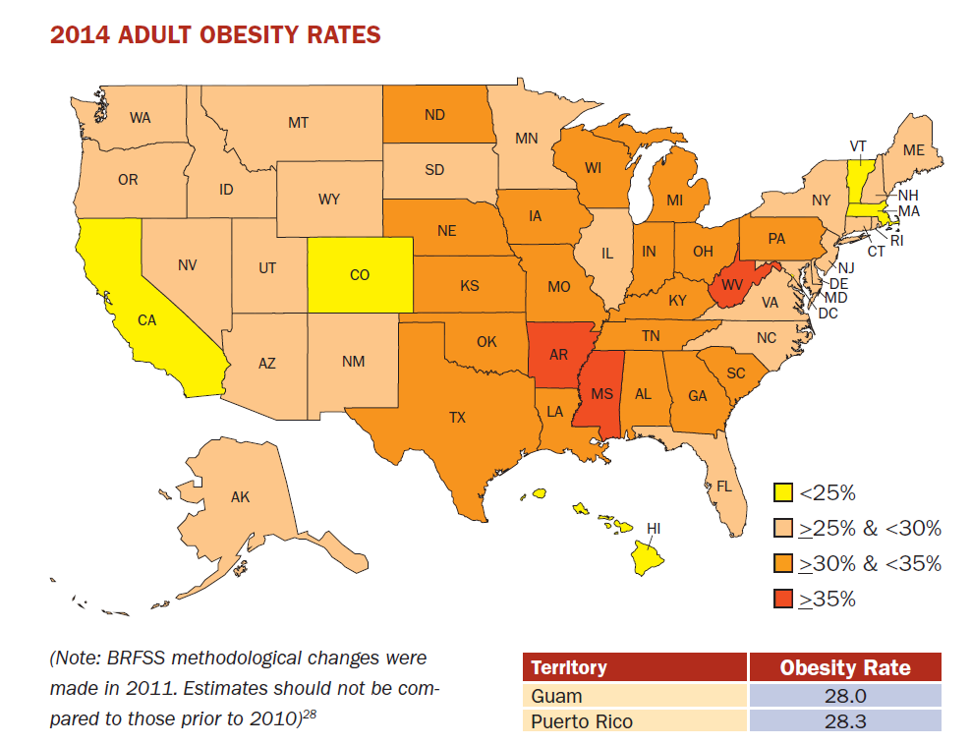
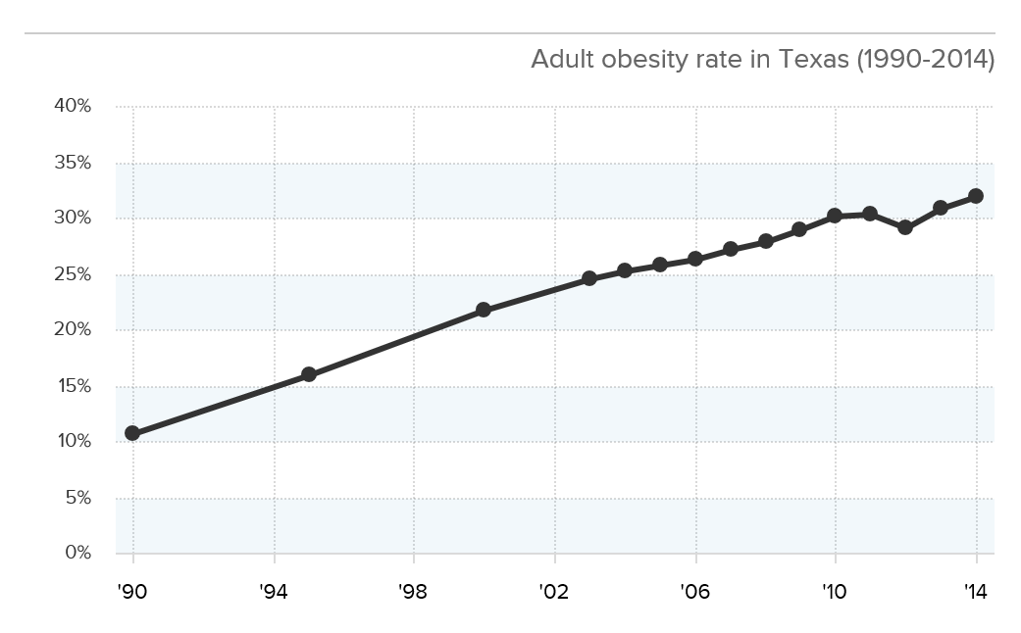
Adult Obesity
Source: http://stateofobesity.org/files/stateofobesity2015.pdf

Slide 47
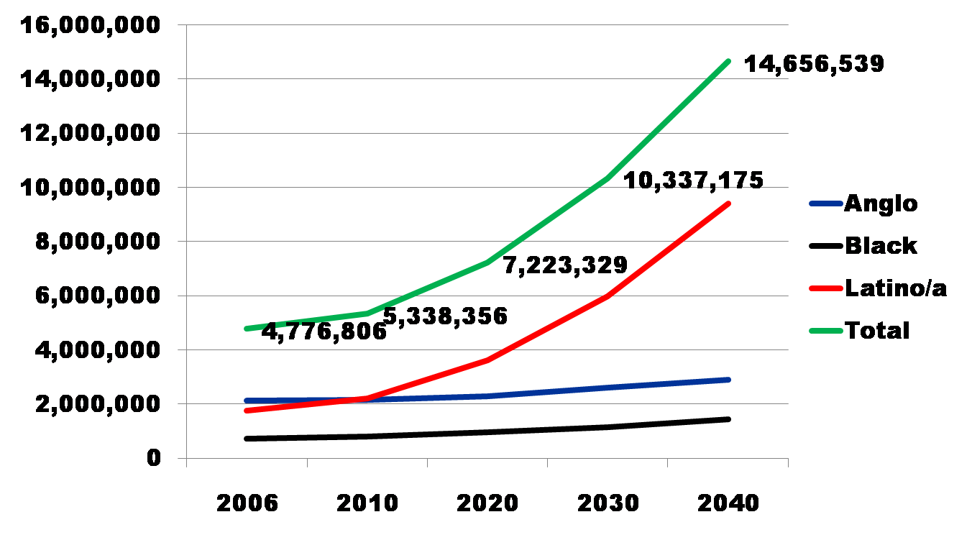
Projected Increase in Obesity in Texas by Ethnicity, 2006 to 2040
Source: Office of the State Demographer projections, using 2000-2004 migration scenario population projections

Slide 48
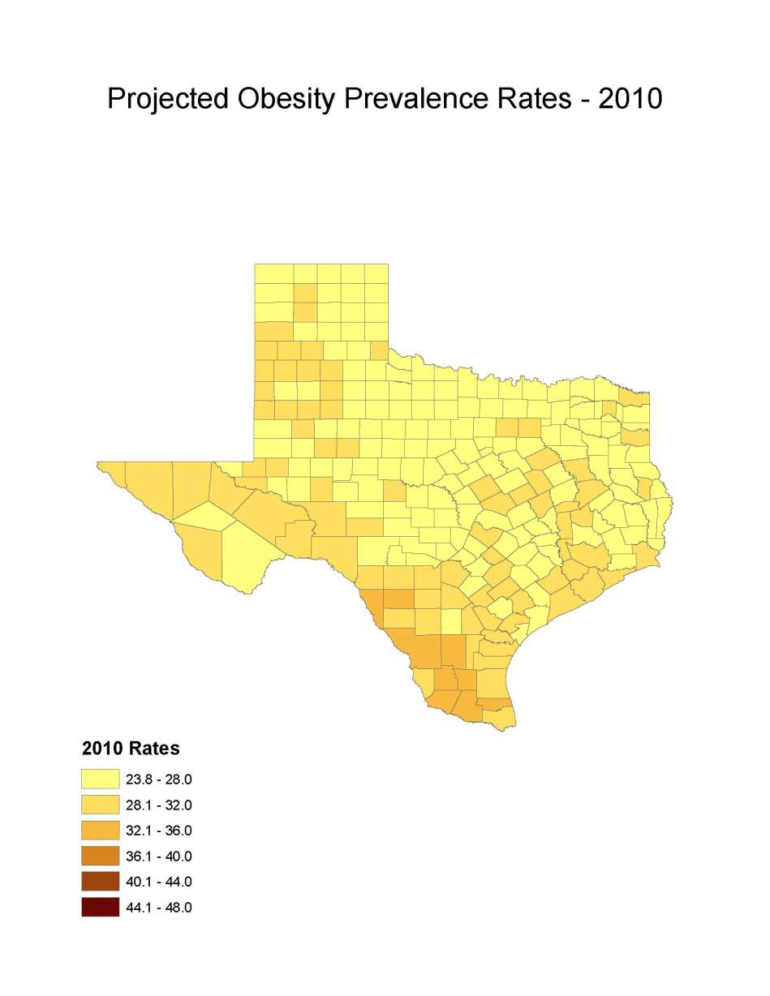
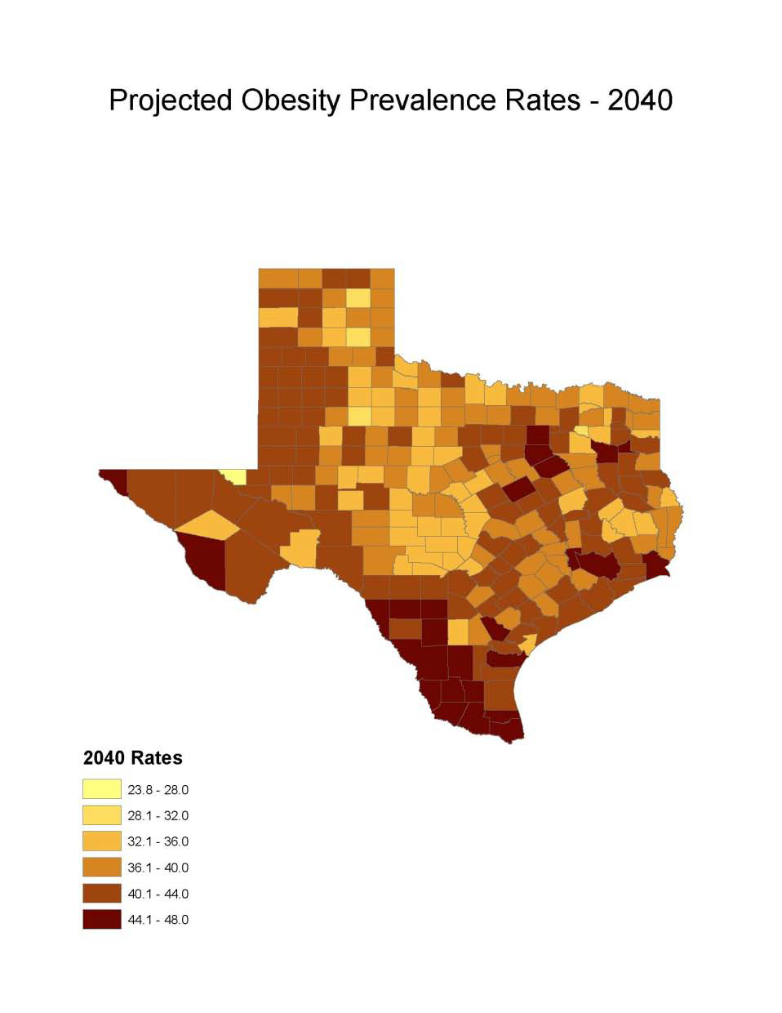
Obesity Prevalence
% adults with obesity: Texas Demographic Center

Slide 49
Projected Number of Adults with Diabetes by Race and Ethnicity, Texas, 2010-2040

Slide 50
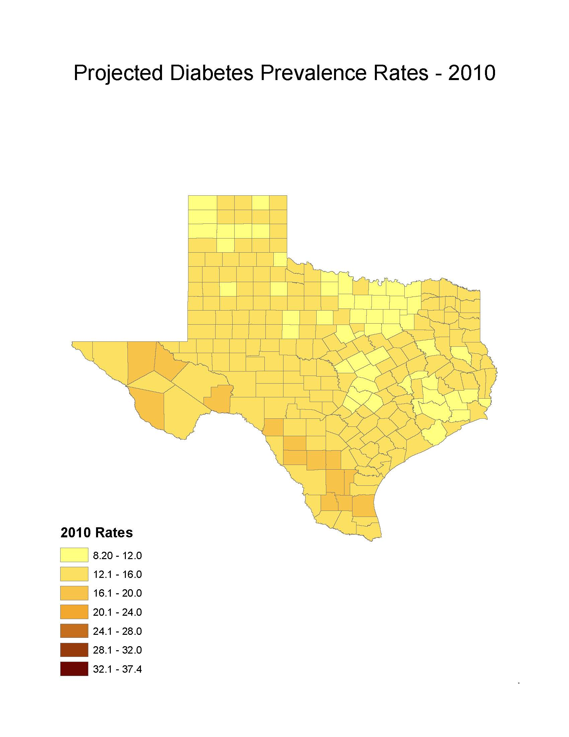
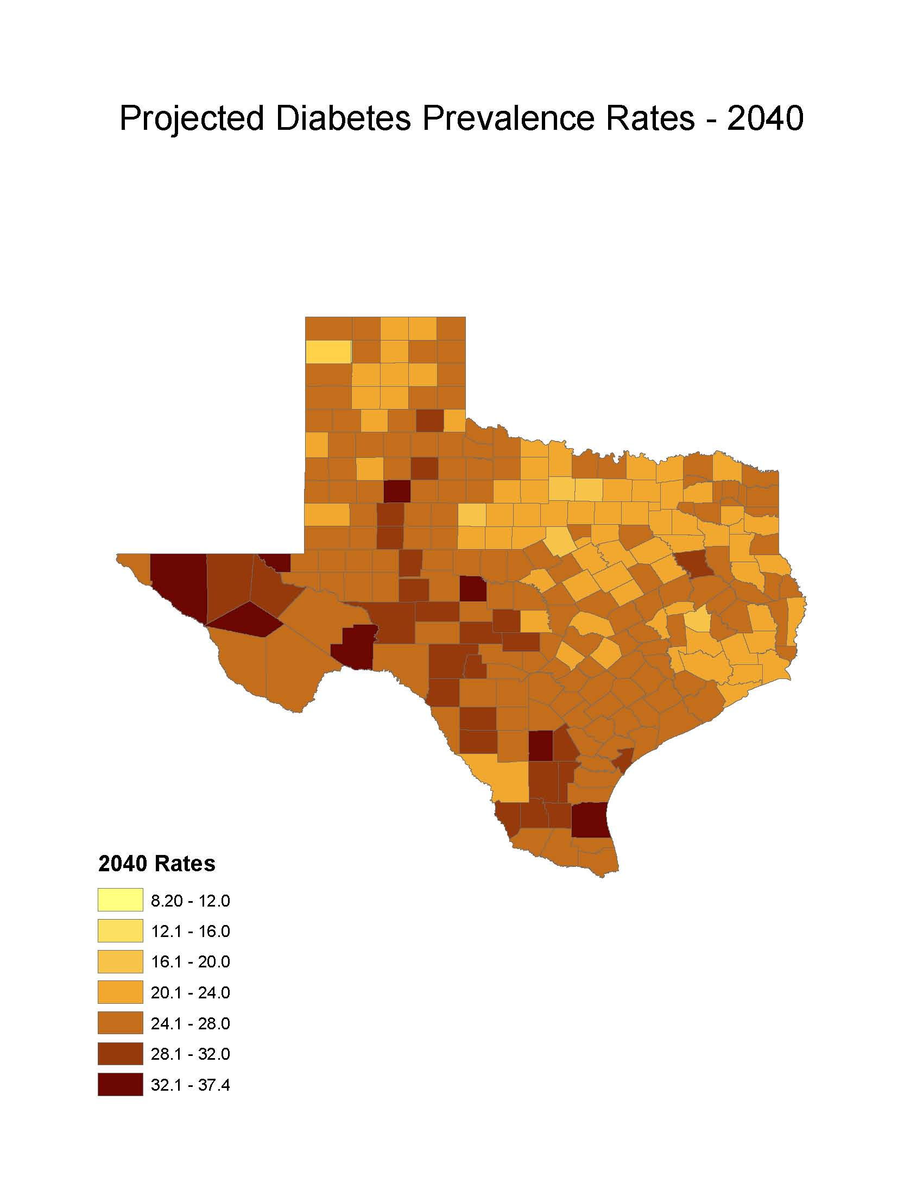
Diabetes Prevalence
% adults with diabetes: Texas Demographic Center

Slide 51

Contact
  State Demographer
  Office: (210) 458-6530
  Email: Lloyd.Potter@utsa.edu
  Internet: demographics.texas.gov
Lloyd Potter, Ph.D.
@TexasDemography
Notes:
The Texas Demgraphic Data Center are committed to supporting your work through providing you with the best, most accurate, and objective information we can identify about our greatest asset, the people of Texas.

