Slide 1

Texas Demographic Trends, Characteristics, and Projections
Texas Statewide Telephone Cooperative, Inc.
Austin, TX
October 13, 2017
@TexasDemography

Slide 2
Demographic Overview
Texas is experiencing significant growth.
Population continues to grow at a steady pace though growth is not geographically evenly distributed.
Growth is not racially/ethnically evenly distributed. Population growth is being driven largely by the Hispanic population.
The population of Texas, while relatively young, is also aging.
The components of population change have varying implications for infrastructure in Texas.
Demographic shifts may have serious implications for maintaining inclusive and equitable economic growth in the state.

Slide 3
Texas is experiencing fast and high growth.

Slide 4
Growing States, 2000-2016
 | 2000 Population | 2010 Population | 2016 Population | Numeric Change 2010-2016 | Percent Change 2010-2016
United States | 281,421,906 | 308,745,538 | 323,127,513 | 14,369,408 | 4.7%
Texas | 20,851,820 | 25,145,561 | 27,862,596 | 2,716,496 | 10.8%
California | 33,871,648 | 37,253,956 | 39,250,017 | 1,995,495 | 5.4%
Florida | 15,982,378 | 18,801,310 | 20,612,439 | 1,807,847 | 9.6%
Georgia | 8,186,453 | 9,687,653 | 10,310,371 | 621,691 | 6.4%
North Carolina | 8,049,313 | 9,535,483 | 10,146,788 | 611,100 | 6.4%
Washington | 5,894,121 | 6,724,540 | 7,288,000 | 563,455 | 8.4%
Arizona | 5,130,632 | 6,392,017 | 6,931,071 | 538,770 | 8.4%
Source: U.S. Census Bureau. 2000 and 2010 Census Count, 2016 Population Estimates.
Notes:
Texas is the second largest state in terms of population (2nd to CA) and area (2nd to AK). In terms of number of people, Texas’ growth exceeds that of all other states between 2010 and 2016.

Slide 5
Total Population in Texas, 1950-2016 (in millions)
Source: U.S. Census Bureau. 2000 and 2010 Census Counts and Population Estimates.
All values for decennial dates are for April 1st of the indicated census year. Values for 2011-2016 are for July 1 as estimated by the U.S. Census Bureau.
Notes:
Between 2000 and 2010 Texas added over 4 million residents. In 6 short years, it is estimated Texas has added over 2 million more, placing Texas population at 27.9 million, on pace to meet or surpass our gains since the last census. Population growth in Texas has been geometric or compounding in nature. Over the past six decades there have been three periods where the numeric growth has increased relative to previous years. We have no indication that the population growth in Texas will slow dramatically in coming years.

Slide 6

Total Estimated Population by County, Texas, 2016
Source: U.S. Census Bureau, 2016 Vintage Population Estimates
Notes:
When we look at the geographic distribution of the population of Texas over time we see continually increasing population in the counties along the I-35 corridor, the Houston area, and the lower Rio Grand Valley. Urbanized areas out west have grown but most counties west have experienced limited growth and some population decline. Approximately 86% of the population is along I-35 and east. This area with the 3 major metropolitan areas at the points is often described as the Texas population triangle.
The counties of Harris, Dallas, Tarrant, Bexar, and Travis make up the points of the “population triangle” in Texas and are the most populated in the State. Collin, Denton, Fort Bend, Hidalgo, and El Paso counties also have significant population concentrations. Many counties west of Interstate 35 are more sparsely populated.

Slide 7
Estimated Population Change, Texas Counties, 2010 to 2016
96 counties lost population over the 6 year period.
Source: U.S. Census Bureau, 2016 Vintage Population Estimates
Notes:
Population change over the decade has been greatest in the urban and suburban population triangle counties. Counties in the lower Rio Grande Valley also had significant growth as did El Paso. Overall, 158 counties gained population while 96 (38%) lost population over the decade.

Slide 8
Estimated Percent Change of the Total Population by County, Texas, 2010 to 2016
Source: U.S. Census Bureau, 2016 Vintage Population Estimates
Notes:
Percent change is an indicator of the speed of population change void of information about the volume of population change. Percent change in the population over the past few years has been greatest in the suburban population triangle counties, notably among counties between San Antonio and Austin. In the early part of the decade, counties in the Eagle Ford Shale area (south east of San Antonio) and the Cline Shale area (Midland and Odessa area), had been growing quickly. This is no longer the case.

Slide 9
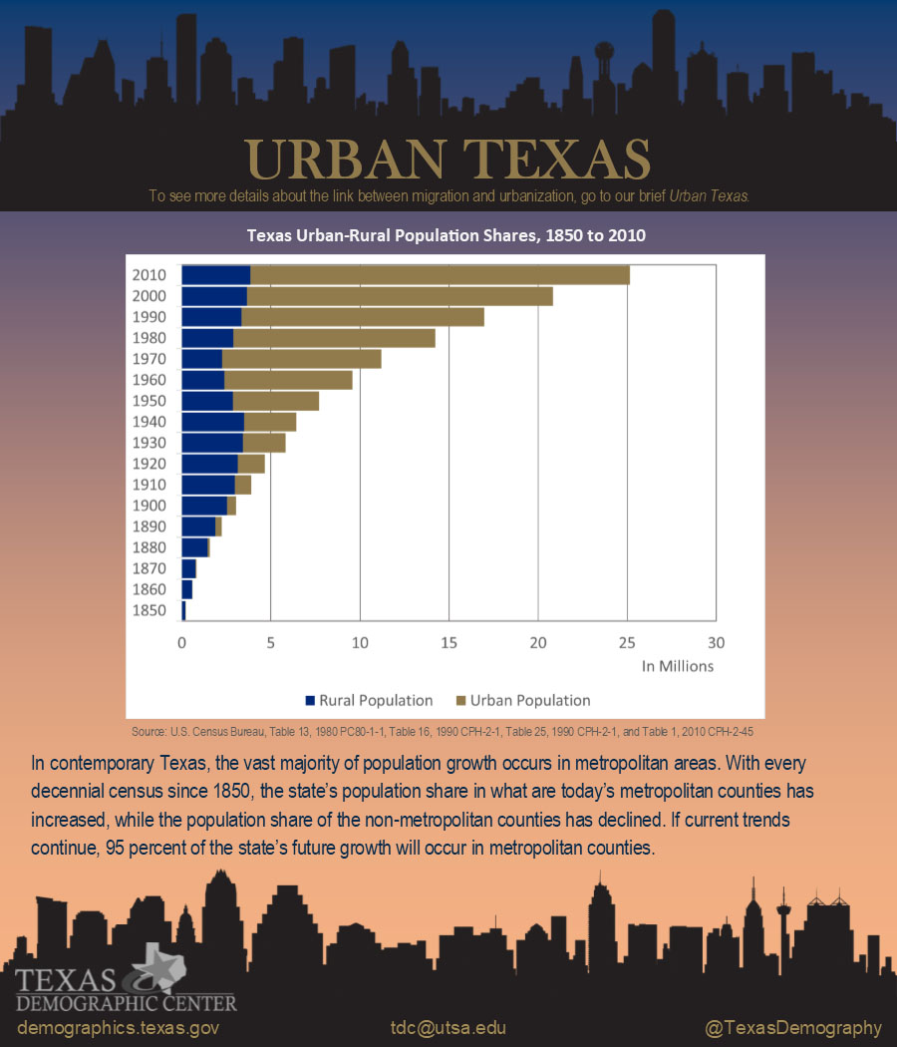

Slide 10
Components of Population Change
by Percent in Texas, 1950-2010
Source: U.S. Census Bureau, Population Estimates
Notes:
It is important to understand a couple of very basic element of population change to think about how growing population may impact our transportation system. Population changes from two factors, one is natural increase which is simply births minus deaths over time. Essentially population added from natural increase are babies who are unlikely to be driving their own vehicle on our roads before age 16. Combine this with the fact that as people die, there are fewer drivers on the road. So the effect of population growth from natural increase on our transportation infrastructure is both lightening, from people dying, and delayed until babies reach the age where they can drive. The second way population changes is from net-migration, which is simply in-minus out migrants. In Texas, the balance has been for us to have more in than out migrants. Migrants, are usually adults who are drivers (though yes, some do have non-driving children) and the may be compounded by the fact that many of the in-migrants may also take a job that requires them to drive. Essentially, migrants immediately contribute to adding stress to the transportation infrastructure.
When we look at population change in Texas, from 1950 to present we can see that before 1970, most of our growth was from natural increase. Starting in the 1970s a much larger percent of our growth is attributed to net migration and this continues to today where approaching half of our population change is from migration.

Slide 11
Top Counties for Percent Growth* in Texas,
2015-2016
County | U.S. Rank | 2015-2016 Percent Population Change | Percent Change from Domestic Migration | Percent Change from International Migration
Kendall | 2 | 5.2% | 95.9% | 4.0%
Hays | 3 | 5.1% | 82.2% | 1.8%
Comal | 6 | 4.4% | 88.5% | 2.0%
Williamson | 14 | 4.1% | 74.1% | 5.6%
Fort Bend | 18 | 3.8% | 59.4% | 15.8%
Montgomery | 24 | 3.7% | 73.5% | 8.0%
Rockwall | 25 | 3.6% | 82.2% | 2.5%
Denton | 28 | 3.6% | 67.1% | 9.0%
Kaufman | 36 | 3.4% | 81.3% | 2.2%
Bastrop | 42 | 3.1% | 83.5% | 0.7%
Ellis | 50 | 3.1% | 78.1% | 2.6%
8
Source: U.S. Census Bureau, 2016 Vintage Population Estimates.
Notes:
Ten percent of the 50 fastest growing counties in the United States from 2015 to 2016 were in Texas. Some of the fastest growing counties in the country continue to be suburban ring counties, such as Kendall, Hays, and Comal counties. Growth among the fastest growing counties in the country stems more from migration than natural increase.

Slide 12
Top Counties for Numeric Growth in Texas,
2015-2016
County | U.S. Rank Population Change | Population Change | Percent of Change from Natural Increase | Percent Change from Domestic Migration | Percent Change from International Migration
Harris | 2 | 56,587 | 79.9% | -27.9% | 48.1%
Tarrant | 5 | 35,462 | 44.4% | 37.7% | 17.9%
Bexar | 7 | 33,198 | 44.6% | 39.3% | 16.1%
Dallas | 9 | 29,209 | 79.9% | -20.9% | 41.0%
Denton | 11 | 27,689 | 23.9% | 67.1% | 9.0%
Fort Bend | 13 | 27,388 | 24.8% | 59.4% | 15.8%
Collin | 14 | 26,506 | 25.8% | 58.7% | 15.5%
Travis | 17 | 24,505 | 44.2% | 33.3% | 22.5%
Williamson | 22 | 20,659 | 20.3% | 74.1% | 5.6%
Montgomery | 24 | 19,769 | 18.5% | 73.5% | 8.0%
Hidalgo* | 54 | 10,529 | 113.5% | -33.4% | 19.9%
Hidalgo County had negative net migration (-13.5% of total population growth).
Source: U.S. Census Bureau, 2016 Vintage Population Estimates
9
Source: U.S. Census Bureau, 2016 Vintage Population Estimates.
Notes:
Ten of the top 25 counties in the United States that were growing the most numerically between 2015 and 2016 were in Texas. These counties are the larger ones in the State and are all counties that have experienced continued growth. However, the components attributing to their population change varies. For instance, natural increase and international migration are playing a key role in population growth in Dallas County. Harris and Tarrant counties are growing about evenly from migration and natural increase. Whereas in the suburban ring counties migration (mostly domestic) is driving population growth. 2016 marked the first year in a few years that Harris County did not add the most people of any other county in the U.S. This drop can most likely be attributed to a decline in oil and gas industry in this region.

Slide 13
Estimated Percent of Total Net-Migrant Flows to and From Texas and Other States, 2015
Source: U.S. Census Bureau, 2016. ACS Migration Flows, 2015

Slide 14
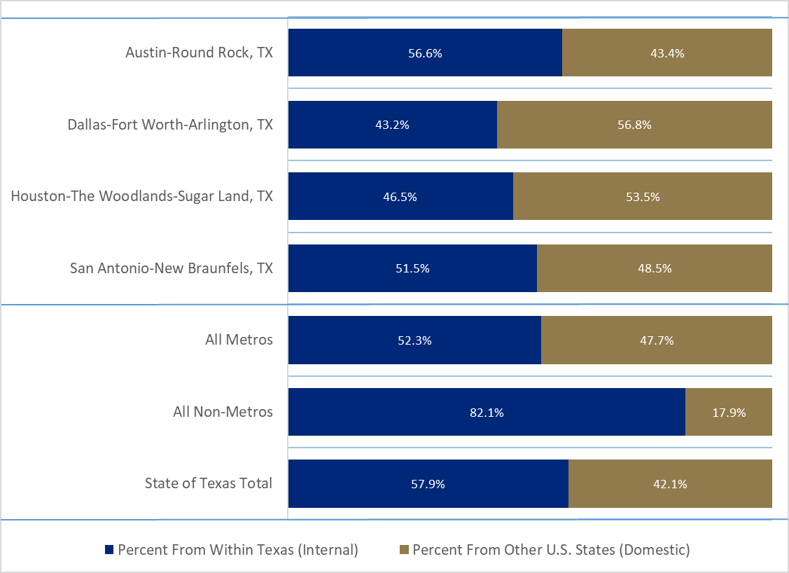
Shares of Internal and Domestic Gross Migration, Texas MSAs, 2010-2014

Slide 15
Texas continues to racially/ethnically diversify.

Slide 16
Texas Racial and Ethnic Composition,
2000, 2010, and 2016
11
Source: U.S. Census Bureau. 2000, 2010 Decennial Census and 2016 Population Estimates
Notes:
As of the 2000 Census, about 53% of Texas’ population was non-Hispanic Anglo, about 32% where of Hispanic descent, about 11% where non-Hispanic African American, and about 4% were non-Hispanic Other.
In 2010, it is estimated that about 45% of the Texas population was non-Hispanic Anglo, 38% of Hispanic descent, 11% were non-Hispanic African American, and about 6% were non-Hispanic Other (largely of Asian descent).

Slide 17
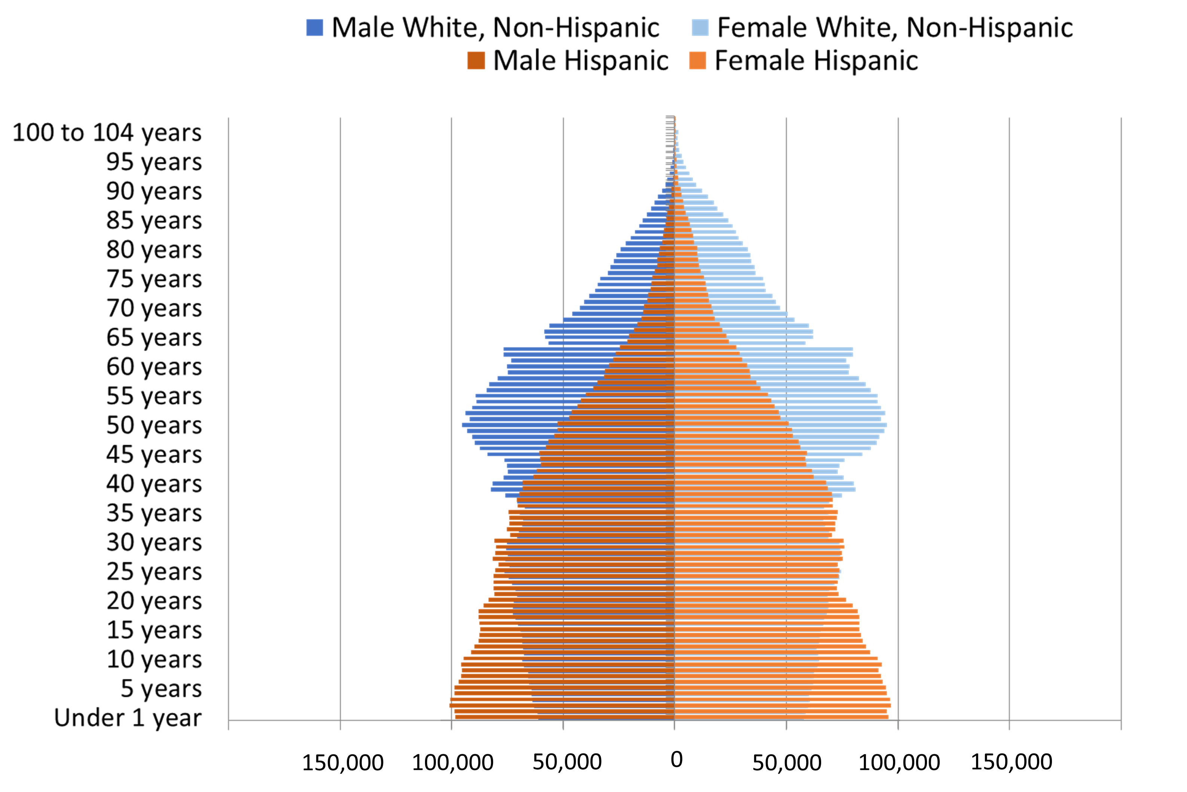
Population Pyramids for Hispanics and Non-Hispanic Whites in Texas, 2010
Notes:
The age distribution of the non-Hispanic white population in Texas is weighted heavily with the “baby boom” generation. Largely the result of lower fertility and less net in-migration, the non-Hispanic white population has relatively fewer young persons relative to those in the middle-age years. In 2010, at ages 37 and younger, the Hispanic population exceeds the non-Hispanic white population. Median age of NH White women is 43.4 years of age, compared to 29.0 years of age for Hispanic women.

Slide 18
Annual Shares of Recent Non-Citizen Immigrants to Texas by World Area of Birth, 2005-2015
Source: U.S. Census Bureau, American Community Survey, 1-Year PUMS

Slide 19
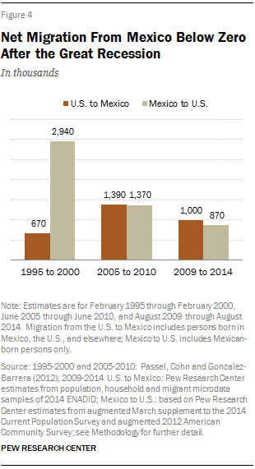
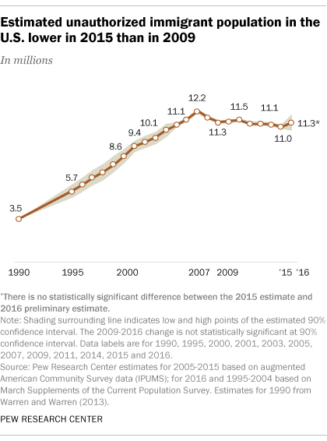
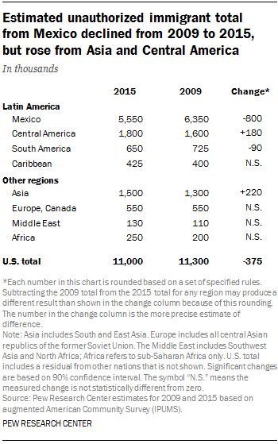
Unauthorized and Mexican Immigration, 2015
Notes:
Texas is estimated to be home to 1.65 million undocumented immigrants, making up about 6% of the total state population but nearly 9% of the state’s work force. The decreasing number of undocumented immigrants could have implications for the growth of the state, its labor force, and the racial make up of Texas immigrants.

Slide 20
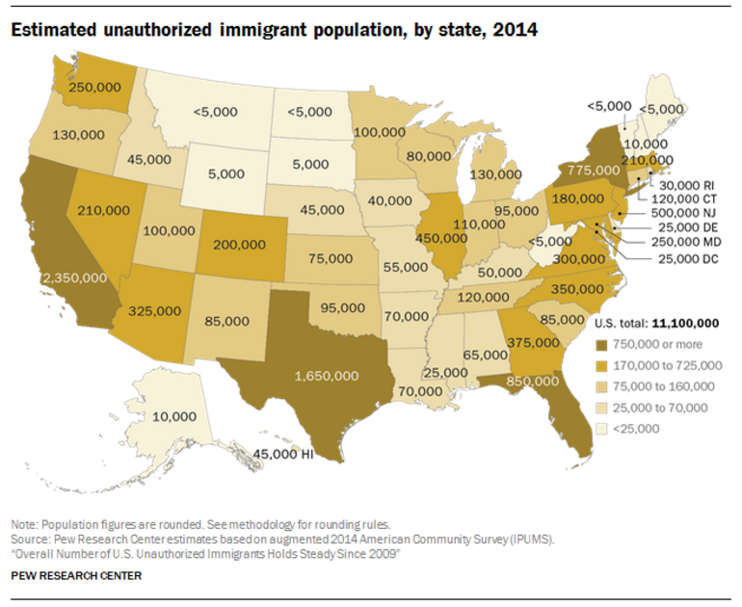

Slide 21


Slide 22
Texas is young, but aging.

Slide 23
States with the Oldest Median Ages, 2000, 2010, 2014
2000 |  |  | 2010 |  |  | 2014
Rank | State | Med Age | Rank | State | Median Age | Rank | State | Median Age
1 | West Virginia | 38.9 | 1 | Maine | 42.7 | 1 | Maine | 44.2
2 | Florida | 38.7 | 2 | Vermont | 41.5 | 2 | New Hampshire | 42.6
3 | Maine | 38.6 | 3 | West Virginia | 41.3 | 3 | Vermont | 42.6
4 | Pennsylvania | 38 | 4 | New Hampshire | 41.1 | 4 | West Virginia | 42.0
5… | Vermont | 37.7 | 5 | Florida | 40.7 | 5 | Florida | 41.8
…46 | California | 33.3 | 46 | California | 35.2 | 46 | Idaho | 35.7
47 | Idaho | 33.2 | 47 | Idaho | 34.6 | 47 | North Dakota | 34.9
48 | Alaska | 32.4 | 48 | Alaska | 33.8 | 48 | Texas | 34.2
49 | Texas | 32.3 | 49 | Texas | 33.6 | 49 | Alaska | 33.3
50 | Utah | 27.1 | 50 | Utah | 29.2 | 50 | Utah | 30.5
- | United States | 35.3 | - | United States | 37.2 | - | United States | 37.7
Source: US Census Bureau, 2000 and 2010 Decennial Censuses US Census Bureau, 2014 Population Estimate by State

Slide 24
Texas Population by Age Group, 2000 to 2014
 | 2000 |  | 2010 |  | 2014 |  | 2000-2014
 | Population | Percent | Population | Percent | Estimate | Percent | Absolute Change | Percent Change
Under 18 | 5,886,759 | 28.2 | 6,865,824 | 27.3 | 7,115,614 | 26.4 | 1,228,855 | 20.9
18 to 64 | 12,892,529 | 61.8 | 15,677,851 | 62.3 | 16,742,263 | 62.1 | 3,849,734 | 29.9
65 and Older | 2,072,532 | 9.9 | 2,601,886 | 10.3 | 3,099,081 | 11.5 | 1,026,549 | 49.5
Total | 20,851,820 | 100 | 25,145,561 | 100 | 26,956,958 | 100 | 6,105,138 | 29.3
Source: US Census Bureau, 2000 and 2010 Censuses, QT-P1 and derived from QT-P1

Slide 25
Population Projections by Age Group,
2010 to 2050
Age Group | 2010 | 2020 | 2030 | 2040 | 2050 | 2010-2050 Percent Change
65 and Older | 2,601,886 | 4,014,083 | 5,929,471 | 7,583,385 | 9,442,865 | 262.9
65-69 | 853,100 | 1,375,699 | 1,779,930 | 2,019,401 | 2,519,575 | 195.3
70-74 | 619,156 | 1,081,697 | 1,569,556 | 1,747,404 | 2,136,439 | 245.1
75-79 | 477,245 | 714,641 | 1,181,376 | 1,568,513 | 1,830,330 | 283.5
80-84 | 347,206 | 440,399 | 794,965 | 1,186,724 | 1,365,653 | 293.3
85+ | 205,501 | 401,647 | 603,644 | 1,061,343 | 1,590,868 | 421.3
Total Population | 25,145,561 | 30,541,978 | 37,155,084 | 44,955,896 | 54,369,297 | 116.2
Source: US Census Bureau, 2010 Census Texas State Data Center, 2014 Projections, 1.0 Migration Scenario

Slide 26
Percent of Population 65 Years Plus, Texas Counties, 2011-2015
Source: U.S. Census Bureau, 2015 American Community Survey 5-Year Estimates
30

Slide 27
Economic Outlook

Slide 28
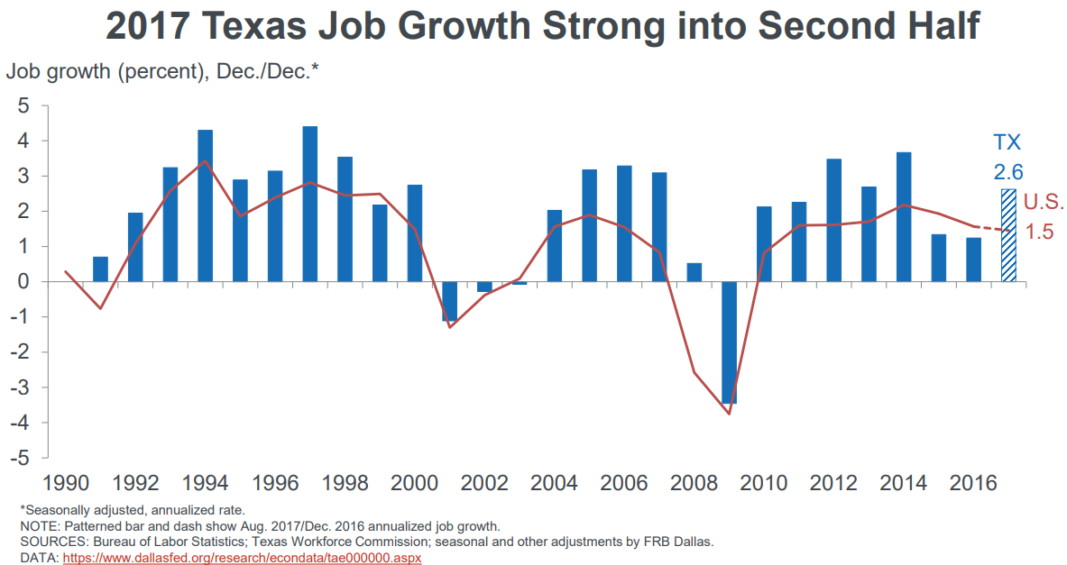
Job Growth, U.S. and Texas, 1990 to Aug 2017
Notes:
According to the Dallas Fed, the Texas economy started strong in 2017 with job growth at 2.6% through August. This compares with a job growth of 1.5% for the U.S. Although early 2016 job growth started slow, the second half improved to 1.9% from 0.6% in the first half. Total job growth in 2017 is forecasted at 2.6%.

Slide 29
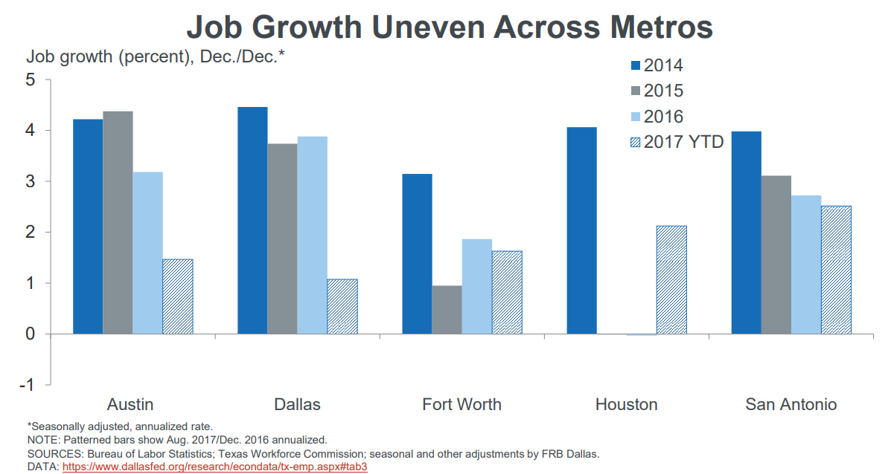

Slide 30
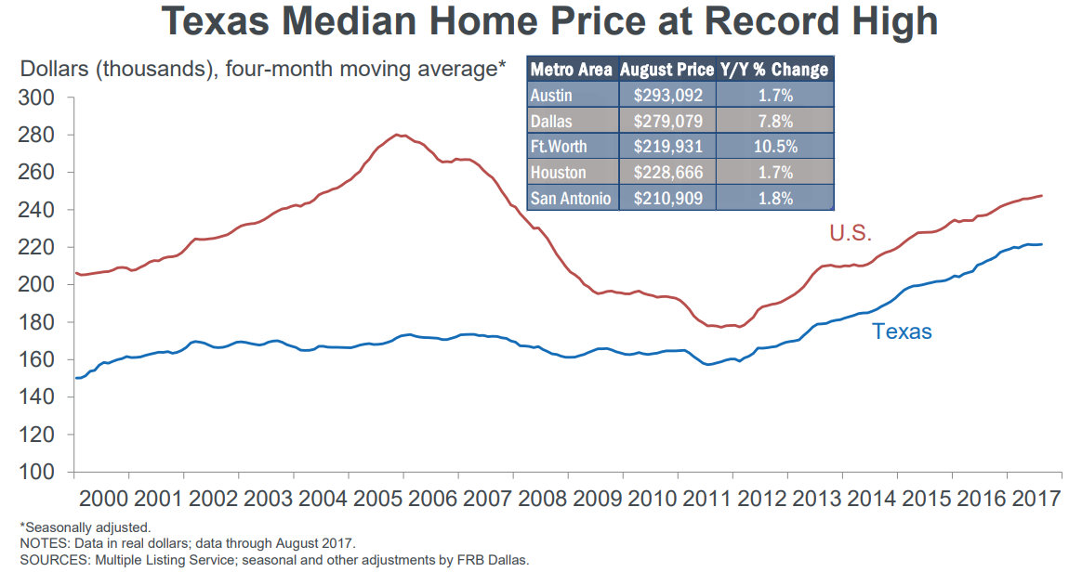

Slide 31
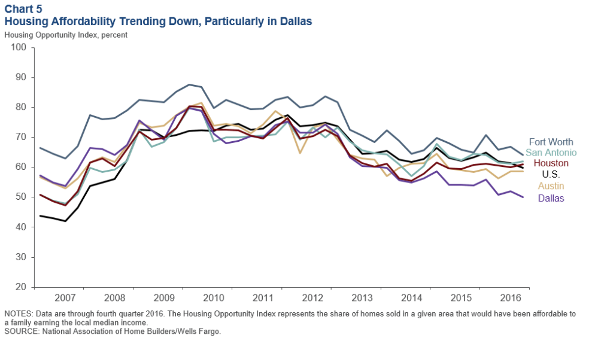
Housing Affordability in Select Texas Metros,
2007-2016
Notes:
Housing affordability—the share of homes sold that were affordable to a median-income family in the area—has fallen in most major Texas metros. Houston is an exception, the result of the oil bust slowing home appreciation. Apartment demand and occupancy rates generally remain high.

Slide 32
Economic Indicators, Texas and U.S., 2016
 | Median Household Income | Change, 2015-2016
Texas | $56,565 | +
Asian | $82,081 | +
NH White | $70,131 | +
Hispanic | $44,579 | +
Black | $42,582 | +
Unemployment rate
  Texas = 5.6%
  U.S. = 5.8%
Median Household Income
  Texas = $56,565
  U.S. = $57,617
Median Family Income
  Texas = $67,025
  U.S. = 71,062
Median earnings for males working full time
  Texas = $47,351
  U.S. = $50,586
Median earnings for females working full time
  Texas = $37,576
  U.S. = $40,626
Poverty rate
  Texas = 15.6% 12.7%
  U.S. = 14.0%
Source: U.S. Census Bureau, 2016 American Community Survey 1-Year Estimates

Slide 33
Telecommunications

Slide 34
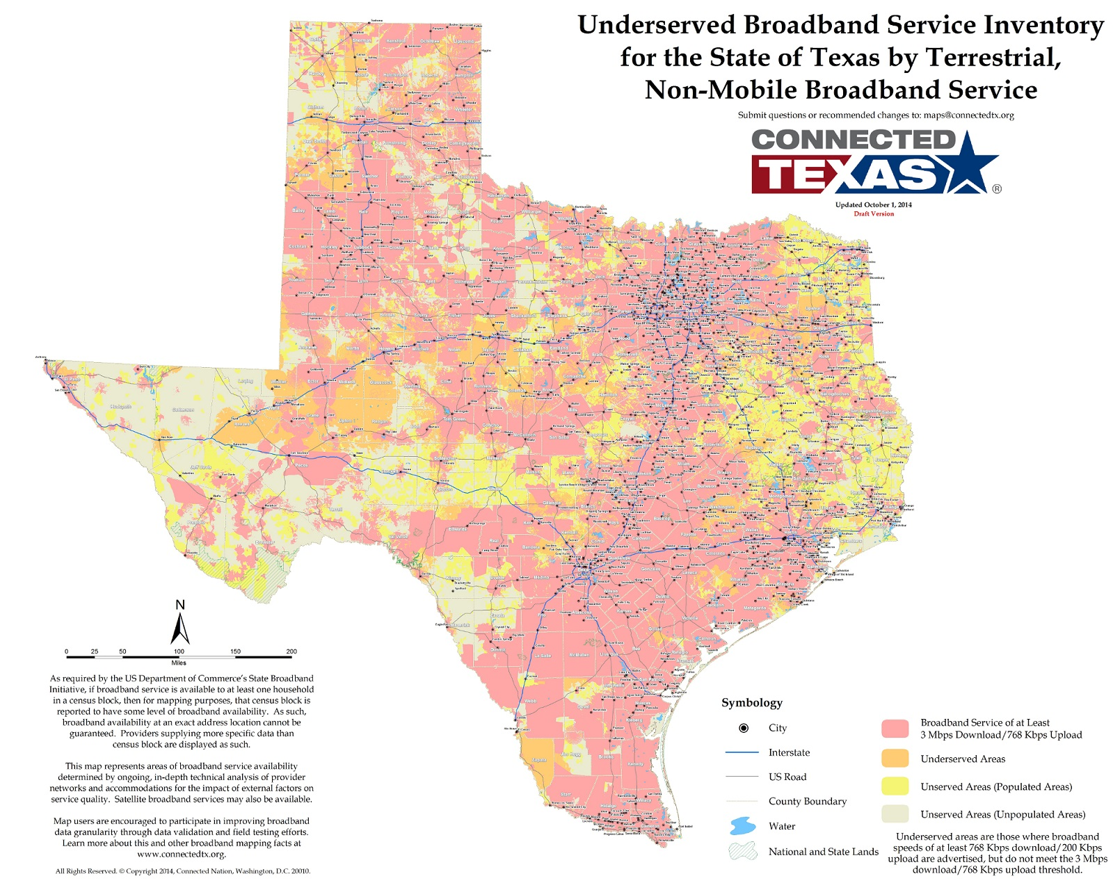

Slide 35
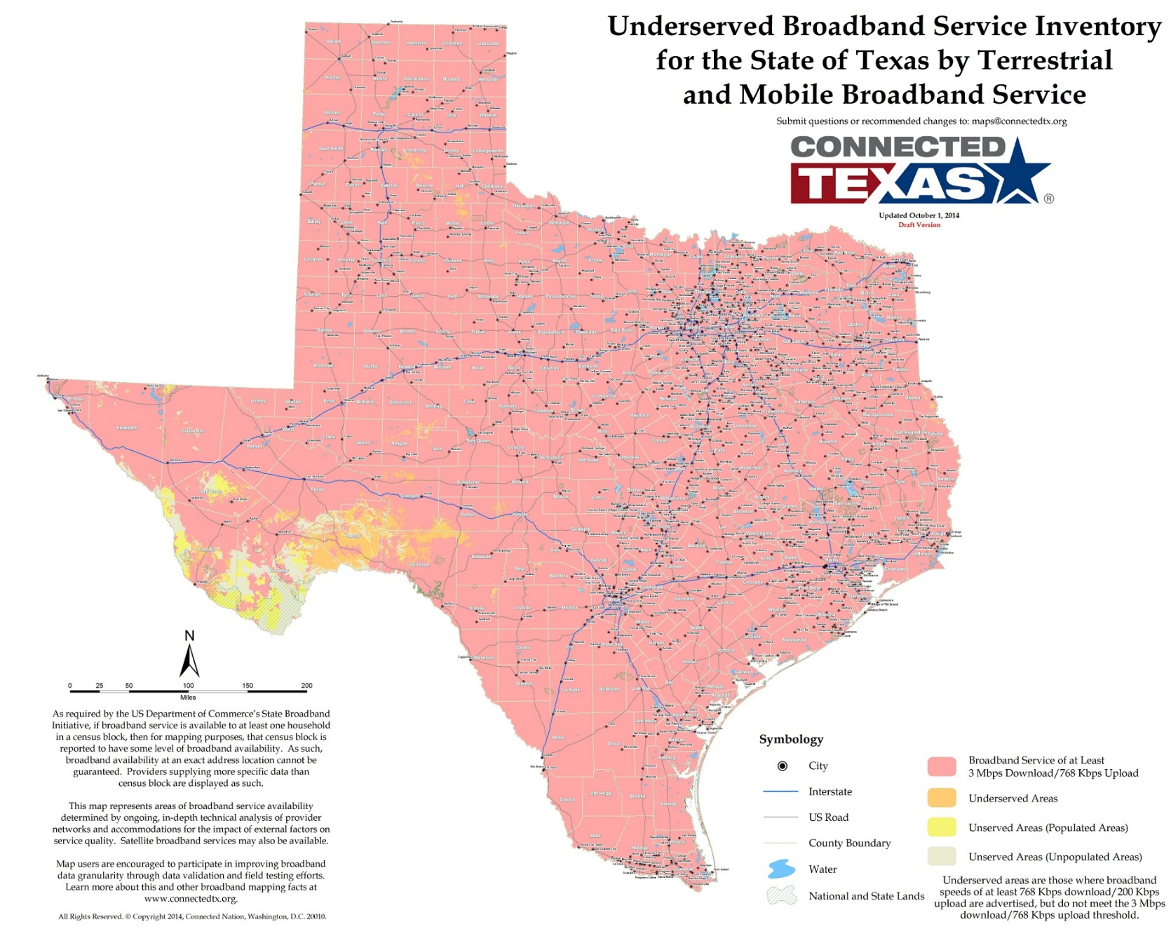

Slide 36
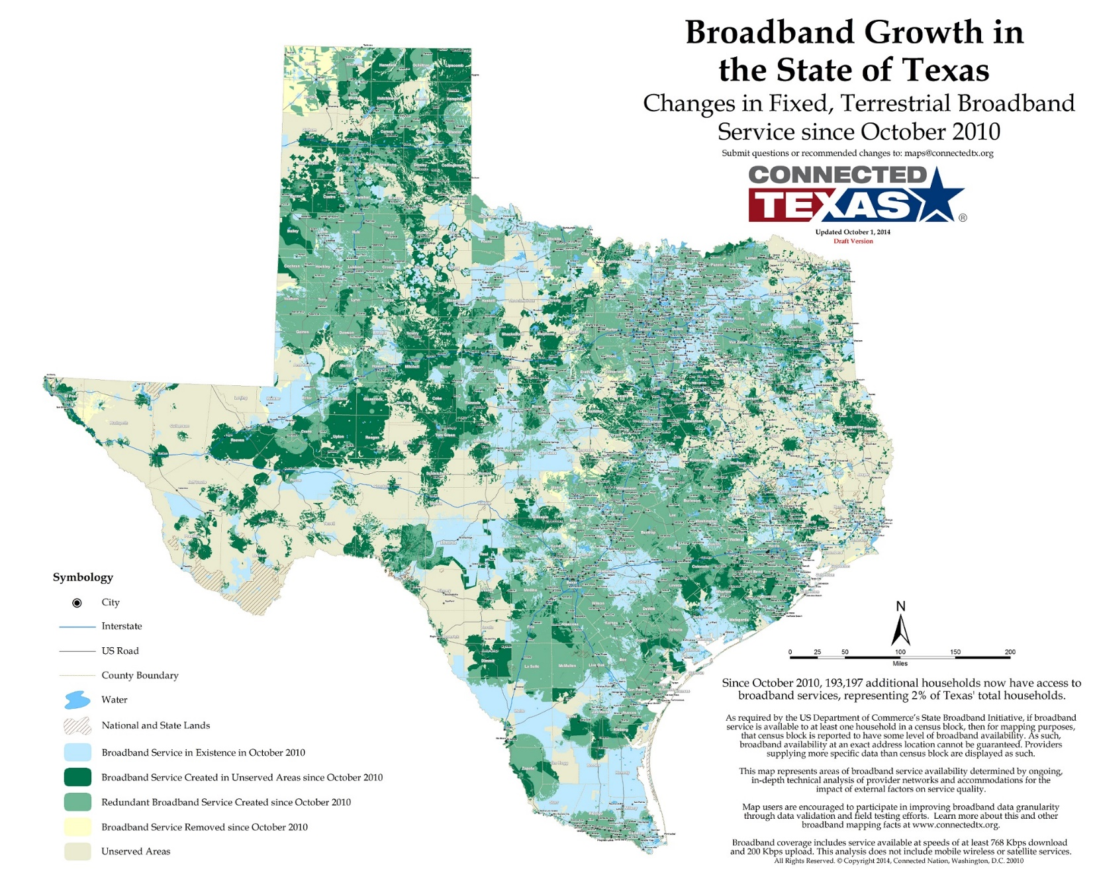

Slide 37
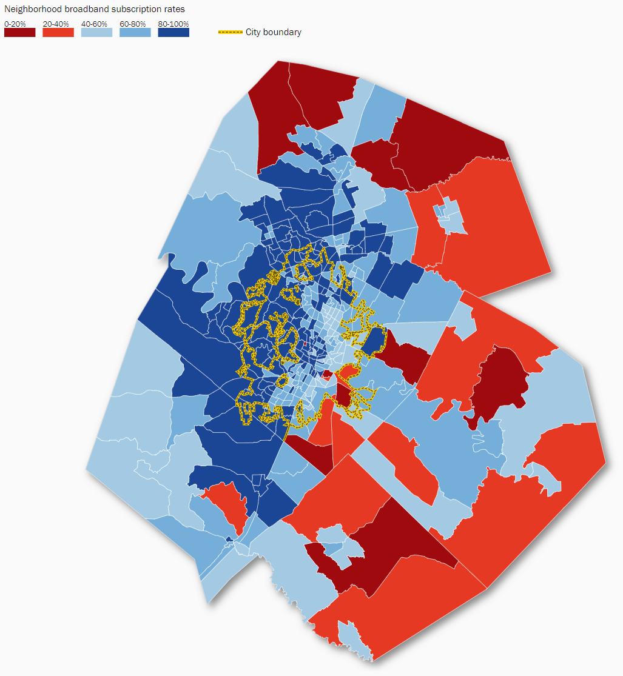
Broadband Subscription Rate by Census Tract, Austin-Round Rock MSA, 2015
Source: The Brookings Institute, Signs of Digital Distress report by A. Tomer, E. Kneebone, and R. Shivaram, 2017

Slide 38
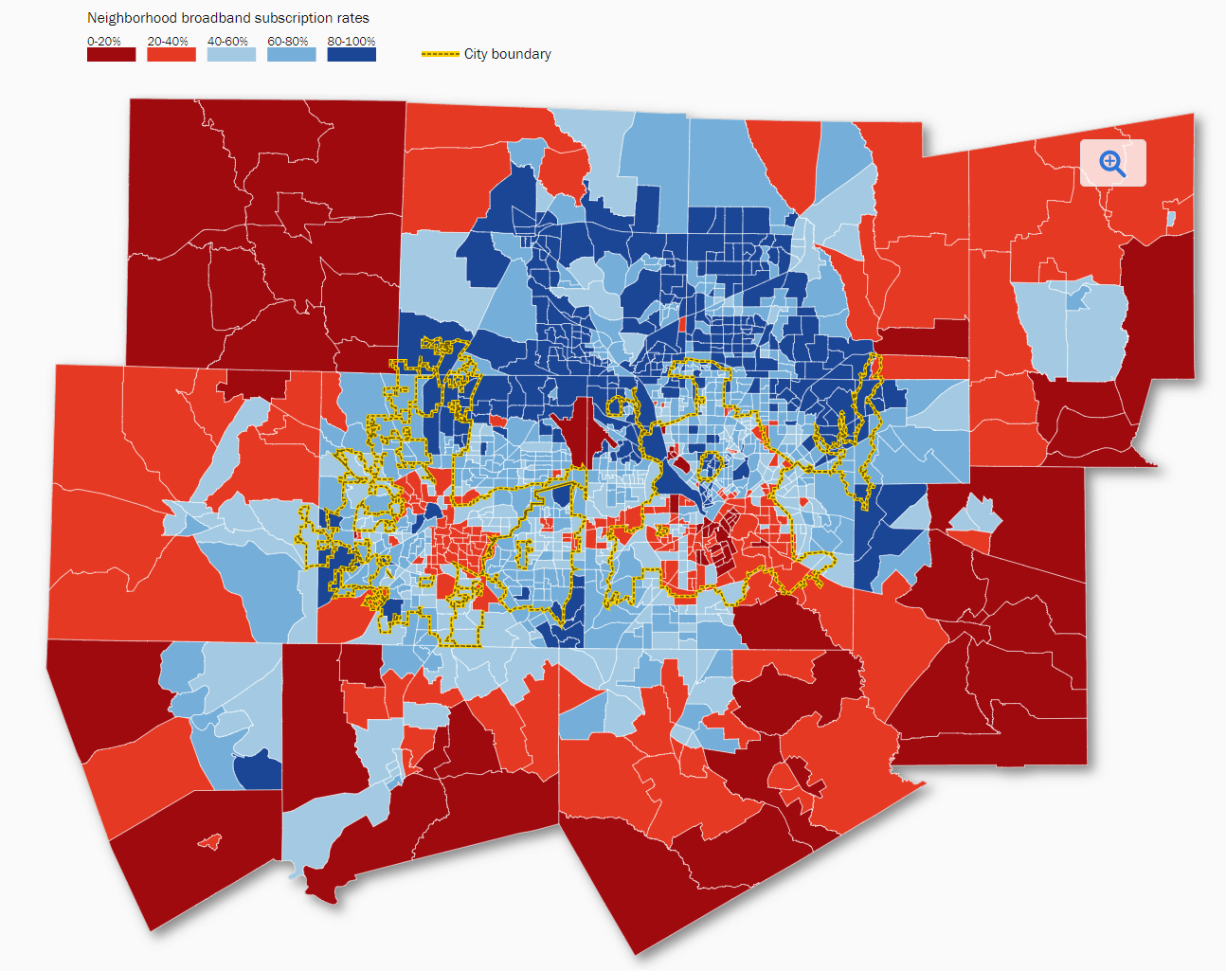
Broadband Subscription Rate by Census Tract, Dallas-Fort Worth-Arlington MSA, 2015
Source: The Brookings Institute, Signs of Digital Distress report by A. Tomer, E. Kneebone, and R. Shivaram, 2017

Slide 39
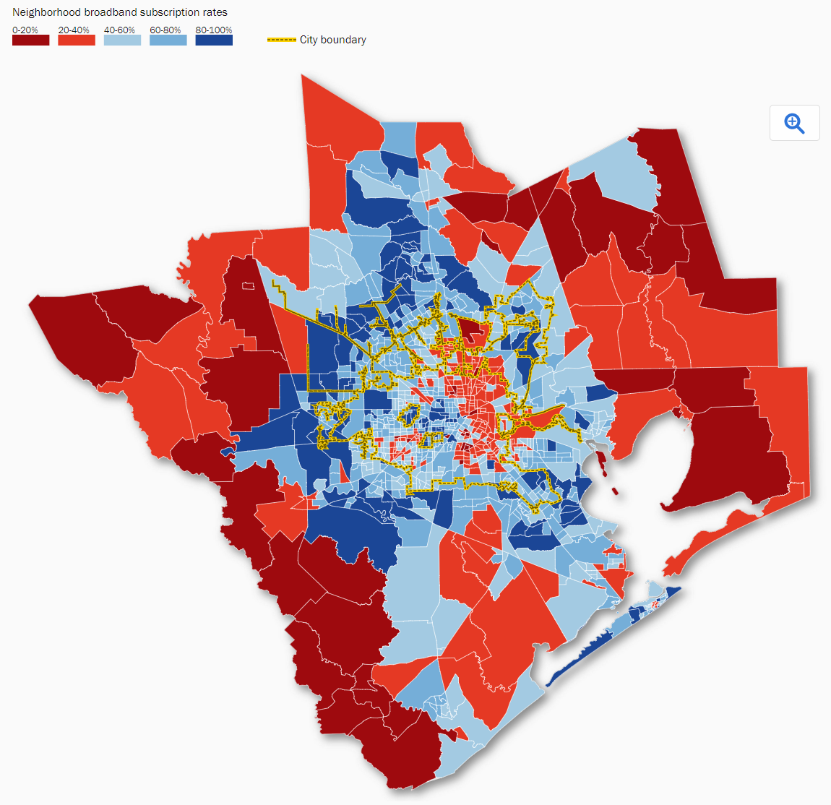
Broadband Subscription Rate by Census Tract, Houston-The Woodlands-Sugar Land MSA, 2015
Source: The Brookings Institute, Signs of Digital Distress report by A. Tomer, E. Kneebone, and R. Shivaram, 2017

Slide 40
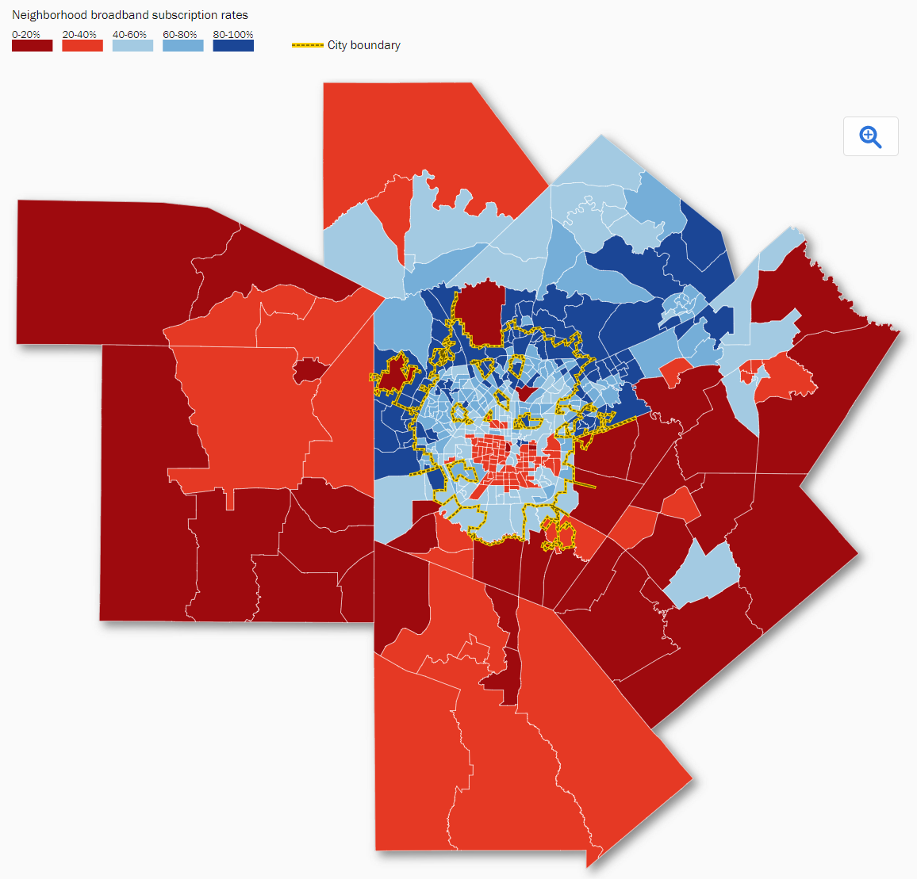
Broadband Subscription Rate by Census Tract, San Antonio-New Braunfels MSA, 2015
Source: The Brookings Institute, Signs of Digital Distress report by A. Tomer, E. Kneebone, and R. Shivaram, 2017

Slide 41
Texas Infrastructure

Slide 42
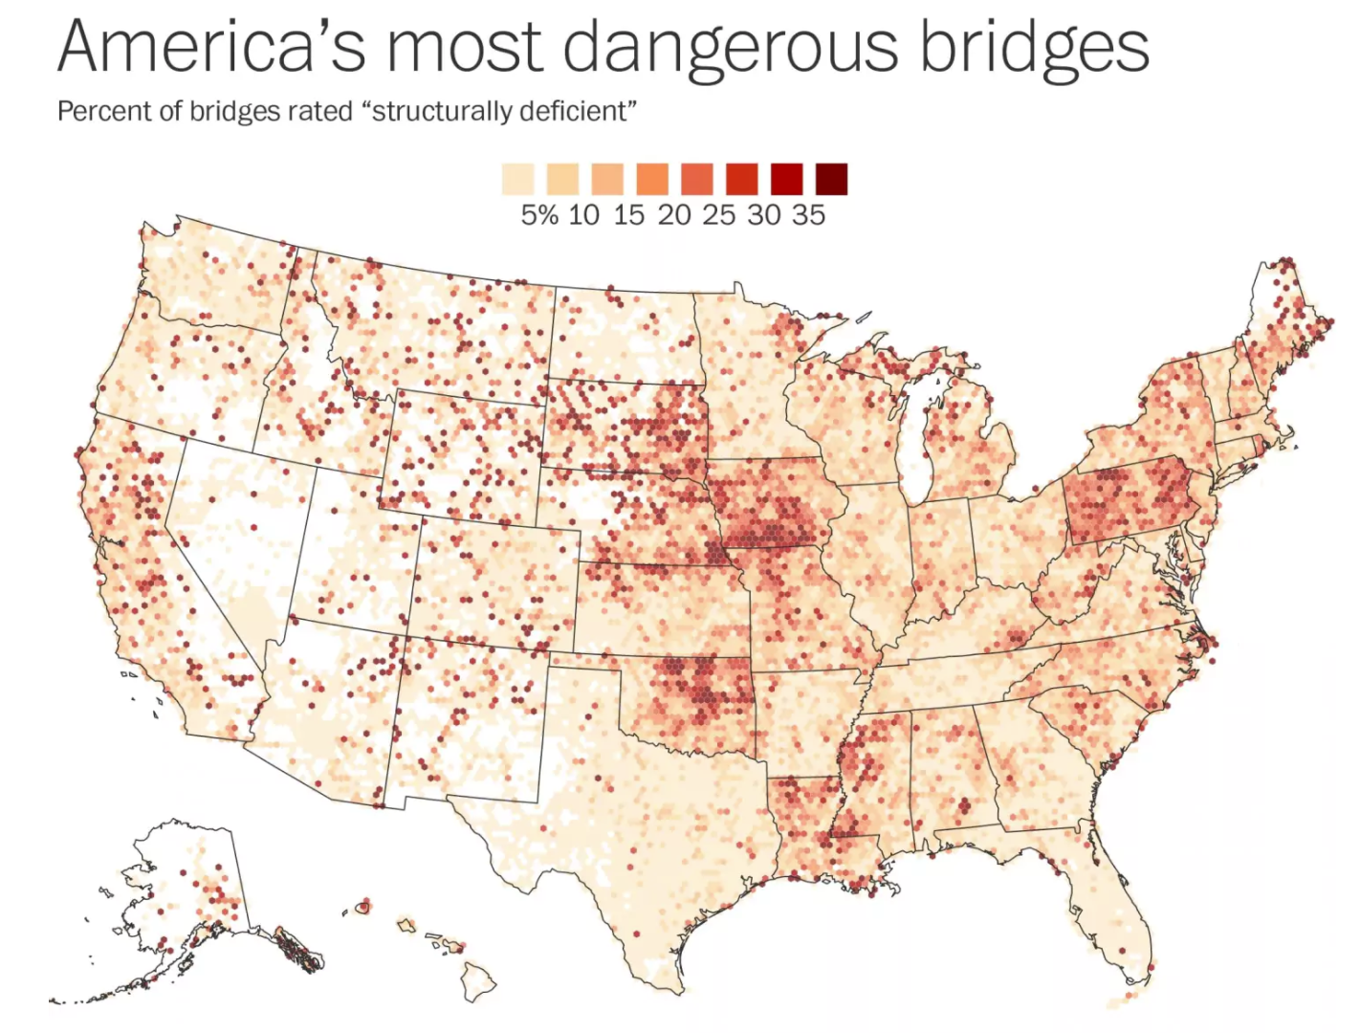
Structurally Deficient Bridges in America, 2015
Source: The Washington Post, 2015
Notes:
Texas has over 53,000 bridges. About 2 percent of these are estimated by Federal Highway Administration to be structurally deficient. This is well below the national average of about 10%. Over three-quarters of structurally deficient bridges are local bridges. Eighty-four percent of structurally deficient bridges in Texas are in rural areas of the state.

Slide 43
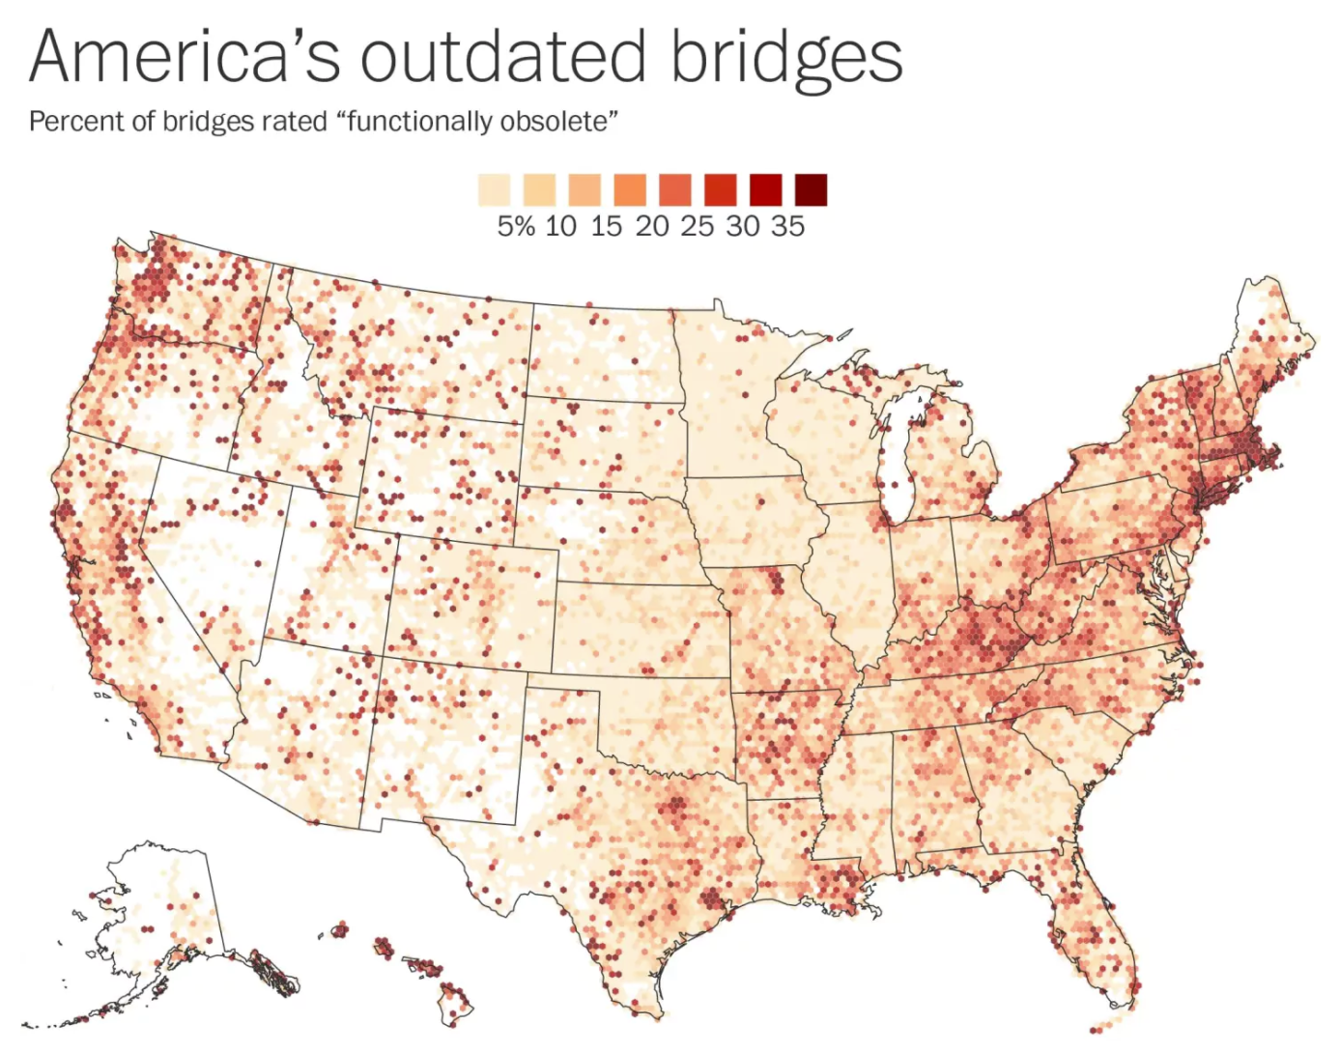
Functionally Obsolete Bridges in America, 2015
Source: The Washington Post, 2015
Notes:
Texas has a total of 52,937 bridges. 8,872 (16.76%) of these are estimated by Federal Highway Administration to be functionally obsolete, or outdated. This compares with a national average of 14% functionally obsolete

Slide 44
Population Projections

Slide 45
Educational Attainment in Texas, 2015
Level of Educational Attainment | Percent of persons aged 25 years and older | State Ranking
High school diploma or equivalency or greater | 81.9 | 49
Bachelors or greater | 27.6 | 29
Source: U.S. Census Bureau, American Community Survey, 5-Year, 2015.

Slide 46
Educational Attainment, Population 25 Years and Older, Texas, 2015
Educational Attainment | NH White |  | Hispanic |  | Black Alone |  | Other Alone
 | Number | % | Number | % | Number | % | Number | %
Population 25 years and older | 8,320,573 | 100 | 5,545,721 | 100 | 1,934,324 | 100 | 2,020,467 | 100
High School Diploma or greater | 7,744,683 | 93.1 | 3,453,129 | 62.3 | 1,690,299 | 87.4 | 1,467,902 | 72.6
Bachelor’s Degree or greater | 2,999,091 | 36 | 710,949 | 12.8 | 420,618 | 21.7 | 601,136 | 29.8
Source: US Census Bureau, 2015 American Community Survey, 5-Year Estimates, S1501.

Slide 47
Percent of persons aged 25 years and older with a high school degree or higher, Texas, 2006-2011

Slide 48
Trends in Educational Attainment of Persons in the Labor Force (25-64 Years of Age) in Texas by Race/Ethnicity – High School Graduates and Above
Source: U.S. Census Bureau, American Community Survey, Public Use Micro Sample, 2001-2011
Notes:
Educational attainment by race/ethnicity in Texas suggests that adults of Hispanic descent are much less likely to have completed high school compared to other race/ethnic groups. Over time, the percent of persons of Hispanic descent who have completed high school has been increasing more rapidly than for other groups but even at this pace of change it will take numerous decades for Hispanics to achieve parity with non-Hispanics in the percent with a high school degree or greater.

Slide 49
Percent of the Civilian Labor Force (ages 25-64) by Educational Attainment for 2011, 2030 Using Constant Rates, Texas
These should be going DOWN
These should be going UP
Sources: U.S. Census Bureau, American Community Survey, 1-Year PUMS.
Texas State Data Center, 2012 Vintage Population Projections, 0.5 Migration Scenario
Notes:
The first assumption (represented by the red columns) is that educational attainment by race/ethnicity and sex would remain the same as it was in 2011. Thus the changes we see in educational attainment in this projection are due only to changes in the racial/ethnic composition of the population (driven by increasing Hispanic population and a leveling of growth among the non-Hispanic white population). Under this scenario, we would see increases of the percent of the labor force with lower levels of education and declines in the percent of the labor force with higher levels.

Slide 50
Percent of the Civilian Labor Force (ages 25-64) by Educational Attainment for 2011, and 2030 Using Trended Rates, Texas
These should be going DOWN
These should be going UP
Sources: U.S. Census Bureau, American Community Survey, 1-Year PUMS.
Texas State Data Center, 2012 Vintage Population Projections, 0.5 Migration Scenario
Notes:
Under the second assumption (green columns) the trends observed in improving educational attainment are projected forward and applied to the projected population by race/ethnicity and sex. Thus the generally positive trends we have noted in improving educational attainment are assumed to continue into the future. The result of this projection suggests that we will see declines in the percent of the labor force with lower levels of education and increases in the percent of the labor force with higher levels of education.

Slide 51
Earnings and Education
Source: US Census Bureau, American Community Survey, 5-Year, 2015, B20004.

Slide 52


  Office: (512) 936-3542
  Lila.Valencia@utsa.edu
  www.texasdemographics.gov
Lila Valencia, Ph.D.
@TexasDemography
Notes:
The Office of the State Demographer and the Texas State Data Center are committed to supporting your work through providing you with the best, most accurate, and objective information we can identify about our greatest asset, the people of Texas.

