Slide 1
Texas Demographics and Real Estate
Texas Association of Realtors
December 11, 2017

Slide 2
Growing States, 2000-2016
 | 2000 Population (millions) | 2010 Population (millions) | 2016 Population (millions) | Numeric Change 2010-2016 (millions) | Percent Change 2010-2016
United States | 281.4 | 308.7 | 323.1 | 14.3 | 4.7%
Texas | 20.8 | 25.1 | 27.8 | 2.7 | 10.8%
California | 33.8 | 37.2 | 39.2 | 1.9 | 5.4%
Florida | 15.9 | 18.8 | 20.6 | 1.8 | 9.6%
Georgia | 8.2 | 9.7 | 10.3 | .6 | 6.4%
North Carolina | 8.0 | 9.5 | 10.1 | .6 | 6.4%
Washington | 5.8 | 6.7 | 7.3 | .6 | 8.4%
Arizona | 5.1 | 6.4 | 6.9 | .5 | 8.4%
Source: U.S. Census Bureau. 2000 and 2010 Census Count, 2016 Population Estimates.
Notes:
Texas is the second largest state in terms of population (2nd to CA) and area (2nd to AK). In terms of number of people, Texas’ growth exceeds that of all other states between 2010 and 205.

Slide 3

Total Estimated Population by County, Texas, 2016
86%
Source: U.S. Census Bureau, 2016 Vintage Population Estimates
Notes:
When we look at the geographic distribution of the population of Texas over time we see continually increasing population in the counties along the I-35 corridor, the Houston area, and the lower Rio Grand Valley. Urbanized areas out west have grown but most counties west have experienced limited growth and some population decline. Approximately 86% of the population is along I-35 and east. This area with the 3 major metropolitan areas at the points is often described as the Texas population triangle.
The counties of Harris, Dallas, Tarrant, Bexar, and Travis make up the points of the “population triangle” in Texas and are the most populated in the State. Collin, Denton, Fort Bend, Hidalgo, and El Paso counties also have significant population concentrations. Many counties west of Interstate 35 are more sparsely populated.

Slide 4
Estimated Population Change, Texas Counties, 2010 to 2016
96 counties lost population over the 6 year period.
Source: U.S. Census Bureau, 2016 Vintage Population Estimates
Notes:
Population change over the decade has been greatest in the urban and suburban population triangle counties. Counties in the lower Rio Grande Valley also had significant growth as did El Paso. Overall, 158 counties gained population while 96 (38%) lost population over the decade.

Slide 5
Estimated Percent Change of the Total Population by County, Texas, 2010 to 2016
Source: U.S. Census Bureau, 2016 Vintage Population Estimates
Notes:
Percent change is an indicator of the speed of population change void of information about the volume of population change. Percent change in the population over the past few years has been greatest in the suburban population triangle counties, notably among counties between San Antonio and Austin. In the early part of the decade, counties in the Eagle Ford Shale area (south east of San Antonio) and the Cline Shale area (Midland and Odessa area), had been growing quickly. This is no longer the case.

Slide 6
Top Counties for Numeric Growth in Texas, 2015-2016
County | U.S. Rank Population Change | Population Change | Percent of Change from Natural Increase | Percent Change from Domestic Migration | Percent Change from International Migration
Harris | 2 | 56,587 | 79.9% | -27.9% | 48.1%
Tarrant | 5 | 35,462 | 44.4% | 37.7% | 17.9%
Bexar | 7 | 33,198 | 44.6% | 39.3% | 16.1%
Dallas | 9 | 29,209 | 79.9% | -20.9% | 41.0%
Denton | 11 | 27,689 | 23.9% | 67.1% | 9.0%
Fort Bend | 13 | 27,388 | 24.8% | 59.4% | 15.8%
Collin | 14 | 26,506 | 25.8% | 58.7% | 15.5%
Travis | 17 | 24,505 | 44.2% | 33.3% | 22.5%
Williamson | 22 | 20,659 | 20.3% | 74.1% | 5.6%
Montgomery | 24 | 19,769 | 18.5% | 73.5% | 8.0%
Hidalgo* | 54 | 10,529 | 113.5% | -33.4% | 19.9%
Hidalgo County had negative net migration (-13.5% of total population growth).
Source: U.S. Census Bureau, 2016 Vintage Population Estimates

Slide 7
Top Counties for Percent Growth* in Texas, 2015-2016
County | U.S. Rank | 2015-2016 Percent Population Change | Percent Change from Domestic Migration | Percent Change from International Migration
Kendall | 2 | 5.2% | 95.9% | 4.0%
Hays | 3 | 5.1% | 82.2% | 1.8%
Comal | 6 | 4.4% | 88.5% | 2.0%
Williamson | 14 | 4.1% | 74.1% | 5.6%
Fort Bend | 18 | 3.8% | 59.4% | 15.8%
Montgomery | 24 | 3.7% | 73.5% | 8.0%
Rockwall | 25 | 3.6% | 82.2% | 2.5%
Denton | 28 | 3.6% | 67.1% | 9.0%
Kaufman | 36 | 3.4% | 81.3% | 2.2%
Bastrop | 42 | 3.1% | 83.5% | 0.7%
Ellis | 50 | 3.1% | 78.1% | 2.6%
*Among Counties with 10,000 or more population in 2016
Source: U.S. Census Bureau, 2016 Vintage Population Estimates

Slide 8
Estimated Percent Population Change, Texas Places, 2015-2016
Source: U.S. Census Bureau, 2016 Vintage Population Estimates

Slide 9
Estimated Percent Population Change, Texas Places, 2015-2016
Source: U.S. Census Bureau, 2016 Vintage Population Estimates

Slide 10
Estimated Percent Population Change, Texas Places, 2015-2016
Source: U.S. Census Bureau, 2016 Vintage Population Estimates

Slide 11
Estimated Percent of Total Net-Migrant Flows to and From Texas and Other States, 2015
Source: U.S. Census Bureau, 2016. ACS Migration Flows, 2015

Slide 12
Texas Racial and Ethnic Composition,
2000, 2010, and 2015
11
Source: U.S. Census Bureau. 2000, 2010 Decennial Census and 2015 Population Estimates
Notes:
As of the 2000 Census, about 53% of Texas’ population was non-Hispanic Anglo, about 32% where of Hispanic descent, about 11% where non-Hispanic African American, and about 4% were non-Hispanic Other.
In 2010, it is estimated that about 45% of the Texas population was non-Hispanic Anglo, 38% of Hispanic descent, 11% were non-Hispanic African American, and about 6% were non-Hispanic Other (largely of Asian descent).

Slide 13
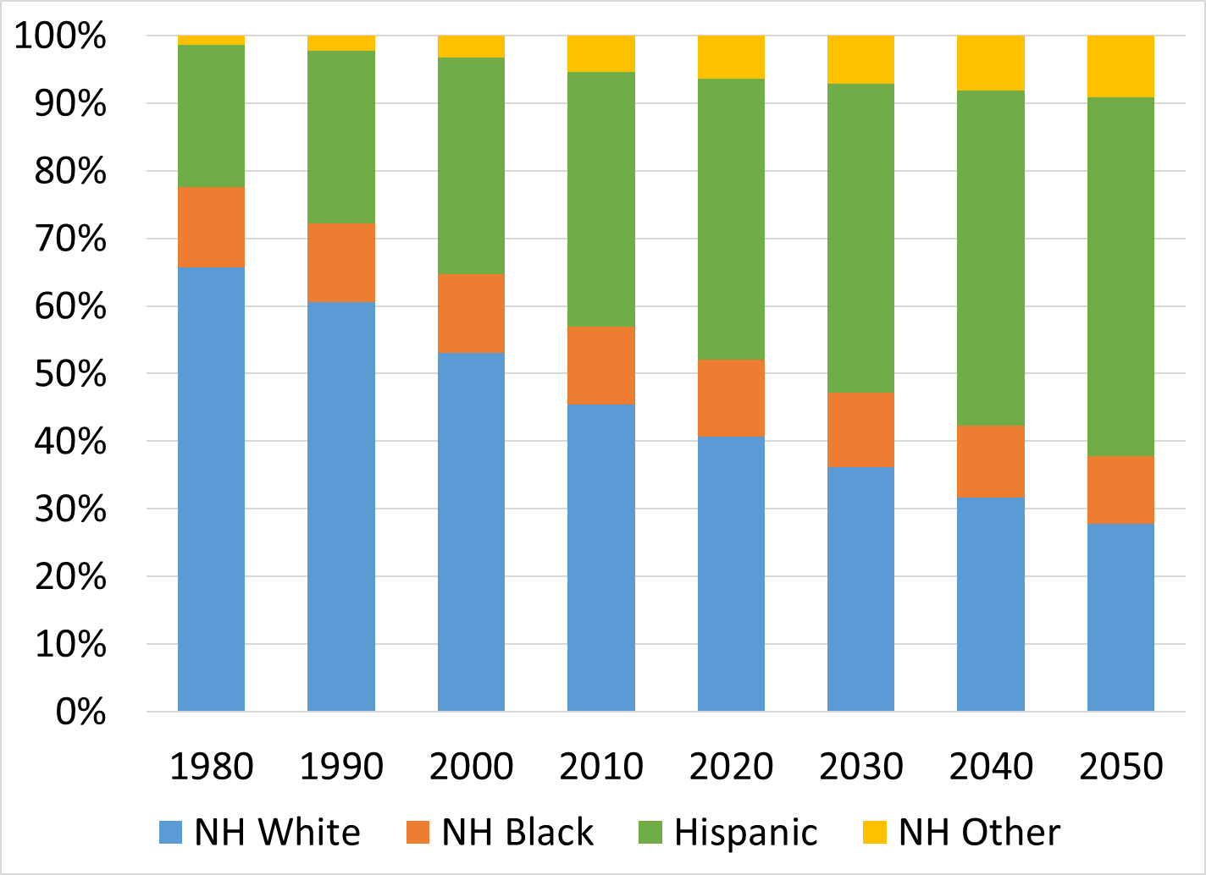
Texas Racial and Ethnic Composition, 1980 to 2050
Source: U.S. Census Bureau, 1980 to 2010 Decennial Censuses; Texas Demographic Center, 2014 Population Projections, Half Migration Scenario

Slide 14
Racial and Ethnic Composition of Texas and Top 10 Most Populous Counties, 2015
 | NH White | NH Black | Hispanic | NH Asian | NH Other
TEXAS | 43.0% | 11.8% | 38.8% | 4.6% | 1.8%
Denton County | 60.9% | 9.3% | 19.2% | 8.0% | 2.6%
Collin County | 59.4% | 9.4% | 15.2% | 13.4% | 2.7%
Travis County | 49.5% | 8.0% | 33.9% | 6.4% | 2.1%
Tarrant County | 48.6% | 15.6% | 28.2% | 5.3% | 2.4%
Fort Bend County | 34.6% | 20.1% | 24.1% | 19.2% | 1.9%
Harris County | 31.0% | 18.5% | 42.0% | 7.0% | 1.6%
Dallas County | 30.6% | 22.3% | 39.5% | 6.0% | 1.6%
Bexar County | 28.7% | 7.3% | 59.5% | 2.7% | 1.7%
El Paso County | 13.1% | 3.2% | 81.3% | 1.2% | 1.2%
Hidalgo County | 7.0% | 0.5% | 91.3% | 1.0% | 0.2%
12
Source: U.S. Census Bureau, 2015 Vintage Population Estimates

Slide 15
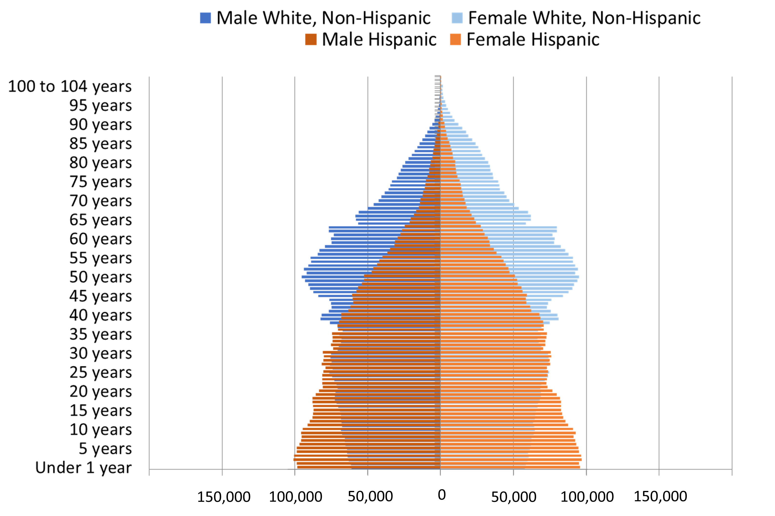
Population Pyramids for Hispanics and Non-Hispanic Whites in Texas, 2010
Notes:
The age distribution of the non-Hispanic white population in Texas is weighted heavily with the “baby boom” generation. Largely the result of lower fertility and less net in-migration, the non-Hispanic white population has relatively fewer young persons relative to those in the middle-age years. In 2010, at ages 37 and younger, the Hispanic population exceeds the non-Hispanic white population.

Slide 16
Annual Shares of Recent Non-Citizen Immigrants to Texas by World Area of Birth, 2005-2015
Source: U.S. Census Bureau, American Community Survey, 1-Year PUMS

Slide 17
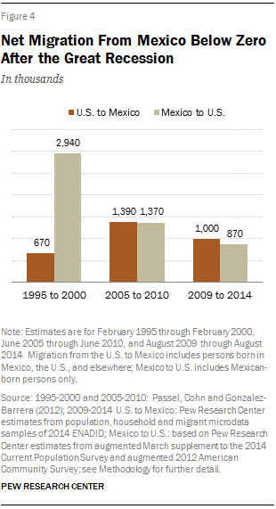
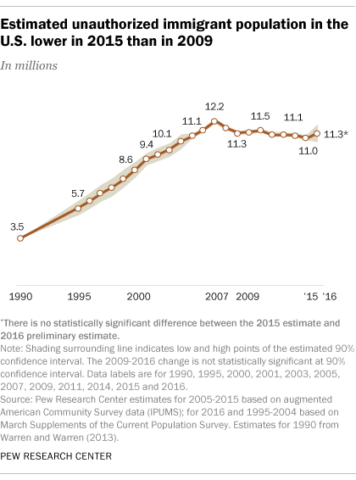
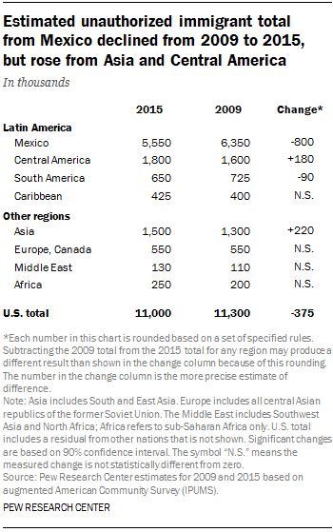
Unauthorized and Mexican Immigration, 2015

Slide 18
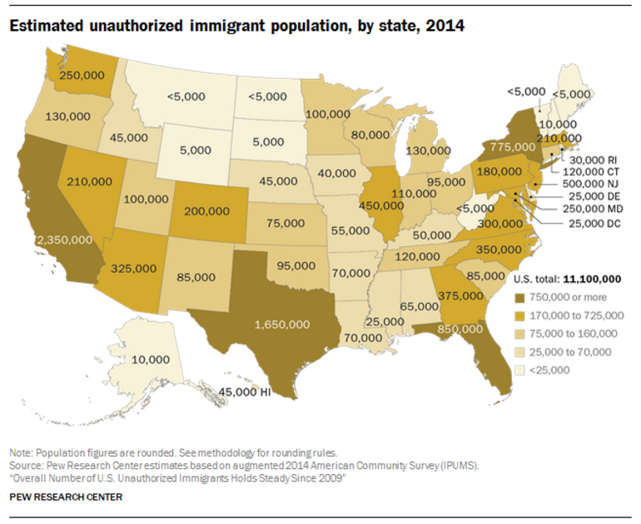

Slide 19


Slide 20
Median Household Income, Texas counties, 2011-2015
Source: U.S. Census Bureau, American Community Survey, 2011-2015 5-Year Sample

Slide 21
Percent of the population with income below poverty, Texas counties, 2011-2015
Source: U.S. Census Bureau, American Community Survey, 2011-2015 5-Year Sample

Slide 22
Percent of the population aged 25 and older with a bachelor’s degree or higher, 2011-2015
Source: U.S. Census Bureau, American Community Survey, 2011-2015 5-Year Sample

Slide 23
Density by Census Tract, Metroplex Area, 1970-2010
1970
1980
1990
2000
2010
Persons per Square Mile
0 – 10
11 – 50
51 – 500
501 – 4,000
4,001 – 56,000
Source: U.S. Census Bureau, decennial censuses. Geolytics, Neighborhood Change Database Tract Data from 1970-2010
Notes:
As more and more people move into our counties and communities, there are more and more persons per square mile. The sequence of images here show how from 1970 to 2010 the urban areas of San Antonio and Austin have become very dense in terms of population and how the are in-between these two cities has become more and more dense. This increasing density is happening in other urban areas of the State and the stress put on the transportation infrastructure from this increasing density creates challenges for our commuting residents and for businesses who are providing services and moving goods.

Slide 24
Percent of Housing Units Built Before 1960, Census Tracts, Metroplex Area, Texas, 2009-2013
Source: U.S. Census Bureau, American Community Survey, 2009-2013 5-Year Sample

Slide 25
Percent of Housing Units Built Between 1960 and 1999, Census Tracts, Metroplex Area, Texas, 2009-2013
Source: U.S. Census Bureau, American Community Survey, 2009-2013 5-Year Sample

Slide 26
Percent of Housing Units Built After 1999, Census Tracts, Metroplex Area, Texas, 2009-2013
Source: U.S. Census Bureau, American Community Survey, 2009-2013 5-Year Sample

Slide 27
Percent of the population living below poverty, DFW area, 2009-2013
Source: U.S. Census Bureau, American Community Survey, 2009-2013 5-Year Sample

Slide 28
Percent of the population that is Hispanic,
Census Tracts, Metroplex Area, Texas, 2009-2013
Source: U.S. Census Bureau, American Community Survey, 5 Year Sample 2009-2013.

Slide 29
Percent of the population that is Black/African American,
Census Tracts, Metroplex Area, Texas, 2009-2013
Source: U.S. Census Bureau, American Community Survey, 5 Year Sample 2009-2013.

Slide 30
Percent of the population that is Asian, Census Tracts, Metroplex Area, Texas, 2009-2013
Source: U.S. Census Bureau, American Community Survey, 5 Year Sample 2009-2013.

Slide 31
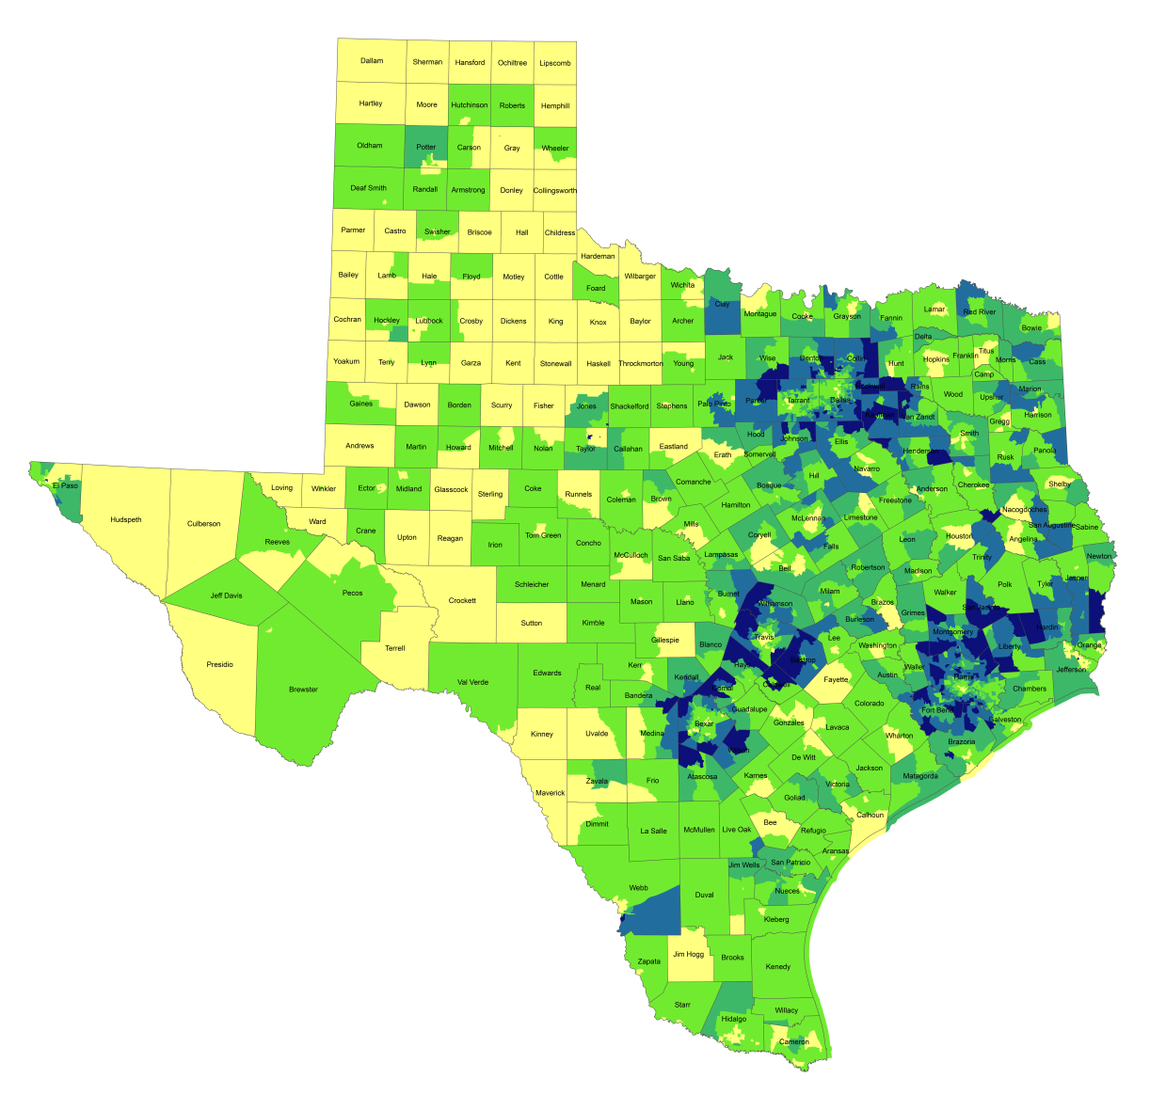
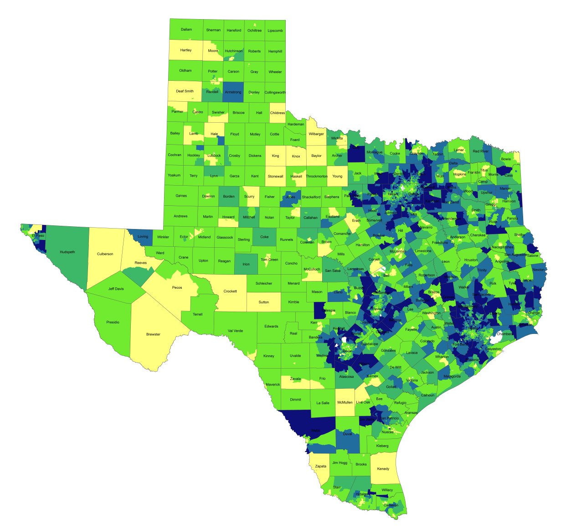
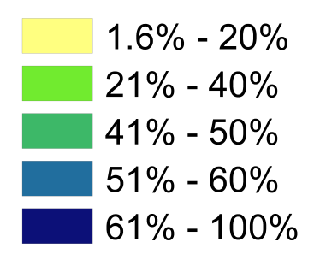
Percentage of Population with Drive Times Longer than 25 Minutes, Texas Census Tracts, 1990 and 2010*
1990
2010*
Source: U.S. Census Bureau, 1990 decennial census and *American Community Survey, 2008-2012 5 Year Sample.
Notes:
One indicator of quality of life is how much time spent commuting to and from work. Commuting takes away time from family and leisure activities and may have an impact on work productivity as well. When we look at the percent of workers who commute longer than 25 minutes by census tract, you can see how increasing population and resulting density, perhaps combined with lagging infrastructure has resulted in increasing commuting times for suburban residents in the more densely populated parts of the state. Commuting time is a factor that some potential business will examine when considering moving operations to a place and one that most can agree is something we want to be as small as possible within reason.

Slide 32
Mean Commute Time (minutes) of workers, Census Tracts, Metroplex Area, Texas, 2009-2013
Source: U.S. Census Bureau, American Community Survey, 5 Year Sample 2009-2013.

Slide 33
Percent of housing units valued at $200,000 or more, Census Tracts, MetroPlex area, 2010-2014
Source: U.S. Census Bureau, American Community Survey, 2010-2014 5-Year Samples

Slide 34
Median Value of Owner Occupied Housing, Census Tracts, MetroPlex, 2010-2014
Source: U.S. Census Bureau, American Community Survey, 2010-2014 5-Year Samples

Slide 35
Percent Change Black Population, Census Tracts, South Dallas, TX, 2010-2014
Source: U.S. Census Bureau, American Community Survey, 2006-2010 and 2010-2014 5-Year Samples

Slide 36
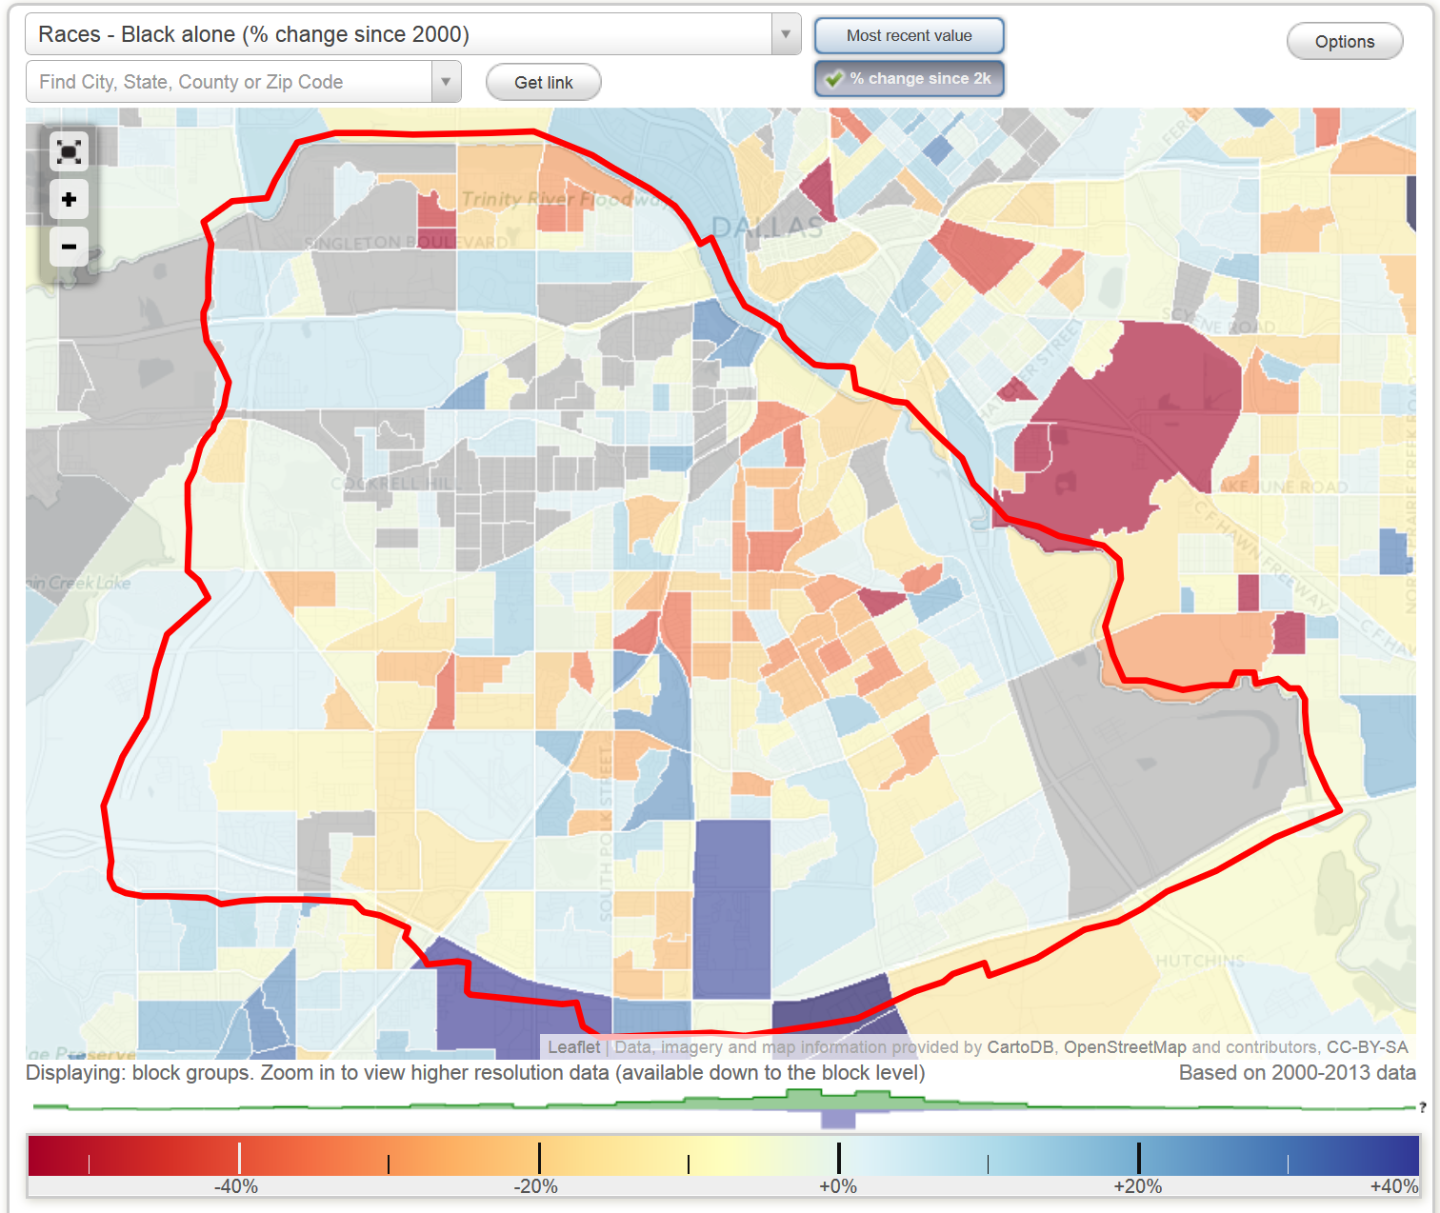
Percent Change Black Population, Block Groups, South Dallas, TX (2000-2013)
http://www.city-data.com/neighborhood/South-Dallas-Dallas-TX.html

Slide 37
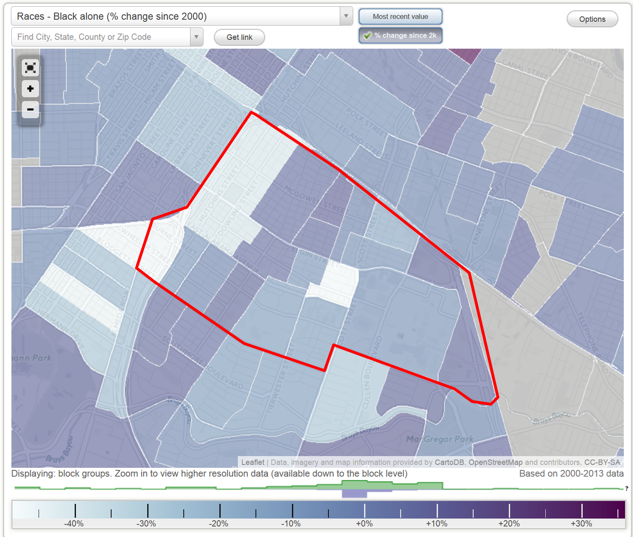
Percent Change Black Population, Block Groups, Third Ward, Houston, TX (2000-2103)
http://www.city-data.com/neighborhood/Third-Ward-Houston-TX.html

Slide 38
Projected Population Growth in Texas,
2010-2050
Source: Texas State Data Center 2016 Population Projections

Slide 39
Projected and Estimated Population Growth in Texas, 2010-2020
Source: Texas State Data Center 2017 Population Projections. U.S. Census Bureau, 2016 Vintage Estimates

Slide 40
Population and Projected Share of Population by Age Group, Texas, 1950 to 2050
Source: U.S. Census Bureau, Decennial Censuses and 2015 Population Estimates; Texas Demographic Center, 2014 Vintage Population Projections, 0.5 Migration Scenario
Notes:
The older population of Texas is growing at an even faster rate than the state as a whole. Over 1 million of the people added to the Texas population between 2000 and 2015 were people aged 65 years and older. This significant increase is driven by the aging of the Baby Boom generation. In 2011, the oldest Baby Boomers turned 65. The older population in Texas is projected to continue its rapid growth, peaking in 2030 when the bulk of the Baby Boomers age into the elder population and leveling off as they age into higher mortality years. By 2050, the elder population and the youth population are projected to make up similar proportions of the state population, projected to be over 40 million.

Slide 41
Percent of Civilian Labor Force by Occupation, Texas, 2008, 2014 and 2014-2008 Difference
Source: U.S. Census Bureau, American Community Survey, 1-Year Sample, 2008, 2010, 2014`

Slide 42
Earnings and Education
Source: US Census Bureau, American Community Survey, 5-Year, 2015, B20004.

Slide 43
Educational Attainment, Persons Aged 25 Years and Older, Texas, 2011 and 2015
 | 2011 | 2015
Percent high school graduate or higher | 81.1% | 82.4% | *
Percent bachelor's degree or higher | 26.4% | 28.4% | *
U.S. Census Bureau American Community Survey, 1-Year Samples, 2011 and 2015
* Years significantly different p<.05

Slide 44
Percent Distribution of Educational Attainment of Persons Aged 25 Years and Older, Texas, 2008, 2011, and 2015
Source: U.S. Census Bureau, American Community Survey, 1-Year Samples, 2008-2015

Slide 45
Educational Attainment of Persons Age 25 Years and Older by Race/Ethnicity, Texas, 2015
Source: U.S. Census Bureau, American Community Survey, 1-Year Sample, 2015

Slide 46
Trends in Educational Attainment of Persons in the Labor Force (25-64 Years of Age) in Texas by Race/Ethnicity – High School Graduates and Above
Source: U.S. Census Bureau, American Community Survey, Public Use Micro Sample, 2001-2011
Notes:
Educational attainment by race/ethnicity in Texas suggests that adults of Hispanic descent are much less likely to have completed high school compared to other race/ethnic groups. Over time, the percent of persons of Hispanic descent who have completed high school has been increasing more rapidly than for other groups but even at this pace of change it will take numerous decades for Hispanics to achieve parity with non-Hispanics in the percent with a high school degree or greater.

Slide 47
Percent of the Civilian Labor Force (ages 25-64) by Educational Attainment for 2011, 2030 Using Constant Rates, Texas
These should be going DOWN
These should be going UP
Sources: U.S. Census Bureau, American Community Survey, 1-Year PUMS.
Texas State Data Center, 2012 Vintage Population Projections, 0.5 Migration Scenario
Notes:
The first assumption (represented by the red columns) is that educational attainment by race/ethnicity and sex would remain the same as it was in 2011. Thus the changes we see in educational attainment in this projection are due only to changes in the racial/ethnic composition of the population (driven by increasing Hispanic population and a leveling of growth among the non-Hispanic white population). Under this scenario, we would see increases of the percent of the labor force with lower levels of education and declines in the percent of the labor force with higher levels.

Slide 48
Percent of the Civilian Labor Force (ages 25-64) by Educational Attainment for 2011, and 2030 Using Trended Rates, Texas
These should be going DOWN
These should be going UP
Sources: U.S. Census Bureau, American Community Survey, 1-Year PUMS.
Texas State Data Center, 2012 Vintage Population Projections, 0.5 Migration Scenario
Notes:
Under the second assumption (green columns) the trends observed in improving educational attainment are projected forward and applied to the projected population by race/ethnicity and sex. Thus the generally positive trends we have noted in improving educational attainment are assumed to continue into the future. The result of this projection suggests that we will see declines in the percent of the labor force with lower levels of education and increases in the percent of the labor force with higher levels of education.

Slide 49

Contact
  State Demographer
  Office: (210) 458-6530
  Email: Lloyd.Potter@utsa.edu
  Internet: demographics.texas.gov
Lloyd Potter, Ph.D.
@TexasDemography
Notes:
The Texas Demgraphic Data Center are committed to supporting your work through providing you with the best, most accurate, and objective information we can identify about our greatest asset, the people of Texas.

